Slide 1
IMPULSE PROJECT
Work Package 7 – Promoting Sustainability through Communication and Dissemination
Closing Conference
Alexandra Schmidli and partners
17 April 2024
IMPULSE is funded by the European Union’s
Horizon 2020 research and innovation programme
under grant agreement No. 871161

Slide 2
WP 7 Objectives and Partners
Promote the IMPULSE project and ELI through activities aiming at attracting new members and strategic partners within ELI and at promoting joint efforts within the European laser community around ELI and the development of high-intensity high-repetition-rate laser science.
Develop communication measures to disseminate the project’s progress and outcomes and raise awareness about ELI. Primary audiences include IMPULSE’s direct participants, future users of the ELI Facilities, the industry and policy-makers. Communication activities will also target the media, scientific associations and the public.
WP7 Partners:

Slide 3
WP7 Tasks Structure
Task 7.1 Definition and roll-out of IMPULSE communication plan, project branding and development of communication material
Task 7.2 – Development and maintenance of project website and social media channels
Task 7.3 – Promote ELI ERIC membership through dedicated activities to national user communities and decision- makers
Task 7.4 – Outreach and support to user communities
Task 7.5 – Science and technology landscape analysis with Laserlab-Europe for the European laser community
Task 7.6 – Promotion of ELI's internationalisation and establishment of strategic partnerships

Slide 4
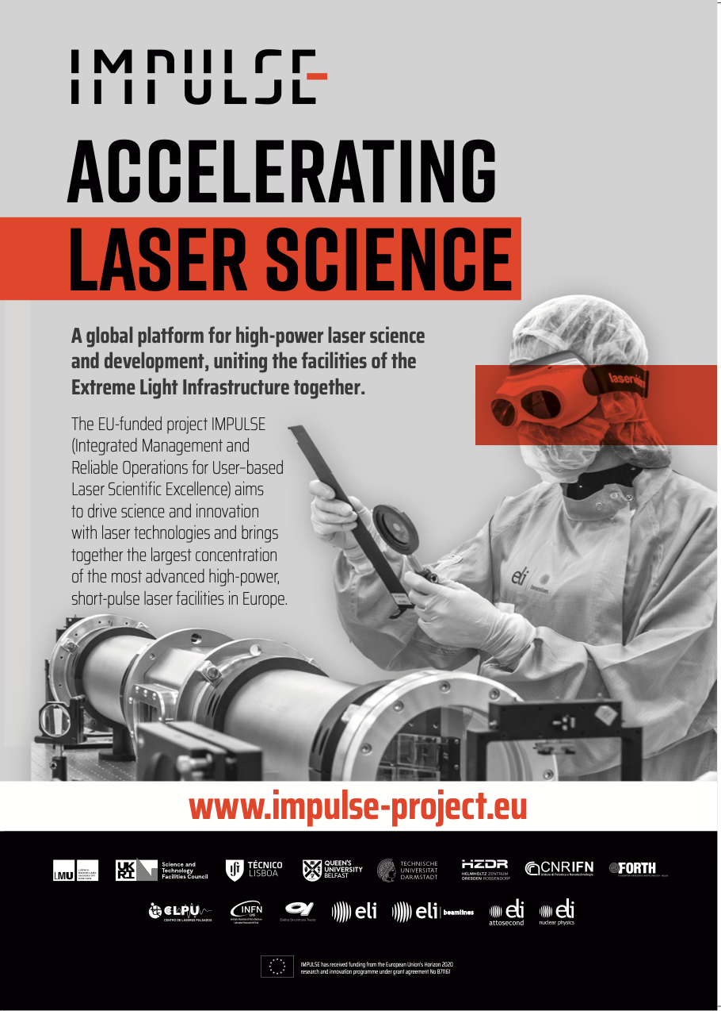
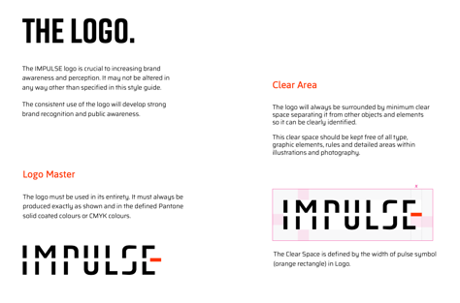
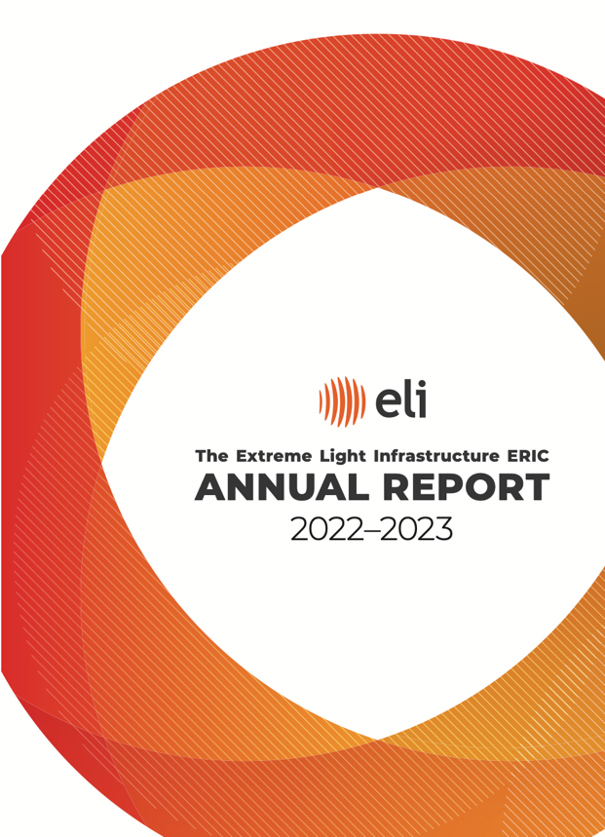
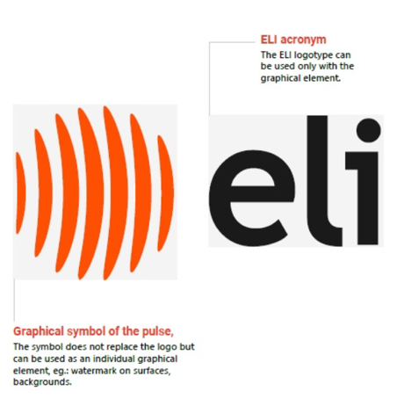
Communication Framework, Branding, Content and Materials
IMPULSE project branding and guidelines
Project communications and dissemination strategy
Core templates, materials and newsletter
ELI Communications Policy and dedicated processes
ELI Communications Strategy
Alignment of ELI Corporate Identity & Visual Guidelines
Joint materials (Annual Reports, brochures, adverts, posters, roll ups, leaflets, posters, video)
Joint mailing list and contact database
Notes:
Starting point 3 Facilities with 3 websites and social media channels
Using IMPULSE not only to promote the project but to start to unify and harmonise the communication of the ELI facilities in general to increase the impact
For this reason the comms had a decent amount of resources – Communication
Continue these activities of the future

Slide 5
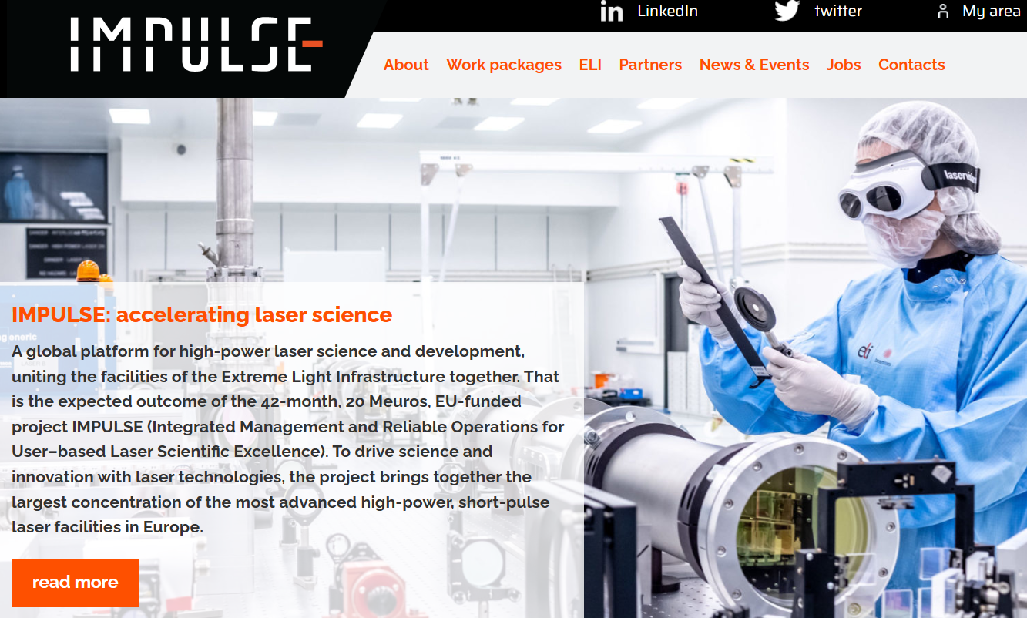
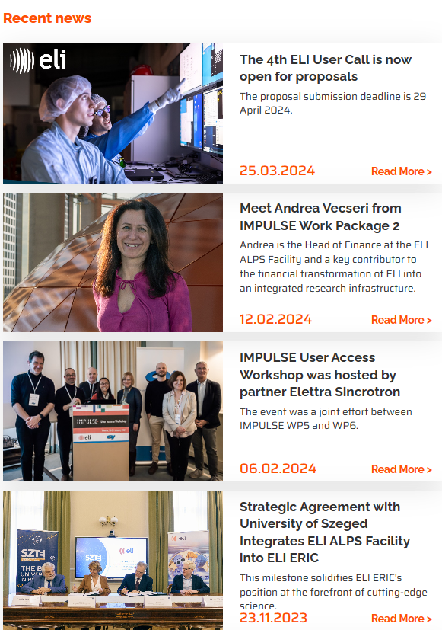
Website and Social Media
Establishment IMPULSE website and social media channels
Cross-promotion on IMPULSE and ELI platforms
Content production for web and social media (publications articles, experiment stories, flagship and access pilots, person profiles, etc.)
Coordination of ELI Websites
Social media analysis
Platform | IMPULSE | ELI Laser
Website | 8000 unique visitors | 32’632 unique visitors
Twitter/X | 23’334 impressions | 483’912 impressions
LinkedIn | 28’009 impressions | 163’320 impressions
Facebook | - | 47’343 impressions
Instagram | - | 3391 engagements
Notes:
Highlights:
User Call announcements and campaigns
Scientific news, results, and publications
People of the Project article series
Event updates and reports

Slide 6
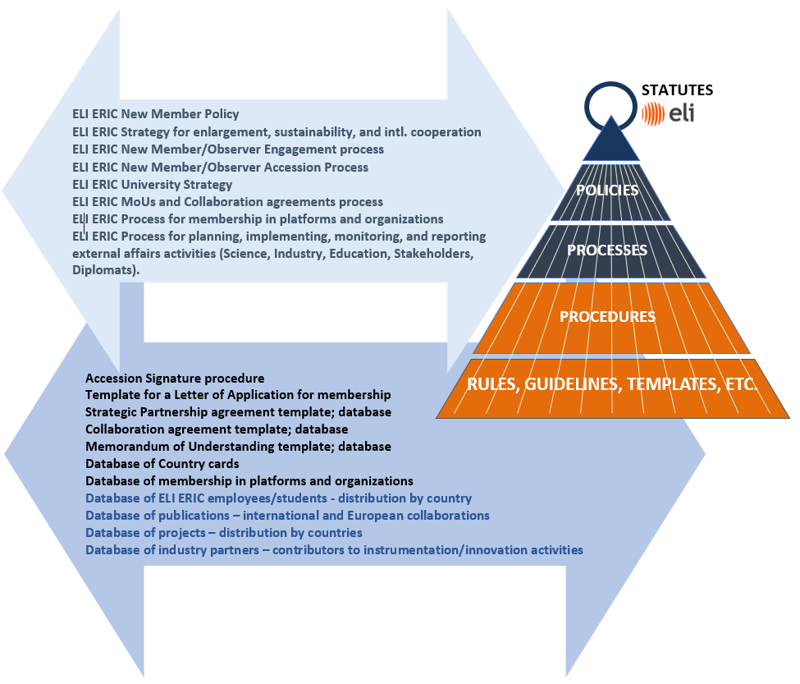
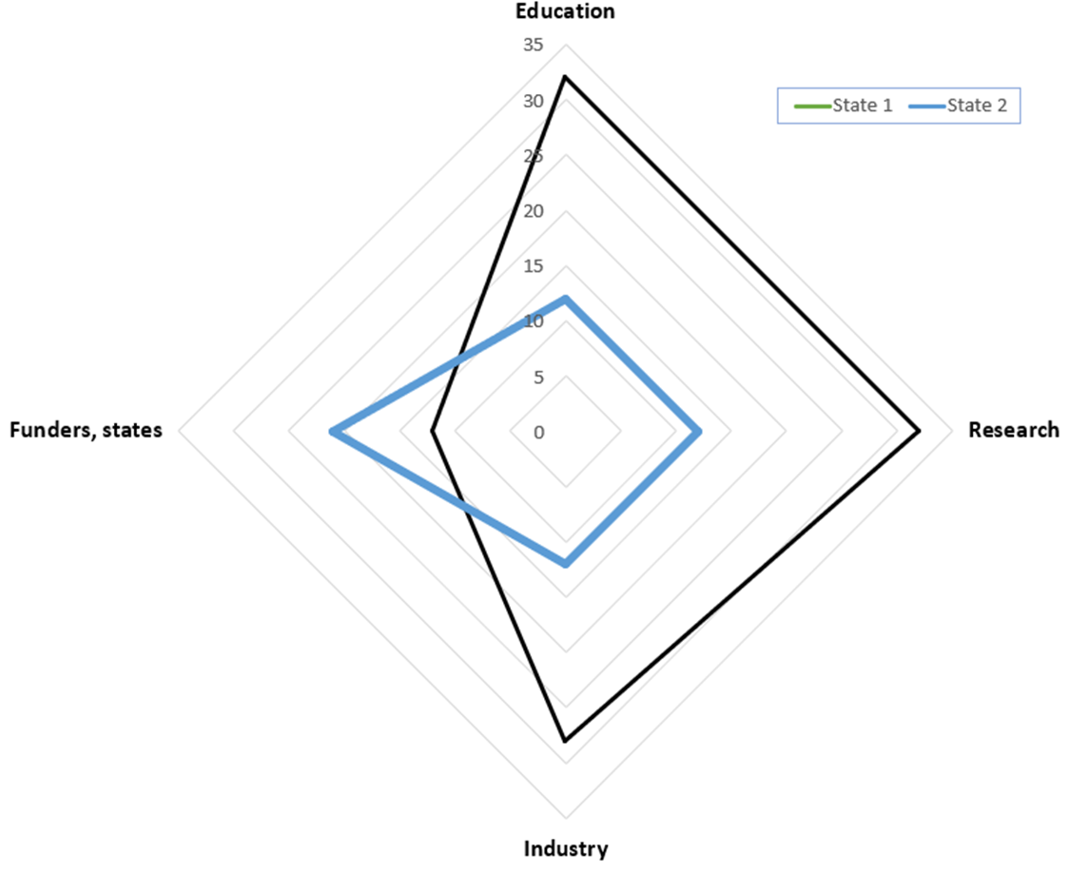
Engagement of New Members and Partners
Establishment and Building a Management System for External Affairs
New Member Policy – in place, Processes and Strategies in place or before approval by the ELI ERIC Management.
Procedures – most in place

Slide 7
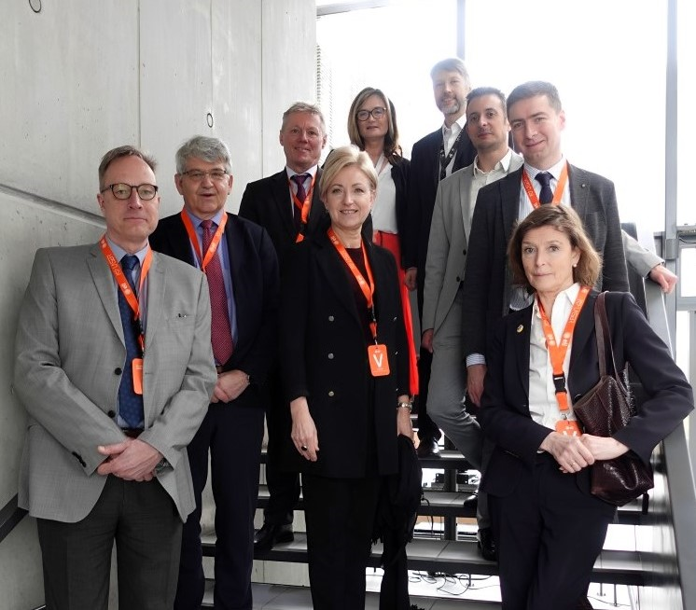
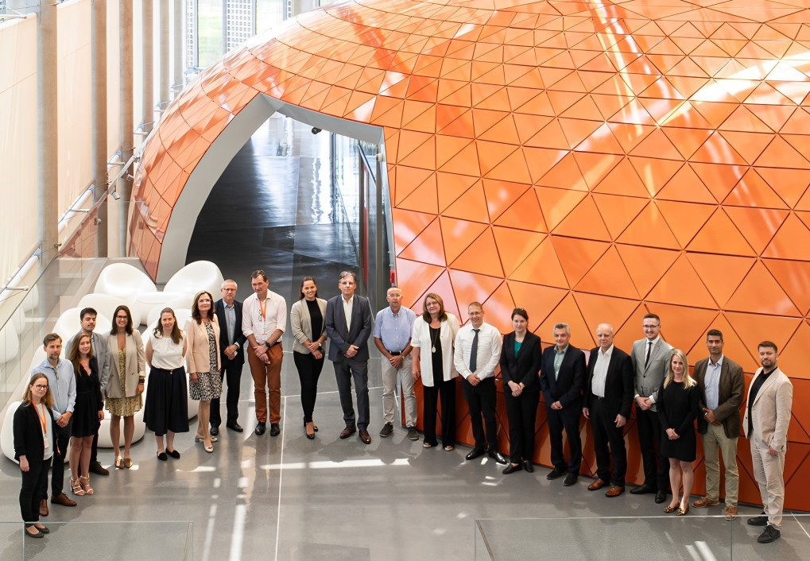
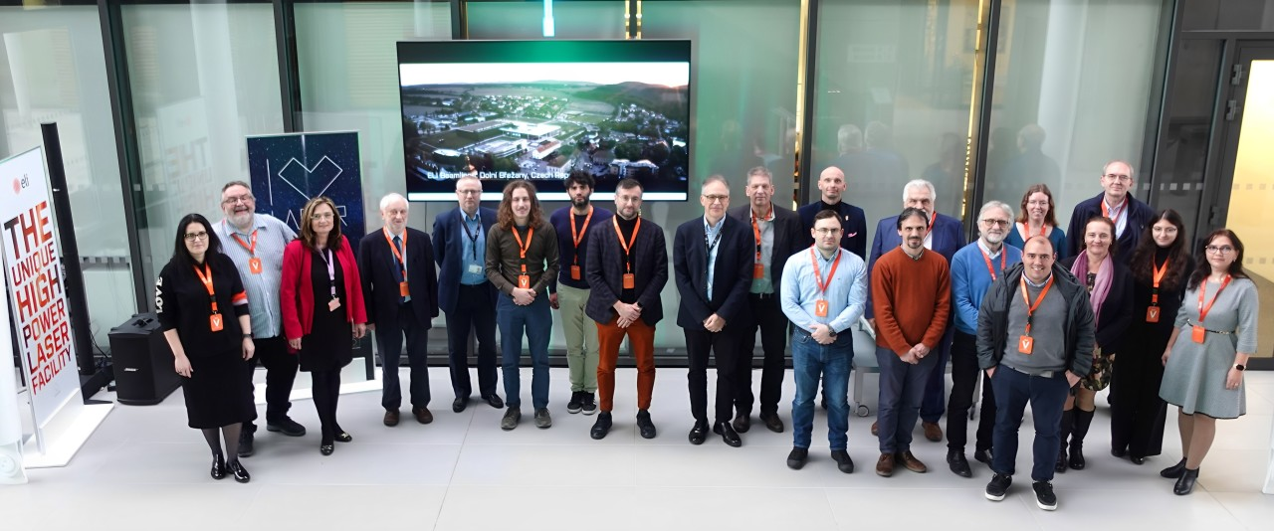
Key Engagement Achievements
System designed, under construction. Tools established, strategic ones x operational ones. Evaluated.
Strategy for external affairs implemented by a systematic approach to Poland, Spain, Slovakia, Canada, Sweden...
Observership of Romania
Participation in international platforms and organisations (EOSC, ERIC Forum);
A systematic approach to diplomats, scientific diplomacy established
Database of Collaboration agreements, MoUs including process. Colaboration agreement concluded e.g. INRS/ALLS, CLPU.
University Strategy, implemented by ELI ERIC University Day, online training courses, visits of students, and internships. Cooperation with the EURIZON project.

Slide 8
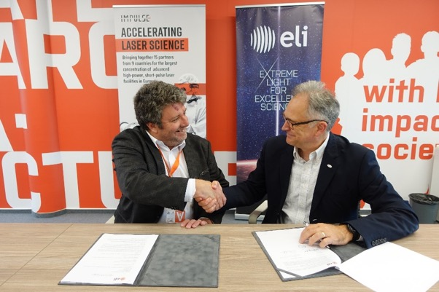
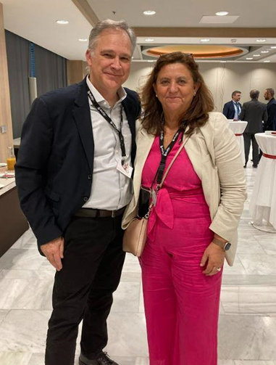
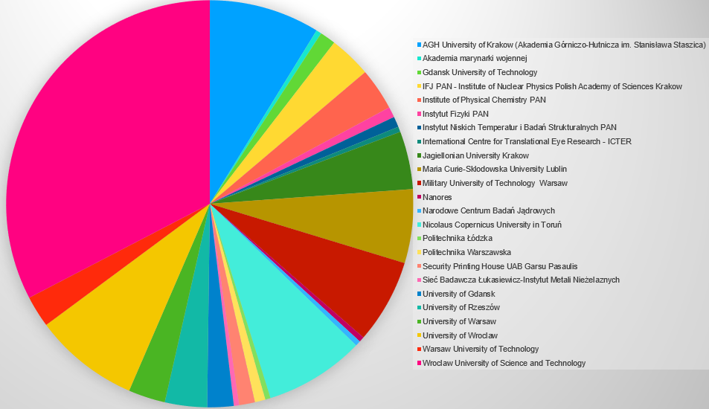
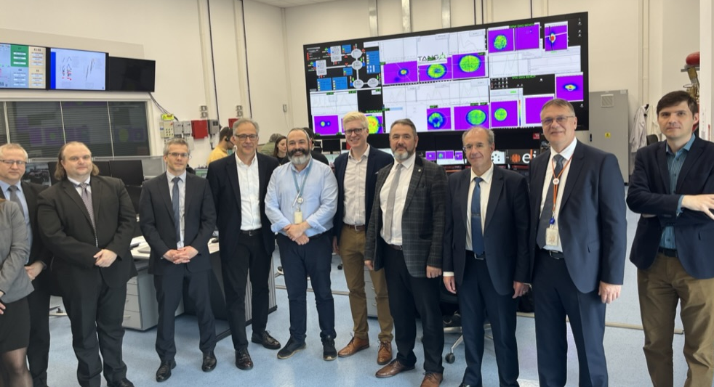
Engagement by Country
Canada: Collaboration Agreement with INRS signed, training program under construction
Germany: engagement with governance, institutional partners, and scientific community, EU projects and workshops
Spain – CLPU: Collaboration agreement before signing, preparation of a proposal to the government, active scientific cooperation, EU Projects, ILO; Poland – engagement on ELI – Polska level, scientific, academic, institutional, industrial, and governmental level (Partner & Industry Day, Student Visit, scientific congress, online training: 9 lectures for 130 – 140 students per lecture from 20 – 24 subjects –Universities, research institutes, and companies.
Romania, Founding Observer status from 1 January 2024, close cooperation with ELI NP on User Calls and more
Switzerland – Bilateral cooperation program for scientific collaboration and student exchange
USA – engagement with the scientific community, projects, and networks LasernetUS/X-lites and scientific community
Additional engagement activities in: Greece, Portugal, Korea, Japan, Slovakia, Sweden, Ukraine, Taiwan, UK and more

Slide 9
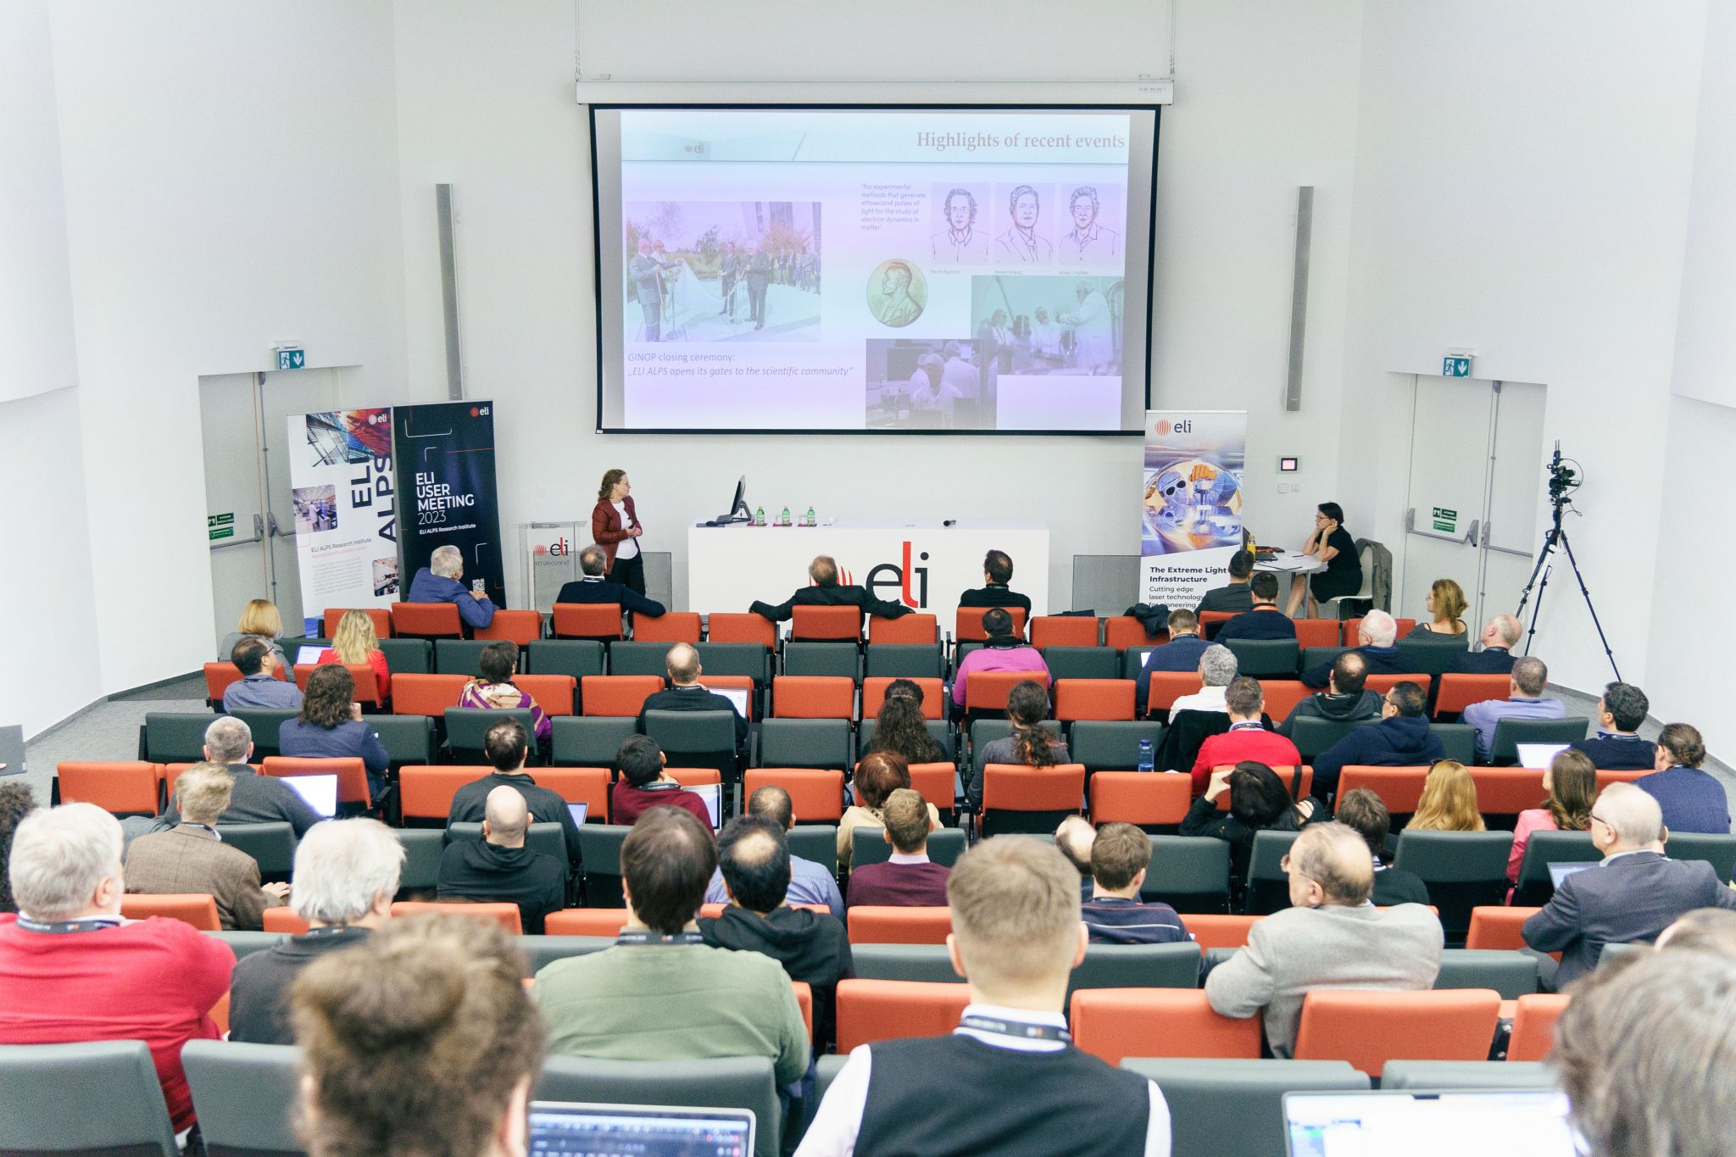
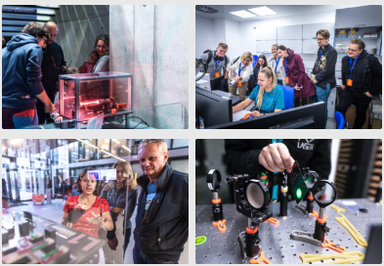
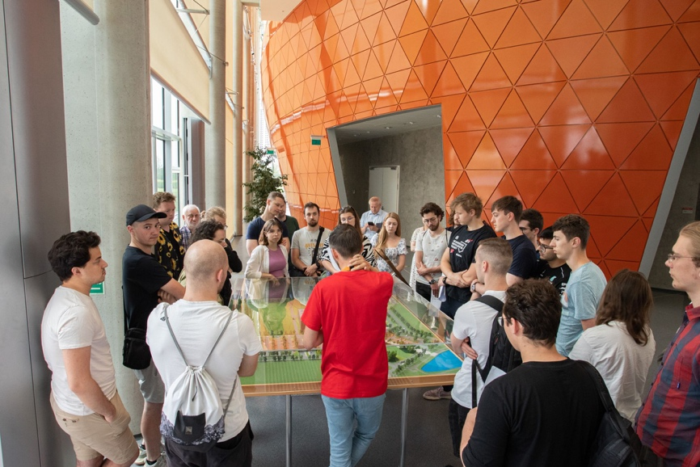
Outreach Activities
Scientific community: 4 User Calls & User Meetings, hosting and participating in scientific conferences, workshops, seminars, etc.
Partners: Cooperation, MoUs, exchanges, cros- promotion in partner networks
Industrial stakeholders: Exhibitions, industry fairs, industry workshops
Education and training: ELISS, Talent Academy, University Days and visits, Internships, PhD Programme, Girls in STEM, Teacher Training
General public: Researcher’s Nights, Open Days, Intl. Day of Light, Visits

Slide 10
Summary of Outreach Activities
250+ Total activities
23 Conferences organised
18 Workshops organised
64 Conferences and Workshops participated in
15 Exhibitions
9 Trade Fairs
7400+ Visitors at ELI annually
30+ Scientific publications

Slide 11
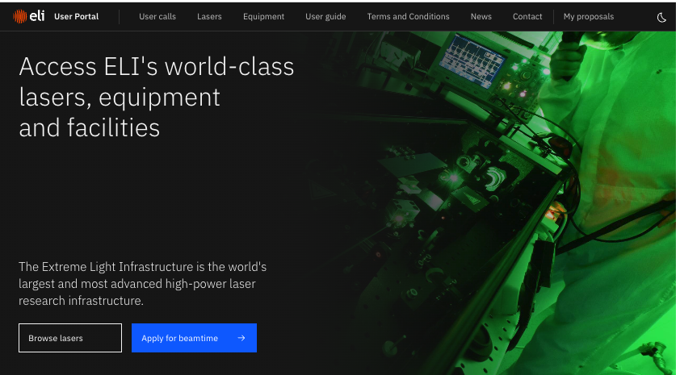
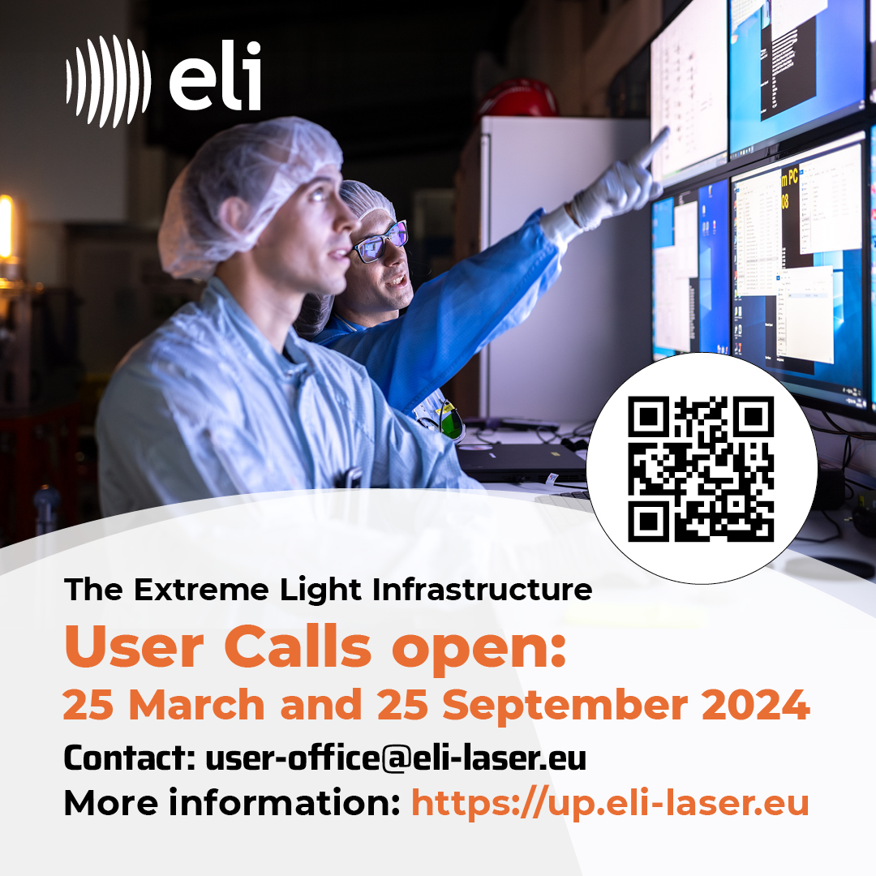
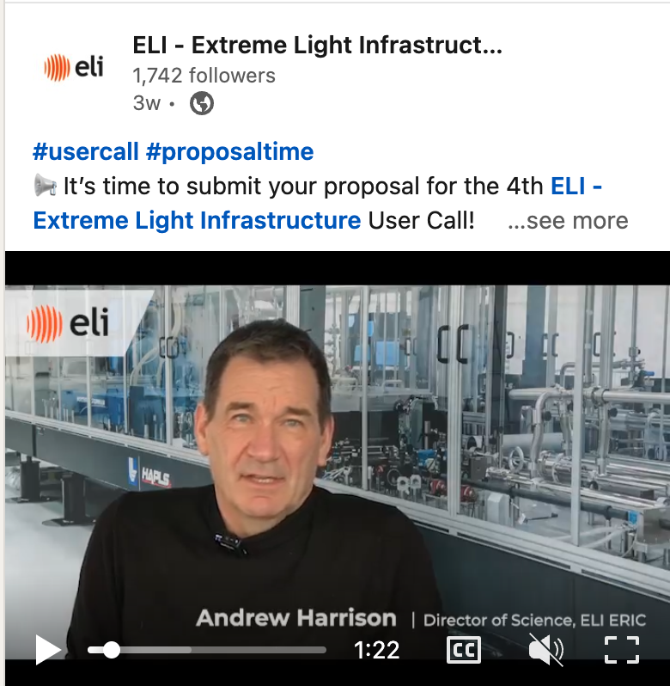
Promotion of Users Calls and User Meeting
Coordination of information and announcement across ELI Facilities
Development of ELI User Portal as a single point of access which enables collection of cohesive analytical data
Promotional materials and campaign (poster, slide, mailing, advert, banners etc.) on social media with instrument specific posts, user testimonials etc.
Dissemination to scientific community, mailing lists, partner networks etc.
Targeted advertising campaign on social media and online
Joint User Meeting for key engagements with User Community
Notes:
Single point of access and allows us to collect data about users

Slide 12
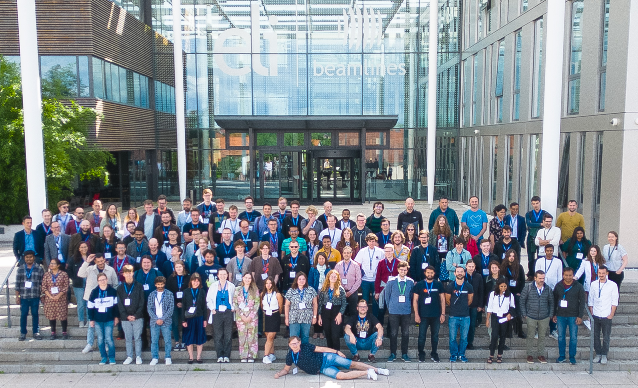
ELI Summer School
ELISS 2021 (online only)
300+ participants from 29 countries
ELISS 2022 (hybrid)
190 (40 in person) participants from 39 countries
3.5 day programme
23 speakers
18 poster submissions
ELISS 2023 (in-person only)
120 participants from 24 countries
4 day programme
32 speakers
38 Poster submissions

Slide 13
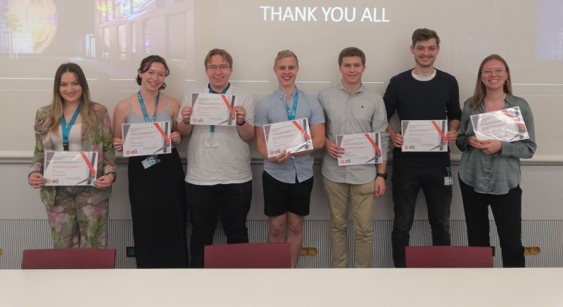
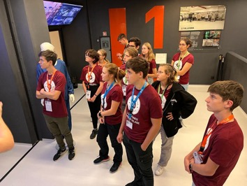
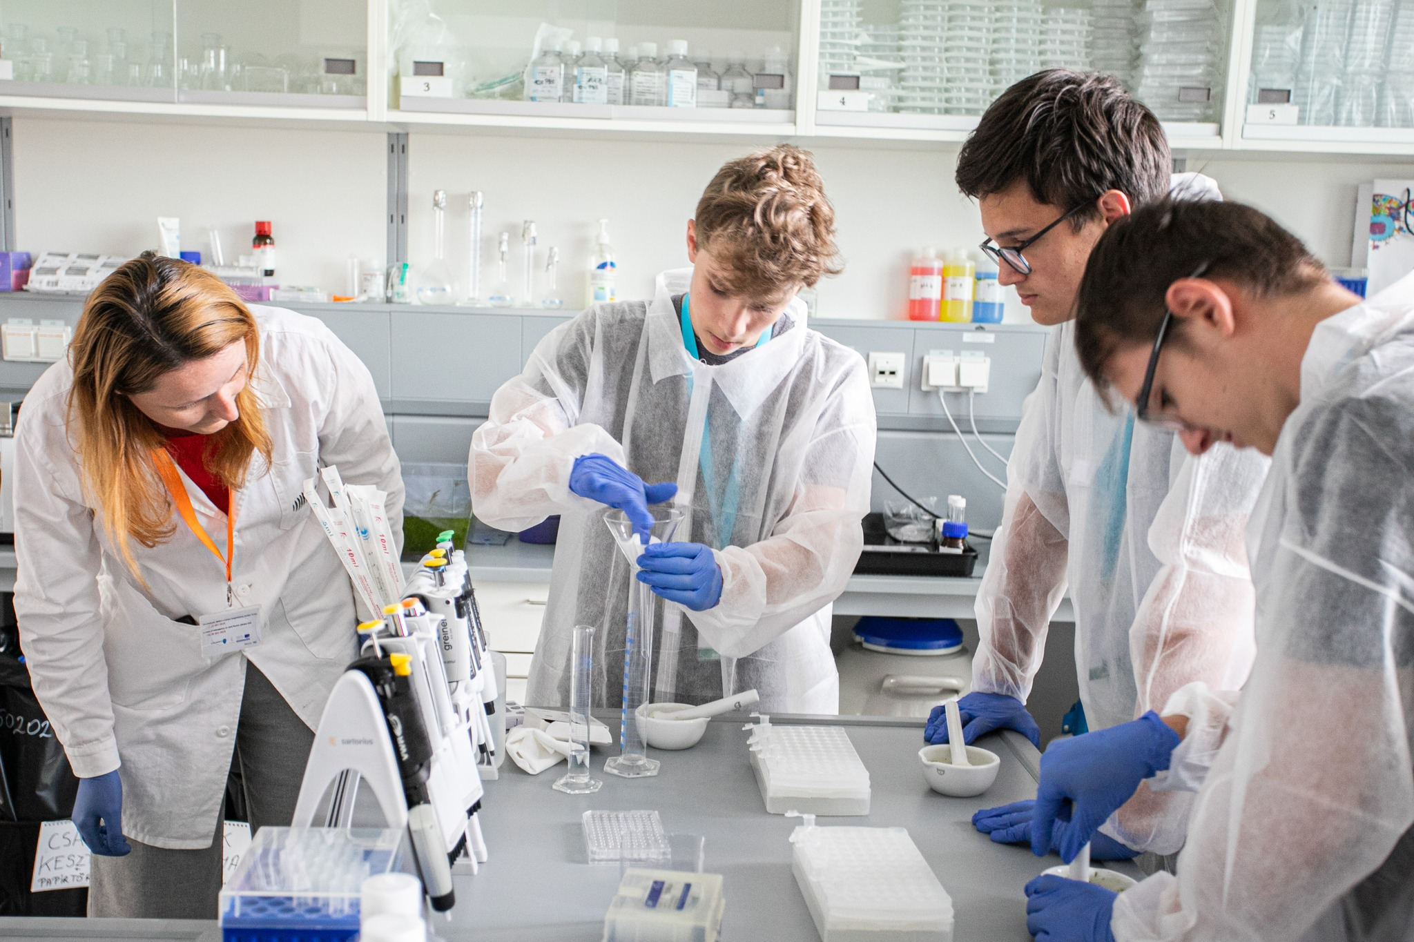
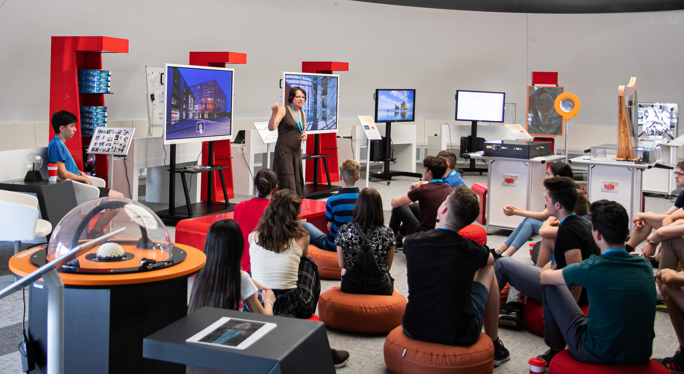
Education and Training Activities
PhDs Programme / University courses
ELI Internships
Competition for secondary school students
Student Summer Camp
Thematic Hands on training
University visits
Teacher training
Online lecture series
Notes:
PhDs / University courses
50+ students
ELI Internships & Summer Camp
45+ internships annually, 2-6 months
Educational competition for secondary school students
Talent Academy & Science Challenge
Hands on training
Hands-on training on fiber handling, splicing, device assembly and diagnostics (16 participants from 6 institutions
Online lecture series
Online course on laser technologies and practical applications for Ukrainian students and scientists (8 lectures / 210 participants)
Teacher training
- 30 high school teachers

Slide 14
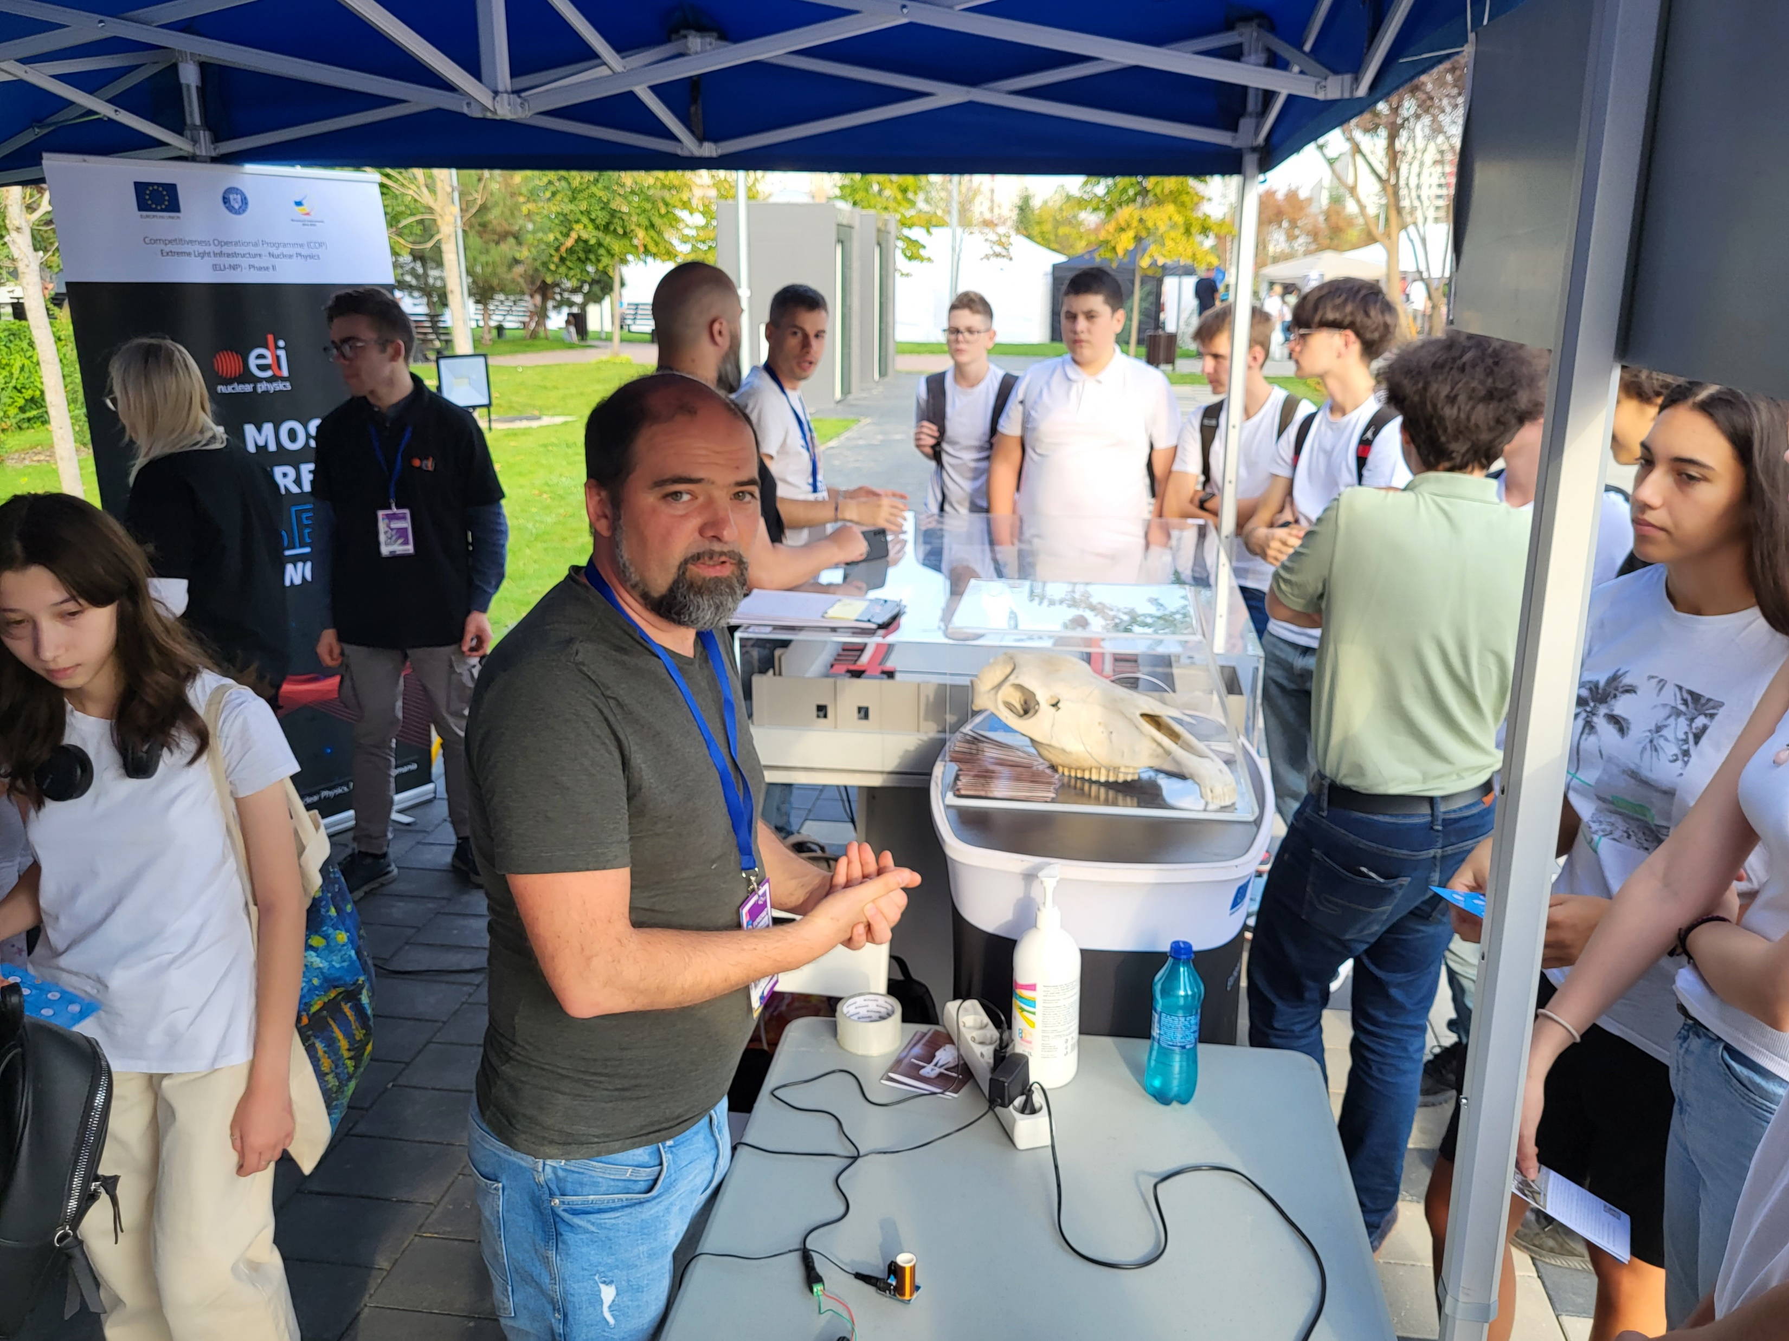
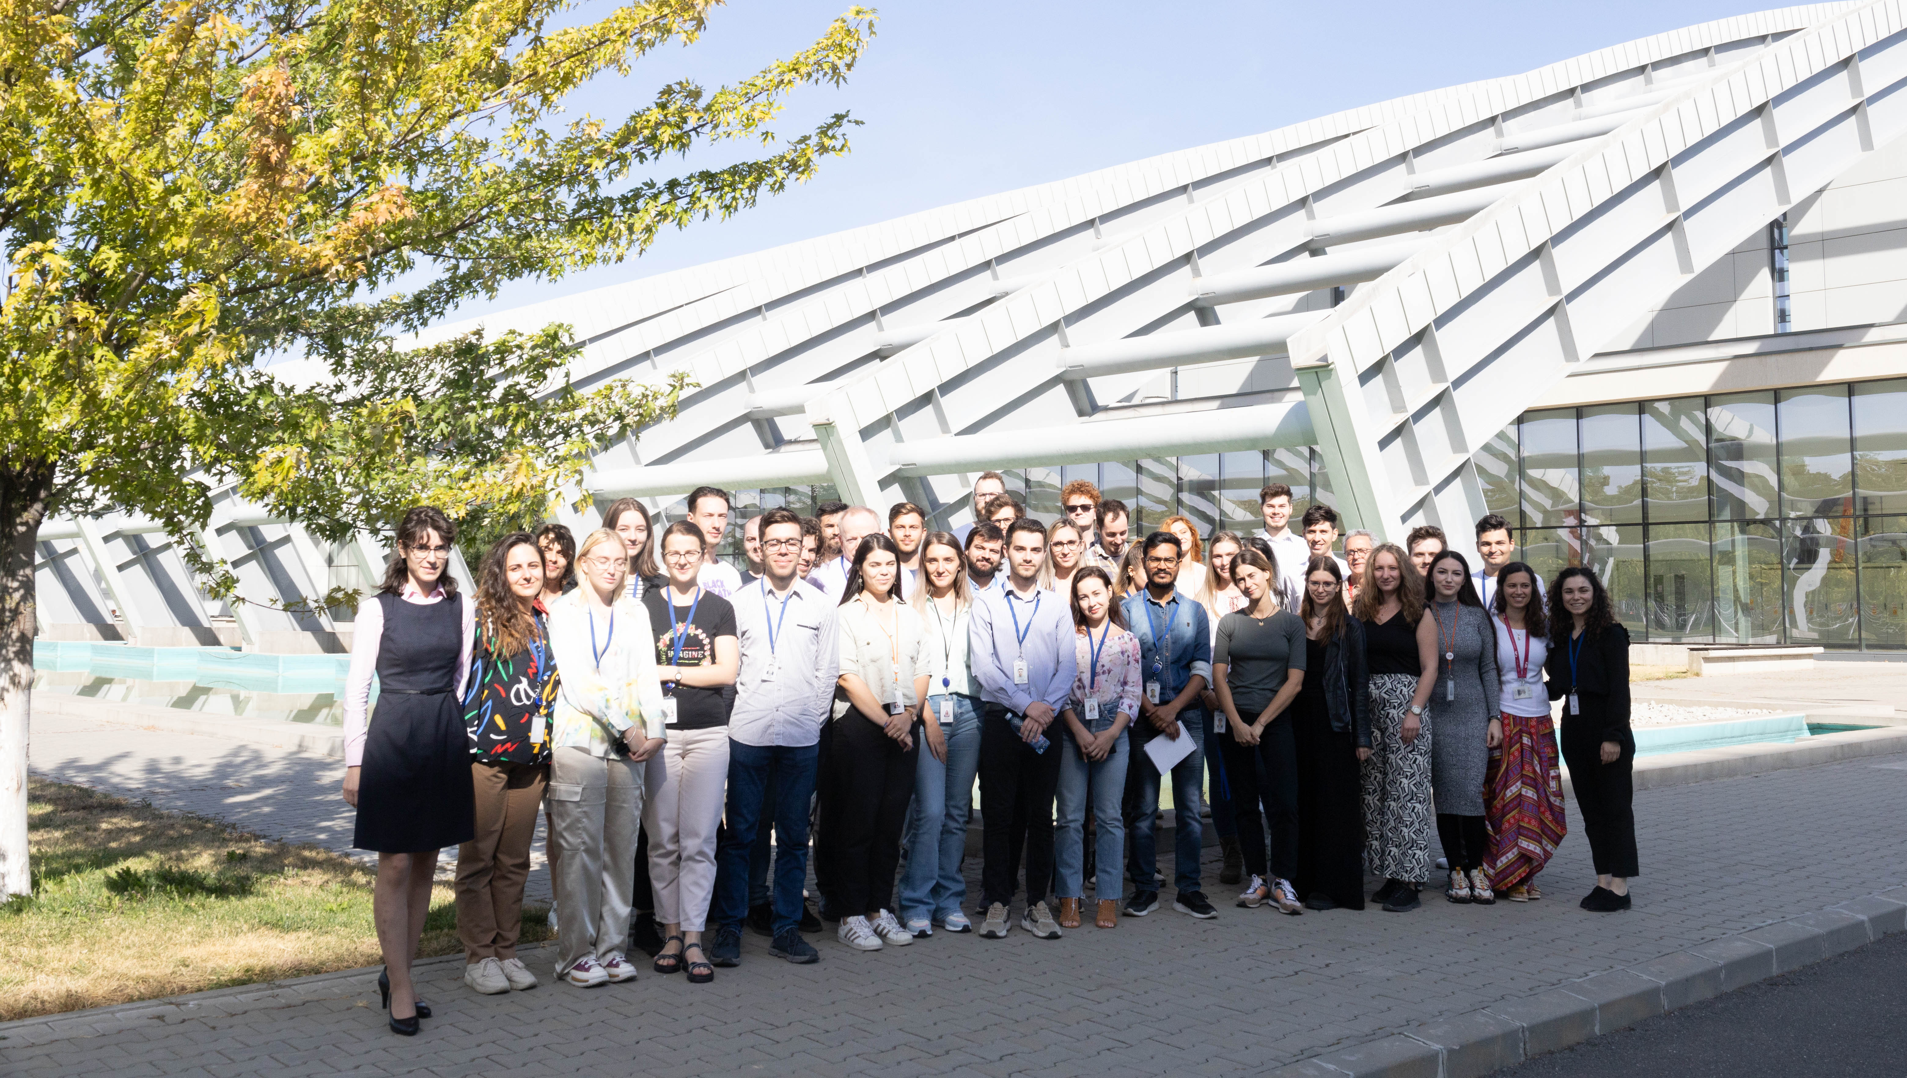
Outreach and Education Activities at ELI NP
Around 1400 visitors only on the site
More than 60 guided tours
7 Outdoor activities ( Researchers Night, Open Days at the Ministry, Summer and Autumn School…)
The Board of Students comprises bachelor's, master's, PhD, and postdoctoral students, Aim: to provide a platform for practicing and enhancing the delivery of public scientific presentations, receiving constructive feedback, and fostering new collaborations and social connections.
Notes:
PhDs / University courses
50+ students
ELI Internships & Summer Camp
45+ internships annually, 2-6 months
Educational competition for secondary school students
Talent Academy & Science Challenge
Hands on training
Hands-on training on fiber handling, splicing, device assembly and diagnostics (16 participants from 6 institutions
Online lecture series
Online course on laser technologies and practical applications for Ukrainian students and scientists (8 lectures / 210 participants)
Teacher training
- 30 high school teachers

Slide 15
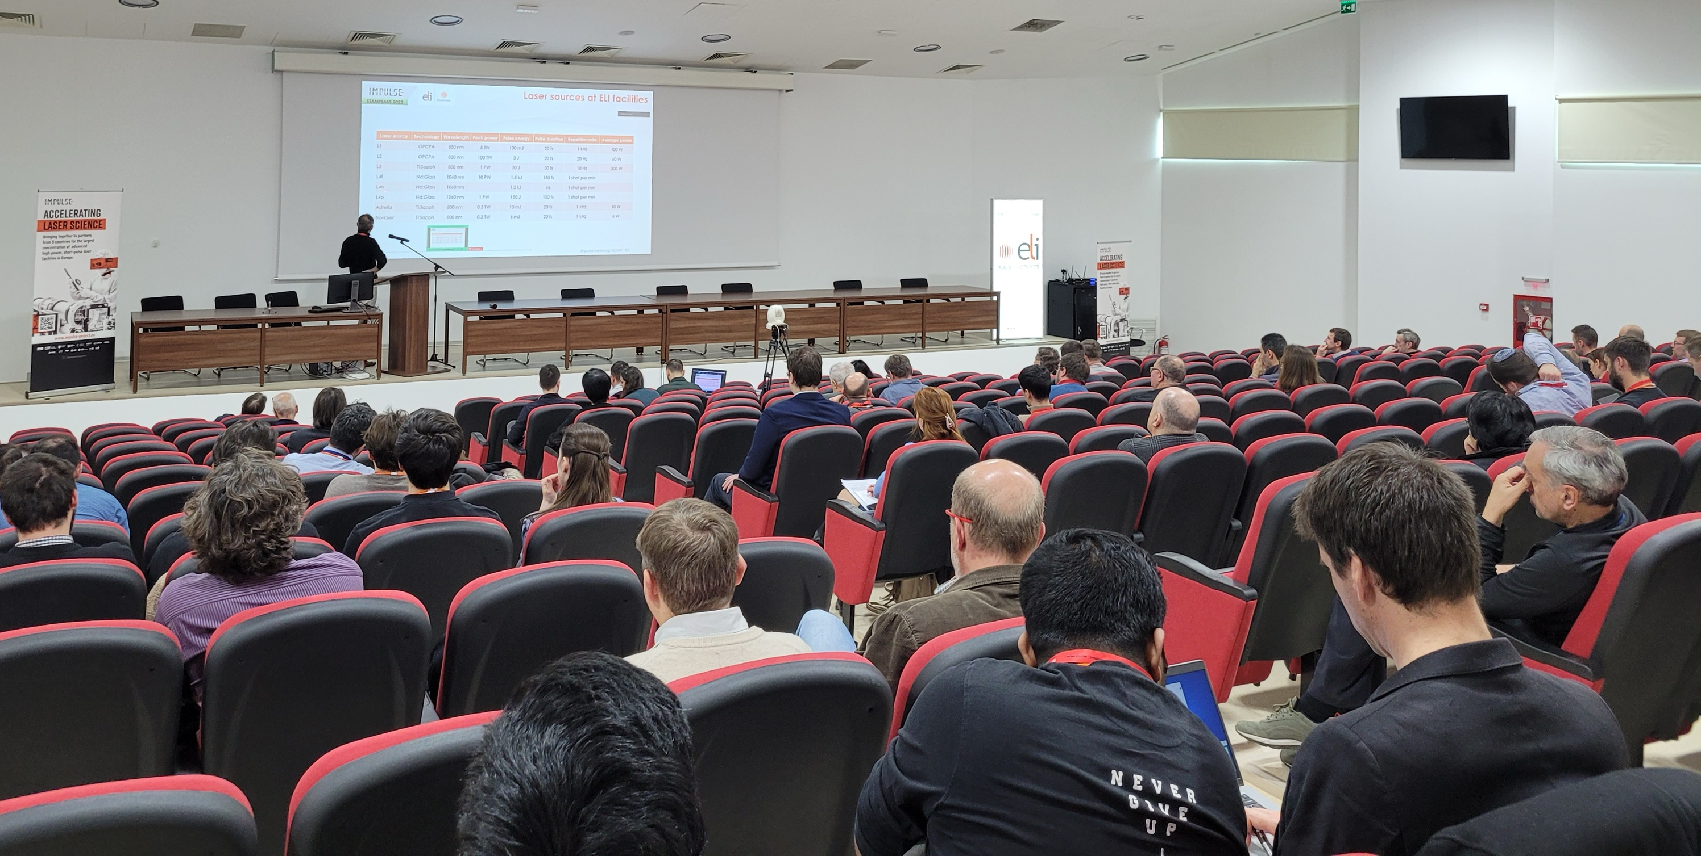
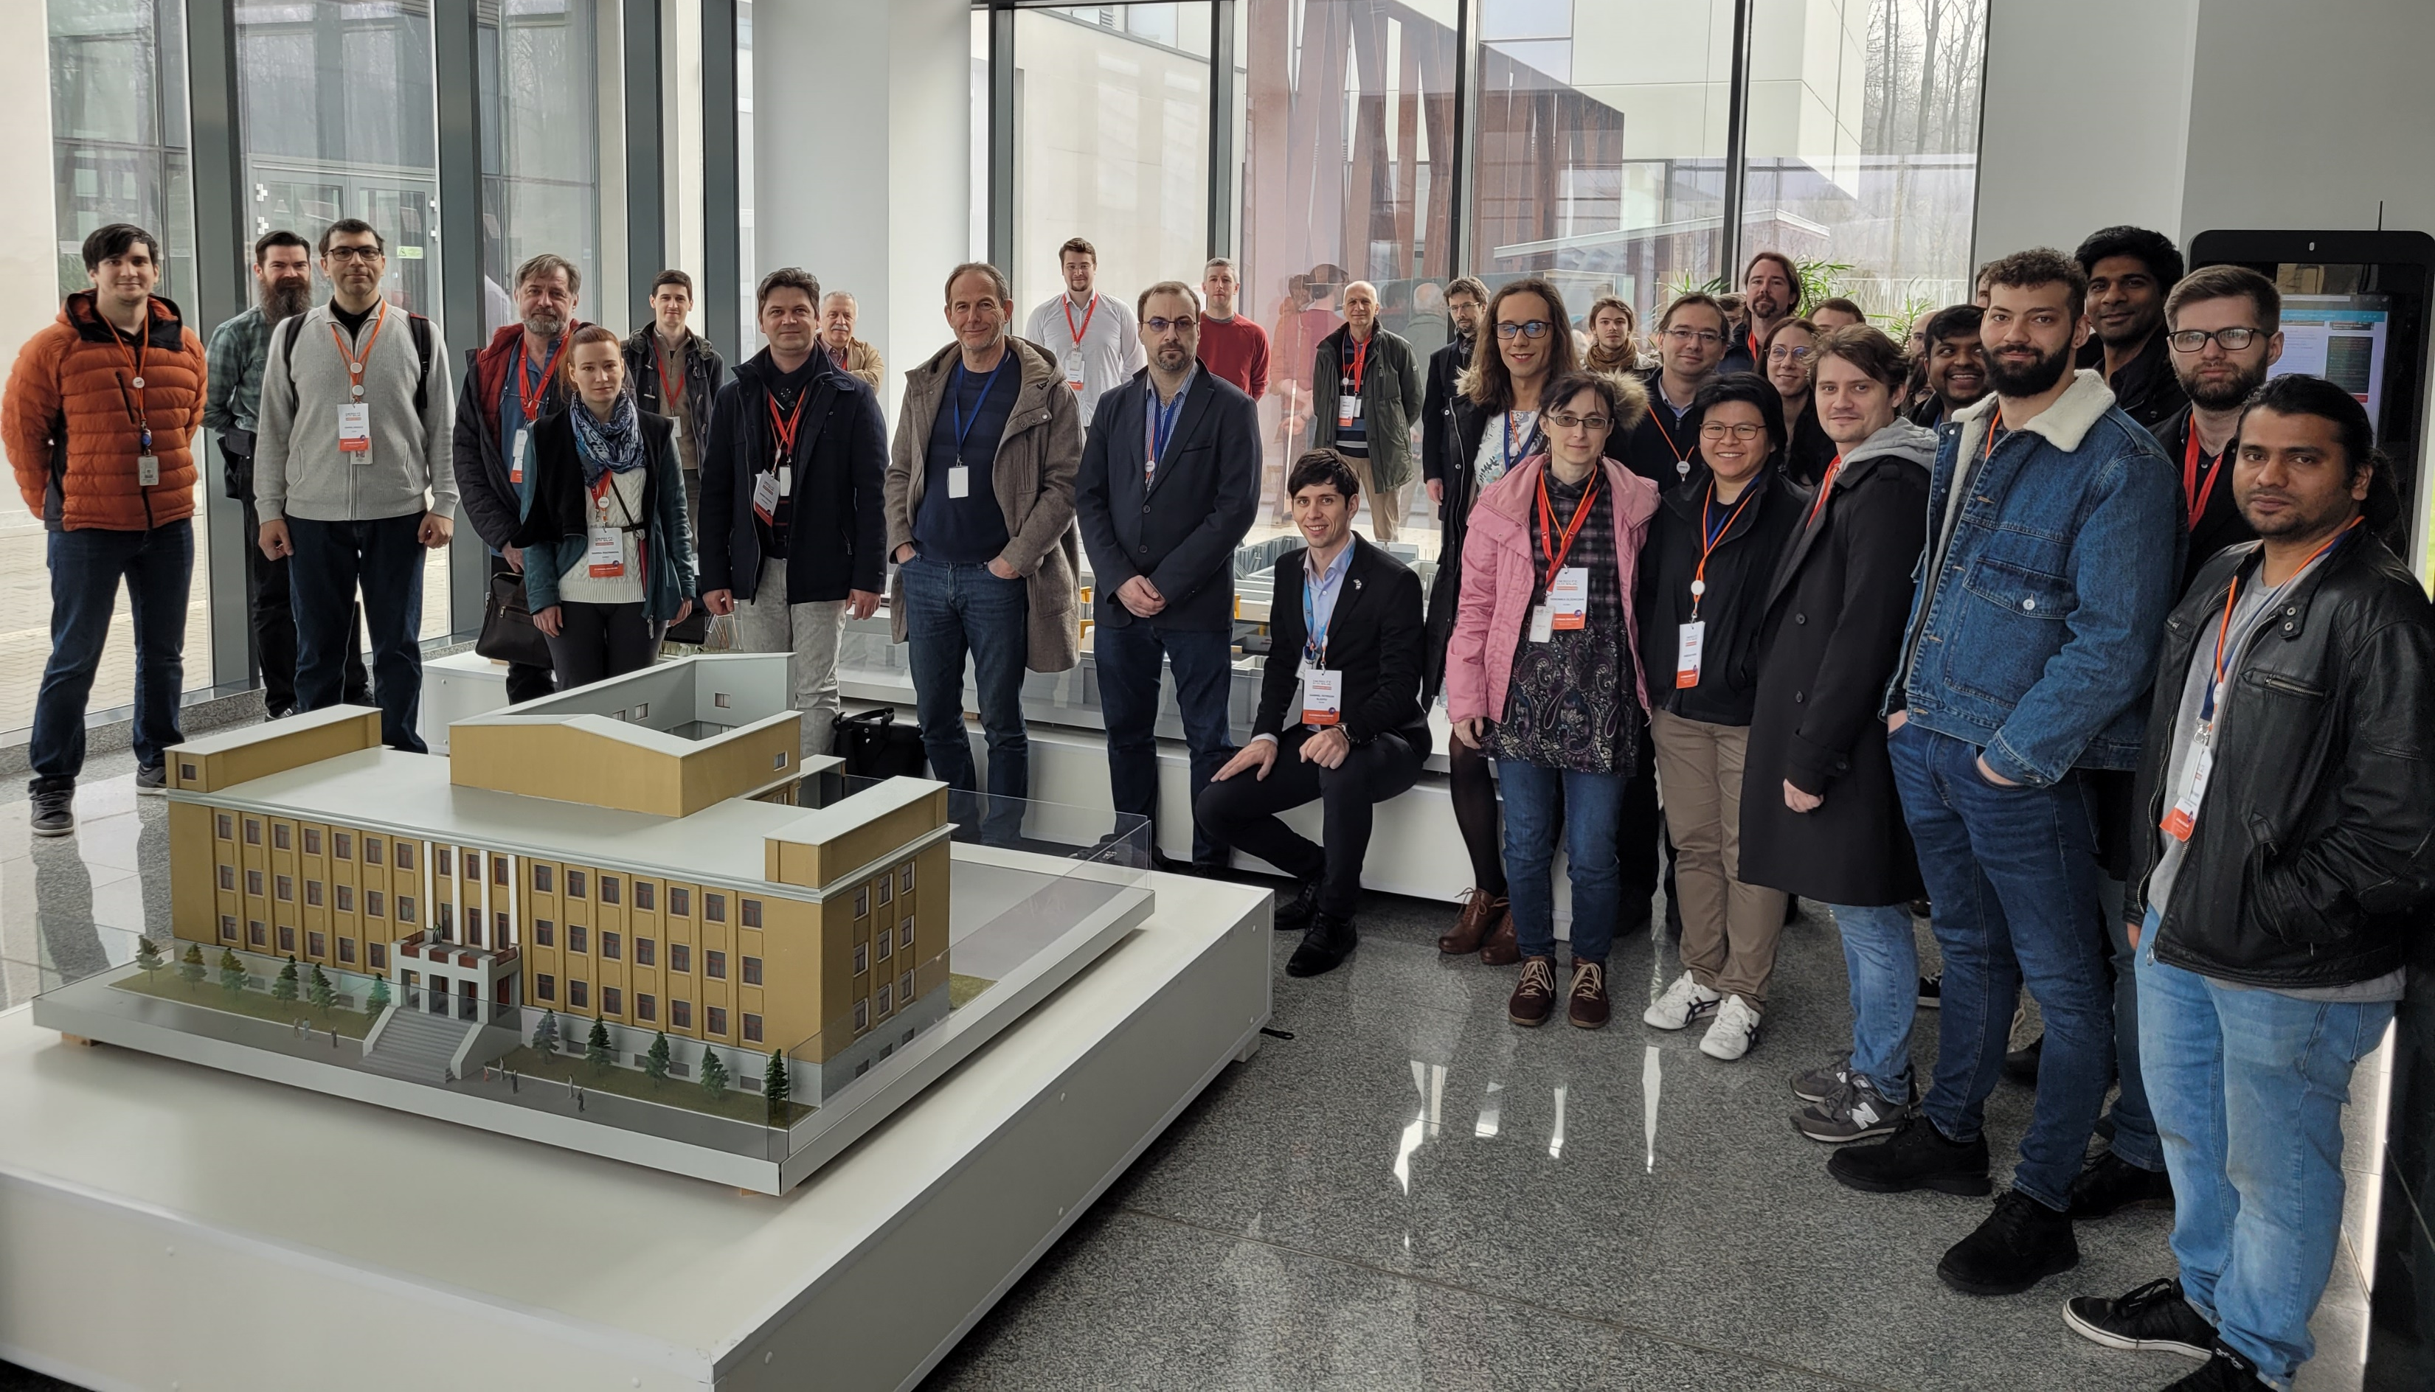
STAMPLASS Workshop hosted at ELI-NP led by WP3 on 21-23 March in Măgurele, România
The availability of reliable solutions and accepted protocols for the metrology of high-peak power, high-repetition rate lasers and the secondary sources derived from them is critical both for the operation of the ELI Facilities and for enabling excellent research and user access at ELI.
Workshop Objective
Identifying standard diagnostics in metrology procedures available for implementation at the ELI Facilities;
Exchange of experience with the scientific community (users, partners, industry) on standard diagnostics for the high-peak-power lasers;
110 participants (ELI facilities, 24 companies and 38 from academia);
3 day programme
37 talks / speakers
12 posters

Slide 16
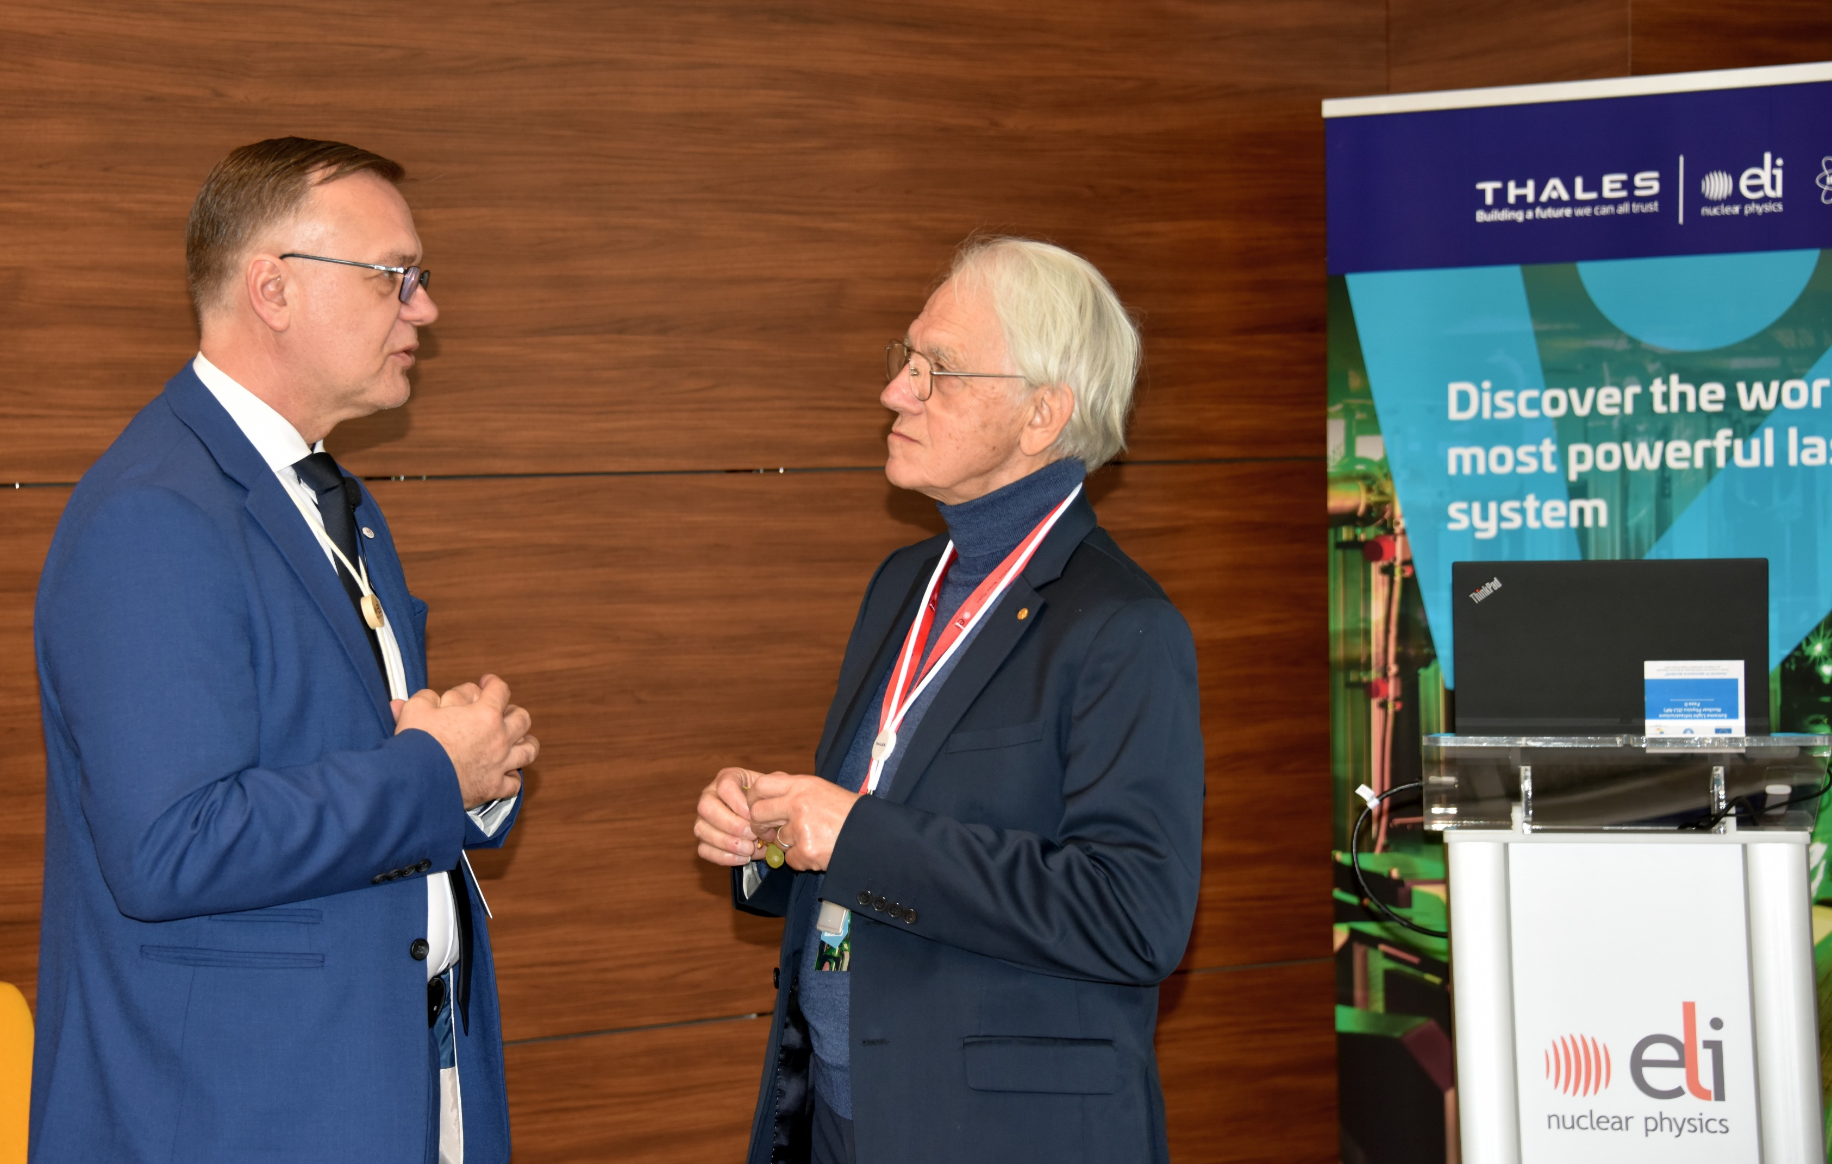
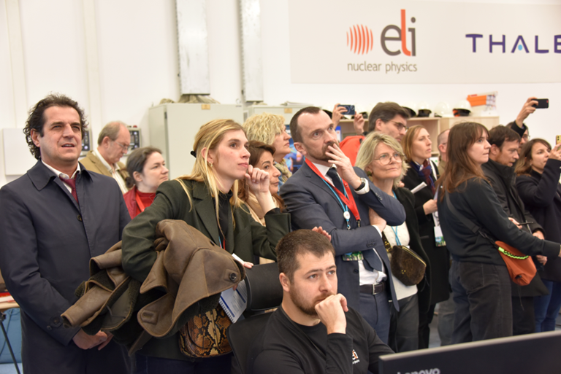
ELI NP / Thales Media Trip
A press trip was organised to celebrate 10 years of successful partnership and excellent collaboration between Thales and ELI-NP teams have made possible great achievements that led to the first 10 PW laser pulses on solid target in April 2023 with the presence of Nobel Laureate Gérard Mourou.
25 journalists from Spain, Italy, France, Germany, Romania, Holland;
20 publications (written media, TV, radio, press agencies );
More than 30 publications all over the world covering the subject

Slide 17
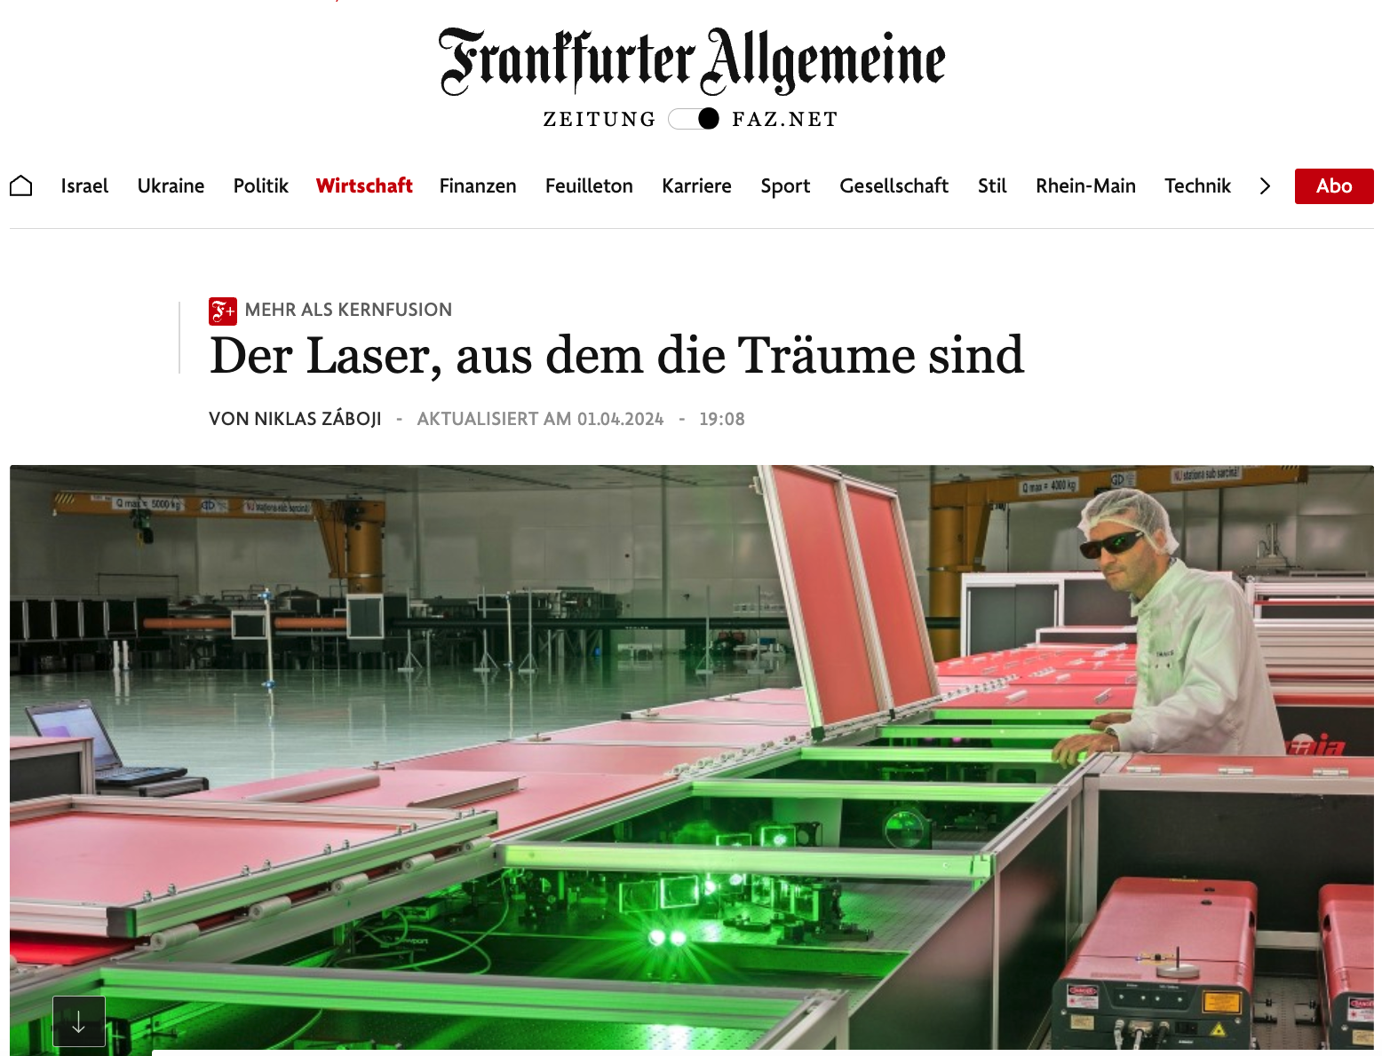
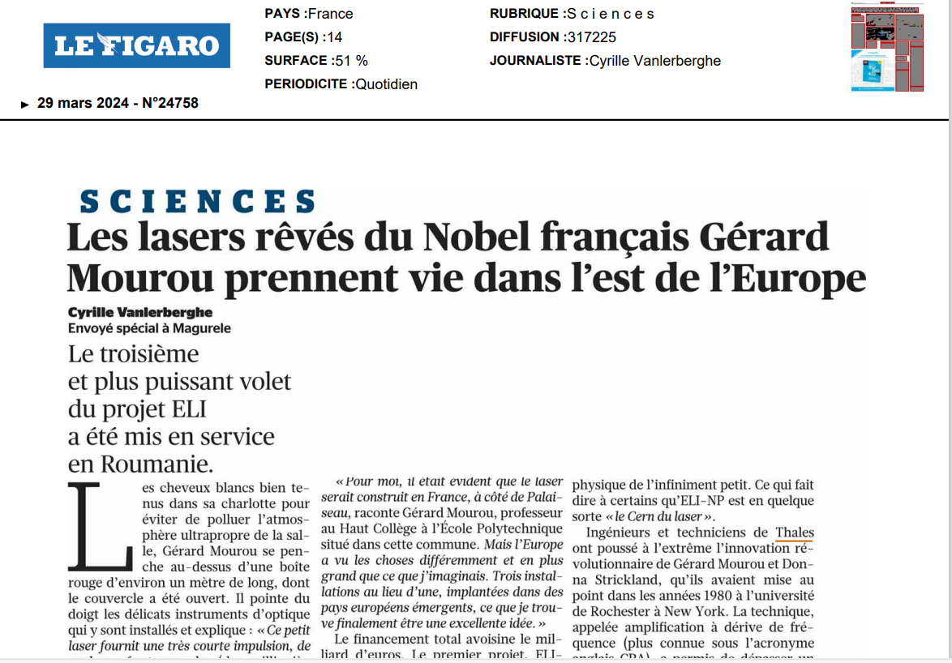
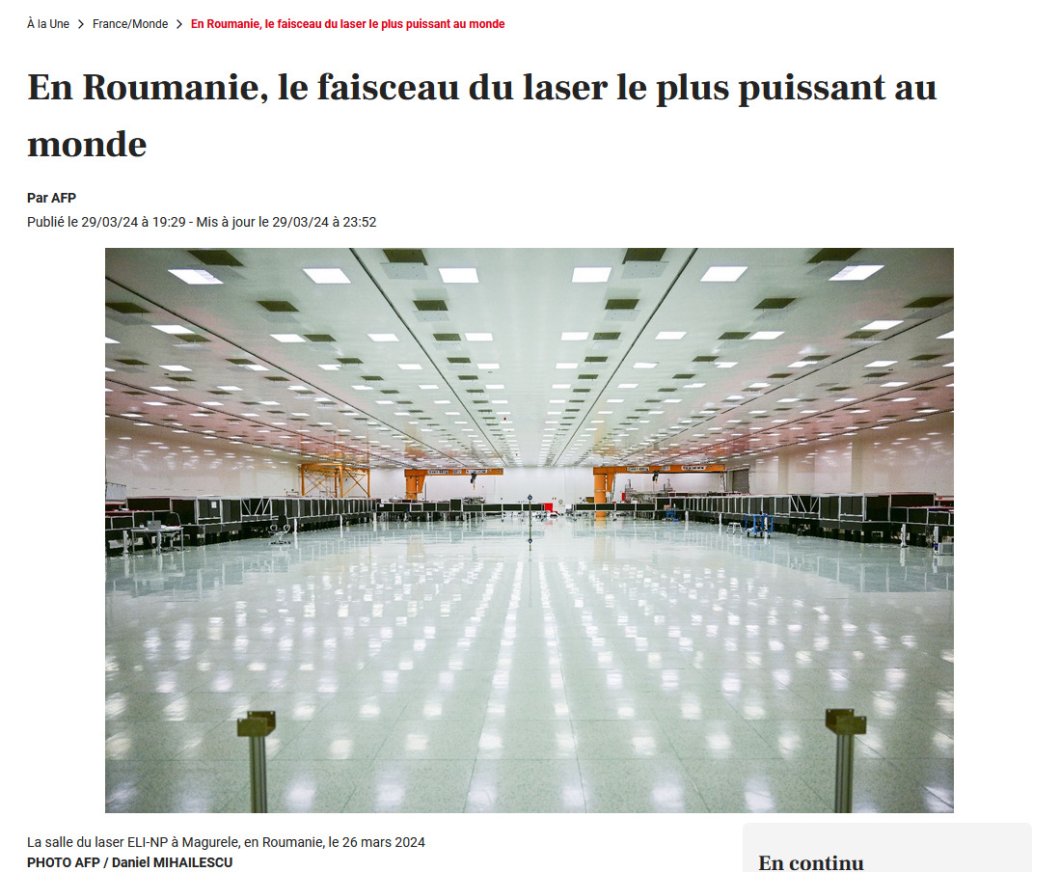
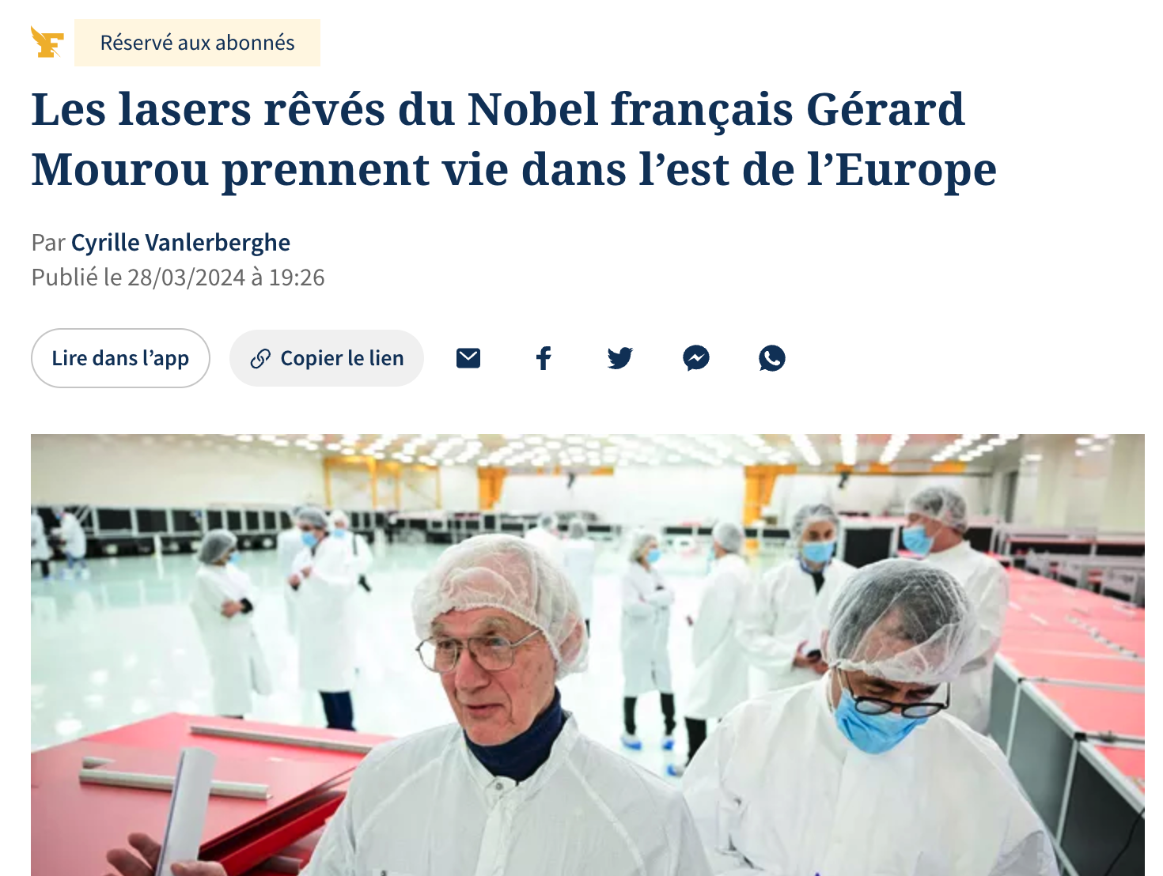
ELI NP / Thales Media Coverage

Slide 18
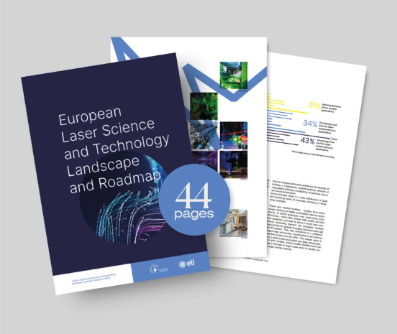
Science and Technology Landscape Report
A community driven landscape analysis to quantify and qualify the European laser community in collaboration with Laserlab-Europe
Laser landscape report in numbers
145 scientific users and 66 research facilities participated in survey
Report downloaded over 1300 times
High-level stakeholder event with 75 participants
Key Recommendations
Establishing a common strategy for laser RIs in Europe to better align efforts, enhance complementarities and increase synergies
Encouraging standardisation and interoperability of laser RIs to improve efficiency, facilitate user mobility and ensure data compatibility
Securing long-term and sustainable funding for laser RIs to ensure their stability, growth and competitiveness
Enhancing coordination between laser RIs and user communities, to gain a better understanding of user needs and requirements, and to better align the development of laser RIs with user demands.

Slide 19
Deliverables
No. | Title | Lead beneficiary | Due month | Due date | Status
D7.1 | Project website and portal | 1 - ELI-ERIC | M5 | 31 Mar 2021 | Submitted
D7.2 | Project communications and dissemination strategy | 1 - ELI-ERIC | M3 | 31 Jan 2021 | Submitted
D7.3 | New members and strategic partners engagement plan | 1 - ELI-ERIC | M9 | 31 Jul 2021 | Submitted 31 Aug 2021
D7.4 | Scientific community outreach strategy | 1 - ELI-ERIC | M12 | 31 Oct 2021 | Submitted
D7.5 | Corporate identity guide and Communications rules for ELI | 1 - ELI-ERIC | M6 | 30 Apr 2021 | Submitted
D7.6 | Annual reports on activities to engage new Partners | 1 - ELI-ERIC | M12 | Submitted annually | Final update by end of project
D7.7 | Annual reports on community outreach activities | 1 - ELI-ERIC | M12 | Submitted annually | Final update by end of project
D7.8 | Report on Laser Science and Technology Roadmap for Europe | 1 - ELI-ERIC | M28 | 28 Feb 2023 | Submitted

Slide 20
Milestones
No. | Title | Lead | Due month | Due date | Status
MS69 | Project website specification | 1 - ELI-ERIC | M3 | 31 Jan 2021 | Achieved
MS70 | Impulse Communication Plan and guidelines | 1 - ELI-ERIC | M6 | 30 Apr 2021 | Achieved
MS71 | Guidelines for the selections of outreach and support to user communities | 1 - ELI-ERIC | M9 | 31 Jul 2021 | Achieved 31 Aug 2021
MS72 | Guidelines to select the events for internationalisation of ELI and establishment of strategic partnerships | 1 - ELI-ERIC | M9 | 31 Jul 2021 | Achieved 31 Aug 2021
MS73 | Guidelines for the Science and technology roadmapping for the European laser community | 1 - ELI-ERIC | M9 | 31 Jul 2021 | Achieved 31 Aug 2021
MS74 | Members of the Science and technology roadmapping committee selected | 1 - ELI-ERIC | M12 | 31 Oct 2021 | Achieved 31 Oct 2021
MS75 | Feedback on activities to communities/decision-makers | 1 - ELI-ERIC | M37 | 30 Nov 2023 Ext. req | To be finalised end of project
MS76 | Feedback on the outreach activities | 1 - ELI-ERIC | M40 | 29 Feb 2024 Ext. req | To be finalised end of project
MS77 | Feedback on establishment of strategic partnerships | 1 - ELI-ERIC | M40 | 29 Feb 2024 Ext. req | To be finalised end of project

Slide 21
WP7 Impacts
Activities are a key driver to align communications activities for the integration of the Facilities as a single organisation and build one ELI brand
Core activities to engage with ELI staff across the Facilities and main partners resulting in joint scientific publications, user proposals, MoUs, collaborations, etc.
Critical for building and launching the User Programme and all related activities
Development and expansion of range of outreach to and support of community building activities in cooperation with Scientific Directorate and User Office
Engagement of potential new members and strategic partners to build ELI member base and network of partners
Expand Education and Training measures, in particular programmes for PhD students
Enhance outreach activities to general public and media

