Slide 1

IMPULSE PROJECT
Innovation
CLOSING MEETING
Aleš Hála
17 April 2024
IMPULSE is funded by the European Union’s
Horizon 2020 research and innovation programme
under grant agreement No. 871161

Slide 2
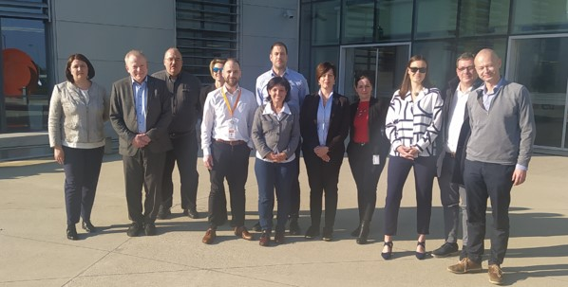





WP6 – Fostering ELI‘s Innovation impact
WP6 mission
  Setting-up of an innovation and technology management process in ELI
  Maximize ELI’s impact on innovation through the development of a shared approach to knowledge transfer and industrial access
The WP6 team, in-person meeting at ELI ALPS facility, 12 April 2022

Slide 3
WP6 – Fostering ELI‘s Innovation Impact
Task 6.1 – Setting-up of ELI ILO with presence at ELI Facilities
Task 6.2 – Development of common processes and “toolbox” in the area of knowledge transfer and exploitation
Task 6.3 – Outreach to industry

Slide 4
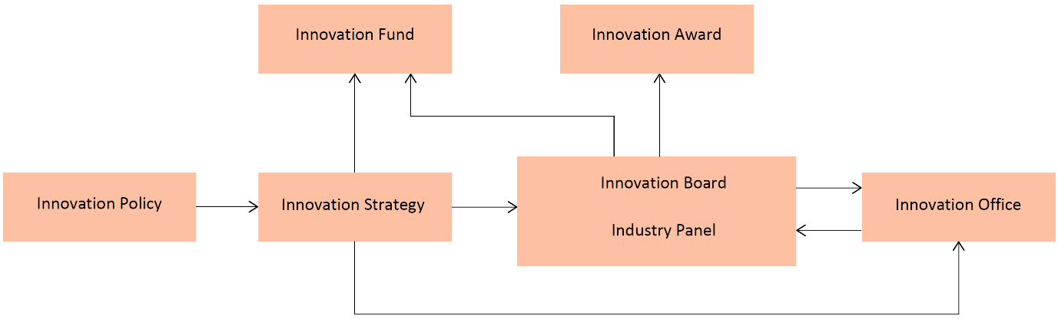
Structure of the ELI innovation management
Task 6.2
Post-Impulse
Task 6.1
Task 6.2
Task 6.1

Slide 5
Task 6.1 Setting-up of ELI ILO with presence at ELI Facilities
Challenge: Establish ELI Industrial Liaison Office (ELI Innovation Office) including recruiting, training, policy and strategy definition
Del / Ms No. | Title | Lead beneficiary
MS62 | Initial ILO key staff hired | ELI Beamlines, ELI ALPS, ELI NP
MS63 | ELI Innovation Policy Draft | ELI Beamlines, ELI ERIC
D6.2 | Strategy for ELI Innovation | ELI Beamlines, ELI ERIC
MS64 | ELI Innovation Strategy presented to GB | ELI Beamlines, ELI ERIC
D6.1 | Setting-up and operation of ELI central ILO and local units, annual reporting of activities | ELI Beamlines, ELI ERIC

Slide 6
Task 6.1 – Setting-up of ELI ILO with presence at ELI Facilities
ELI Facility Innovation Offices set up on 12 May 2021 (MS62)
  ELI Beamlines / ELI ERIC – Aleš Hála, Andrea Cejnarová
  ELI ALPS – Dávid Bereczkei, László Jaloveczki, Zsuzsa Hegedüsné Halmágyi, Zoltán Gyarmati, József Kanyári
  ELI NP – Daniela Zamfir, Marius Jurca
The responsibilities are coordination and management of relations with industry, monitoring and capturing of innovative ideas, commercialisation of IP, support to proprietorial (industrial) use of the ELI’s instrumentation and outreach to industrial and application partners
During the Impulse project, WP6 had 49 online meetings, 5 in-person meetings

Slide 7
Task 6.1 – Setting-up of ELI ILO with presence at ELI Facilities
Sharing of the best practices in innovation processes (2021)
3 June 2021 | Elettra | Alifax, SXFEL
14 July 2021 | STFC | Cobalt Ltd., SciTech Ltd.
8 September 2021 | STFC | Keit Spectrometers Ltd., Thru vision
22 September 2021 | Elettra | KYMA
3 November 2021 | Elettra | Dynamic High Pressure, Environmental monitoring station, case study of Pall Corp.
3 November 2021 | STFC | EPAC centre, industry access case studies (OxSyBio, Pepsico, Finden, Malvern Panalytical, Johnson Mathey, UCN, Offord Nanoimaging, EvoTech, AstraZeneca)
28 July 2021 | ELI Beamlines | Licence of Compact XUV spectrometer / beam profiler to HP Spectroscopy GmbH
11 August 2021 | ELI ALPS | Research project of Nuclear waste management (Shortening of halftime of nuclear waste)
25 August 2021 | ELI NP | Introduction of IRASM (Multipurpose Irradiation Facility Centre) devoted to production and R&D centre offering industrial irradiation services, consultation, analyses, training and research in radiation processing
22 September 2021 | ELI Beamlines | Device QURe-, offering radiotherapy with high energy electrons generated by high power lasers combined with X-ray monitoring
6 October 2021 | ELI ALPS | Research project of infrared reflective polymer/phase change materials encapsulations for rendering perovskite photovoltaics environmentally robust and efficient
20 October 2021 | ELI NP | Non-destructive material inspections using brilliant gamma beams at ELI NP

Slide 8
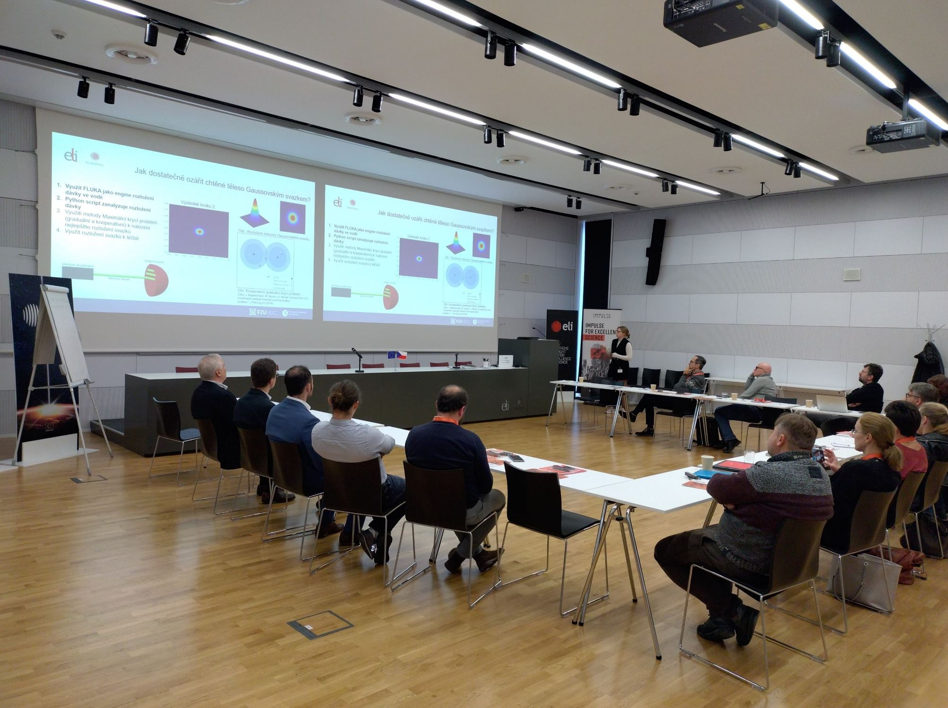
Task 6.1 – Setting-up of ELI ILO with presence at ELI Facilities
Indetification of innovation-related activities at ELI Facilities (2021–2024) based on the scientific fields at ELI facilities
ELI ALPS Facility | Production of high-quality reflective optical elements leading to coating of large-surface optical elements (2022 – 2024) Methods of micro-nano structuring of thermoelectric materials (2022 – onwards) LEPRO (Laser Driven Electron and Proton Beam) for radiation oncology (2023 – onwards) In-vacuum pressure sensing (2021 – onwards) Conversion of MEMS microphones with Focused Ion Beam technology to cancel microphone sensitivity at low frequencies (2020 – 2023)
ELI Beamlines Facility | Development, production, repair and testing of high-quality reflective optical elements (2020 – onwards) LOTO – Low Toxicity Radiotherapy using the Very High Energy Electrons (2021 – onwards) Development of enhanced detector prototype used for the online characterization of pulsed mixed radiation fields (2022 – onwards) Development of non-destructive material inspection methods (2020 – onwards)
ELI NP Facility | COMP – Production of large-scale reflective laser optics (2023 – 2026) ARGOS – Development of a new laser protection goggles (2023 – 2026) MDFM – Development of a new wavefront correction scheme (2023 – 2026) T-Ninjas – γδ-CAR-T cell assisted Boron Neutron Capture Therapy (BNCT) (2020 – 2022)
A joint workshop with Society for Radiation Oncology, Biology and Physics of the Czech Republic, held at ELI Beamlines facility on 14 December 2022

Slide 9
Task 6.1 – Setting-up of ELI ILO with presence at ELI Facilities
Identified & selected pilot innovation projects across ELI facilities (MS67)
LOTO – Low Toxicity Radiotherapy using the Very High Energy Electrons
    Based on research programmes focused on the laser-driven electron acceleration for medical applications
    Performance and completion of the preclinical phase of testing, prototyping
Innovative zebrafish embryo model for radiation research
  Insights into special features of different laser-driven ionizing beams
  Development of applications in radiation therapy
Development of 2-Steps BNCT-Immunotherapy “PROCTI” (Personalized Radio-Oncology with CAR-T Cells Immunotherapy)
  Enhancing the new field of radio-immunology by using genetically modified and personalized γδ CAR-T cells

Slide 10
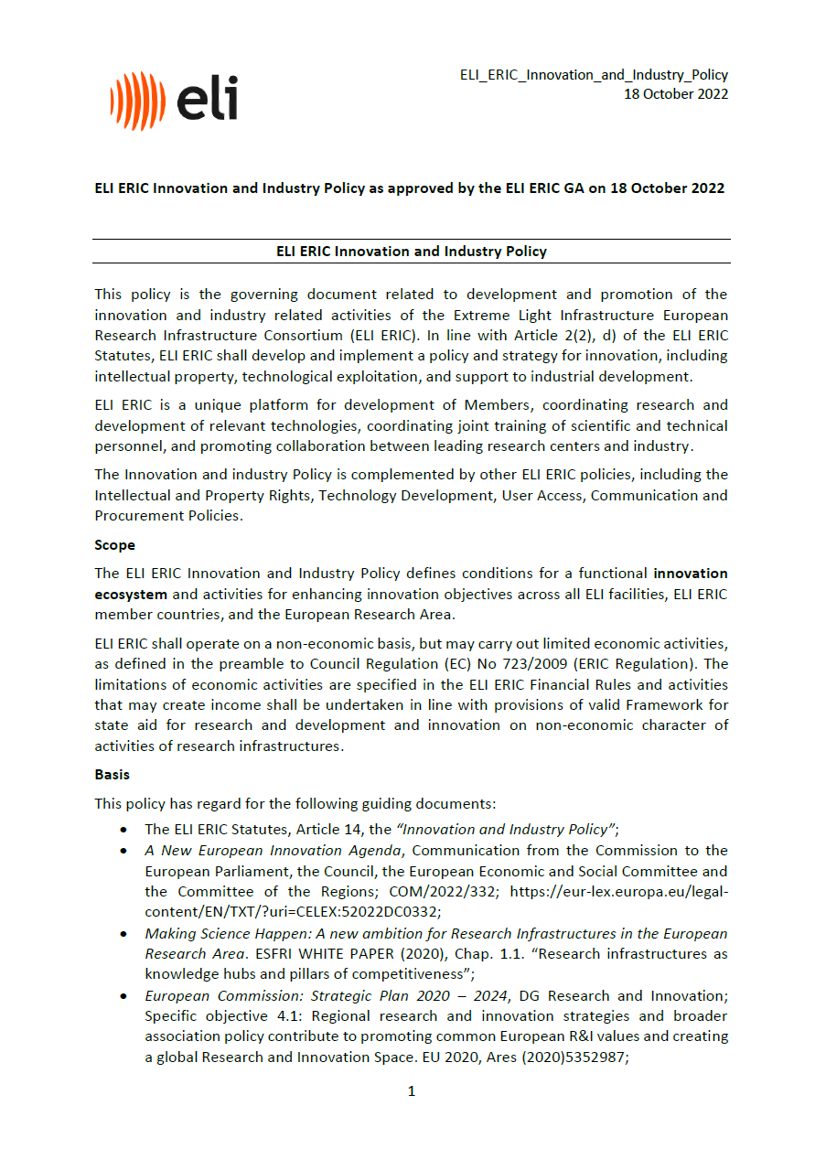
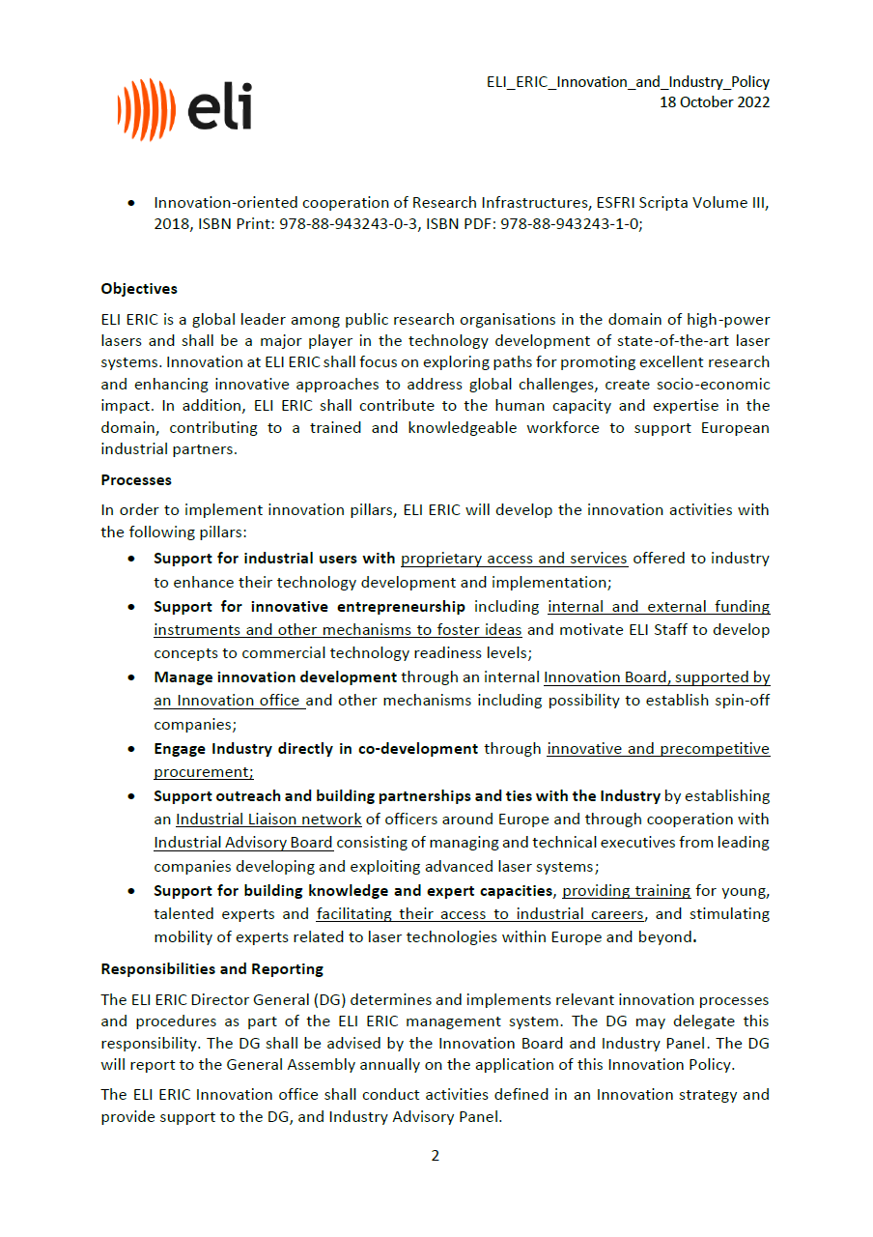
Task 6.1 – Setting-up of ELI ILO with presence at ELI Facilities
ELI Innovation Policy (MS63)
General approach of ELI to innovation and industrial collaborations
Aim is to unify and coordinate innovation activities at ELI and arrange cohesive communication towards industrial partners
Approved by the General Assembly on 18 October 2022

Slide 11
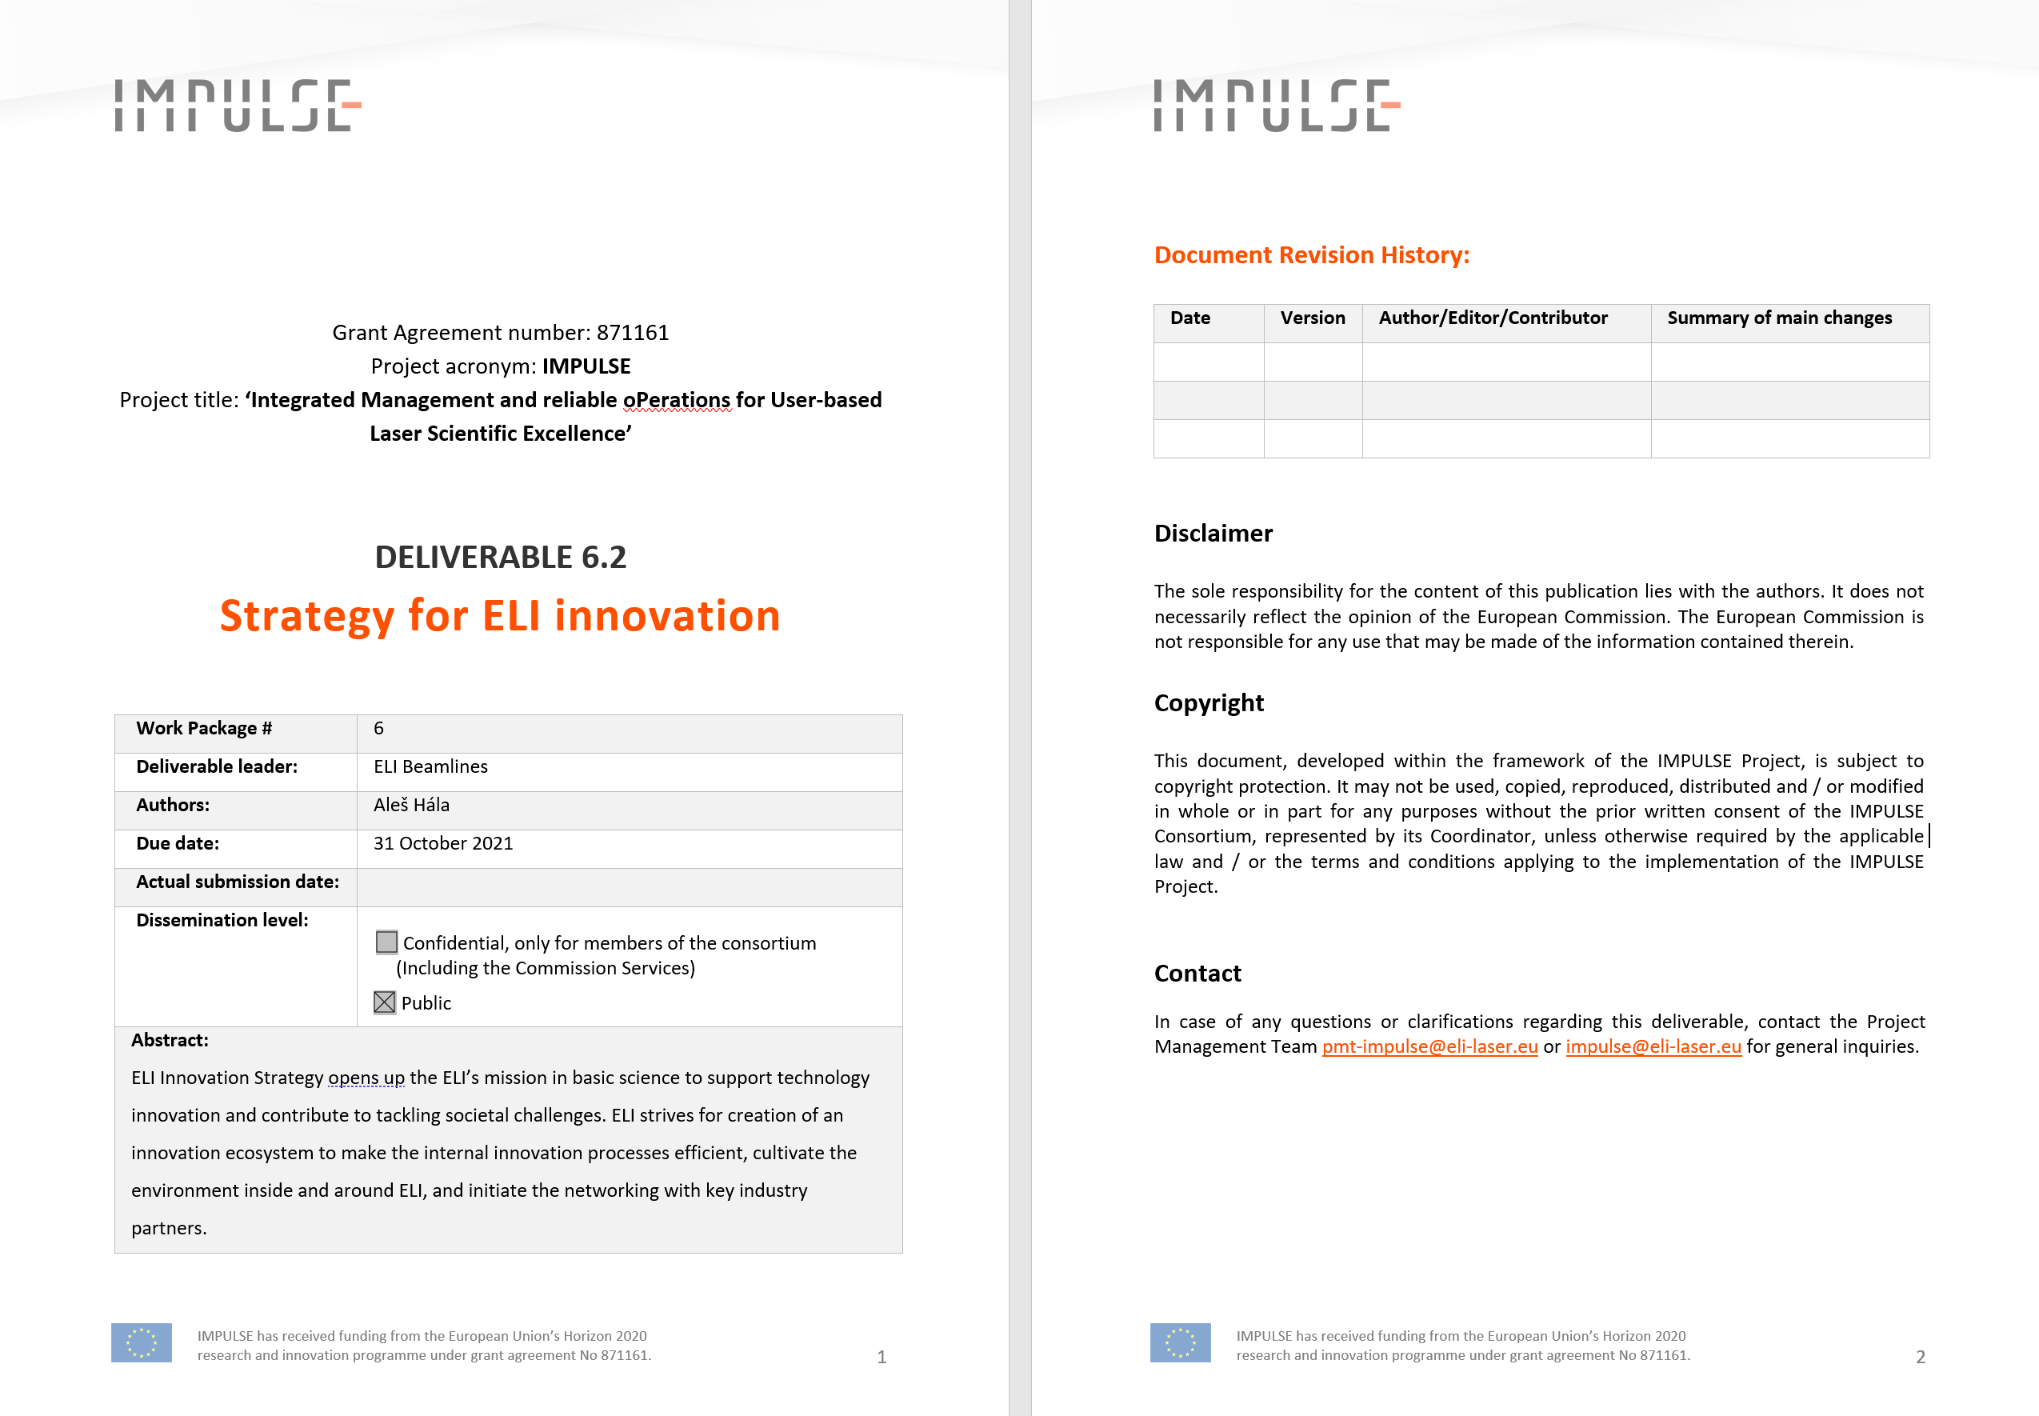
Task 6.1 – Setting-up of ELI ILO with presence at ELI Facilities
ELI Innovation Strategy (D6.2)
Roadmap for ELI activities to fulfil targets in innovations and become a reliable and beneficial partner for industry.
General procedures and guidelines for innovation processes and cooperation with partners
Concept presented and agreed by the General Assembly on 18 October 2022
Adopted and implemented by ELI Facilities

Slide 12
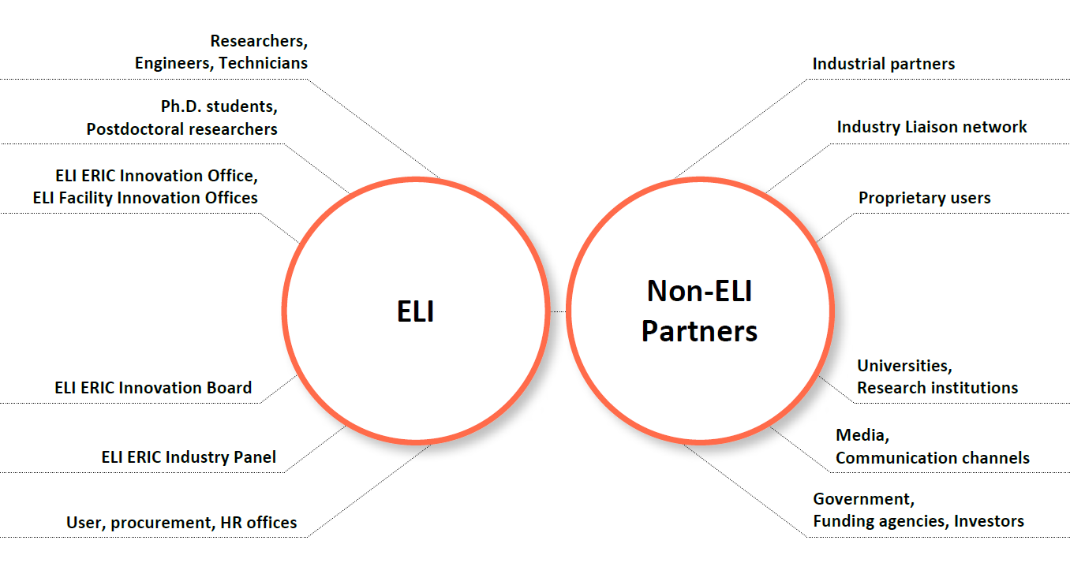
Task 6.1 – Setting-up of ELI ILO with presence at ELI Facilities
ELI lnnovation Strategy key processes:
    Proprietary access for industry users with additional services offered to industry (targetry, samples preparation, expert consultancy)
    Support to innovative entrepreneurship of ELI personnel and its support through ELI ERIC Innovation Fund
    Collaborations with industry leading to new technologies and identification of new application areas incl. innovative procurement and precompetitive procurement
    Identification, protection and commercialization of outcomes of research, engineering and technical teams
    Industrial Liaison network to build the partnership with industry community throughout Europe and wider
    Building knowledge and skills capital by building expert capacities, providing training for industry, enabling access to talent and stimulating mobility of experts related to laser technologies within Europe and wider
ELI innovation ecosystem stakeholders

Slide 13




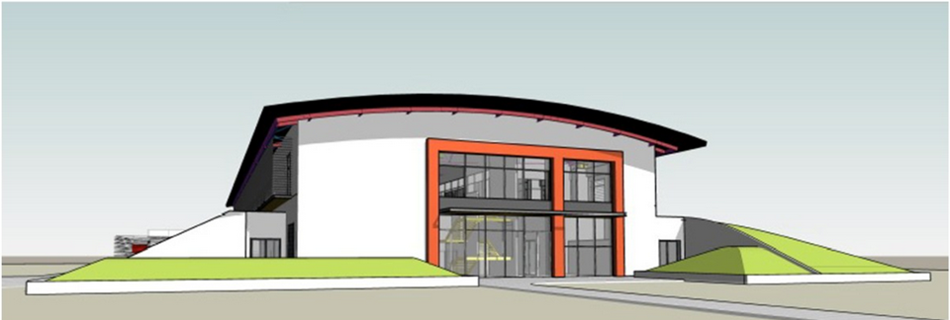


Task 6.1 – Setting-up of ELI ILO with presence at ELI Facilities
Proprietary access for industry
Support to innovative entrepreneurship of ELI personnel
Collaborations with industry leading to new technologies

Slide 14
Task6.2 – Development of common processes and “toolbox” in the area of knowledge transfer and exploitation
Challenge: Preparation of tools necessary to identify, finance and develop innovative technologies and services of ELI exploitable by industry
Del / Ms No. | Title | Lead beneficiary
D6.4 | Setting-up of ELI Innovation Board | ELI Beamlines
MS66 | Innovation Board convened | ELI Beamlines
MS67 | Pilot Innovation Projects Selected | ELI NP
MS68 | Innovation Fund Established | ELI ALPS
D6.3 | Report on implementation measures of ELI Innovation Strategy | ELI NP
D6.5 | Report on meetings of ELI Innovation Board | ELI ERIC
D6.6 | Report on organization of industry events at ELI | ELI ALPS

Slide 15
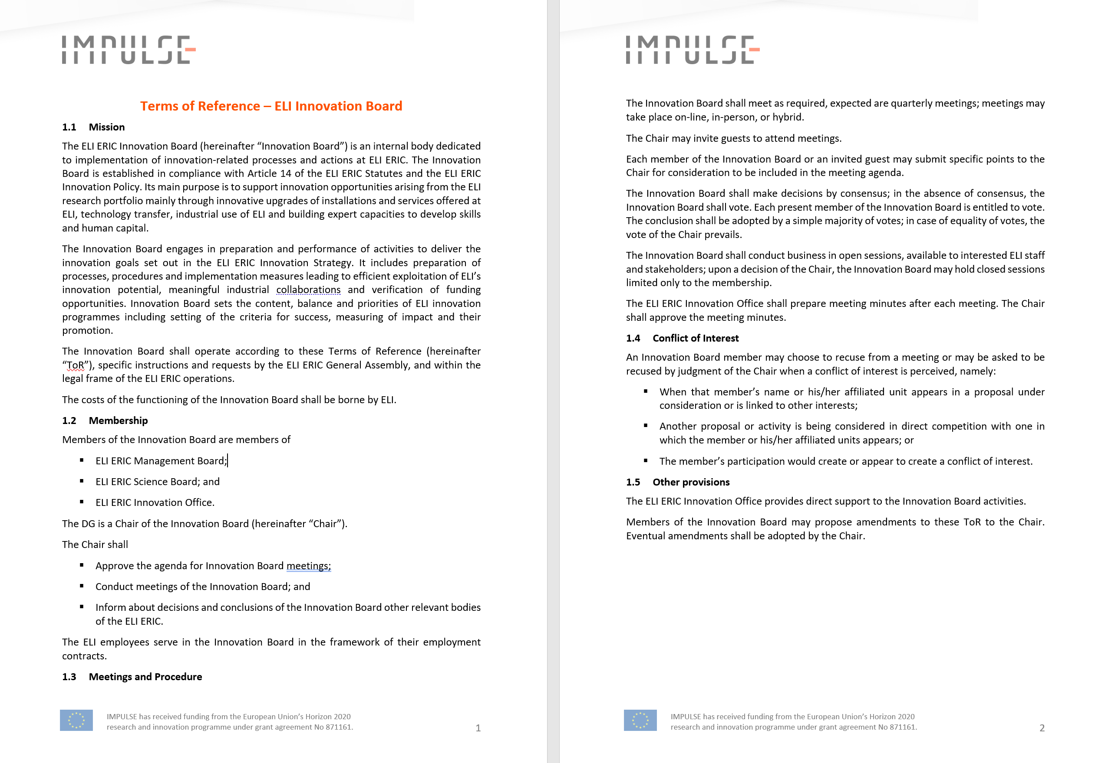
Task 6.2 – Development of common processes and “toolbox” in the area of knowledge transfer and exploitation
ELI Innovation Board (D6.4)
Preparation of processes, procedures and implementation in ELI ERIC funding schemes and other mechanisms aiming at identification, and development of innovations at ELI
Guidance on innovation-driven procurements
Recommendation on IP provisions
Kick-off meeting on 22 November 2022

Slide 16
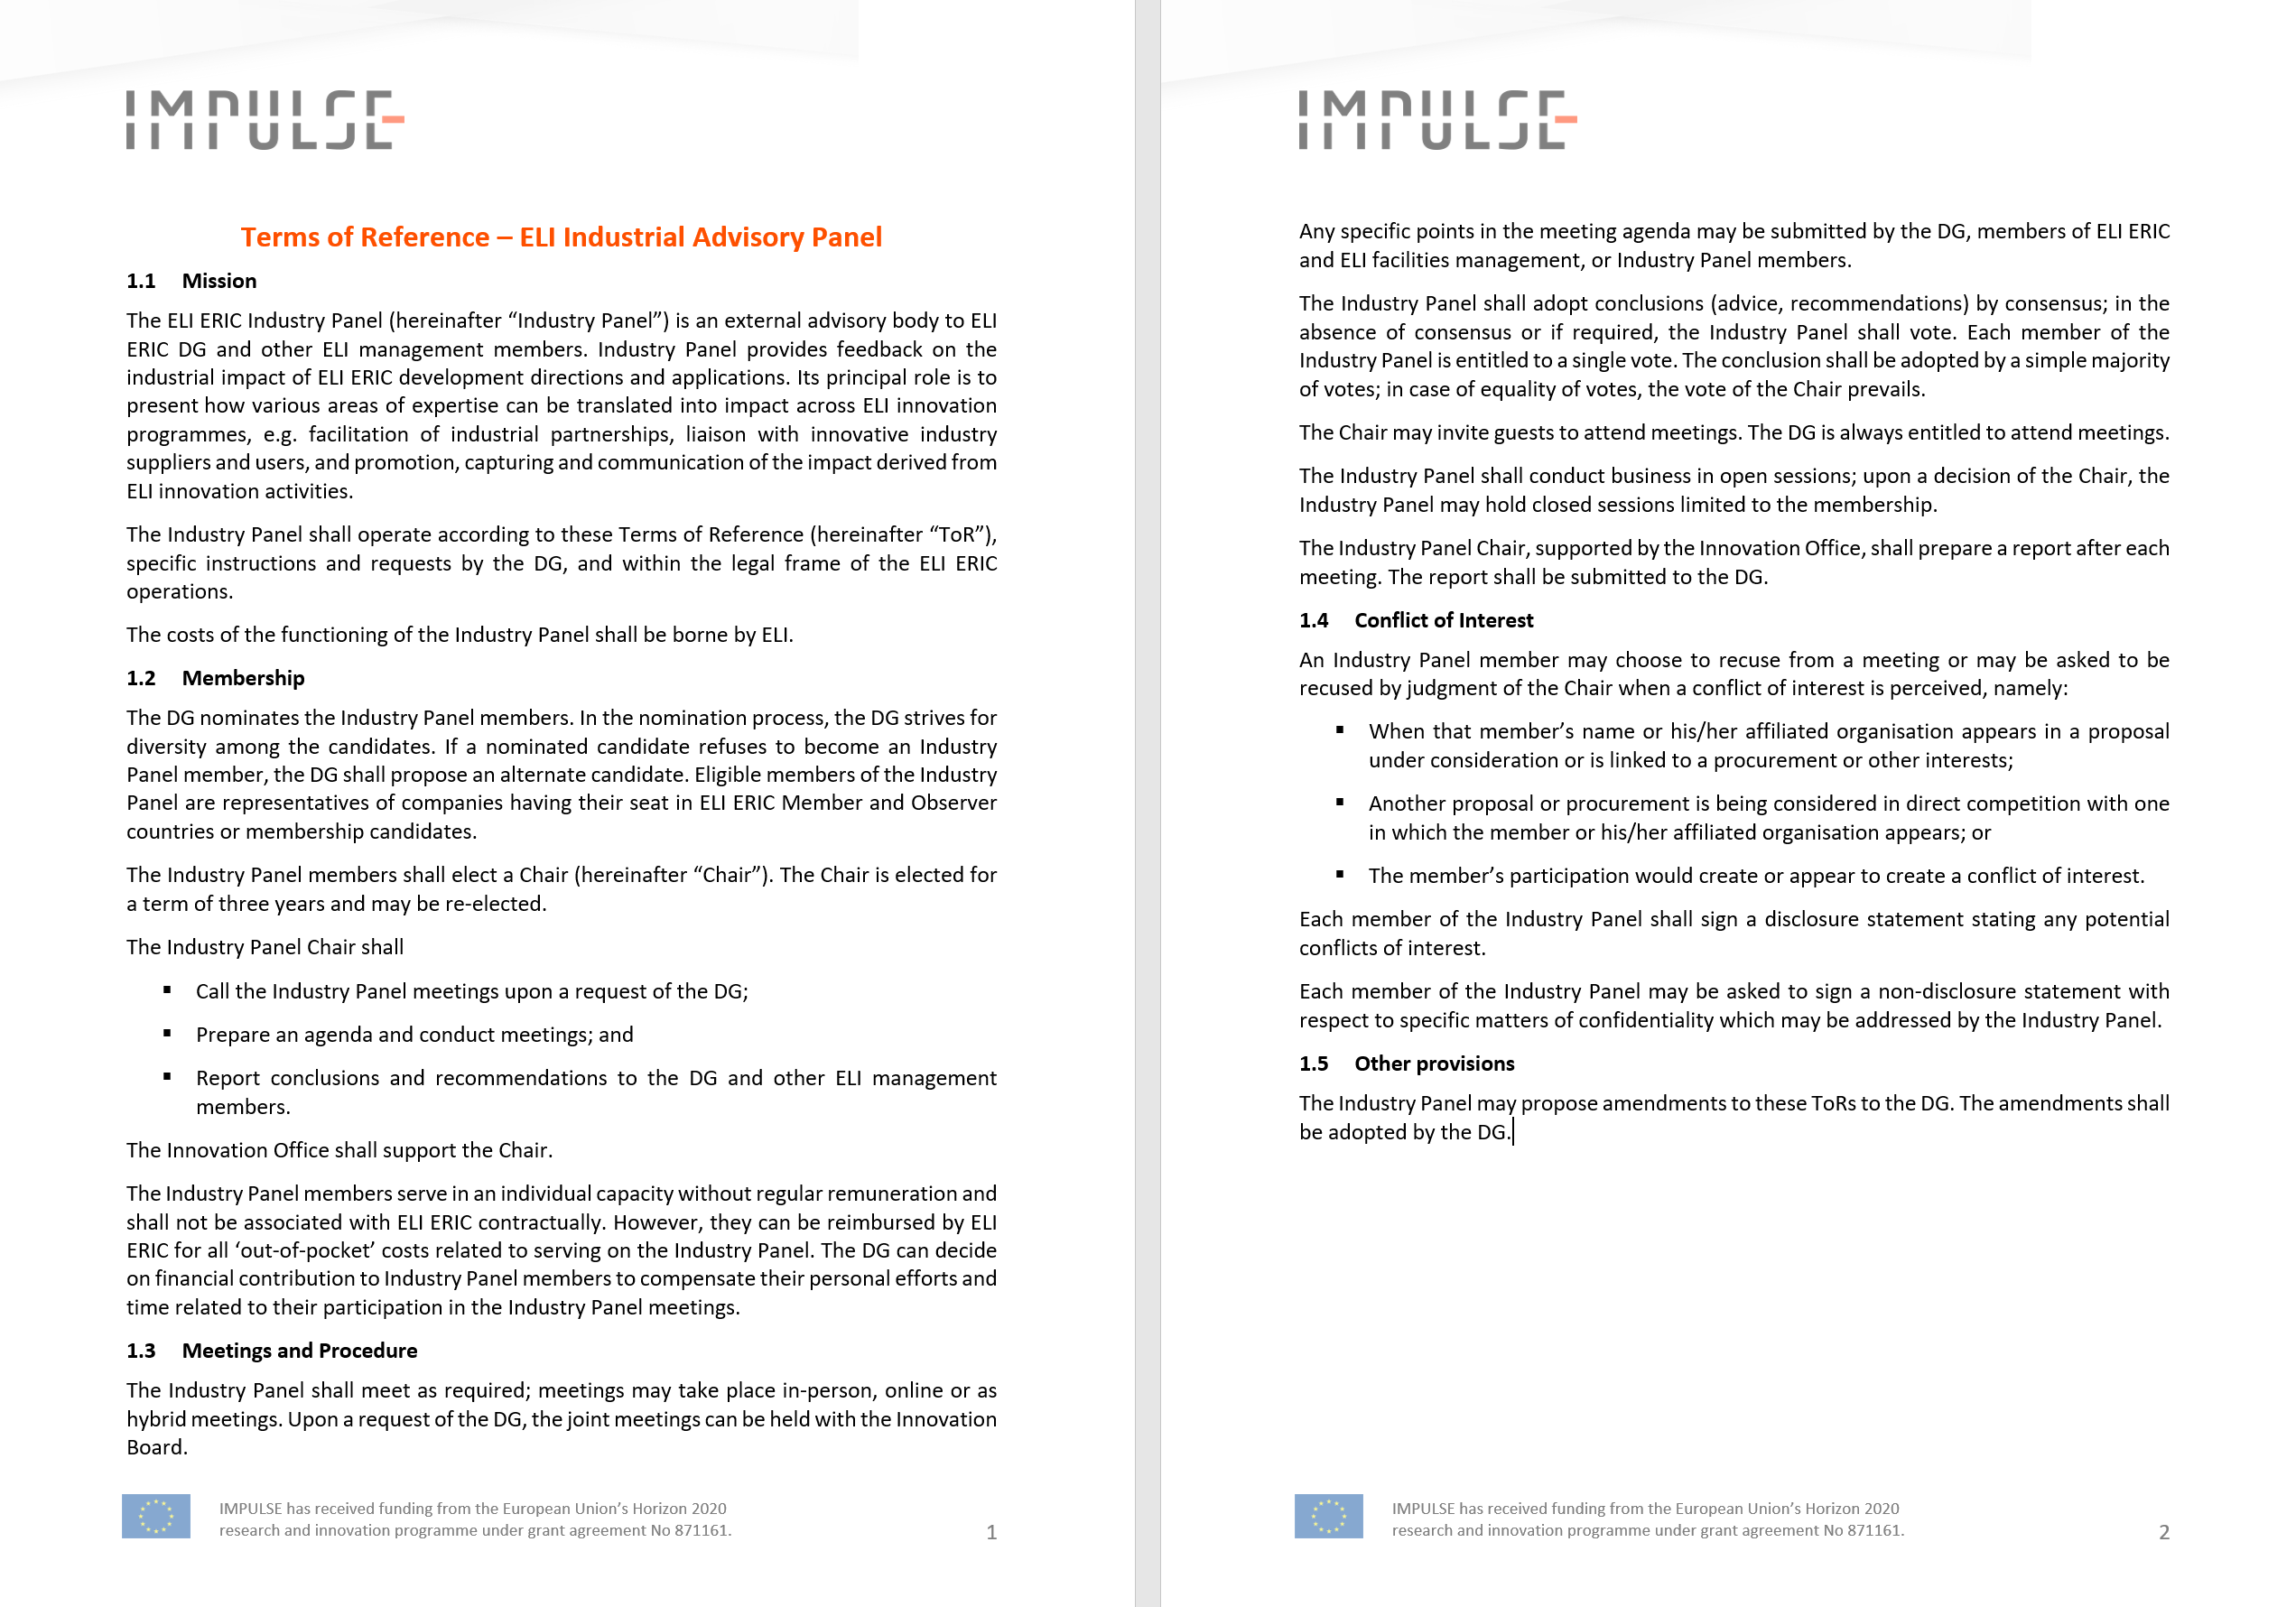
Task 6.2 – Development of common processes and “toolbox” in the area of knowledge transfer and exploitation
ELI Industrial Advisory Panel
  Large laser systems suppliers approached
  Other technology companies (SMEs) from ELI ERIC founding member and observer countries
External advisory body to ELI ERIC DG and other management members
Feedback on the industrial impact of ELI ERIC development directions and applications

Slide 17
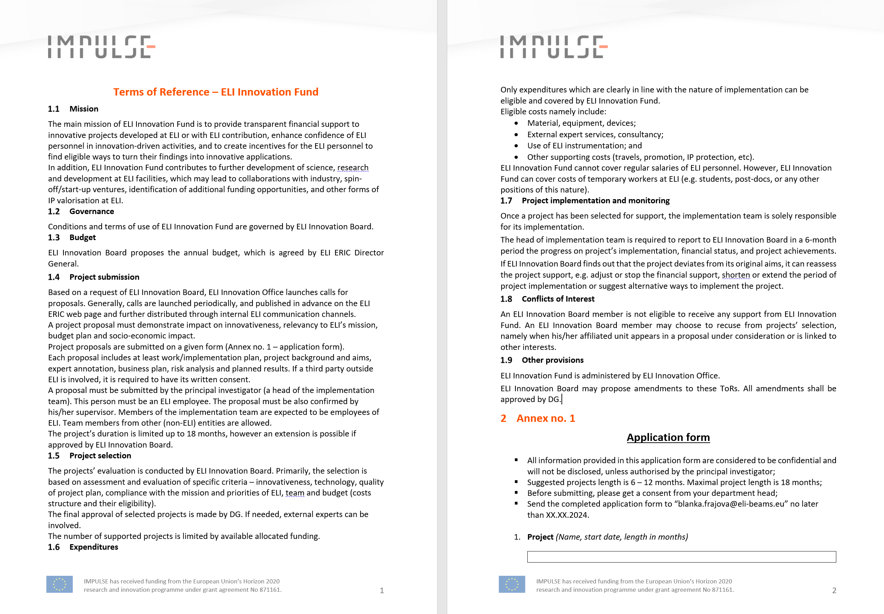
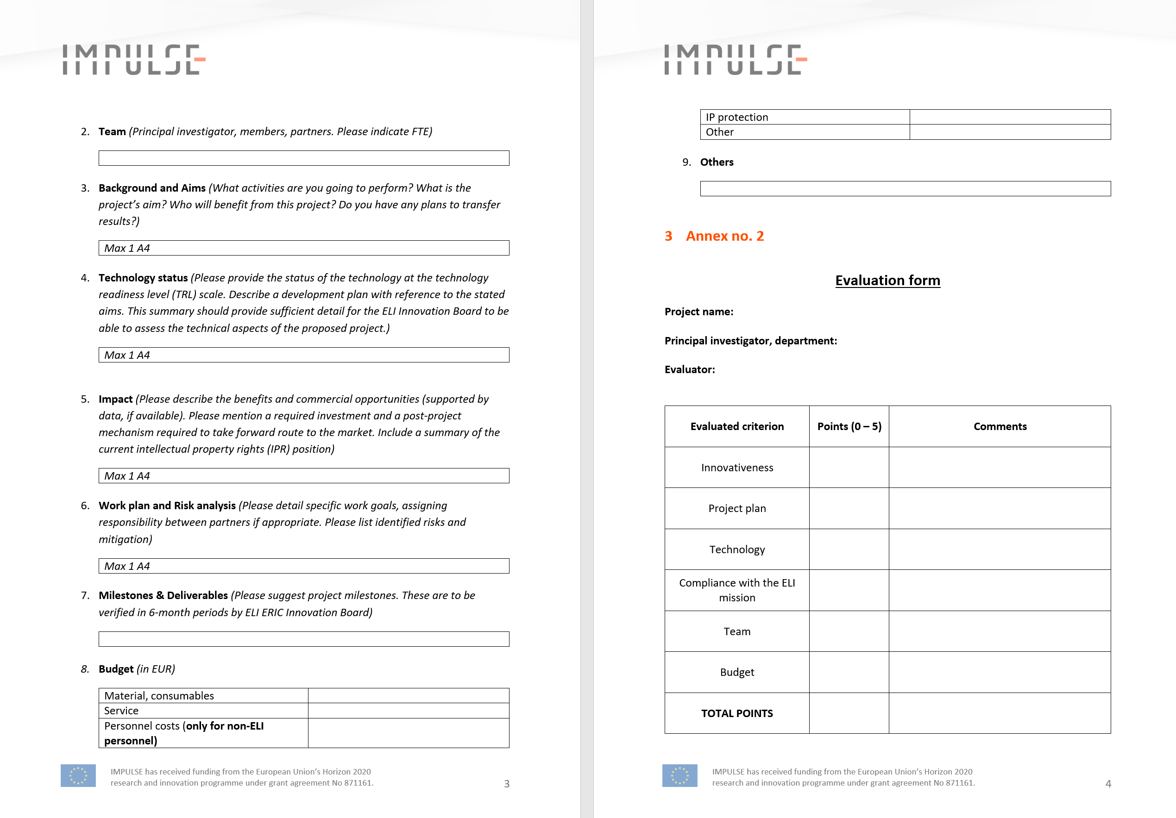
Task 6.2 – Development of common processes and “toolbox” in the area of knowledge transfer and exploitation
ELI Innovation Fund (MS68)
Internal tool for financial support of innovations
Seed investments to high capital-intensive fields and might have a low interest of non-public investors
Catalytic role in the identification and selection of ideas
Based on the provisions set out in the ELI Innovation Policy and ELI Innovation Strategy
Governed by ELI Innovation Board
Administered by ELI Innovation Office

Slide 18
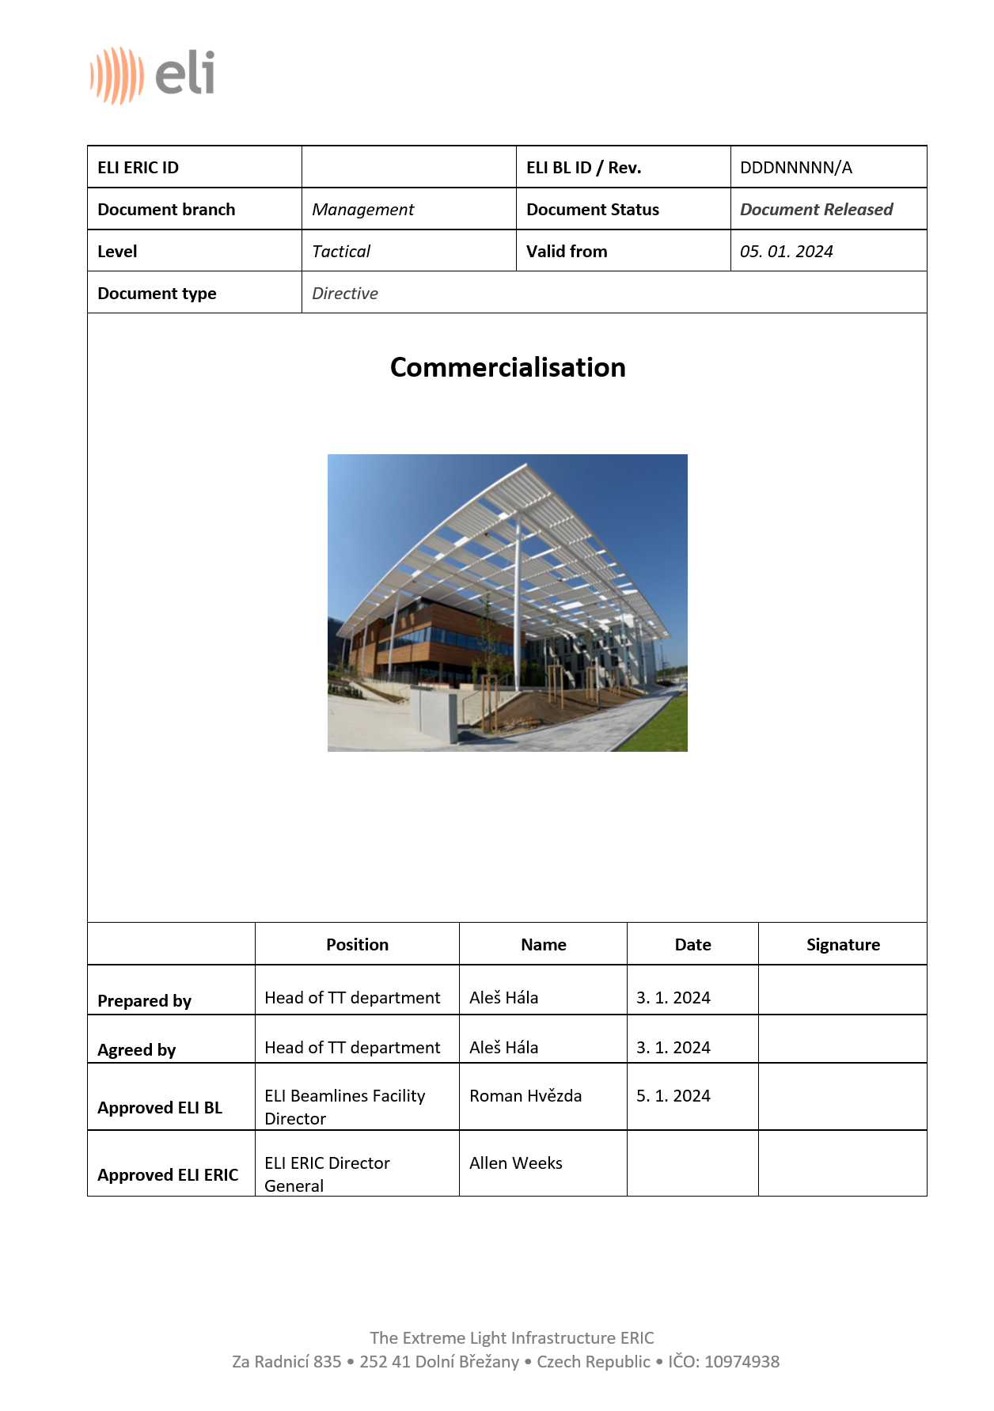
Task 6.2 – Development of common processes and “toolbox” in the area of knowledge transfer and exploitation
ELI directive for technology and knowledge transfer
Guidelines for commercialisation of results at ELI
Compliant with Innovation and Industry policy, IPR policy and IPR directive
Valorisation of results by capturing and exploiting its economic potential
ELI carries out commercialisation of its results within the framework of knowledge transfer
Administered by ELI Innovation Office

Slide 19
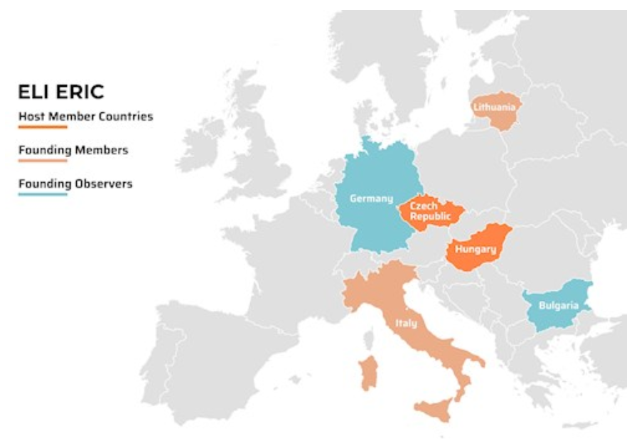
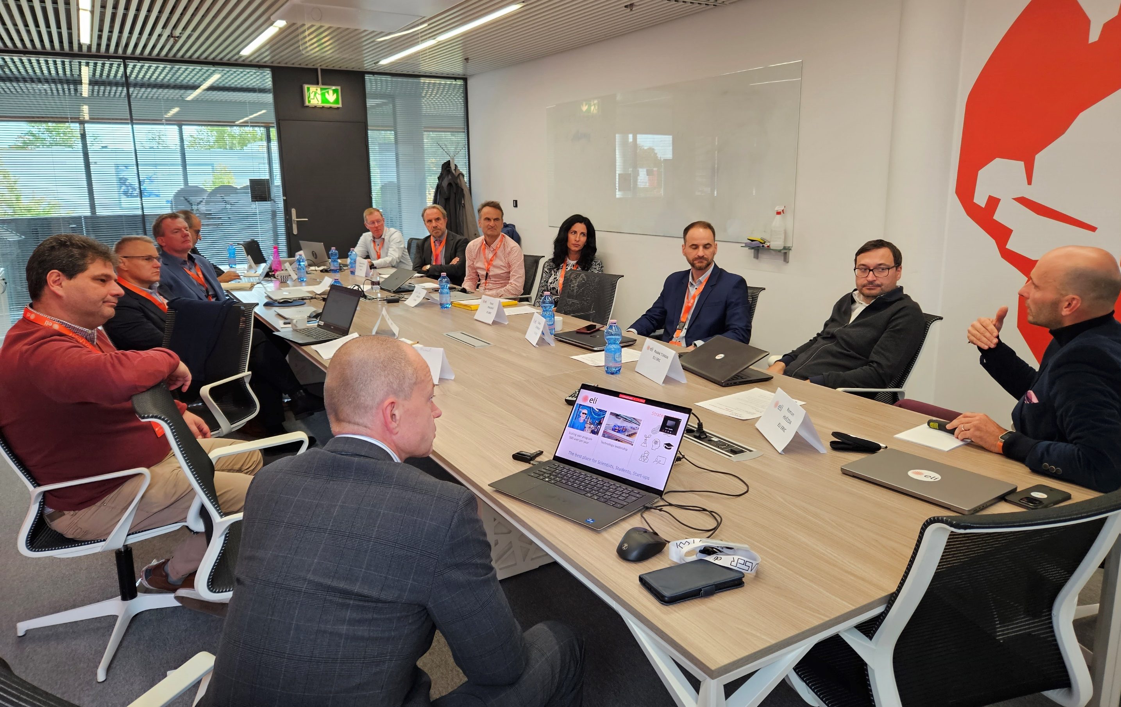
Task 6.2 – Development of common processes and “toolbox” in the area of knowledge transfer and exploitation
Industry Liaison Office (ILO) network for ELI
Identification of new technology/service suppliers to ELI
Engaging partners for innovation-driven projects
Introduction of new industry partners to ELI teams
In-person ILO network for ELI meeting on 17 Oct 2023 at ELI Beamlines facility

Slide 20
Task 6.3 – Outreach to industry
Challenge: ELI industrial cooperation opportunities will be communicated, piloted and promoted
Del / Ms No. | Title | Lead beneficiary
MS65 | Presentation materials presenting possibilities of industrial use of ELI | ELI ERIC

Slide 21


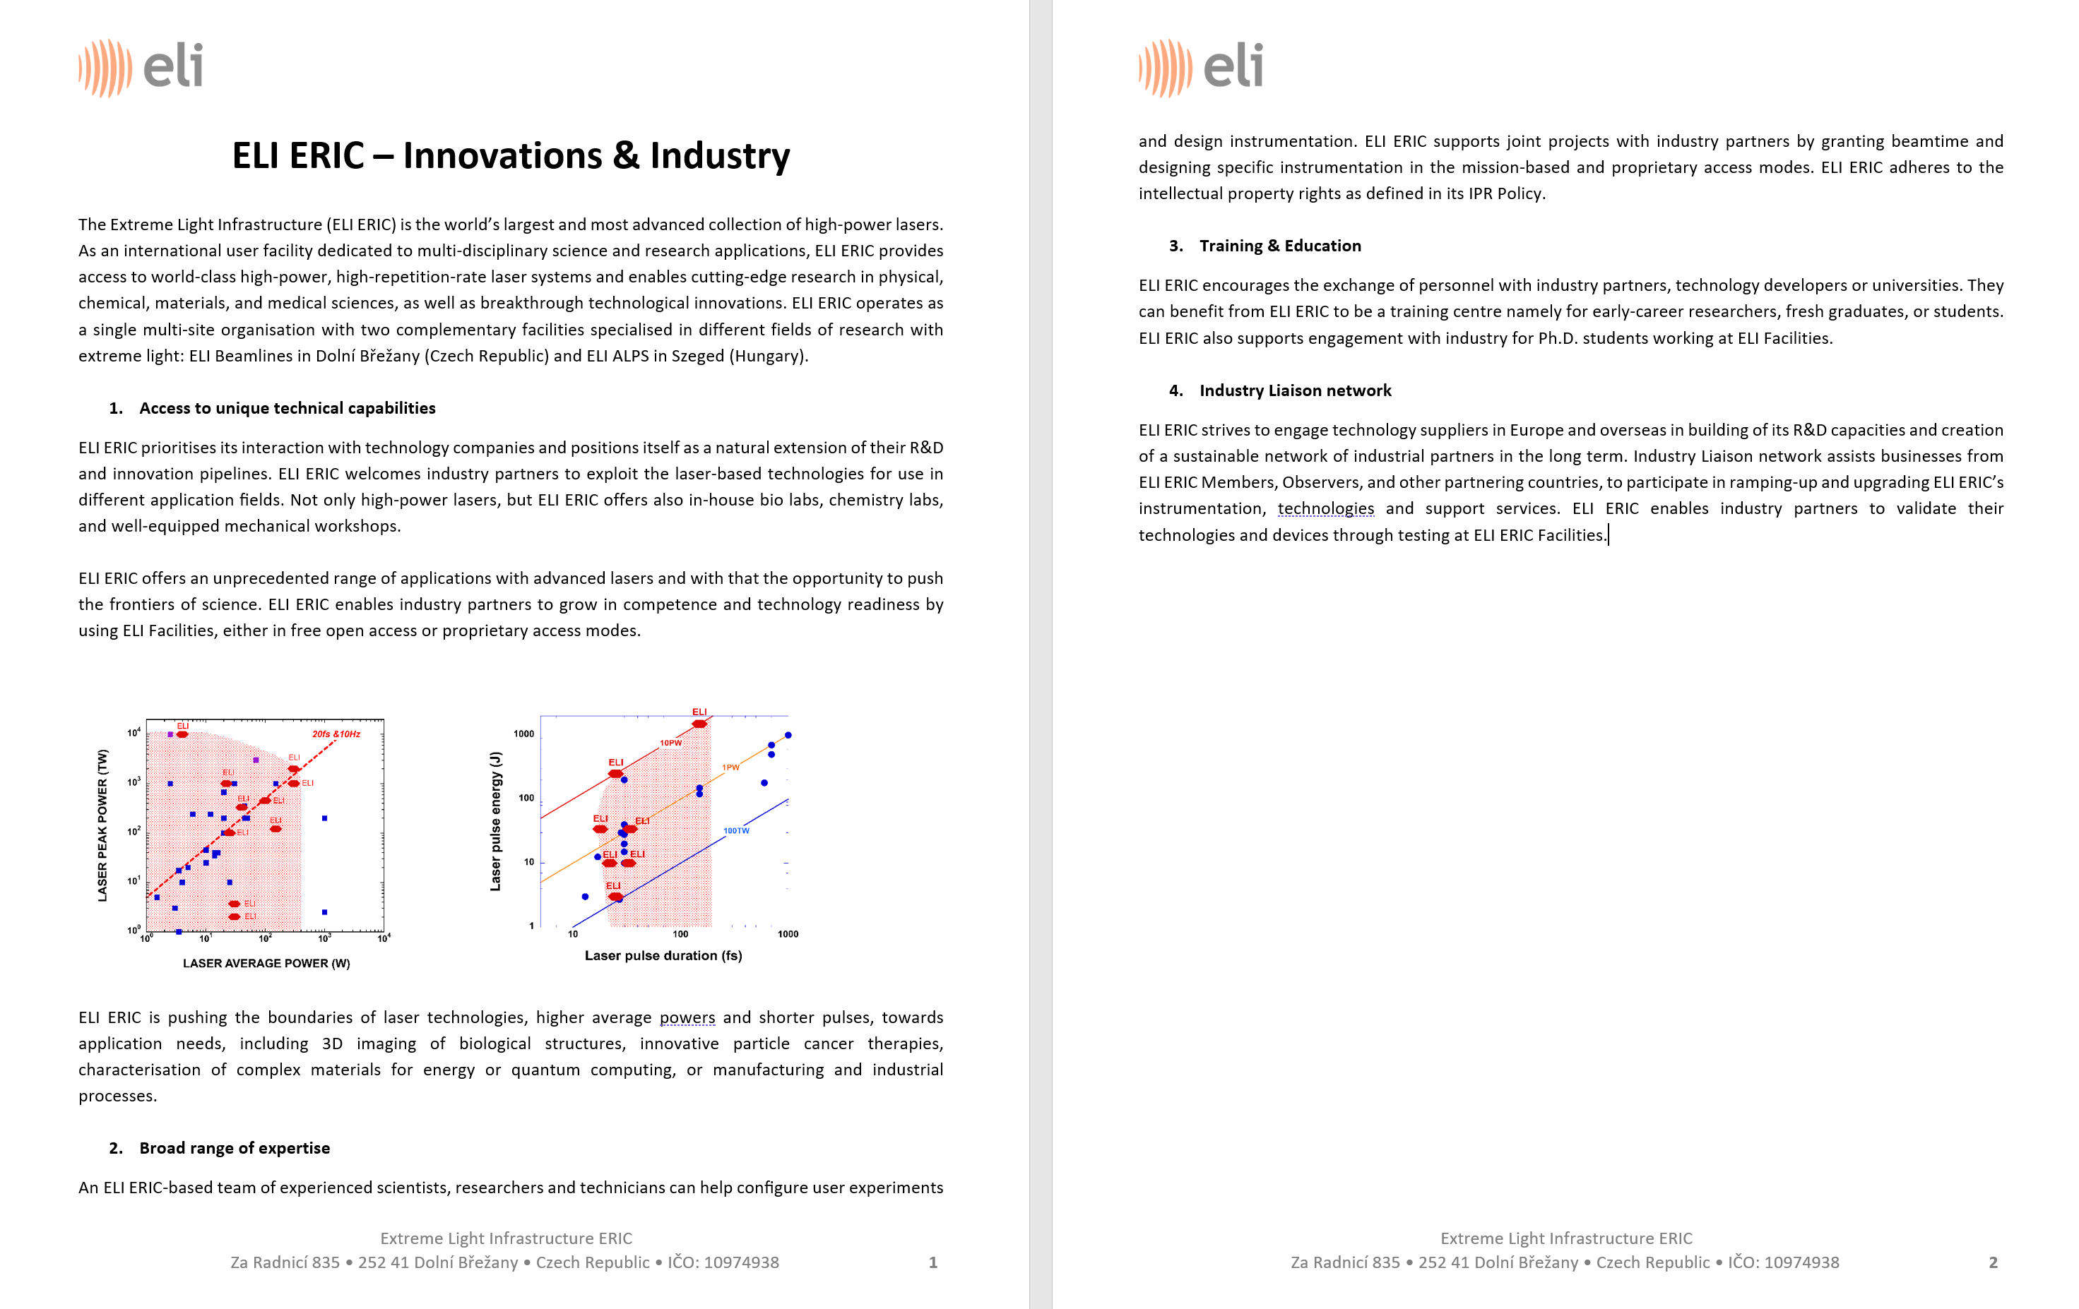
Task 6.3 – Outreach to industry
ELI presentation materials (MS65)

Slide 22
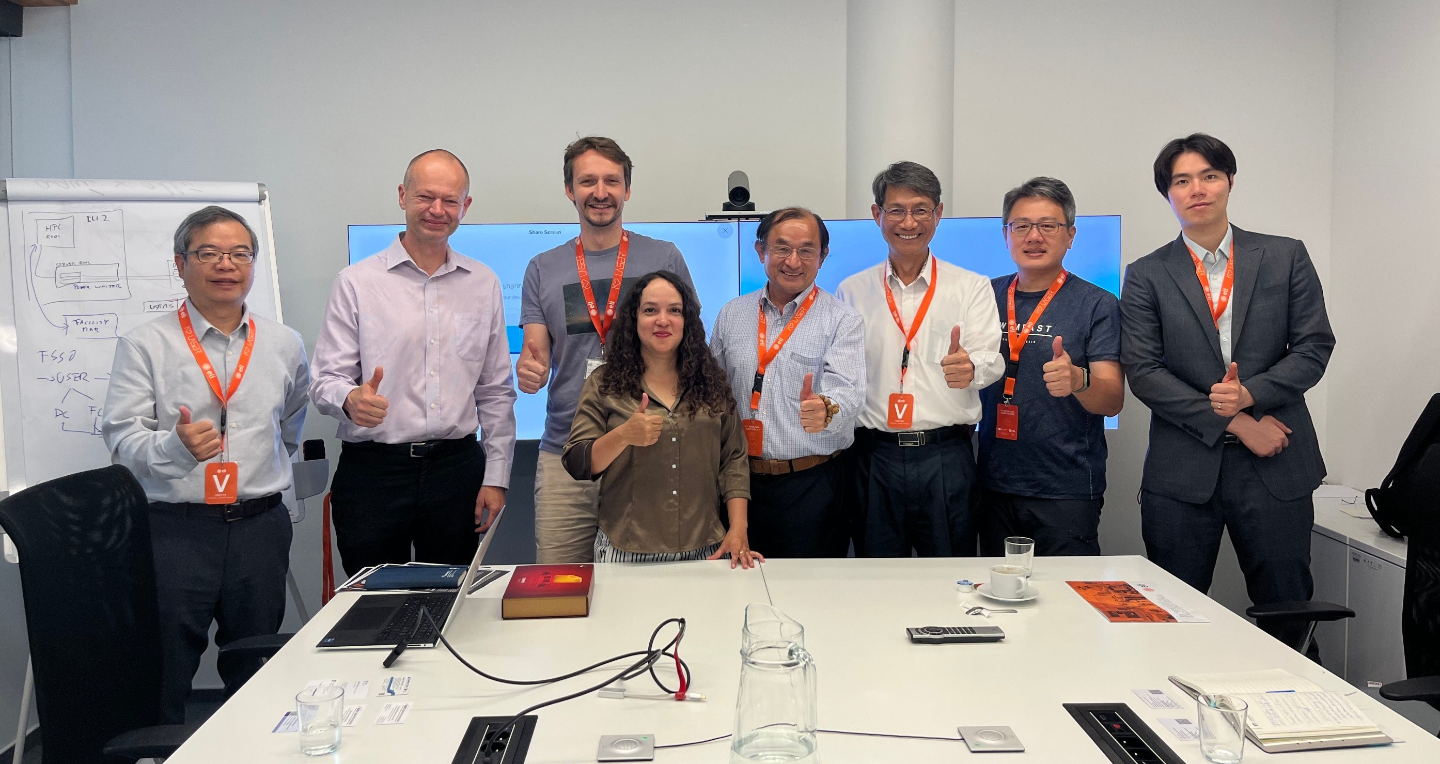
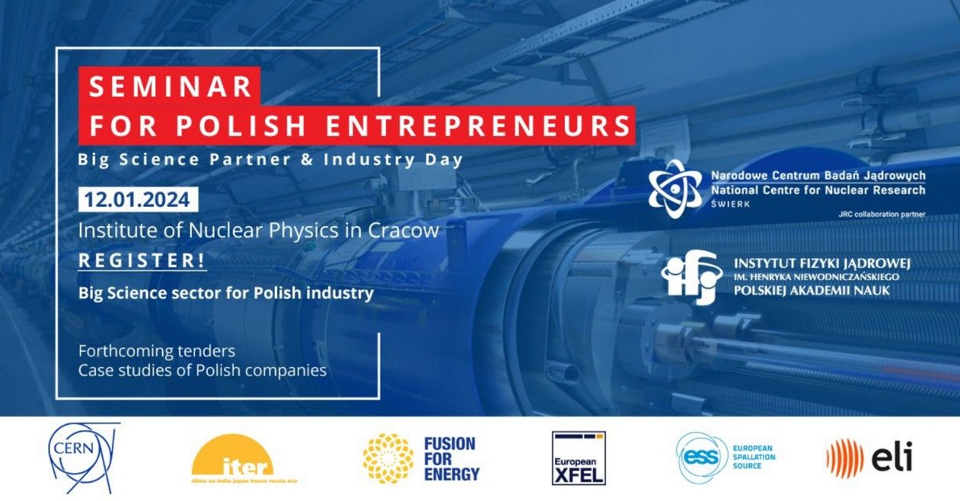
Task 6.3 – Outreach to industry
ELI‘s presentations to industrial & application partners
Presentation for ITRI about ELI‘s capacities for semiconductor industry,, ELI Beamlines facility, June 2023

Slide 23
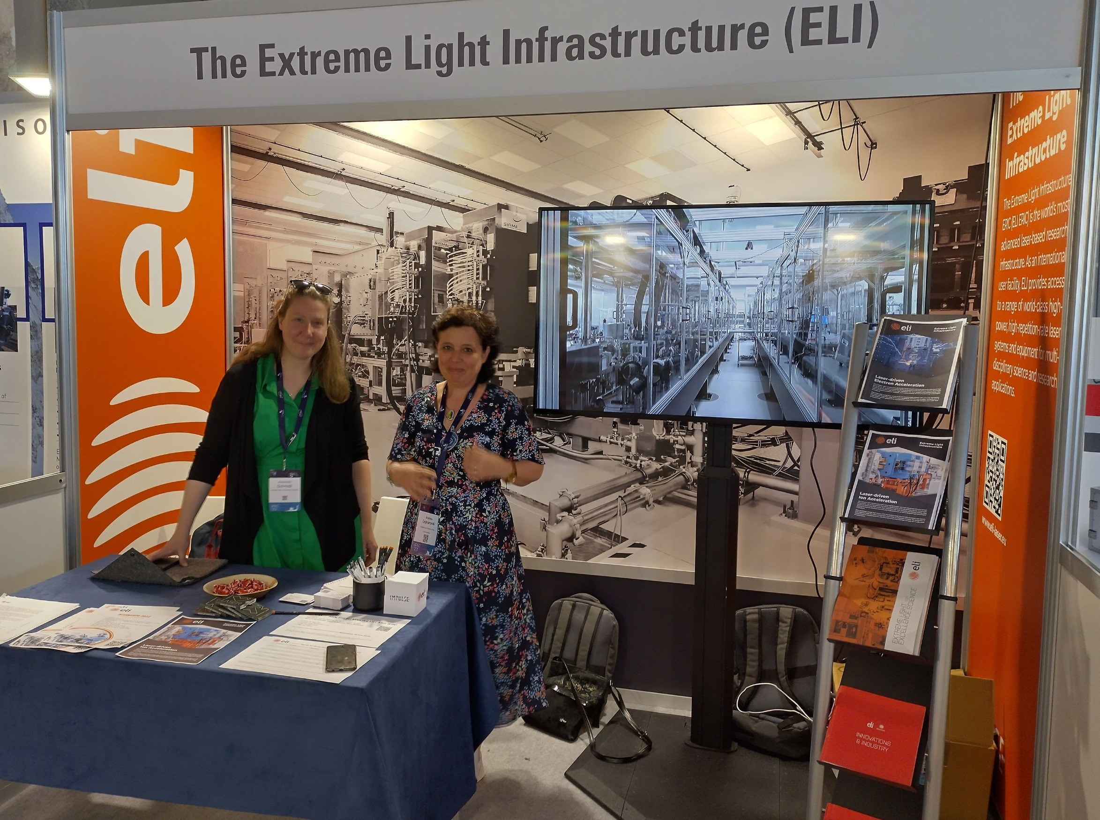
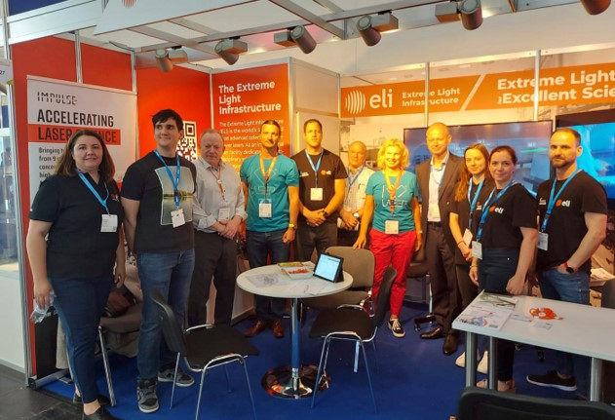
Task 6.3 – Outreach to industry
ELI‘s presentation at conferences & trade fairs
International Particle Acceleration Conference‘23, Venice, May 2023
Over 50 companies incl. SMEs approached
Over 100 visits of Ph.D. students and Postdoc
International Industry Liaison Officers approached
Laser World of Photonics, Munich, June 2023
Over 200 international companies approached incl. SMEs
Over 100 visits of Ph.D. students and Postdoc
Joint presentation of ELI facilities to industry

Slide 24
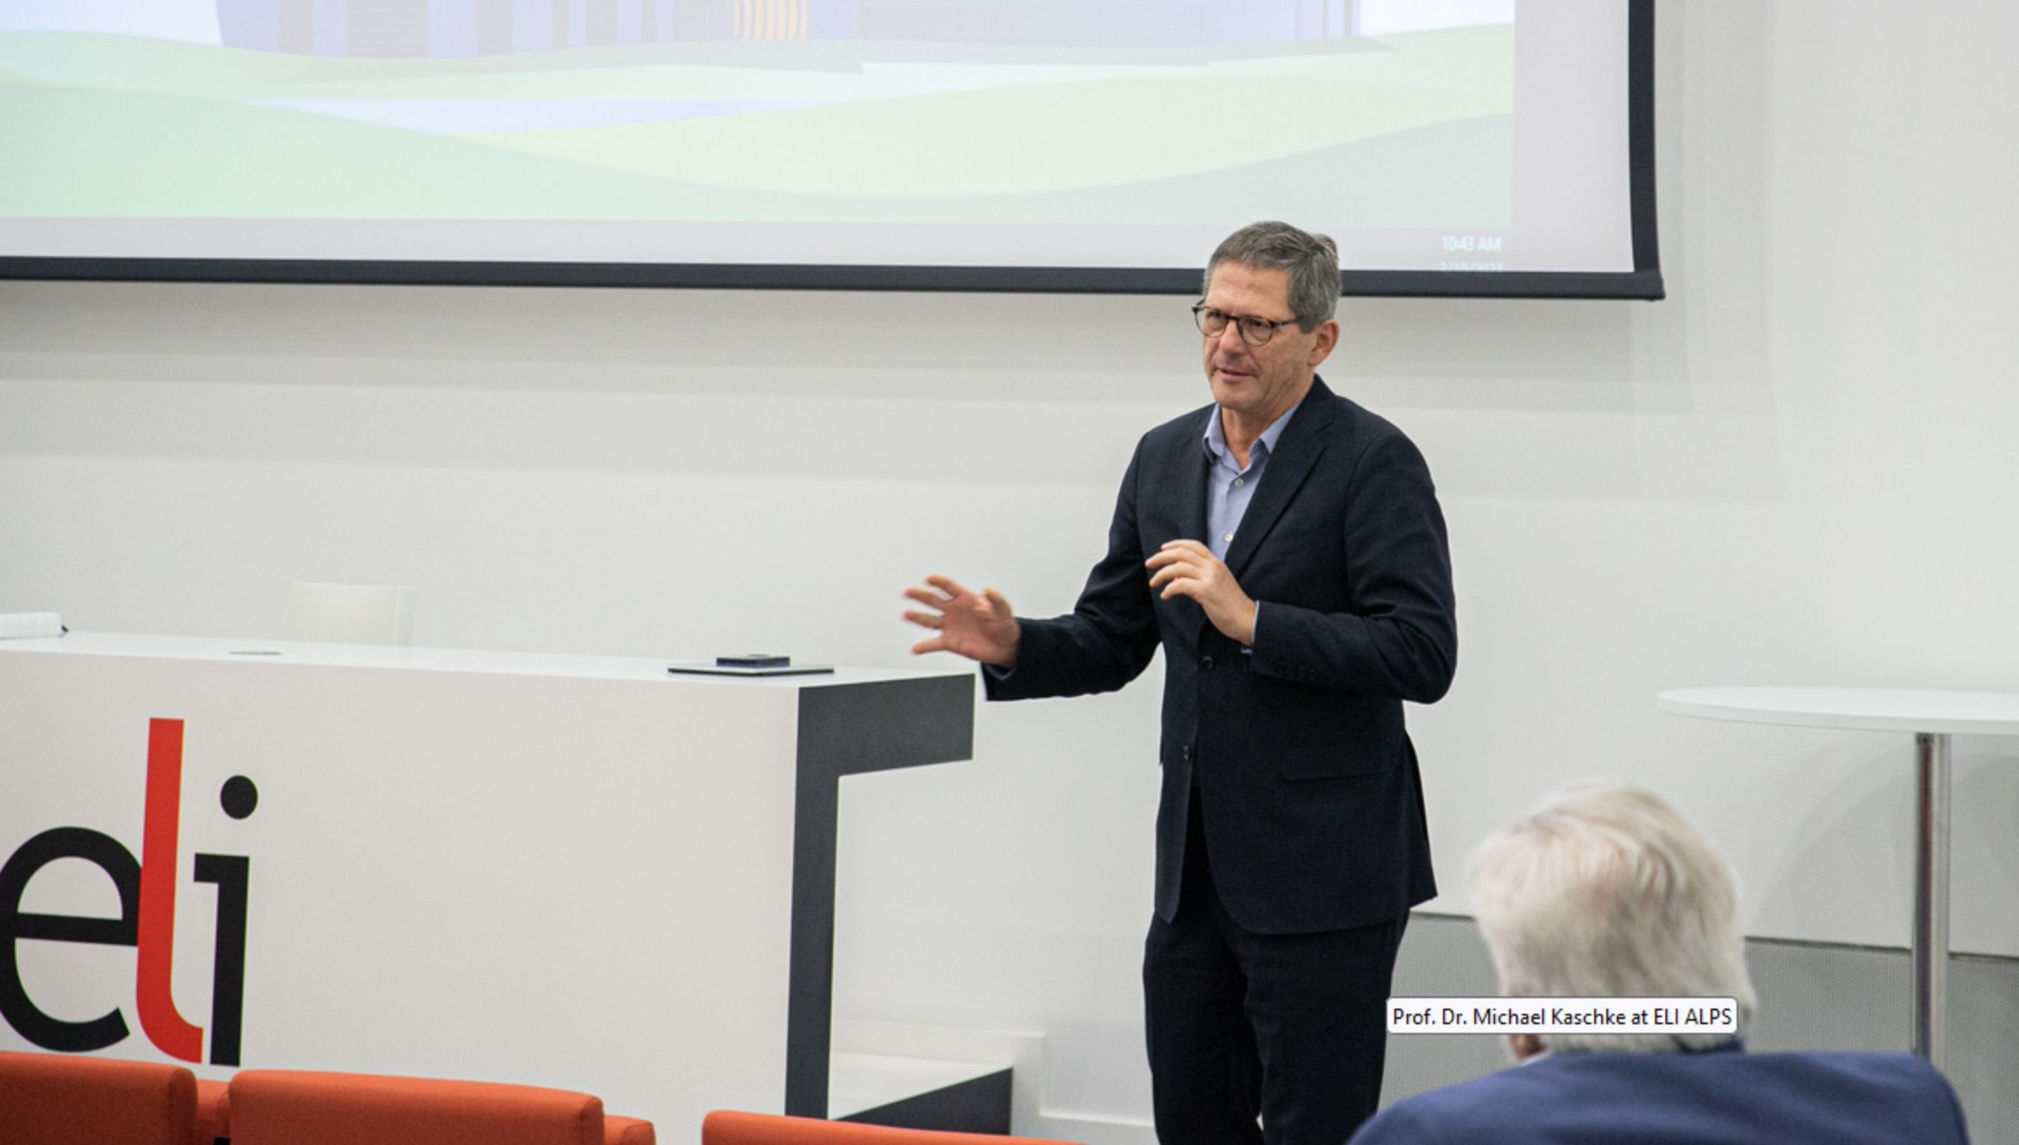
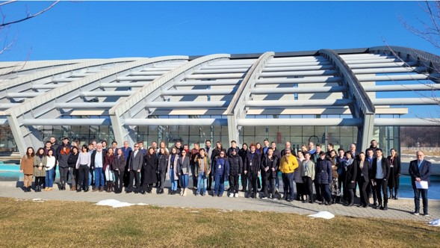
Task 6.3 – Outreach to industry
Awareness raising, education & motivation of industry and ELI personnel
Conference on bridging the gap between industry and academia at ELI ALPS facility on 10 March 2023
Young Researchers’ Day at ELI NP facility, February 2024

Slide 25
Summary & Conclusions
Innovation management system across ELI facilities established, operational ELI Innovation Offices
ELI Innovation Policy & ELI Innovation Strategy approved, demonstrated steps of implementation
Incorporation of ELI Innovation Board into innovation management structure, meetings carried out
Setting-up of ELI Innovation Fund, projects for support are being identified
Continuous support to engagement of ELI personnel in innovations across ELI facilities
Continuous support to ELI‘s collaborations with industry and facilitation of proprietorial user access
Post-Impulse innovation management activities
  On-going coordination of ELI‘s Innovation Offices
  Use of ELI Innovation Fund for projects‘ identification and support
  Introduction of ELI Innovation Award programme and its integration into ELI‘s innovation management system

Slide 26

THANK YOU
FOR your ATTENTION
Aleš Hála
IMPULSE is funded by the European Union’s
Horizon 2020 research and innovation programme
under grant agreement No. 871161

Slide 27
















