Slide 1

IMPULSE PROJECT
Work Package 5 – Enabling Excellent User Access
CLOSING MEETING
O. Tesileanu, Z. Varadi, T. Kecskés for the WP5 group
17 April 2024
IMPULSE is funded by the European Union’s
Horizon 2020 research and innovation programme
under grant agreement No. 871161

Slide 2
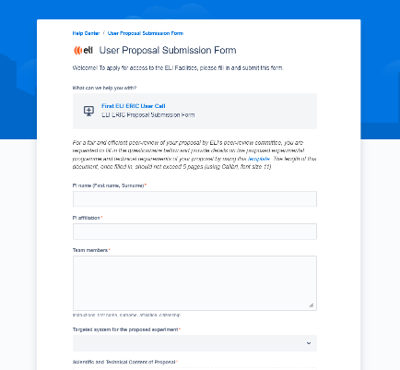
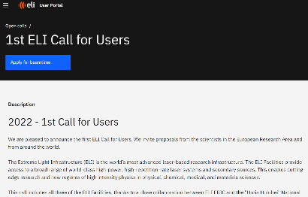
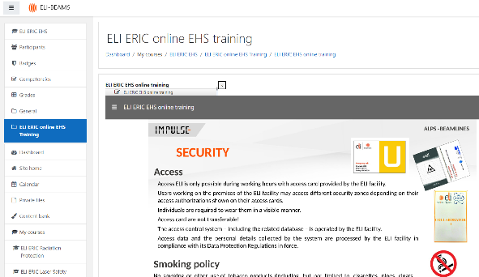
WP5 – Objectives and Tasks
Main objective: Implementing standards and practices in all areas related to user experience to support the development of ELI as the most advanced user facility in the world in the field of laser-driven science.
Performing open access pilot experiments to demonstrate the feasibility of the user access workflows at the ELI facilities, and flagship experiments to demonstrate the capacity to perform state-of-the-art experiments
Enhancing safety culture and providing efficient training methods for the users, including an online training platform
Activity is performed within 6 Tasks related to:
  User office – T5.1 – Setting-up and development of user management processes and user offices
  User portal – T5.2 – Development and maintenance of user portal, including online data service
  Implementation of Access pilot experiments – T5.3-5.5 (one for each facility)
  Training for users – T5.6 – Training measures for users, including safety
6 Deliverables and 6 Milestones

Slide 3
Scientific and Technical aims of IMPULSE
Implement standards and practices related to supporting excellent user experience and the establishment of ELI as the most advanced laser-based science facility in the world
Optimise the operations of state-of-the-art, high-peak-power, high-repetition-rate laser systems by identifying and understanding how to manage the key technologies and the operational risks involved
1. Design and implement resource management rules and processes, including cost standards, cost control processes, budgetary processes
2. Set up and develop user management processes and user offices
3. Develop and maintain user portal, including online data services
4. Implement access pilots
8. Promote ELI's establish (international) strategic partnerships
5. Training measures towards users (including safety)
6. Outreach and support to user communities
7. Science and technology road-mapping for the European laser community

Slide 4
Scientific and Technical aims of IMPULSE
Implement standards and practices related to supporting excellent user experience and the establishment of ELI as the most advanced laser-based science facility in the world
Optimise the operations of state-of-the-art, high-peak-power, high-repetition-rate laser systems by identifying and understanding how to manage the key technologies and the operational risks involved
9. Standardise metrology procedures for lasers and secondary sources
10. Optimise spare parts management for cost efficiency, machine safety and reliability
11. Build capacity through training of operating teams
12. Identify and develop new key optical components for long-term sustainability: strategies to increase the laser-induced damage threshold (LIDT)
13. Define a standard approach to target design and debris shielding
14. Define and conduct world-leading experiments to showcase the unique capabilities of the ELI Facilities

Slide 5
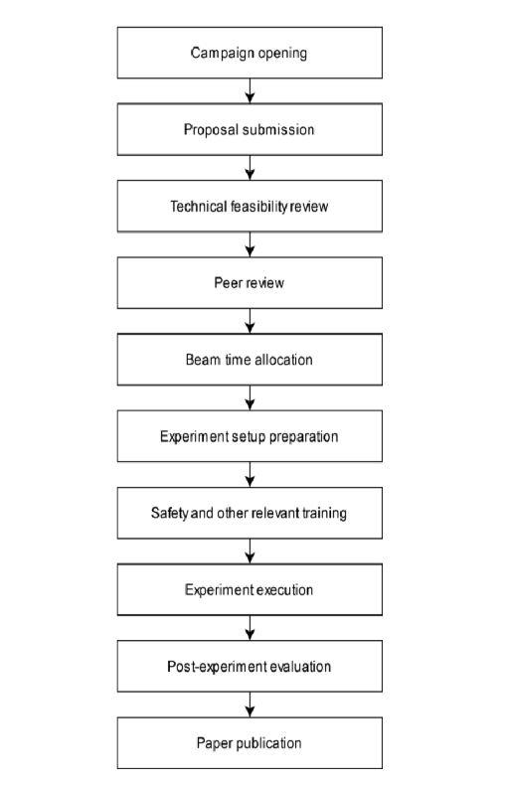
2. Set up and develop user management processes and user offices
WP5 Tasks
PHASE 1
Issue: The need to operate user access to ELI as a distributed user facility
IMPULSE Task 5.1 (ELI-ERIC, ELI-ALPS, ELI-BL, ELI-NP, Elettra, HZDR): Setting-up and development of user management processes and user offices: The expected outcome of the task was the establishment of a general user office at ELI ERIC and of local user offices at the ELI Facilities, fully equipped in terms of processes to address all dimensions of access management in compliance with the highest quality standards currently observed at world-class research infrastructures.
PHASE 2
PHASE 3

Slide 6
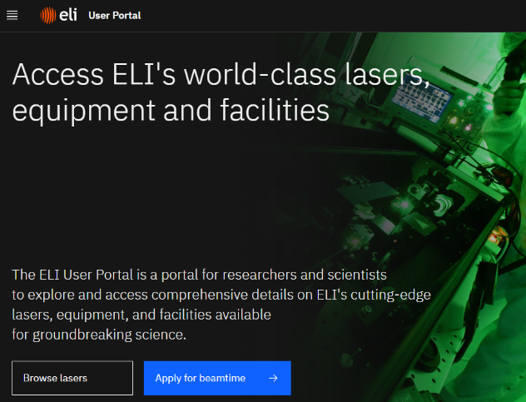
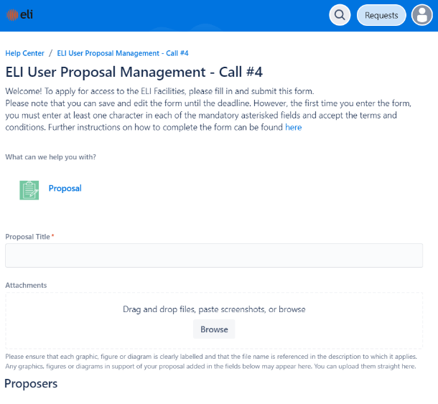
3. Develop and maintain user portal, including online data services
WP5 Tasks
Issue: The need for a single point of access for users to the distributed ELI infrastructure
Task 5.2 (ELI-ERIC, ELI-ALPS, ELI-BL, ELI-NP, Elettra, HZDR) – Development and maintenance of user portal, including the online data services: the implementation for daily operation of the ELI Facilities of online and offline tools for communicating ELI’s scientific offer, joint proposal management system and related helpdesk, and services related to experiment preparation, user feedback and administration of the user office.

Slide 7
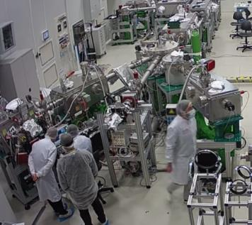
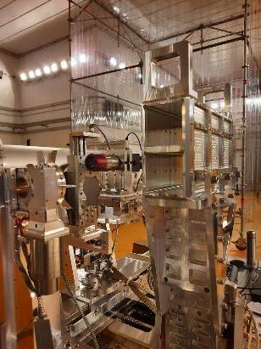
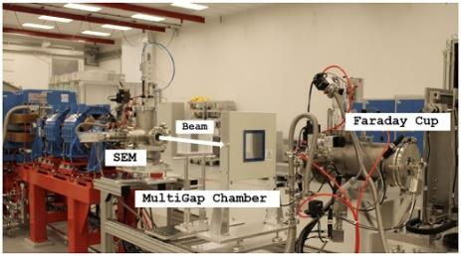
WP5 Tasks
Issue: Demonstrate the feasibility of the user access workflows and the capacity to perform state-of-the-art experiments
Tasks 5.3, 5.4, 5.5 (ELI-ALPS, ELI-BL, ELI-NP) – Implementation of Access Pilots: The ELI facilities have selected experiments to support two specific activities:
  Demonstrate the capacity of the ELI Facilities to deliver access and run systems on a routine, reliable basis and thus deliver best-in-class access quality – Open access pilot experiments
  Demonstrate the ELI’s capacity to deliver high-impact scientific experiments – Flagship experiments
4. Implement access pilots
14. Define and conduct world-leading experiments to showcase the unique capabilities of the ELI Facilities

Slide 8

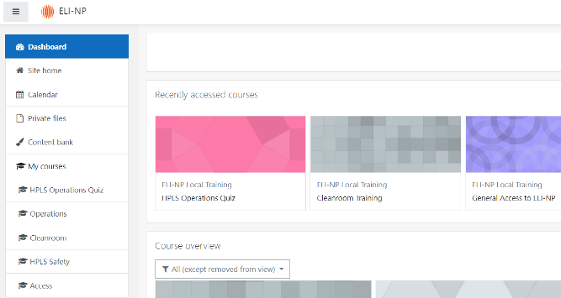
WP5 Tasks
Issue: Consistently organize training of users prior to accessing the ELI facilities to perform experiments
Task 5.6 (ELI-ERIC, ELI-ALPS, ELI-BL, ELI-NP) – Training measures for users, including safety: User-friendly, standardized training procedures, reducing the burden on users and personnel, based on a Centralized Online Training System. Secure operation while maintaining a smooth and staff-friendly operation (for both users and permanent staff).
5. Training measures towards users (including safety)

Slide 9
WP5 Participation
Activity based on the participation of ELI-ERIC and the ELI hosting institutions and on the expertise of selected external partners, Elettra and HZDR, which supported ELI in the setting-up the user office and user management processes
Partner facilities Elettra and HZDR involved in the activities of T5.1, 5.2 and 5.6 from the initial stages of definition of the user access workflows, needed capabilities and features of the ELI User portal and the training requests and expectations for users
Elettra and HZDR organized workshops for the follow-up of the ELI user access calls and exchanges on the experience at the ELI pillars for the User office personnel
WP5 Leadership: Prof. Kazuo Tanaka (until 2022), Dr. Ovidiu Tesileanu
ELI ERIC IT leads development activities of the Users portal and online training platform
At each ELI facility:
  Head of User office and user office personnel
  One responsible person for one of the priority Safety areas for training
  Involvement of the safety teams in development of training courses
  Scientific teams involved in the flagship experiments preparations and specific trainings

Slide 10
High-level Objectives and WP5
Integration of the Facilities
Technical Synergies
The selection and performance of the flagship experiments have allowed sharing expertise and information on the long-term vision on the science to be performed at the ELI facilities
Develop a common workflow and policies for all three ELI facilities, for open access of users in the scientific community.
Organization of joint Open calls for users, ELI ERIC (ALPS and Beamlines) and ELI-NP – agreements
Access and User Programme
Develop a common training platform for users, guaranteeing a consistent experience when accessing any of the three sites.
Common data policy and collaboration between the facilities towards consistent data management procedures

Slide 11
Non-scientific objectives of IMPULSE
Successful ‘Transition and Integration from Construction to Sustainable Operations’ with a single access point to ELI Facilities
Position ELI as a leading global platform for high-power laser development and drive innovation in the field
1. Define access agreements with the ELI Facilities
2. Define, set up and implement an integrated management system for ELI
3. Define legal framework for transition from agreements-based access to integrated operations
4. Develop and implement a Management Information System (MIS) / IT infrastructure supporting the integrated management of ELI
5. Define and implement training measures supporting the implementation of integrated management System
6. Maximise ELI’s impact on innovation through the development of a shared approach to knowledge transfer and industrial access.

Slide 12
Non-scientific objectives of IMPULSE
Successful ‘Transition and Integration from Construction to Sustainable Operations’ with a single access point to ELI Facilities
Position ELI as a leading global platform for high-power laser development and drive innovation in the field
1. Define access agreements with the ELI Facilities
2. Define, set up and implement an integrated management system for ELI
✓ Within WP5 it was developed the User portal, managing open calls for users
✓ Discussed and signed during the preparations of the first joint user call, open in 2022
5. Define and implement training measures supporting the implementation of integrated management System
✓ The implementation of the training platform Moodle, initially for the safety training but aiming to include training of employees in the future

Slide 13
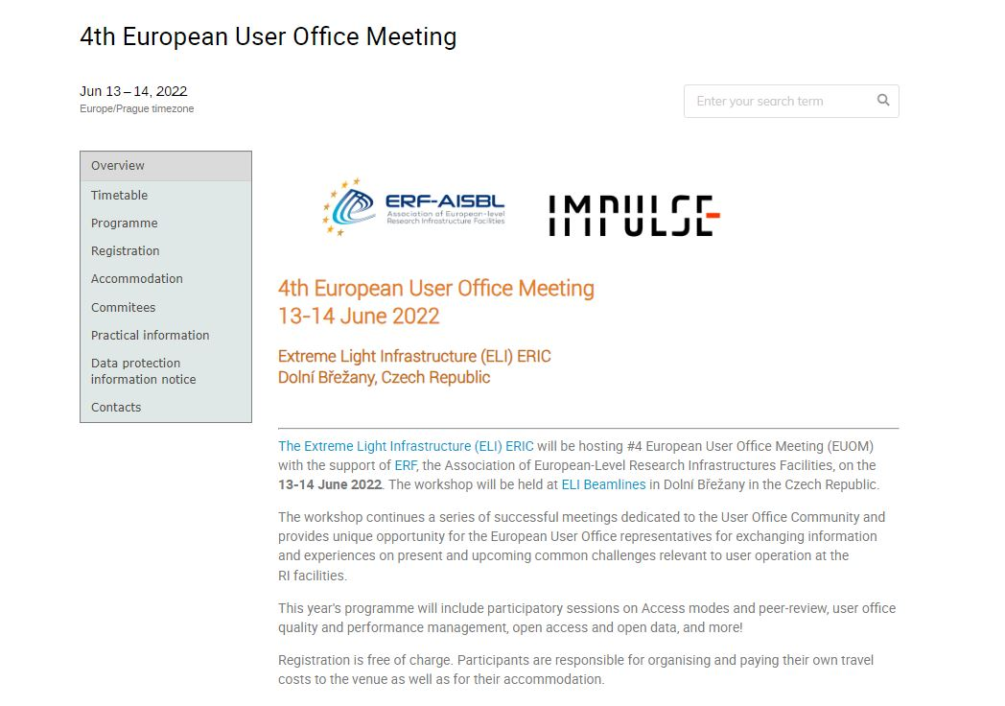
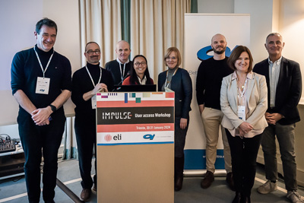
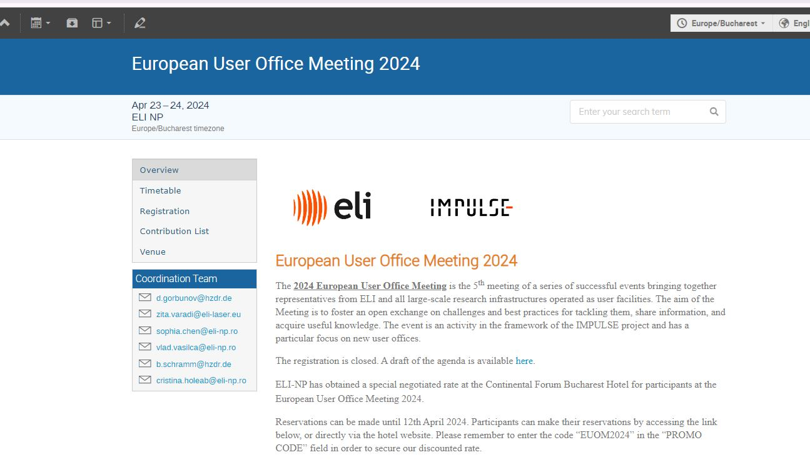
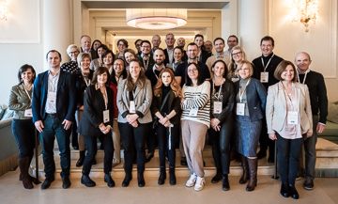
Task 5.1 Setting-up and development of user management processes and user offices
Task Leader: Z. Varadi (since 2023) , T. Ivanoaica (until end 2022)
Participating Partners : ELI-ERIC, ELI-ALPS, ELI-BL, ELI-NP, Elettra, HZDR
4th European User Office Meeting 13-14 June 2022 at ELI Beamlines
5th Europeam User Office Meeting
23-24 April 2024 at ELI NP hosted by HZDR
User Access Workshop
30-31 January 2024 at Elettra, Trieste

Slide 14

Task 5.1 Setting-up and development of user management processes and user offices
ELI User Office – activities
Facilities access approval
User events
Co-ordination of preparation of User calls, proposal review process, communication of outcomes
Support for User access
Ensuring users are provided with scientific/technical plan, schedule and support for experiment; travel and accommodation arrangements; safety training; access to site and on-site services….
Post-experiment support
Gathering information, performing appropriate level of analysis on performance of instruments and other technical services; user satisfaction and feedback; publications and other outcomes of experiments
Visibility and exchange
Planning and implementation of various events related to users
Continued development of user access strategy, services, exchange of information with other ELI functions and other User offices…
Functioning user offices at the facilities, a team of 5 at ELI ERIC and team of 4 at ELI NP assist user access
Development of a single workflow
Collaboration with Instrument Scientist, IT and Safety and Comms teams
Synergies
  WP2: Access, Data, Data protection, ICT, EHS, IPR, Dissemination, Communication Policies
  WP3: SOP
  WP7: Communication, Meeting organisation

Slide 15
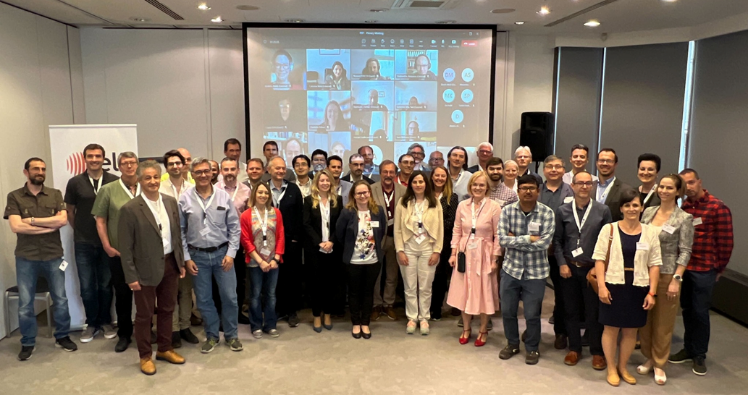
Task 5.1 Setting-up and development of user management processes and user offices
ELI User Calls – Overview
Proposal selection procedure
  more than 60 external experts involved in the PRP in 6 subpanels
  invitation for 3 years
  First meeting 5-6 June 2023
ELI ERIC USER Programme Open Excellence-Based Access
Year | User Call | ELI Facilities Combined |  | ELI Facilities Individually
 |  | Proposals Submitted | Beamtime Granted | Proposals Submitted / Beamtime Granted
 |  |  |  | ELI Beamlines | ELI ALPS | ELI NP
2022 | 1st | 44 | 29 | 17/17 | 11/8 | 16/4
2023 | 2nd | 102 | 67 | 49/31 | 35/32 | 18/4
2023 | 3rd | 81 | 58 | 33/26 | 38/28 | 10/4
Total |  | 227 | 154 | 99/74 | 84/68 | 44/12

Slide 16
Task 5.1 Setting-up and development of user management processes and user offices
ELI User Calls – Overview
Experiments status
CALL 4
25 March –
29 April 2024
CALL 5
25 September - 29 October 2024
Implementation
April 2025 – October 2025
CALL 6
Spring 2025
CALL 7
Autumn 2025
Implementation
October 2025 – April 2026
Implementation
April 2026 – October 2026
Implementation
October 2024 – April 2025
Submission
Evaluation
Selection
Scheduling
Preparation
Access management
Experiment
Data transfer
Research report
Feedback
Call
Follow up-publication

Slide 17
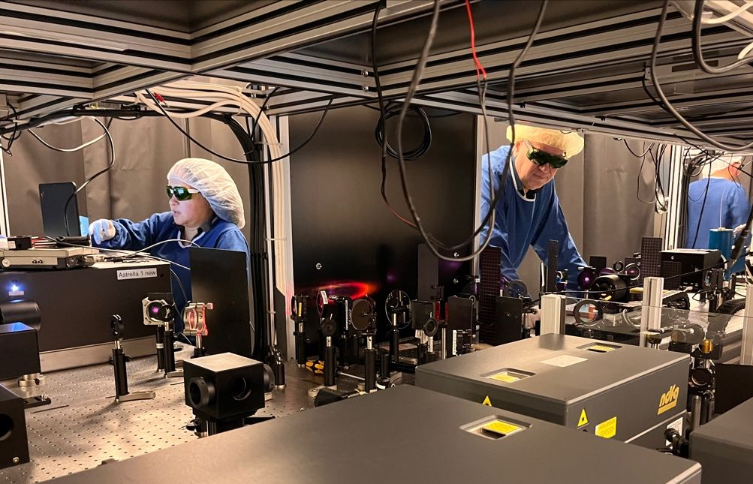
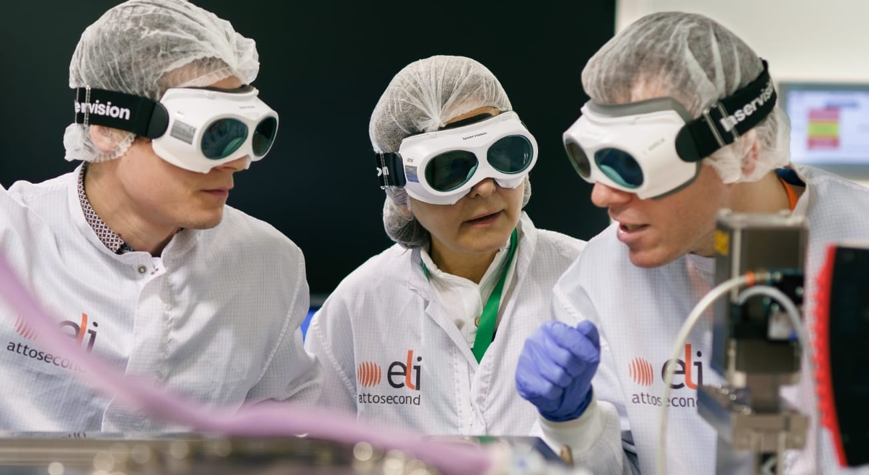
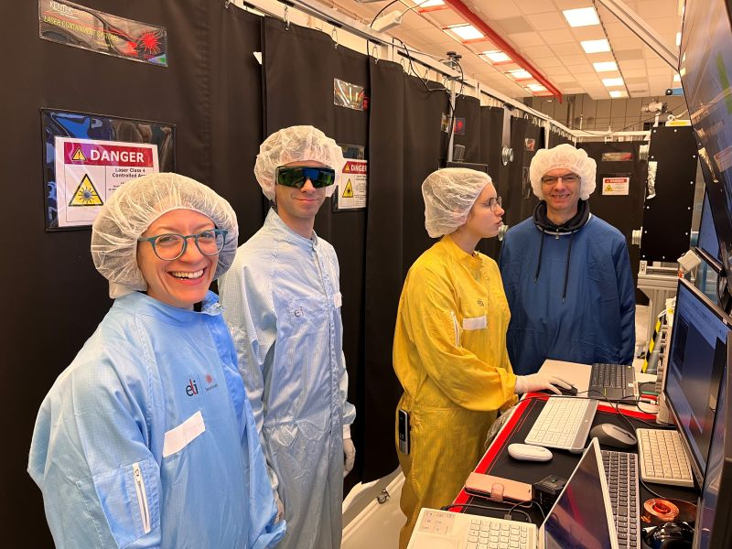
Task 5.1 Setting-up and development of user management processes and user offices
„While there were a few issues along the way, the level of professionalism and responsiveness was much greater than could be reasonably expected for a facility only just beginning external user operations. We would like to extend our sincere gratitude for the exceptionally hard work that went in to supporting our experiment and for the willingness to be flexible and adapt to the needs of the project as it evolved – that really was crucial to its success.”
„The colleagues at ELI are helpful and, equally important, they are highly qualified. I am convinced that this research infrastructure can contribute to important scientific discoveries.”
„The painstaking work of my colleagues at the MIR beamline go above and beyond, providing invaluable support that exceeds all expectations, fostering an environment where users can explore innovative avenues beyond conventional boundaries.”

Slide 18
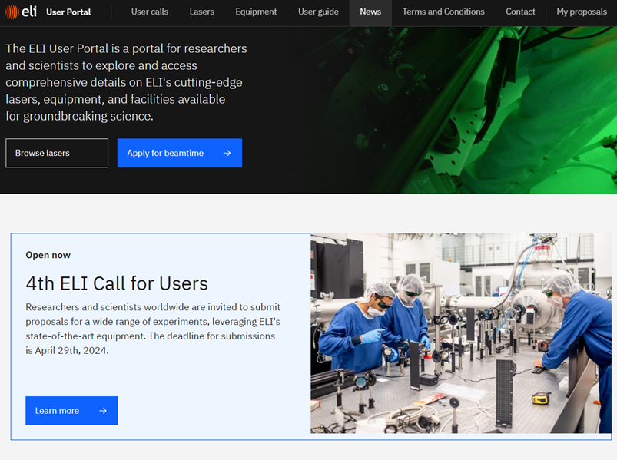
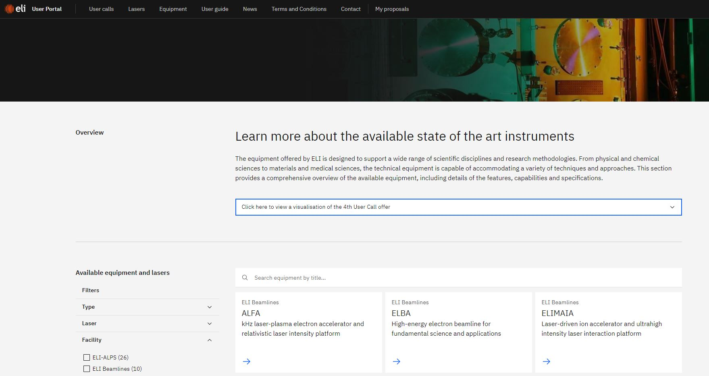
Task 5.2 Development and maintenance of user portal, including online data service
Task Leader: L. Schrettner (since 2023) ; T. Ivanoaica (until 2022)
Participating partners: ELI-ERIC, ELI-ALPS, ELI-BL, ELI-NP, Elettra, HZDR
The Portal operational since the start of the first ELI ERIC call for users (June 2022)
Core feature of the Portal:
  Campaign management :
  up.eli-laser.eu

Slide 19
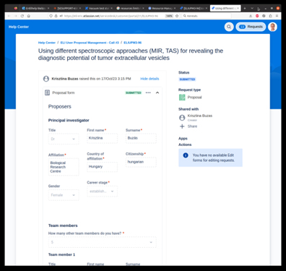
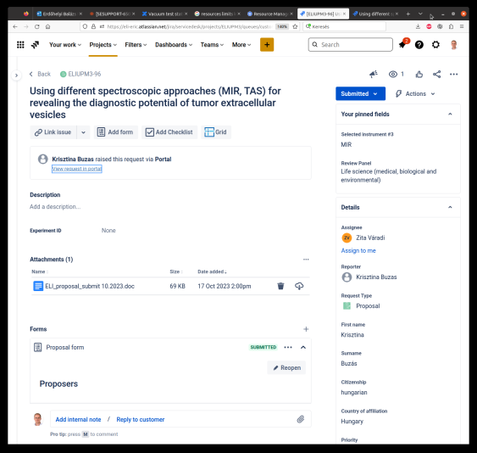
Task 5.2 Development and maintenance of user portal, including online data service
Core feature of the Portal:
Proposal management
  JIRA Service Management system
  Cutomers = Applicants
  Agents = User Office
UserOfficeProject at Github
ELI ERIC joins an international collaboration with ESS and STFC to build a flexible web application to effectively run and organize user programs
launch from Call 5, September 2024
Customer view
Agent view

Slide 20
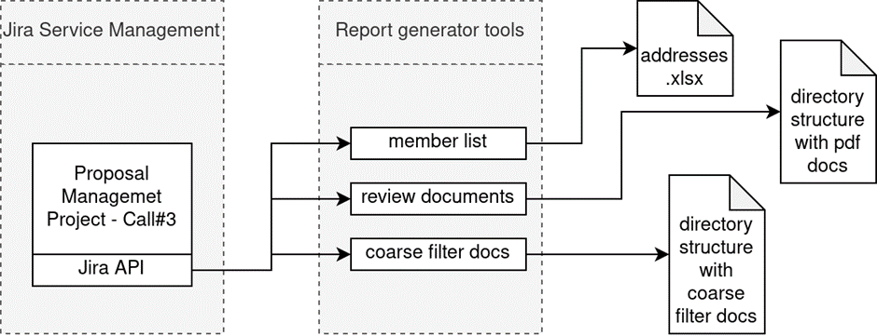
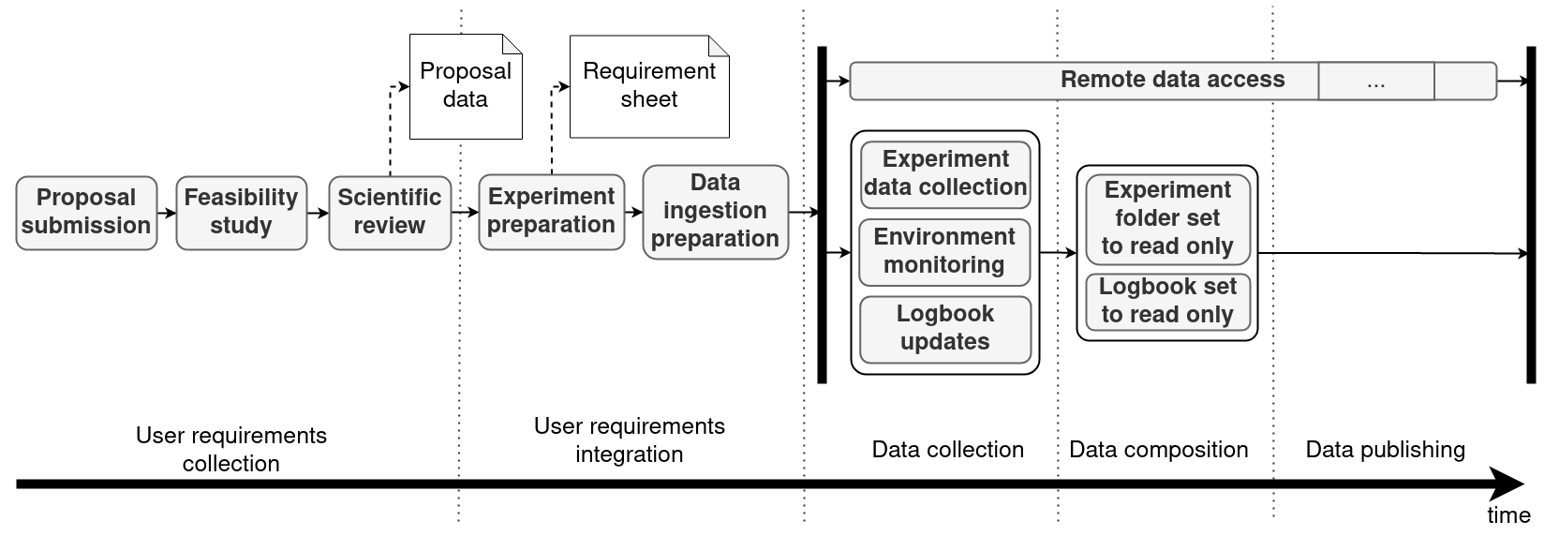
Task 5.2 Development and maintenance of user portal, including online data service
Core features of the Portal:
Custom made report generation for Feasibility and Peer Review
Data management
  The experiment folder is made read-only to prevent any further change on the collected data.
  The electronic logbook document is set read-only
  The experiment data is stored on the central storage on Hard Disk Drives (HDDs) and backups are made regularly with a Tape Drive Backup System
Introduction of a Data Management Plan
Data&Computation review at the facilities in 2024/25

Slide 21
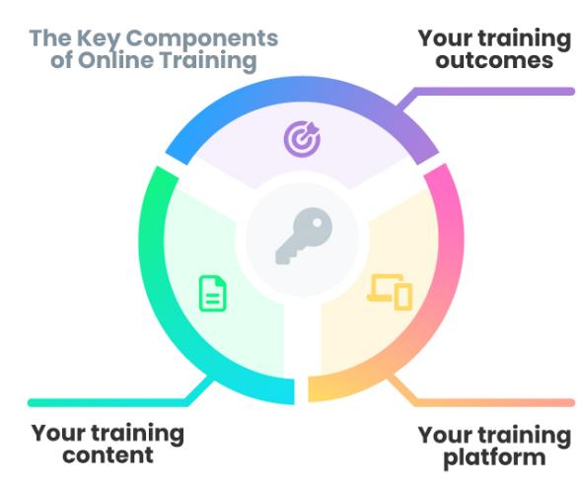

Tasks 5.6 Training measures for users, including safety
Task Leader: Tamara Kecskés (since 2023), T. Ivanoaica (until end 2022)
Participating partners: ELI-DC/ERIC, ELI-ALPS, ELI-BL, ELI-NP
  Safety teams Training material development
  IT teams Moodle platform: technical support
  (accounts, training development tool / service)
  User Office
  Procedure definition
  Communication
  Account request
  Records
Other WPs: WP2: EHS Policy; WP3: Operator trainings; WP7: Template and design

Slide 22
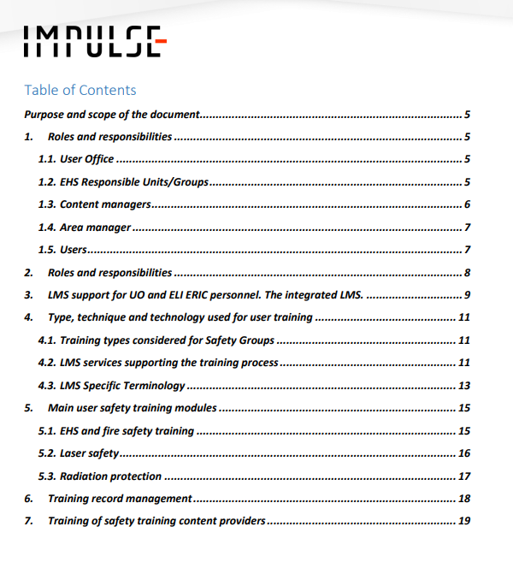

Tasks 5.6 Training measures for users, including safety
Learning Management System
  A detailed description of training measures and tools for users (D5.5)
  Moodle
    Central Federated Course Catalogue
    Local instances
    Common platform required for the future
    Training record management

Slide 23


Tasks 5.6 Training measures for users, including safety
Training materials
User safety training programs
  Harmonized and unified ERIC level online EHS, Laser safety and Radiation protection training
    Training materials in ppt (starting point for further development)
    Exam: quizzes
    User satisfiction survey
    Guide for implementation of unified trainings
  Local safety trainings
Roles
  Content providers
  Content managers
Training material editing tool and service

Slide 24
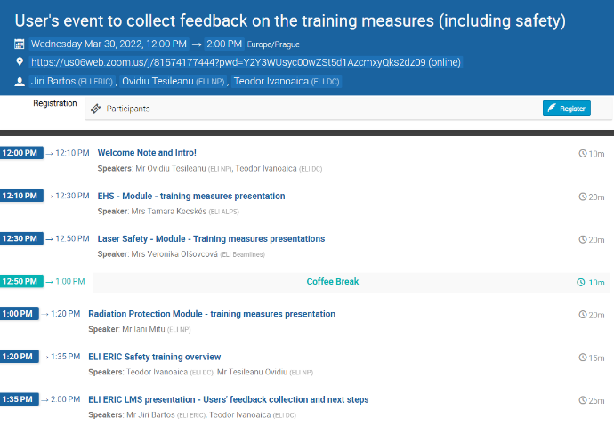
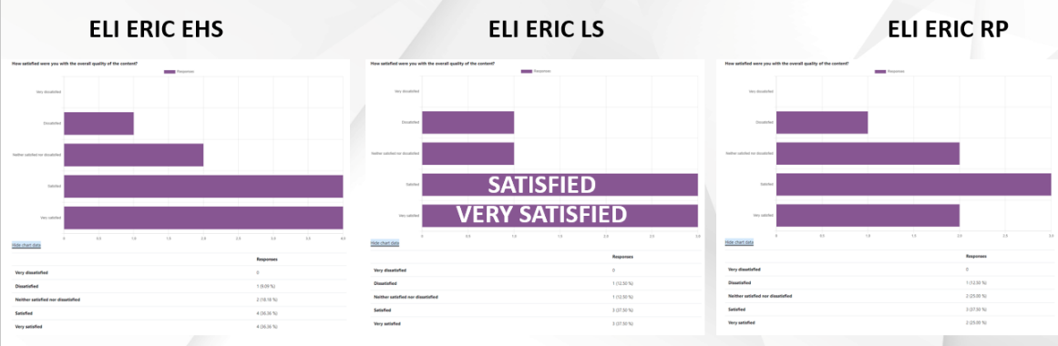
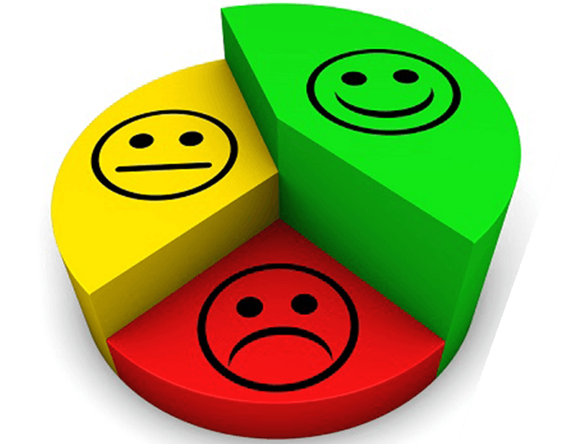
Tasks 5.6 Training measures for users, including safety
User satisfaction survey: feedback collection
March 2022: MS 5.8 - User’s event to collect feedback on the training measures
March 2024: Safety, UO, IT: repeated feedback collection
more interactivity

Slide 25
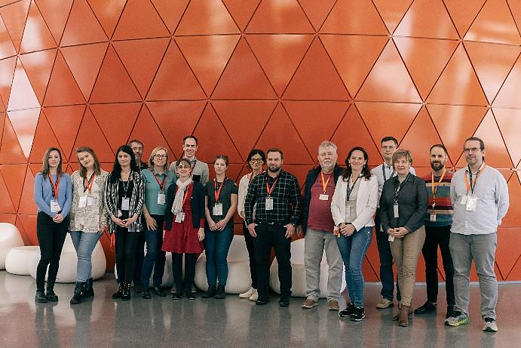
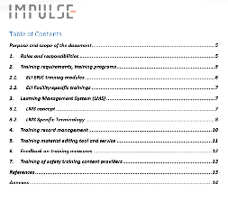
Tasks 5.6 Training measures for users, including safety
Train the trainers
December 2022: Prague: training course on Moodle and H5P tool
April 2023: Document on „Process and methodology of curriculum development”
January 2024: User access workshop, Elettra Sincrotrone Trieste
March 2024: In-person EHS Workshop, Szeged, ELI ALPS
Report on implementation of
user training activities (D5.6)

Slide 26
Tasks 5.6 Training measures for users, including safety
Plan for after IMPULSE
User trainings → Employee, contractor trainings
Safety trainings → Other topics
Training level | Trained persons | Topic | Type, Technique, Tool
ELI ERIC | User | Safety | Online
ELI Facility | User | Safety | Online and on-site
 | User | Exp. specific
 | User | General
 | Employee | HR
 |  | IT
 |  | Job specific (T 3.4)
 | Contractor

Slide 27
Tasks 5.3 – 5.5 Implementation of Access Pilots at ELI-ALPS, ELI Beamlines, ELI-NP
Task Leaders: D. Charalambidis (ALPS, T5.3), T.M. Jeong (BL, T5.4), D. Doria (NP, T5.6)
Flagship experiments: each ELI facility selected the topics of the Flagship projects and defined the scope within IMPULSE of these projects
The flagship topics were presented to ELI ERIC ISTAC in December 2021 and May 2022, receiving positive feedback from the members
The Flagship experiments were selected among the most challenging commissioning experiments at the facilities
Open access pilot experiments: each ELI facility has selected one or two user experiments (from the open calls organized during the IMPULSE timeframe) to
particularly track the functioning of user access workflow and procedures
Joint task meetings were organized periodically throughout IMPULSE for reaching common understanding and criteria for the selection and follow-up of the experiments

Slide 28
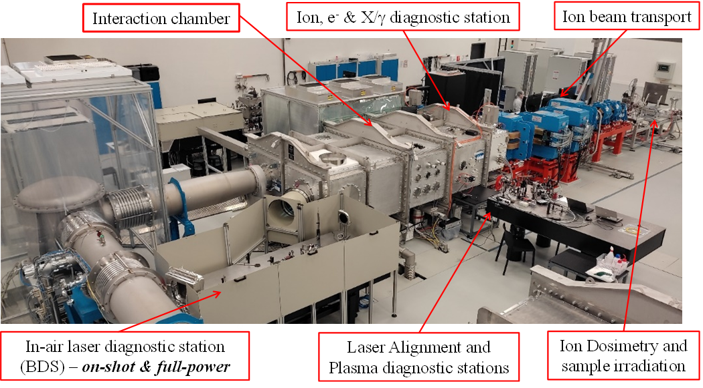
Tasks 5.3 – 5.5 Implementation of Access Pilots at ELI-ALPS, ELI Beamlines, ELI-NP
The selection of the Open Access Pilot experiments was done based on the following criteria:
Challenging experimental setup proposed, requiring concerted actions between the user and the facility sides for the technical preparation but also from the logistics point of view (such as equipment shipment and/or procurement)
Extended collaborations and experimental teams / shifts involved, challenging the organization of user training and access at the facility
Experiments building on, and improving the existing
infrastructure
Mitigation of delays and rescheduling if needed
Challenging requirements for data acquisition - long runs,
real time analysis

Slide 29
Open Access Pilot Experiments
Progress in selection and performance reported in Deliverable 5.4 - Annual report on implementation of access pilots
Beamtime was allocated for these in 2023 and 2024
Examples of Open Access Pilot experiments:
ELI-NP: UPM-47 ”Dispersion relation and pulse shaping of fs laser-driven transient pulsed electromagnetic fields” experiment led by P. Bradford from York University, UK
took place successfully in February-March 2023 at ELI-NP’s E5 area (1PW beam)
The experiment was technically challenging, involved logistics support with shipment of equipment to ELI-NP, and several teams participated (challenging for user access management)
Feedback (e.g.): There were some issues with the shipment of equipment by the user team to the facility, a clear procedure must be developed

Slide 30
Open Access Pilot Experiments
Examples of Open Access Pilot experiments:
ELI Beamlines: UPM-33 “Towards Molecular Frame Photoelectron Angular Distribution Measurements of Polyatomic Molecules” experiment led by PI Dr. J. Woodhouse from University of Southampton, UK
took place successfully in the E1 experimental area of ELI Beamlines in May 2023
The access pilot experiment required a substantial rebuild of the laser beam delivery to the MAC station and the commissioning of additional equipment, leading to improved experimental capabilities
Feedback from facility (e.g): Verified the ability to run long integration times (including overnight) to pursue low signal measurements
Feedback from user (e.g.): The data acquisition software still needs work. The users would like to see a functioning system that allows for on-the-fly analysis of the data, a quicker pipeline for real time feedback based on summed images is needed for decisions during the experiment

Slide 31
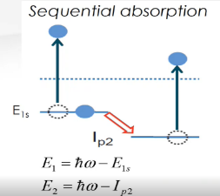
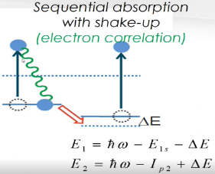
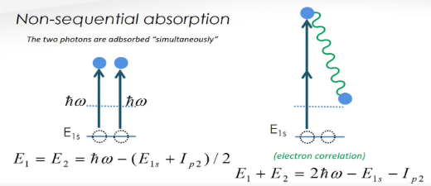
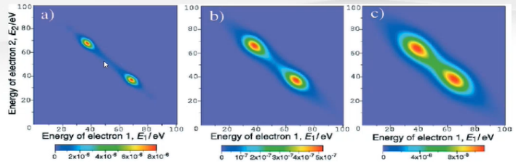
Flagship Experiments at ELI-ALPS
NONLINEARATTO – “Investigation of correlated electronic dynamics by nonlinear attosecond spectroscopy”
Principal Investigator: Giuseppe Sansone, Univ. of Freiburg; Local PI at ELI-ALPS: Zsold Diveki
The high XUV intensities and the ultra-short XUV pulses required are two experimental challenges anticipated to be tackled by the SYLOS driven attosecond beamlines
Collaborative project between the Univ. of Freiburg, MPI für Kernphysik,
Heidelberg, FORTH and ELI-ALPS
Objective: Investigation of electronic correlation in simple quantum
systems, such as atoms & small molecules by nonlinear spectroscopy in
the extreme ultraviolet (XUV) spectral range.
Means: SYLOS Compact GHHG + Reaction Microscope (ReMi) endstation

Slide 32
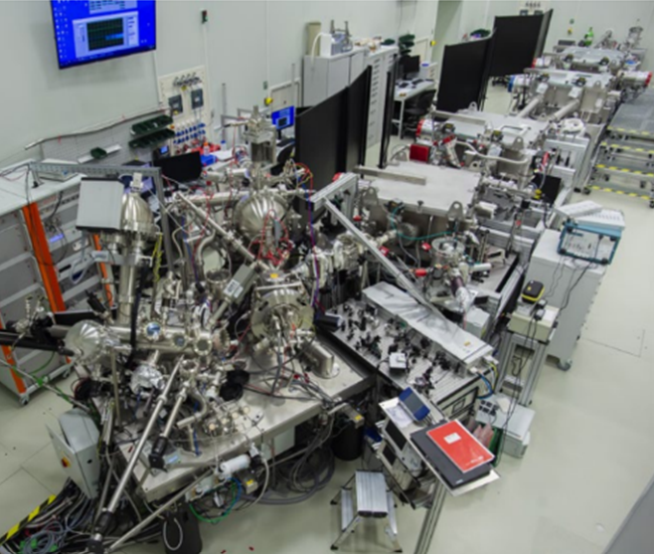
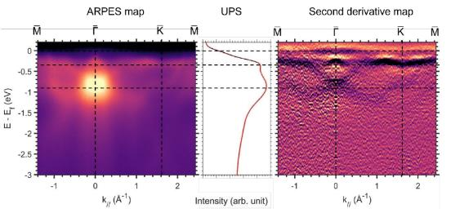
Flagship Experiments at ELI-ALPS
TSRMM – “Time- and Spin-Resolved Momentum Microscopy”
P.I.: Martin Aeschlimann, Univ. of Kaiserslautern; Local PI at ELI-ALPS: Lászlό Ovári
Challenge the full capabilities of the ELI-ALPS surface science end station and its ultrafast, high-flux and repetition-rate light sources
Collaborative project between the Univ. of Kaiserslautern, the Univ. of Göttingen and ELI-ALPS
Objective: Advanced understanding of the microscopic mechanism and interactions that dominate the optically induced magnetization dynamics in condensed matter.
Means: SYLOS Compact GHHG + HR condensed matter GHHG beamline and the NanoEsca end-station

Slide 33
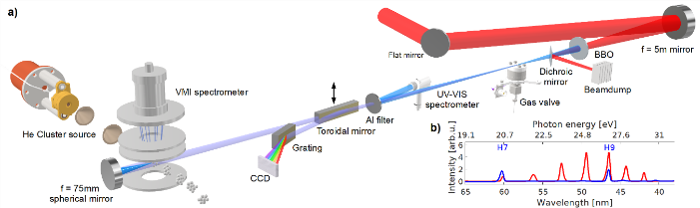
Flagship Experiments at ELI Beamlines
XUV tuning – “Studies of collective dynamics at the nanoscale using intense, spectrally-tunable XUV pulses from High-Harmonic Generation”
PI: Prof. Marcel Mudrich from Aarhus University and Dr. Jakob Andreasson (local PI)
Development of the ability to tune the XUV output of the high intensity HHG source by tuning the wavelength of the drive laser (L1 Allegra) for applications in XUV/optical pump-probe experiments
Experiments have been performed in 2022 and 2023 and high-quality data has been obtained and published; next session in 2024
Means: L1 Allegra laser, HHG beamline, MAC station

Slide 34
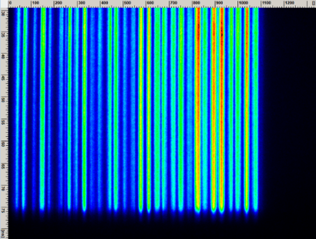
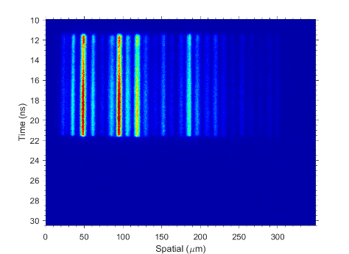
Flagship Experiments at ELI Beamlines
L4nP3– “Characterizing shock-compressed plastics for mimicking planetary interiors and synthesis of nanodiamonds”
PI: Prof. Kraus from Rostock University and Dr. Florian Condamine (local PI); collaboration Rostock Univ.-Beamlines-SLAC
Selected for commissioning of critical diagnostics required in measuring shock velocities, pressures, and temperature under extreme conditions
Objective: The investigation of laser-driven shocks within solid targets, one of the most extensively explored areas in High-Energy Density Physics (HEDP), serving dual purposes in Inertial Confinement Fusion (ICF) and laboratory astrophysics research
The first experiment beamtimes were carried out in June and October 2023 (>500 shots at >200J/pulse), the data currently under analysis by Prof. Kraus' team
certain issues within the L4n beamline came to light - prepulse
identified and rectified

Slide 35
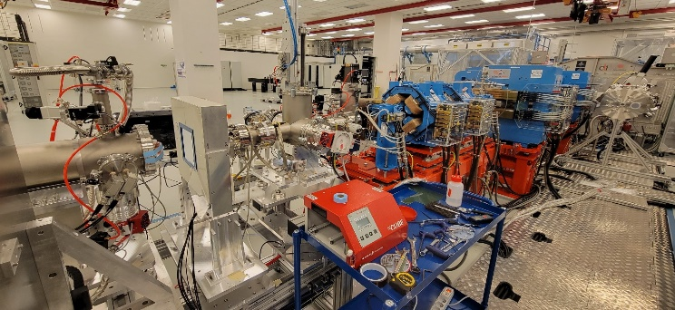
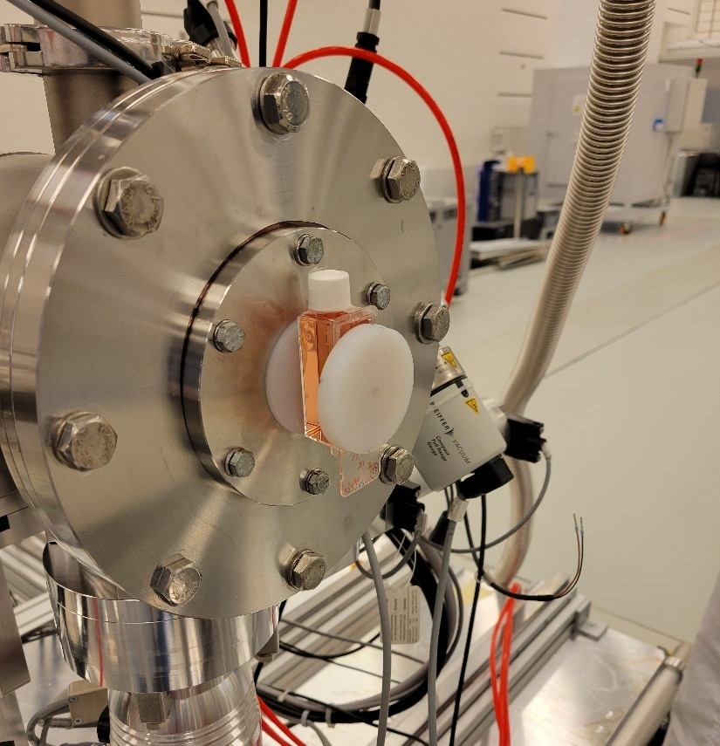
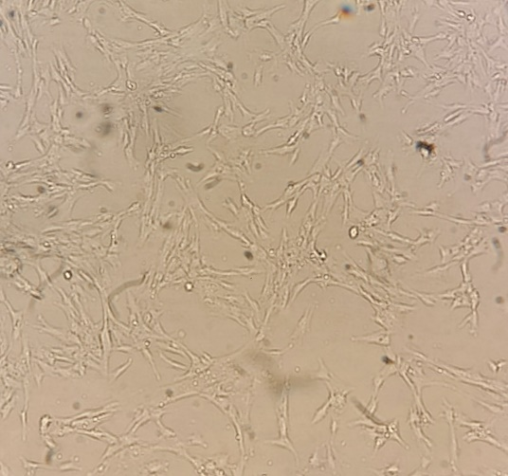
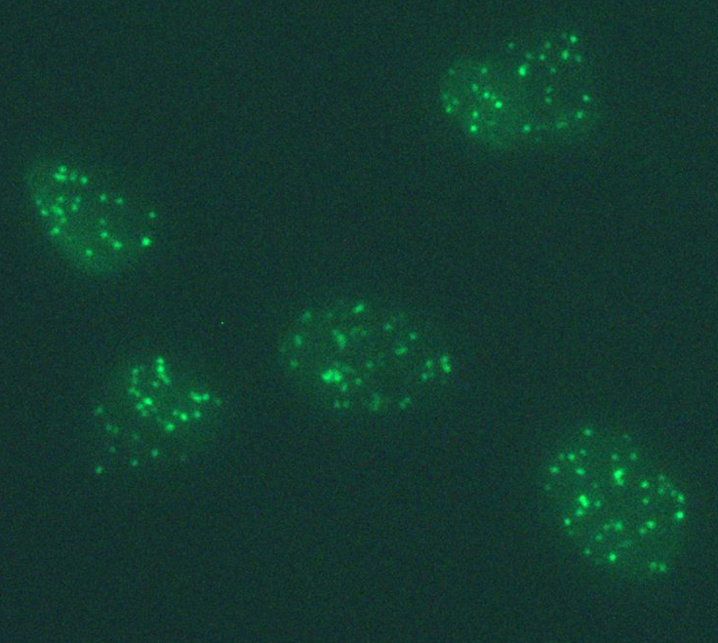

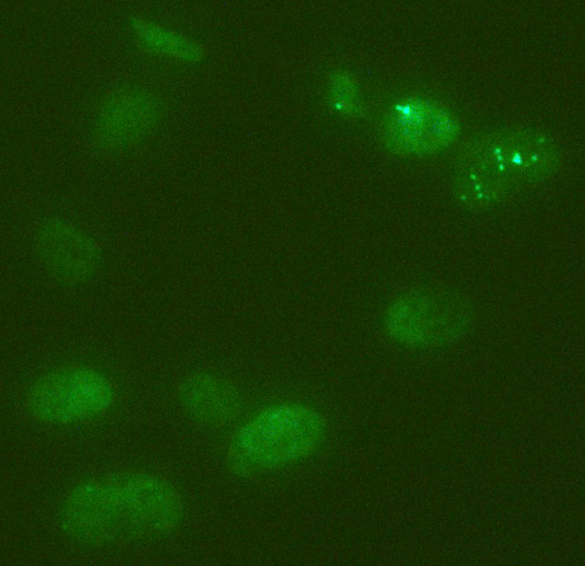
Flagship Experiments at ELI Beamlines
FLAIM at ELIMAIA – “Flash and ultrahigh dose-rate radiobiology with Laser Accelerated Ions for Medical research”
PI: Prof. Marco Borghesi and Professor Kevin Prise from Queen’s Univ. Belfast (UK), and Dr. Lorenzo Giuffrida (local PI)
Selected for the highly challenging commissioning of a new beamline providing unique accelerated ions parameters for medical applications
Collaborative project between Queen’s Univ. Belfast (UK), INFN-LNS (IT), Naples Univ. (IT), Nuclear Physics Institute CAS (CZ), Laboratory of Immunotherapy CAS (CZ), ELI ALPS, ELI-NP
Objective: The study of the biological response of cells to ultrashort ion bursts and how the presence of oxygen affects the ultra-high dose rate radiobiology
Means: ELIMED section of the ELIMAIA beamline, L3 PW laser
Experiments in 2023 and March 2024, protons 25-30 MeV obtained
First irradiation of cells in-vitro at ELI Beamlines
Cell cultureAG01522
Proton beam Homogeneity
Irradiated sample
1.48 Gy, 30 min
Not irradiated sample

Slide 36
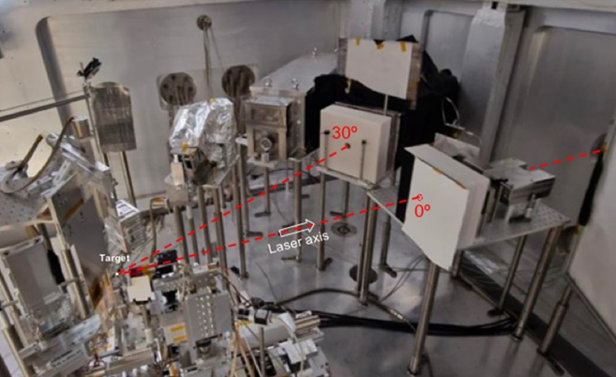
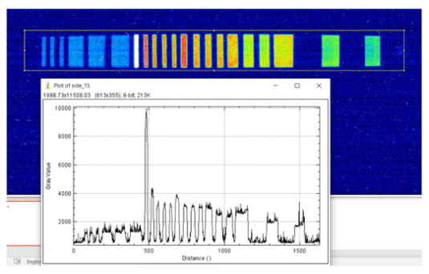
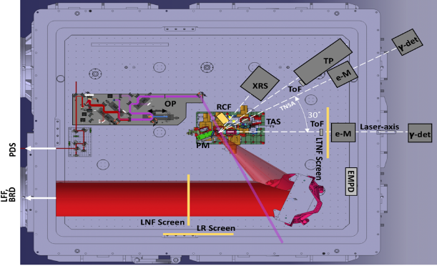
Flagship Experiment at ELI-NP
RADLAPLAS - “Investigation of the generation of synchrotron-like radiation from laser-plasma interaction”
PI: Domenico Doria, ELI-NP
Selected due to the challenging commissioning of ultra-high intensity demonstration (10²³ Wcm⁻²) and high contrast at unprecedented 10 PW
Objective: gamma flash generation via foam/aerogel targets, investigating the laser-to-gamma conversion efficiency of the energy and possibly the scaling law for laser powers between 1 and 10 PW
Collaborative project between the HZDR Dresden, KPSI and Osaka U. Japan, RAL UK, LLE and Rochester U. USA, ELI Beamlines and ELI-NP
Completed two sessions of beamtime in 2023, with several improvements introduced in the setup meanwhile
To continue with flagship application “Stimulated emission of long-lived nuclear isomers via X-rays burst” beyond IMPULSE

Slide 37
Excellence as User Facility
The first four ELI open calls for users have been successfully organized with IMPULSE support, jointly for all three ELI facilities
Feedback has been gathered from the users, facility scientists and user offices, and the workflow and procedures for user access improved during IMPULSE
Support of the Open Access pilot experiments allowed tackling more challenging topics, leading to improvements in the experimental and administrative capabilities of the facilities
User Portal up and running from the 1st call, continuing improvements and plans for a major upgrade for the 5th User call (based on a new platform)
Each Flagship experiment has produced during IMPULSE relevant results demonstrating the capability of ELI to deliver high-impact scientific experiments; the interest of the scientific community is demonstrated by the commitment to continue these experimental campaigns beyond IMPULSE

Slide 38

We are grateful to the WP5 team members, who engaged with enthusiasm and started great collaborations between the facilities, on all scientific, technical and administrative topics pertaining to IMPULSE.
Thanks to the management of the ELI ERIC and ELI Facilities for their support towards common operation and user access workflows and procedures, and in general for the IMPULSE project.
A special Thank you to the IMPULSE project management team, who diligently followed up and supported us in the WP activities and decisions whenever needed.
And, of course…
THANK YOU
FOR your ATTENTION
O. Tesileanu, Z. Varadi, T. Kecskés
IMPULSE is funded by the European Union’s
Horizon 2020 research and innovation programme
under grant agreement No. 871161

Slide 39
















