Slide 1

IMPULSE PROJECT
Development of technical capacity
WP4 – Key technologies & enhanced experiments
CLOSING MEETING
Daniel Kramer *
17 April 2024
IMPULSE is funded by the European Union’s
Horizon 2020 research and innovation programme
under grant agreement No. 871161

Slide 2
Development of technical capacity
Task 4.1 – Key optical components long term sustainability: strategies to increase the LIDT
  Better coatings & metrology (designs, vendor surveys, LIDT testing)
  (Priority) Dependable Access to very large high power coatings (mirrors, gratings)
  All ELI facilities
  Task leader: Daniel Kramer ELI Beamlines
  Coordinators: S. Kahaly ALPS, D. Ursescu NP
Testing according to ISO standards
12. Identify and develop new key optical components for long-term sustainability: strategies to increase the laser-induced damage threshold (LIDT)
10. Optimise spare parts management for cost efficiency, machine safety and reliability

Slide 3
Development of technical capacity
Tasks in WP4
Task 4.2 – Definition of a standard approach to target design and debris shielding
  Improve target area optics protection (Debris etc) and electronics protection (EMP)
  Master lifecycle of complex targetry enabling strategic long-term decisions
  All ELI facilities, STFC, HZDR, TUD
  Task leader: Mihail Cernaianu ELI NP
  Coordinators: S. Weber BL, S. Kahaly ALPS, U. Schramm HZDR, G. Schaumann TUD, C. Spindloe STFC
13. Define a standard approach to target design and debris shielding

Slide 4
Development of technical capacity
Tasks in WP4
Task 4.3 – Development of software toolboxes to enable optimized operation
  Better control systems integration of complex/expensive devices
  Implementation of SW tools for high peak power laser operation and optimization
  All ELI facilities, Elettra
  Task leader: Lajos Schrettner ELI-ALPS
  Coordinators: B. Plötzeneder, D. Peceli (BL), [B. de Boisdeffre], S. Moldoveanu and C. Ene (NP), M. Lonza (ELETTRA)
14. Define and conduct world-leading experiments to showcase the unique capabilities of the ELI Facilities

Slide 5
Development of technical capacity
Tasks in WP4
Task 4.4 - Key technologies to enhance experimental performances of secondary sources
  Development of detectors or experimental setups to improve high rep rate experimental programs
4.4a Task Leader: Zsolt Divéki ELI ALPS (formerly Sergei Kühn)
  FORTH is building a Magnetic Bottle Electron ToF Spectrometer prototype
  CNR is building a 2 axis XUV Polarimeter prototype
  STFC is lending a Liquid Jet experimental station and provides training
4.4b Task Leader: Daniele Margarone ELI Beamlines
  QUB develops enhanced helical coil experimental setup for high repetition rate p+ generation
  INFN develops a detector array to measure Bragg peak for p+ beams
14. Define and conduct world-leading experiments to showcase the unique capabilities of the ELI Facilities

Slide 6
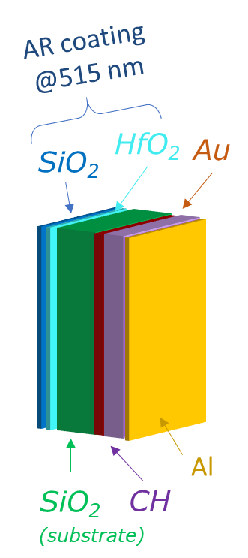
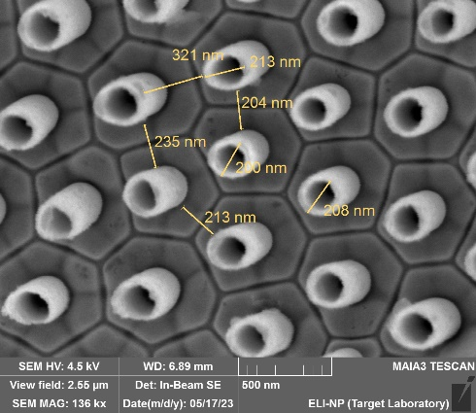
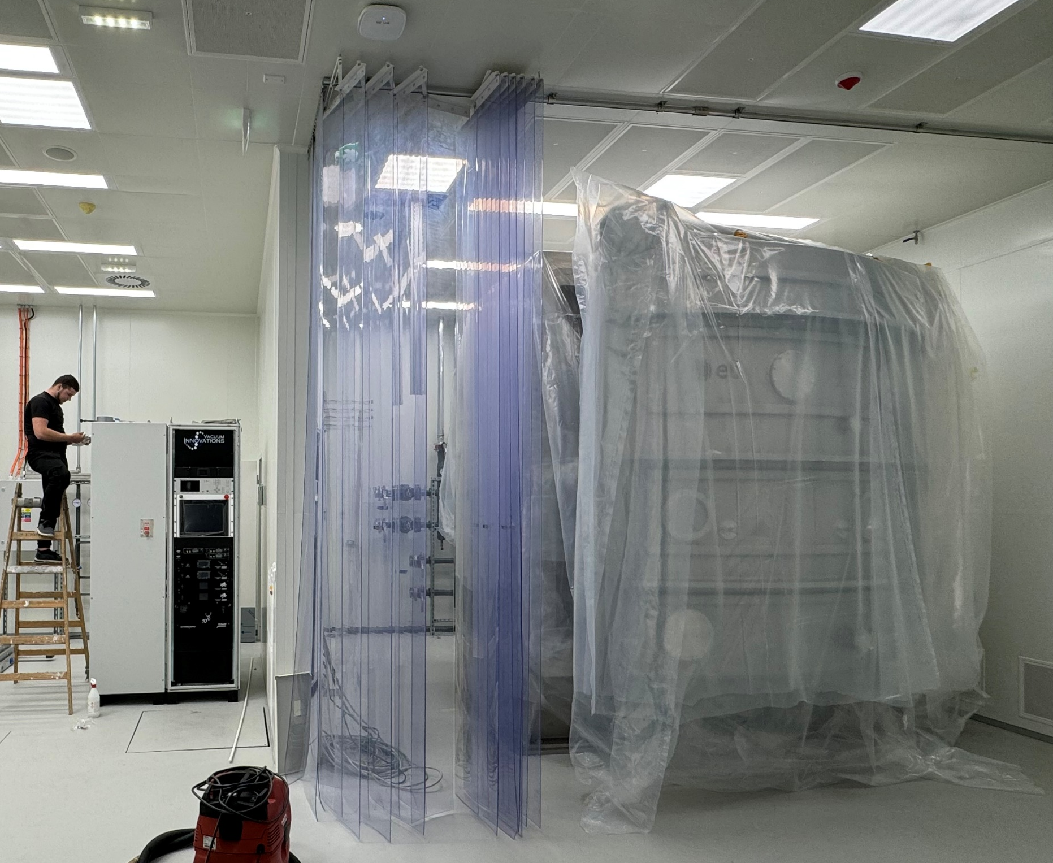
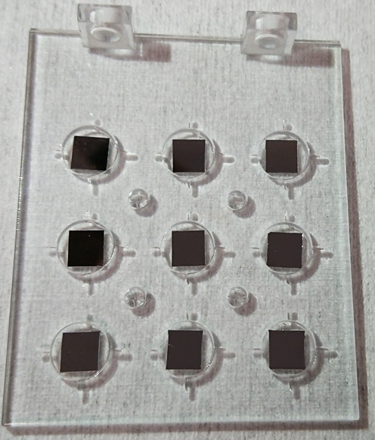
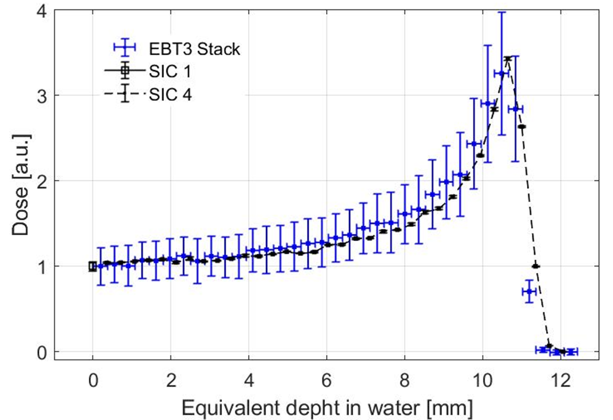
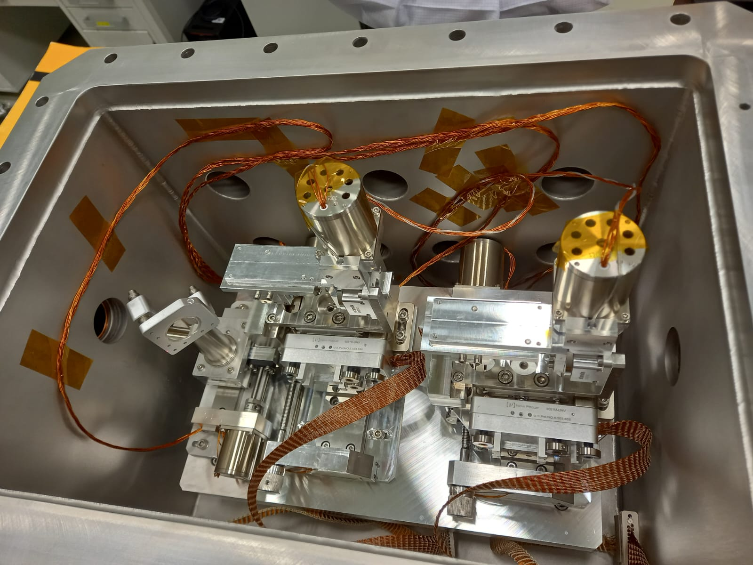
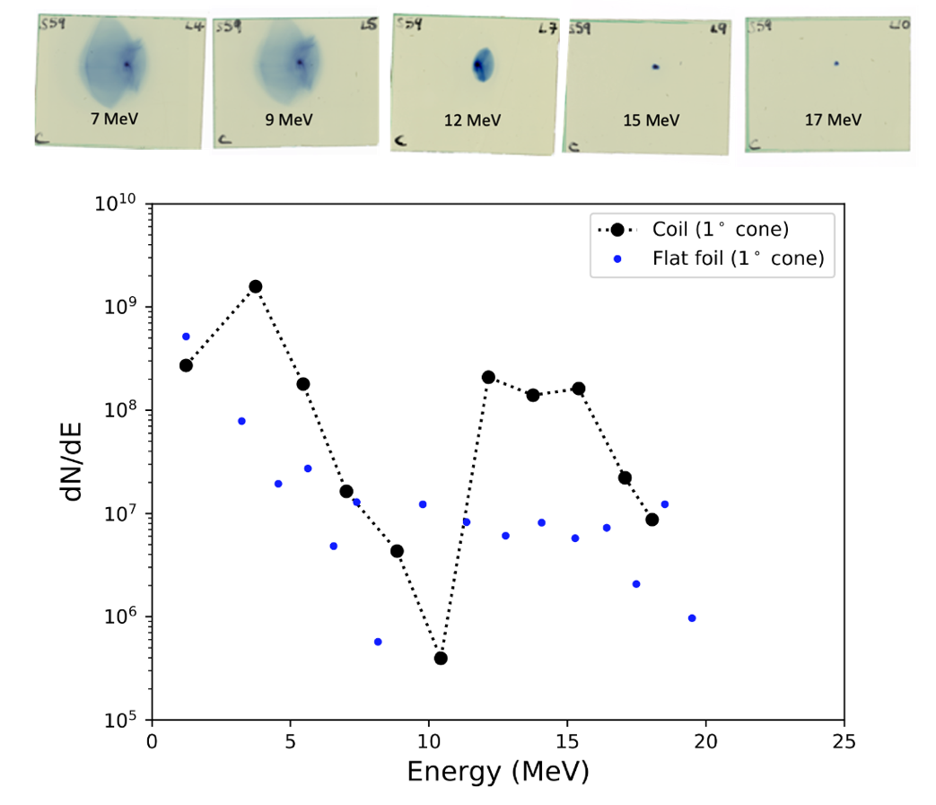
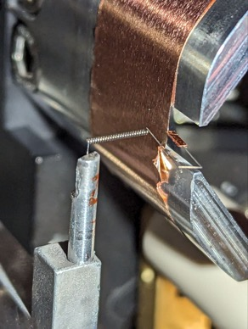
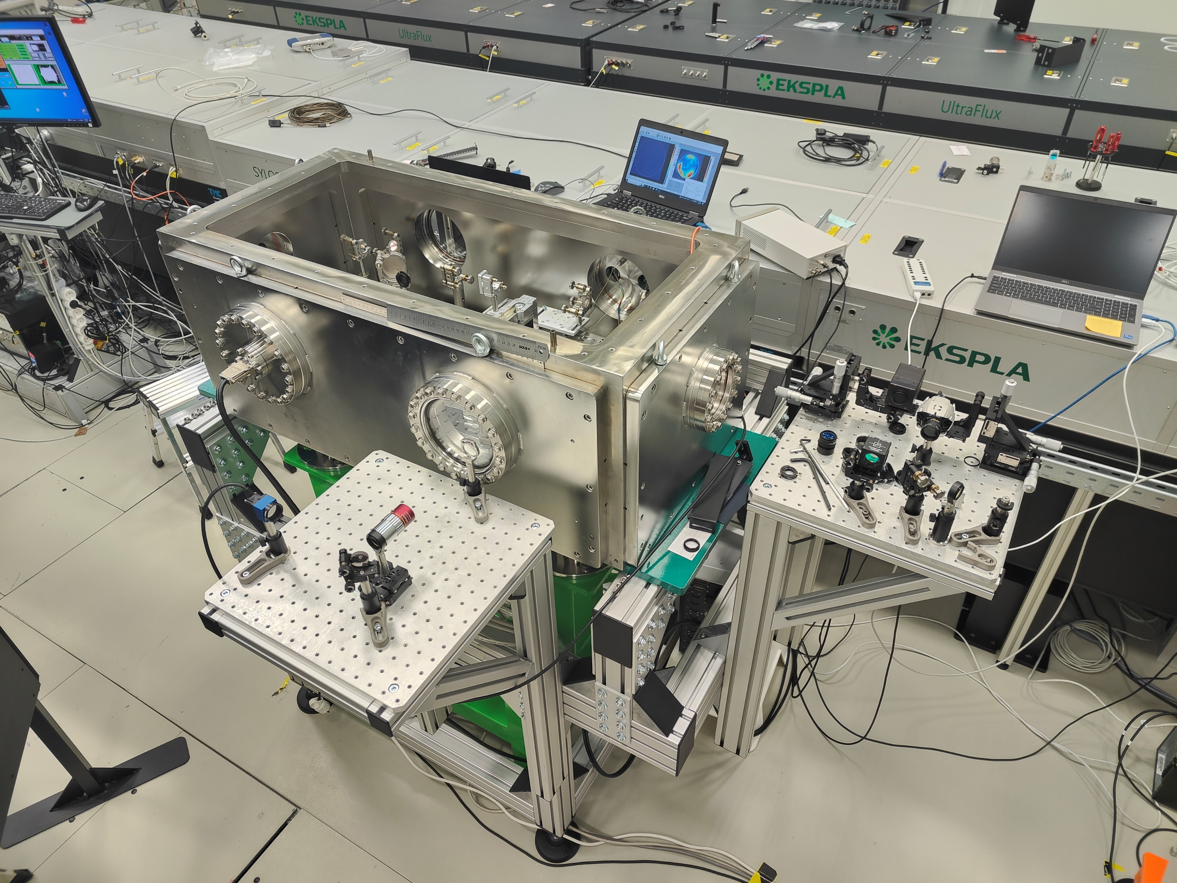
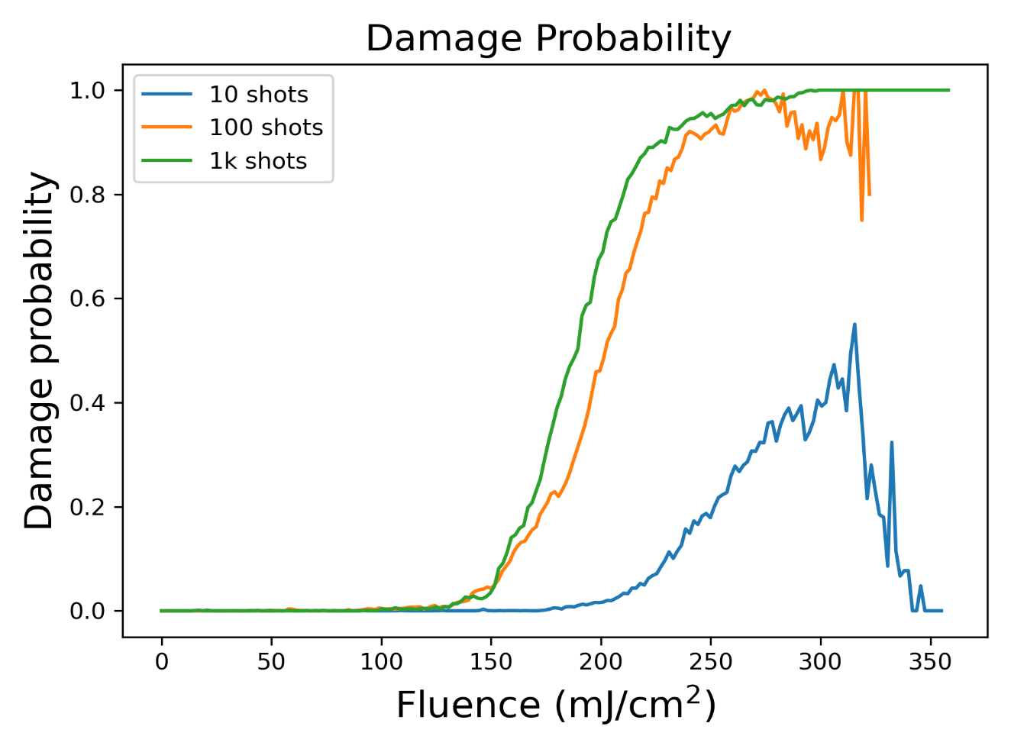
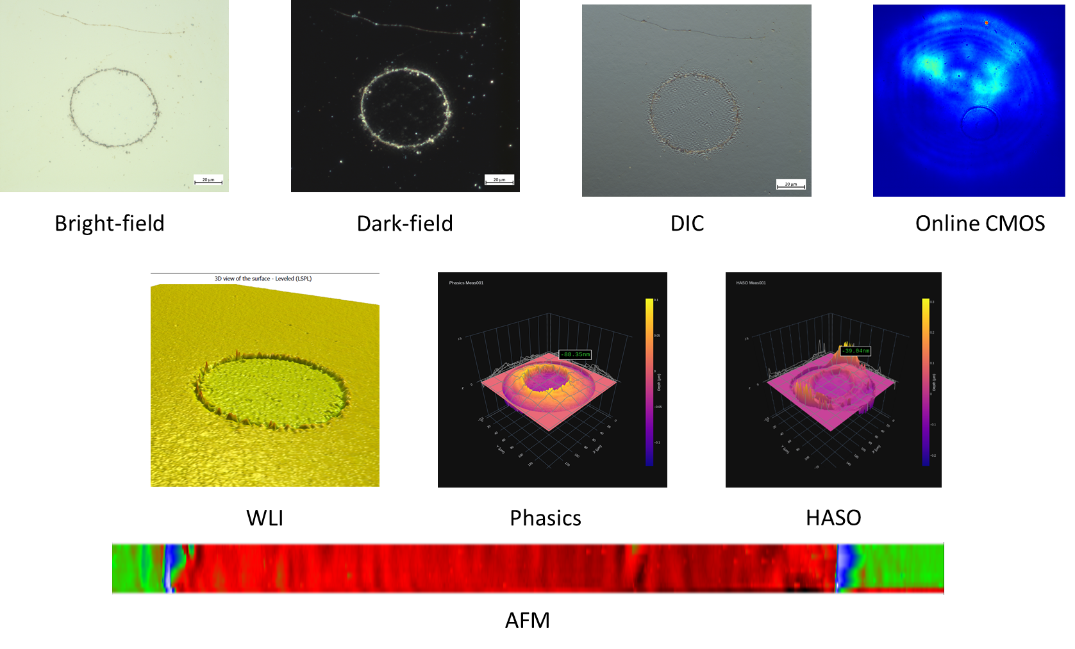
Development of technical capacity

Slide 7
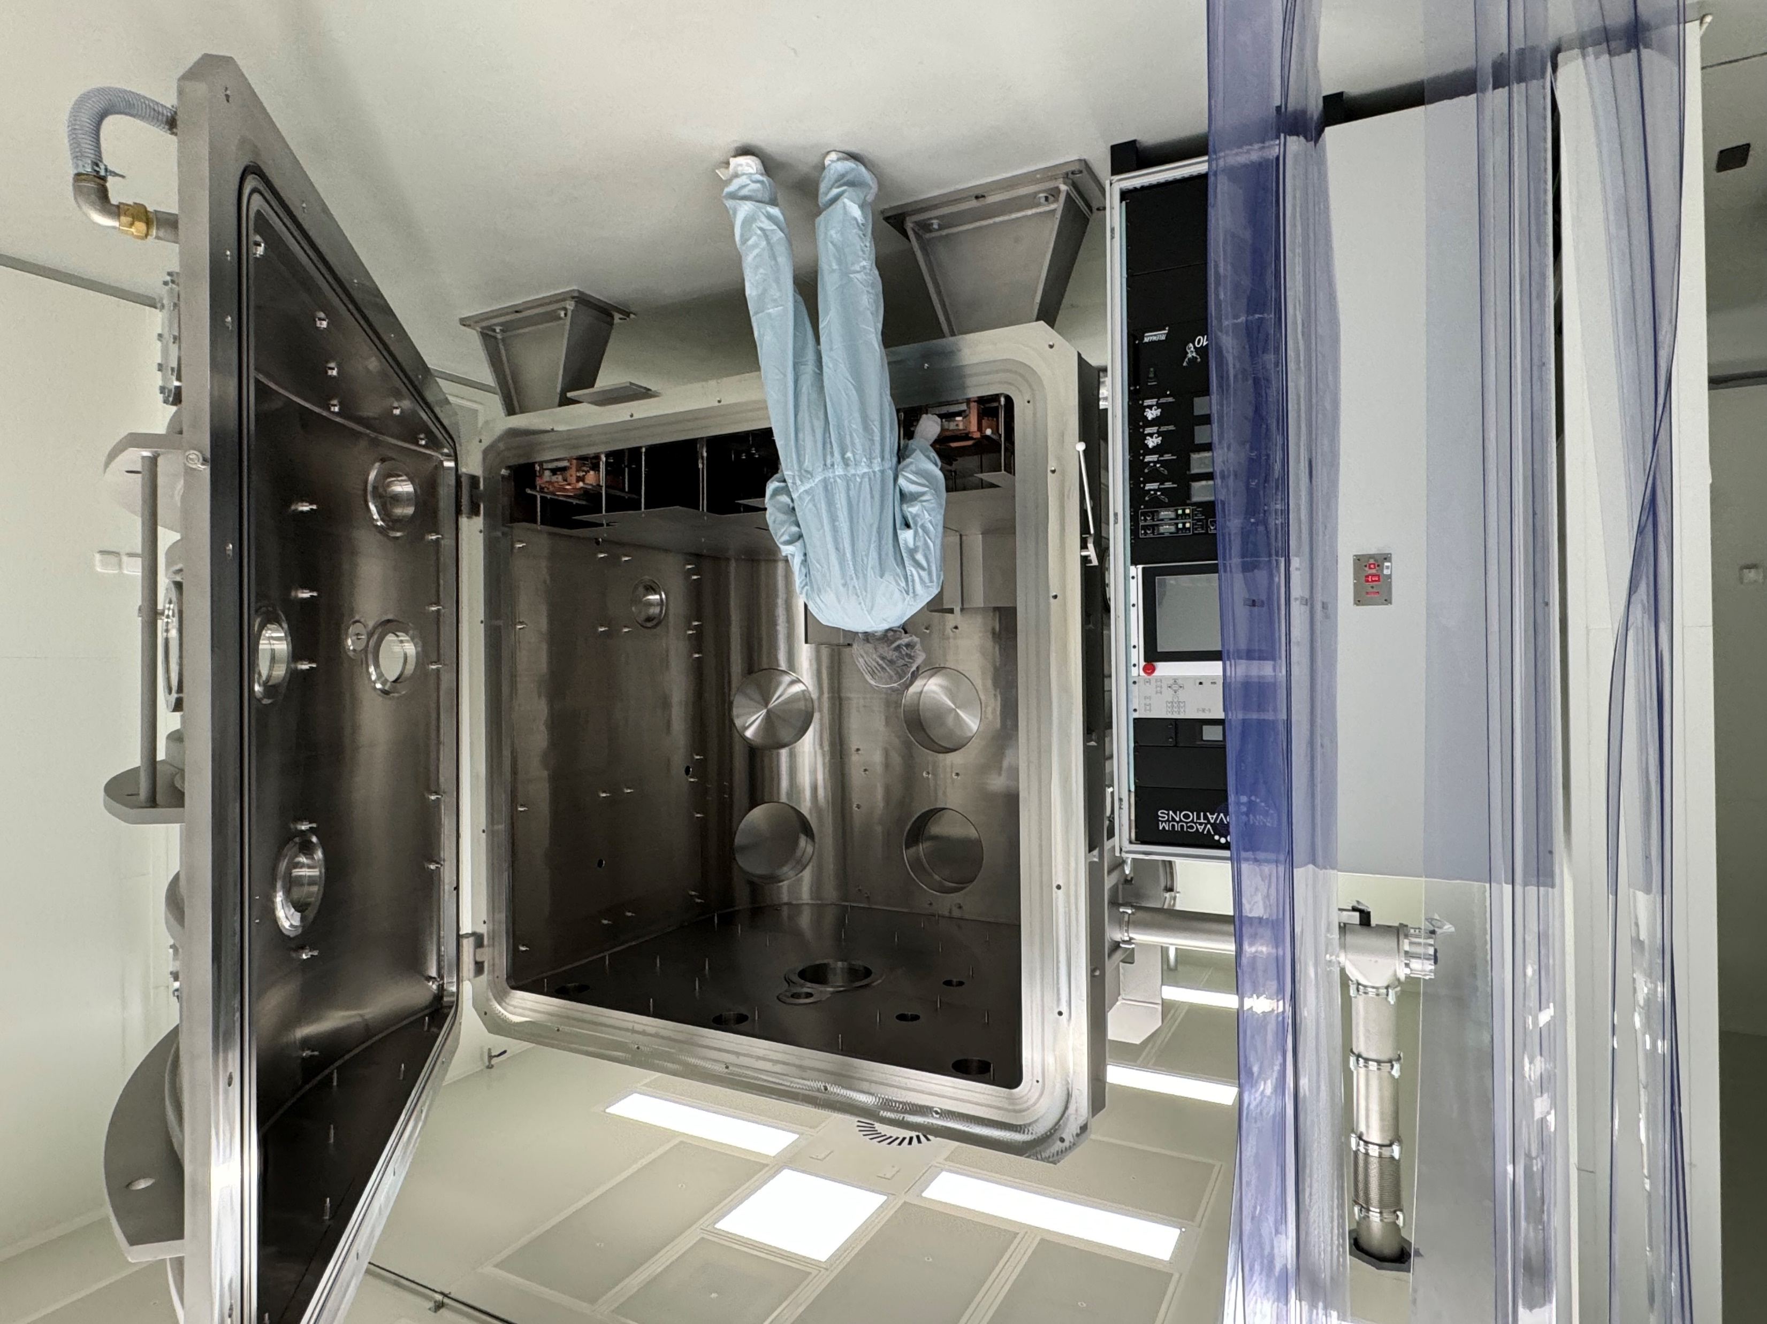
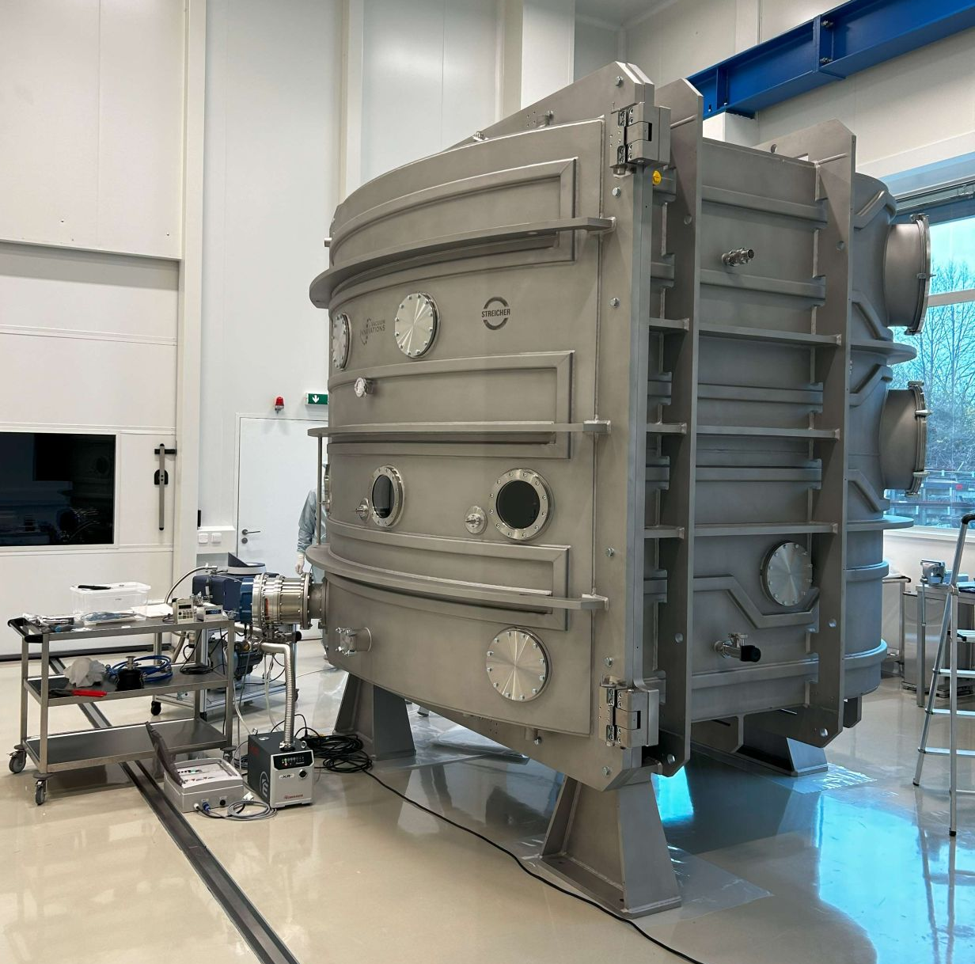
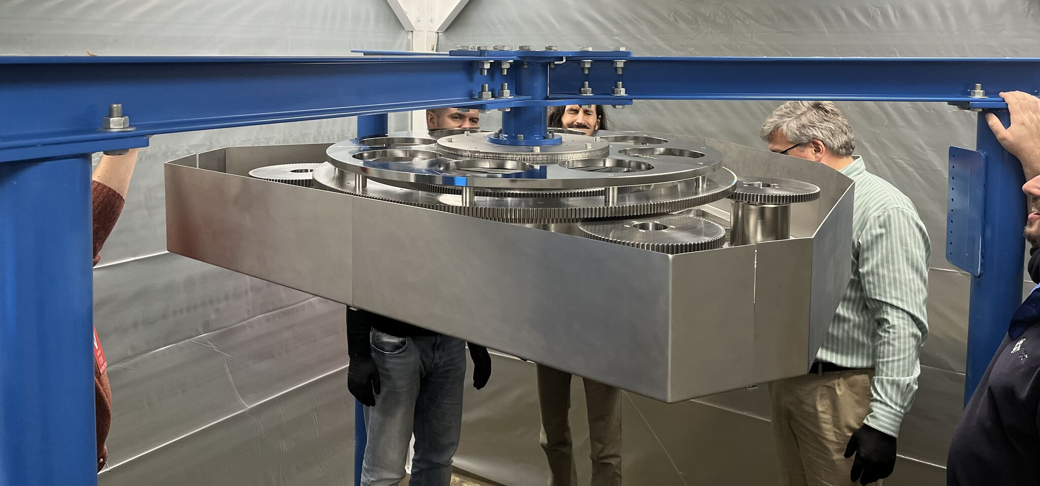
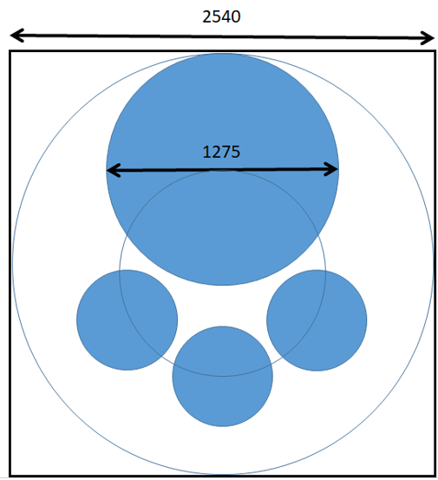
ELIAS – ELI Advanced coating System
Task 4.1
J. Oliver (Vacuum Innovations), T. Tolenis, D. Kramer (ELI BL), et al.
ELI BL technical teams, S. Hejtmánek (Streicher)
ELIAS laboratory created in ELI BL
Experience from largest US laser labs helped in the design (SANDIA, LLE, LLNL)
Unique 1.2 m aperture for HE laser optics in planetary motion
Coating Process R&D and related LIDT funded by THRILL Horizon Europe project
Enables largest >5 PW laser projects

Slide 8
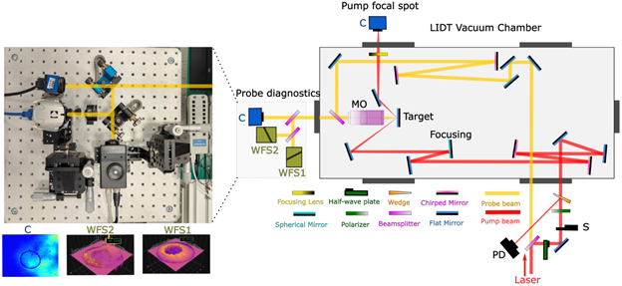
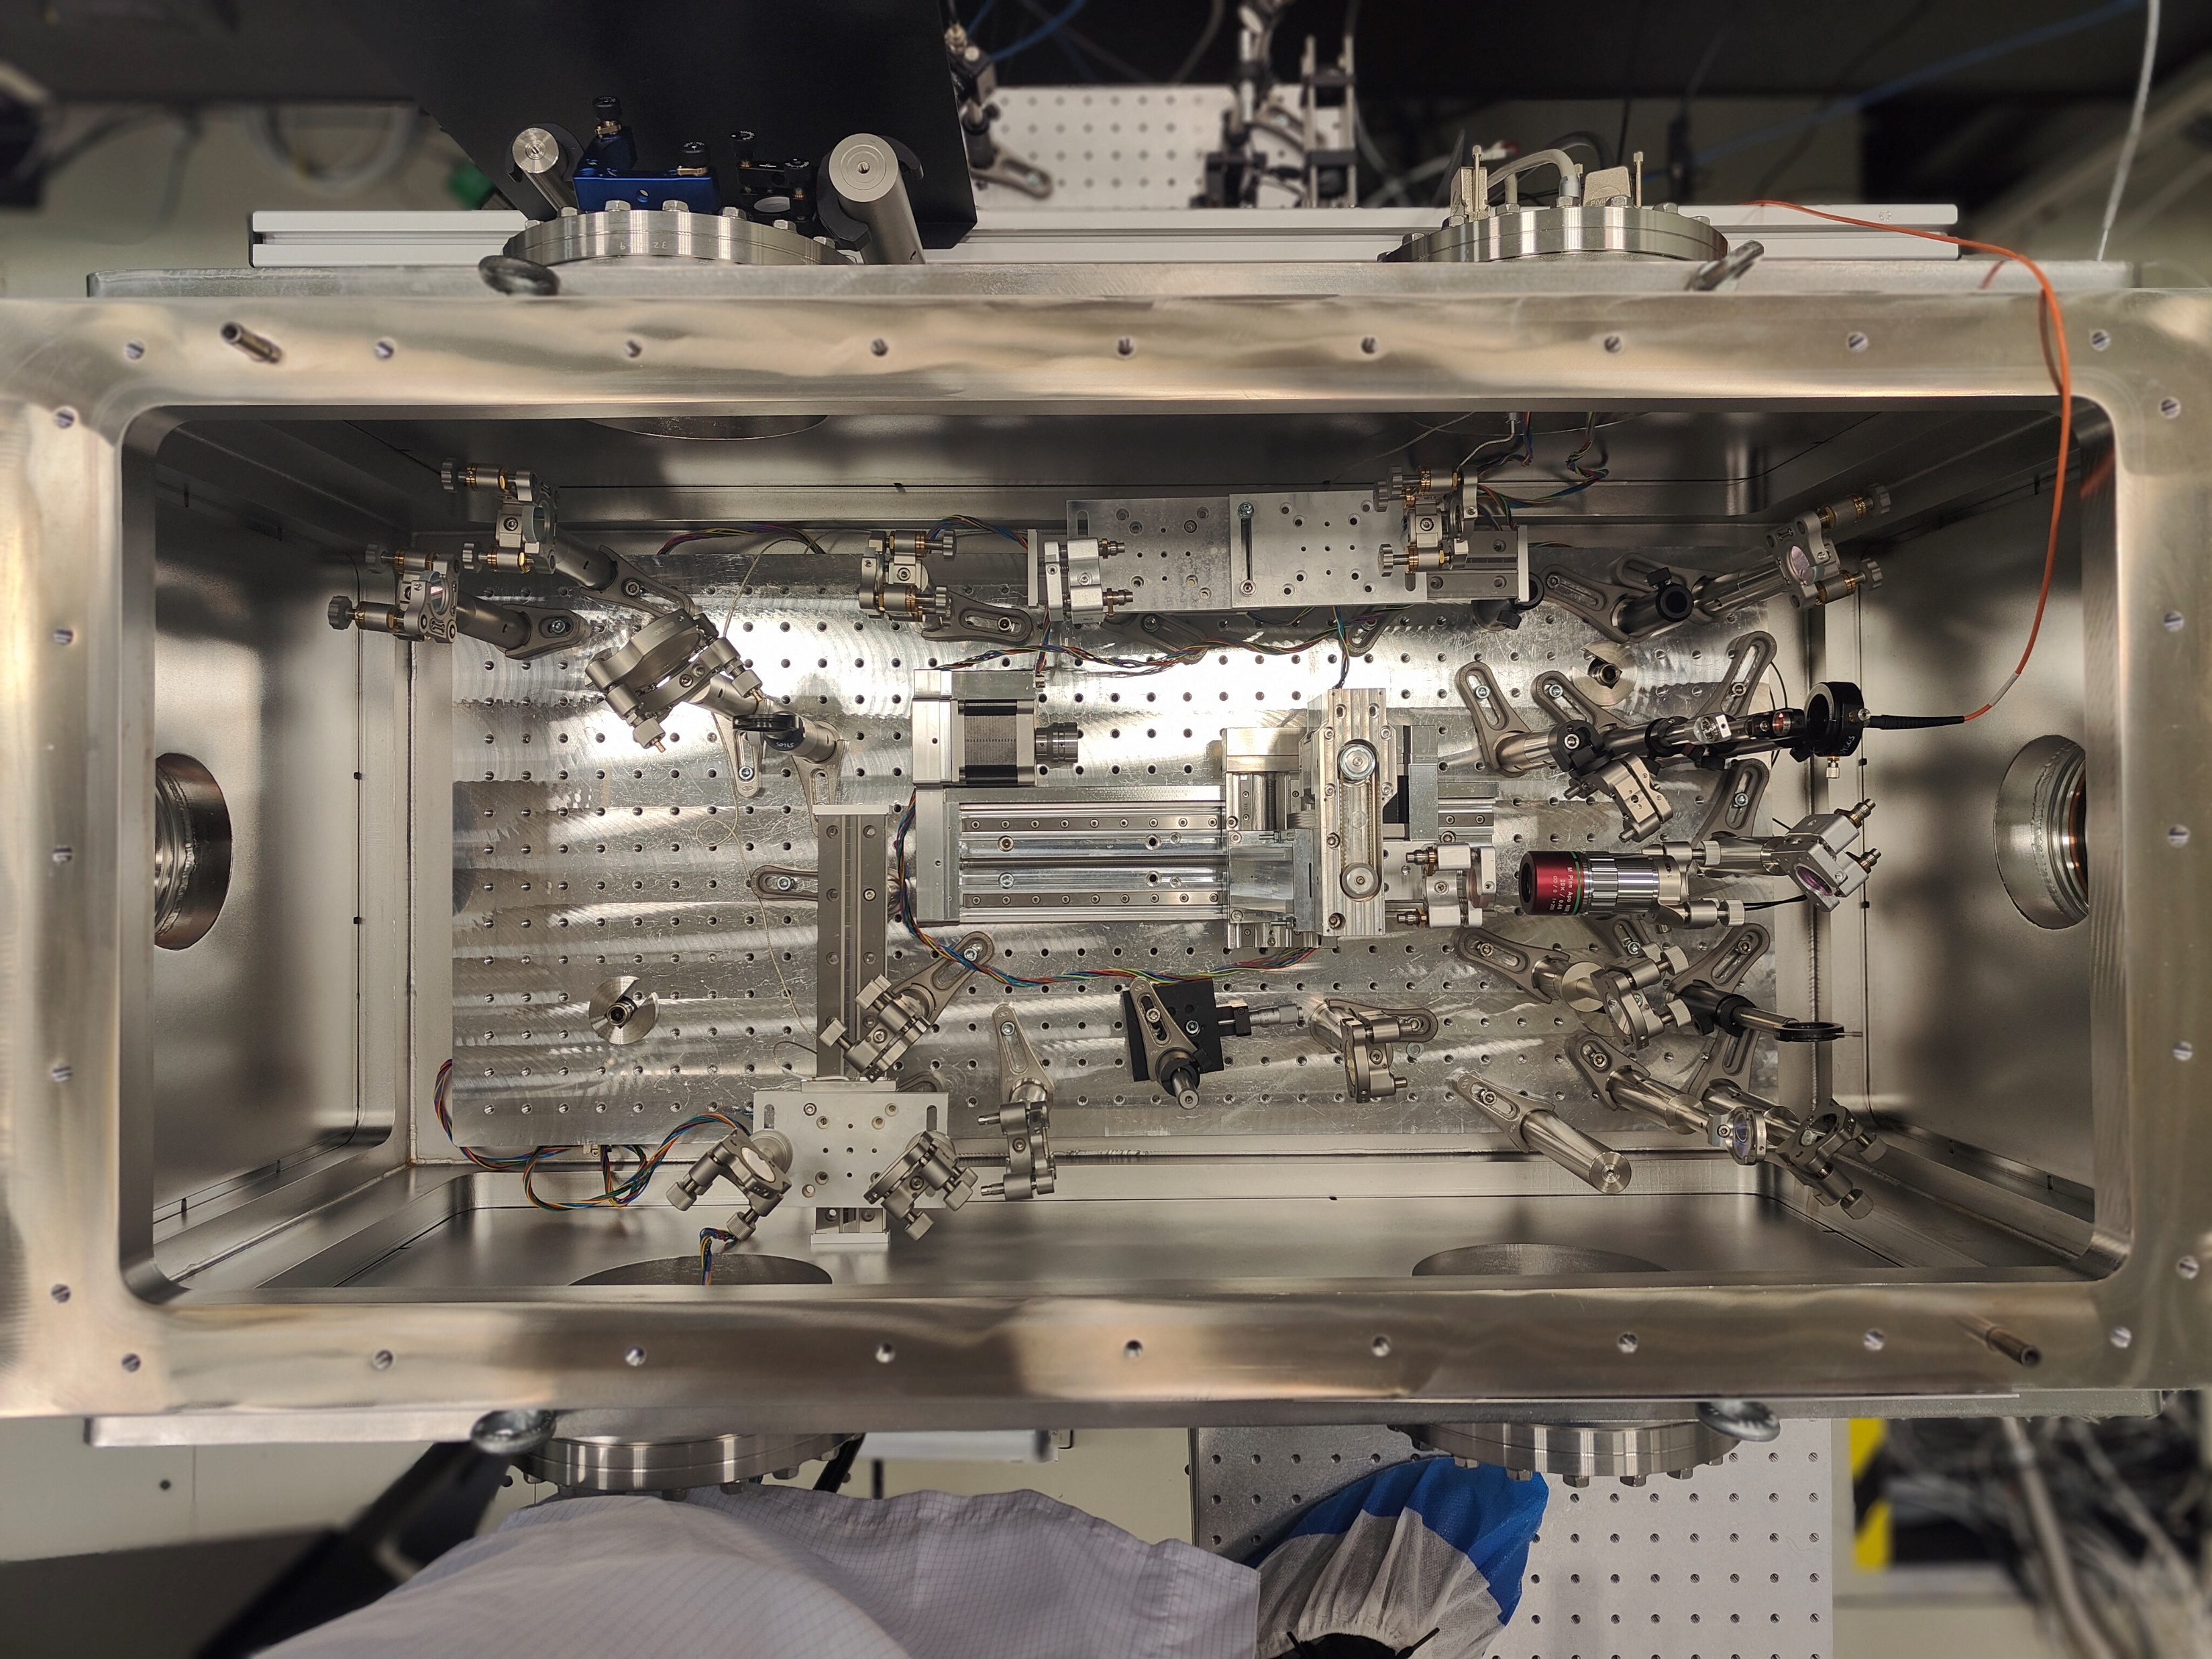
LIDT prototype @ELI-ALPS
Task 4.1
S. Kahaly ALPS, T. Somoskői, N. Ahmed (PhD student)
Currently offered to users ELI-ERIC Call 4 (https://up.eli-laser.eu/call/4th-eli-call-for-users-819757098 )
[ELI BL LIDT system part of user experiment in May 2024]
Top view

Slide 9
LIDT beamtime with large beam at ELI-NP
PI: D. Ursescu for T4.1
Task 4.1
First campaign May 2022:
Gabriel Bleotu, Alice Dumitru, Cristian Alexe, Andrei Naziru, Stefan Popa, Dan Matei, Ioan Dancus, Daniel Ursescu (ELI-NP), Tamas Somoskoi (ELI-ALPS)
Second campaign September 2022:
Gabriel Bleotu, Andrei Naziru, Andrew-Hiroaki Okukura, Stefan Popa, Vicentiu Iancu, Dan Matei, Alice Dumitru, Cristian Alexe, Dan Matei, Vlad Musat, Maria Talposi, Daniel Ursescu (ELI-NP), Tamas Somoskoi, Naveed Ahmed, Subhendu Kahaly (ELI-ALPS) Chauvin Adrien, Daniel Kramer (ELI-Beamlines)

Slide 10
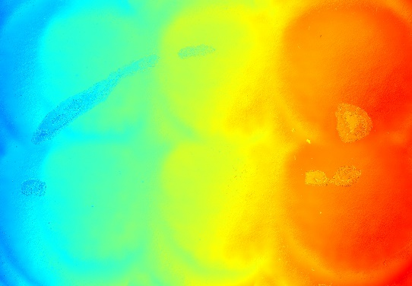
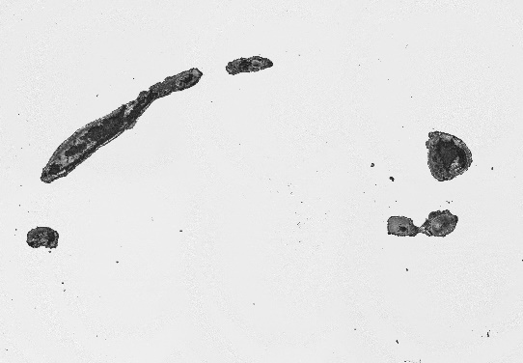
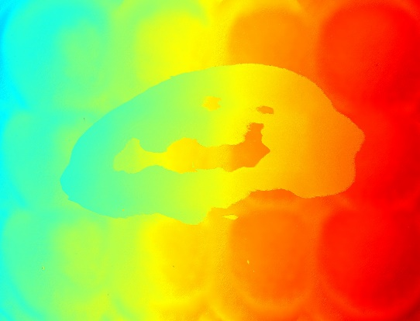
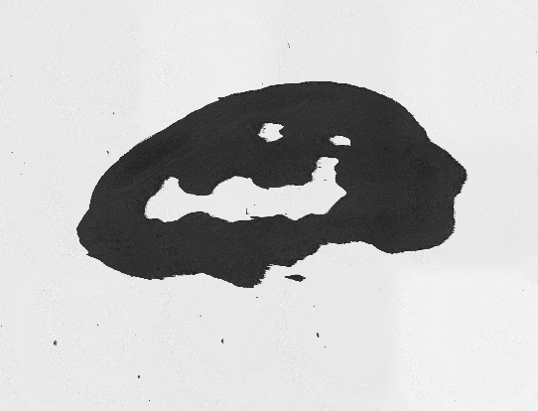
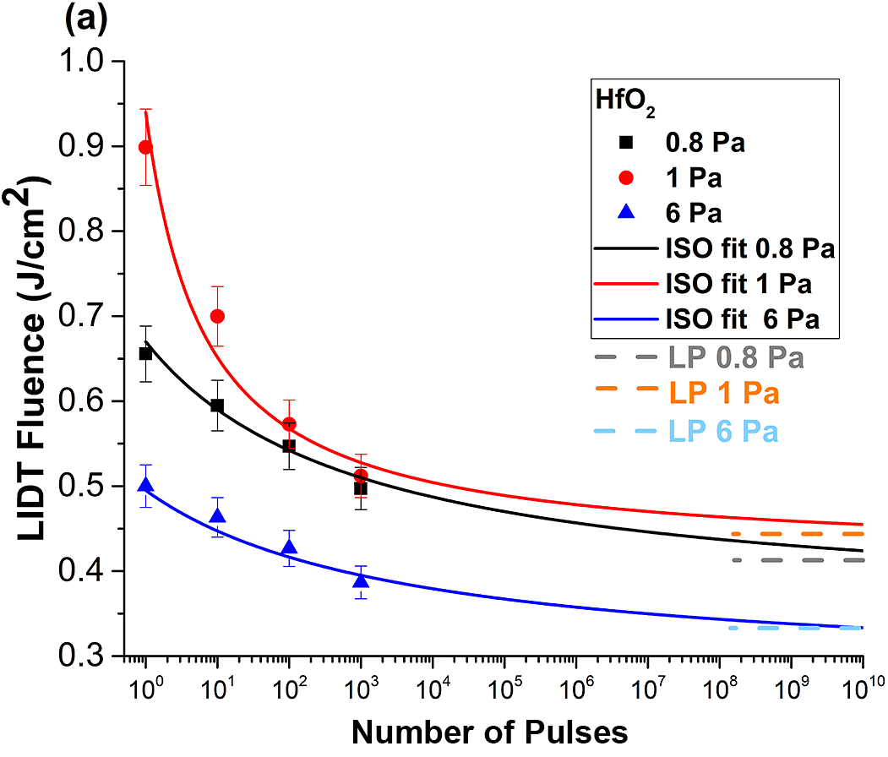
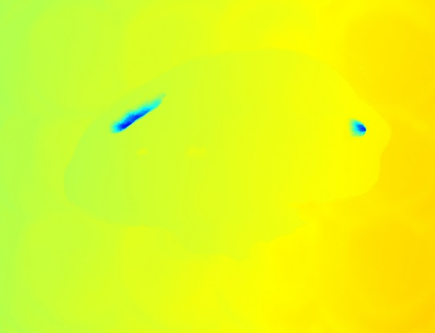
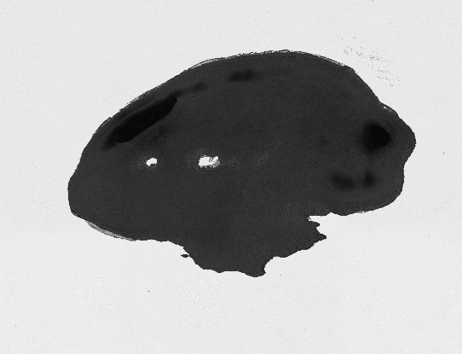
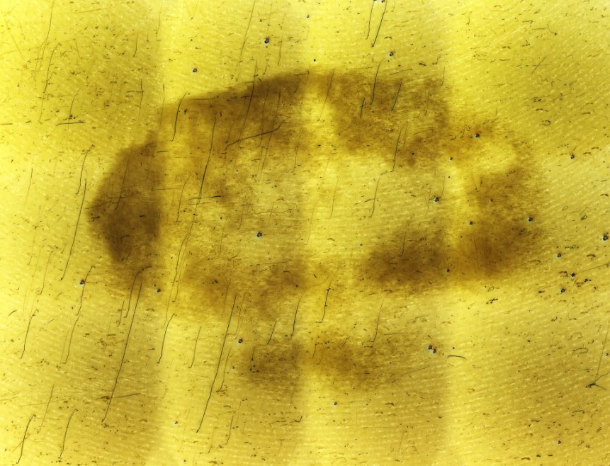
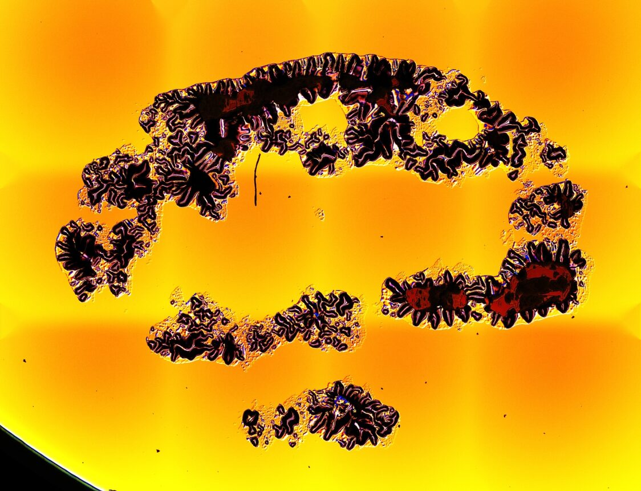
LIDT beamtime with large beam at ELI-NP
Task 4.1
Metrology done in ALPS, NP and BL
Interesting method for ultrafast pulses – close to operational mode
The Arthur Guenther Best Poster Award for G. Bleotu
Measured Damage
Binary damage map
10 shots
https://doi.org/10.1117/12.2641616
100 shots
1000 shots

Slide 11
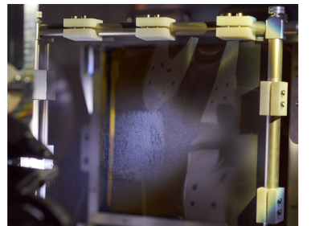
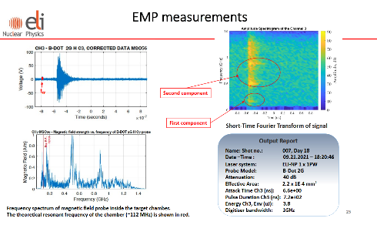
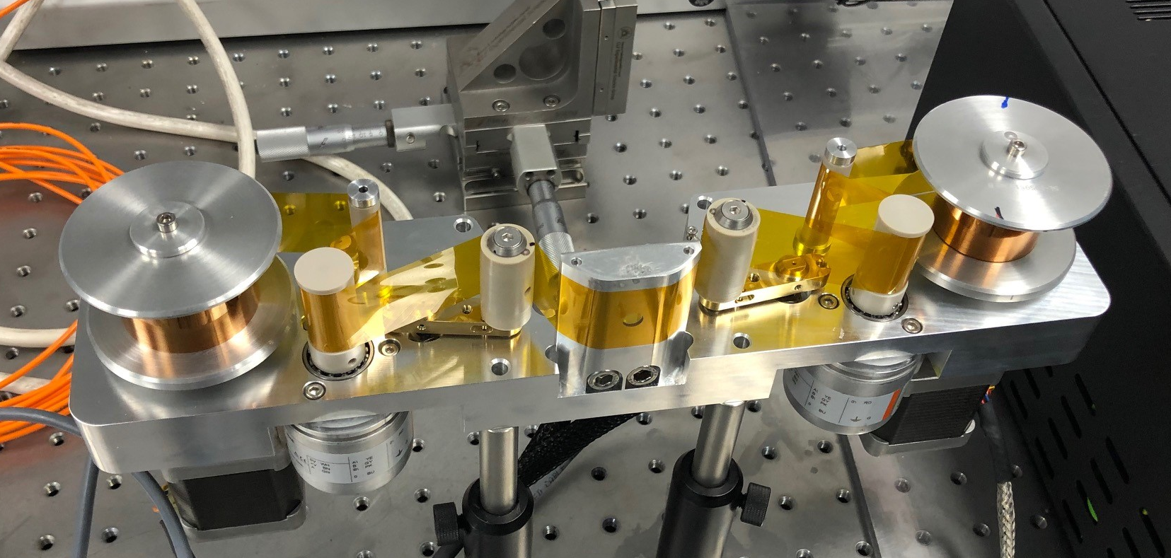
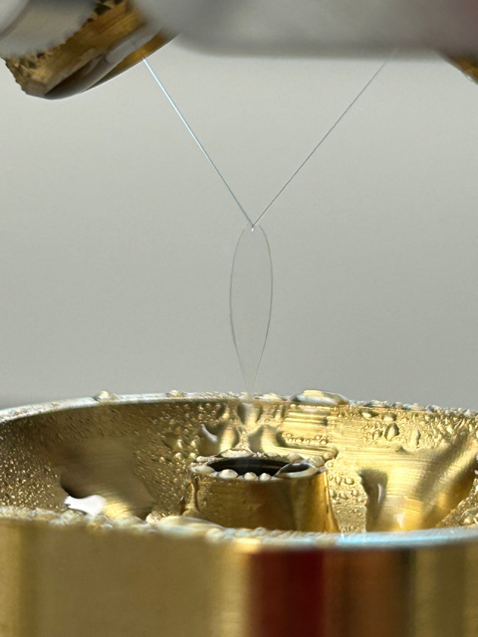
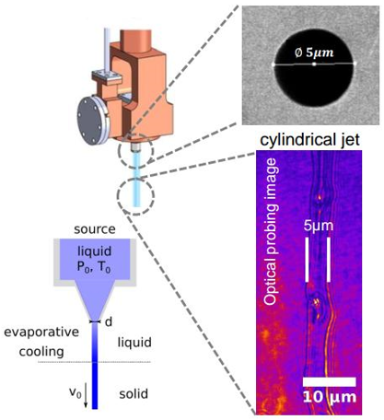
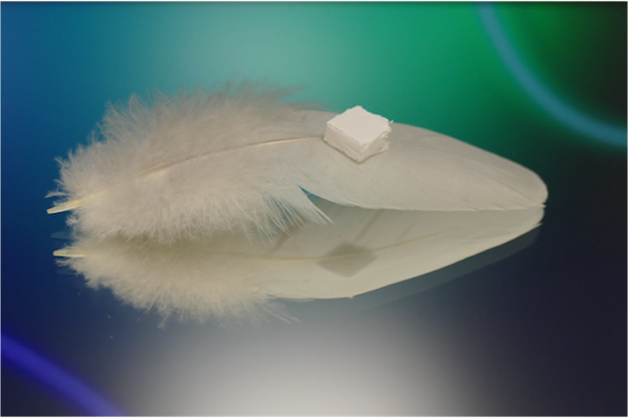
WP4.2 targets, EMP and Debris shielding
Task 4.2
M. Cernaianu (NP)
And many others
D4.3 – Detailed analysis of users' target needs to implement mitigation strategies of EMP protection and debris shielding
D4.4 – Target production strategy and report on implementation
2 key deliverables
+User Workshops
Many target types developed and produced for experiments
Exhaustive list of
  target type requirements for each facility
  manufacturing/procurement methods
  Decision trees for user proposals
Tape targets developments STFC
Liquid leaf/jet target developments STFC
Foam/aerogel developments in TUD
Cryo targets
HZDR

Slide 12
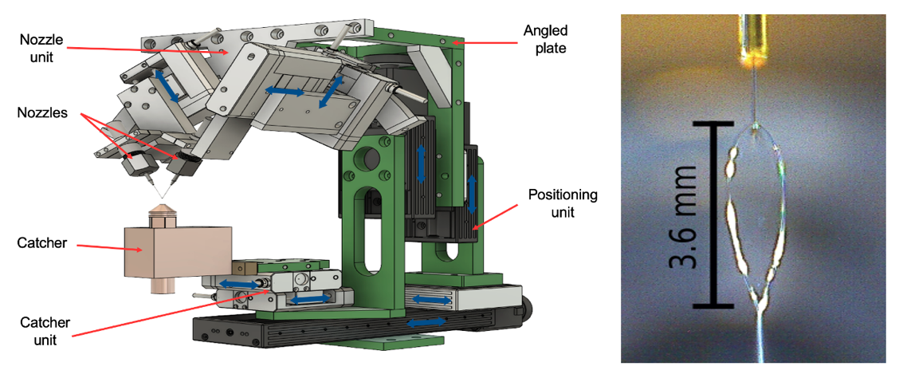
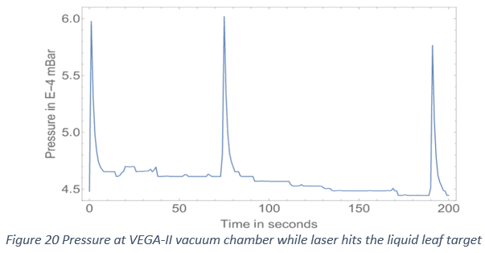
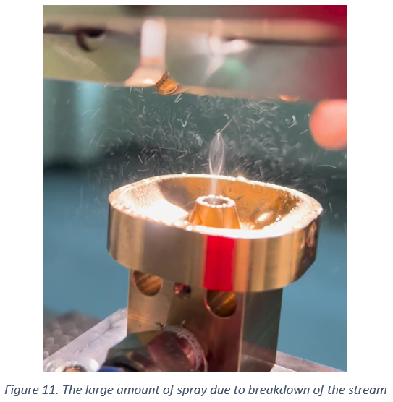
WP4.2 liquid target developments
Task 4.2
M. Cernaianu (NP), G.Schaumann, D. Hofmann, T. Bauer, J. Kurzschenkel, F. Christ (TUD)
C.Spindloe, W.Robins, S.Astbury, R. Sarasola, H. Edwards, K, Federov, D. Crestani (STFC)
Rep rate enabling
High vacuum possibilities (challenging)
Shock propagation risks
Biological samples possible
Liquid leaf/jet target developments STFC / ALPS
Liquid leaf system in TUD

Slide 13
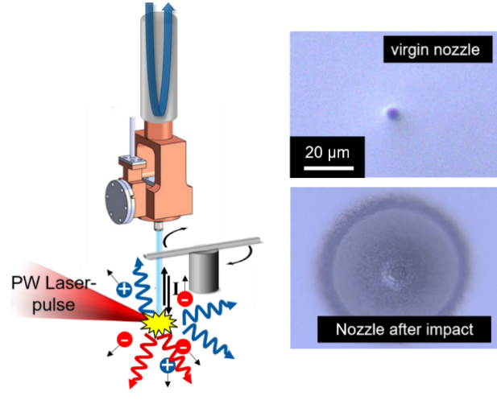
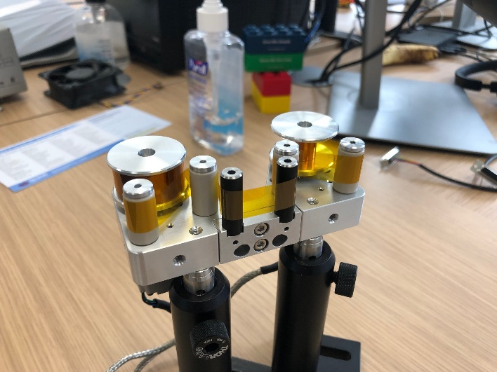
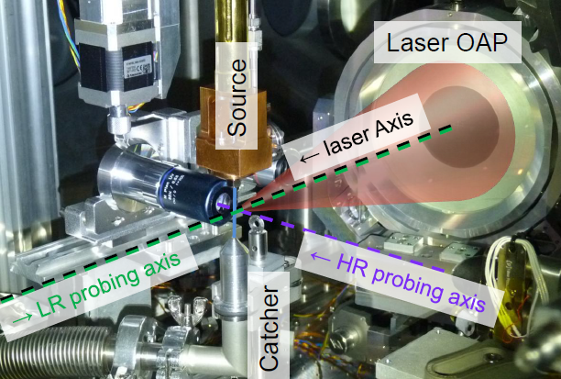
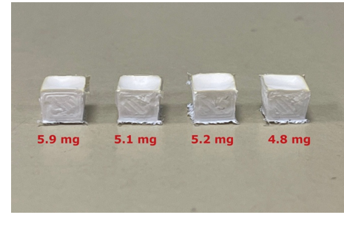
WP4.2 tape, cryogenic and foam targets
Task 4.2
M. Cernaianu (NP), U. Schramm, S. Assenbaum, C. Bernert, M. Rehwald (HZDR)
Tapes enable high repetition rates
Complex targets possible but development needed (collaborations)
Foam/aerogel developments in TUD
[1]C. C. Gheorghiu et al. Materials 15, 6134 (2022);
[2] C. C. Gheorghiu et al. High Power Laser Science and Engineering 10, e3 (2021);
[3] C. C. Gheorghiu et al. Frontiers in Physics 9, 727498 (2021);
[4] Balázs Nagyillés et al. Phys. Rev. Applied 20, 054048 – 2023
[5] C. B. Curry, et al. Journal of Visualized Experiments 9, 159 (2020)
[6] M. Rehwald, et al. Nature Communications 14, 4009 (2023)
[7] C. Bernert, et al. Physical Review Applied 19, 014070 (2023)
[8] C. Bernert, et al. Scientific Reports 12, 7287 (2022)
[9] M. Rehwald, et al. Journal of Physics Conf. Ser. 2420, 012034 (2023)

Slide 14
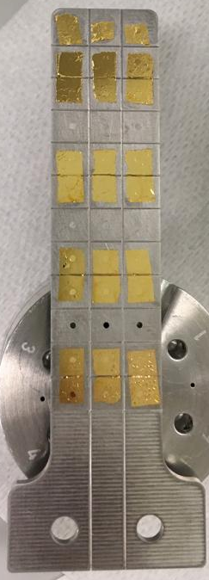
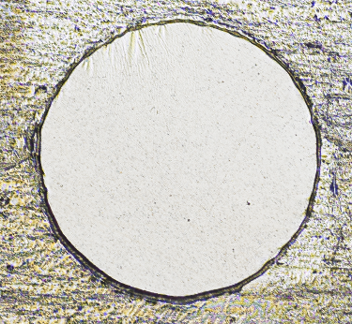
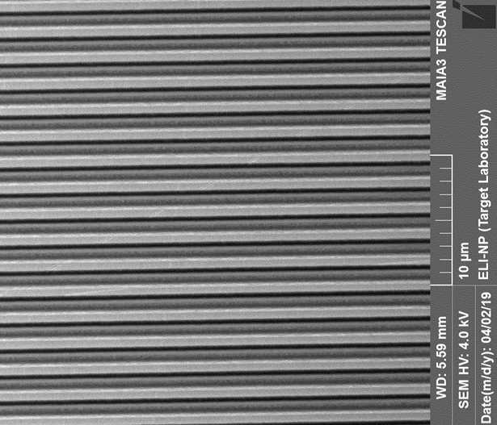
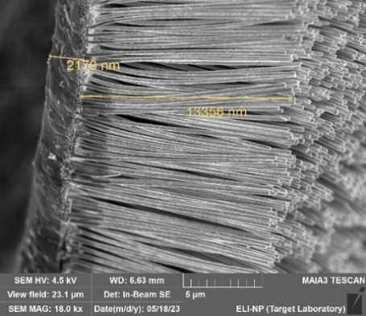
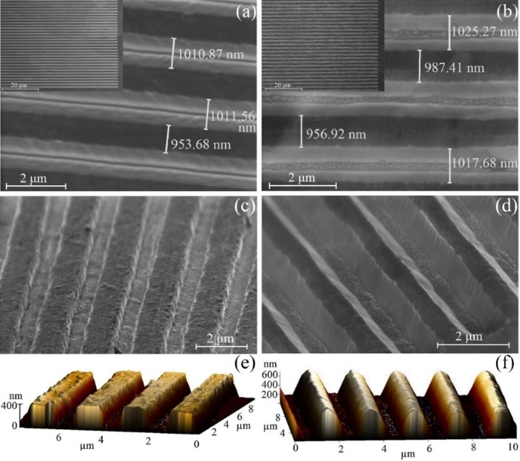
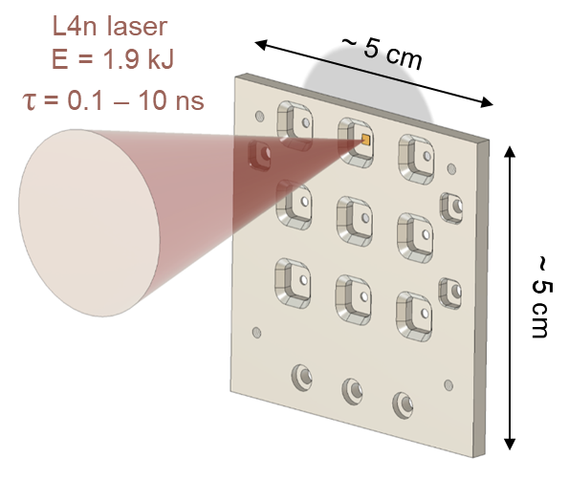
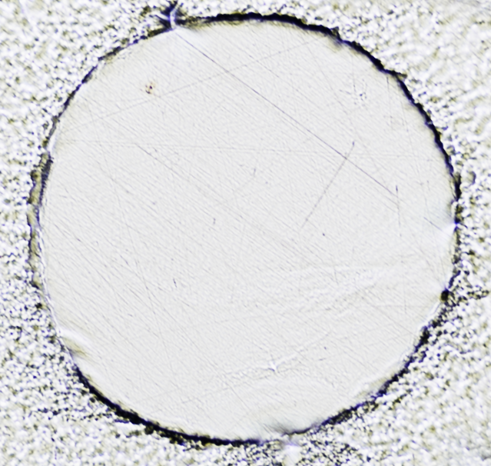
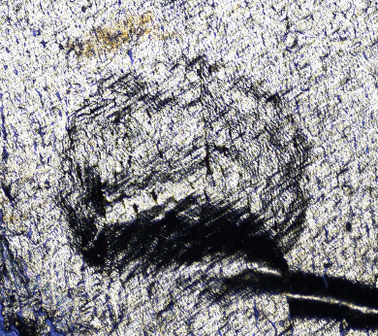
Selection of Targets produced at ELI-NP Target Lab
Task 4.2
Freestanding metallic films
Metallic nanowires/nanotubes
Periodic gratings on metallic foils
Multilayered targets
(ELI-Beamlines collab – for X-Ray generation)
Free-standing Al target
Au freestanding targets on a frame
SEM and AFM images of highly-periodic 1µm wide metallic gratings fabricated by Ar-ion milling and e-beam lithography
Two possible shapes: rectangular and sinusoidal like.
Free-standing Au target
- Au freestanding targets (thickness: 20 - 800 nm)
3D printed plastic frame with mounted multilayered targets
- Al freestanding targets (thickness:
8 - 800 nm)
SEM images of metallic(Cu, Ni) nanowires (top) and nano-tubes fabricated by electrochemistry
wrinkled

Slide 15
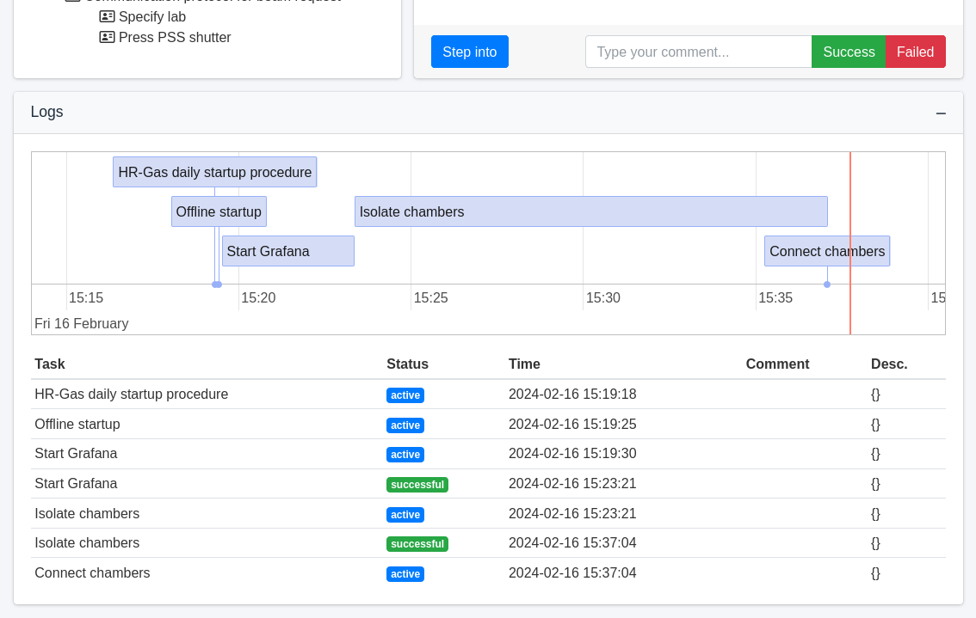
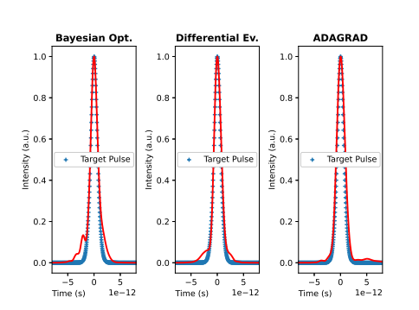
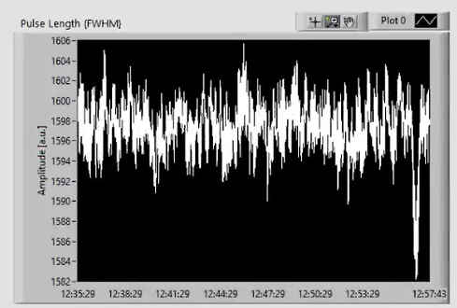

WP4.3 SW tools to optimize laser operations
Task 4.3
L. Schrettner (ALPS), D. Peceli, B. Plötzeneder (BL), M. Lonza (Elettra), et al.
ALPS timing/timestamping designed with help of Elettra
Control system config DB & device API
ELK feasibility study – data patterns and predictive capabilities for maintenance
Time Series correlations in Grafana
Machine learning / AI
  LIDT data processing improvement
  Optimization in closed loop of Dispersion management
Universal ELI sequencer

Slide 16





WP4.3 integration of complex systems
Task 4.3
L. Schrettner (ALPS), C. Ene, S. Moldoveanu (NP), facility controls teams
SCADA Integration of HPLS1 amp in NP
  Tango interfaces
  Panorama HMI interf.
Personal and Machine Safety integration
Intergation of nanoESCA system in ALPS
Data visible in Grafana after integration
noMachine remote access used

Slide 17



Task 4.4_A: MBES
Task 4.4
Z. Divéki (ALPS), P. Tzallas, M. Skantzakis (FORTH), et al.
FORTH
  Estimated operation parameters:
    Energy resolution: ΔE/E < 5%
    Mass resolution: Δm/m < 0.5%
    Compatible with vacuum: 10-9 mbar < P < 10-6 mbar
    Length: 2.2 m
    Collection solid angle: 2 π or π field free,
    4 π with applied electric field
  Tested in FORTH

Slide 18


Task 4.4_A: Polarimeter
Task 4.4
L. Poletto, M. Nisoli, M. Lucchini, M. Talarico (CNR), Z. Divéki, T. Csizmadia, M. Balázs (ALPS), et al.
CNR
  Developed by CNR team and commissioned
  Installed at ELI-ALPS user beamline
  Can measure different polarizations of secondary beams (EUV)
  Generation of circularly pol. XUV beams was demonstrated
Polarizer assembly
3 mirror assembly
In each plane
Polarimeter assembly

Slide 19





Task 4.4_A: Liquid jet
Task 4.4
Z. Diveki (ALPS), R. Chapman, E. Springate, J. Thompson (STFC), et al.
STFC
  Liquid jet setup delivered to ELI-ALPS
  Assembled together with eTOF
  ATI from liquid water and aqueous solutions tested

Slide 20


Compact proton beamline development at ELI_BL
Task 4.4
Marco Borghesi, S. Kar, P. Martin, O.Cavanagh, C. Fegan, A. McCay, C. Whiteside (QUB)
P. Cirrone, G. Petringa, A. Pappalardo (LNS-INFN), ELI-BL team
Implementation at ELIMAIA (ELIUPM 137 – Kar)
Aims: proton collimation
energy boost and selection
flux enhancement
progress towards high-rep operation
Divergence < 1º
Coil sync energy ~7 MeV
Highest proton energies at ELI BL
25X
Flux increase
Standard foil
coil
29 MeV
33 MeV
37 MeV
44 MeV

Slide 21





Towards rep-rated operation
Task 4.4
EM pulse picked up by a small Cu flag detached from tape drive
Evidence of focusing
To be optimized by improving EM pulse coupling
Target refresh by customized tape drive
Capable of 10 Hz operation
10 µm Cu tape
5 MeV
7 MeV
9 MeV

Slide 22






Injection into beamline
Task 4.4
VULCAN PW (RAL) –
coupling of coil to simple radiobiology beamline
Future plans: injection in ELIMED beamline
Flat foil dose @ 35 MeV
~ 1 Gy
First results from
FLAIM campaign
Coil injection could lead to
~ Gy dose in single shot
Ultra-high dose rate regime:
~10⁸ Gy/s
Foil/coil: dose @ 35 MeV
~ 70 Gy
1.5 Gy, 100 shots

Slide 23




Task 4.4_B: INFN PRAGUE detector
Task 4.4
G. Petringa, P. Cirrone, M. Guarrera, A. Amato, C. Verona, A. Kurmanova (INFN)
  SiC detector stack developed
  Custom electronics, each of 80 chips characterized (30 rejected)
  Reconstructs Bragg Peak with high accuracy
  Rep rate enabling

Slide 24
Beyond Impulse
Very important work done supporting laser operations and experimental programs
ELI teams clearly interested in follow-up collaborations
  LIDT studies across facilities
  Coating developments
  Data management, visualization
  AI / Machine Learning
  Target developments
  …
Testing according to ISO standards

Slide 25

THANK YOU
FOR your ATTENTION
Daniel Kramer
Thanks to all the partners and participants for their excellent work
IMPULSE is funded by the European Union’s
Horizon 2020 research and innovation programme
under grant agreement No. 871161

Slide 26
















