Slide 1

IMPULSE PROJECT
Efficient operations
CLOSING MEETING
András Makai
17 April 2024
IMPULSE is funded by the European Union’s
Horizon 2020 research and innovation programme
under grant agreement No. 871161

Slide 2
Tasks overview
Standard
Maintenance
Procedures
Efficient
Procurement
Planning
Stock
Management
And
Planning
Task 3.1:
Joint definition, review and optimisation
of operational modes
Task 3.2:
Standardisation of metrology procedures
for lasers and secondary sources
Task 3.3:
Optimised management of spare parts to
maximise cost efficiency, machine safety
and reliability
Task 3.4:
Capacity building through training of
operating teams
Risk
Management
Standard
Operating
Procedures
Operation of
Scientific Equipment
Parts
Management
Part
Selection for
Developments
Roles
And
Responsibilities
Efficient
Operations
Standardized
Measurement
Protocols
Diagnostic
Equipment
Operator
Trainings
Training
Formats
Training
Materials
Key
Parameter
Definitions
Training
Plans
Consistency
Across
Facilities
Notes:
Rather complicated workpackage
Operation of scientific equipment
with standard procedures, roles and responsibilities for the stakeholders of these procedures and risk management
Standardized measurement protocols
with collecting all the available diagnostic equipment across facilities, definition of the key parameters to be measured, and protocols to ensure the consistency across facilities, and these protocols can contribute to the training materials of our sources and end stations
Part Management
with a common database to address the management and planning of the stock kept at each facility, ensure the efficient procurement planning, provide a base for the systems to be developed later, and manage the risk connected to part failures and long lead time spares.
and Operator Trainings
to provide a framework of training plans, training materials with proven formats, to well defined and harmonised roles and responsibilities

Slide 3
Tasks overview
Standard
Maintenance
Procedures
Task 3.1:
Joint definition, review and optimisation
of operational modes
Risk
Management
Standard
Operating
Procedures
Operation of
Scientific Equipment
Roles
And
Responsibilities
Efficient
Operations

Slide 4

Task 3.1: Joint definition, review and optimi-sation of operational modes
Task objectives
Ensure routine, reliable and risk-controlled operations of the lasers and secondary sources
Consistency of the experimental conditions & the maximisation of beam availability & parameters
Establish & implement clear & detailed procedures for the operation of the various experimental systems
A clear description of the various roles and functions of the staff involved
The optimised operation modes & tested alignment & operational procedures, implemented at the ELI facilities
Participants:
ELI ALPS, ELI ERIC, ELI NP
Bálint Kiss
T3.1 leader
Standard
Maintenance
Procedures
Risk
Management
Standard
Operating
Procedures
Operation of
Scientific Equipment
Roles
And
Responsibilities
Efficient
Operations

Slide 5
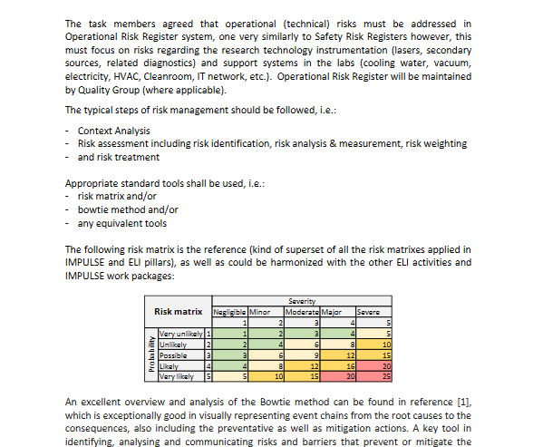
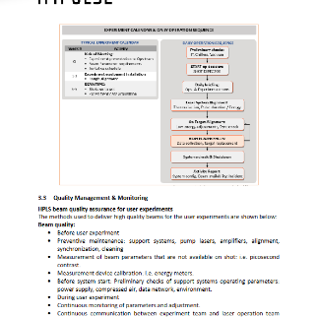
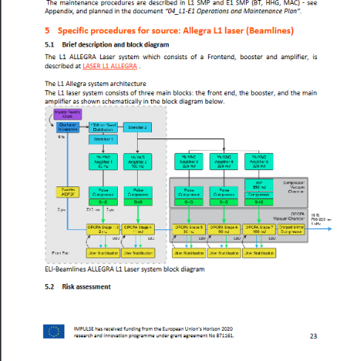
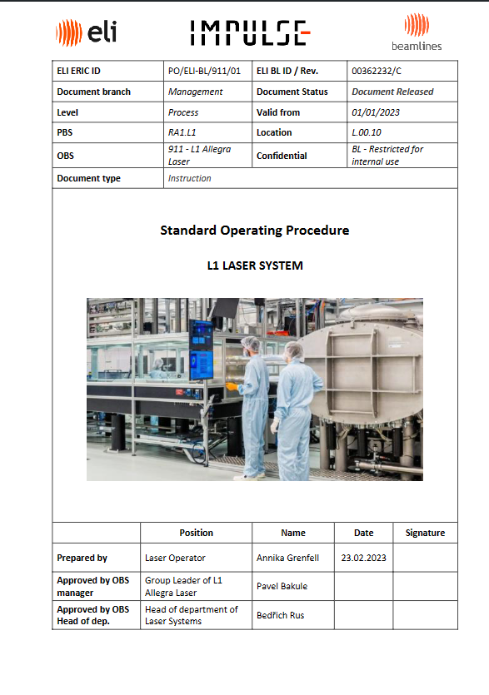
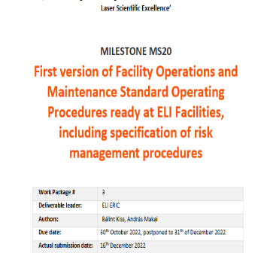
Task 3.1 in the spotlight
The Terms of Reference (100+ definitions)
General procedures collected (operation, risk management, roles and responsibilities, etc..)
Source specific SOP documents written in a harmonized structure for complete experimental chains
Expert review of the SOPs with participation of 5 external experts (laser facility operations, maintenance): no major issues identified

Slide 6
Tasks overview
Standard
Maintenance
Procedures
Task 3.1:
Joint definition, review and optimisation
of operational modes
Risk
Management
Standard
Operating
Procedures
Operation of
Scientific Equipment
Roles
And
Responsibilities
Efficient
Operations

Slide 7
Tasks overview
Standard
Maintenance
Procedures
Efficient
Procurement
Planning
Stock
Management
And
Planning
Task 3.1:
Joint definition, review and optimisation
of operational modes
Task 3.2:
Standardisation of metrology procedures
for lasers and secondary sources
Task 3.3:
Optimised management of spare parts to
maximise cost efficiency, machine safety
and reliability
Task 3.4:
Capacity building through training of
operating teams
Risk
Management
Standard
Operating
Procedures
Operation of
Scientific Equipment
Parts
Management
Part
Selection for
Developments
Roles
And
Responsibilities
Efficient
Operations
Standardized
Measurement
Protocols
Diagnostic
Equipment
Operator
Trainings
Training
Formats
Training
Materials
Key
Parameter
Definitions
Training
Plans
Consistency
Across
Facilities

Slide 8
Tasks overview
Task 3.2:
Standardisation of metrology procedures
for lasers and secondary sources
Efficient
Operations
Standardized
Measurement
Protocols
Diagnostic
Equipment
Training
Materials
Key
Parameter
Definitions
Consistency
Across
Facilities

Slide 9

Task 3.2: Standardisation of metrology proce-dures for lasers and secondary sources
9. Standardise metrology procedures for lasers and secondary sources
Task objectives
Collect measurement devices and instruments available in ELI facilities
Definition of key parameters of lasers and secondary sources
Metrology solutions (diagnostics instruments and protocols) standardized across ELI facilities
Collaboration on cross calibration of measurement devices, to ensure consistency across facilities in services provided to users
Participants:
ELI NP, ELI ALPS, ELI ERIC, CLPU, HZDR, LMU
Daniel Ursescu
T3.2 leader
Efficient
Operations
Standardized
Measurement
Protocols
Diagnostic
Equipment
Training
Materials
Key
Parameter
Definitions
Consistency
Across
Facilities

Slide 10
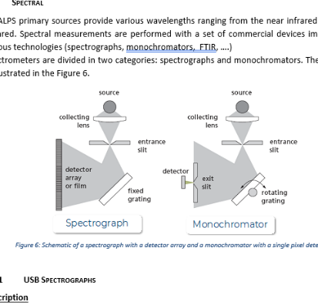
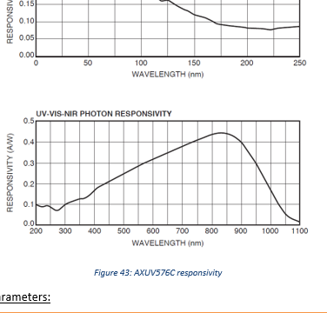
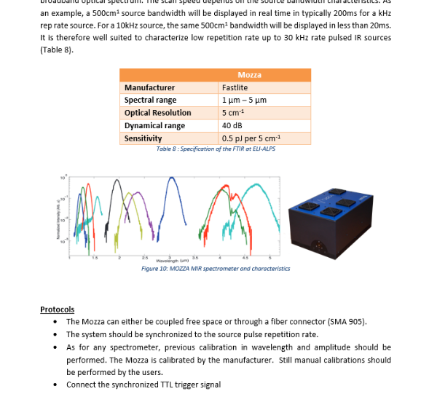
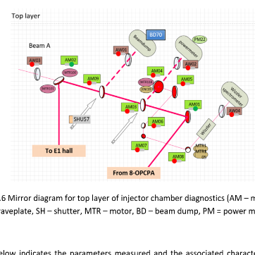
Task 3.2 in the spotlight
Collection of available source specific diagnostic equipment and key parameters in 7 fields (laser, proton & ion, electron, X-ray, Gamma, XUV and THz)
Measurement procedures for each of the devices/parameters
Meeting with key stakeholders from community (academia, industry) to share results of our standardization efforts: STAMPLASS conference– great success > 100 participants

Slide 11
Tasks overview
Task 3.2:
Standardisation of metrology procedures
for lasers and secondary sources
Efficient
Operations
Standardized
Measurement
Protocols
Diagnostic
Equipment
Training
Materials
Key
Parameter
Definitions
Consistency
Across
Facilities

Slide 12
Tasks overview
Standard
Maintenance
Procedures
Efficient
Procurement
Planning
Stock
Management
And
Planning
Task 3.1:
Joint definition, review and optimisation
of operational modes
Task 3.2:
Standardisation of metrology procedures
for lasers and secondary sources
Task 3.3:
Optimised management of spare parts to
maximise cost efficiency, machine safety
and reliability
Task 3.4:
Capacity building through training of
operating teams
Risk
Management
Standard
Operating
Procedures
Operation of
Scientific Equipment
Parts
Management
Part
Selection for
Developments
Roles
And
Responsibilities
Efficient
Operations
Standardized
Measurement
Protocols
Diagnostic
Equipment
Operator
Trainings
Training
Formats
Training
Materials
Key
Parameter
Definitions
Training
Plans
Consistency
Across
Facilities

Slide 13
Tasks overview
Efficient
Procurement
Planning
Stock
Management
And
Planning
Task 3.3:
Optimised management of spare parts to
maximise cost efficiency, machine safety
and reliability
Risk
Management
Parts
Management
Part
Selection for
Developments
Efficient
Operations

Slide 14
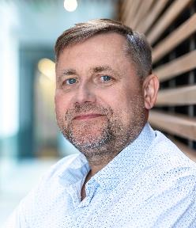
Task 3.3: Optimised management of spare parts to maximise cost efficiency, machine safety and reliability
Efficient
Procurement
Planning
Stock
Management
And
Planning
Risk
Management
Task objectives
Roll-out of the spare parts database at the ELI Facilities
Effectively collect, manage and integrate all available information on spare parts
Spare parts database specified and implemented jointly
ELI-wide standardization of equipment, components, parts
Joint procurement planning & stock mgmt., ELI-wide optimised procurement of spare parts
Spare parts consumption and replacement rate: statistics, analysis, impacts
Participants:
ELI ERIC, ELI ALPS, ELI NP, STFC
Parts
Management
Part
Selection for
Developments
Efficient
Operations
10. Optimise spare parts management for cost efficiency, machine safety and reliability
Pavel Bakule
T3.3 leader

Slide 15
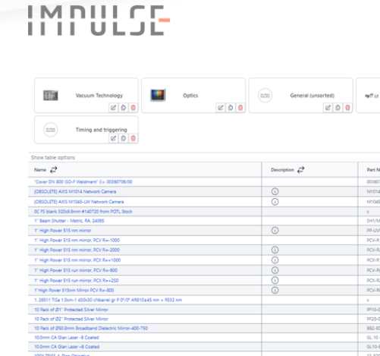
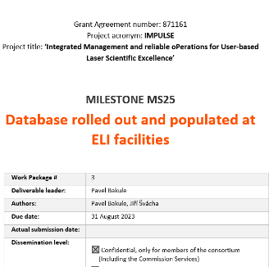
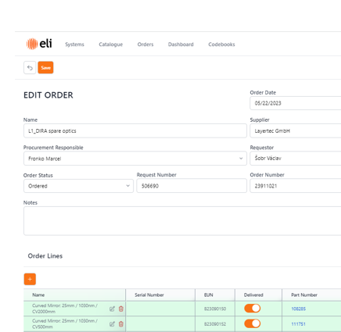

Task 3.3 in the spotlight
Full specifications for functionality of the ELI Operations and Maintenance Database (ELI-PANDA)
ELI-PANDA is rolled-out in each ELI facility, and used in the everyday operation
Discussions & synergy with WP2, about ERP interfacing, involvment of procurement & logistics groups
Long-term vision of database development – beyond IMPULSE project

Slide 16
Tasks overview
Efficient
Procurement
Planning
Stock
Management
And
Planning
Task 3.3:
Optimised management of spare parts to
maximise cost efficiency, machine safety
and reliability
Risk
Management
Parts
Management
Part
Selection for
Developments
Efficient
Operations

Slide 17
Tasks overview
Standard
Maintenance
Procedures
Efficient
Procurement
Planning
Stock
Management
And
Planning
Task 3.1:
Joint definition, review and optimisation
of operational modes
Task 3.2:
Standardisation of metrology procedures
for lasers and secondary sources
Task 3.3:
Optimised management of spare parts to
maximise cost efficiency, machine safety
and reliability
Task 3.4:
Capacity building through training of
operating teams
Risk
Management
Standard
Operating
Procedures
Operation of
Scientific Equipment
Parts
Management
Part
Selection for
Developments
Roles
And
Responsibilities
Efficient
Operations
Standardized
Measurement
Protocols
Diagnostic
Equipment
Operator
Trainings
Training
Formats
Training
Materials
Key
Parameter
Definitions
Training
Plans
Consistency
Across
Facilities

Slide 18
Tasks overview
Task 3.4:
Capacity building through training of
operating teams
Roles
And
Responsibilities
Efficient
Operations
Operator
Trainings
Training
Formats
Training
Materials
Training
Plans

Slide 19

Task 3.4: Capacity building through training of operating teams
11. Build capacity through training of operating teams
Task objectives
Efficiency by providing training aiming at ensuring operators can provide best support to users
Cost-efficient operations through the definition of a harmonised staffing model (and related competence profiles) facilitating inter-operability of staff at ELI.
Participants:
ELI ALPS, ELI NP, ELI ERIC, STFC
Zita Váradi
T3.4 leader
Roles
And
Responsibilities
Efficient
Operations
Operator
Trainings
Training
Formats
Training
Materials
Training
Plans

Slide 20
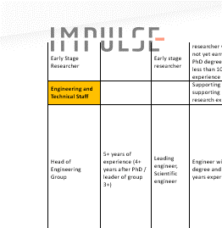
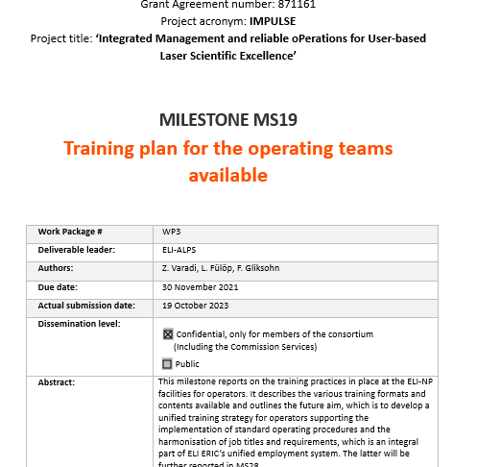
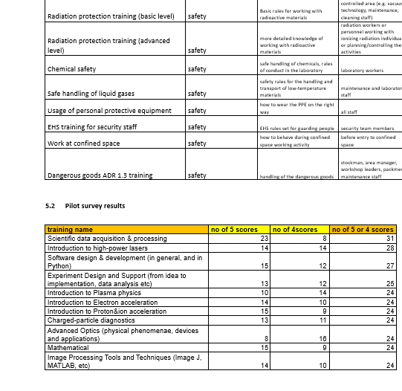

Task 3.4 in the spotlight
Training interest survey completed, results were analysed
Preparations for a harmonised staffing model was done by collecting positions from all 3 pillars and linking them to proposed ELI ERIC positions
Focus on laser operators to address the most important trainings related to user services
workshop organized to discuss long-term traning strategy & outline ELI ERIC’s unified employment system

Slide 21
Tasks overview
Task 3.4:
Capacity building through training of
operating teams
Roles
And
Responsibilities
Efficient
Operations
Operator
Trainings
Training
Formats
Training
Materials
Training
Plans
Notes:
What is your topic about?
What was it supposed to deliver through which tasks?
Who was involved?
How did you contribute to the achievement of project objectives relevant for your WP?
This will give the idea of work, main actors and contribution to the project objectives

Slide 22
Tasks overview
Standard
Maintenance
Procedures
Efficient
Procurement
Planning
Stock
Management
And
Planning
Task 3.1:
Joint definition, review and optimisation
of operational modes
Task 3.2:
Standardisation of metrology procedures
for lasers and secondary sources
Task 3.3:
Optimised management of spare parts to
maximise cost efficiency, machine safety
and reliability
Task 3.4:
Capacity building through training of
operating teams
Risk
Management
Standard
Operating
Procedures
Operation of
Scientific Equipment
Parts
Management
Part
Selection for
Developments
Roles
And
Responsibilities
Efficient
Operations
Standardized
Measurement
Protocols
Diagnostic
Equipment
Operator
Trainings
Training
Formats
Training
Materials
Key
Parameter
Definitions
Training
Plans
Consistency
Across
Facilities
Notes:
What is your topic about?
What was it supposed to deliver through which tasks?
Who was involved?
How did you contribute to the achievement of project objectives relevant for your WP?
This will give the idea of work, main actors and contribution to the project objectives

Slide 23
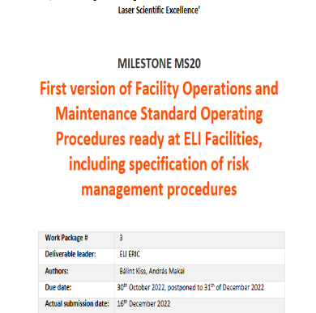

Harmonised structure of procedures
Standard operating procedures and standard maintenance procedures
  Levels of harmonisation:
    Beamline chain level: primary source, secondary source and end station
    Facility level: different beamlines
    ELI ERIC level: across the facilities
Ensures all necessary topics are addressed, no gaps, no overlaps
1000+ pages of general procedures processed
755 pages of SOP and SMP procedures written

Slide 24
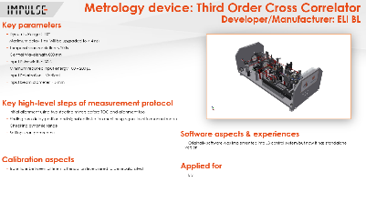
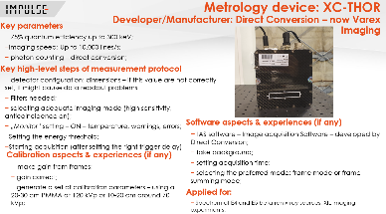
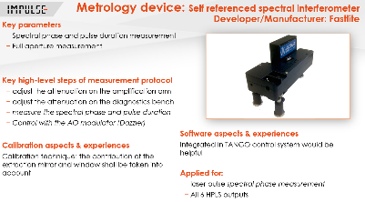
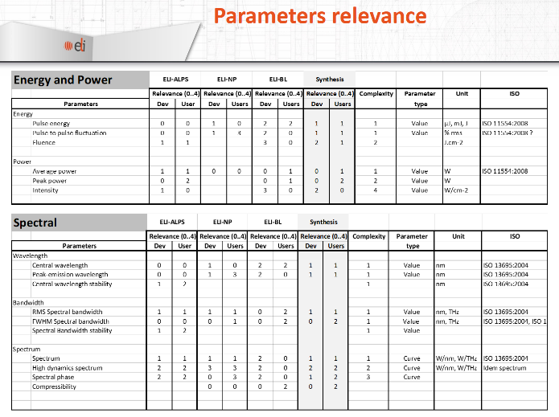
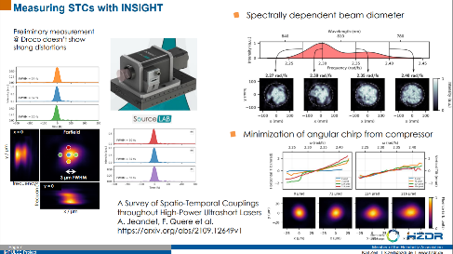
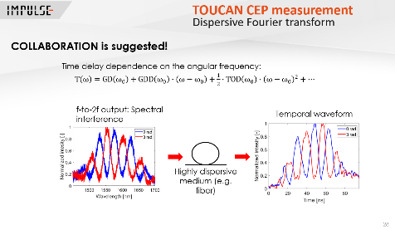
Harmonised metrology
66 diagnostic devices listed and reviewed
Comparable results, crosscalibrated measurement methods
~ 30 primary and secondary sources
~150 measured parameters addressed
Beyond IMPULSE:
  ISO compliance, certification
  ISO standards on measurement methods

Slide 25
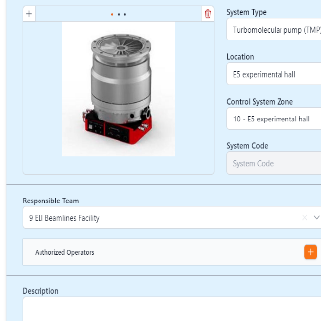
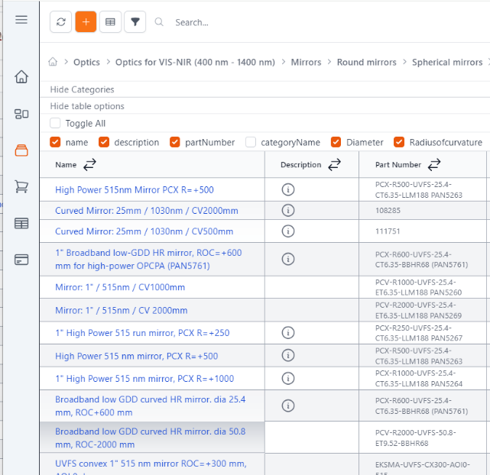
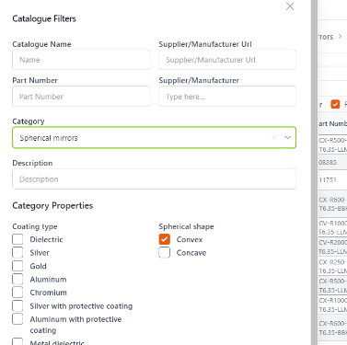
ELI Operations and Maintenance Database (ELI-PANDA)
Design and programming by ELI colleagues (in-house know-how)
Containes systems, subsystems, key components, connected procurements, availability
Efficient procurement planning
Risk management
Reports, risk analysis
~ 3000 parts in catalogue
Synergy with WP2
Beyond IMPULSE:
  Connection with ERP

Slide 26
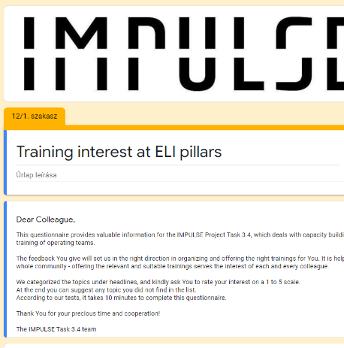
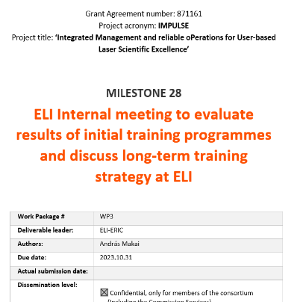
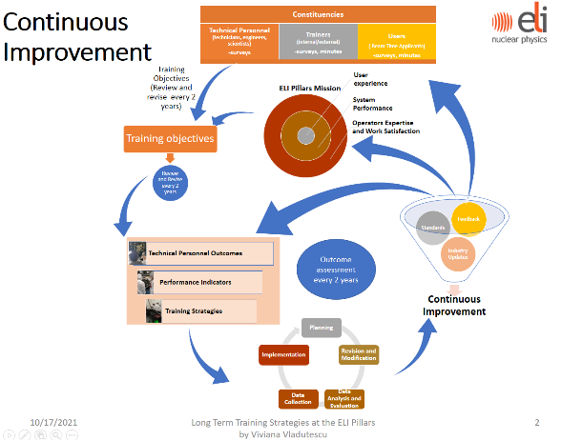
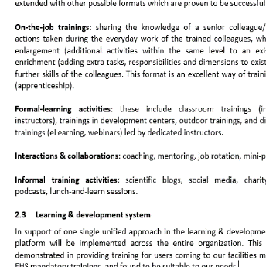
Operator trainings
Moodle as a standard platform (WP5 synergy)
Training plans and strategy available
Levels of trainings:
  Trainings required by local laws & EHS - priority
  General facility-specific on-boarding
  Field-specific trainings according to job requirements
  Cross-facility trainings
Feedback, monitoring and evaluation

Slide 27

THANK YOU
FOR your ATTENTION
András Makai
IMPULSE is funded by the European Union’s
Horizon 2020 research and innovation programme
under grant agreement No. 871161

Slide 28
















