Slide 1

IMPULSE PROJECT
INTEGRATION
CLOSING MEETING
Gábor Németh
17 April 2024
IMPULSE is funded by the European Union’s
Horizon 2020 research and innovation programme
under grant agreement No. 871161

Slide 2

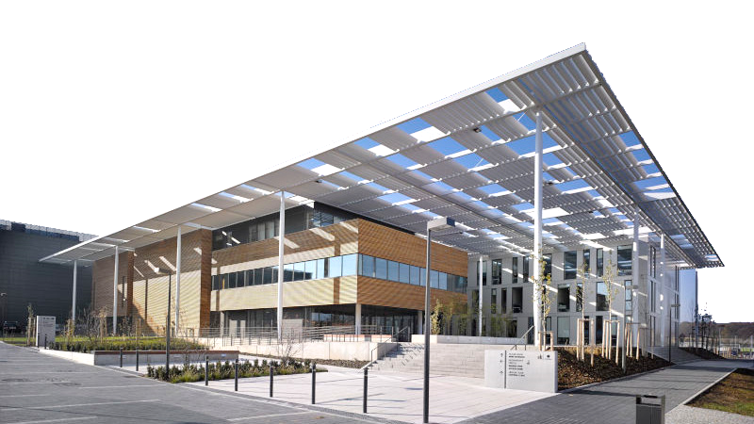
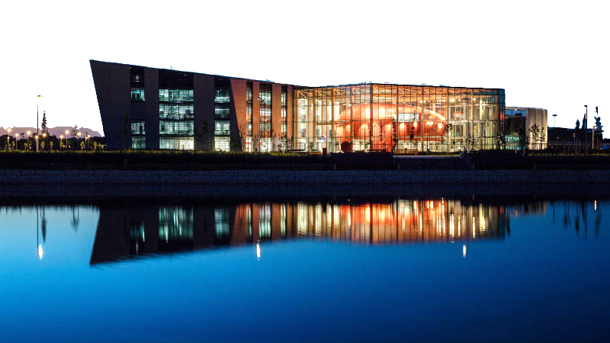
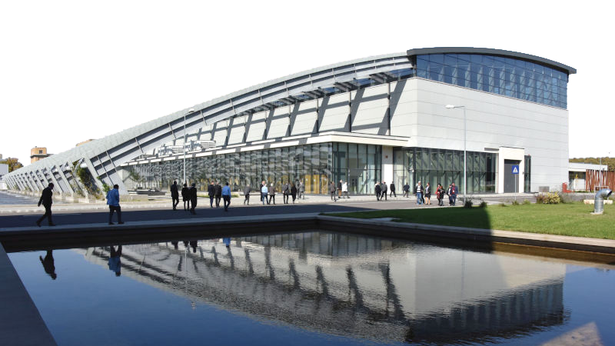



INTEGRATION
OBJECTIVES
SINGLE INTEGRATED ORGANIZATION
WHITEBOOK
ELI ERIC STATUTES, ANNEXES
SHARED
MANAGEMENT SYSTEM
INFORMATION SYSTEMS
INTEGRATION MODEL
APPENDIX 1 - The ELI ERIC Management Operations Model
Addressed in WP2

Slide 3
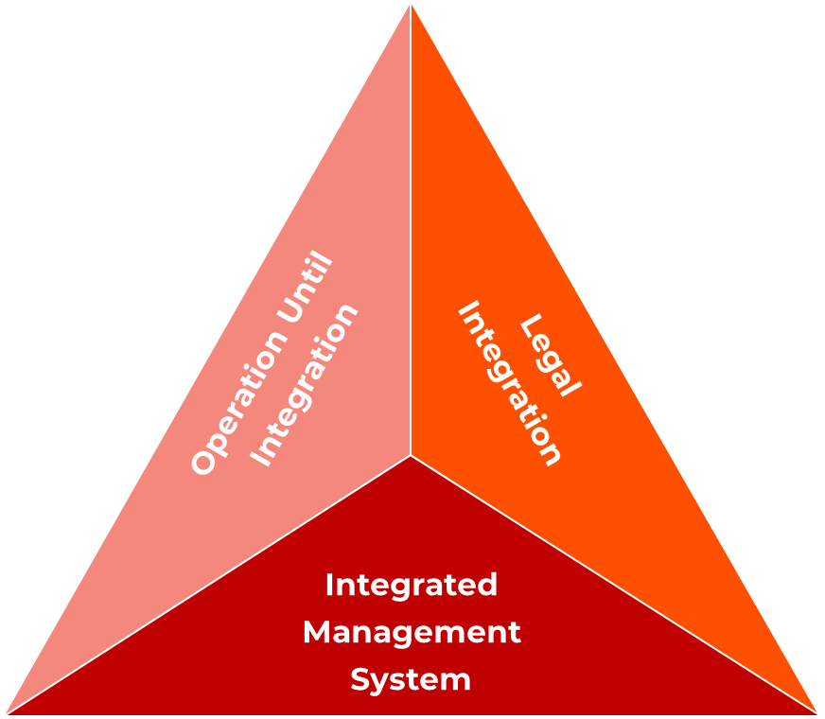
CONSIDERATIONS

Slide 4


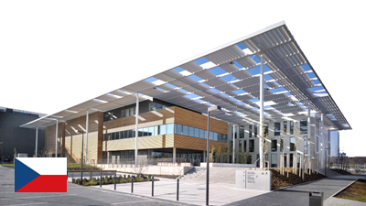
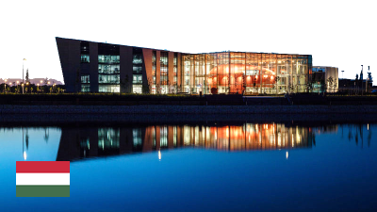
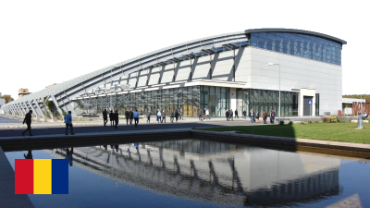




CONSIDERATIONS
PROJECT START
LEGAL INTEGRATION
CONSTRUCTION / INITIAL OPERATIONS
SUSTAINABLE OPERATIONS
SAME MODEL FOR ALL 3 FACILITIES but follows a different timeline considering their integration readiness (implementation of certain elements is dependent on the actual legal transition).
?
TIMELINE
2020
2021
2022
2023
2024
2025
Partners involved:

Slide 5
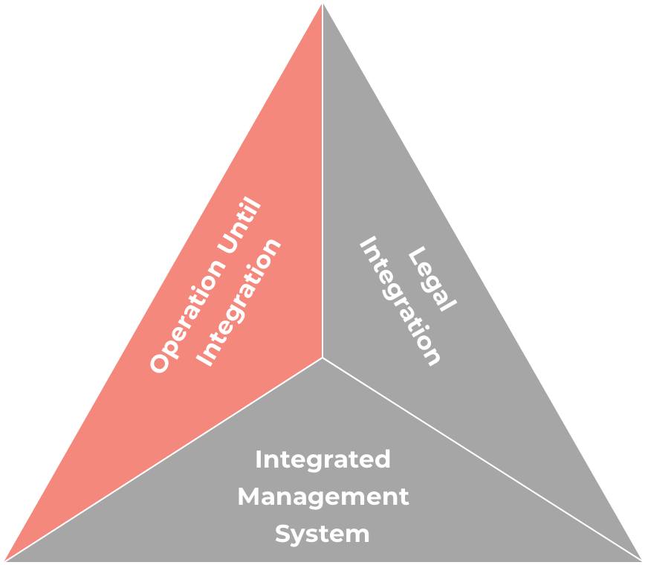
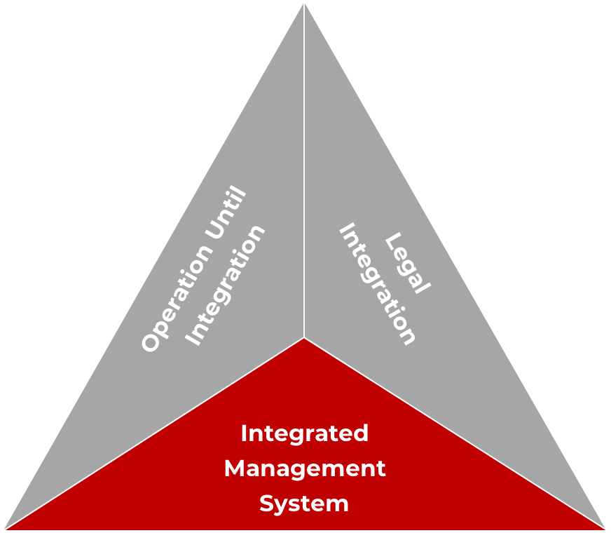
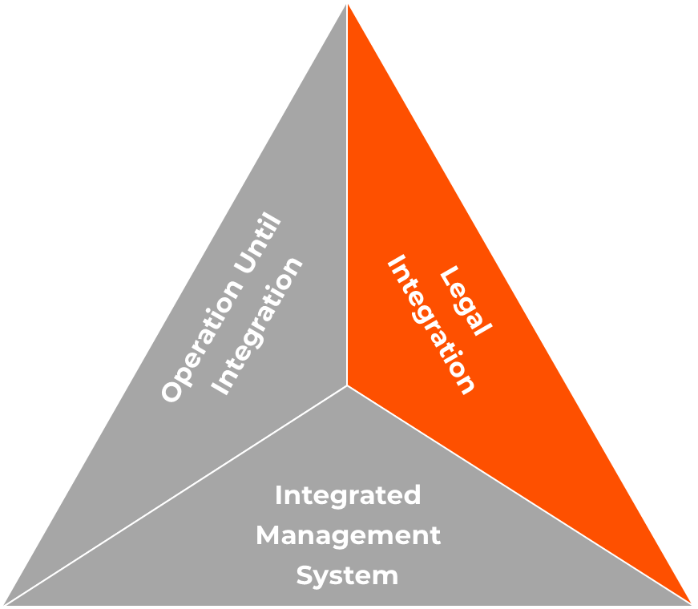
WP2 OBJECTIVES
PROJECT START
LEGAL INTEGRATION
PROJECT START
PROJECT START
LEGAL INTEGRATION
LEGAL INTEGRATION
CONSTRUCTION / INITIAL OPERATIONS
SUSTAINABLE OPERATIONS
CONSTRUCTION / INITIAL OPERATIONS
SUSTAINABLE OPERATIONS
CONSTRUCTION / INITIAL OPERATIONS
Management system implementation
Management system implementation
Ensure that the governance and management of the transition period leading to integration is well regulated and controlled through the definition of access agreements with the organisations hosting the ELI Facilities;
Ensure that the governance and management of the transition period leading to integration is well regulated and controlled through the definition of access agreements with the organisations hosting the ELI Facilities;
Ensure that the governance and management of the transition period leading to integration is well regulated and controlled through the definition of access agreements with the organisations hosting the ELI Facilities;
Design and implement management unity within ELI through the gradual roll-out of an integrated management system based on established international standards together with supporting IT systems;
Design and implement management unity within ELI through the gradual roll-out of an integrated management system based on established international standards together with supporting IT systems;
Define and plan the legal transition from agreements-based access to integrated operations.

Slide 6
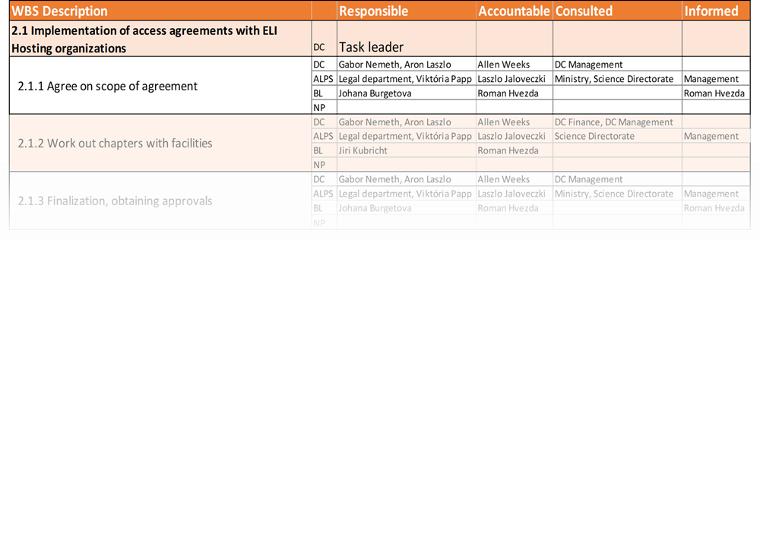
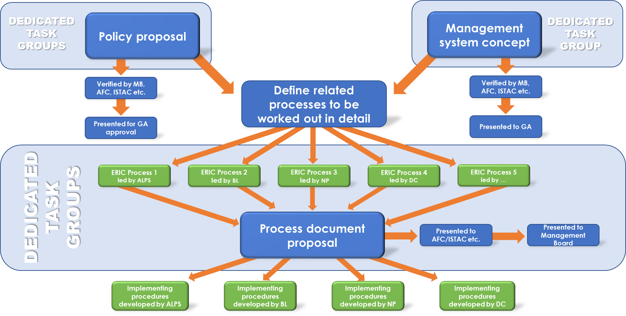
APPROACH TO RESULT DELIVERY
RACI for each sub-Task
Establish core working group (for coordination, engage decision makers, permanent)
Workplan and schedule
Working methodology
Dedicated working group for each subtask (temporary)
Example: working methodology reflecting relation to WP2 Tasks
Numerous working groups engaging experts representing every facet of the Facilities
E.g: 15 policies, 7 ERP modules

Slide 7
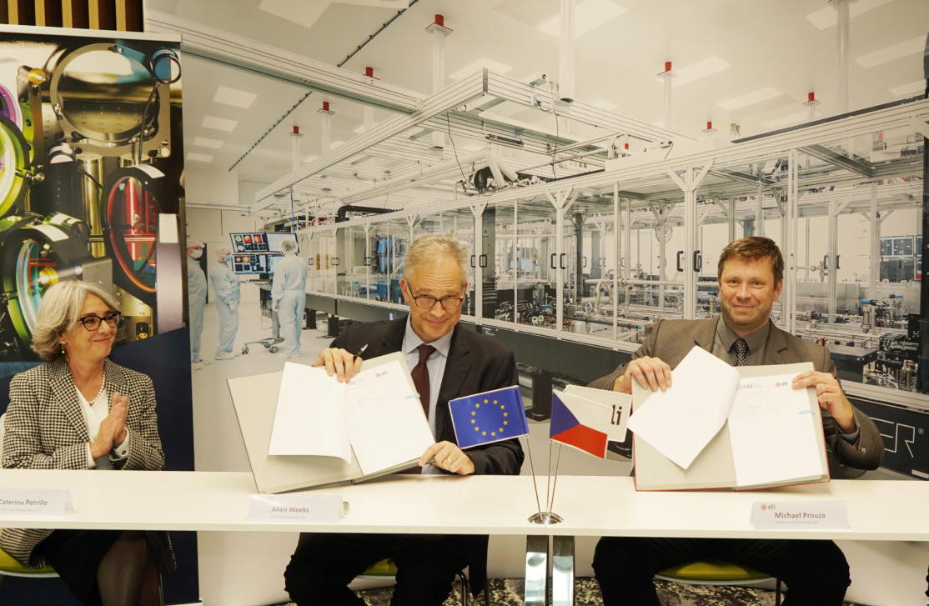
ACHIEVEMENTS_ACCESS AGREEMENTS
TASK
Implementation of agreements between ELI ERIC and ELI Facility hosting organizations
A common template for the operating agreement covering the initial operations period enabling ELI ERIC and the Host Institutions to organise access of users selected by using common standards.
define the conditions under which the ELI Facilities are made available
should be consistent but need to be tailored to the distinctive characteristics of each ELI Facility (reflect the specific timing of their commissioning, their readiness for users and the integration level relative to ELI ERIC)
OUTCOME
Main Agreement | Annex 1: Technical Annex(es) | Annex 2
Terms and conditions under which the Facilities are made available; Forms a legal basis for the agreement | Specific information for each ELI Facility, including definition of the exact technical scope, cost, and schedule/ milestones for systems to formally enter into ‘Operations’, technical acceptance and quality Technical and Organizational milestones | Quarterly reporting template Annual report template

Slide 8


ACHIEVEMENTS_ACCESS AGREEMENTS
TASK
Implementation of agreements between ELI ERIC and ELI Facility hosting organizations
A common template for the operating agreement covering the initial operations period enabling ELI ERIC and the Host Institutions to organise access of users selected by using common standards.
Period | M6 | M12 | M18 | M24
Scope | Main Body of Agreement | Technical Annex | OA with ALPS and Beamlines | Access Agr. with ELI NP
Methodology | Developed via: Dedicated working group | Developed via: Bilateral meetings | Presentation to governance | Bilateral discussions
Achievement | Main Body of agreement presented to GA | TA development completed | Signed with ELI Beamlines in Jan 2022 Signed with ELI ALPS in March 2022 | Signed in May 2022
OUTCOME

Slide 9
ACHIEVEMENTS_INT. MGMT SYSTEM
TASK
Definition and launch of the integrated management system for ELI
Preparation and implementation of the key policies foreseen in the ELI ERIC Statutes as well as their implementing processes and procedures.
QMS in compliance with the ISO standard
Policies need to be adopted by the GA (approval process)
OUTCOME
ELI ERIC has a clear mission and responsibility for the operation of the research infrastructure. That includes:
Define the overall strategy;
Provide and support effective access to the research infrastructure;
Define common standards and interoperability among the ELI Facilities;
Provide and support training and facilitate mobility of researchers, technical and administrative personnel;
Support technology transfer activities.
Common, integrated approach (QMS) to ensure consistency, quality conformity
The quality system shall be structured, reproducible, and applied consistently across all the ELI ERIC Facilities.

Slide 10

ACHIEVEMENTS_INT. MGMT SYSTEM
TASK
Definition and launch of the integrated management system for ELI
Preparation and implementation of the key policies foreseen in the ELI ERIC Statutes as well as their implementing processes and procedures.
QMS in compliance with the ISO standard
Policies need to be adopted by the GA (approval process)
OUTCOME
L1: POLICIES
STRATEGIC
AMBITION
The management system takes policies from ‘governance’ level and then translates those into operational processes and procedures.
Development in 2 phases.
L2: PROCESSES
TACTICAL
WHAT
L3: PROCEDURES
OPERATIVE
L4: RECORDS,
GUIDELINES, ETC.
HOW
SUB-OPERATIVE
DOCUMENTATION HIERARCHY
LOCAL SPECIFICS

Slide 11


ACHIEVEMENTS_INT. MGMT SYSTEM
TASK
Definition and launch of the integrated management system for ELI
Preparation and implementation of the key policies foreseen in the ELI ERIC Statutes as well as their implementing processes and procedures.
STATUTORY POLICIES
NON-STATUTORY POLICIES
Data Policy
Environment, Health and Safety policy
OUTCOME
Financial Policy
Data Protection and Privacy policy
Access Policy
Gender and Diversity Policy
IPR Policy
Communication Policy
Employment Policy
ICT policy
Dedicated working groups including management and topic experts from the three ELI Facilities and ELI ERIC.
Dissemination Policy
Procurement Policy
New Member Policy
Every individual policy is required to go through its own and unique verification process prior to presenting to the ELI ERIC General Assembly for final acceptance.
Innovation and Industry Policy
Scientific evaluation Policy
LEVEL 1 DOCUMENTATION

Slide 12
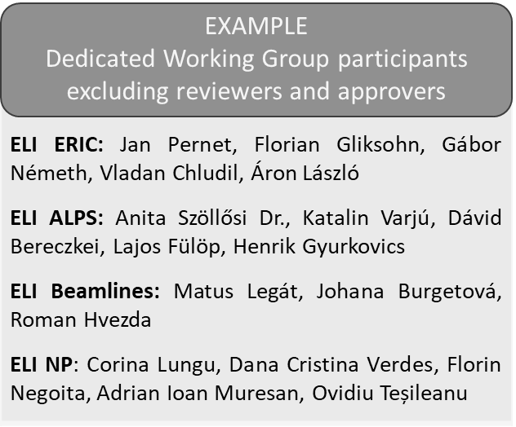
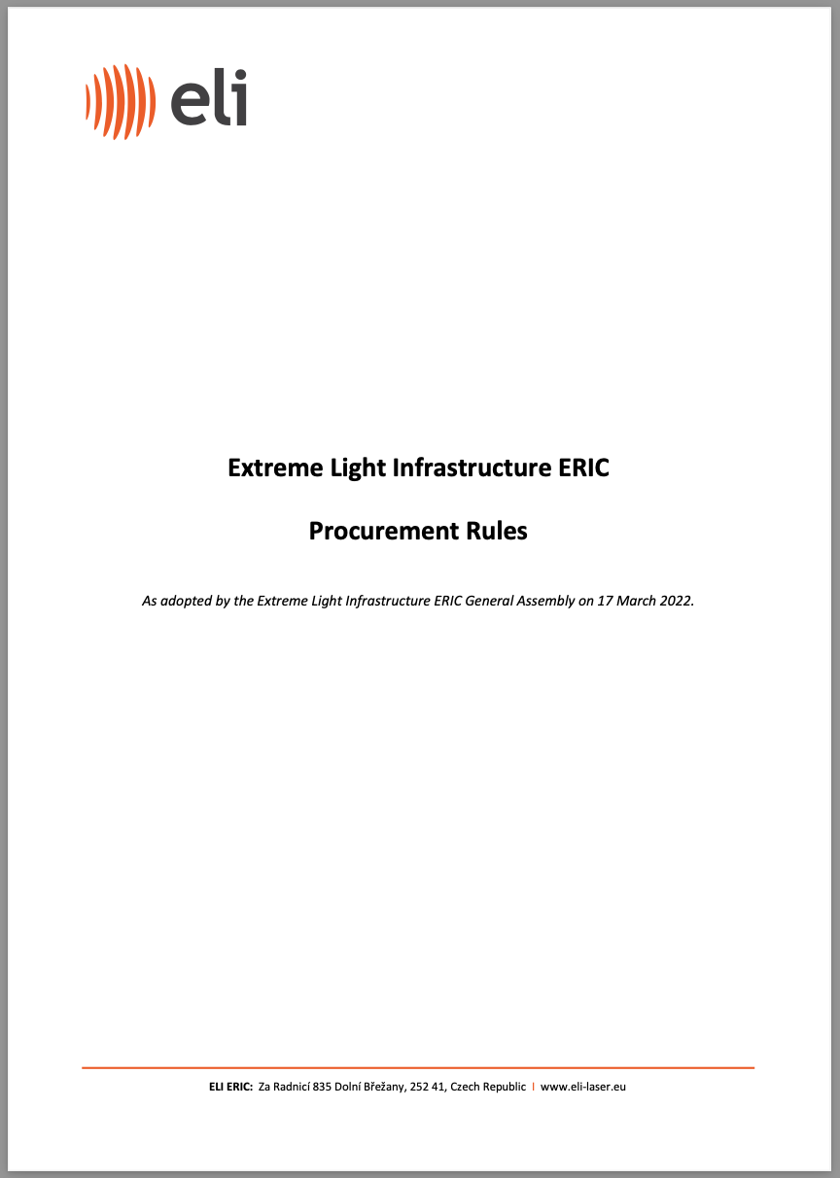

ACHIEVEMENTS_INT. MGMT SYSTEM
Other essential Level 1 documentation completed
PROCUREMENT RULES
  WP2 dedicated working group
  ERIC is recognised as an international organisation for the purpose of the directive on public procurement
  Replace EU/National public procurement directives
  Published on ELI ERIC website

Slide 13

ACHIEVEMENTS_IMS PROCESSES
  Phase 2 - Level 2 and Level 3 documentation, implementing regulations derived from the top-level management documentation.
  Most critical to ensure smooth operation, provide input to ERP development.
PRIORITY AREAS
APPROACH
dedicated task groups
mapping and developing the major processes expected to be common throughout the entire organization
facility specific procedures in compliance with common processes
  Procurement
  Finance
  Employment
  Communications
  Grant Management
  New Member engagement and External Relations
  User Access
  Management of governance activities

Slide 14

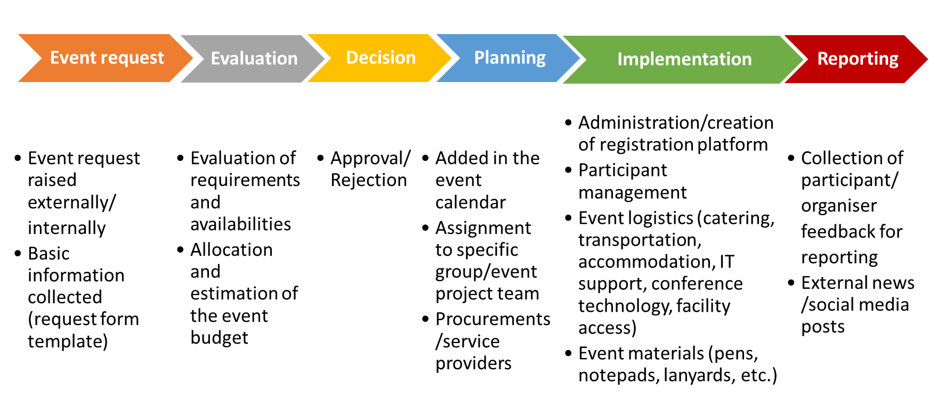
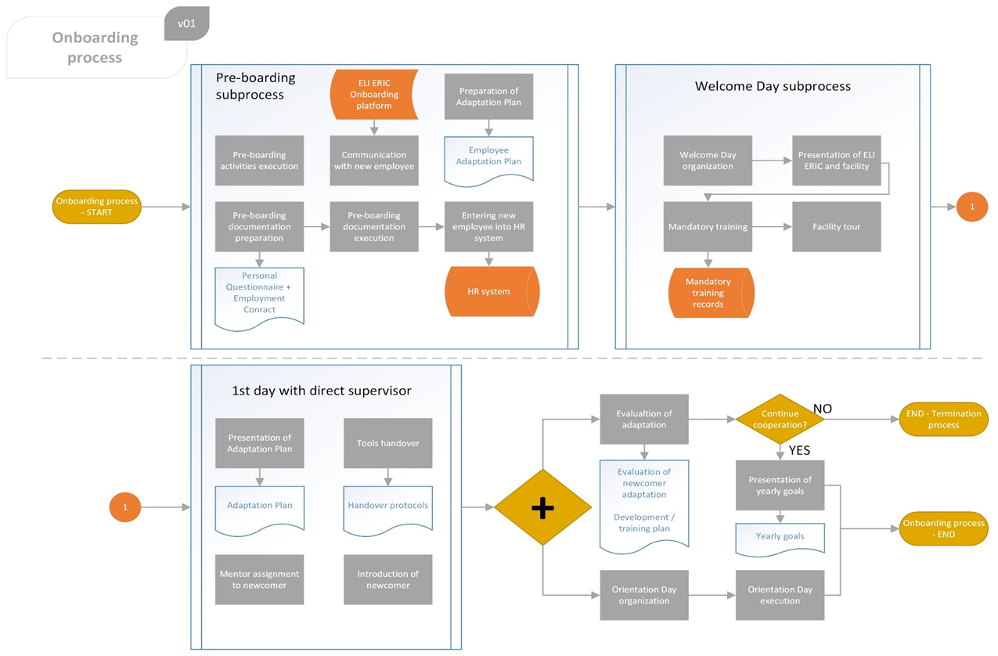
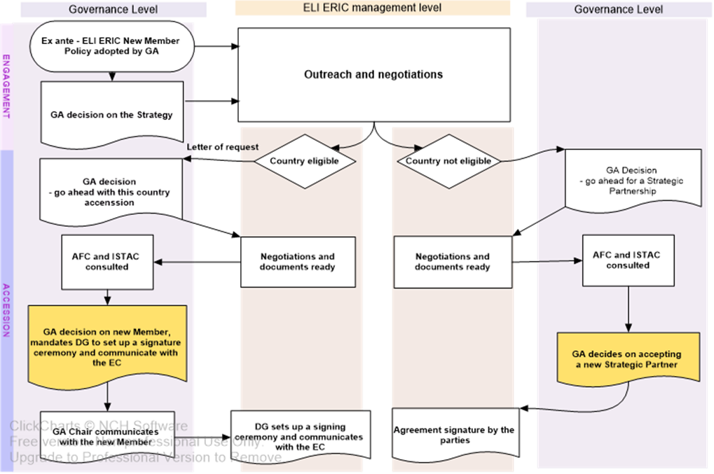
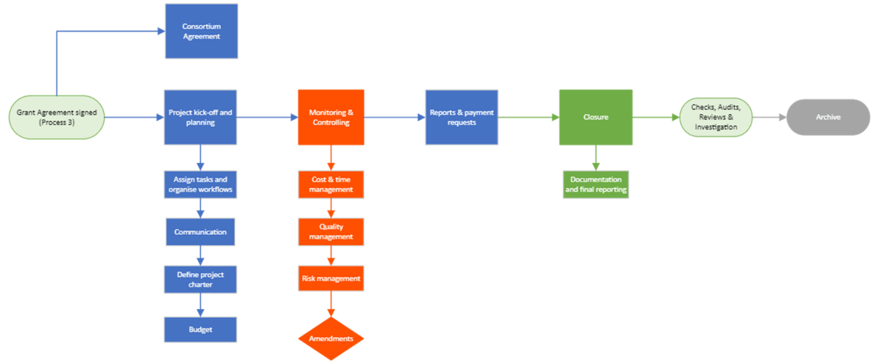
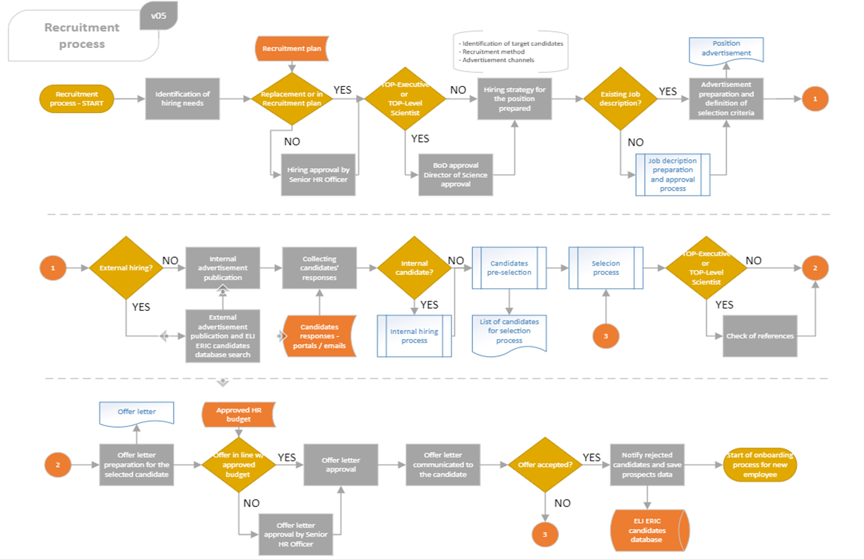
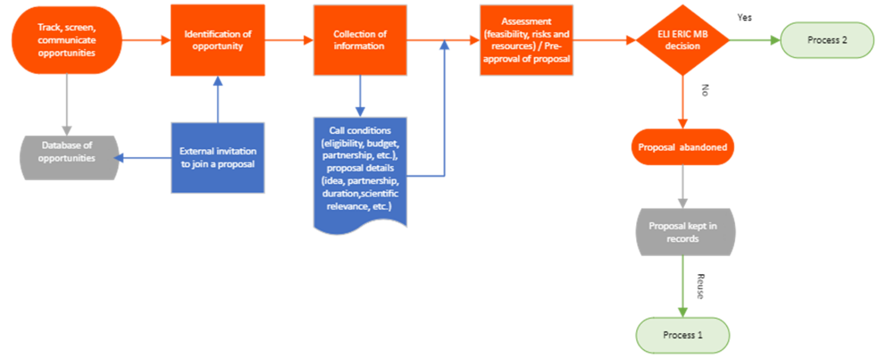
ACHIEVEMENTS_IMS PROCESSES
HIGHLIGHTS OF ACHIEVEMENTS
  Processes developed and/or approved exist for all areas (gradual approach), examples
  Employment – Recruitment and selection, On-boarding, Regular performance assessment, Learning and career development, Compensation and benefits, HR planning, etc.
  New Member Accession process
  Communications – Visits and Event organization
  Establishment of ELI ERIC Grants Office, processes developed
  Establishment of ELI ERIC User Office, processes developed in line with specifications, close collaboration with WP5

Slide 15

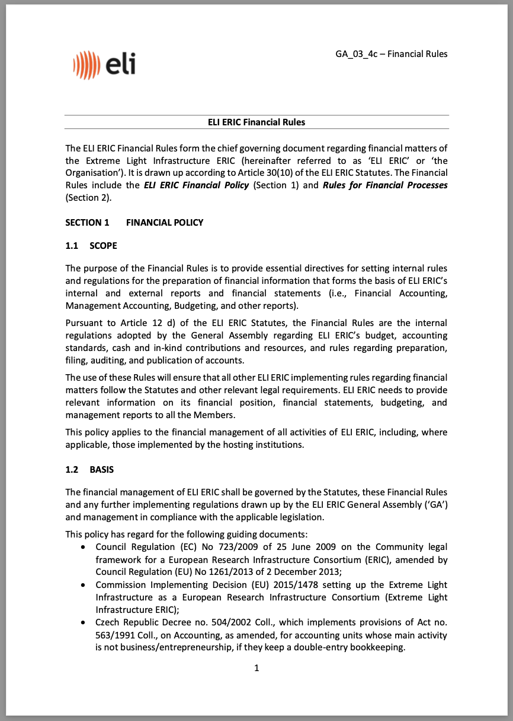
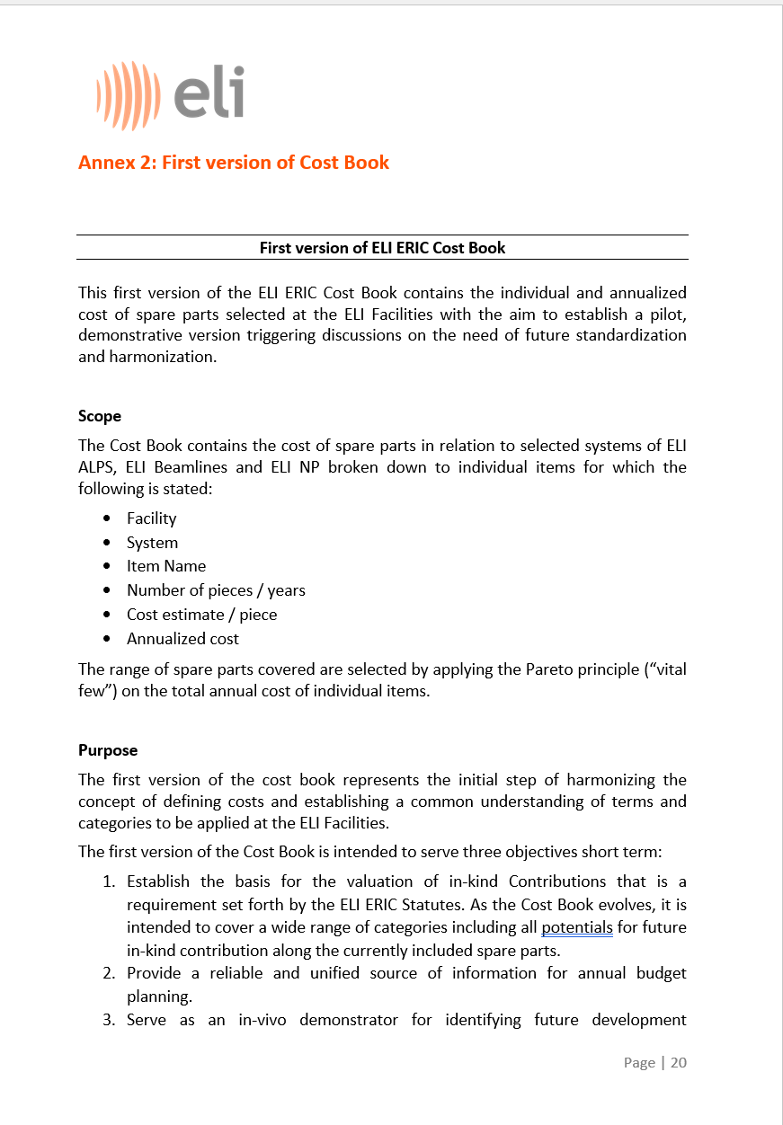

ACHIEVEMENTS_INT. MGMT SYSTEM
TASK
Definition of management practices and processes
Establishment of management rules, processes, cost standards and budgetary processes
FINANCIAL RULES
OUTCOME
  Internal regulations on budgeting, accounting standards, cash and in-kind contributions, rules regarding preparation, filing, auditing, and publication of accounts
  Processes defined in the Financial Rules are being constantly refined based on practical experience and upon the guidance and requirements provided by the AFC
  Dedicated Task Group established engaging financial experts from ELI DC and ELI Facilities
Focus on spare parts
Close collaboration between WP2 and WP3
The results were also utilized by WP3 when developing PANDA
COST BOOK
  The first version of the cost book represents the initial step of harmonizing the concept of defining costs and establishing a common understanding of terms and categories to be applied at the ELI Facilities.

Slide 16
ACHIEVEMENTS_ERP AND TRAINING
TASK
Align strategies for IT “back-office” systems and networks to provide a unified environment to ELI staff and external users Design an ERP system for ELI
Roadmap for ERP rollout (D2.5) Initial implementation and deployment of the core components of the ERP system
Common ERP to support the IMS.
Solution for information sharing and management of resources and risks within ELI
Gradual approach considering legal status and maturity
OUTCOME
ACTIVITIES IN 3 AREAS:
Ensure uninterrupted operations after ELI Beamlines integration
Business requirements of ERP modules
IT Systems and IT Infrastructure supporting the Integrated Management System
Deploy temporary solution until roll-out of the final ELI ERIC ERP implementation
Conclude contracts with providers of existing solutions covering procurement, finance, accounting, and HR
Migration of legacy data, update of workflows,
Conduct relevant trainings
Dedicated WG-s representing the future “users” of each module
Finance and accounting module
Procurement module
HR module
Travel and expenses module
Stocks and Inventory module
Project management module
Document Management System
Task group consisting of IT experts from ELI Facilities and ELI ERIC
Develop functional and structural requirements of the underlying IT infrastructure that supports all ELI sites providing the connection details for ERP integration
TEMPORARY
BASIS FOR ERP TENDER

Slide 17
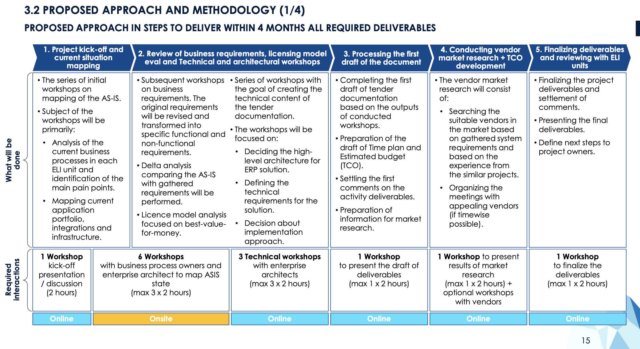
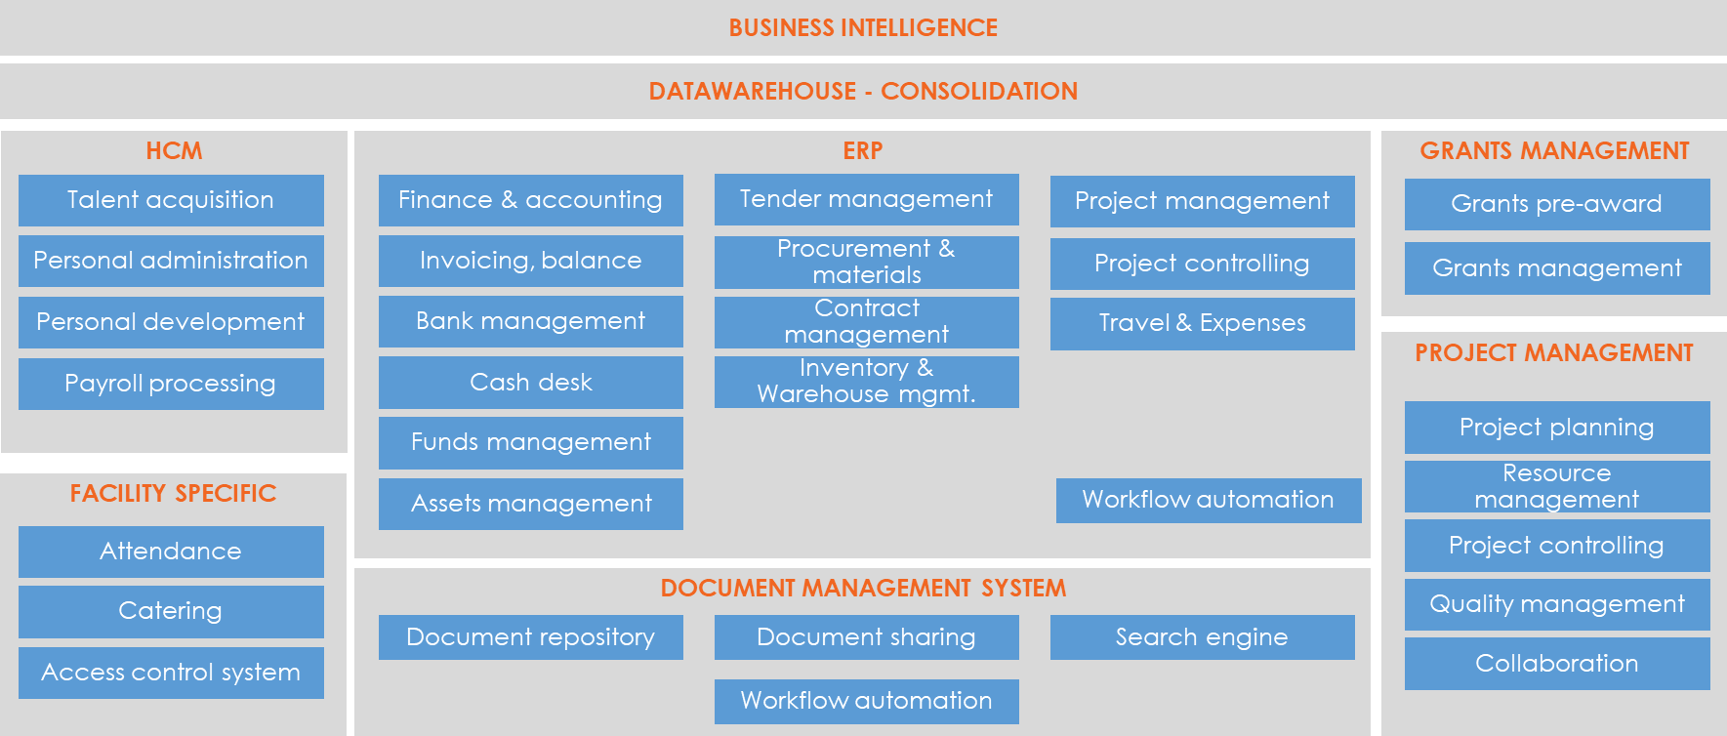
ACHIEVEMENTS_ERP AND TRAINING
TASK
Align strategies for IT “back-office” systems and networks to provide a unified environment to ELI staff and external users Design an ERP system for ELI
Roadmap for ERP rollout (D2.5) Initial implementation and deployment of the core components of the ERP system
End of 2023 – details of ELI ALPS’s legal transition finalized
Sufficient information to complete roadmap, final functional and technical requirements
OUTCOME
STEPS TO FINAL COMPLETION:
Update of Roadmap, tender documentation – April 2024
Publication of tender – May 2024
Gradual implementation – from 2025
ELI ERIC REFERENCE ARCHITECTURE
Common ERP modules
New common applications with interface to ERP modules
  DMS
  Project/Grant management

Slide 18
ACHIEVEMENTS_LEGAL TRANSITION
TASK
Define legal framework for transition from agreements-based access to integrated operations
Preparation and implementation of legal measures to transition the ELI Facilities to integrated operations
Handover of direct operational responsibility to ELI ERIC by ELI Beamlines in 2023 and by ELI ALPS in 2024
Different approach by Host States required the development and implementation of alternate solutions leading to the same results - a single integrated organization, with unified governance and single management.
OUTCOME
ELI Beamlines
ELI ALPS
Preparatory work to develop legal structure of integration involved various experts of ELI Beamlines, ELI ERIC, FZU and the Czech Member of ELI ERIC
ELI Beamlines became legally and organisationally integrated with ELI ERIC according to a set of agreements reached between ELI ERIC and FZU at the General Assembly in October 2022
Assets were transferred in Nov 2022, staff employed by ELI ERIC from Jan 2023.
Legal analysis on the conditions and options to integrate the ELI ALPS Facility into ELI ERIC
Common effort by ELI ERIC, ELI ALPS, ELI ALPS’s owners, HU Member, external experts
September - GA decision to acquire controlling share in ELI-HU Nonprofit Ltd.
2023 December GA – Final approval
1 Jan 2024, ELI ERIC became the majority owner of ELI-HU

Slide 19

WP2_INTERESTING FACTS, INDIRECT BENEFITS
62
72
40
INTERNAL
PARTICIPANTS
CORE WORKING- GROUP MEETINGS
DEDICATED SUB-TASK GROUPS
Indirect benefits
Bring teams/colleagues together
Help establish common ELI culture, common objectives, benefits of synergy
Break-down barriers, pre-conceptions
Identify differences in methodologies and terminology, support establishment of common vocabulary

Slide 20
INTEGRATION_OUTLOOK
The foundation of the ELI ERIC management system was laid down in the first part of the project (Management system concept, development of policies)
In the second part, major and critical functions have been implemented, and with the conclusion of the legal transition of both ELI ALPS and ELI Beamlines, all technical obstacles are cleared to complete the missing elements and focus on all outstanding detail.
This common effort is going to continue in a manner similar to how it was initiated under WP2. IMPULSE has had an invaluable role in developing and implementing the required methodologies and practices, establishing the basis of all future collaboration between the Facilities as one integrated organization.
Engagement of ELI NP in future activities (even before their legal transition) is expected to continue smoothly, building on the excellent working relationship established during the IMPULSE project. The aim is to extend the integrated management system as soon as the transition details and conditions are finalized on political level.
Deployment of the final ERP solution falls in line with the finalization of all outstanding Level 2 and Level 3 documentation, allowing the full completion of the Integrated Management System and its supporting IT systems in 2025.

Slide 21


THANK YOU
FOR your ATTENTION
Gábor Németh
ELI ERIC
IMPULSE is funded by the European Union’s
Horizon 2020 research and innovation programme
under grant agreement No. 871161

Slide 22
















