Slide 1




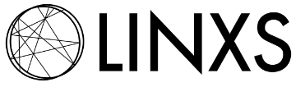








Analyzing transient data with KiMoPack “the basics”
Jens Uhlig
et al. Chemical Physics Lund University

Slide 2
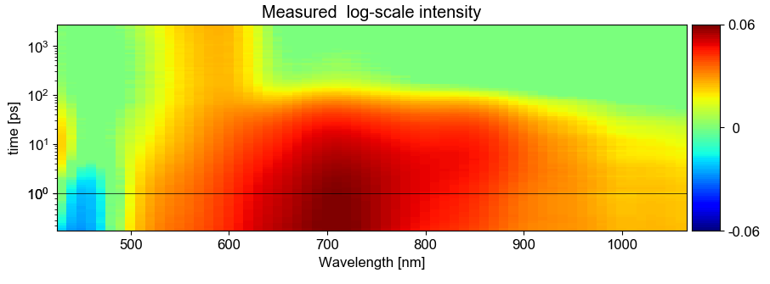
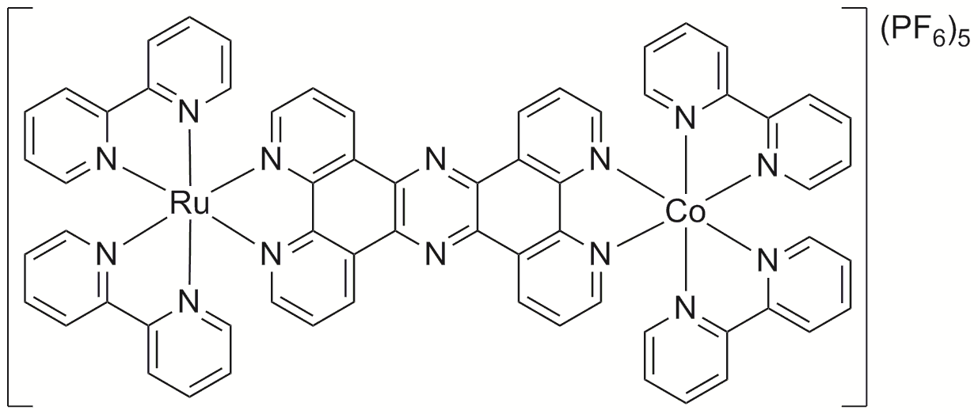
Ru=Co studies with optical pump-probe
< 50 fs
240 fs
e_{g}
*
t_{2g}
240 fs
¹Co^{III}
²Co^{II}*
Notes:
And see that electron arrives after 240 fs
Spin flip after 1.9 ps
Expansion < 3 ps
(latest measurements in similar molecule = coherent oscillation!)
Relaxation 12 ps

Slide 3
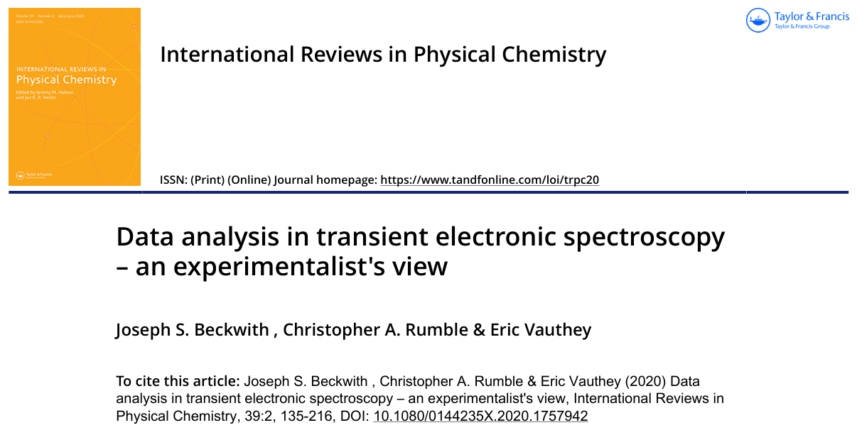
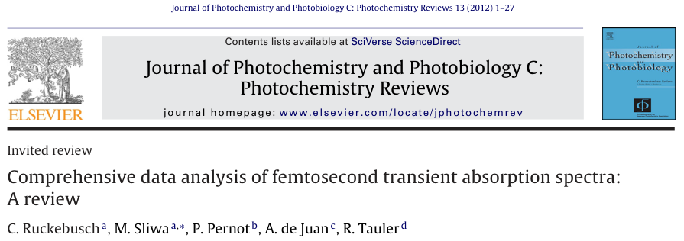

Slide 4
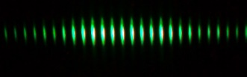
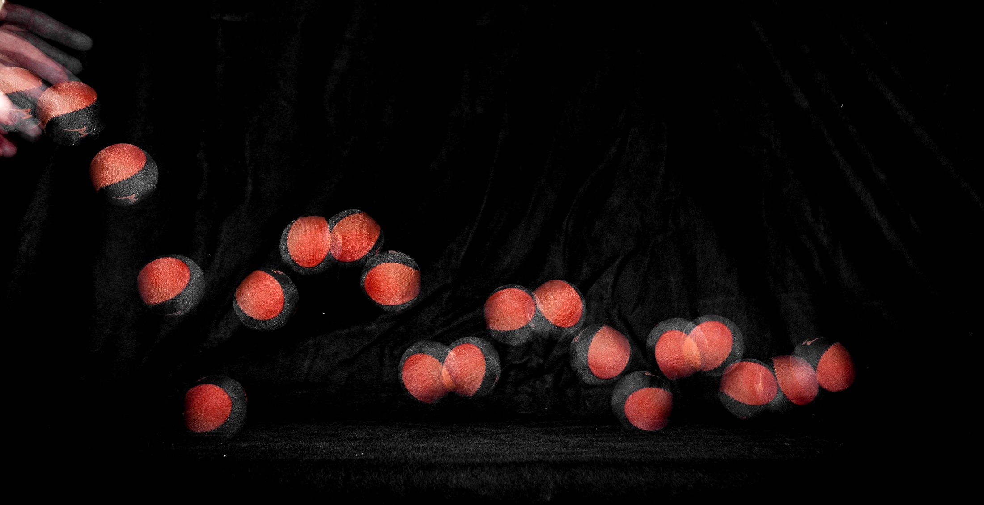
Stroboscopic effect
Notes:
Interaction in different energy regions,
Nyquist theorem
x-rays (or similar wavelength

Slide 5
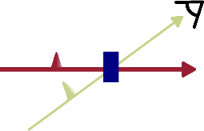
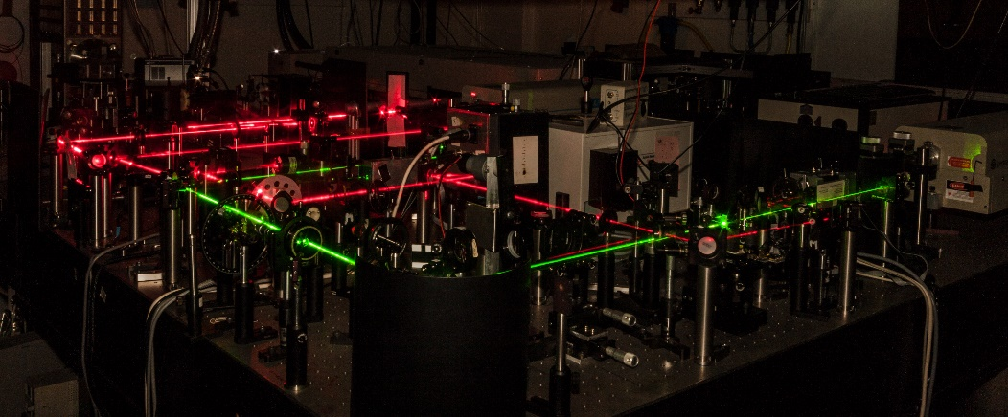
Two laser beams
Notes:
Among the many techniques
Overlap in time and space jitter?

Slide 6
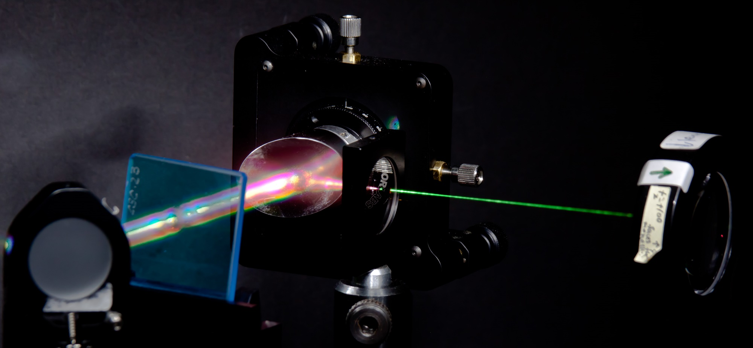
White light generation
Notes:
Among the many techniques
Overlap in time and space jitter?

Slide 7
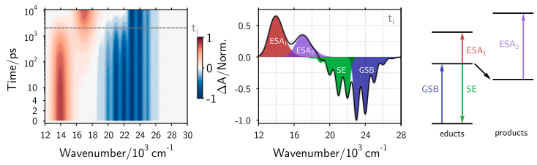
For now we focus on TA
International Reviews in Physical Chemistry, 39:2, 135-216, DOI: 10.1080/0144235X.2020.1757942
Notes:
And see that electron arrives after 240 fs
Spin flip after 1.9 ps
Expansion < 3 ps
(latest measurements in similar molecule = coherent oscillation!)
Relaxation 12 ps

Slide 8
So What?/Why? from which follows How?
Fingerprinting directly? → Requires (temporally or spectrally) isolated region
Linear Combination analysis ( 0.4 *f(t) * A + 0.3 * f`(t) * B + ...) →
Very difficult because there are so many influences that can alter the spectra in the optical regime.
Notes:
And see that electron arrives after 240 fs
Spin flip after 1.9 ps
Expansion < 3 ps
(latest measurements in similar molecule = coherent oscillation!)
Relaxation 12 ps

Slide 9
So What?/Why? from which follows How?
Reaction schemes → defined by species and process times, need modelling
Yields/optimization → Need (careful) normalization and quantitative analysis
Parameter and values → need Modelling with error evaluation
Fingerprinting directly? → Requires (temporally or spectrally) isolated region
Linear Combination analysis ( 0.4 *f(t) * A + 0.3 * f`(t) * B + ...) →
Very difficult because there are so many influences that can alter the spectra in the optical regime.
Model independent extraction (SVD/PCA) Challenging, because the “math” does not know Chemistry/Physics, just linear combinations
Notes:
And see that electron arrives after 240 fs
Spin flip after 1.9 ps
Expansion < 3 ps
(latest measurements in similar molecule = coherent oscillation!)
Relaxation 12 ps

Slide 10
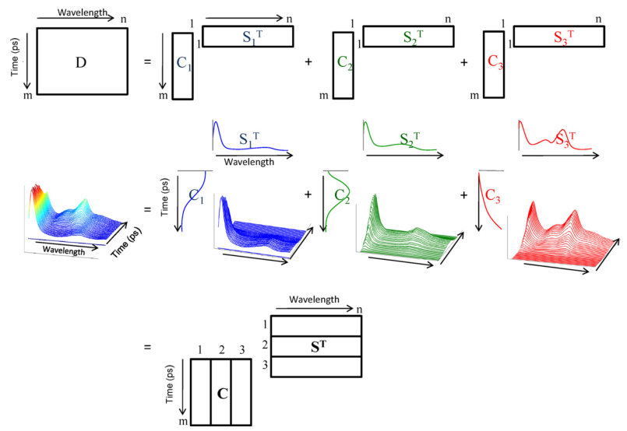
What is SVD?
D = CS^{T} + E

Slide 11
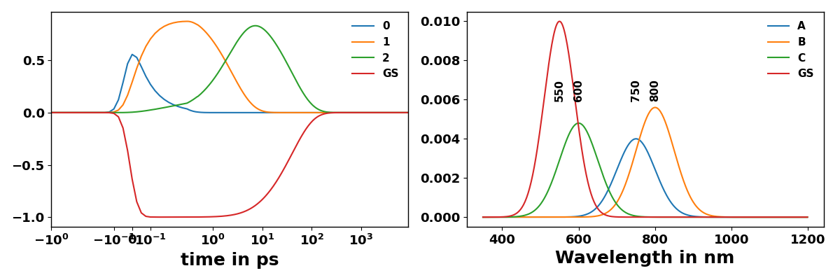
What is SVD?

Slide 12
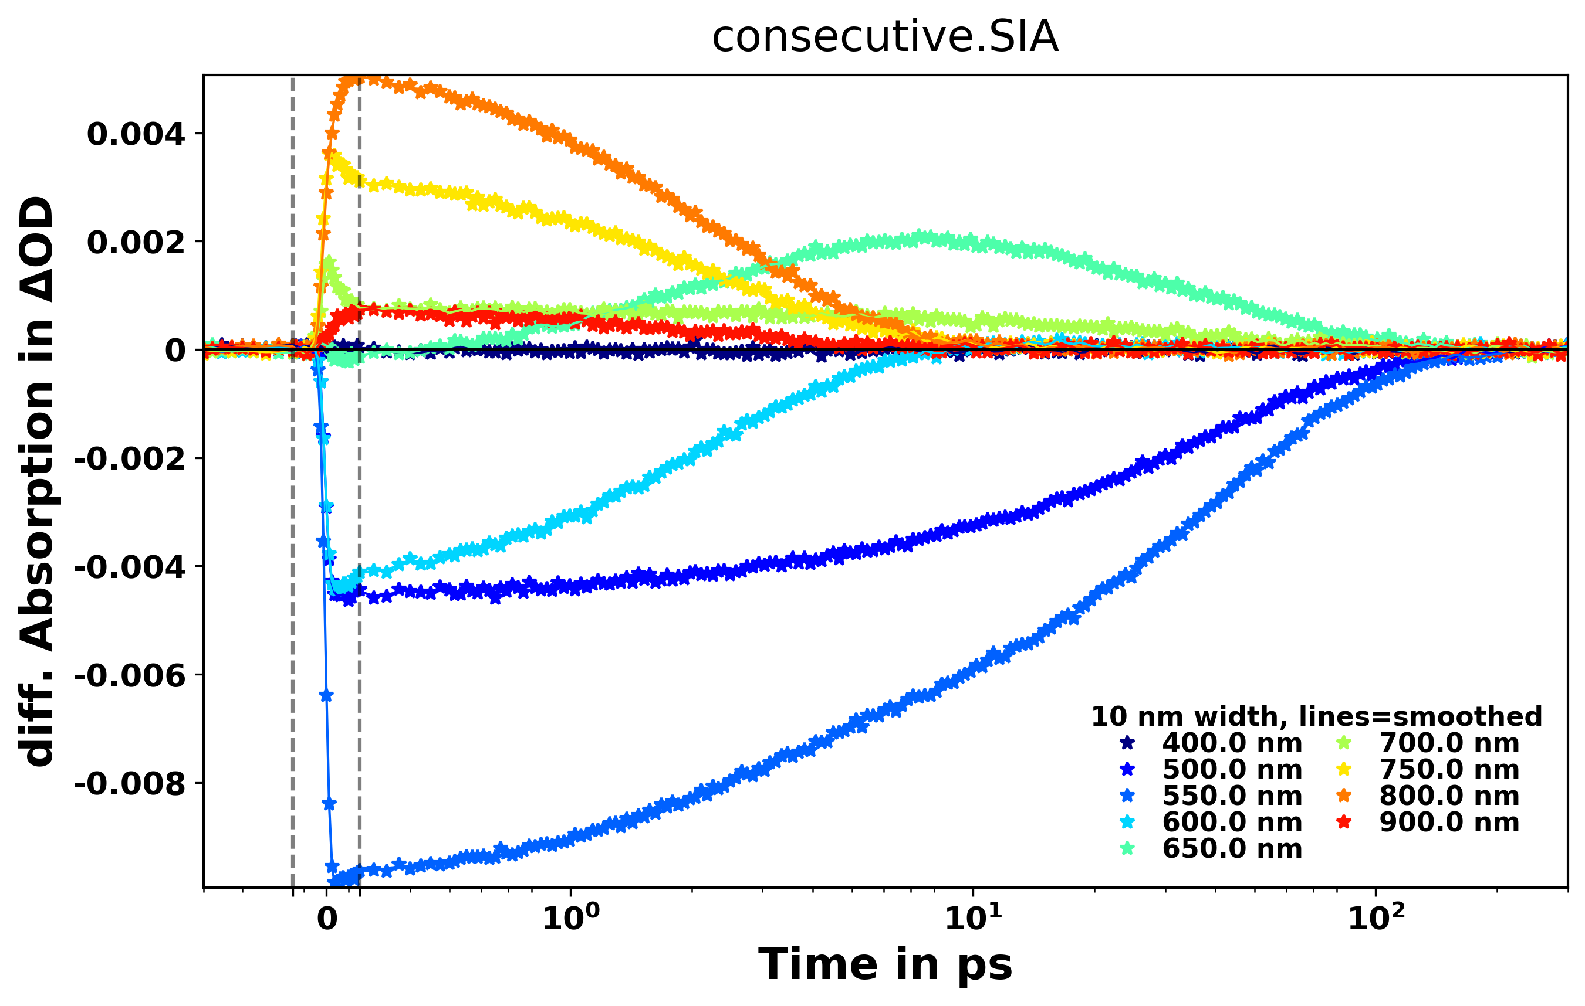
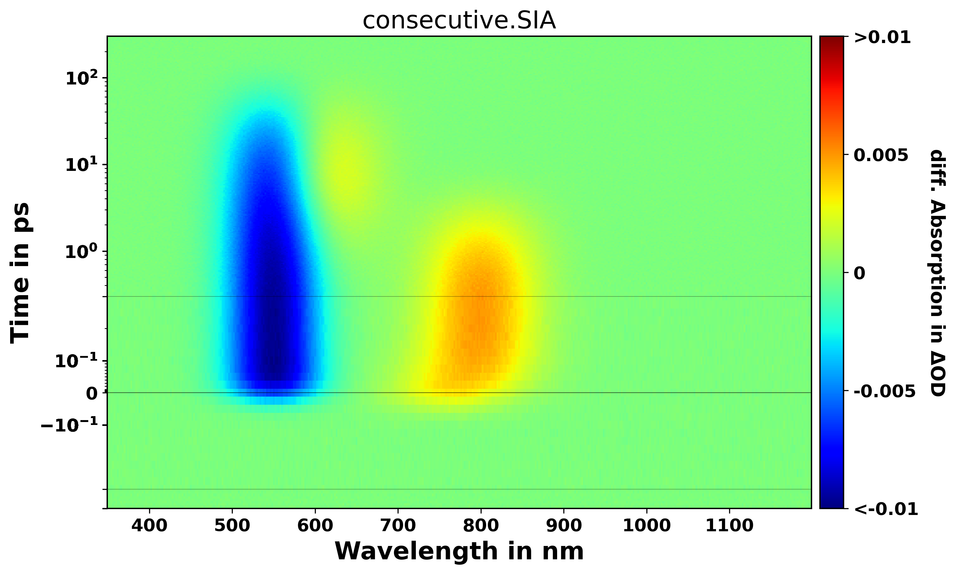
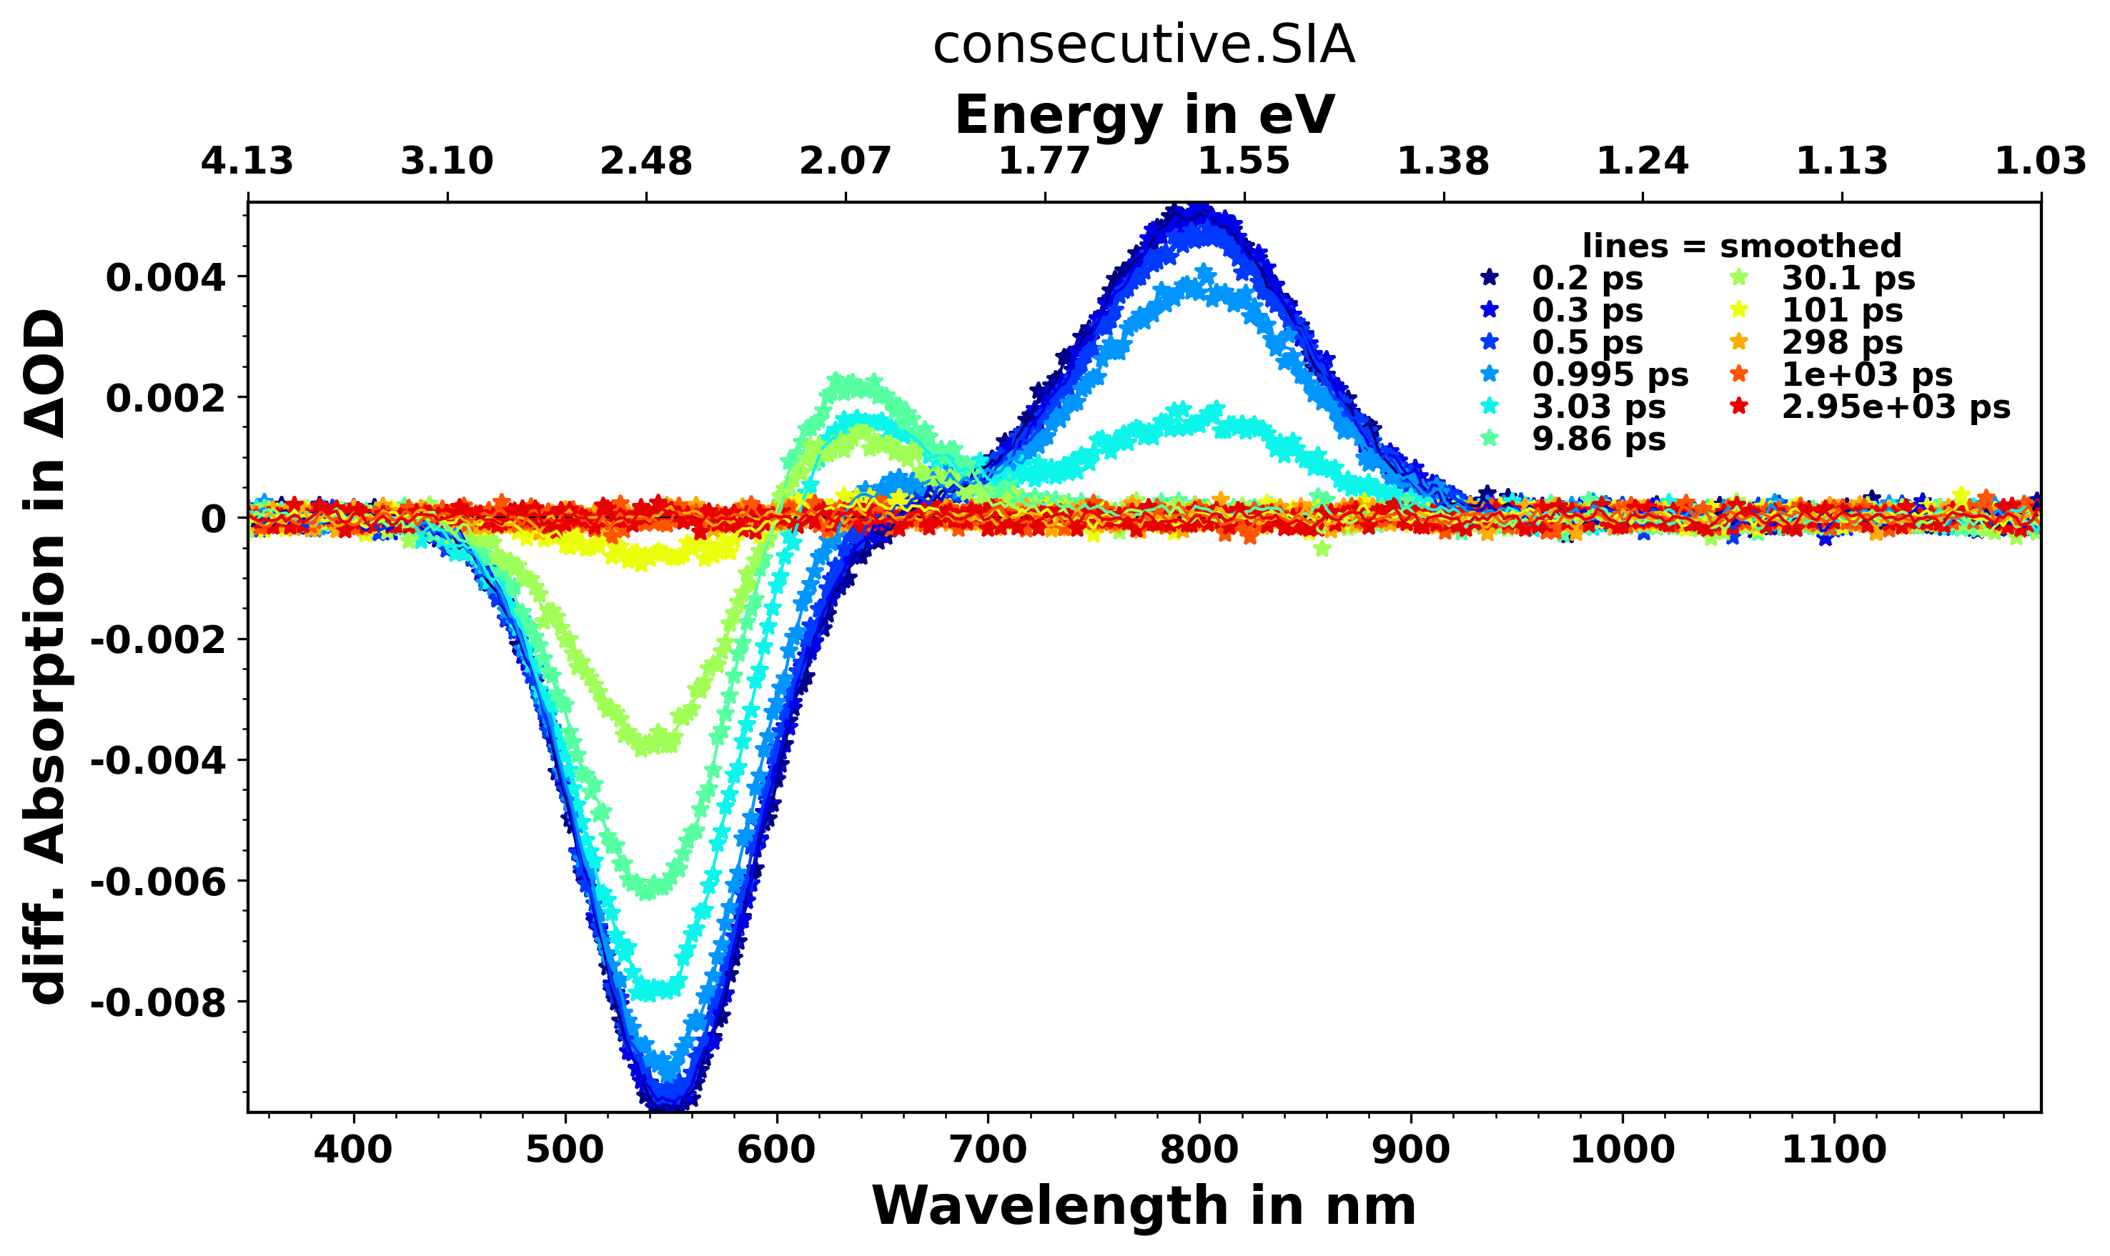
Lets create data

Slide 13
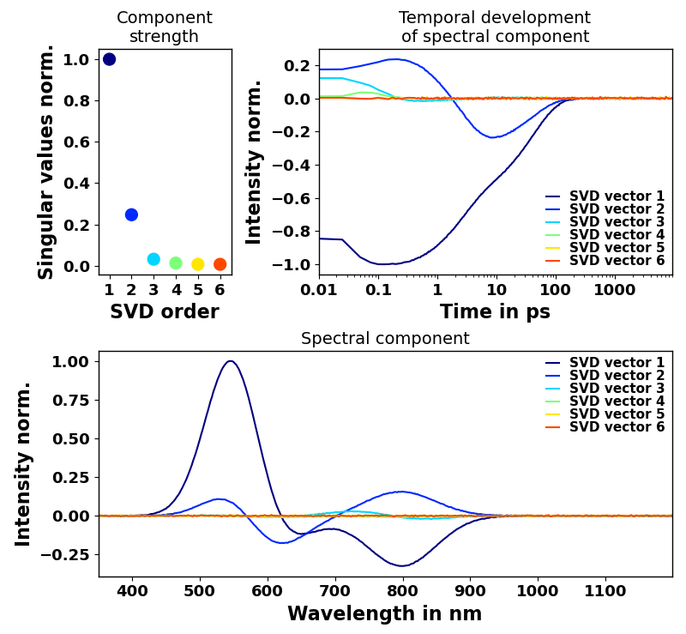
What is SVD?

Slide 14
So What?/Why? from which follows How?
Reaction schemes → defined by species and process times, need modelling
Yields/optimization → Need (careful) normalization and quantitative analysis
Parameter and values → need Modelling with error evaluation
Fingerprinting directly? → Requires (temporally or spectrally) isolated region
Linear Combination analysis ( 0.4 *f(t) * A + 0.3 * f`(t) * B + ...) →
Very difficult because there are so many influences that can alter the spectra in the optical regime.
Model independent extraction (SVD/PCA) Challenging, because the “math” does not know Chemistry/Physics, just linear combinations
Process oriented extraction – Modelling under assumption of decays
Species/Target analysis
All require Data pre-processing/munging
Number of tools like Glotaran, TIMP....
Not enough for me so I developed KiMoPack (kinetic modelling pack)
Learning by doing...
https://pubs.acs.org/doi/10.1021/acs.jpca.2c00907
Notes:
And see that electron arrives after 240 fs
Spin flip after 1.9 ps
Expansion < 3 ps
(latest measurements in similar molecule = coherent oscillation!)
Relaxation 12 ps

Slide 15
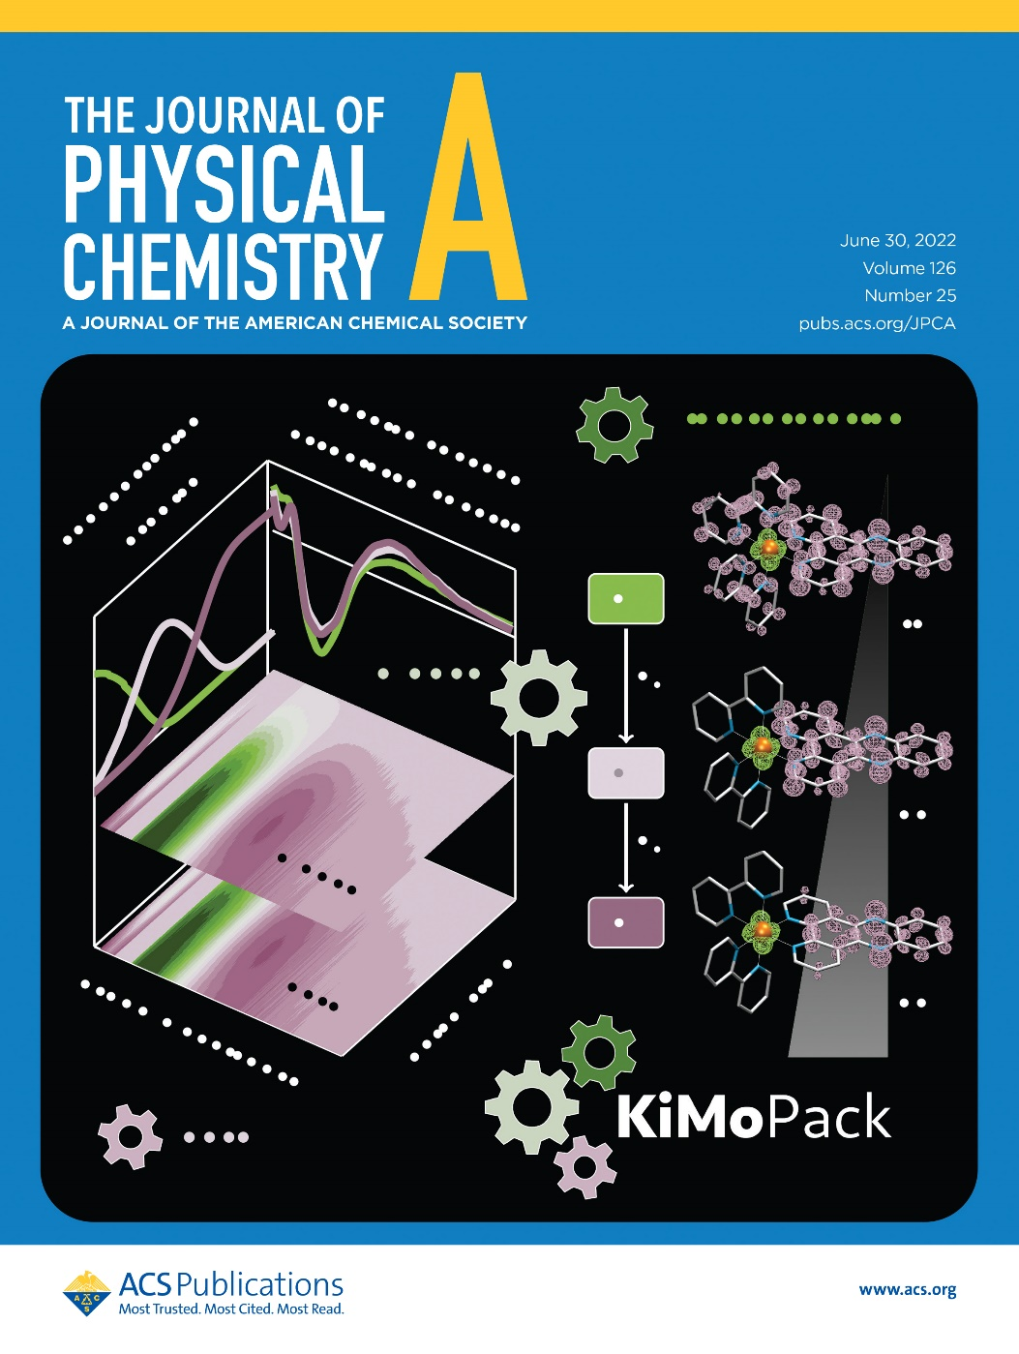
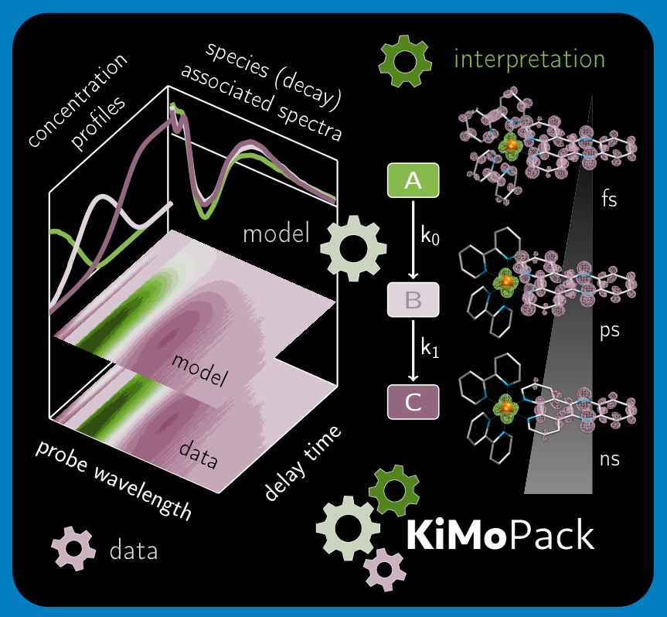
KiMoPack 1
Implementation of Data-Analysis
for “non – coders”
and an aid for “coders”
Based on Python
Notes:
Among the many techniques
Overlap in time and space jitter?

Slide 16
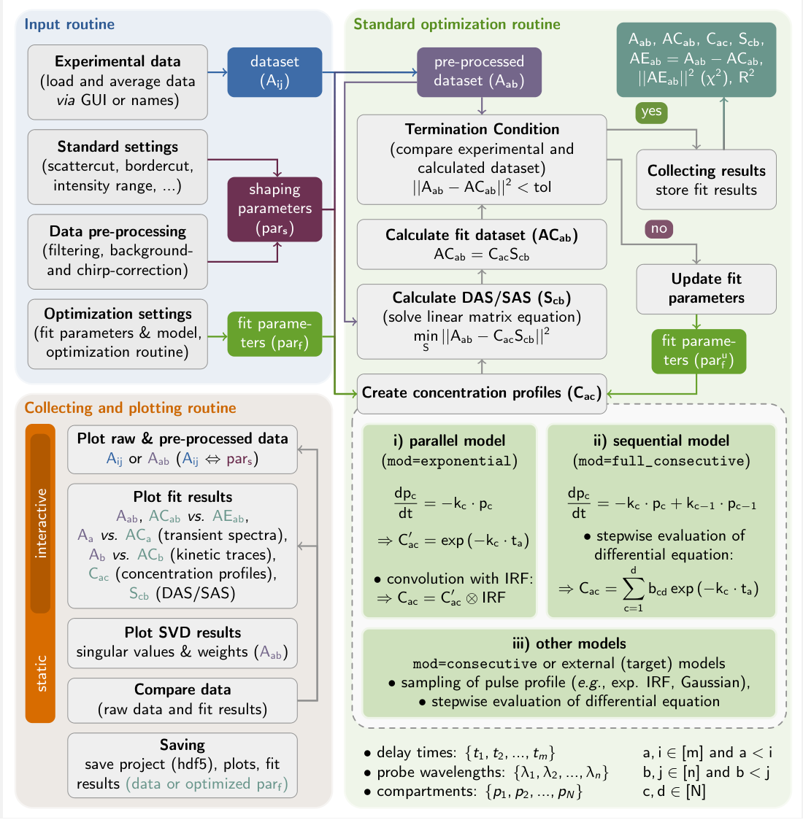
KiMoPack 2 several modules
Notes:
Among the many techniques
Overlap in time and space jitter?

Slide 17
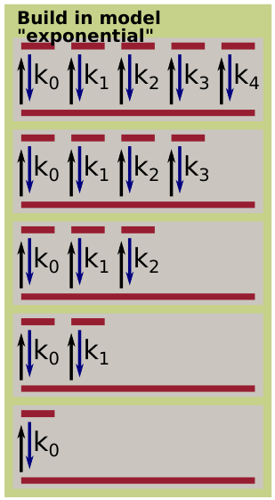
Exponential Models

Slide 18
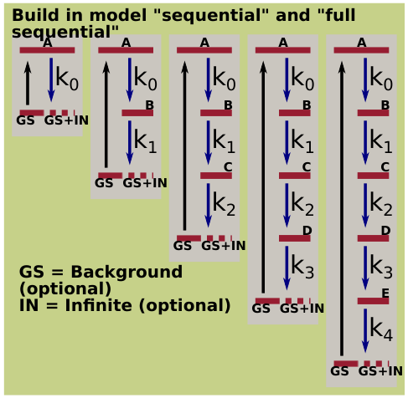
Sequential Models
Notes:
And see that electron arrives after 240 fs
Spin flip after 1.9 ps
Expansion < 3 ps
(latest measurements in similar molecule = coherent oscillation!)
Relaxation 12 ps

Slide 19
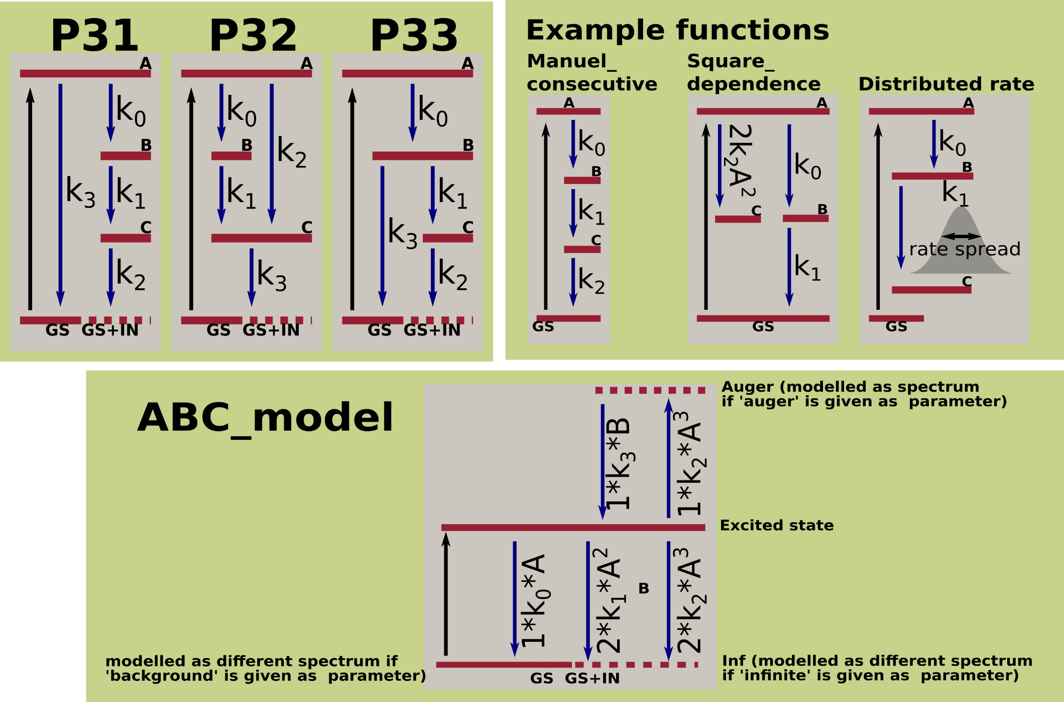
Advanced Fitting function – all with 4 rates
Notes:
Among the many techniques
Overlap in time and space jitter?

Slide 20
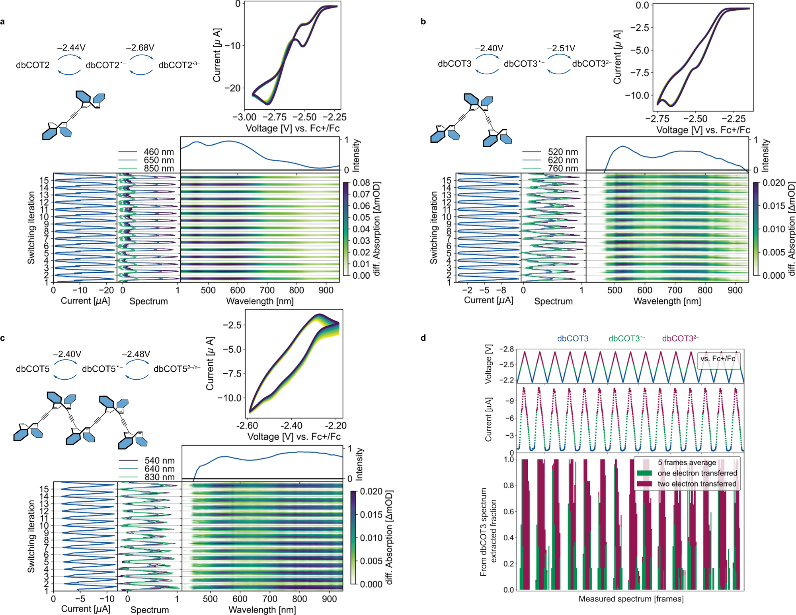
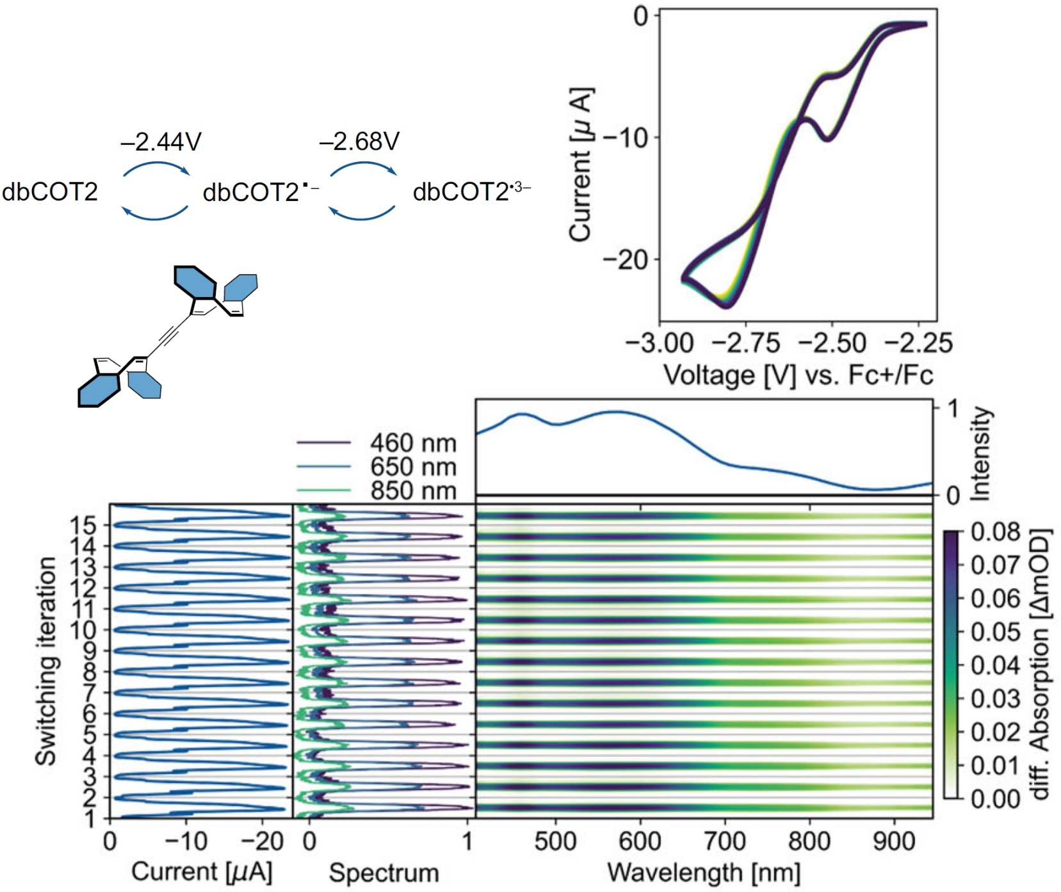
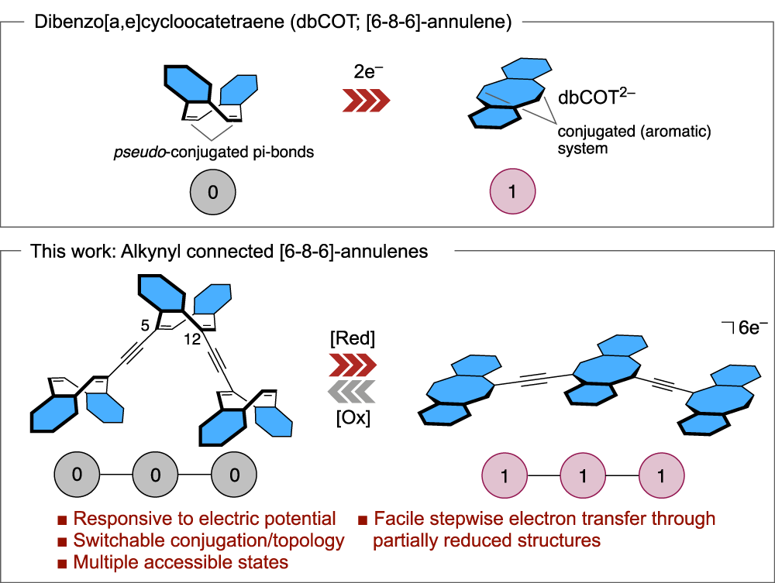
Annulene Story
Notes:
molecules

Slide 21
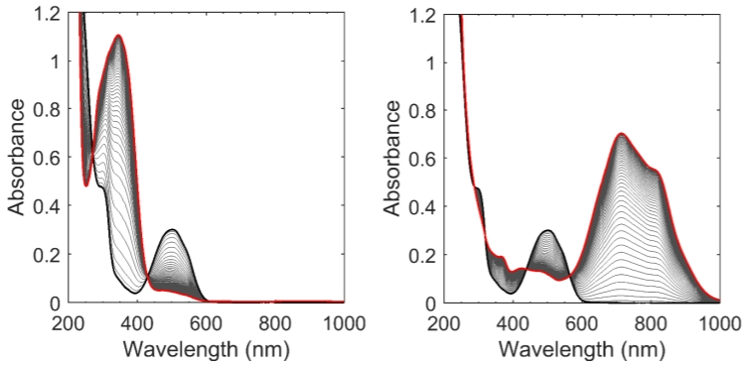
Spectro-electro-chemistry

Slide 22
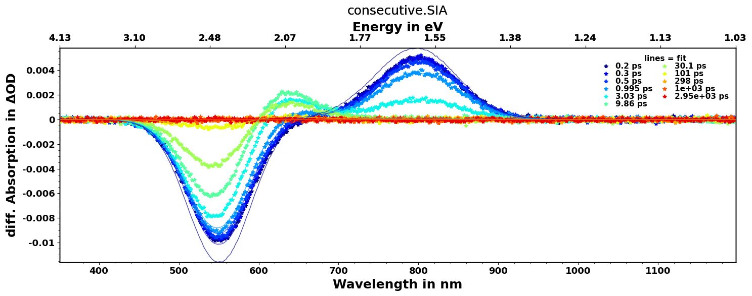
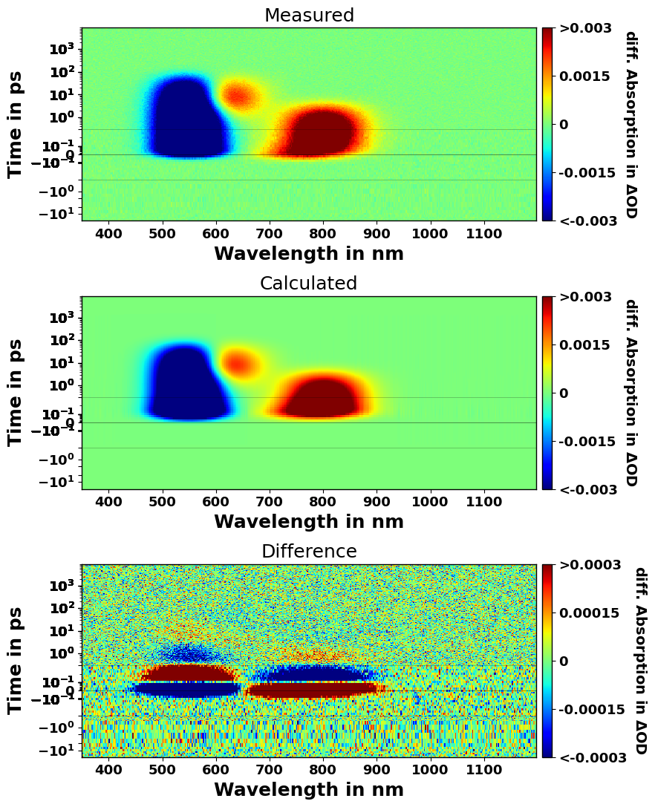
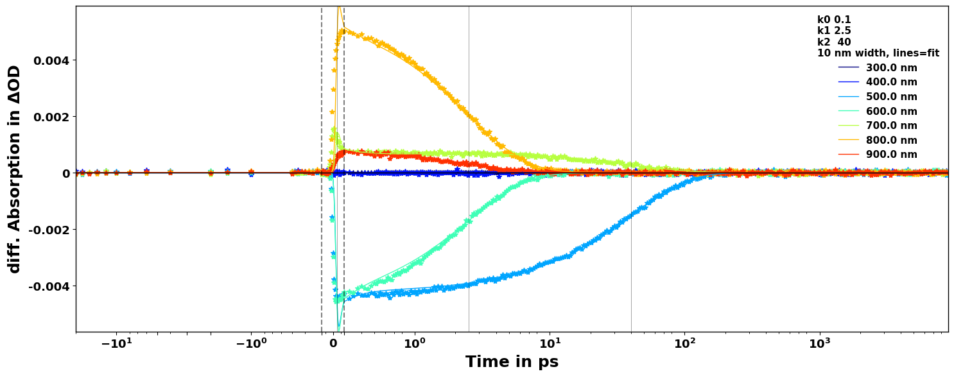
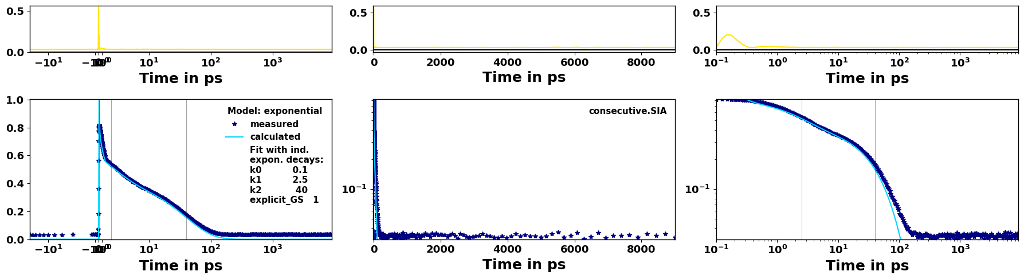
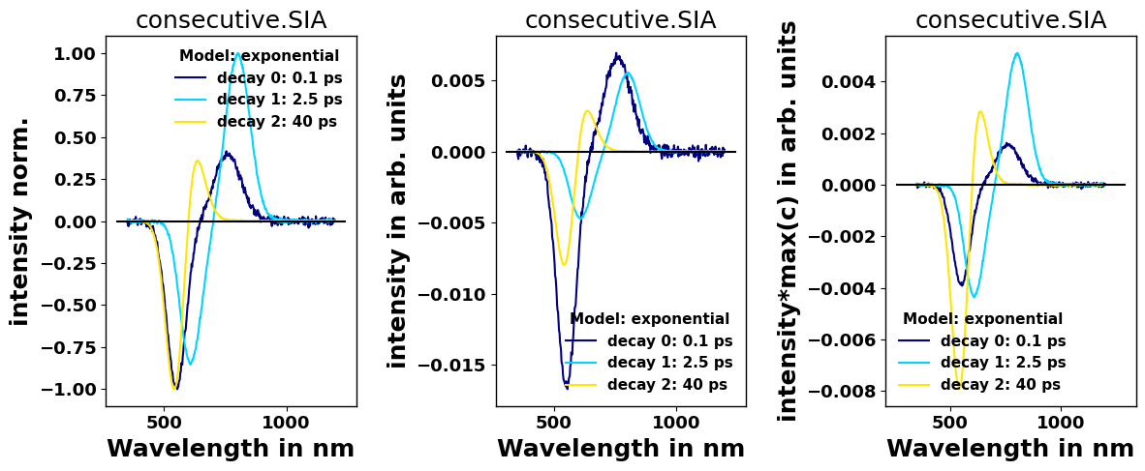
Report_slide
Fit Results:
Model Used: exponential
The minimum error is:9.04047701e-03
The minimum R2-value is:9.74276111e-01
In Rates
value init_value vary min max expr
k0 10.0 10.0 False 9.090909 11.111111 None
k1 0.4 0.4 False 0.333333 0.5 None
k2 0.025 0.025 False 0.02 0.033333 None
t0 0 0 False -0.1 0.1 None
resolution 0.086 0.086 False 0.04 0.5 None
explicit_GS 1 1 False -inf inf None
The rates converted to times with unit ps
value init_value vary min max expr
k0 0.1 0.1 False 0.09 0.11 None
k1 2.5 2.5 False 2.0 3.0 None
k2 40.0 40.0 False 30.0 50.0 None
explicit_GS 1 1 False -inf inf None

Slide 23
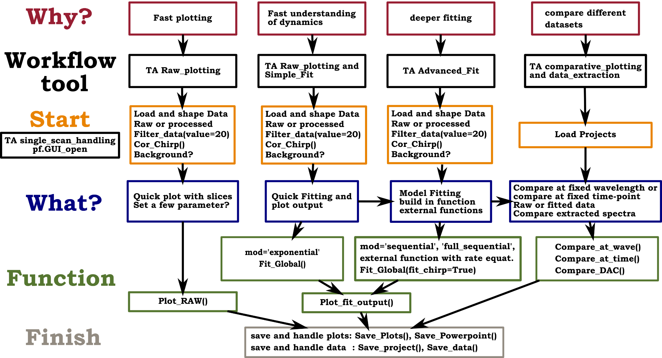
Overview
Notes:
Among the many techniques
Overlap in time and space jitter?

Slide 24
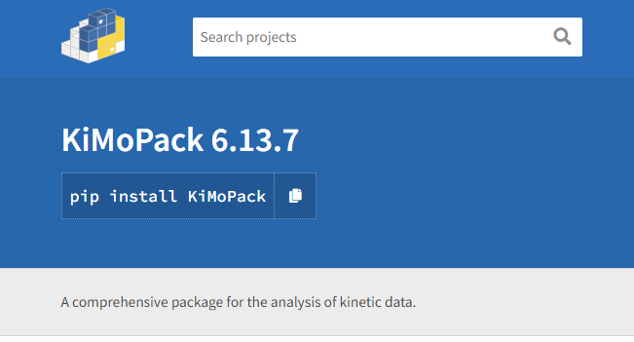
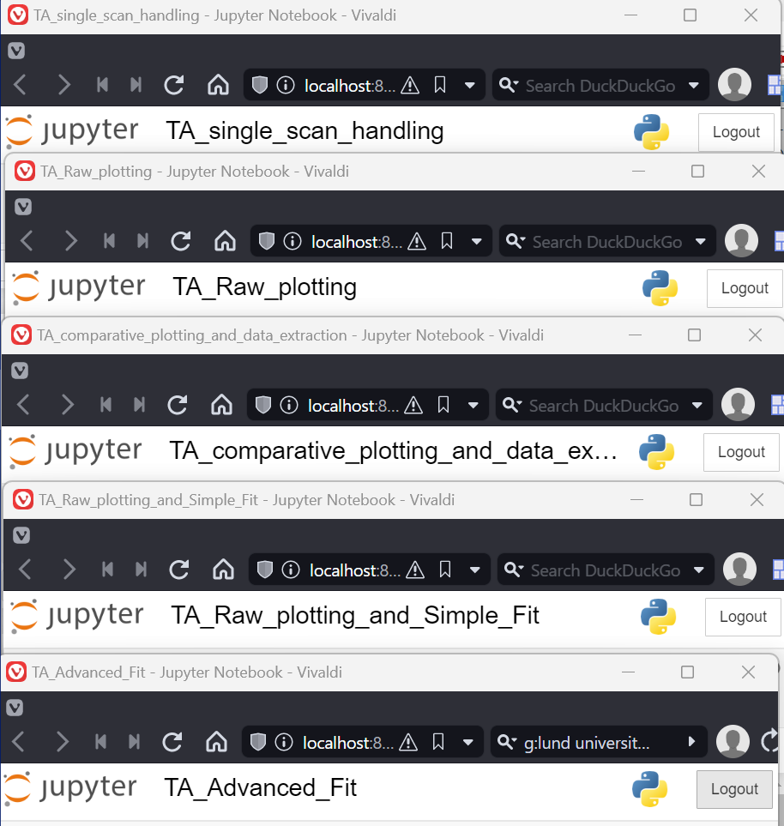
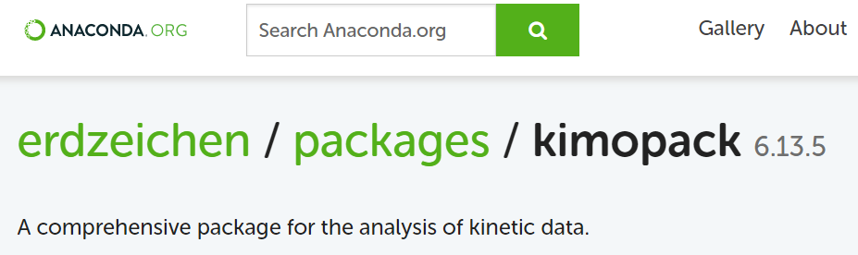
What is it? Code + Workflow sheets + Tutorials
Notes:
Among the many techniques
Overlap in time and space jitter?

Slide 25
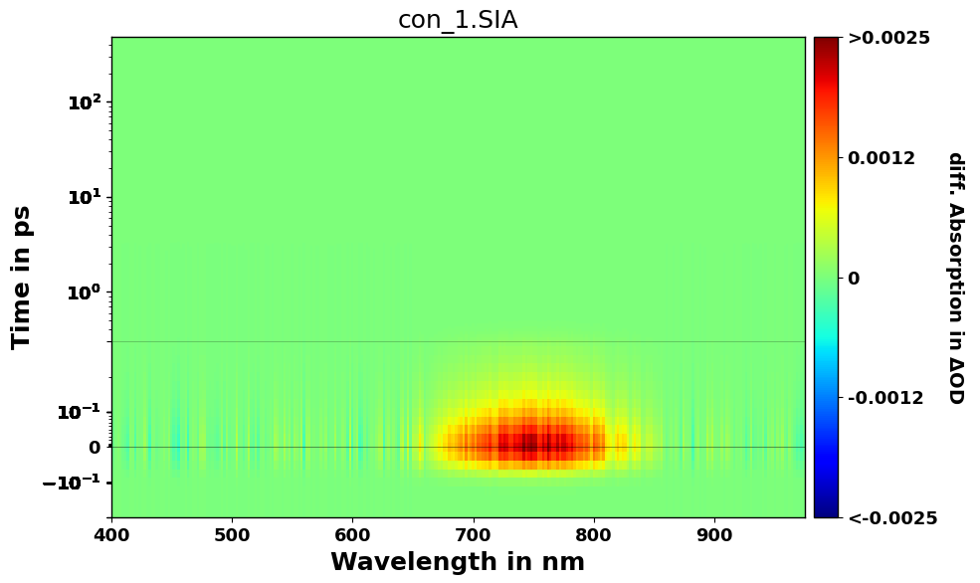
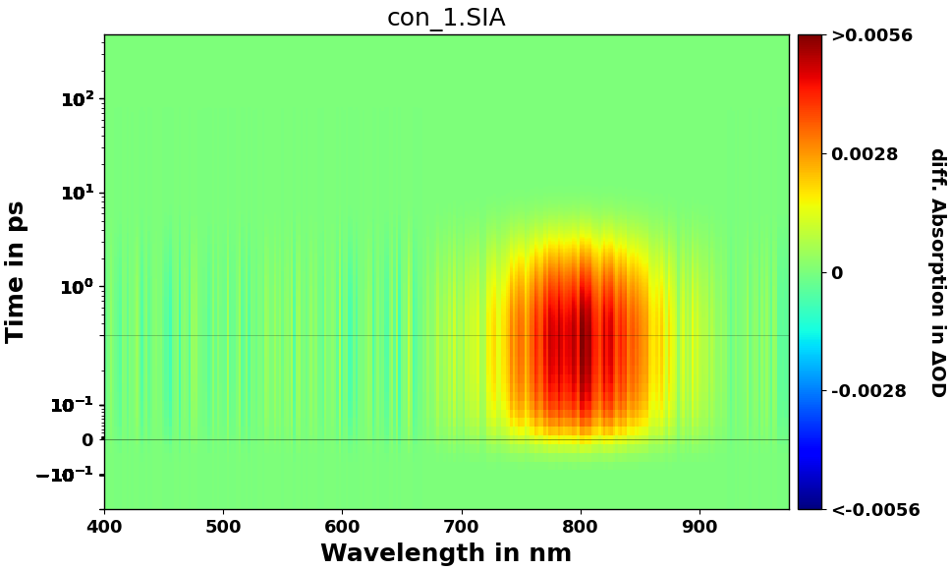
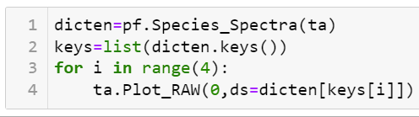
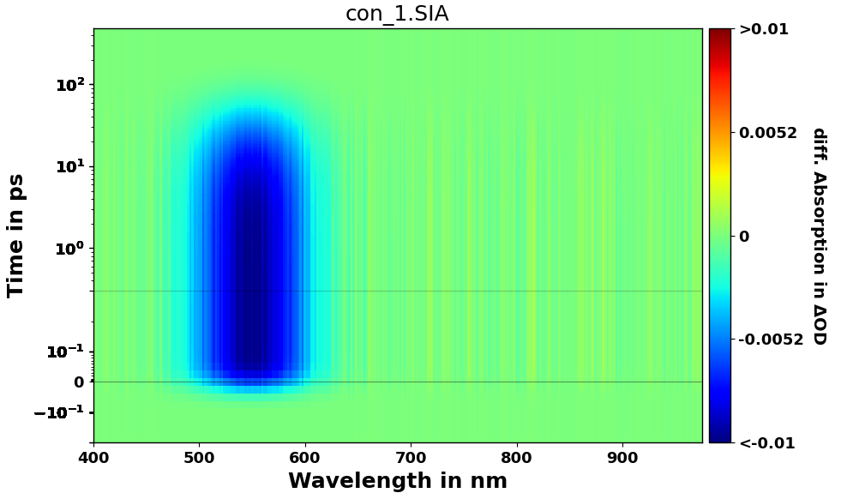
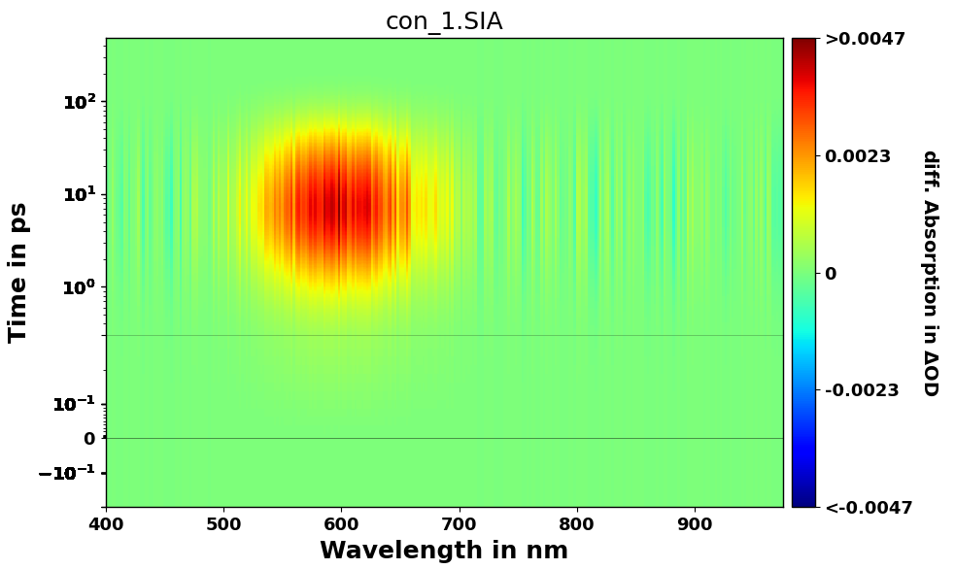
The step beyond
Notes:
Among the many techniques
Overlap in time and space jitter?

Slide 26
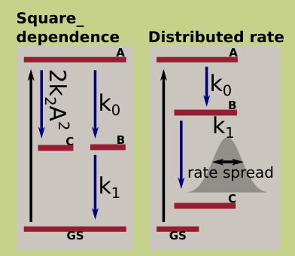
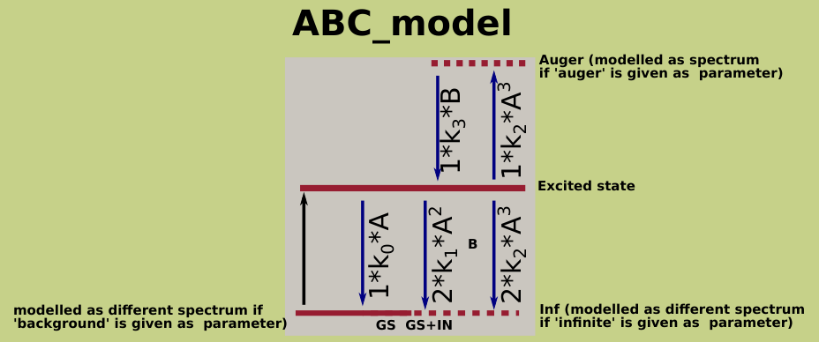
The step beyond
Notes:
Among the many techniques
Overlap in time and space jitter?

Slide 27
The step beyond
Test multiple models and compare the results. Compare:
1. Quality of representation (R2 value)
2. Features left in spectrum
3. Sensitivity and stability (play with corner parameters, binning, starting guesses)
4. Check confidence interval
5. Use common sense
6. Check Globally? - use dump_parameter
7. Use different measurements
Add additional information to the modelling
Measure excitation fraction, maybe even track it
Excited state means you start to get quantitative!
Notes:
Among the many techniques
Overlap in time and space jitter?

Slide 28
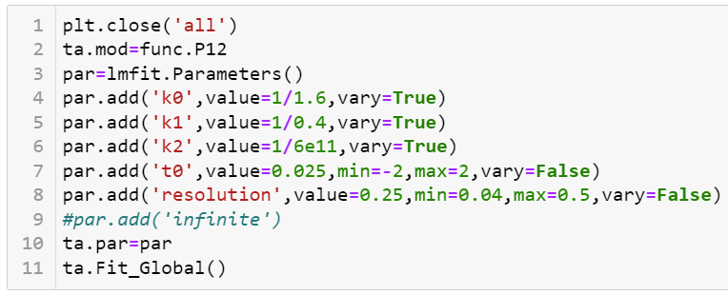
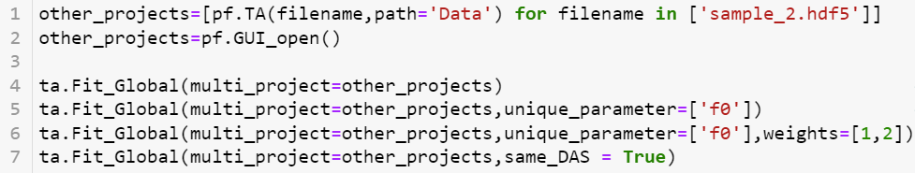
Multi-Modal - Models
Notes:
Among the many techniques
Overlap in time and space jitter?

Slide 29
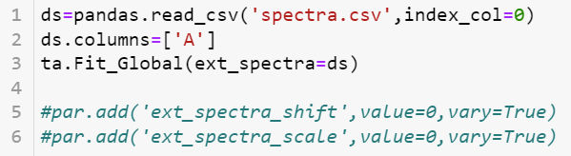



The step beyond
Notes:
Among the many techniques
Overlap in time and space jitter?

Slide 30
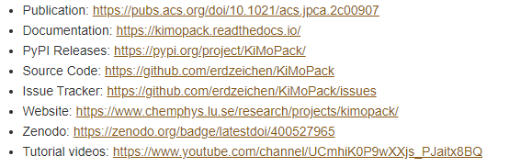

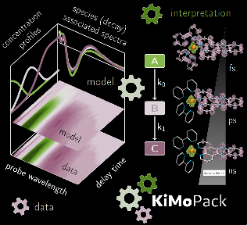
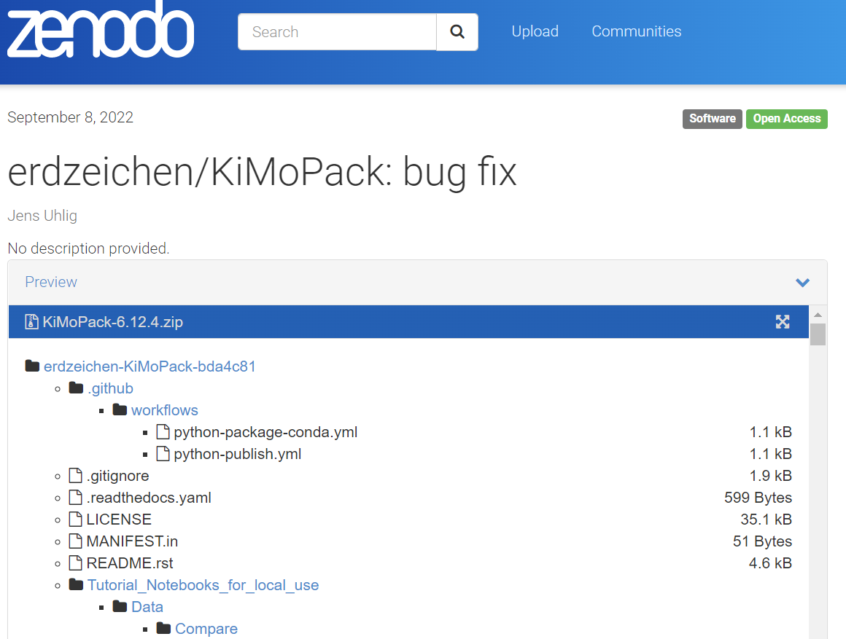
Reproducibility and Usability.
The JPCA (Together with Carolin Müller and Axl Eriksson)
publication introduces methods,
discusses criteria what a good fit and shows is
pdf’s of (tutorial) analysis worksheets (as SI).
Published and tracked code, Pypi, Github and Zenodo
Each “release” receives unique DOI from Zenodo and is “locked”
Code extensively documented (6000 lines) and open source
80+ pages manual
Tutorial analysis worksheets
Tutorial videos (youtube)
Active support + development (e.g. creating import scripts)
Notes:
Among the many techniques
Overlap in time and space jitter?

Slide 31
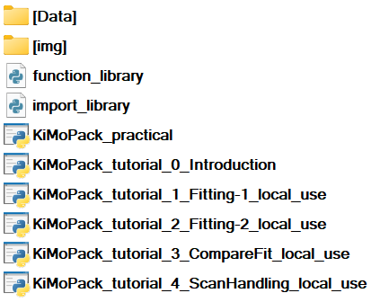
Tutorials
Notes:
Among the many techniques
Overlap in time and space jitter?

Slide 32

Tutorials - Practical
Notes:
Among the many techniques
Overlap in time and space jitter?

Slide 33

Tutorials - Compare
Compare different measurements, or simulations
Spectra, kinetics, DAS/SAS
Plus external spectra
Notes:
Among the many techniques
Overlap in time and space jitter?

Slide 34

Tutorials – Single_scans
Filter scans after:
single outlier
sample damage
Manual (like here) or zscore_filter applied to all or window
Notes:
Among the many techniques
Overlap in time and space jitter?

Slide 35
Overview
Notes:
Among the many techniques
Overlap in time and space jitter?

