Slide 1











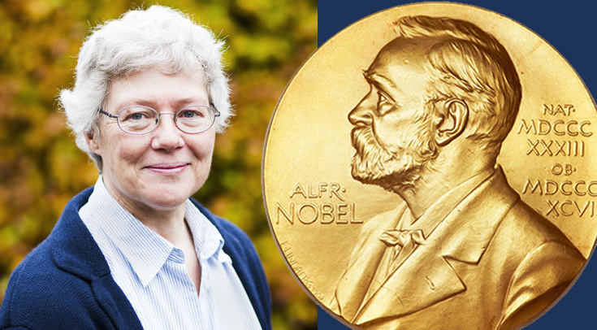


Science for and with laser based x-ray sources
Jens Uhlig et al.
Chemical Physics Lund University
Complementary Spectroscopic Approaches: Numbers

Slide 2
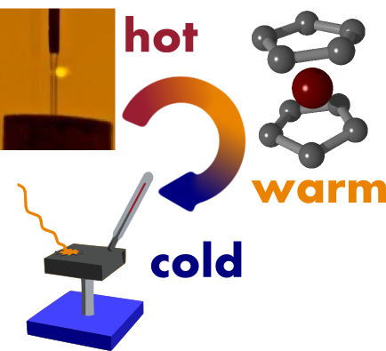
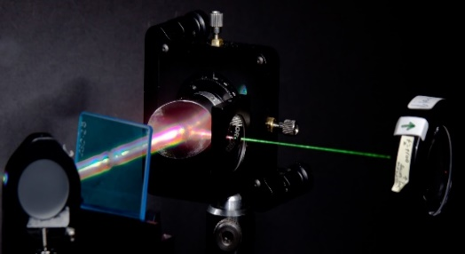
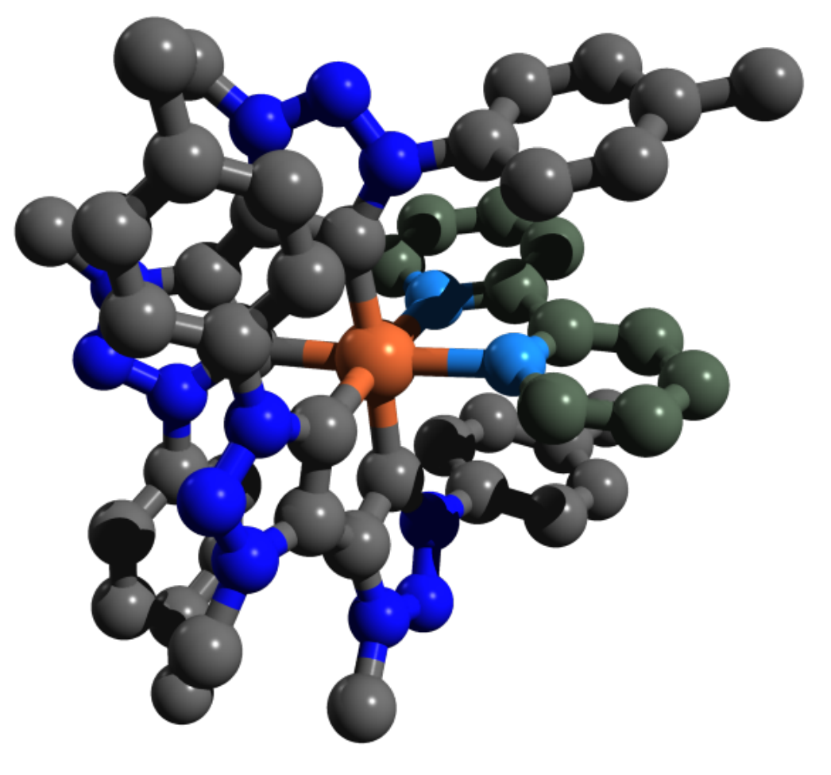
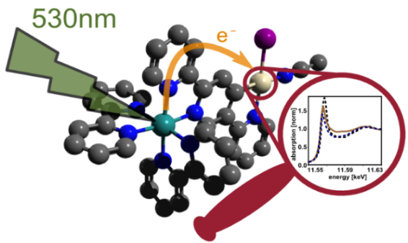
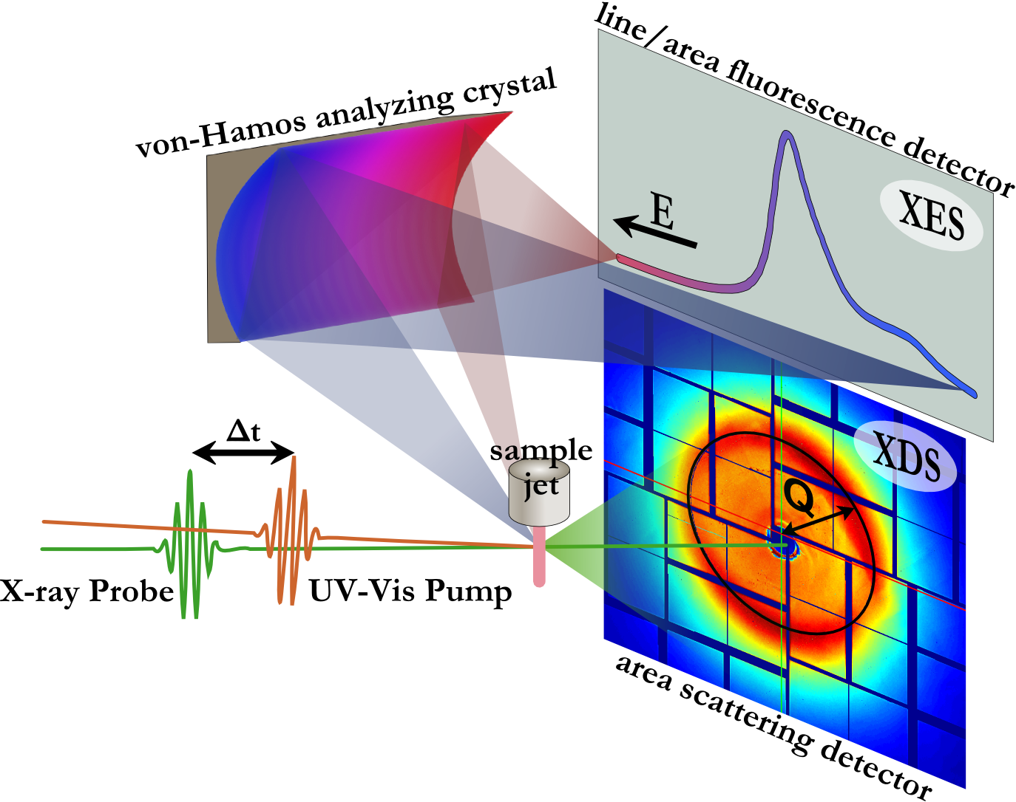
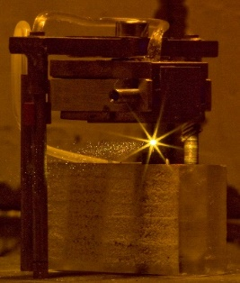
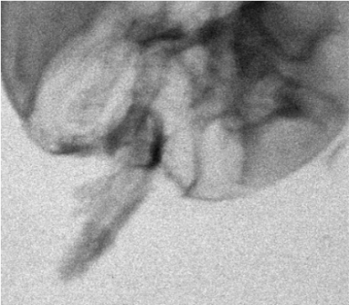
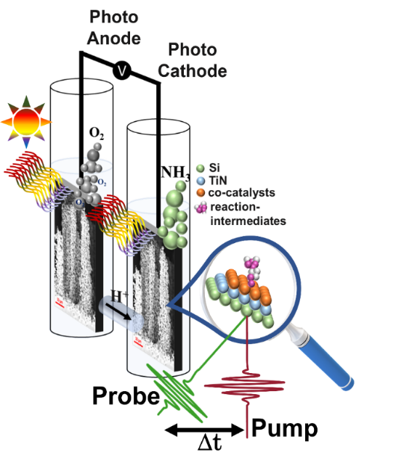

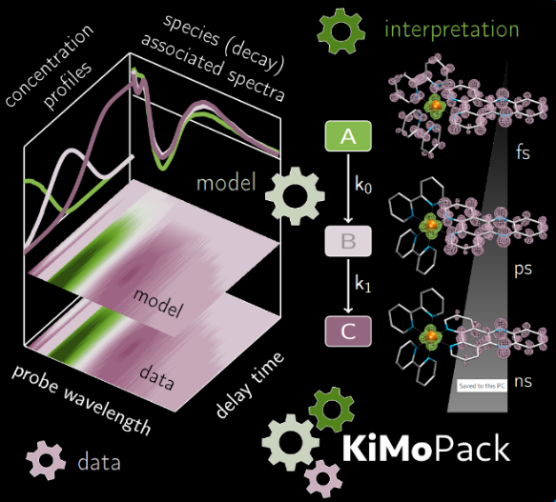
About me
Notes:
Among the many techniques
Overlap in time and space jitter?

Slide 3
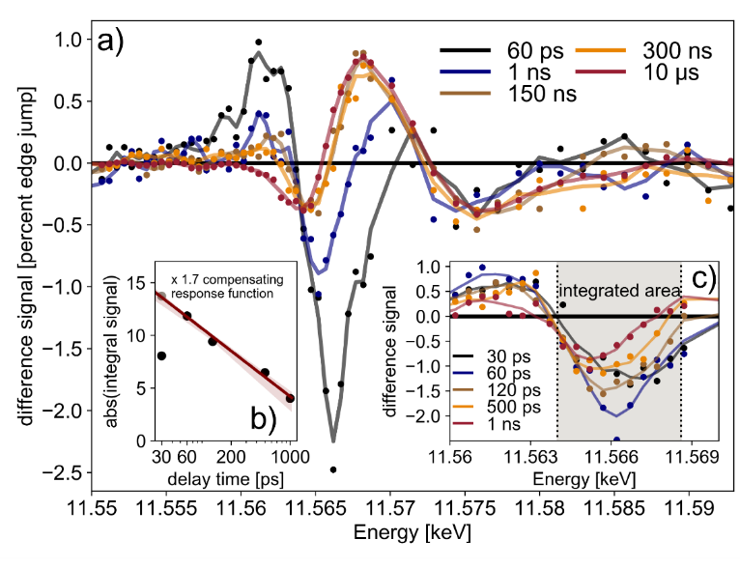
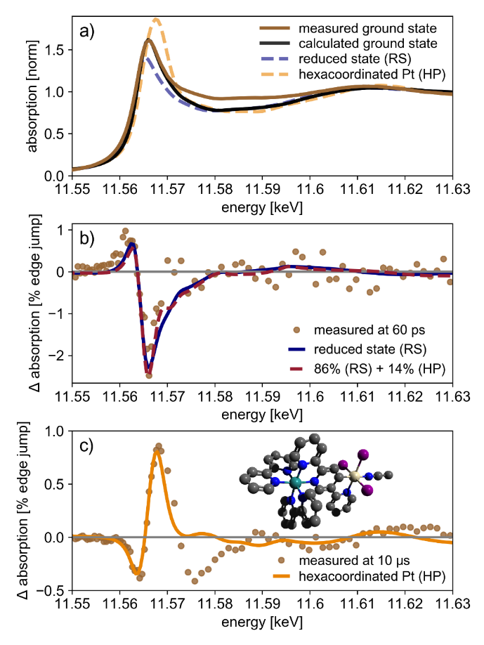
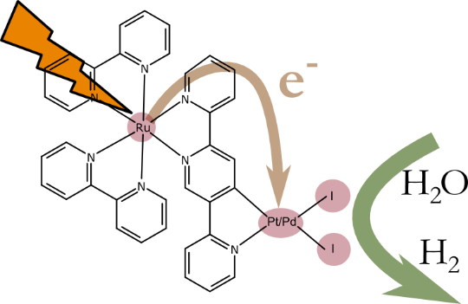
The advantage of synchrotrons
J. Phys. Chem. A 2018, 122, 31, 6396–6406 DOI:10.1021/acs.jpca.8b00916
Notes:
Among the many techniques
Overlap in time and space jitter?

Slide 4
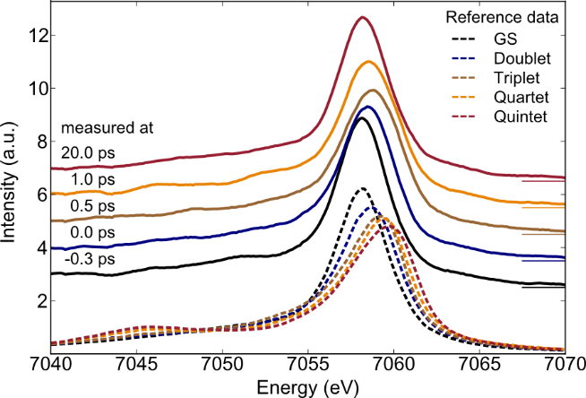
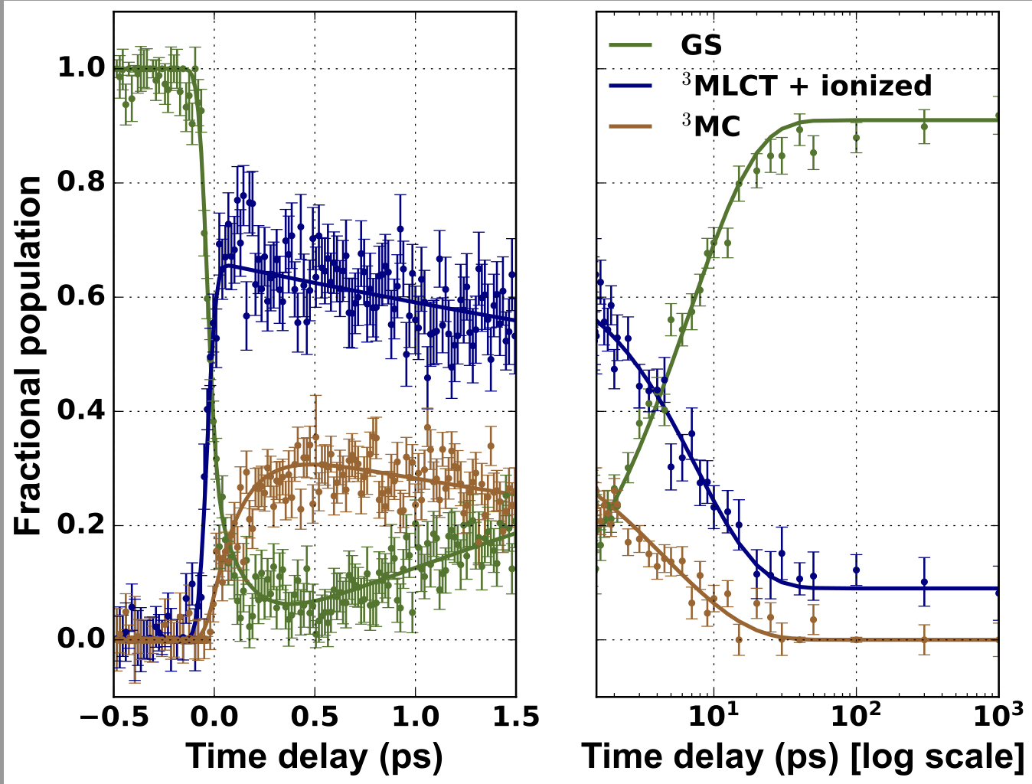
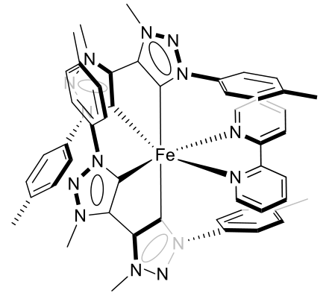
Hot dynamics
Angewandte Chemistry
https://doi.org/10.1002/anie.201908065
Notes:
Among the many techniques
Overlap in time and space jitter?

Slide 5
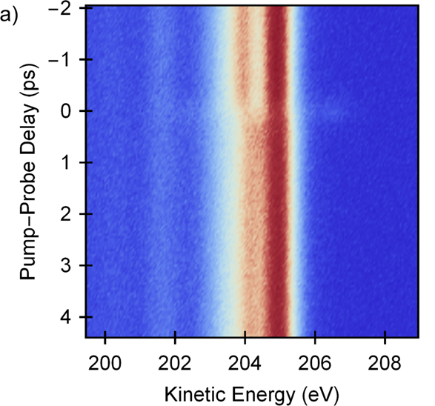
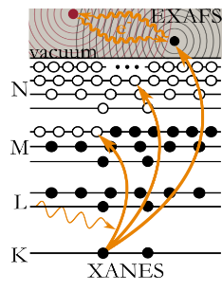
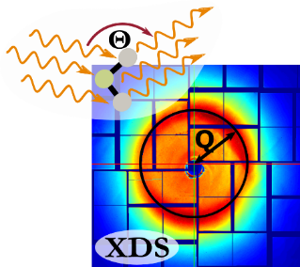


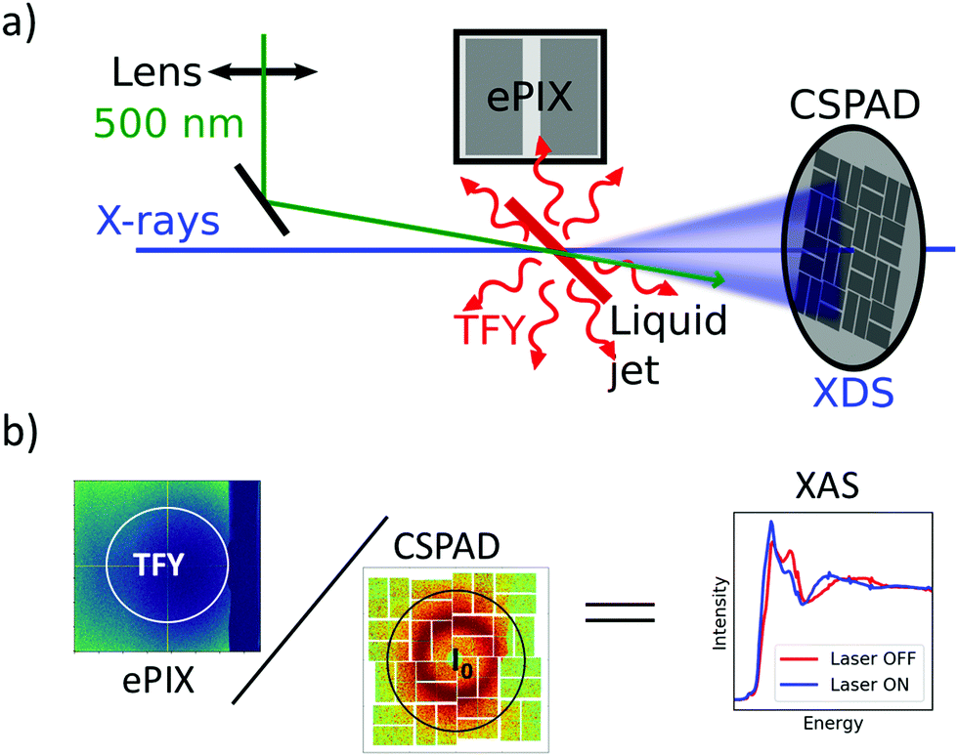
Four very different type of experiments
J. Phys. Chem. A 2018, 122, 31, 6396–6406
DOI:10.1021/acs.jpca.8b00916
Angewandte Chemistry,
2019, 132, 372-380
Nat Commun 12, 1196 (2021).
DOI: 10.1038/s41467-021-21454-3
Nature Communications
11, 634 (2020).
DOI: 10.1039/C9CP03483H
Phys. Chem. Chem. Phys., 2020, 22, 2660-2666
Chem. Rev. 2017, 117, 16, 10940–11024
DOI: 10.1021/acs.chemrev.6b00807
Notes:
Many of the features in XANES spectra can be teased out to glean detailed information regarding the MOs and M-L orbital overlap. And even more comprehensive picture is obtained by collecting XANES data at both the metal and ligand K-edges!
Note that I did not even mention L-edges, M-edges, etc. Those come from higher energy core electrons (2p etc.)

Slide 6
Always start with WHY?
prepare proposal + beamtime
analysis of large amount of data
(multiple man years)
Time
Effort Risk
Costs
Risk
When we started Slicing sources
Waiting time: min 6 month
usually 1 year
without Covid19
Science
Proposal success
Experimental outcome
Necessities?
Funding?
Time-resolved experiments XFEL:
10 persons 1 week USA = 40 kEuro
Facility 2-3 MEuro / beamtime
Proposal (>one week) + Preparation
Time-resolved experiments for multiple days:
1g sample at 20mg/week and person?
Damage? Success?
No guarantee of proposal success (Grants?)

Slide 7
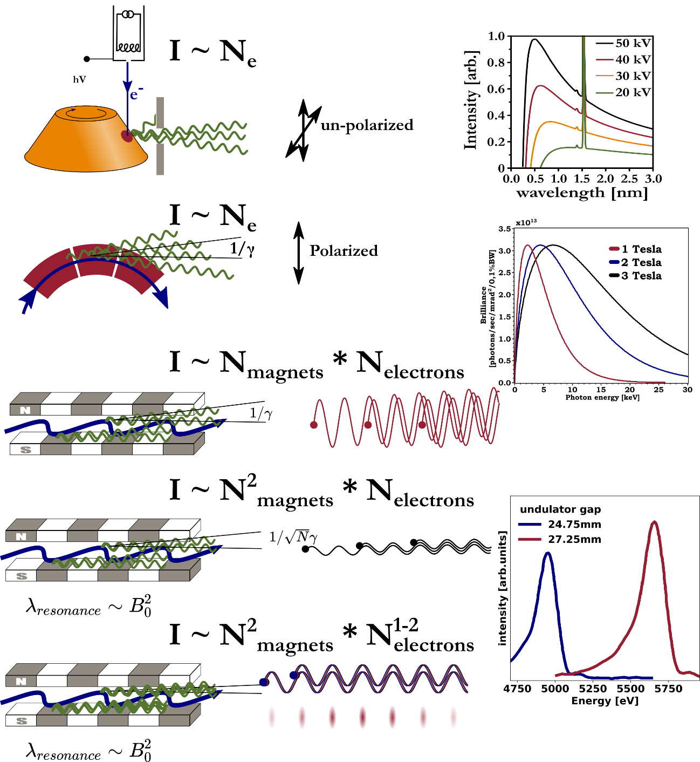
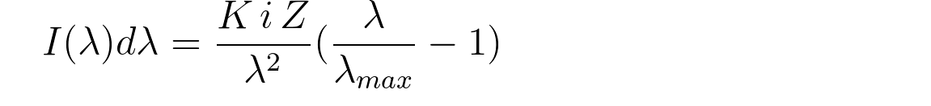
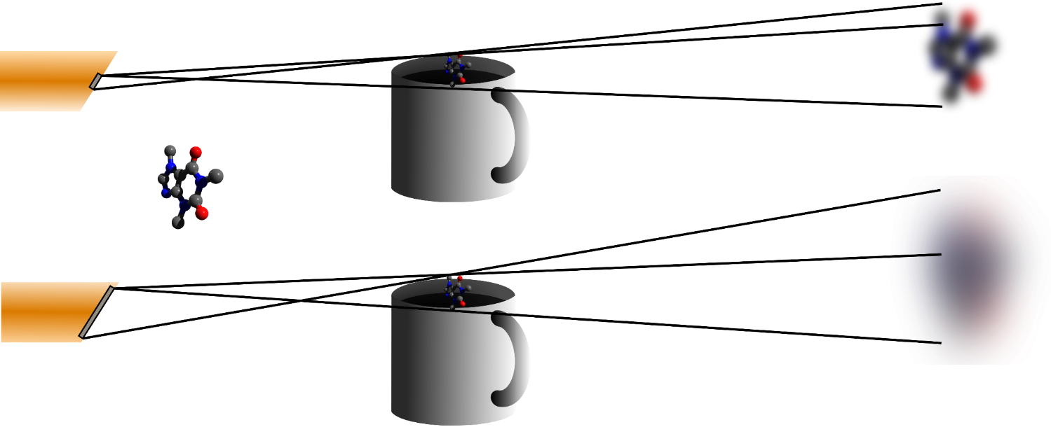
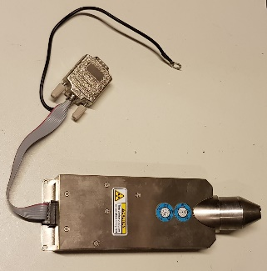
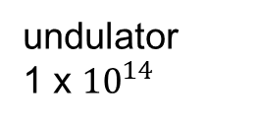
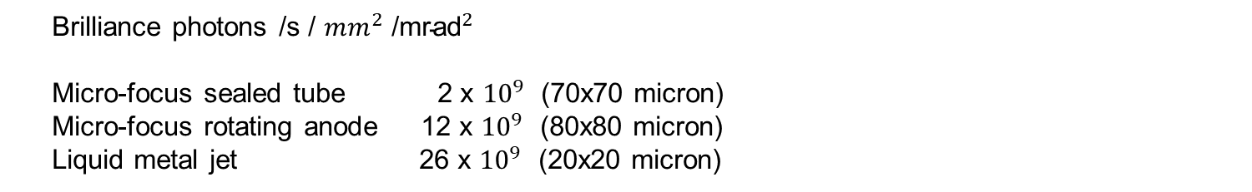
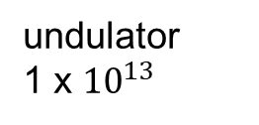
Lab – based (steady state) - sources
Limit? Melting of copper!
20kV * 40mA on 100µm x 100µm close to 50% of melting power
Lamp 200V, 4A = 800W lamp
Brilliance photons /s / ${mm}^{2}$ /${\text{mrad}}^{2}$
Micro-focus sealed tube 2 x ${10}^{9}$ (70x70 micron)
Micro-focus rotating anode 12 x ${10}^{9}$ (80x80 micron)
Liquid metal jet 26 x ${10}^{9}$ (20x20 micron)
undulator
1 x ${10}^{14}$
In characteristic emission lines or full spectrum (assume a few keV bandwidth)
corresponding: 1 x ${10}^{5}$ph /s / ${mm}^{2}$ /${\text{mrad}}^{2}$ /eV
undulator
1 x ${10}^{13}$
15 cm
How to use:
efficient detection, experiment design
T. Skarzynski, “Collecting data in the home laboratory: evolution of X-ray sources, detectors and working practices,” Acta Crystallographica Section D Biological Crystallography, vol. 69, no. 7, Art. no. 7, Jun. 2013, doi: 10.1107/s0907444913013619

Slide 8
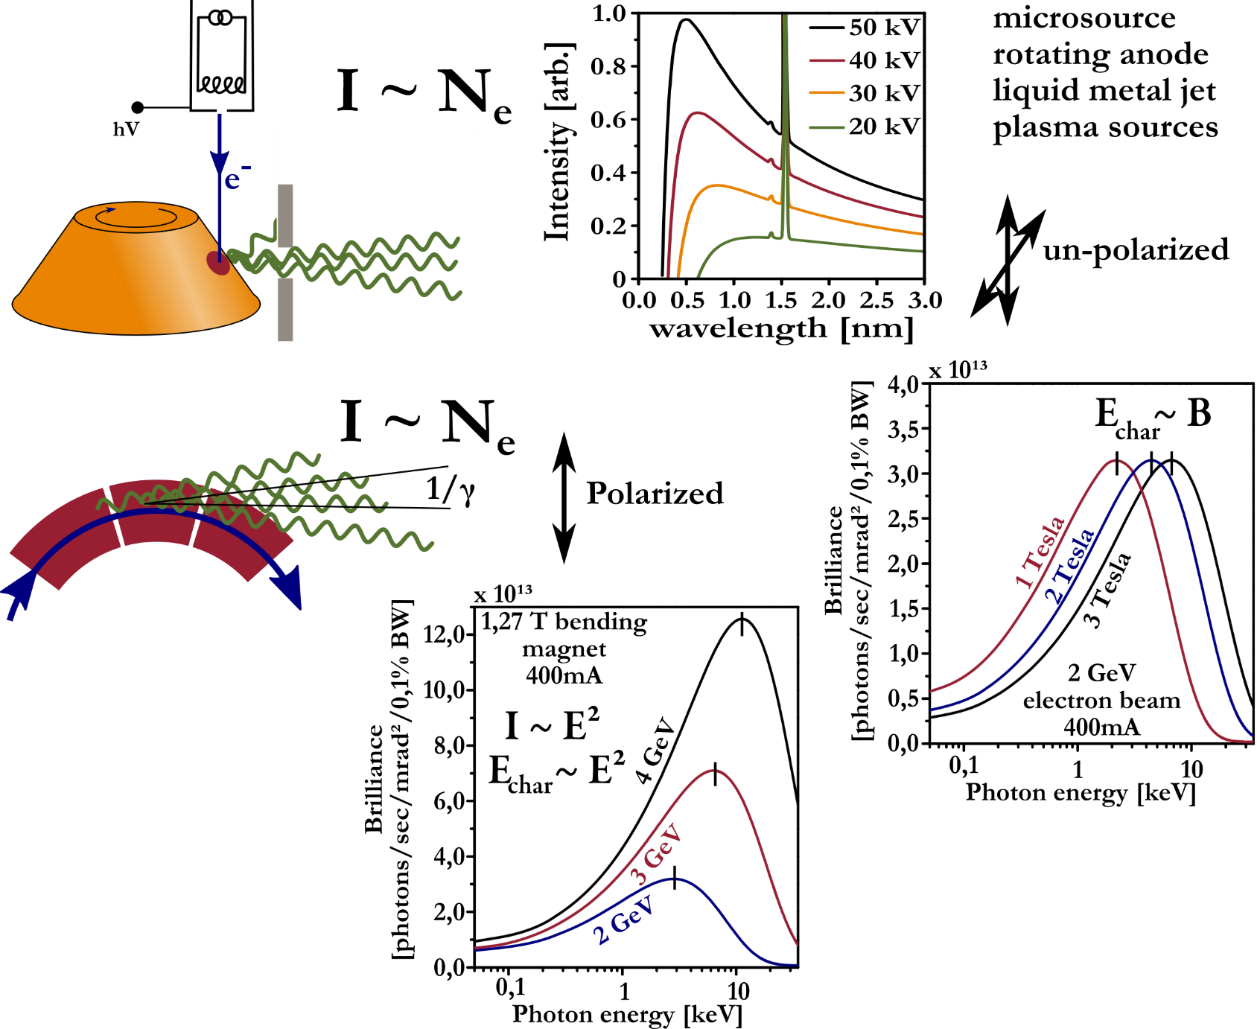
X-ray tube bremsstrahlung

Slide 9
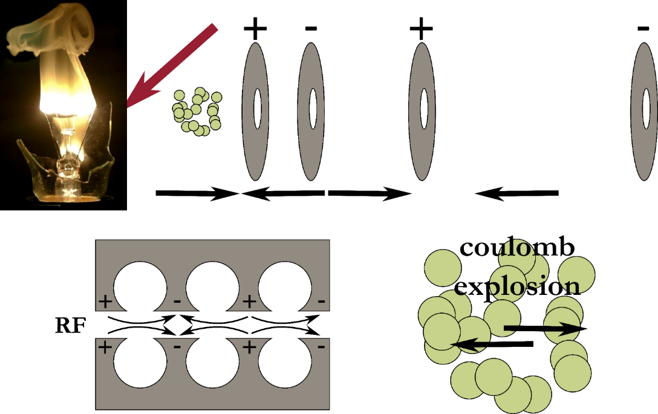
accelerating electrons

Slide 10
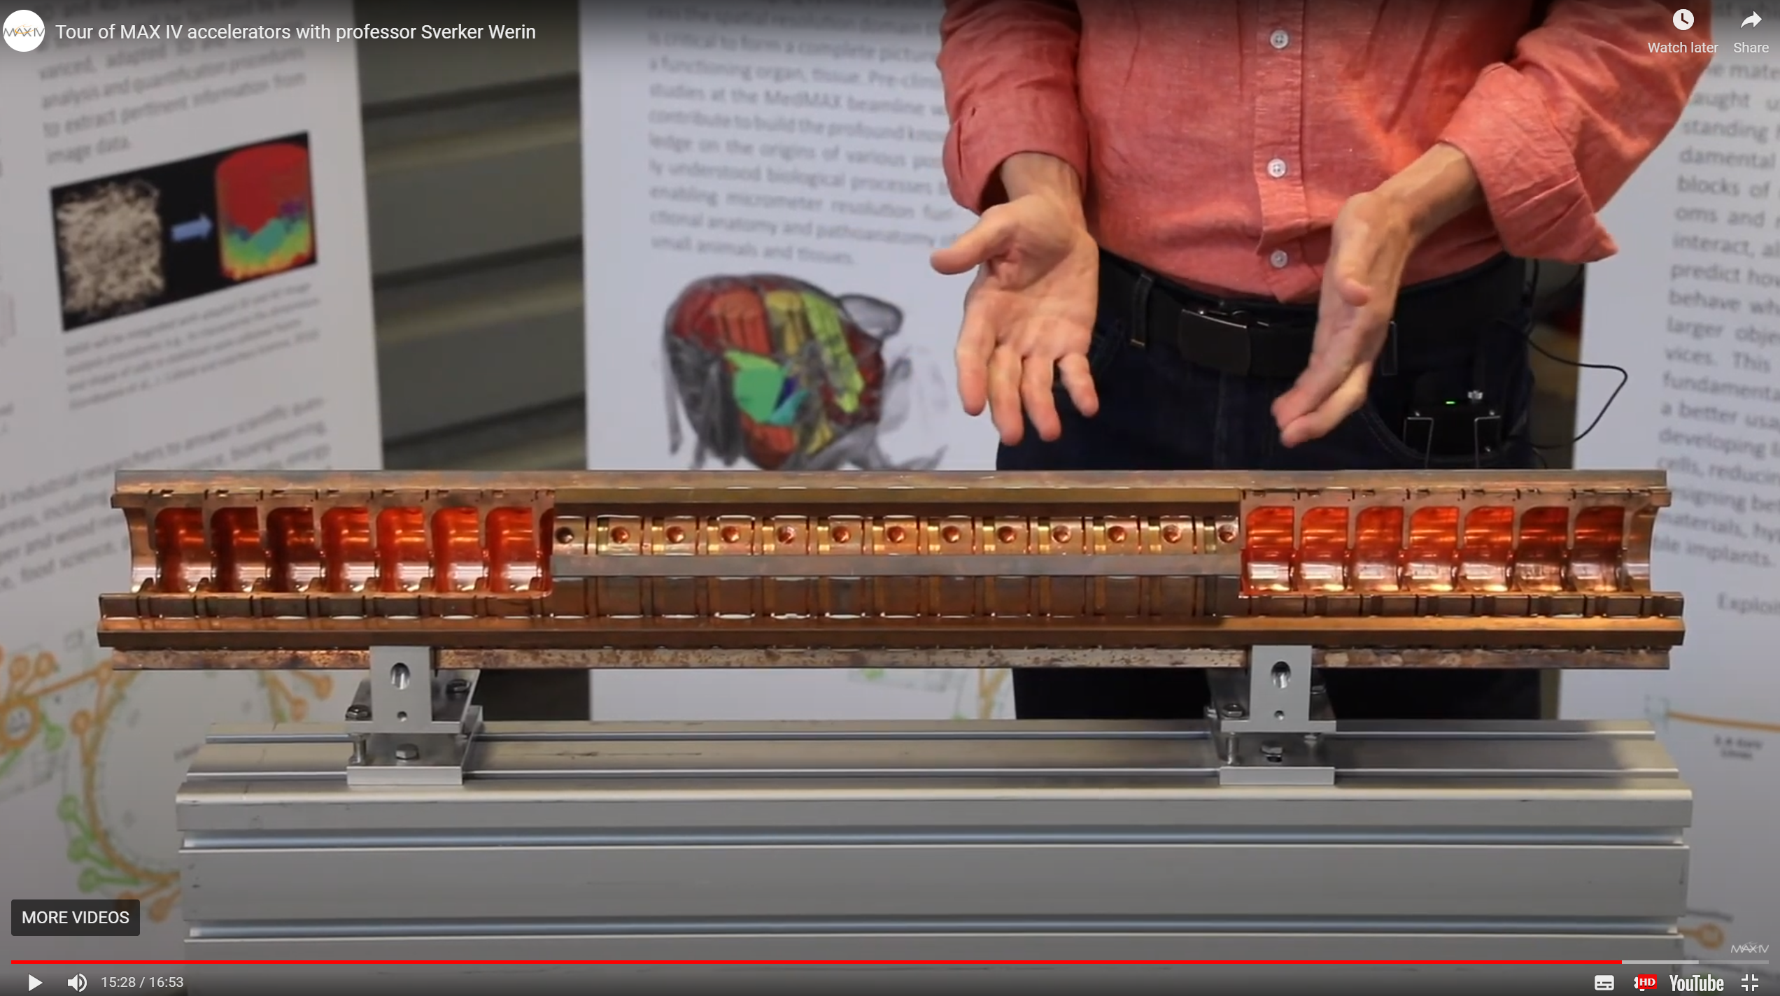
clystron

Slide 11
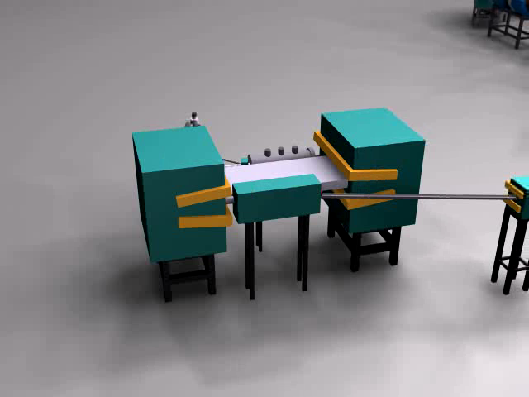
Video Circulating electrons
ISA, Centre for Storage Ring Facilities, Aarhus
https://www.isa.au.dk/animations/animations.asp
Accessed May 11 2020

Slide 12
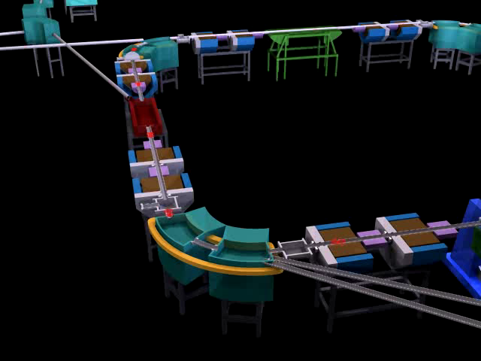
Video Insertion devices tangential beam
ISA, Centre for Storage Ring Facilities, Aarhus
https://www.isa.au.dk/animations/animations.asp
Accessed May 11 2020

Slide 13
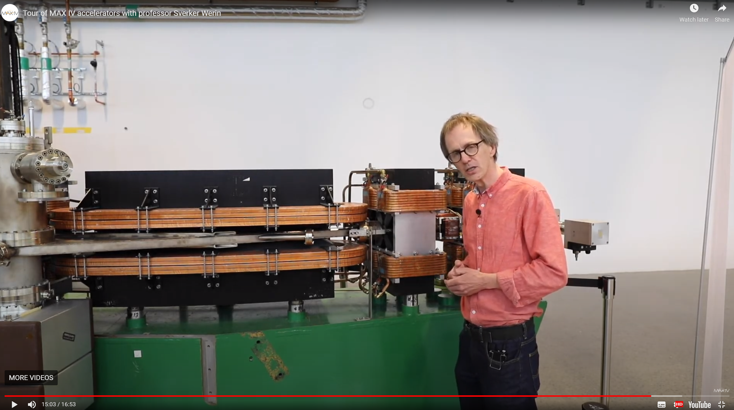
Old Bending magnet

Slide 14
Bending magnet

Slide 15
Bunch modes

Slide 16
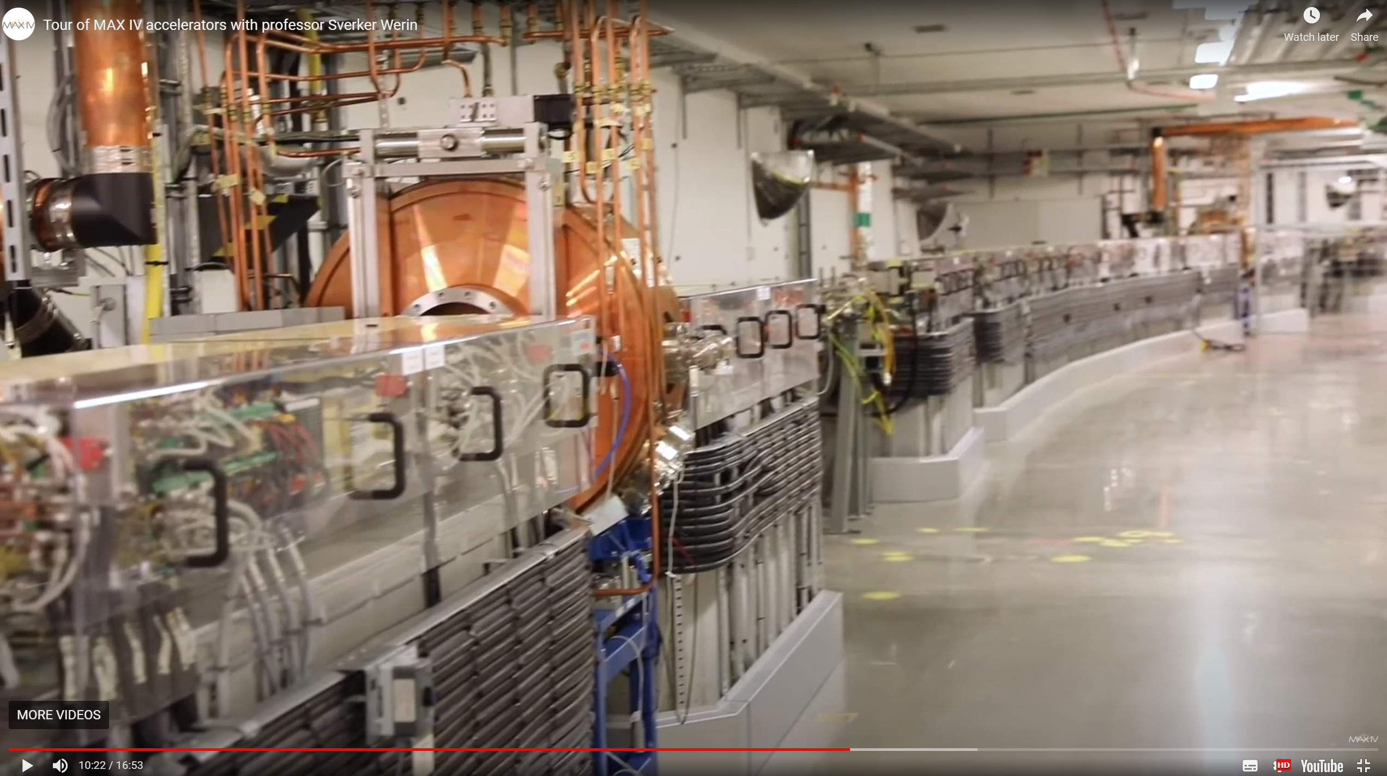
Look into ring

Slide 17
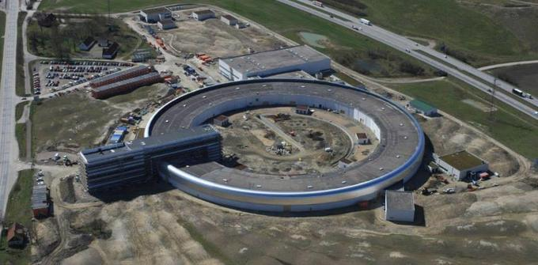
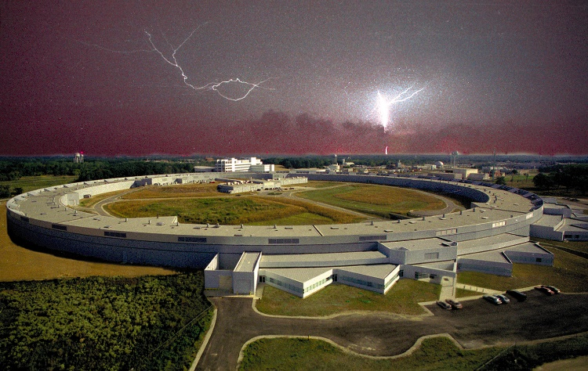
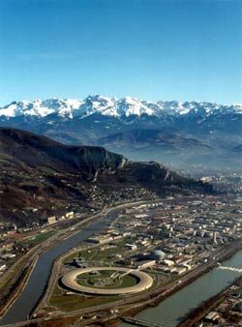
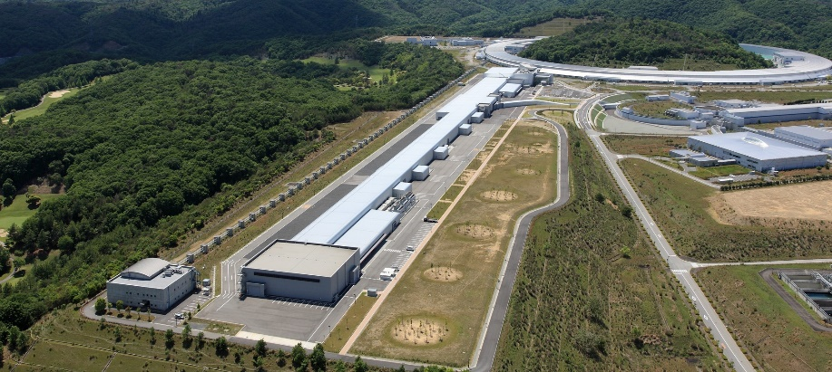
Synchrotrons
MaxIV, Lund 3 & 1.5 GeV ring
APS Chicago 6 GeV ring
100ps 10^13ph/s
8 GeV ring
SACLA 1ps 10^12ph/s
Osaka/Japan
ESRF Grenoble /France
6 GeV ring
100ps 10^14ph/s
Notes:
Among the many techniques
Overlap in time and space jitter?

Slide 18
Video Insertion devices tangential beam
ISA, Centre for Storage Ring Facilities, Aarhus
https://www.isa.au.dk/animations/animations.asp
Accessed May 11 2020

Slide 19
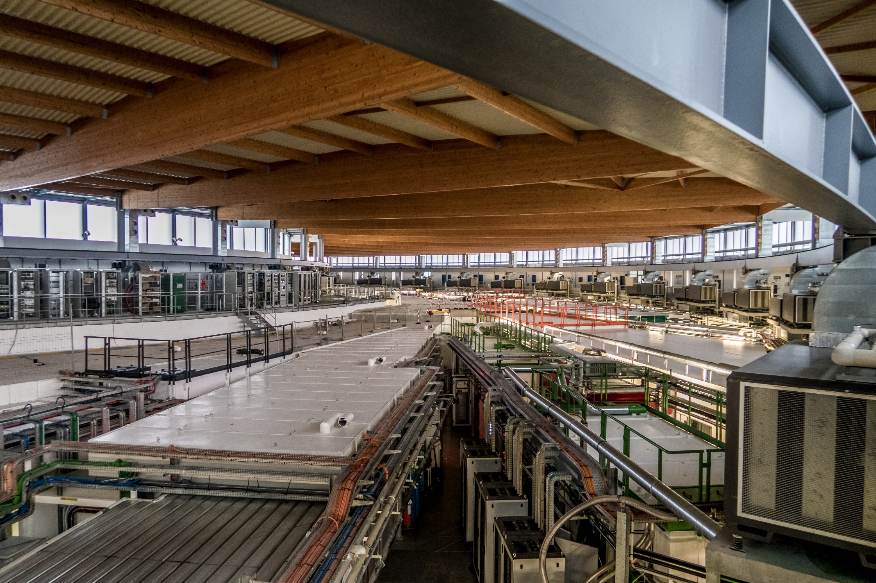
Photo Soleil, beamlines

Slide 20
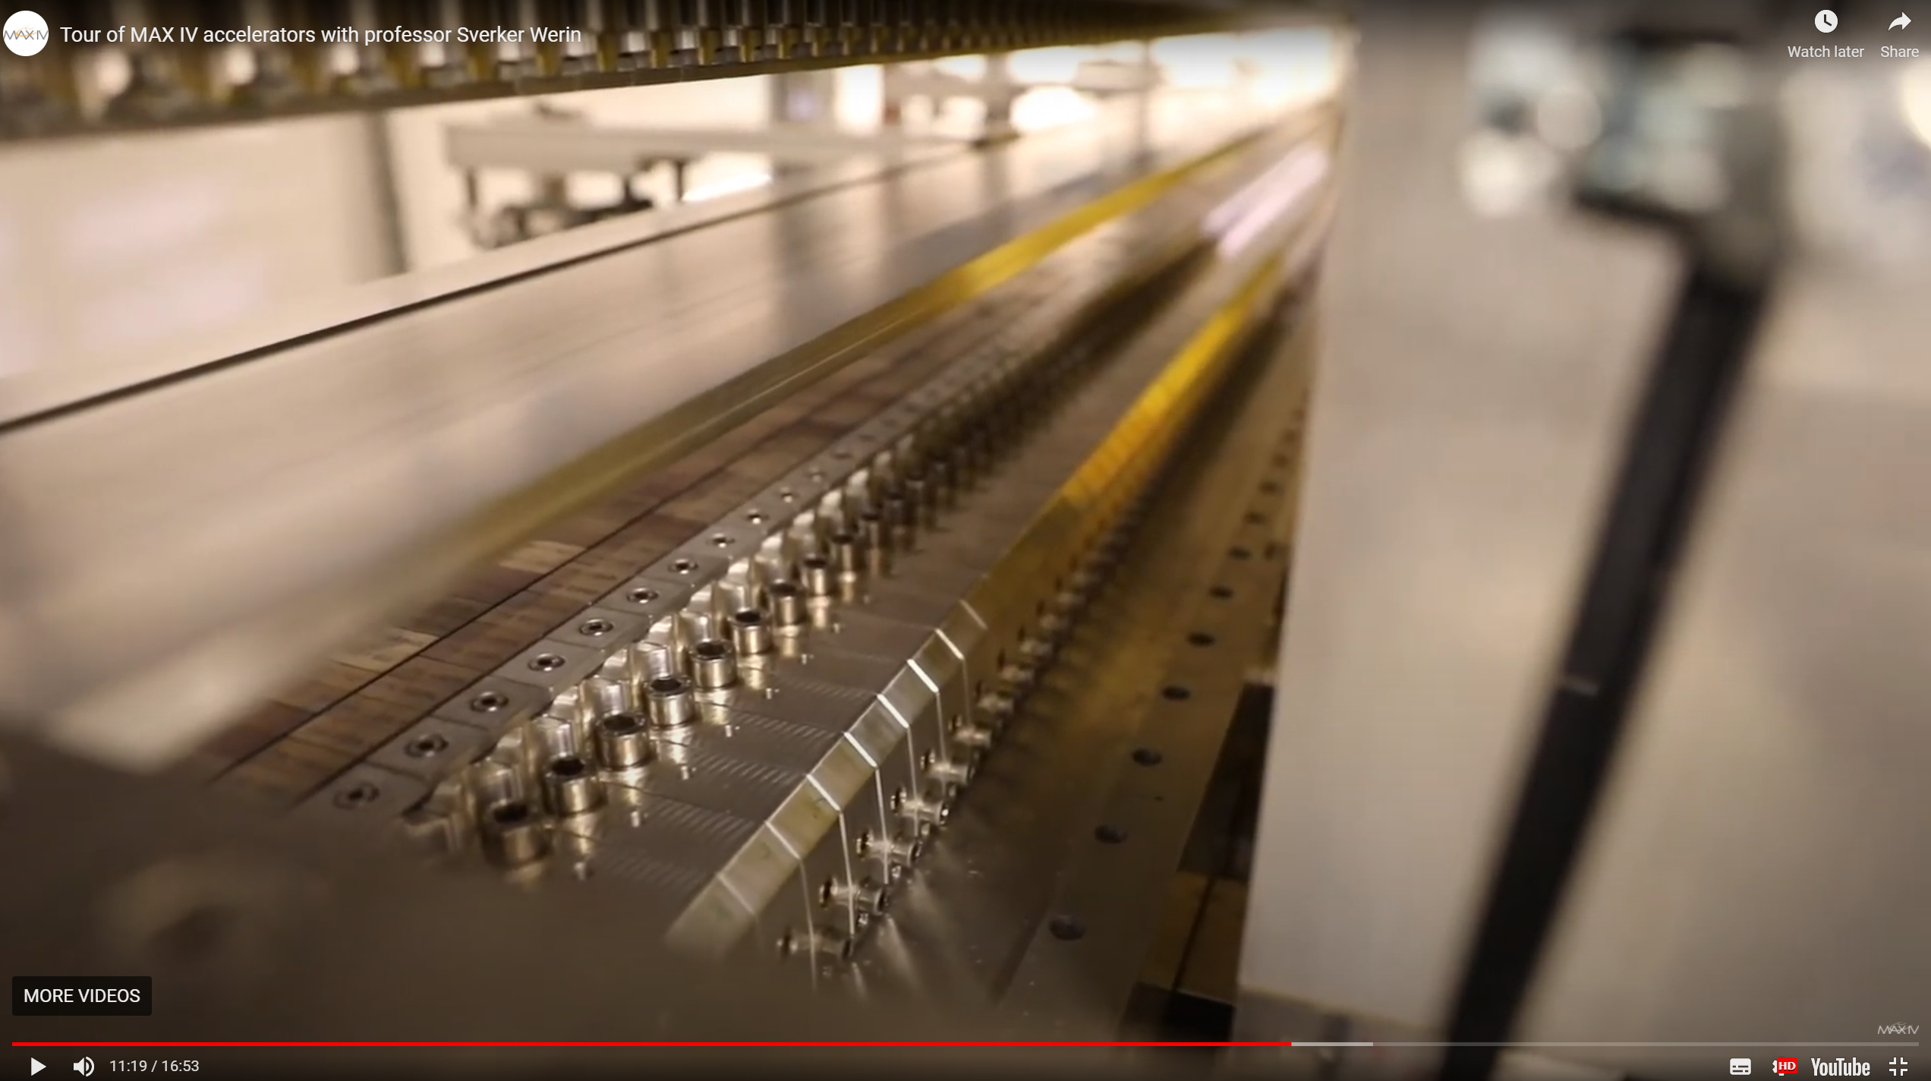
Look onto Undulator

Slide 21
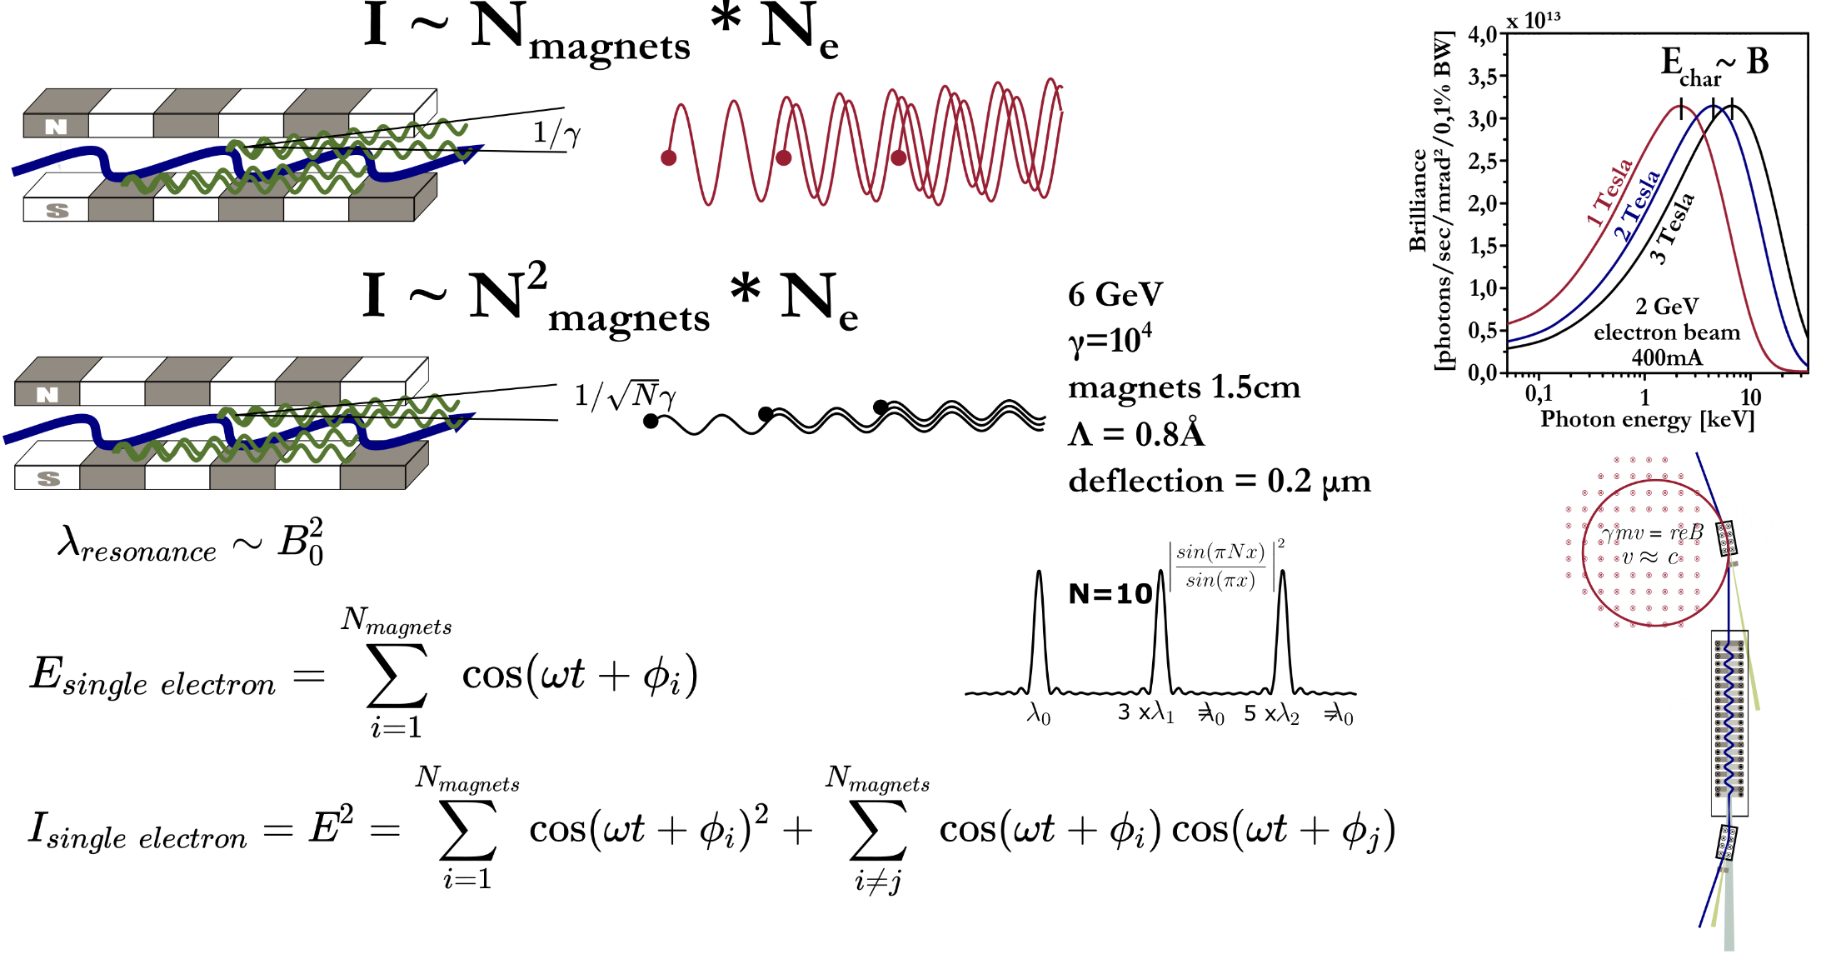
Wiggler and Undulator

Slide 22
Wiggler and Undulator

Slide 23

Wiggler and Undulator
$$K=\frac{e{λ_{u}B}_{0}}{2πcm_{e}}$$

Slide 24
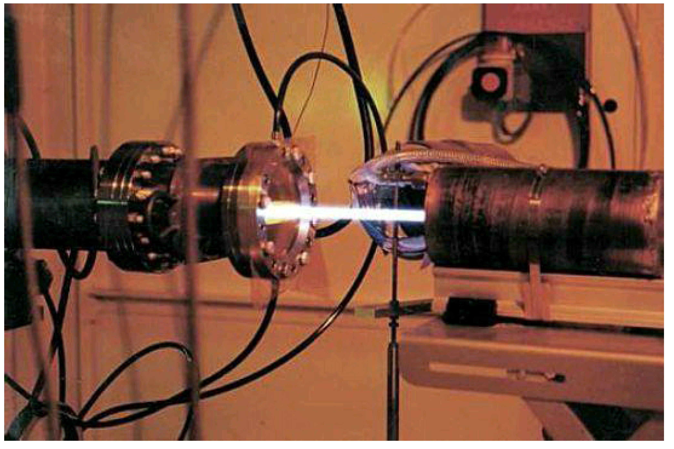
Wiggler and Undulator

Slide 25
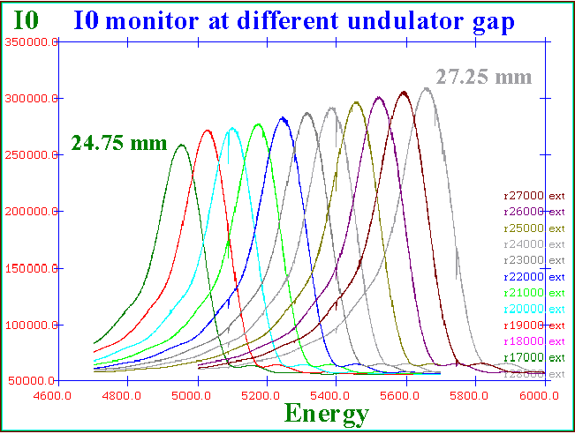
Undulator spectrum
ESRF ID26
https://www.esrf.eu/home/UsersAndScience/Experiments/EMD/ID26/Characteristics/ScanningModes.html

Slide 26
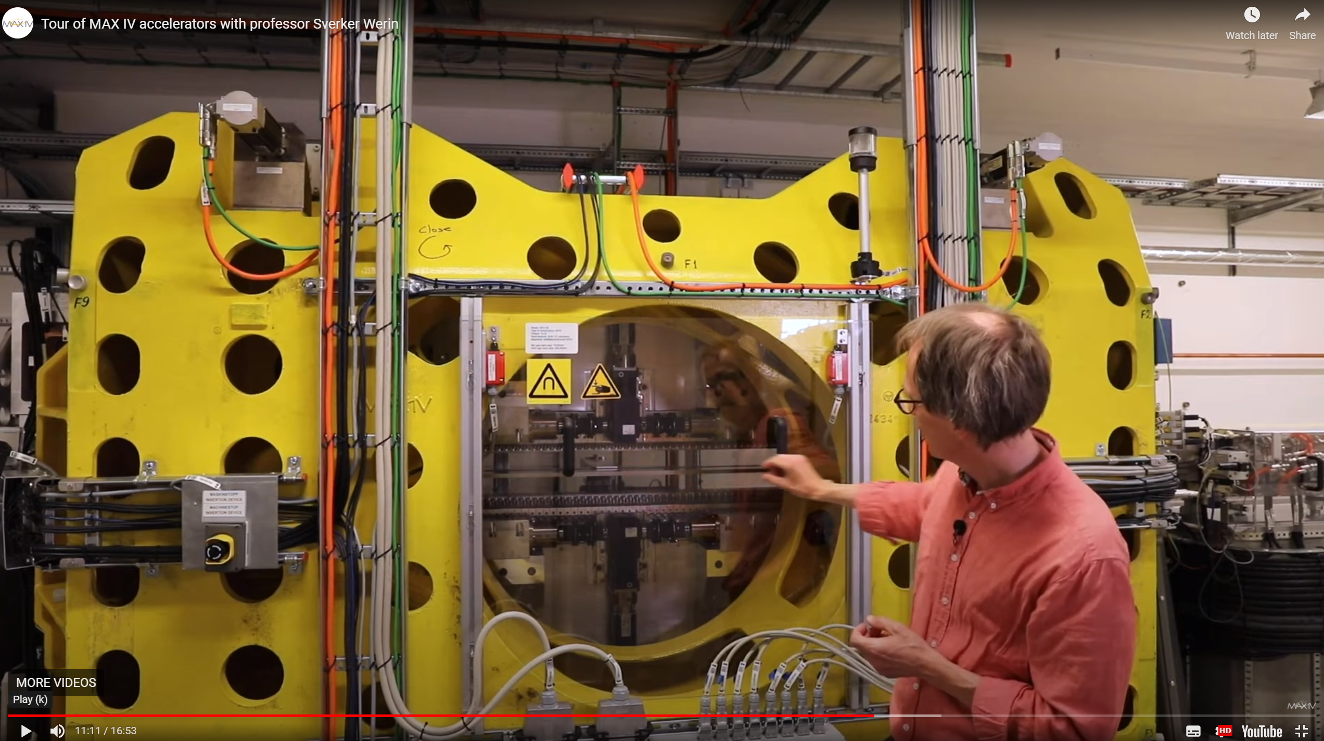
Look onto undulator from outside

Slide 27
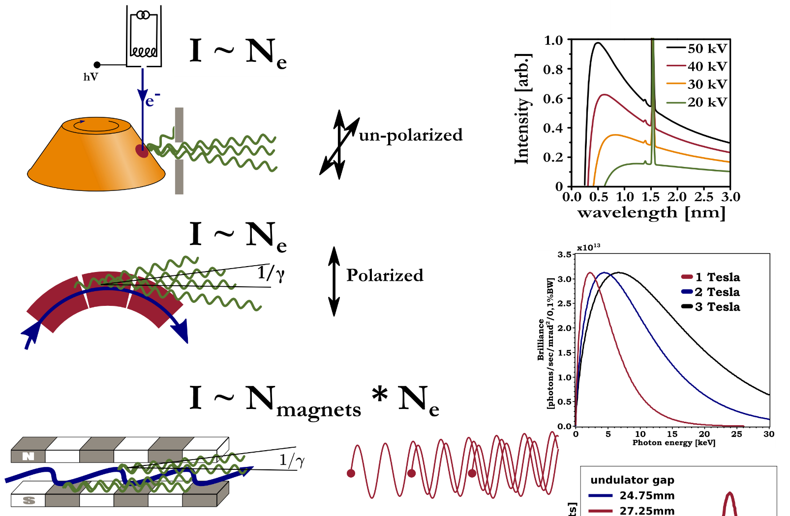
Sources 1st-3rd generation

Slide 28
Synchrotron sources

Slide 29
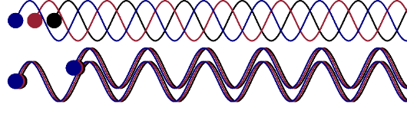
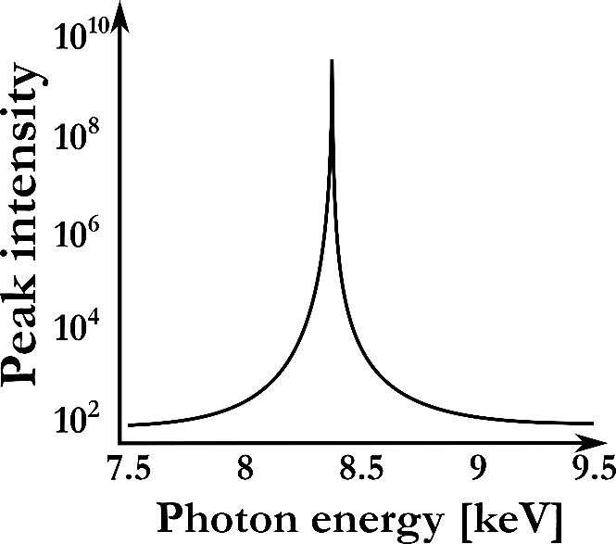
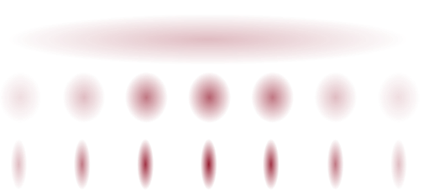
We create structure in the electron bunches
λ
Y. Ding, C. Behrens, P. Emma, J. Frisch, Z. Huang, H. Loos, P. Krejcik, M.-H. Wang, Physical Review Special Topics - Accelerators and Beams. 2011, 14 (12). DOI: 10.1103/physrevstab.14.120701.
SACLA Research Frontiers 2015 , Sato, T. and Yabashi, M.
http://www.spring8.or.jp/pdf/en/res_fro/15/128_129.pdf

Slide 30
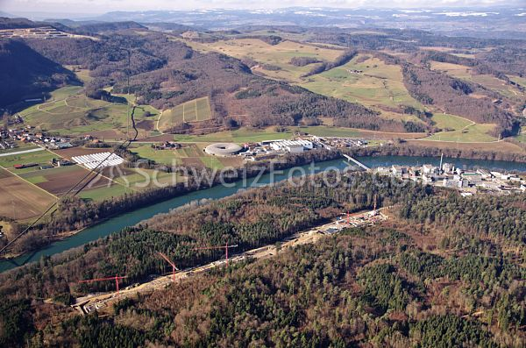
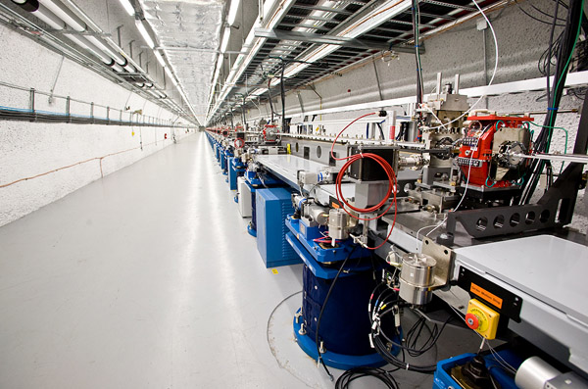

Short pulse sources
Swizzfel 50fs 10^12ph/s
Villigen, close to Zurich/Switzerland
3km linac 100fs 10^12ph/s
LCLS Stanford /California
European XFEL 50fs 10^17ph/s
Hamburg
FEMTOMAX at MAXIV 100fs 10^7ph/s scanable, Lund
Notes:
Among the many techniques
Overlap in time and space jitter?

Slide 31
Sources
ph/s (in 1eV)
10⁹
Excillium
10¹¹
10¹¹
10¹³
10¹⁴
10¹³

Slide 32


Accellerator based sources

Slide 33


Betatron 1
2-3 J in 50 fs
A. Macchi, M. Borghesi and M. Passoni, Ion acceleration by superintense laser-plasma interaction, Reviews of Modern Physics, 2013, 85, 751–793.
A. Döpp, B. Mahieu, A. Lifschitz, C. Thaury, A. Doche, E. Guillaume, G. Grittani, O. Lundh, M. Hansson, J. Gautier, M. Kozlova, J. P. Goddet, P. Rousseau, A. Tafzi, V. Malka, A. Rousse, S. Corde and K. T. Phuoc, Stable femtosecond X-rays with tunable polarization from a laser-driven accelerator, Light: Science & Applications, 2017, 6, e17086.

Slide 34


Betatron 2
High power laser facilities (dream beam)
Betatron oscillations
very short pulses
Inverse Compton sources
very high energy photons
@7keV = 7eV so
1e8 photons/shot/str
200 shots = 1e10 photons/h/str/eV
5Hz = 2e12 photons/h/str/eV
1KHz (plan) = 2e13 photons/h/str/eV
Images: Sci Rep 12, 10855 (2022). https://doi.org/10.1038/s41598-022-14748-z
Lund: Sci Rep . 2020 Oct 8;10(1):16807. doi: 10.1038/s41598-020-73805-7.

Slide 35



HHG 1
A. Harth, C. Guo, Y.-C. Cheng, A. Losquin, M. Miranda, S. Mikaelsson, C. M. Heyl, O. Prochnow, J. Ahrens, U. Morgner, A. L’Huillier and C. L. Arnold, Compact 200 kHz HHG source driven by a few-cycle OPCPA, Journal of Optics, 2018, 20, 14007.
Time delay differences [τ_{A}(2s) − τ_{A}(2p)] in neon
M. Isinger, R. J. Squibb, D. Busto, S. Zhong, A. Harth, D. Kroon, S. Nandi, C. L. Arnold, M. Miranda, J. M. Dahlström, E. Lindroth, R. Feifel, M. Gisselbrecht and A. L’Huillier, Photoionization in the time and frequency domain, Science, 2017, 358, 893–896.

Slide 36

HHG 2
Science, Kapteyn Volume: 336, Issue: 6086,
Pages: 1287-1291, DOI: (10.1126/science.1218497)

Slide 37

HHG 3
3e5 ph/str/h @4keV,
But 1e12/str/h @400eV (heard)
Optica, Vol. 9, No. 9 / September 2022 /
1003, https://doi.org/10.1364/OPTICA.456481

Slide 38
Source comparison

Slide 39







x-rays from water in general
500ph/eV/sr/shot = 1.8e9/ph/eV/h
4 micron
Notes:
Plasma source

Slide 40
Laboratory pump – probe setup
Fiber optic
Waterjet
Notes:
Laser based setup

Slide 41

time-resolved XAFS and XES at low excitation yield
64h
Wrong Experiment!!!
5e9ph/str/eV/h @4mJ
XES:
5e12ph/str/h (1000eV absorbed)
No detector saturation
The Journal of Physical Chemistry Letters, vol. 8, no. 5, pp. 1099–1104, Feb. 2017, doi: 10.1021/acs.jpclett.7b00078.

Slide 42




time-resolved XAFS and XES at low excitation yield
NIST with optics
12h
1 person setup and run,
4h accumulation,
3d printed chamber
NO optics
8ml at 6m/s, 10mMol, 15%
Physical Review X, vol. 6, no. 3, Sep. 2016,
doi: 10.1103/physrevx.6.031047.

Slide 43





My confession, I also went for bigger sources
Notes:
Plasma source

Slide 44



Spectrum at Eli
J. Synchrotron Radiat., vol. 28, no. 6, pp. 1778–1785, Nov. 2021, doi: 10.1107/s1600577521008729.
Notes:
Plasma source

Slide 45




Flux and fluctuations last year
J. Synchrotron Radiat., vol. 28, no. 6, pp. 1778–1785,
Nov. 2021, doi: 10.1107/s1600577521008729.
3e9ph/str/eV/h @30mJ (now is 100mJ)
With single crystal detector:
So 2h for steady state Kalpha after reasonable improvement with 100mJ in 2min
With the 16 crystal Zoltan will show you the same time for Kbeta
Differential spectrum x 10 – x100 (20-200min)
Notes:
Plasma source

Slide 46


Plasma
OPCPA
5e14ph/h in Kalpha = 1/4LCLS
800nm
1e13ph/h in Kalpha
1e12ph/eV/h
X50 water
Elsaesser, Nature Photonics, vol. 8, no. 12, pp. 927–930, 2014, doi: 10.1038/nphoton.2014.256. (same numbers CLEO 2022)

Slide 47


Using Plasma sources
1.5m
Geometry is the key, or: how much of the flux can you catch?
Here 6 cm!
15cm
Elaesser, CLEO, IEEE, 2022
JM2E.3
Price 400kEuro,
New bands from BASF, changing bands regularly
Here 1.8 cm = 11x the used flux

Slide 48

As seen with x-ray eyes. Simultaneous XES/XDS and slow XAS

Slide 49

Flux for different pump-probe techniques
Notes:
Interaction in different energy regions,
Nyquist theorem
x-rays (or similar wavelength

Slide 50

Flux for different pump-probe techniques
Notes:
Interaction in different energy regions,
Nyquist theorem
x-rays (or similar wavelength

Slide 51


Numbers from Experiments:
XANES, need for SN=4 3.2e6 photons/point, for f=20%,
XES, 4500 Kalpha max point, 700 Kbeta max point
Physical Review X, vol. 6, no. 3, Sep. 2016, doi: 10.1103/physrevx.6.031047.

Slide 52
Source comparison
OPCPA:
5e14ph/h/str in Kalpha = 1/4LCLS
800nm:
1e12ph/eV/h/str broadband copper
2e9/ph/eV/h/str broadband water
XAS: 200eV
XES: 1500eV
APS 7keV (approx.)
1e14 ph/s @ 6MHz mono chrome
2e13 ph/s @ 1.25 MHz
7e16 ph /h monochrome
LCLS 7keV (approx.)
1e10 ph/shot @ 60Hz
2e15 ph /h polychrome
2e13 ph /h monochrome

Slide 53





Crystal geometries
cylindrical bend
von-Hamos
Spherical bend,
Johan/Johannson
Flat
motor control
200 eV
Ø 0.2 mm on 25 cm
1mrad
$${≈1×10}^{−7}$$
shielding
0.2 mm x 10 cm
on 25 cm ${≈3×10}^{−5}$
motor control
Ø 10 cm 1/3
on 50 cm ${≈8×10}^{−4}$
0.5 eV
scanning
Gerry Seidler Global XAFS club
https://www.youtube.com/watch?v=3lJ9uE7Xvcg&t=101s

Slide 54

high efficient crystal detectors: efficiency <1e-7

Slide 55

How to use all these numbers:
XAS
XES
cylindrical bend von-Hamos
200 eV
Source to sample 2cm,
300 micron spot
str= 3e-5 str area
2e9ph/str/eV/h @8mJ
0.2 mm x 10 cm
on 25 cm ${≈3×10}^{−5}$
XAS: 200eV x 2e9ph/str/eV/h
x 3e-5 str =6e4/h we need 3e6 = 50h
XES: 1500eV x 2e9ph/str/eV/h = 3e12/h/str useful from the source
x 3e-5 str = 9e7/h hit sample and are absorbed
x 0.3 emission prob = 2.7e7/h/str emitted into 4pi
x 3e-5 str = 810/h detected Kalpha (1eV)
need 4500 = 5.5h
= 40/h detected Kbeta (all spectrum)
need 700 = 17 h
What can we improve? More crystals(x6)
Direct detection = 5000/s in theory, measured, 6h for small array, Factor 10 possible

Slide 56
Plan experiment

Slide 57
Global analysis
Notes:
Among the many techniques
Overlap in time and space jitter?

Slide 58





Summary and Acknowledgments
Care for your photons
Thanks for your attention

