Slide 1
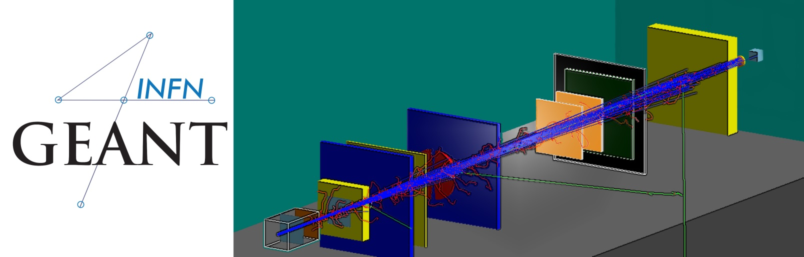


Interaction with the Geant4 kernel – part 1
A lot of material by G.A.P. Cirrone, L Pandola and J. Pipek
Notes:
[Sources]
- Cirrone - Kernel I.ppt, user-provided source deck; visible content preserved without modification.
[/Sources]

Slide 2






… User classes (cont'ed)
At initialization
At execution
G4VUserDetectorConstruction
G4VUserPrimaryGeneratorAction
G4VUserPhysicsList
G4UserRunAction*
G4UserEventAction
G4VUserActionInitialization
G4UserStackingAction
G4UserTrackingAction
G4UserSteppingAction
Global: only one instance exists in memory, shared by all threads.
Local: an instance of each action class exists for each thread.
(*) Two RunAction's allowed: one for master and one for threads
Notes:
[Sources]
- Cirrone - Kernel I.ppt, user-provided source deck; visible content preserved without modification.
[/Sources]

Slide 3
Outlook
Run, Event, Track, ...
a word about multi-threading
Optional user action classes
Command-based scoring
Accumulables
Analysis tools (detached slides)
Notes:
[Sources]
- Cirrone - Kernel I.ppt, user-provided source deck; visible content preserved without modification.
[/Sources]

Slide 4
Part I: The main ingredients
Notes:
[Sources]
- Cirrone - Kernel I.ppt, user-provided source deck; visible content preserved without modification.
[/Sources]

Slide 5
Geant4 terminology: an overview
The following keywords are often used in Geant4
Run, Event, Track, Step
Processes: At Rest, Along Step, Post Step
Cut (or production threshold)
Worker/master thread (for MT)
Notes:
[Sources]
- Cirrone - Kernel I.ppt, user-provided source deck; visible content preserved without modification.
[/Sources]

Slide 6
Run, Event and Tracks
Run
One Run consists of
Event #1 (track #1, track #2, ......)
Event #2 (track #1, track #2, ......)
.........
Event #N (track #1, track #2, ......)
Event 0
track 1
track 2
track 3
track 4
Event 1
track 1
track 2
track 3
Event 2
track 1
Event 3
track 1
track 2
track 3
track 4
Notes:
[Sources]
- Cirrone - Kernel I.ppt, user-provided source deck; visible content preserved without modification.
[/Sources]

Slide 7
The Event (G4Event)
An Event is the basic unit of simulation in Geant4
At the beginning of processing, primary tracks are generated and they are pushed into a stack
A track is popped up from the stack one-by-one and ‘tracked’
Secondary tracks are also pushed into the stack
When the stack gets empty, the processing of the event is completed
G4Event class represents an event. At the end of a successful event it has:
List of primary vertices and particles (as input)
Hits and Trajectory collections (as outputs)
G4EventManager class manages the event
G4UserEventAction is the optional User hook
Notes:
[Sources]
- Cirrone - Kernel I.ppt, user-provided source deck; visible content preserved without modification.
[/Sources]

Slide 8
The Run (G4Run)
As an analogy with a real experiment, a run of Geant4 starts with ‘Beam On’
Within a run, the User cannot change
The detector setup
The physics setting (processes, models)
A Run is a collection of events with the same detector and physics conditions
At the beginning of a Run, geometry is optimised for navigation and cross section tables are (re)calculated
The G4(MT)RunManager class manages the processing of each Run, represented by:
G4Run class
G4UserRunAction for an optional User hook
Notes:
[Sources]
- Cirrone - Kernel I.ppt, user-provided source deck; visible content preserved without modification.
[/Sources]

Slide 9
The Track (G4Track)
The Track is a snapshot of a particle and it is represented by the G4Track class
It keeps ‘current’ information of the particle (i.e. energy, momentum, position, polarization, ..)
It is updated after every step
The track object is deleted when
It goes outside the world volume
It disappears in an interaction (decay, inelastic scattering)
It is slowed down to zero kinetic energy and there are no 'AtRest' processes
It is manually killed by the user
No track object persists at the end of the event
G4TrackingManager class manages the tracking
G4UserTrackingAction is the optional User hook
Notes:
[Sources]
- Cirrone - Kernel I.ppt, user-provided source deck; visible content preserved without modification.
[/Sources]

Slide 10
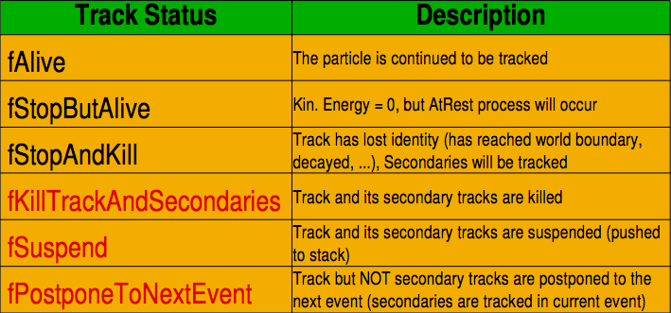
G4TrackStatus
After each step the track can change its state
The status can be (red can only be set by the User)
Notes:
[Sources]
- Cirrone - Kernel I.ppt, user-provided source deck; visible content preserved without modification.
[/Sources]

Slide 11
The Step (G4Step)
G4Step represents a step in the particle propagation
A G4Step object stores transient information of the step
In the tracking algorithm, G4Step is updated each time a process is invoked (e.g. multiple scattering)
You can extract information from a step after the step is completed, e.g. in
ProcessHits() method of your sensitive detector (see later)
UserSteppingAction() of your step action class file (see later)
Notes:
[Sources]
- Cirrone - Kernel I.ppt, user-provided source deck; visible content preserved without modification.
[/Sources]

Slide 12
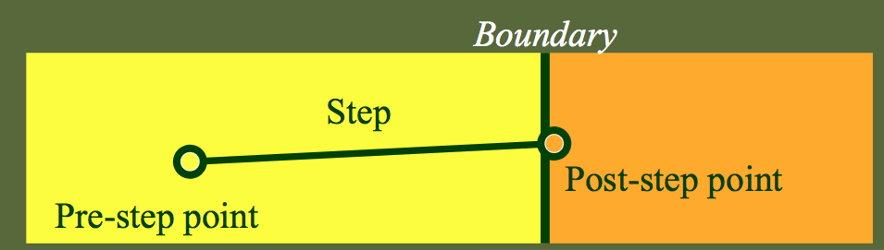
The Step in Geant4
The G4Step has the information about the two points (pre-step and post-step) and the ‘delta’ information of a particle (energy loss on the step, .....)
Each point knows the volume (and the material)
In case a step is limited by a volume boundary, the end point physically stands on the boundary and it logically belongs to the next volume
G4UserSteppingAction is the optional User hook
Notes:
[Sources]
- Cirrone - Kernel I.ppt, user-provided source deck; visible content preserved without modification.
[/Sources]

Slide 13
The G4Step object
A G4Step object contains
The two endpoints (pre and post step) so one has access to the volumes containing these endpoints
Changes in particle properties between the points
Difference of particle energy, momentum, .....
Energy deposition on step, step length, time-of-flight, ...
A pointer to the associated G4Track object
Volume hierarchy information
G4Step provides many Get… methods to access information or object istances
G4StepPoint* GetPreStepPoint(), .......
Notes:
[Sources]
- Cirrone - Kernel I.ppt, user-provided source deck; visible content preserved without modification.
[/Sources]

Slide 14
The geometry boundary
To check if a step ends on a boundary, one may compare if the physical volume of pre and post-step points are equal
One can also use the step status
Step Status provides information about the process that restricted the step length
It is attached to the step points: the pre has the status of the previous step, the post of the current step
If the status of POST is fGeometryBoundary the step ends on a volume boundary (does not apply to word volume)
To check if a step starts on a volume boundary you can also use the step status of the PRE-step point
Notes:
[Sources]
- Cirrone - Kernel I.ppt, user-provided source deck; visible content preserved without modification.
[/Sources]

Slide 15
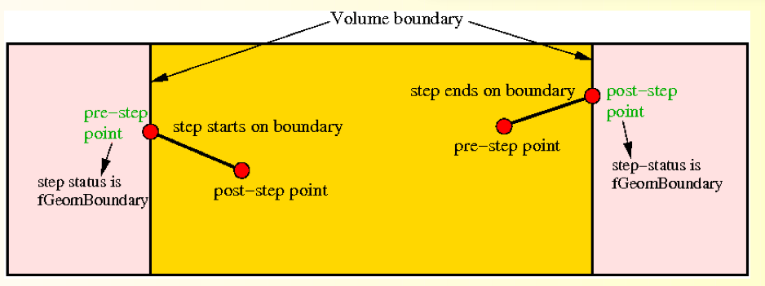
Step concept and boundaries
Notes:
[Sources]
- Cirrone - Kernel I.ppt, user-provided source deck; visible content preserved without modification.
[/Sources]

Slide 16
Example: parent track and process
if (track->GetTrackID() != l)
{
G4cout << "Particle is a secondary" << G4endl;
if (track->GetParentID() == l)
{
G4cout << "But parent was a primary" << G4endl;
}
// Get process information
G4VProcess* creatorProcess = track->GetCreatorProcess();
G4String processName = creatorProcess->GetProcessName();
G4cout << "Particle was created by " << processName << G4endl;
}
}
Notes:
[Sources]
- Cirrone - Kernel I.ppt, user-provided source deck; visible content preserved without modification.
[/Sources]

Slide 17
Example: boundaries
G4StepPoint* preStepPoint = step -> GetPreStepPoint();
G4StepPoint* postStepPoint = step -> GetPostStepPoint();
// Use the GetStepStatus() method of G4StepPoint to get the status of the
// current step (contained in post-step point) or the previous step
// (contained in pre-step point):
if(preStepPoint -> GetStepStatus() == fGeomBoundary) {
G4cout << "Step starts on geometry boundary" << G4endl;
}
if(postStepPoint -> GetStepStatus() == fGeomBoundary) {
G4cout << "Step ends on geometry boundary" << G4endl;
}
// You can retrieve the material of the next volume through the
// post-step point:
G4Material* nextMaterial = step->GetPostStepPoint()->GetMaterial();
Notes:
[Sources]
- Cirrone - Kernel I.ppt, user-provided source deck; visible content preserved without modification.
[/Sources]

Slide 18
Example: step "deltas"
MySensitiveDetector::ProcessHits(G4Step* step, G4TouchableHistory*) {
// Total energy deposition on the step (= energy deposited by energy loss
// process and energy of secondaries that were not created since their
// process and energy of secondaries that were not created since their
// energy was < Cut):
G4double energyDeposit = step -> GetTotalEnergyDeposit();
// Difference of energy, position and momentum of particle between pre-
// and post-step point
G4double deltaEnergy = step -> GetDeltaEnergy();
G4ThreeVector deltaPosition = step -> GetDeltaPosition();
G4double deltaMomentum = step -> GetDeltaMomentum();
// Step length
G4double stepLength = step -> GetStepLength();
}
Notes:
[Sources]
- Cirrone - Kernel I.ppt, user-provided source deck; visible content preserved without modification.
[/Sources]

Slide 19
Example: particle info
// Retrieve from the current step the track (after PostStepDolt of
// step is completed):
G4Track* track = step -> GetTrack();
// From the track you can obtain the pointer to the dynamic particle:
const G4DynamicParticle* dynParticle = track -> GetDynamicParticle();
// From the dynamic particle, retrieve the particle definition:
G4ParticleDefinition* particle = dynParticle -> GetDefinition();
// The dynamic particle class contains e.g. the kinetic energy after the step:
G4double kinEnergy = dynParticle -> GetKineticEnergy();
// From the particle definition class you can retrieve static
// information like the particle name:
G4String particleName = particle -> GetParticleName();
G4cout << particleName << ": kinetic energy of "
<< (kinEnergy / MeV) << " MeV" << G4endl;
Notes:
[Sources]
- Cirrone - Kernel I.ppt, user-provided source deck; visible content preserved without modification.
[/Sources]

Slide 20
Part II: Optional User Action classes
Notes:
[Sources]
- Cirrone - Kernel I.ppt, user-provided source deck; visible content preserved without modification.
[/Sources]

Slide 21
Optional user classes
Five base classes with virtual methods the user may override to step during the execution of the application ("user hooks“)
G4UserRunAction
G4UserEventAction
G4UserTrackingAction
G4UserStackingAction
G4UserSteppingAction
Default implementation (not purely virtual): do nothing
Therefore, override only the methods you need.
e.g. actions to be done at the beginning and end of each event
Notes:
[Sources]
- Cirrone - Kernel I.ppt, user-provided source deck; visible content preserved without modification.
[/Sources]

Slide 22
Multi-threaded processing of events
Master thread
Worker 1
Worker 2
Worker 3
G4Run (100 evts)
G4Run (33 evts)
G4Run (34 evts)
G4Run (33 evts)
Event 0
Event 33
Event 67
...
...
...
Event 32
Event 66
Event 99
Results
Results
Results
G4Run::Merge()
Results
Notes:
[Sources]
- Cirrone - Kernel I.ppt, user-provided source deck; visible content preserved without modification.
[/Sources]

Slide 23
User actions in MT mode
Master
Geometry
Physics
RunAction
READONLY
Workers
Primary
Primary
Primary
RunAction
RunAction
RunAction
EvtAction
EvtAction
EvtAction
Notes:
[Sources]
- Cirrone - Kernel I.ppt, user-provided source deck; visible content preserved without modification.
[/Sources]

Slide 24

G4UserRunAction
void BeginOfRunAction(const G4Run*)
void EndOfRunAction(const G4Run*)
G4Run* GenerateRun()
Uses:
Book/output histograms and other analysis tools
Custom G4Run with additional information
Define parameters
MT
Notes:
[Sources]
- Cirrone - Kernel I.ppt, user-provided source deck; visible content preserved without modification.
[/Sources]

Slide 25
G4UserEventAction
void BeginOfEventAction(const G4Event*)
void EndOfEventAction(const G4Event*)
Uses:
Hit collection and event analysis
Event selection
Logging (e.g. output event number)
Notes:
[Sources]
- Cirrone - Kernel I.ppt, user-provided source deck; visible content preserved without modification.
[/Sources]

Slide 26
G4UserStackingAction
G4ClassificationOfNewTrack ClassifyNewTrack(const G4Track*)
void NewStage()
void PrepareNewEvent()
Uses:
Pre-selection of tracks (~manual cuts)
Optimization of the order of track execution
Notes:
[Sources]
- Cirrone - Kernel I.ppt, user-provided source deck; visible content preserved without modification.
[/Sources]

Slide 27
G4UserTrackingAction
void PreUserTrackingAction(const G4Track*)
void PostUserTrackingAction(const G4Track*)
Uses:
Track pre-selection
Store trajectories
Notes:
[Sources]
- Cirrone - Kernel I.ppt, user-provided source deck; visible content preserved without modification.
[/Sources]

Slide 28
G4UserSteppingAction
void UserSteppingAction(const G4Step*)
Uses:
Get information about particles
Kill tracks under specific circumstances
Notes:
[Sources]
- Cirrone - Kernel I.ppt, user-provided source deck; visible content preserved without modification.
[/Sources]

Slide 29
User-defined run class
MT
class MyRun : public G4Run
{ ... };
Virtual methods
RecordEvent()
called at the end of each event
alternative to EndOfEventAction() of the EventAction class
Merge()
Called at the end of each worker run by the master
When/why to use it?
Convenient in MT-mode, because it allows the merging of information (global quantities) from thread-local runs into the master
UserEventAction is thread-local
Notes:
[Sources]
- Cirrone - Kernel I.ppt, user-provided source deck; visible content preserved without modification.
[/Sources]

Slide 30
Registration of user actions
In multi-threading mode (and sequential), objects of user action classes must be registered to the G4(MT)RunManager via a user-defined action initialization class
In sequential mode, the actions can also be registered to the run manager directly (not recommended)
runManager->SetUserInitialization( new MyActionInitialization);
runManager->SetUserAction(new MyRunAction);
Notes:
[Sources]
- Cirrone - Kernel I.ppt, user-provided source deck; visible content preserved without modification.
[/Sources]

Slide 31

MyActionInitialization
Register thread-local user actions
void MyActionInitialization::Build() const
{
//Set mandatory classes
SetUserAction(new MyPrimaryGeneratorAction());
// Set optional user action classes
SetUserAction(new MyEventAction());
SetUserAction(new MyRunAction());
}
Also the primary
generator
Register RunAction for the master (optional)
void MyActionInitialization::BuildForMaster() const
{
// Set optional user action classes
SetUserAction(new MyMasterRunAction());
}
Notes:
[Sources]
- Cirrone - Kernel I.ppt, user-provided source deck; visible content preserved without modification.
[/Sources]

Slide 32
Multiple user actions
G4MultiRunAction
G4MultiEventAction
G4MultiTrackingAction
G4MultiSteppingAction
no G4MultiStackingAction
auto multiAction = new G4MultiEventAction{ new MyEventAction1,
new MyEventAction2 };
//...
multiAction->push_back(new MyEventAction3);
SetUserAction(multiAction);
Containers enabling to have multiple user actions of the same “kind”, implemented as customized std::vector’s.
Notes:
[Sources]
- Cirrone - Kernel I.ppt, user-provided source deck; visible content preserved without modification.
[/Sources]

Slide 33
Part III: Command-based scoring
Notes:
[Sources]
- Cirrone - Kernel I.ppt, user-provided source deck; visible content preserved without modification.
[/Sources]

Slide 34
Command-based scoring
UI commands for scoring → no C++ required, apart from instantiating G4ScoringManager in main()
int main() {
…
G4ScoringManager::GetScoringManager(); …
}
Define a scoring mesh
/score/create/boxMesh <mesh_name>
/score/open, /score/close
Define mesh parameters
/score/mesh/boxsize <dx> <dy> <dz>
/score/mesh/nbin <nx> <ny> <nz>
/score/mesh/translate,
Define primitive scorers
/score/quantity/eDep <scorer_name>
/score/quantity/cellFlux <scorer_name>
currently 20 scorers are available
Define filters
/score/filter/particle <filter_name> <particle_list>
/score/filter/kinE <filter_name> <Emin> <Emax> <unit>
currently 5 filters are available
Output
/score/draw <mesh_name> <scorer_name>
/score/dump,
/score/list
Notes:
[Sources]
- Cirrone - Kernel I.ppt, user-provided source deck; visible content preserved without modification.
[/Sources]

Slide 35
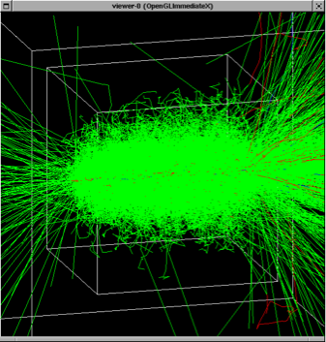
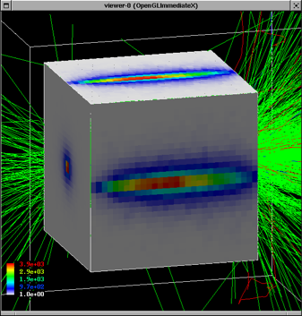
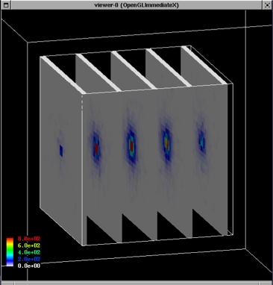
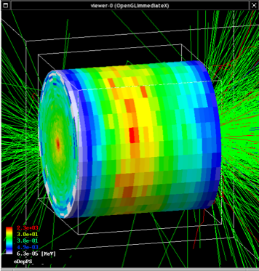
35
Notes:
[Sources]
- Cirrone - Kernel I.ppt, user-provided source deck; visible content preserved without modification.
[/Sources]

Slide 36
G4analysis tools
(detached session)
Notes:
[Sources]
- Cirrone - Kernel I.ppt, user-provided source deck; visible content preserved without modification.
[/Sources]

Slide 37
Geant4 analysis classes
A basic analysis interface is available in Geant4 for histograms (1D and 2D) and ntuples
Make life easier because they are thread-safe
ROOT is not! Manual text output usually not!
No need to worry about the interference of threads
Unique interface to support different output formats
ROOT, AIDA XML, CSV and HBOOK
Code is the same, just change one line to switch from one to an other
Everything done via G4AnalysisManager
Singleton class → use Instance()
UI commands available
Notes:
[Sources]
- Cirrone - Kernel I.ppt, user-provided source deck; visible content preserved without modification.
[/Sources]

Slide 38

g4analysis
Selection of output format is performed by including a proper header file
All the rest of the code unchanged
Unique interface
#ifndef MyAnalysis_h
#define MyAnalysis_h 1
#include "g4root.hh"
//#include "g4xml.hh"
//#include "g4csv.hh" // can be used only with ntuples
#endif
Advanced topic: It is possible to use more formats at the same time. See documentation.
Notes:
[Sources]
- Cirrone - Kernel I.ppt, user-provided source deck; visible content preserved without modification.
[/Sources]

Slide 39
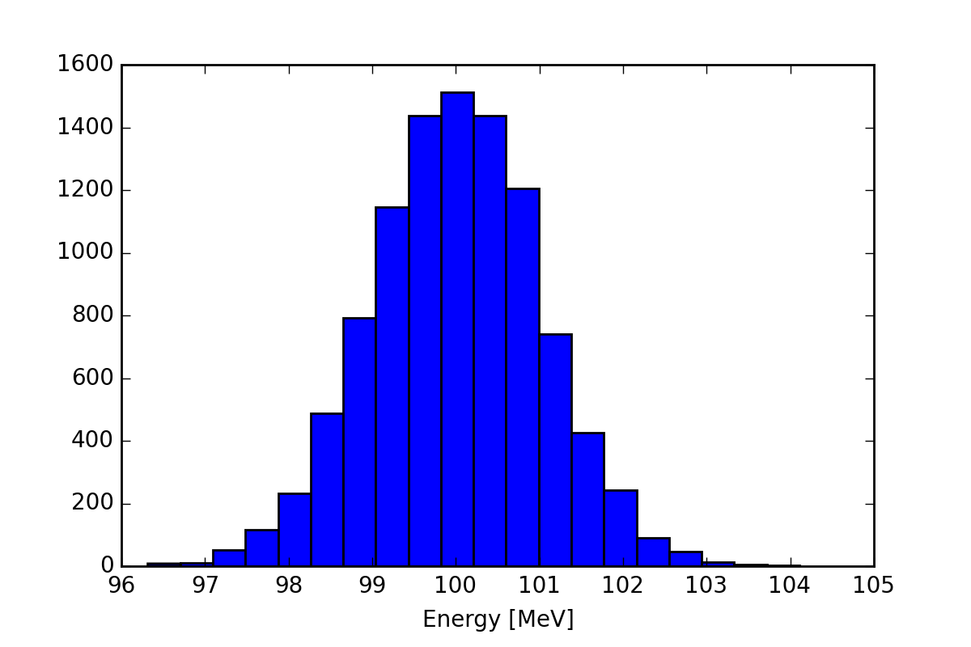
Histograms
Notes:
[Sources]
- Cirrone - Kernel I.ppt, user-provided source deck; visible content preserved without modification.
[/Sources]

Slide 40
Open file and book histograms
#include "MyAnalysis.hh"
void MyRunAction::BeginOfRunAction(const G4Run* run)
{
// Get analysis manager
G4AnalysisManager* man = G4AnalysisManager::Instance();
man->SetVerboseLevel(1);
man->SetFirstHistoId(1);
// Creating histograms
man->CreateH1("h","Title", 100, 0., 800);
man->CreateH1("hh","Title",100,0.,10);
// Open an output file
man->OpenFile("myoutput");
}
Open output file
Notes:
[Sources]
- Cirrone - Kernel I.ppt, user-provided source deck; visible content preserved without modification.
[/Sources]

Slide 41
Fill histograms and write on file
#include "MyAnalysis.hh"
void MyEventAction::EndOfEventAction(const G4Run* aRun)
{
auto man = G4AnalysisManager::Instance();
man->FillH1(1, fEnergyAbs/MeV);
man->FillH1(2, fEnergyGap/MeV);
}
void MyRunAction::EndOfRunAction(const G4Run* aRun)
{
G4AnalysisManager::Instance()->Write();
}
int main()
{
...
G4AnalysisManager::Instance()->CloseFile();
}
ID=1
ID=2
Notes:
[Sources]
- Cirrone - Kernel I.ppt, user-provided source deck; visible content preserved without modification.
[/Sources]

Slide 42
Ntuples
EventID | Energy | x | y
0 | 99.5161753 | -0.739157031 | -0.014213165
1 | 98.0020355 | 1.852812521 | 1.128640204
2 | 100.0734469 | 0.863203688 | -0.277949199
3 | 99.3508677 | -2.063452685 | -0.898594988
4 | 101.2505954 | 1.030581054 | 0.736468229
5 | 98.9849841 | -1.464509417 | -1.065372115
6 | 101.1547644 | 1.121931704 | -0.203319254
7 | 100.8876748 | 0.012068917 | -1.283410959
8 | 100.3013861 | 1.852532119 | -0.520615895
9 | 100.6295882 | 1.084122362 | 0.556967258
10 | 100.4887681 | -1.021971662 | 1.317380892
11 | 101.6716567 | 0.614222096 | -0.483530242
12 | 99.1083093 | -0.776034456 | 0.203524549
13 | 97.3595776 | 0.814378204 | -0.690615126
14 | 100.7264612 | -0.408732803 | -1.278746667
Notes:
[Sources]
- Cirrone - Kernel I.ppt, user-provided source deck; visible content preserved without modification.
[/Sources]

Slide 43
Ntuples support
g4tool supports ntuples
Any number of ntuples
Any number of columns per ntuple
Supported types are int/float/double
For more complex tasks (e.g. full functionality of ROOT TTrees) have to link ROOT directly
And take care of thread-safety
Notes:
[Sources]
- Cirrone - Kernel I.ppt, user-provided source deck; visible content preserved without modification.
[/Sources]

Slide 44
Book ntuples
#include "MyAnalysis.hh"
void MyRunAction::BeginOfRunAction(const G4Run* run)
{
// Get analysis manager
auto man = G4AnalysisManager::Instance();
man-> SetFirstNtupleId(1);
// Creating ntuple
man->CreateNtuple("name", "Title");
man->CreateNtupleDColumn("Eabs");
man->CreateNtupleDColumn("Egap");
man->FinishNtuple();
man->CreateNtuple("name2","title2");
man->CreateNtupleIColumn("ID");
man->FinishNtuple();
}
Notes:
[Sources]
- Cirrone - Kernel I.ppt, user-provided source deck; visible content preserved without modification.
[/Sources]

Slide 45
Fill ntuples
File handling and general clean-up as shown for histograms
#include "MyAnalysis.hh"
void MyEventAction::EndOfEventAction(const G4Run* aRun)
{
auto man = G4AnalysisManager::Instance();
man->FillNtupleDColumn(1, 0, fEnergyAbs);
man->FillNtupleDColumn(1, 1, fEnergyGap);
man->AddNtupleRow(1);
man->FillNtupleIColumn(2, 0, fID);
man->AddNtupleRow(2);
}
ID=1,
columns 0, 1
Notes:
[Sources]
- Cirrone - Kernel I.ppt, user-provided source deck; visible content preserved without modification.
[/Sources]

Slide 46
G4Accumulable<T>
Templated class to collect simple information
Thread-safe
Accumulable during Run
Value merge at the end (explicit)
Scalar variables only (otherwise, expert)
Alternative to ntuples/histograms (later)
Managed by G4AccumulableManager
Geant4 10.2: Previously named G4Parameter!
Notes:
[Sources]
- Cirrone - Kernel I.ppt, user-provided source deck; visible content preserved without modification.
[/Sources]

Slide 47
G4Accumulable – C++ (1)
► G4Accumulable.hh
1) Declare (instance) variables (of RunAction)
G4Accumulable<G4int> fNElectrons;
G4Accumulable<G4double> fAverageElectronEnergy;
2) Register to accumulable manager (in RunAction constructor)
G4AccumulableManager* accManager = G4AccumulableManager::Instance();
accManager->RegisterAccumulable(fNElectrons);
accManager->RegisterAccumulable(fAverageElectronEnergy);
3) Reset to zero values (in RunAction::BeginOfRunAction)
G4AccumulableManager* accManager = G4AccumulableManager::Instance();
accManager->Reset();
4) Update during run (e.g. in Stacking action)
fNElectrons += 1; // Normal arithmetics
Notes:
[Sources]
- Cirrone - Kernel I.ppt, user-provided source deck; visible content preserved without modification.
[/Sources]

Slide 48
G4Accumulable – C++ (2)
5) Merge after run (in RunAction::EndOfRunAction)
G4AccumulableManager* accManager = G4AccumulableManager::Instance();
accManager->Merge();
6) Report after run (in RunAction::EndOfRunAction)
G4AccumulableManager* accManager = G4AccumulableManager::Instance();
if (IsMaster())
{
if (fNElectrons.GetValue())
{
G4cout << " * Produced " << fNElectrons.GetValue();
G4cout << " secondary electrons/event. Average energy: ";
G4cout << fAverageElectronEnergy.GetValue()/keV/fNElectrons.GetValue();
G4cout << " keV" << G4endl;
}
else
G4cout << " * No secondary electrons produced" << G4endl;
}
Notes:
[Sources]
- Cirrone - Kernel I.ppt, user-provided source deck; visible content preserved without modification.
[/Sources]

Slide 49
More slides…
Notes:
[Sources]
- Cirrone - Kernel I.ppt, user-provided source deck; visible content preserved without modification.
[/Sources]

Slide 50
Output stream (G4cout)
G4cout is a iostream object defined by Geant4.
Used in the same way as standard std::cout
Output streams handled by G4UImanager
G4endl is the equivalent of std::endl to end a line
MT-handling: will display also the threadID
WT1> I am here
WT5> I am here
Output strings may be displayed in another window (Qt GUI) or redirected to a file
Notes:
[Sources]
- Cirrone - Kernel I.ppt, user-provided source deck; visible content preserved without modification.
[/Sources]

Slide 51
Example: output on screen
void SteppingAction::UserSteppingAction(const G4Step* aStep)
{
// Collect data
G4Track* theTrack = aStep->GetTrack();
G4DynamicParticle* particle = theTrack->GetDynamicParticle();
G4ParticleDefinition* parDef = particle->GetDefinition();
G4double edep = aStep->GetTotalEnergyDeposit();
G4double particleCharge = particle->GetCharge();
G4double kineticEnergy = theTrack->GetKineticEnergy();
// The output
G4cout
<< "Energy deposited--->" << " " << edep << "
<< "Charge--->" << " " << particleCharge << " "
<< "Kinetic Energy --->" << " " << kineticEnergy << " " << G4endl;
}
Notes:
[Sources]
- Cirrone - Kernel I.ppt, user-provided source deck; visible content preserved without modification.
[/Sources]

Slide 52
Output on screen: an example
Begin of Event: 0
Energy deposited---> 9.85941e-22 Charge---> 6 Kinetic energy---> 160
Energy deposited---> 8.36876 Charge---> 6 Kinetic energy---> 151.631
Energy deposited---> 8.63368 Charge---> 6 Kinetic energy---> 142.998
Energy deposited---> 5.98509 Charge---> 6 Kinetic energy---> 137.012
Energy deposited---> 4.73055 Charge---> 6 Kinetic energy---> 132.282
Energy deposited---> 0.0225575 Charge---> 6 Kinetic energy---> 132.254
Energy deposited---> 1.47468 Charge---> 6 Kinetic energy---> 130.785
Energy deposited---> 0.0218983 Charge---> 6 Kinetic energy---> 130.76
Energy deposited---> 5.22223 Charge---> 6 Kinetic energy---> 125.541
Energy deposited---> 7.10685 Charge---> 6 Kinetic energy---> 118.434
Energy deposited---> 6.62999 Charge---> 6 Kinetic energy---> 111.804
Energy deposited---> 6.50997 Charge---> 6 Kinetic energy---> 105.294
Energy deposited---> 6.28403 Charge---> 6 Kinetic energy---> 99.0097
Energy deposited---> 5.77231 Charge---> 6 Kinetic energy---> 93.2374
Energy deposited---> 5.2333 Charge---> 6 Kinetic energy---> 88.0041
Energy deposited---> 3.9153 Charge---> 6 Kinetic energy---> 84.0888
Energy deposited---> 14.3767 Charge---> 6 Kinetic energy---> 69.7121
Energy deposited---> 14.3352 Charge---> 6 Kinetic energy---> 55.3769
Notes:
[Sources]
- Cirrone - Kernel I.ppt, user-provided source deck; visible content preserved without modification.
[/Sources]

Slide 53
Example: output to an ASCII file
MT
#include <fstream>
class SteppingAction{
// ...
std::ofstream fout;
};
SteppingAction::SteppingAction() : fout("outfile.txt") { }
void SteppingAction::UserSteppingAction(const G4Step* aStep)
{
G4Track* theTrack = aStep->GetTrack();
G4double edep = aStep->GetTotalEnergyDeposit();
G4double kineticEnergy = theTrack->GetKineticEnergy();
// The output
fout
<< "Energy deposited--->" << " " << edep << " "
<< "Kinetic Energy -->" << " " << kineticEnergy << G4endl;
}
Notes:
[Sources]
- Cirrone - Kernel I.ppt, user-provided source deck; visible content preserved without modification.
[/Sources]

Slide 54
Hands-on session
Task4
Task4a: User Actions
Task4b: Command-based scoring
Notes:
[Sources]
- Cirrone - Kernel I.ppt, user-provided source deck; visible content preserved without modification.
[/Sources]

