Slide 1
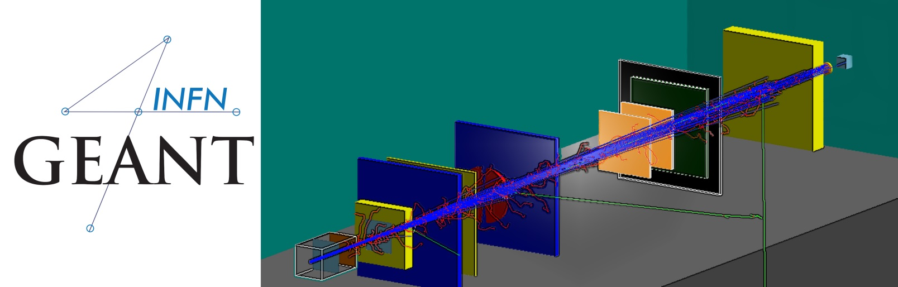


XIII International GEANT4 SCHOOL
Physics in Geant4 — part 2
Production cuts, electromagnetic, optical and hadronic physics — and how well they are validated
Alberto Sciuto
A lot of material by J. Pipek
Original slides by G.A.P. Cirrone and Luciano Pandola
INFN – Laboratori Nazionali del Sud
alberto.sciuto@lns.infn.it
27-31 July 2026 ELI Beamlines Facility Czech Republic

Slide 2
01
PART I
Tracking cuts
Mixed Monte Carlo: tracking cuts and cut-in-range
2

Slide 3
PART I · TRACKING CUTS
Solution: the mixed Monte Carlo
Simulate explicitly (i.e. force a step) only the interactions with energy loss (or change of direction) above a threshold W₀:
DETAILED SIMULATION
CONDENSED SIMULATION
“hard” interactions
“soft” interactions
interactions above threshold are simulated one by one
like the γ interactions
the effect of all sub-threshold interactions is described statistically
Hard interactions occur much less frequently than soft interactions
i
Lowering W₀ creates more explicit secondaries; Geant4 still uses condensed transport and process-specific model limits.
Geant4 · Physics — part 2
3
Notes:
[Sources]
- https://geant4.web.cern.ch/documentation/dev/bfad_html/ForApplicationDevelopers/TrackingAndPhysics/physicsProcess.html
- https://geant4.web.cern.ch/documentation/dev/bfad_html/ForApplicationDevelopers/TrackingAndPhysics/thresholdVScut.html
- https://geant4.web.cern.ch/documentation/dev/bfad_html/ForApplicationDevelopers/TrackingAndPhysics/cutsPerRegion.html
[/Sources]

Slide 4
PART I · TRACKING CUTS
The G4VProcess
Physics processes are derived from the G4VProcess base class
Abstract class defining the common interface of all processes in Geant4
AlongStep
soft: continuous energy loss along the track
+
−
Three kinds of “actions”:
AtRest
+
−
decays at rest, e⁺ annihilation
+
−
AlongStep
PostStep
+
−
continuous (inter)actions along the path of the particle — the “soft” interactions
+
−
hard: point-like
interaction
PostStep
point-like (inter)actions: decay in flight, hadronic interactions — the “hard” interactions
Geant4 · Physics — part 2
4
Notes:
[Sources]
- https://geant4.web.cern.ch/documentation/dev/bfad_html/ForApplicationDevelopers/TrackingAndPhysics/physicsProcess.html
- https://geant4.web.cern.ch/documentation/dev/bfad_html/ForApplicationDevelopers/TrackingAndPhysics/thresholdVScut.html
- https://geant4.web.cern.ch/documentation/dev/bfad_html/ForApplicationDevelopers/TrackingAndPhysics/cutsPerRegion.html
[/Sources]

Slide 5
PART I · TRACKING CUTS
Geant4 production cuts
TRADITIONAL MC: TRACKING CUT-OFF
GEANT4: NO TRACKING CUTS
particles are stopped when a cut-off energy is reached, and the residual energy is deposited at that point
may cause imprecise stopping location and energy deposition
particle and material dependence
all tracks are followed down to zero energy …
… or until they leave the world volume or are destroyed in interactions
could still be implemented manually by the user
Geant4 production cuts decide whether eligible secondaries are created; they do not stop an already created track.
i
Cuts are converted to energy thresholds for secondary γ, e⁻, e⁺ and proton/recoil-ion production in the processes that use them.
Geant4 · Physics — part 2
5
Notes:
[Sources]
- https://geant4.web.cern.ch/documentation/dev/bfad_html/ForApplicationDevelopers/TrackingAndPhysics/physicsProcess.html
- https://geant4.web.cern.ch/documentation/dev/bfad_html/ForApplicationDevelopers/TrackingAndPhysics/thresholdVScut.html
- https://geant4.web.cern.ch/documentation/dev/bfad_html/ForApplicationDevelopers/TrackingAndPhysics/cutsPerRegion.html
[/Sources]

Slide 6
PART I · TRACKING CUTS
Geant4 way of cuts: cut-in-range
Set a production threshold as a range, not as an energy
• Current reference physics lists commonly default to 0.7 mm
• Each material converts that range to a particle-dependent energy threshold
• Created tracks are still transported to zero range unless another process kills them
• Cuts can be overridden per particle and per region
RANGE → ENERGY
the production threshold is internally converted to the energy threshold W₀, depending on particle type and material
the effective energy threshold is different in each material
Geant4 · Physics — part 2
6
Notes:
[Sources]
- https://geant4.web.cern.ch/documentation/dev/bfad_html/ForApplicationDevelopers/TrackingAndPhysics/physicsProcess.html
- https://geant4.web.cern.ch/documentation/dev/bfad_html/ForApplicationDevelopers/TrackingAndPhysics/thresholdVScut.html
- https://geant4.web.cern.ch/documentation/dev/bfad_html/ForApplicationDevelopers/TrackingAndPhysics/cutsPerRegion.html
[/Sources]

Slide 7

PART I · TRACKING CUTS
Production cut
Key ingredient of the mixed MC: the energy threshold W₀ — the best compromise between:
ACCURACY
PERFORMANCE
need to go low enough to get the physics you are interested in
can’t go too low: some processes have an infrared divergence causing huge CPU time
Geant4 · Physics — part 2
7
Notes:
[Sources]
- https://geant4.web.cern.ch/documentation/dev/bfad_html/ForApplicationDevelopers/TrackingAndPhysics/physicsProcess.html
- https://geant4.web.cern.ch/documentation/dev/bfad_html/ForApplicationDevelopers/TrackingAndPhysics/thresholdVScut.html
- https://geant4.web.cern.ch/documentation/dev/bfad_html/ForApplicationDevelopers/TrackingAndPhysics/cutsPerRegion.html
[/Sources]

Slide 8
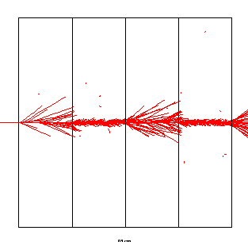
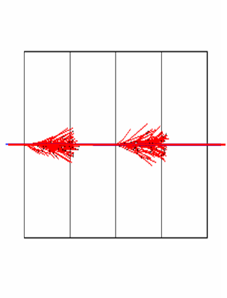

PART I · TRACKING CUTS
Cut in range — what changes
500 MeV p · LAr–Pb sampling calorimeter
Cut = 455 keV
(range in LAr = 1.5 mm)
alternating Pb / LAr layers
Cut = 2 MeV
Threshold in range: 1.5 mm → 455 keV electron energy in liquid Ar · 2 MeV electron energy in Pb
Geant4 · Physics — part 2
8
Notes:
[Sources]
- https://geant4.web.cern.ch/documentation/dev/bfad_html/ForApplicationDevelopers/TrackingAndPhysics/physicsProcess.html
- https://geant4.web.cern.ch/documentation/dev/bfad_html/ForApplicationDevelopers/TrackingAndPhysics/thresholdVScut.html
- https://geant4.web.cern.ch/documentation/dev/bfad_html/ForApplicationDevelopers/TrackingAndPhysics/cutsPerRegion.html
[/Sources]

Slide 9
PART I · TRACKING CUTS
SetCuts()
Defines range cuts for γ, e⁻, e⁺ and proton/recoil-ion production
Implemented in G4VUserPhysicsList::SetCuts()
The lower conversion edge is 990 eV unless changed before initialization
Remember: production threshold ≠ tracking cut
IN YOUR PHYSICS LIST
void MyPhysicsList::SetCuts()
{
defaultCutValue = 0.5 * mm;
SetCutsWithDefault();
SetCutValue(0.1 * mm, "gamma");
SetCutValue(0.01 * mm, "e+");
G4ProductionCutsTable::GetProductionCutsTable()
->SetEnergyRange(100*eV, 100.*GeV);
}
Most reference physics lists default to 0.7 mm.
SetEnergyRange lowers the possible W₀ from 990 eV to 100 eV.
i
i
Geant4 · Physics — part 2
9
Notes:
[Sources]
- https://geant4.web.cern.ch/documentation/dev/bfad_html/ForApplicationDevelopers/TrackingAndPhysics/physicsProcess.html
- https://geant4.web.cern.ch/documentation/dev/bfad_html/ForApplicationDevelopers/TrackingAndPhysics/thresholdVScut.html
- https://geant4.web.cern.ch/documentation/dev/bfad_html/ForApplicationDevelopers/TrackingAndPhysics/cutsPerRegion.html
[/Sources]

Slide 10
PART I · TRACKING CUTS
Cuts — UI commands
/run/setCut 10 mm
universal cut — whole world, all particles
/cuts/setLowEdge 100 eV
set the lower cut-energy edge — before /run/initialize
/run/setCutForAGivenParticle gamma 0.1 mm
cut for a specific particle (whole world)
/run/setCutForARegion myRegion 0.01 mm
cut for a region (all particles)
/run/dumpCouples
print a summary of particles / regions / cuts
Geant4 · Physics — part 2
10
Notes:
[Sources]
- https://geant4.web.cern.ch/documentation/dev/bfad_html/ForApplicationDevelopers/TrackingAndPhysics/physicsProcess.html
- https://geant4.web.cern.ch/documentation/dev/bfad_html/ForApplicationDevelopers/TrackingAndPhysics/thresholdVScut.html
- https://geant4.web.cern.ch/documentation/dev/bfad_html/ForApplicationDevelopers/TrackingAndPhysics/cutsPerRegion.html
[/Sources]

Slide 11
PART I · TRACKING CUTS
G4StepLimiter
An alternative way to define the level of tracking detail.
WHY?
HOW?
you want to see the exact track of the particle
you don’t trust the chord finder for your magnetic field
include the G4StepLimiter process in your physics list
set “user limits” for the logical volumes of interest
physicsList->RegisterPhysics(new G4StepLimiterPhysics()); // modular physics list
logVol->SetUserLimits(new G4UserLimits(1.0 * mm));
i
Formally a physics process competing with all the others — it always proposes the same step length.
Geant4 · Physics — part 2
11
Notes:
[Sources]
- https://geant4.web.cern.ch/documentation/dev/bfad_html/ForApplicationDevelopers/TrackingAndPhysics/physicsProcess.html
- https://geant4.web.cern.ch/documentation/dev/bfad_html/ForApplicationDevelopers/TrackingAndPhysics/thresholdVScut.html
- https://geant4.web.cern.ch/documentation/dev/bfad_html/ForApplicationDevelopers/TrackingAndPhysics/cutsPerRegion.html
[/Sources]

Slide 12
PART I · TRACKING CUTS
Cuts per region
A complex detector may contain many different sub-detectors involving:
finely segmented volumes
position-sensitive materials (e.g. Si trackers)
large, undivided volumes (e.g. calorimeters)
inert materials
The same cut may not be appropriate for all of these
The user can define regions (G4Region, independent of the geometry hierarchy tree) and assign different cuts to each region
A region can contain a subset of the logical volumes
WORLD — DEFAULT REGION
tracker
region
0.01 mm
calorimeter
region
1 mm
different production thresholds per region
Geant4 · Physics — part 2
12
Notes:
[Sources]
- https://geant4.web.cern.ch/documentation/dev/bfad_html/ForApplicationDevelopers/TrackingAndPhysics/physicsProcess.html
- https://geant4.web.cern.ch/documentation/dev/bfad_html/ForApplicationDevelopers/TrackingAndPhysics/thresholdVScut.html
- https://geant4.web.cern.ch/documentation/dev/bfad_html/ForApplicationDevelopers/TrackingAndPhysics/cutsPerRegion.html
[/Sources]

Slide 13
02
PART II
Processes & models
How the description of physics is organised in Geant4
13

Slide 14
PART II · PROCESSES & MODELS
Philosophy
Provide a general model framework that allows the implementation of complementary / alternative models to describe the same process (e.g. Compton scattering)
a given model could work better in a certain energy range
Decouple the modeling of cross sections and of final-state generation
Provide processes containing:
many possible models and cross sections
default cross sections for each model
i
Models are under continuous development.
Geant4 · Physics — part 2
14
Notes:
[Sources]
- https://geant4.web.cern.ch/documentation/dev/bfad_html/ForApplicationDevelopers/TrackingAndPhysics/physicsProcess.html
- https://geant4.web.cern.ch/documentation/dev/prm_html/PhysicsReferenceManual/electromagnetic/introduction/introduction.html
[/Sources]

Slide 15
03
PART III
EM physics
Processes, models and packages for electromagnetic interactions
15

Slide 16
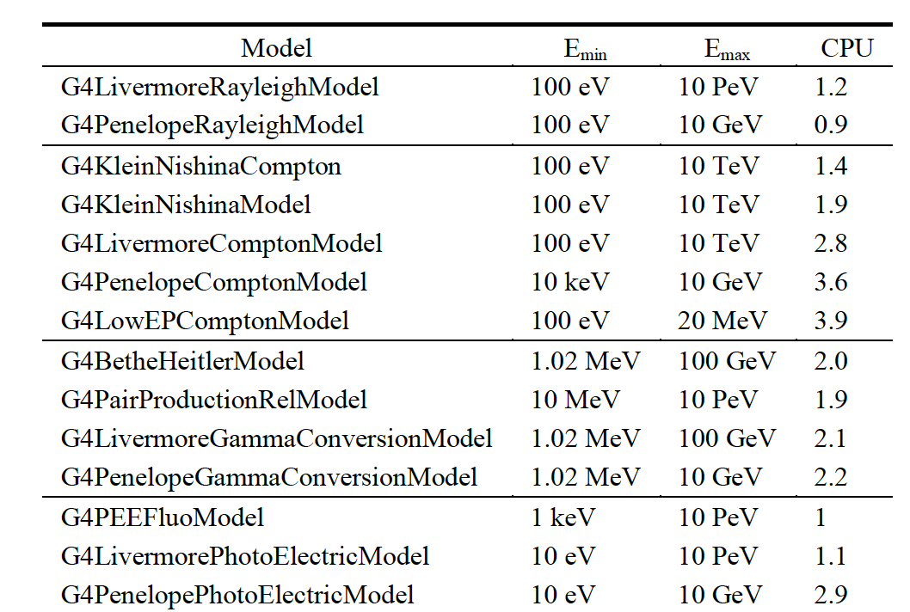
PART III · EM PHYSICS
Inventory (and specs) of the models for γ-rays
Many models available for each process
Plus one full set of polarized models
They differ for energy range, precision and CPU speed
Final-state generators
Different mixtures available in the Geant4 EM constructors
a similar situation holds for e±
Geant4 · Physics — part 2
16
Notes:
[Sources]
- https://geant4.web.cern.ch/documentation/dev/plg_html/PhysicsListGuide/electromagnetic/emphyslist.html
- https://geant4.web.cern.ch/documentation/dev/prm_html/PhysicsReferenceManual/electromagnetic/
[/Sources]

Slide 17
PART III · EM PHYSICS
EM concept
The same physics process (e.g. Compton scattering) can be described by different models — alternative or complementary in a given energy range:
G4KleinNishinaCompton
the standard model
G4LivermoreComptonModel
specialized low-energy, based on the Livermore database
G4PenelopeComptonModel
specialized low-energy, based on the Penelope analytical model
G4LivermorePolarizedComptonModel
low-energy, Livermore database with polarization
G4PolarizedComptonModel
Klein–Nishina with polarization
G4LowEPComptonModel
full relativistic 3D simulation
Different models can be combined, so that the appropriate one is used in each energy range (→ performance optimization).
i
Geant4 · Physics — part 2
17
Notes:
[Sources]
- https://geant4.web.cern.ch/documentation/dev/plg_html/PhysicsListGuide/electromagnetic/emphyslist.html
- https://geant4.web.cern.ch/documentation/dev/prm_html/PhysicsReferenceManual/electromagnetic/
[/Sources]

Slide 18
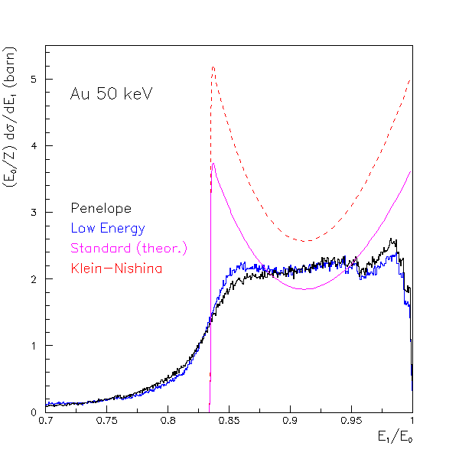
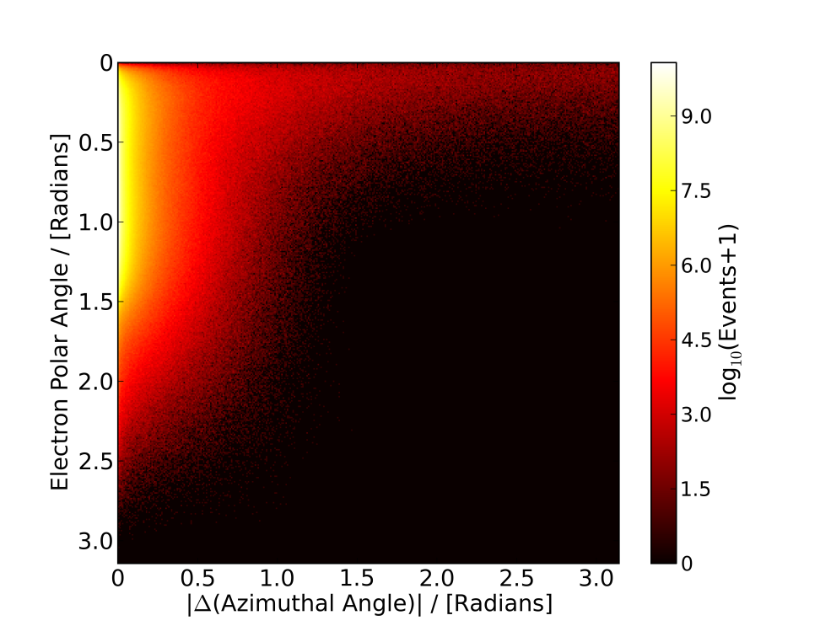
PART III · EM PHYSICS
For example: Compton scattering
New model: G4LowEPComptonModel (Monash U.)
two-body relativistic 3-dim framework
relativistic impulse approximation
bound atomic electrons
electron distribution not uniform in φ w.r.t. the photon scattering plane
CPU time is the price to pay for better precision.
Au, 50 keV
250 keV γ in Pb
!
Geant4 · Physics — part 2
18
Notes:
[Sources]
- https://geant4.web.cern.ch/documentation/dev/plg_html/PhysicsListGuide/electromagnetic/emphyslist.html
- https://geant4.web.cern.ch/documentation/dev/prm_html/PhysicsReferenceManual/electromagnetic/
[/Sources]

Slide 19
PART III · EM PHYSICS
Packages overview
Models and processes for EM interactions in Geant4 are grouped in several packages:
Standard
γ-rays and e± up to 100 TeV; hadrons and ions up to 100 TeV
Muons
muons up to 1 PeV
X-rays
X-rays and optical photon production
Optical
optical photon interactions
High-Energy
processes at high energy (> 10 GeV); physics for exotic particles
Low-Energy
specialized low-energy γ/e± models; applicability limits are process dependent
Polarization
simulation of polarized beams
Geant4 · Physics — part 2
19
Notes:
[Sources]
- https://geant4.web.cern.ch/documentation/dev/plg_html/PhysicsListGuide/electromagnetic/emphyslist.html
- https://geant4.web.cern.ch/documentation/dev/prm_html/PhysicsReferenceManual/electromagnetic/
[/Sources]

Slide 20
PART III · EM PHYSICS
EM processes: γ-rays, e± and μ±
PHOTONS · E±
MUONS Μ±
PHOTONS
γ conversion in e±
G4GammaConversion
Ionisation
G4MuIonisation
Compton scattering
G4ComptonScattering
Bremsstrahlung
G4MuBremsstrahlung
Photoelectric effect
G4PhotoElectricEffect
Mult. scattering
G4MuMultipleScattering
Rayleigh scattering
G4RayleighScattering
e± pair prod.
G4MuPairProduction
e± · e⁺
Ionisation
G4eIonisation
Bremsstrahlung
G4eBremsstrahlung
Muon processes select energy-dependent models internally.
User alternatives are more limited than for γ/e±, but custom models are possible.
Multiple scattering
G4eMultipleScattering
i
Annihilation (e⁺)
G4eplusAnnihilation
Geant4 · Physics — part 2
20
Notes:
[Sources]
- https://geant4.web.cern.ch/documentation/dev/plg_html/PhysicsListGuide/electromagnetic/emphyslist.html
- https://geant4.web.cern.ch/documentation/dev/prm_html/PhysicsReferenceManual/electromagnetic/
[/Sources]

Slide 21
PART III · EM PHYSICS
Standard models
Complete set of models for e±, γ, ions, hadrons, μ± — tailored to the requirements of HEP applications
“cheaper” in terms of CPU
include high-energy corrections (e.g. LPM); assumptions made in the low-energy regime
Theoretical or phenomenological models: Bethe–Bloch, corrected Klein–Nishina, …
Photoabsorption Ionization (PAI) — ionization energy loss of a relativistic charged particle in matter
Specific high-energy extensions available: extra processes, as γ → μ⁺μ⁻, e⁺e⁻ → μ⁺μ⁻
Dedicated sub-library for optical photons — produced by scintillation or Cherenkov effect
Geant4 · Physics — part 2
21
Notes:
[Sources]
- https://geant4.web.cern.ch/documentation/dev/plg_html/PhysicsListGuide/electromagnetic/emphyslist.html
- https://geant4.web.cern.ch/documentation/dev/prm_html/PhysicsReferenceManual/electromagnetic/
[/Sources]

Slide 22
PART III · EM PHYSICS
Livermore (& polarized) models
Based on publicly available evaluated data tables from the Livermore data library: e⁻, γ
EADL — Evaluated Atomic Data Library
EEDL — Evaluated Electrons Data Library
EPDL97 — Evaluated Photons Data Library
binding energies: Scofield
Mixture of experiments and theories
In principle, tables go down to ~10 eV
Applications: medical, underground and rare events, space
POLARIZED MODELS
same calculation of the cross section, different way to produce the final state
describe in detail the kinematics of polarized photon interactions
application: space missions for the detection of polarized photons
Geant4 · Physics — part 2
22
Notes:
[Sources]
- https://geant4.web.cern.ch/documentation/dev/plg_html/PhysicsListGuide/electromagnetic/emphyslist.html
- https://geant4.web.cern.ch/documentation/dev/prm_html/PhysicsReferenceManual/electromagnetic/
[/Sources]

Slide 23
PART III · EM PHYSICS
Penelope models
Geant4 includes the low-energy models for electrons, positrons and photons from the Monte Carlo code PENELOPE (PENetration and Energy LOss of Positrons and Electrons)
Nucl. Instr. Meth. B 207 (2003) 107 — Geant4 implements v2008 of Penelope
Physics models specifically developed by the group of F. Salvat et al.
Great care dedicated to the low-energy description: atomic effects, fluorescence, Doppler broadening, …
Mixed approach: analytical, parameterized and database-driven
Dedicated Penelope models are used for γ, e⁻ and e⁺ below 1 GeV in G4EmPenelopePhysics
Provides dedicated low-energy positron models as well as photon and electron models
Geant4 · Physics — part 2
23
Notes:
[Sources]
- https://geant4.web.cern.ch/documentation/dev/plg_html/PhysicsListGuide/electromagnetic/emphyslist.html
- https://geant4.web.cern.ch/documentation/dev/prm_html/PhysicsReferenceManual/electromagnetic/
[/Sources]

Slide 24
PART III · EM PHYSICS
When / why to use low-energy models
USE LIVERMORE OR PENELOPE WHEN YOU…
DO NOT USE WHEN…
need precise treatment of EM showers and interactions at low energy (keV scale)
are interested in atomic effects, as fluorescence x-rays, Doppler broadening, etc.
can afford a more CPU-intensive simulation
want to cross-check another simulation (e.g. with a different model)
your application is mainly above the MeV scale
→ same results as the Standard EM models, with a performance penalty
Geant4 · Physics — part 2
24
Notes:
[Sources]
- https://geant4.web.cern.ch/documentation/dev/plg_html/PhysicsListGuide/electromagnetic/emphyslist.html
- https://geant4.web.cern.ch/documentation/dev/prm_html/PhysicsReferenceManual/electromagnetic/
[/Sources]

Slide 25
PART III · EM PHYSICS
EM physics constructors — ready for use
G4EmStandardPhysics
default
COMBINED PHYSICS
G4EmStandardPhysics_option1
EMV · fast configuration; minimal stepping safeguards
Standard > 1 GeV
Low-energy < 1 GeV
G4EmStandardPhysics_option2
EMX · standard models with simple step limitation
G4EmStandardPhysics_option3
EMY · more accurate boundary/step treatment
G4EmStandardPhysics_option4
EMZ · high-accuracy mixture; LowEP Compton below 20 MeV
G4EmLivermorePhysics
Advantage of these classes: they are tested on a regular basis and used for regular validation.
G4EmLivermorePolarizedPhysics
i
G4EmPenelopePhysics
G4EmLowEPPhysics
G4EmDNAPhysics_*
…and more
Current overview: Geant4 11.4 Physics List Guide
Geant4 · Physics — part 2
25
Notes:
[Sources]
- https://geant4.web.cern.ch/documentation/dev/plg_html/PhysicsListGuide/electromagnetic/emphyslist.html
- https://geant4.web.cern.ch/documentation/dev/prm_html/PhysicsReferenceManual/electromagnetic/
[/Sources]

Slide 26
PART III · EM PHYSICS
How to extract physics?
Possible to retrieve physics quantities via G4EmCalculator or directly from the physics models
the physics list should be initialized
Example — total cross section (cm⁻¹) of process procName for particle particle in material matName:
G4EmCalculator emCalculator;
G4Material* material =
G4NistManager::Instance()->FindOrBuildMaterial("matName");
G4double massSigma = emCalculator.ComputeCrossSectionPerVolume
(energy, particle, procName, material);
G4cout << G4BestUnit(massSigma, "Surface/Volume") << G4endl;
A good example:
$G4INSTALL/examples/extended/electromagnetic/TestEm14
Geant4 · Physics — part 2
26
Notes:
[Sources]
- https://geant4.web.cern.ch/documentation/dev/plg_html/PhysicsListGuide/electromagnetic/emphyslist.html
- https://geant4.web.cern.ch/documentation/dev/prm_html/PhysicsReferenceManual/electromagnetic/
[/Sources]

Slide 27
04
PART IV
Optical physics
Optical photons: production, tracking and optical properties
27

Slide 28
PART IV · OPTICAL PHYSICS
Optical photons
Dedicated particle in Geant4: G4OpticalPhoton
different from G4Gamma — no smooth transition between them
polarization information included
The same concept applies to G4Phonon (and other exotic particles)
HANDLING OPTICAL PHOTONS REQUIRES
processes able to produce optical photons (G4Scintillation, G4Cerenkov, …)
processes describing the interaction of optical photons:
bulk processes — absorption, elastic scattering, WLS
boundary processes — reflection, refraction, …
according to the laws of optics
Geant4 · Physics — part 2
28
Notes:
[Sources]
- https://geant4.web.cern.ch/documentation/dev/bfad_html/ForApplicationDevelopers/TrackingAndPhysics/physicsProcess.html
- https://geant4.web.cern.ch/documentation/dev/prm_html/PhysicsReferenceManual/electromagnetic/optical_photons/optical.html
[/Sources]

Slide 29
PART IV · OPTICAL PHYSICS
OpPhoton tracking
By default, track Čerenkov secondaries before resuming the primary; configure this through G4OpticalParameters:
G4OpticalParameters::Instance()->
SetCerenkovTrackSecondariesFirst(true);
Good tracking requires accurate knowledge of bulk and surface optical properties
not always available (especially for boundaries) — so, tuning from the data
!
Make sure that you really need it (!)
Example:
examples/extended/optical
Geant4 · Physics — part 2
29
Notes:
[Sources]
- https://geant4.web.cern.ch/documentation/dev/bfad_html/ForApplicationDevelopers/TrackingAndPhysics/physicsProcess.html
- https://geant4.web.cern.ch/documentation/dev/prm_html/PhysicsReferenceManual/electromagnetic/optical_photons/optical.html
[/Sources]

Slide 30
PART IV · OPTICAL PHYSICS
Processes to create opPhotons
Geant4 optical photons are produced by Čerenkov and scintillation processes:
G4Cerenkov
G4Scintillation
via G4OpticalPhysics
Pure “AlongStep” processes
average number according to ΔE in the step; actual number sampled from a Poisson distribution
can still limit the step in special cases (e.g. refraction index drops below the Cerenkov threshold)
emission position sampled uniformly along the step
Scintillation yield, spectrum and time can be set by the user
slow/fast component, different yields per particle
!
Warning: these processes generate optical photons without energy conservation.
Geant4 · Physics — part 2
30
Notes:
[Sources]
- https://geant4.web.cern.ch/documentation/dev/bfad_html/ForApplicationDevelopers/TrackingAndPhysics/physicsProcess.html
- https://geant4.web.cern.ch/documentation/dev/prm_html/PhysicsReferenceManual/electromagnetic/optical_photons/optical.html
[/Sources]

Slide 31
PART IV · OPTICAL PHYSICS
Processes to handle opPhotons
Optical photons are handled by — all “discrete” processes:
G4OpAbsorption
bulk absorption
G4OpRayleigh / G4OpMieHG
Rayleigh or Mie scattering
G4OpWLS / G4OpWLS2
wavelength shifting
G4OpBoundary
refraction and reflection at medium boundaries
Geant4 keeps track of polarization — but not of the overall phase → no interference
The user can supply:
WLS emission spectrum and decay time
reflectivity, surface properties (roughness, specular, metal vs. dielectric, …) of all boundaries
mean free path for Rayleigh scattering and absorption
Geant4 · Physics — part 2
31
Notes:
[Sources]
- https://geant4.web.cern.ch/documentation/dev/bfad_html/ForApplicationDevelopers/TrackingAndPhysics/physicsProcess.html
- https://geant4.web.cern.ch/documentation/dev/prm_html/PhysicsReferenceManual/electromagnetic/optical_photons/optical.html
[/Sources]

Slide 32
PART IV · OPTICAL PHYSICS
Optical properties
BULK PROPERTIES
BOUNDARY PROPERTIES
stored as G4MaterialPropertiesTable, attached to G4Material
refractive index, absorption length and Rayleigh mean free path vs photon energy
scintillation yield, spectra and time constants
WLS properties
G4MaterialPropertiesTable attached to G4OpticalSurface, which belongs to:
G4LogicalBorderSurface — ordered pair of logical volumes
G4LogicalSkinSurface — skin of a logical volume
reflectivity and efficiency vs photon energy, polished vs. rough, dielectric vs. metal, specular lobe vs. spike, rms roughness, …
!
Typical case: properties are unknown (especially for surfaces) and have to be tuned from data.
Geant4 · Physics — part 2
32
Notes:
[Sources]
- https://geant4.web.cern.ch/documentation/dev/bfad_html/ForApplicationDevelopers/TrackingAndPhysics/physicsProcess.html
- https://geant4.web.cern.ch/documentation/dev/prm_html/PhysicsReferenceManual/electromagnetic/optical_photons/optical.html
[/Sources]

Slide 33
05
PART V
Hadronic physics
A very quick overview — data-driven, parametrised and theory-driven models
33

Slide 34
PART V · HADRONIC PHYSICS
Hadronic processes
At rest
Elastic
Inelastic
stopped muon, pion, kaon, anti-proton; radioactive decay; particle decay (decay-in-flight is PostStep)
the same process handles all long-lived hadrons — multiple models available
different processes for each hadron (possibly with multiple models vs. energy); photo-nuclear, electro-nuclear, mu-nuclear
Capture
Fission
pion⁻ and kaon⁻ in flight, neutron
Geant4 · Physics — part 2
34
Notes:
[Sources]
- https://geant4.web.cern.ch/documentation/dev/plg_html/PhysicsListGuide/physicslistguide.html
- https://geant4.web.cern.ch/documentation/dev/prm_html/PhysicsReferenceManual/hadronic/
[/Sources]

Slide 35
PART V · HADRONIC PHYSICS
The hadronic physics challenge
Three energy regimes:
LOW ENERGY
≲ 100 MeV
CASCADE REGION
~100 MeV to several GeV
STRING REGION
≳ 10 GeV
nuclear physics at low energy
resonance and cascade region
QCD strings
Model hand-offs deliberately overlap; the exact boundaries depend on the selected reference physics list.
Geant4 · Physics — part 2
35
Notes:
[Sources]
- https://geant4.web.cern.ch/documentation/dev/plg_html/PhysicsListGuide/physicslistguide.html
- https://geant4.web.cern.ch/documentation/dev/prm_html/PhysicsReferenceManual/hadronic/
[/Sources]

Slide 36
PART V · HADRONIC PHYSICS
Reference physics lists for hadronic interactions
TWO FAMILIES OF BUILDERS FOR THE HIGH-ENERGY PART
QGS
lists based on the Quark Gluon String model for high-energy hadronic interactions of protons, neutrons, pions and kaons
FTF
based on the FTF (FRITIOF-like string) model for protons, neutrons, pions and kaons
THREE FAMILIES FOR THE CASCADE ENERGY RANGE
BIC
binary cascade
BERT
Bertini cascade
INCLXX
Liège intranuclear cascade model
Geant4 · Physics — part 2
36
Notes:
[Sources]
- https://geant4.web.cern.ch/documentation/dev/plg_html/PhysicsListGuide/physicslistguide.html
- https://geant4.web.cern.ch/documentation/dev/prm_html/PhysicsReferenceManual/hadronic/
[/Sources]

Slide 37
PART V · HADRONIC PHYSICS
ParticleHP models
ParticleHP uses evaluated nuclear-data libraries rather than cascade parameterisations
• Neutron HP: elastic, inelastic, capture and fission from thermal energies to 20 MeV
• Current AllHP reference-list variants extend ParticleHP to p, d, t, ³He and α below 200 MeV
• Neutron data are supplied in G4NDL format; charged-particle HP uses the installed particle-HP data
• Results depend on isotope coverage and on the selected evaluated library
Use it deliberately: low-energy neutron transport can be CPU-intensive, and thermal scattering data must match the material.
!
Geant4 · Physics — part 2
37
Notes:
[Sources]
- https://geant4.web.cern.ch/documentation/dev/plg_html/PhysicsListGuide/physicslistguide.html
- https://geant4.web.cern.ch/documentation/dev/prm_html/PhysicsReferenceManual/hadronic/
[/Sources]

Slide 38
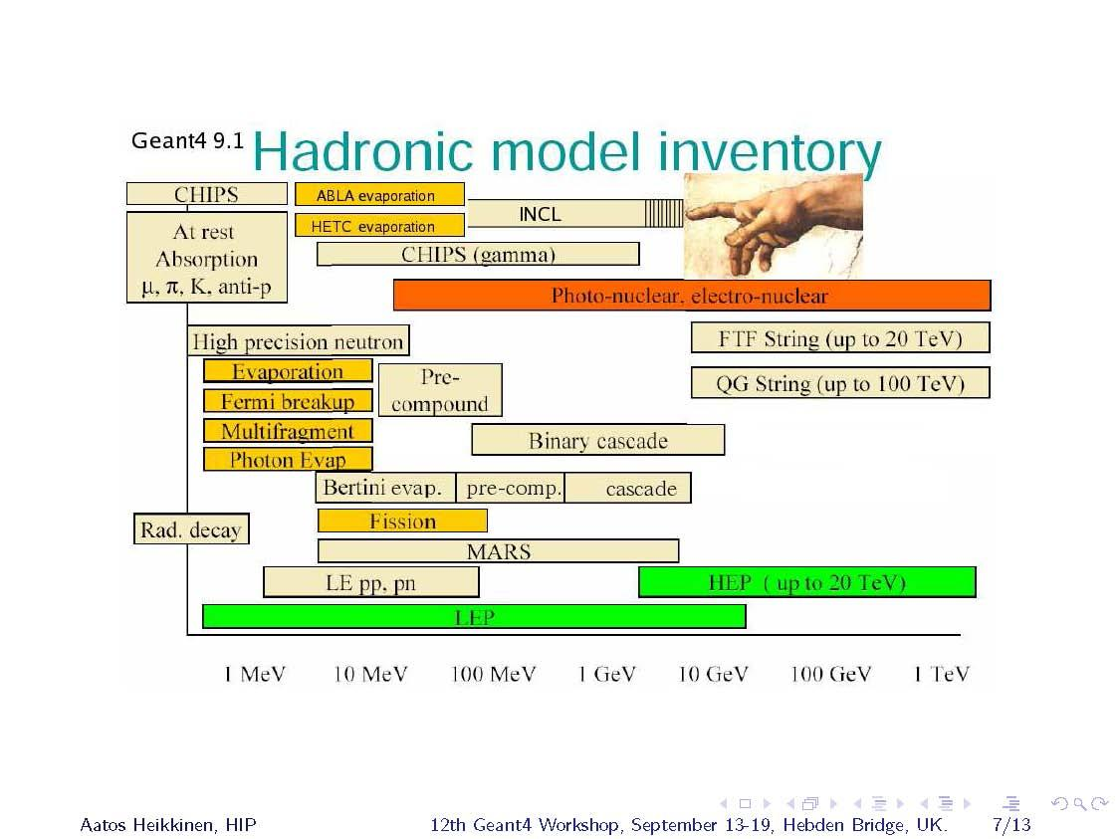
PART V · HADRONIC PHYSICS
Hadronic model inventory
Geant4 · Physics — part 2
38
Notes:
[Sources]
- https://geant4.web.cern.ch/documentation/dev/plg_html/PhysicsListGuide/physicslistguide.html
- https://geant4.web.cern.ch/documentation/dev/prm_html/PhysicsReferenceManual/hadronic/
[/Sources]

Slide 39
PART V · HADRONIC PHYSICS
Cross sections
Default cross-section sets are provided for each type of hadronic process: fission, capture, elastic, inelastic
can be overridden or completely replaced
Different types of cross-section sets:
some contain only a few numbers to parameterize the cross section
some represent large databases (data-driven models)
Cross-section management:
Applicable cross-section data sets are queried in reverse registration order: the last applicable set has priority.
Geant4 · Physics — part 2
39
Notes:
[Sources]
- https://geant4.web.cern.ch/documentation/dev/plg_html/PhysicsListGuide/physicslistguide.html
- https://geant4.web.cern.ch/documentation/dev/prm_html/PhysicsReferenceManual/hadronic/
[/Sources]

Slide 40
PART V · HADRONIC PHYSICS
Geant4 extensions / exotic
The tracking implemented in Geant4 is very general and transparent
possible to accommodate custom particles and processes
possible to accommodate alternative models, also to be used together with the Geant4 ones
Recent development: possibility to simulate solid-state effects (e.g. channeling)
extension of G4Material to include lattice properties (e.g. unit cell)
framework generic enough to include other kinds of auxiliary material properties
See:
examples/extended/exoticphysics
Geant4 · Physics — part 2
40
Notes:
[Sources]
- https://geant4.web.cern.ch/documentation/dev/plg_html/PhysicsListGuide/physicslistguide.html
- https://geant4.web.cern.ch/documentation/dev/prm_html/PhysicsReferenceManual/hadronic/
[/Sources]

Slide 41
06
PART VI
Validation
How well do the models reproduce the data?
41

Slide 42
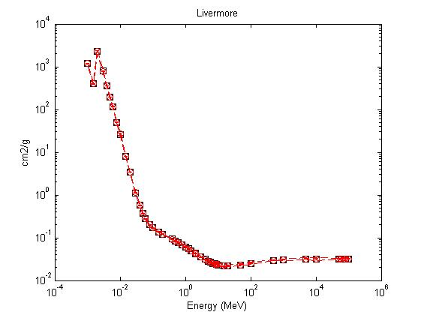
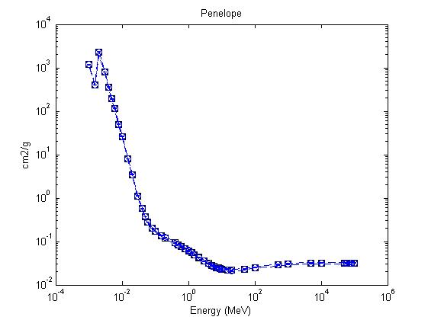
PART VI · VALIDATION
EM validation — 1
Tens of papers and studies available — Geant4 Collaboration + user community
Results can depend on the specific observable / reference — data selection and assessment are critical
Livermore vs. XCOM — NIM B 316 (2013) 1
Penelope vs. XCOM — arXiv:1307.0933
Geant4 · Physics — part 2
42
Notes:
[Sources]
- https://geant-val.cern.ch/
- https://geant4.web.cern.ch/collaboration/working_groups/physval-wg/
[/Sources]

Slide 43
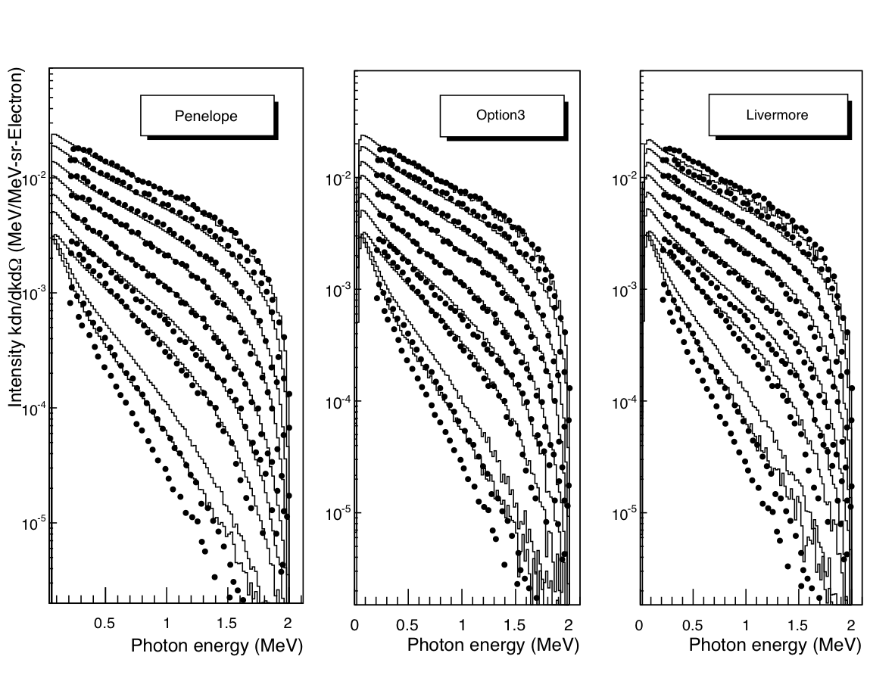
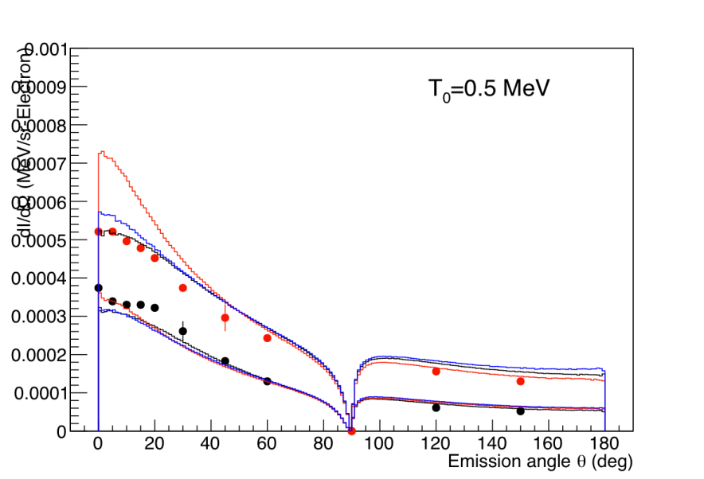
PART VI · VALIDATION
EM validation — 2
In general, satisfactory agreement — a validation/verification repository is available on the web:
Current validation portal: https://geant-val.cern.ch/
Electron scattering — Ross et al., Med. Phys. 35 (2008) 4121
Geant4 · Physics — part 2
43
Notes:
[Sources]
- https://geant-val.cern.ch/
- https://geant4.web.cern.ch/collaboration/working_groups/physval-wg/
[/Sources]

Slide 44
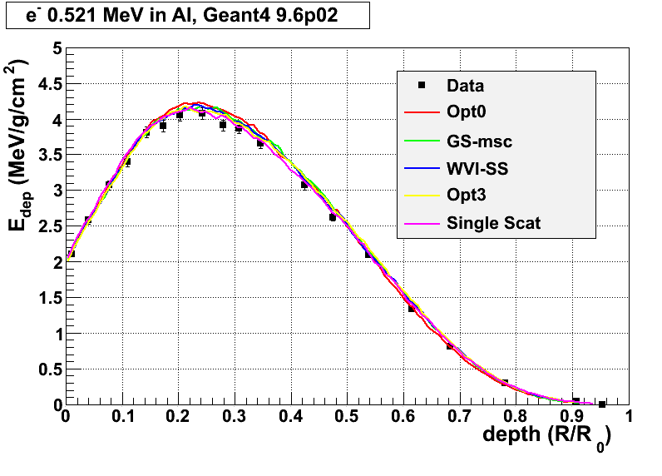
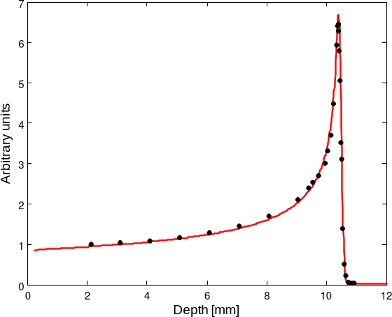
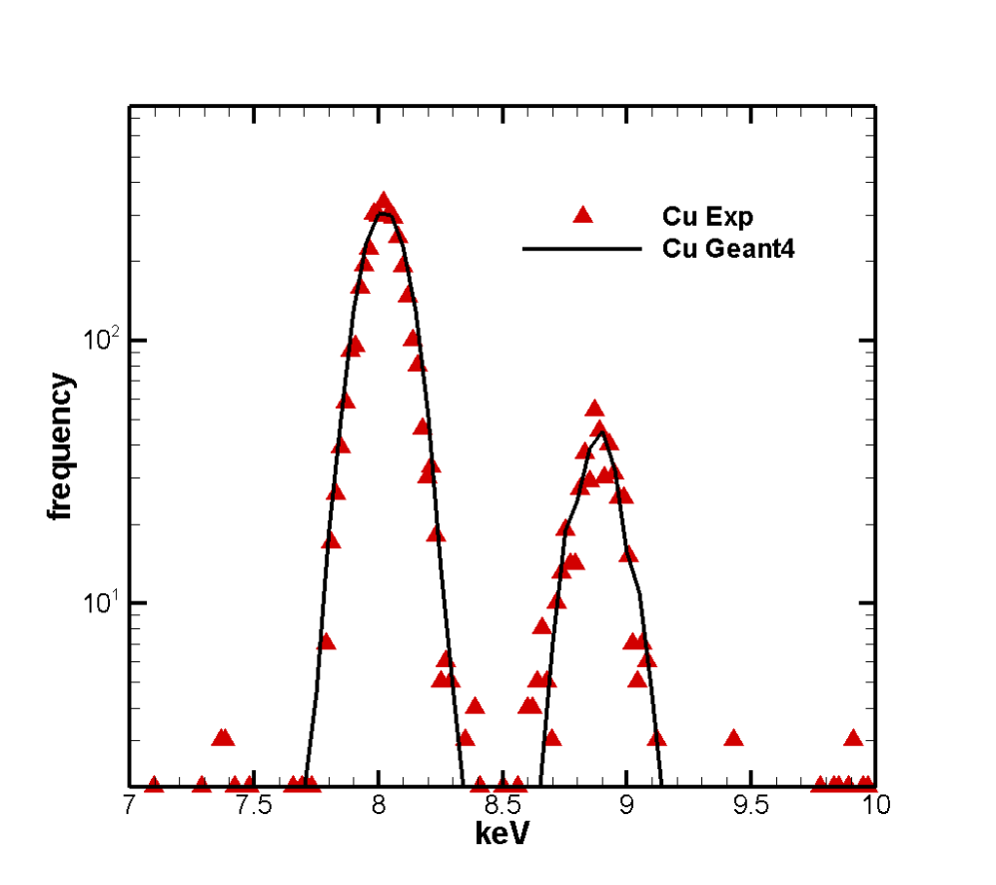
PART VI · VALIDATION
EM validation — 3
¹²C ions, 62 MeV/n
e⁻ showers — longitudinal profiles
Geant4 · Physics — part 2
44
Notes:
[Sources]
- https://geant-val.cern.ch/
- https://geant4.web.cern.ch/collaboration/working_groups/physval-wg/
[/Sources]

Slide 45
PART VI · VALIDATION
Hadronic validation
A website is available to collect relevant information for the validation of the Geant4 hadronic models (plots, tables, references to data and to models, etc.)
Several physics lists and several use-cases have been considered (e.g. thick target, stopped particles, low-energy)
Includes final states and cross sections
https://geant-val.cern.ch/
https://geant4.web.cern.ch/collaboration/working_groups/physval-wg/
Geant4 · Physics — part 2
45
Notes:
[Sources]
- https://geant-val.cern.ch/
- https://geant4.web.cern.ch/collaboration/working_groups/physval-wg/
[/Sources]

Slide 46
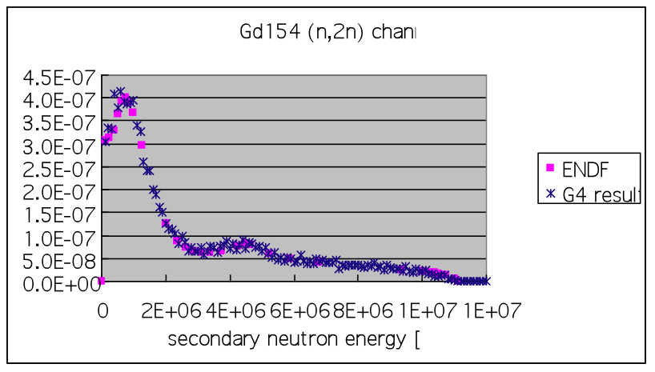
PART VI · VALIDATION
Secondary-neutron spectrum: ¹⁵⁴Gd(n,2n)
Geant4 · Physics — part 2
46
Notes:
[Sources]
- https://geant-val.cern.ch/
- https://geant4.web.cern.ch/collaboration/working_groups/physval-wg/
[/Sources]

Slide 47
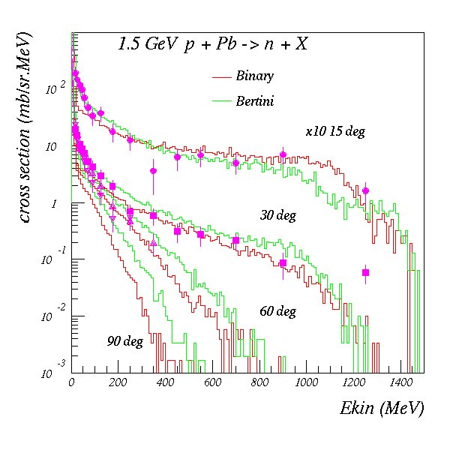
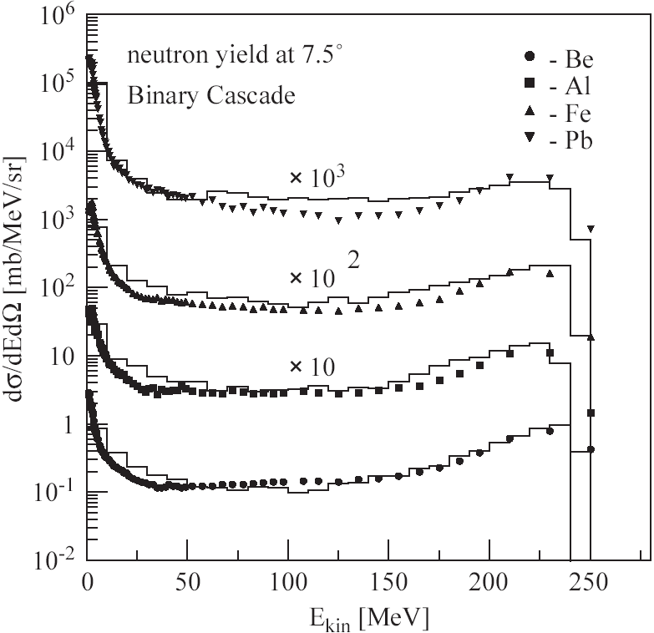
PART VI · VALIDATION
Nuclear fragmentation & neutron production
Bertini and Binary cascade models: neutron production vs. angle, from 1.5 GeV protons on lead
Binary cascade model: double-differential cross-section for neutrons produced by 256 MeV protons on different targets
Geant4 · Physics — part 2
47
Notes:
[Sources]
- https://geant-val.cern.ch/
- https://geant4.web.cern.ch/collaboration/working_groups/physval-wg/
[/Sources]

Slide 48
AND NOW
Next Lesson
Alberto Sciuto · alberto.sciuto@lns.infn.it
48

Slide 49
✳
APPENDIX
Backup
Extra material: naming schemes, NeutronHP, cuts per region and physics-list code examples
49

Slide 50
BACKUP
EM concept: naming schemes
PROCESSES
a physical interaction or process is described by a process class
naming scheme: «G4ProcessName»
G4ComptonScattering
photon Compton scattering
MODELS
a process can be simulated according to several models, each described by a model class
naming scheme: «G4ModelNameProcessNameModel»
models can be alternative and/or complementary on certain energy ranges — see the Geant4 manual for the full list
G4LivermoreComptonModel
the Livermore Compton model
Geant4 · Physics — part 2
50
Notes:
[Sources]
- https://geant4.web.cern.ch/documentation/dev/plg_html/PhysicsListGuide/electromagnetic/emphyslist.html
- https://geant4.web.cern.ch/documentation/dev/prm_html/PhysicsReferenceManual/electromagnetic/
[/Sources]

Slide 51
BACKUP
NeutronHP models
NeutronHP provides high-precision, evaluated-data transport for low-energy neutrons
• Elastic, inelastic, capture and fission from thermal energies to 20 MeV
• Uses evaluated libraries in G4NDL format; results depend on the installed library and isotope coverage
• Thermal-scattering data are essential below a few eV when available
• Enabled by reference lists ending in _HP and by Shielding
Use it deliberately: low-energy neutron tracking can be CPU-intensive, and nuclear-data limitations propagate to the result.
!
Geant4 · Physics — part 2
51
Notes:
[Sources]
- https://geant4.web.cern.ch/documentation/dev/plg_html/PhysicsListGuide/physicslistguide.html
- https://geant4.web.cern.ch/documentation/dev/prm_html/PhysicsReferenceManual/hadronic/
[/Sources]

Slide 52
BACKUP
Cuts per region — C++ code
void MyPhysicsList::SetCuts()
{
SetCutsWithDefault(); // default production thresholds for the world volume
// same cuts for all particle types
G4Region* region = G4RegionStore::GetInstance()->GetRegion("myRegion1");
G4ProductionCuts* cuts = new G4ProductionCuts;
cuts->SetProductionCut(0.01*mm); // γ, e-, e+, proton
region->SetProductionCuts(cuts);
// individual production thresholds for different particles
region = G4RegionStore::GetInstance()->GetRegion("myRegion2");
cuts = new G4ProductionCuts;
cuts->SetProductionCut(1 * mm, "gamma");
cuts->SetProductionCut(0.1 * mm, "e-");
region->SetProductionCuts(cuts);
SetCutValue(0.01 * mm, "gamma", "absorber"); // ... or (simpler)
}
Geant4 · Physics — part 2
52
Notes:
[Sources]
- https://geant4.web.cern.ch/documentation/dev/bfad_html/ForApplicationDevelopers/TrackingAndPhysics/physicsProcess.html
- https://geant4.web.cern.ch/documentation/dev/bfad_html/ForApplicationDevelopers/TrackingAndPhysics/thresholdVScut.html
- https://geant4.web.cern.ch/documentation/dev/bfad_html/ForApplicationDevelopers/TrackingAndPhysics/cutsPerRegion.html
[/Sources]

Slide 53
BACKUP
Code example (1/2): explicit process building
NEUTRON · ELASTIC SCATTERING
1. retrieve the process manager
2. create the process
3. get the model, limit its energy range
4. register the model to the process
5. attach the process to the particle
// retrieve the process manager for the neutron
G4ParticleDefinition* neutron =
G4Neutron::NeutronDefinition();
G4ProcessManager* neutronProcessManager =
neutron->GetProcessManager();
// create the process for elastic scattering
G4HadronElasticProcess* neutronElasticProcess =
new G4HadronElasticProcess();
// get the HP model for elastic scattering
G4NeutronHPElastic* neutronElasticModel =
new G4NeutronHPElastic();
neutronElasticModel->SetMaxEnergy(20.*MeV);
// register the model to the process
neutronElasticProcess->RegisterMe(neutronElasticModel);
// attach the process to the neutron
neutronProcessManager->
AddDiscreteProcess(neutronElasticProcess);
Geant4 · Physics — part 2
53
Notes:
[Sources]
- https://geant4.web.cern.ch/documentation/dev/plg_html/PhysicsListGuide/physicslistguide.html
- https://geant4.web.cern.ch/documentation/dev/prm_html/PhysicsReferenceManual/hadronic/
[/Sources]

Slide 54
BACKUP
Code example (2/2): two models on one process
PROTON · INELASTIC SCATTERING
two models registered on the same process
SetMaxEnergy / SetMinEnergy define the energy ranges where each model applies
Binary cascade ≤ 4 GeV, FTF ≥ 4 GeV
// create the process for inelastic scattering
G4ProtonInelasticProcess* protonInelasticProcess =
new G4ProtonInelasticProcess();
// model 1: Binary cascade up to 4 GeV
G4BinaryCascade* protonInelasticModel1 =
new G4BinaryCascade();
protonInelasticModel1->SetMaxEnergy(4*GeV);
protonInelasticProcess->
RegisterMe(protonInelasticModel1);
// model 2: FTF from 4 GeV upwards
G4TheoFSGenerator* protonInelasticModel2 =
new G4TheoFSGenerator("FTFB");
protonInelasticModel2->SetHighEnergyGenerator(
new G4FTFModel);
protonInelasticModel2->SetMinEnergy(4.0*GeV);
protonInelasticProcess->
RegisterMe(protonInelasticModel2);
Geant4 · Physics — part 2
54
Notes:
[Sources]
- https://geant4.web.cern.ch/documentation/dev/plg_html/PhysicsListGuide/physicslistguide.html
- https://geant4.web.cern.ch/documentation/dev/prm_html/PhysicsReferenceManual/hadronic/
[/Sources]

Slide 55
BACKUP
Example: physics list for γ-rays
ONLY POSTSTEP
G4ProcessManager* pmanager =
G4Gamma::GammaDefinition()->GetProcessManager();
pmanager->AddDiscreteProcess(new G4PhotoElectricEffect);
pmanager->AddDiscreteProcess(new G4ComptonScattering);
pmanager->AddDiscreteProcess(new G4GammaConversion);
pmanager->AddDiscreteProcess(new G4RayleighScattering);
Use AddDiscreteProcess because γ-ray processes have only PostStep actions
For each process, the default model is used among all the available ones (e.g. G4KleinNishinaCompton for G4ComptonScattering)
Geant4 · Physics — part 2
55
Notes:
[Sources]
- https://geant4.web.cern.ch/documentation/dev/plg_html/PhysicsListGuide/electromagnetic/emphyslist.html
- https://geant4.web.cern.ch/documentation/dev/prm_html/PhysicsReferenceManual/electromagnetic/
[/Sources]

Slide 56
BACKUP
Alternative cross sections
Cross-section data sets may be added or replaced for a specific process, particle, material or energy range. Applicability and priority are defined by each data set.
Examples include:
• evaluated neutron data for elastic, inelastic, capture and fission
• alternative nucleon and ion–nucleus reaction cross sections
• isotope-production and photo-nuclear data
Always verify the active set and its applicability in the current Physics Reference Manual.
Information on the available cross sections:
geant4.web.cern.ch/documentation/dev/prm_html/PhysicsReferenceManual/hadronic/
Geant4 · Physics — part 2
56
Notes:
[Sources]
- https://geant4.web.cern.ch/documentation/dev/plg_html/PhysicsListGuide/physicslistguide.html
- https://geant4.web.cern.ch/documentation/dev/prm_html/PhysicsReferenceManual/hadronic/
[/Sources]

