Slide 1




Geant4 Examples
Fateme Farokhi
INFN-LNS
XIII Geant4 International School,
ELI Beamlines, Prague,
July, 27-31, 2026
Fateme Farokhi, PhD, farokhi_f@lns.infn.it
Notes:
Approx. time: 45 s
Good morning everyone. My name is Fateme Farokhi, from INFN-LNS. In this part of the Geant4 School, I will give an overview of the Geant4 example applications. The goal is not to explain every example in detail, but to show where the examples are, how they are organized, and how they can help us learn good Geant4 practice. I will start from the official web pages and the user guide, then I will discuss the three main groups of examples: basic, extended, and advanced. Finally, I will focus on a few useful examples, especially for medical and hadrontherapy applications.
21

Slide 2

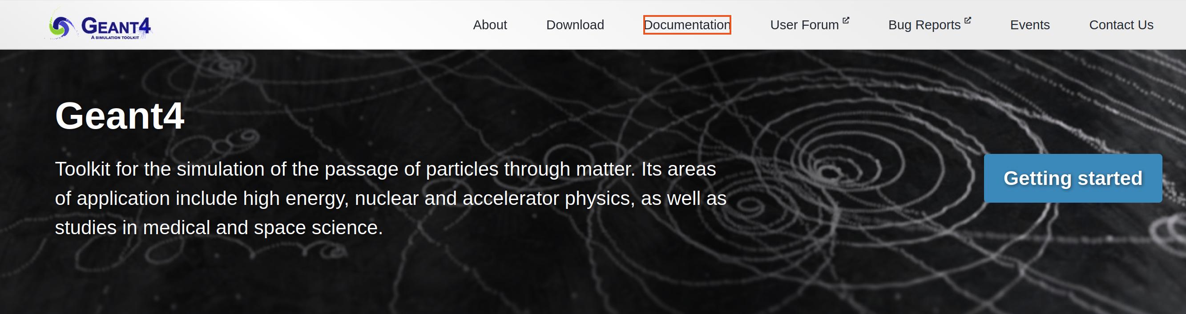
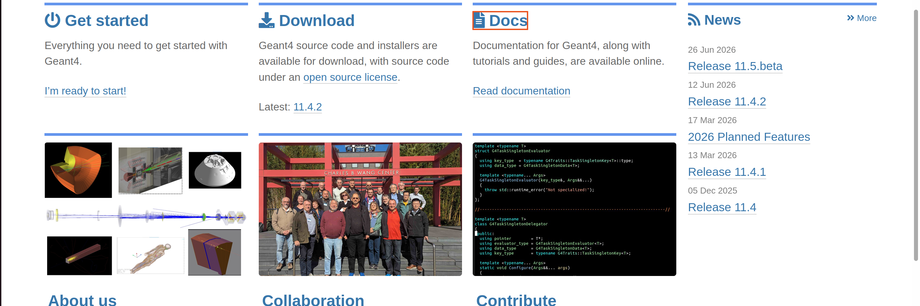
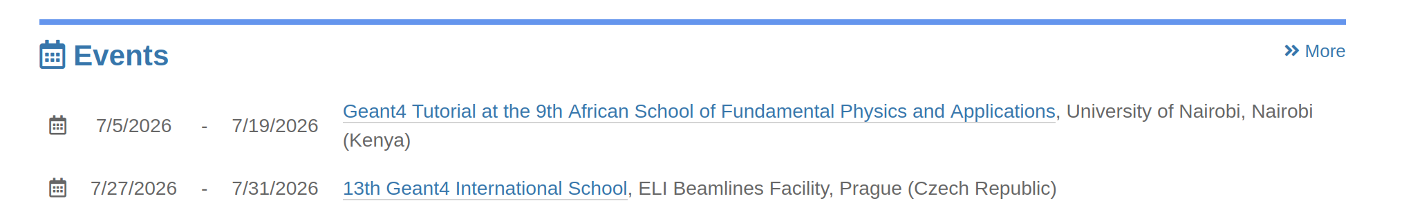
Geant4 web pages
https://geant4.web.cern.ch/
Notes:
Approx. time: 1 min
This slide shows the official Geant4 web page. This page is very useful because it is the central place for documentation, download links, releases, examples, and training material. When we work with Geant4, it is important to use the official documentation because examples and commands can change between versions. For new users, I recommend starting from the web page and then moving to the documentation and examples. During hands-on exercises, if a command or class is unclear, this website is usually the first place to check.
21

Slide 3
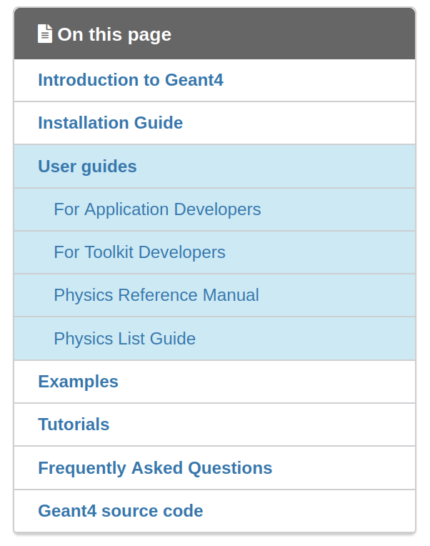
User Guide
Main documentation pages for learning, developing, and checking Geant4 physics models.
□ For Application Developers: Start here if you are new to Geant4; it explains how to build a practical simulation application.
□ For Toolkit Developers: For users who want to extend Geant4 itself.
□ Physics Reference Manual: Detailed theory, models, and parameterisations of the physics interactions implemented in Geant4.
□ Physics List Guide: Explains reference physics lists and electromagnetic options; useful when choosing the physics for a simulation.
□ Examples Documentation: Describes the basic, extended, and advanced examples, with source-code documentation generated by Doxygen.
Fateme Farokhi, PhD, farokhi_f@lns.infn.it
Notes:
Approx. time: 1 min
Here I show the Geant4 User Guide area. The User Guide is divided into different parts. For example, there is documentation for application developers, toolkit developers, and physics reference information. For this school, the most important part is usually the guide for application developers, because it explains how to build a Geant4 application: geometry, materials, primary particles, physics lists, scoring, visualization, and analysis. The examples are strongly connected to the User Guide. When we read an example, we can also check the related section in the guide to understand why the code is written in that way.
21

Slide 4
Overview of the examples
Basic
Extended
Advanced
Fateme Farokhi, PhD, farokhi_f@lns.infn.it
Notes:
Approx. time: 45 s
Geant4 examples are organized into three main categories: basic, extended, and advanced. This classification is very helpful for learning. Basic examples are the best starting point for beginners. Extended examples introduce more specific applications and more realistic use cases. Advanced examples are closer to complete simulation applications. In this presentation, I will move from simple examples to more realistic examples, so we can see how the complexity increases step by step.
<number>

Slide 5
The Geant4 Examples
This module collects 3 sets of user examples aimed to demonstrate to the user how to make correct use of the GEANT4 toolkit by implementing in a correct way those user-classes which the user is supposed to customize in order to define his/her own simulation setup.
Basic:
set of examples oriented to novice users and covering the most typical use-cases of a Geant4 application with keeping simplicity and ease of use
Extended:
set of examples that may require some additional libraries besides of Geant4. This set covers many specific use cases for actual detector simulation
Advanced:
set of examples that covers the use-cases typical of a "toolkit"-oriented kind of development, where real complete applications for different simulation studies are provided; may require additional third party products to be built
Notes:
Approx. time: 2 min
This slide summarizes the purpose of the three example groups. The examples are not only demonstrations; they show how to correctly implement the user classes that we usually customize in our own Geant4 applications. Basic examples keep the code simple and are useful for learning the structure of a Geant4 application. Extended examples cover more specific detector and physics cases, and sometimes they require extra libraries. Advanced examples are closer to real applications. They are useful when we want to understand how a complete simulation study is organized, for example in medical physics or detector development. The important message is: when starting a new project, do not start from zero. First search for a similar Geant4 example and adapt it carefully.
<number>

Slide 6
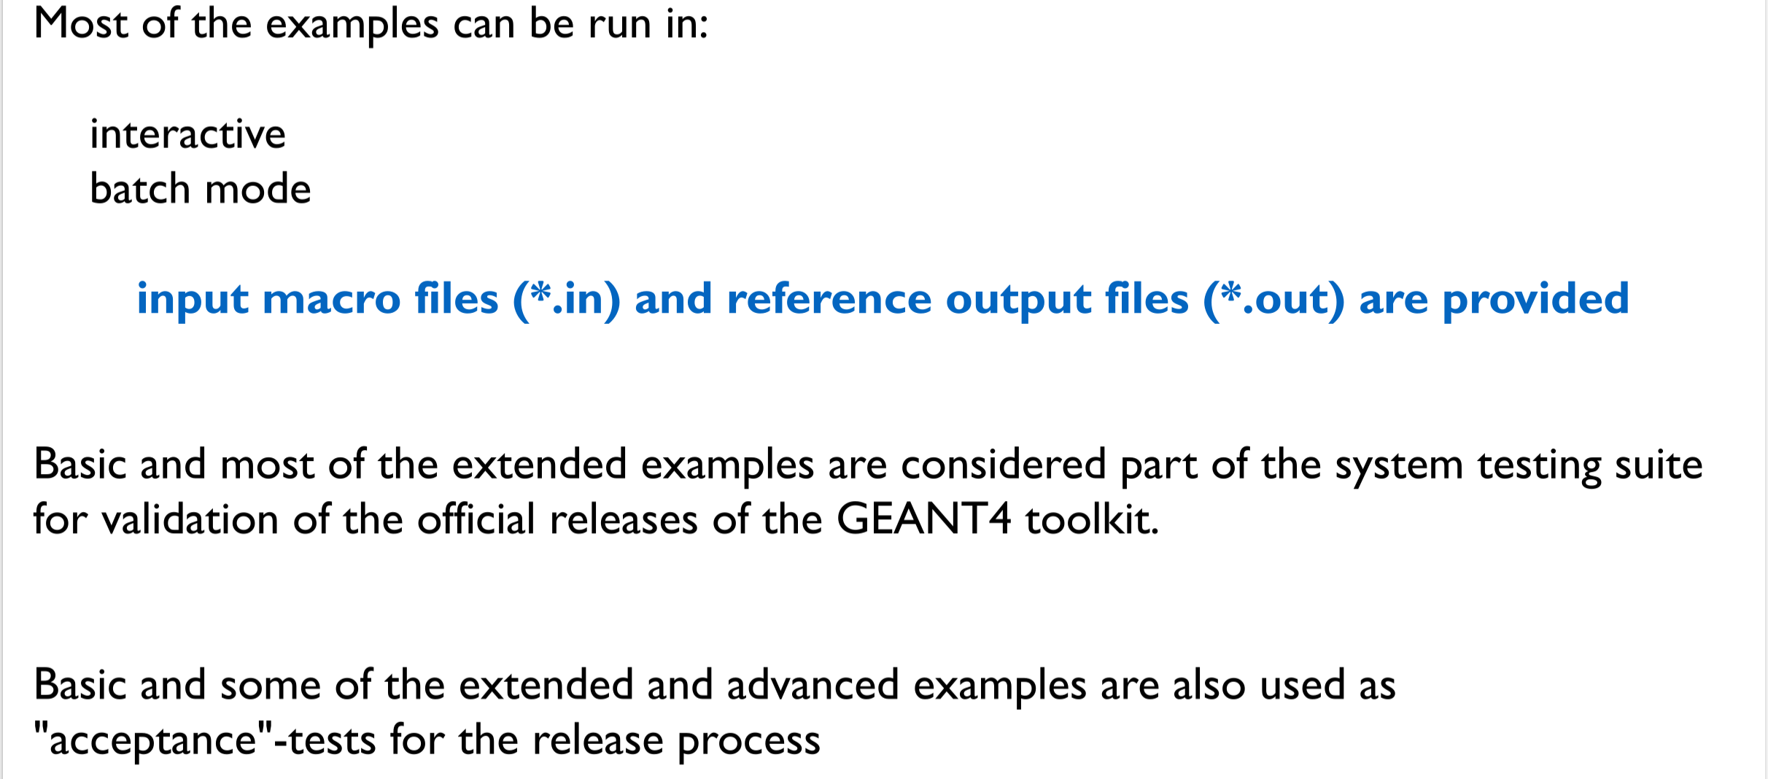
The Geant4 Examples
Fateme Farokhi, PhD, farokhi_f@lns.infn.it
Notes:
Approx. time: 1 min
Here I want to emphasize that most examples can be run in different ways. Usually, there is an interactive mode, where we can visualize the geometry and type commands manually. There is also batch mode, where we run a macro file. Macro files are very useful because they keep the simulation settings reproducible. In many examples, the macro files are placed in a macro directory or near the example source code. Basic and many extended examples are also used as part of the Geant4 testing suite, so they are good references for stable and correct usage. Some advanced examples are also used as application examples for release processes.
<number>

Slide 7
The Geant4 Examples
….Where??
geant4-v11.4.2/Source/examples/basic
geant4-v11.4.2/Source/examples/extended
geant4-v11.4.2/Source/examples/advanced
Fateme Farokhi, PhD, farokhi_f@lns.infn.it
Notes:
Approx. time: 45 s
This slide answers a practical question: where are the examples located? In a Geant4 installation or source directory, the examples are inside the examples folder. There are three main subdirectories: basic, extended, and advanced. For example, in this version, the paths are geant4-v11.4.2/Source/examples/basic, extended, and advanced. When you install Geant4, I recommend opening these directories and exploring the CMakeLists file, the source files, and the macro files. This helps you understand how each example is built and executed.
<number>

Slide 8
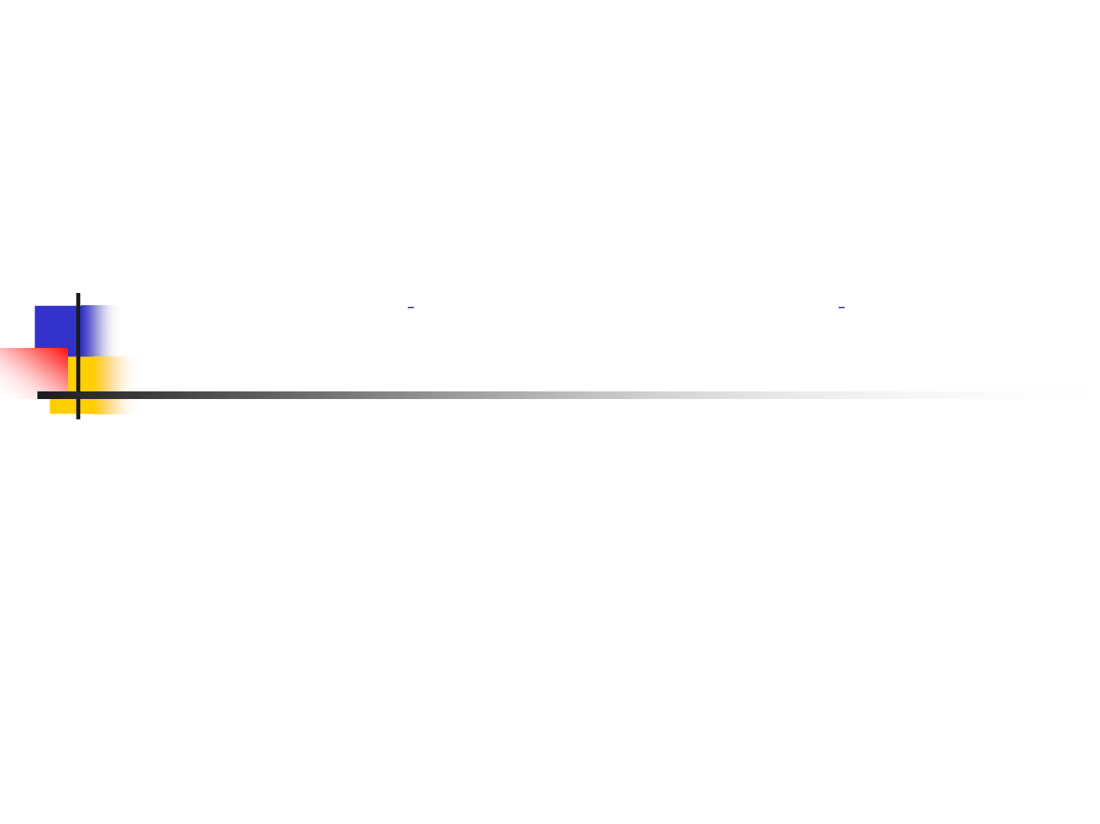
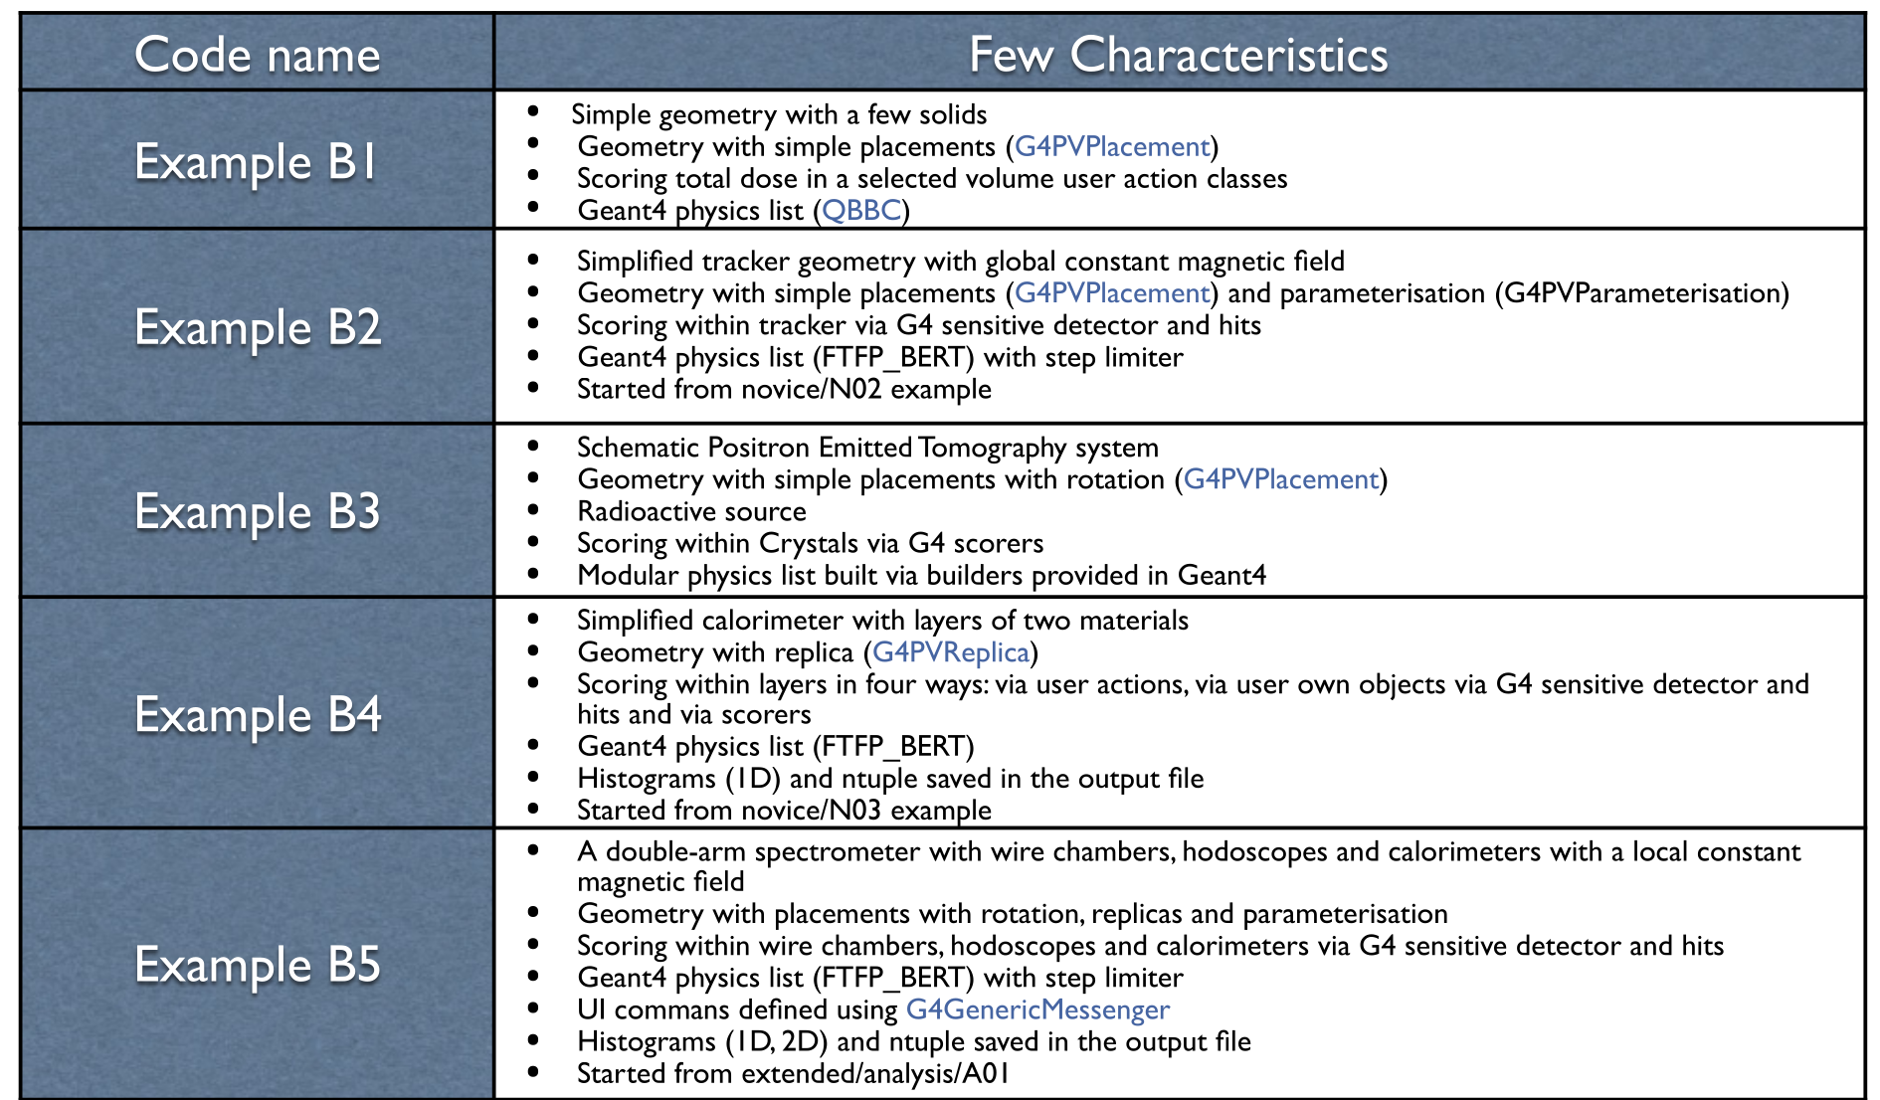
Basic Examples
Fateme Farokhi, PhD, farokhi_f@lns.infn.it
Notes:
Approx. time: 1 min
Now we start with the basic examples. This table lists examples B1 to B5 and their main characteristics. These examples are designed for beginners. They introduce the standard structure of a Geant4 application: detector construction, physics list, action initialization, primary generator, stepping action, and run or event actions. The important point is that each example adds a new concept. So, if someone is new to Geant4, it is better to start from B1 and then move gradually to B2, B3, and so on.
<number>

Slide 9
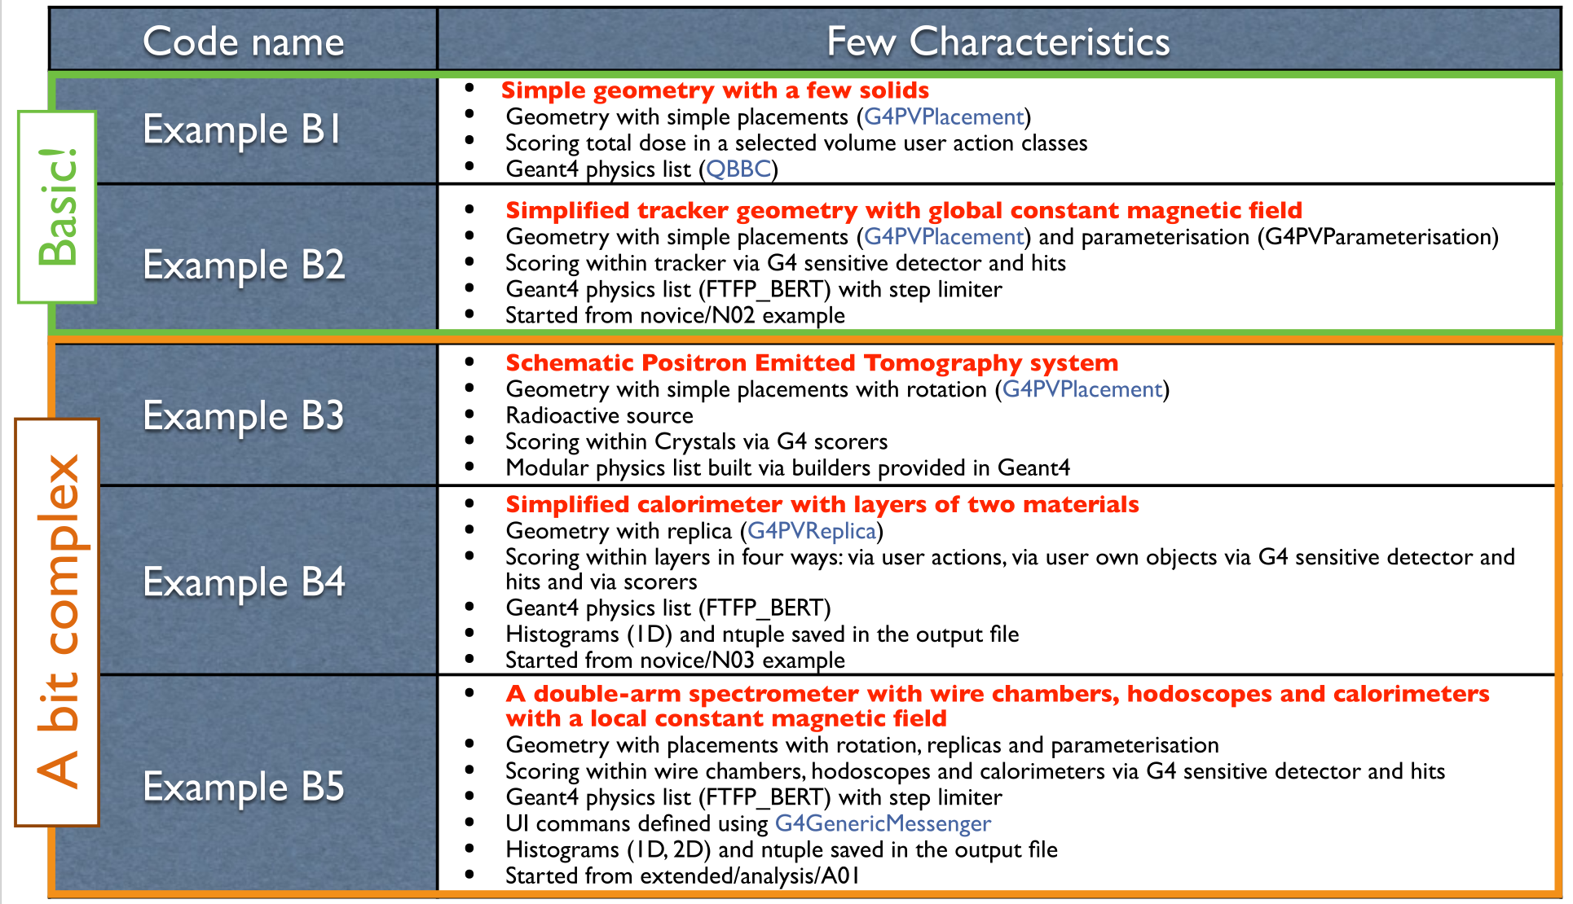
Basic Examples
Fateme Farokhi, PhD, farokhi_f@lns.infn.it
Notes:
Approx. time: 1 min
This slide shows the same basic examples, but now with a stronger focus on their learning role. Some examples are more focused on geometry and sensitive detectors, while others introduce scoring, actions, and analysis. For students, basic examples are useful because the code is not too large. You can open one class at a time and understand its role. For example, if you want to learn how scoring is implemented, B3 is a good example. If you want to learn a general application structure, B1 is usually the starting point.
<number>

Slide 10
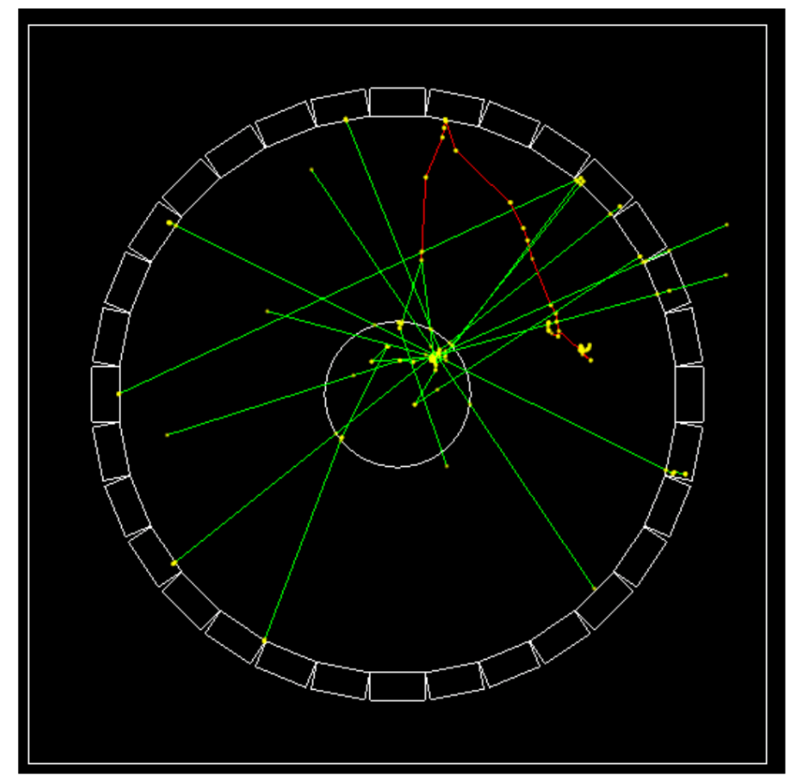
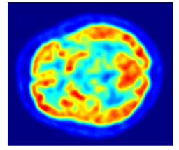
Example B3 - the geometry
PET (Positron Emitted Tomography) is a nuclear medicine functional imaging technique that is used to observe metabolic processes in the body as an aid to the diagnosis of disease. The system detects pairs of gamma rays emitted indirectly by a positron-emitting radionuclide, most commonly ﬂuorine-18, which is introduced into the body on a biologically active molecule called a radioactive tracer.
Fateme Farokhi, PhD, farokhi_f@lns.infn.it
Notes:
Approx. time: 1.5 min
Here I introduce example B3. This example is based on a simplified PET system. PET means positron emission tomography. In PET, a radioactive tracer emits positrons. When a positron annihilates with an electron, two gamma photons of 511 keV are emitted almost back-to-back. A PET scanner detects these gamma photons in coincidence. In the B3 example, the geometry contains a ring of crystals and a patient volume. The purpose is not to simulate a full clinical PET scanner, but to demonstrate how geometry, sensitive detectors, and scoring can be connected in a simple medical imaging example.
<number>

Slide 11
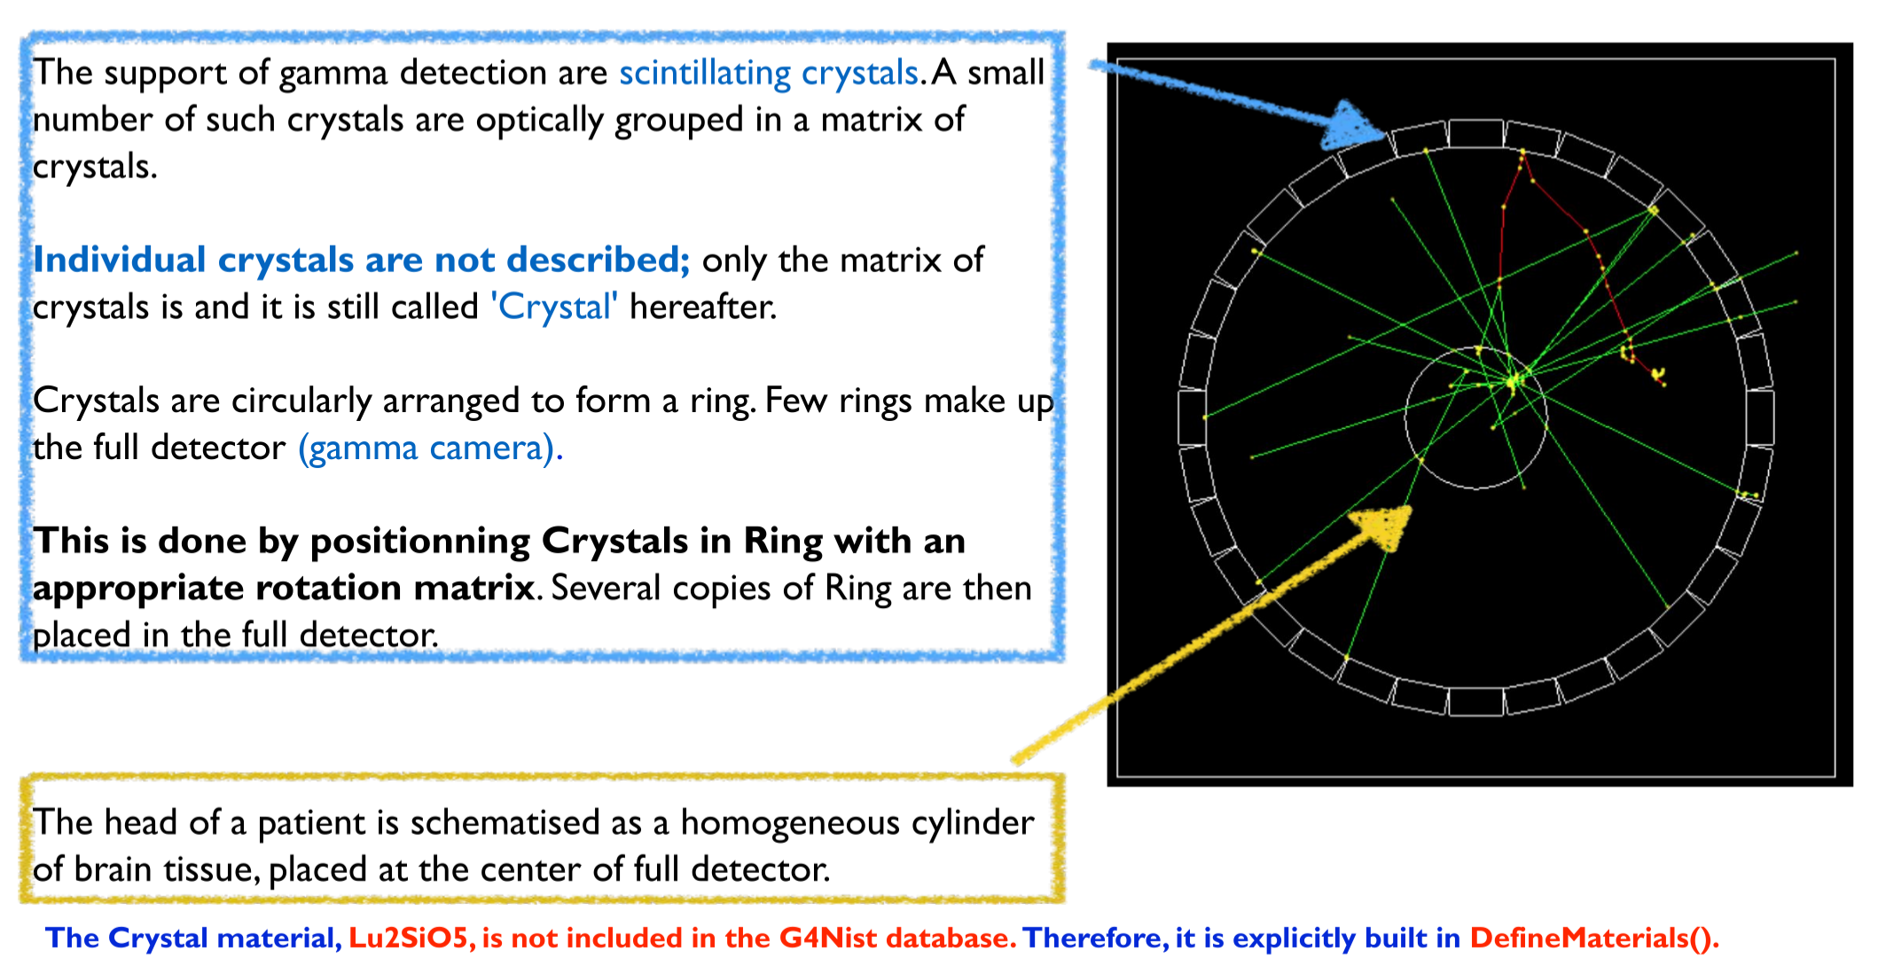
Example B3 - the geometry
Fateme Farokhi, PhD, farokhi_f@lns.infn.it
Notes:
Approx. time: 1.5 min
This slide shows the B3 geometry more clearly. The ring represents the detector crystals, and the central region represents the patient or phantom volume. The example defines crystal detectors around the patient. A good event is related to energy deposition in two separate crystals, corresponding to the two 511 keV photons from annihilation. This is a very useful example because it connects a real imaging concept with Geant4 implementation. It also shows how we can define sensitive volumes and collect detector response information during the simulation.
<number>

Slide 12
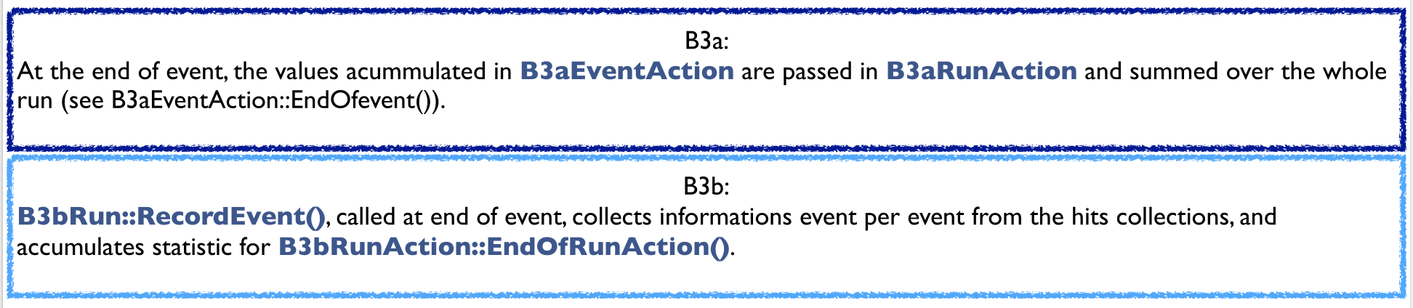
Example B3 - the output
DETECTOR RESPONSE : scorers
A 'good' event is an event in which an identical energy of 511 keV is deposited in two separate Crystals.
A count of the number of such events corresponds to a measure of the efficiency of the PET system.
The total dose deposited in a patient during a run is also computed.
Scorers are defined in B3DetectorConstruction::ConstructSDandField().
There are two G4MultiFunctionalDetector objects:
• the Crystal (EnergyDeposit)
• the Patient (DoseDeposit)
Two variants of accumulation event statistics in a run are demonstrated in this example:
Notes:
Approx. time: 2 min
This slide explains the output of example B3. The detector response is obtained using scorers. In this example, a good event is defined when 511 keV is deposited in two separate crystals. Counting such events gives an estimate of the detection efficiency of the PET system. The example also calculates the dose deposited in the patient. In the code, the scorers are defined in the detector construction class, in the method ConstructSDandField. Two G4MultiFunctionalDetector objects are used: one for energy deposition in the crystals and one for dose deposition in the patient. This is a key concept: in Geant4, scoring allows us to convert particle interactions into useful physical quantities.
<number>

Slide 13
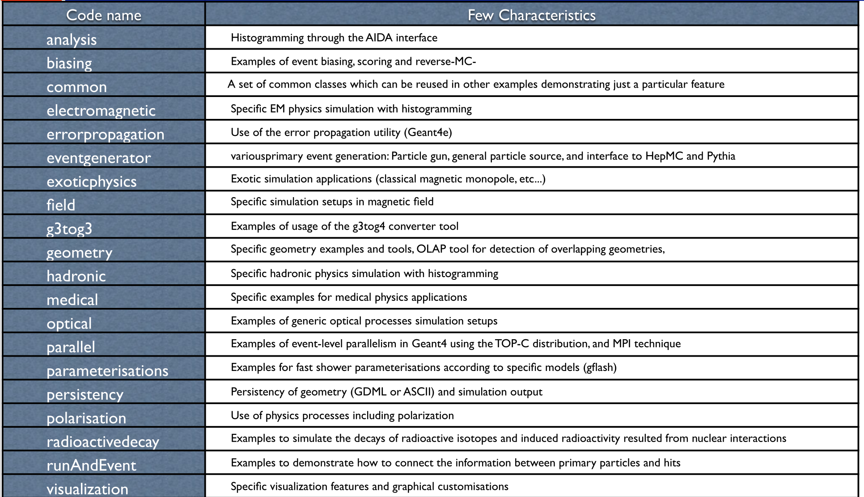
Extended Examples
Notes:
Approx. time: 1 min
Now we move from basic to extended examples. Extended examples cover many more specific use cases. They include examples for electromagnetic physics, hadronic physics, optical photons, biasing, field propagation, geometry, medical applications, and many others. These examples are more application-oriented than the basic examples. They are useful when we need a starting point for a specific project. For example, if our project involves optical photons, medical physics, or DNA physics, we should look first in the extended examples.
<number>

Slide 14
Extended Examples
Notes:
Approx. time: 1 min
In this slide, I highlight that the extended examples include a dedicated medical category. This is important for us because many school participants are interested in medical physics or radiation biology applications. The medical examples show how Geant4 can be used for dosimetry, hadrontherapy, DNA-scale simulations, radiobiology, and other biomedical topics. Compared with basic examples, these examples are more realistic and closer to research applications.
<number>

Slide 15
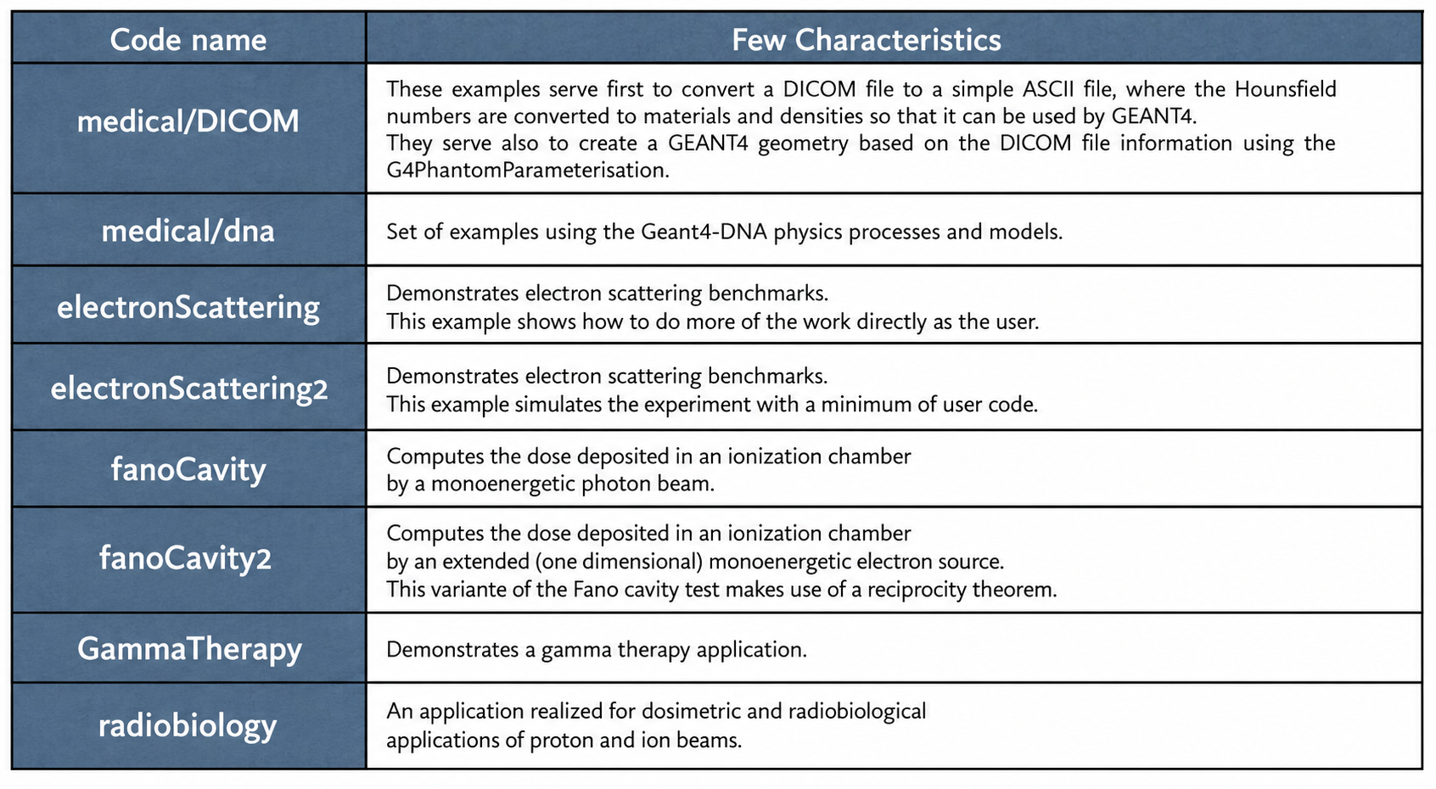
Medical examples
Fateme Farokhi, PhD, farokhi_f@lns.infn.it
Notes:
Approx. time: 1.5 min
Here we see the list of medical examples. Each medical example is designed to demonstrate a specific feature. For example, some examples focus on dose calculation, some on brachytherapy, some on electron scattering, and some on Geant4-DNA. This list is useful because it helps users select the correct starting point. If you want to simulate radiation transport in water at the microscopic scale, you should look at the DNA examples. If you want to simulate a treatment beamline or patient-related setup, you may need examples related to hadrontherapy or other medical applications.
<number>

Slide 16
Medical examples
Fateme Farokhi, PhD, farokhi_f@lns.infn.it
Notes:
Approx. time: 1 min
In this slide, the medical/dna category is highlighted. This category is very important for simulations at very small scales, especially when we are interested in track structure, water radiolysis, and radiation-induced biological damage. Geant4-DNA provides physics and chemistry models for liquid water and biological media at microscopic and nanoscopic scales. In this presentation, I only mention this category briefly, because it will be discussed in more detail in the Geant4-DNA session.
<number>

Slide 17
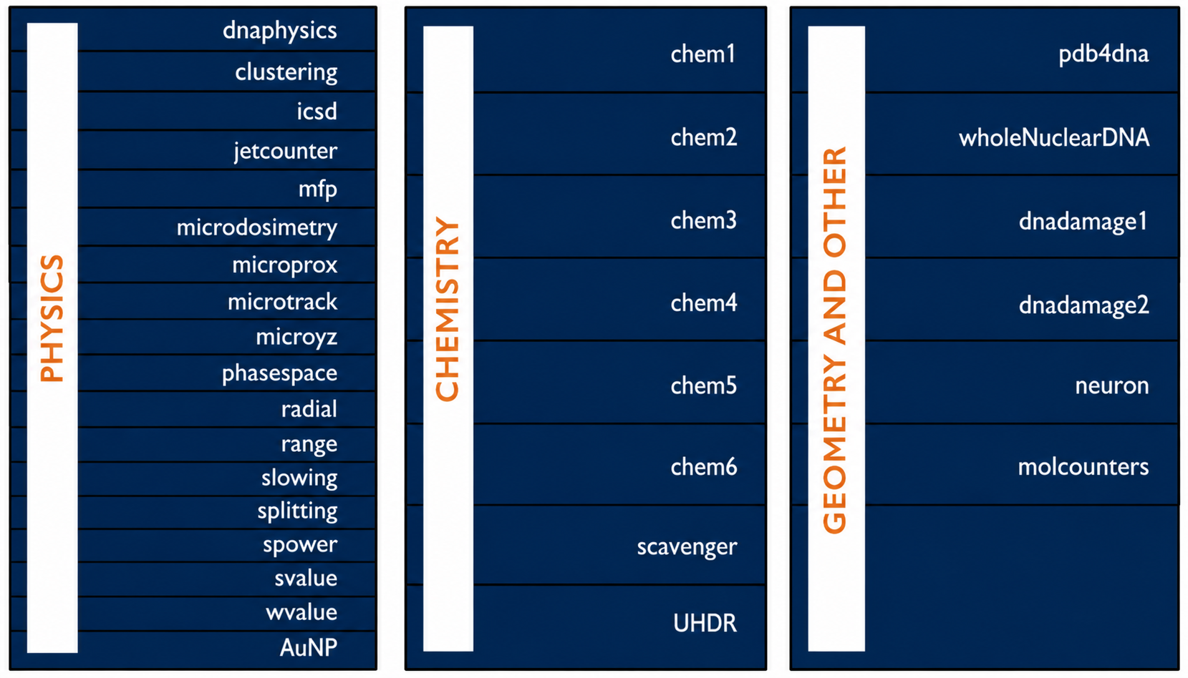
Medical: dna
See the Geant4-DNA session!
Notes:
Approx. time: 1 min
This slide gives a quick overview of the medical DNA examples. They include examples related to physics, chemistry, and DNA geometry or damage models. For example, some examples simulate physical interactions in liquid water, some simulate chemical species after radiolysis, and some are related to DNA damage scoring. The main message is that Geant4-DNA is a rich set of examples, but it deserves a dedicated session. So, here I just point students to this category and connect it to the later Geant4-DNA presentation.
<number>

Slide 18
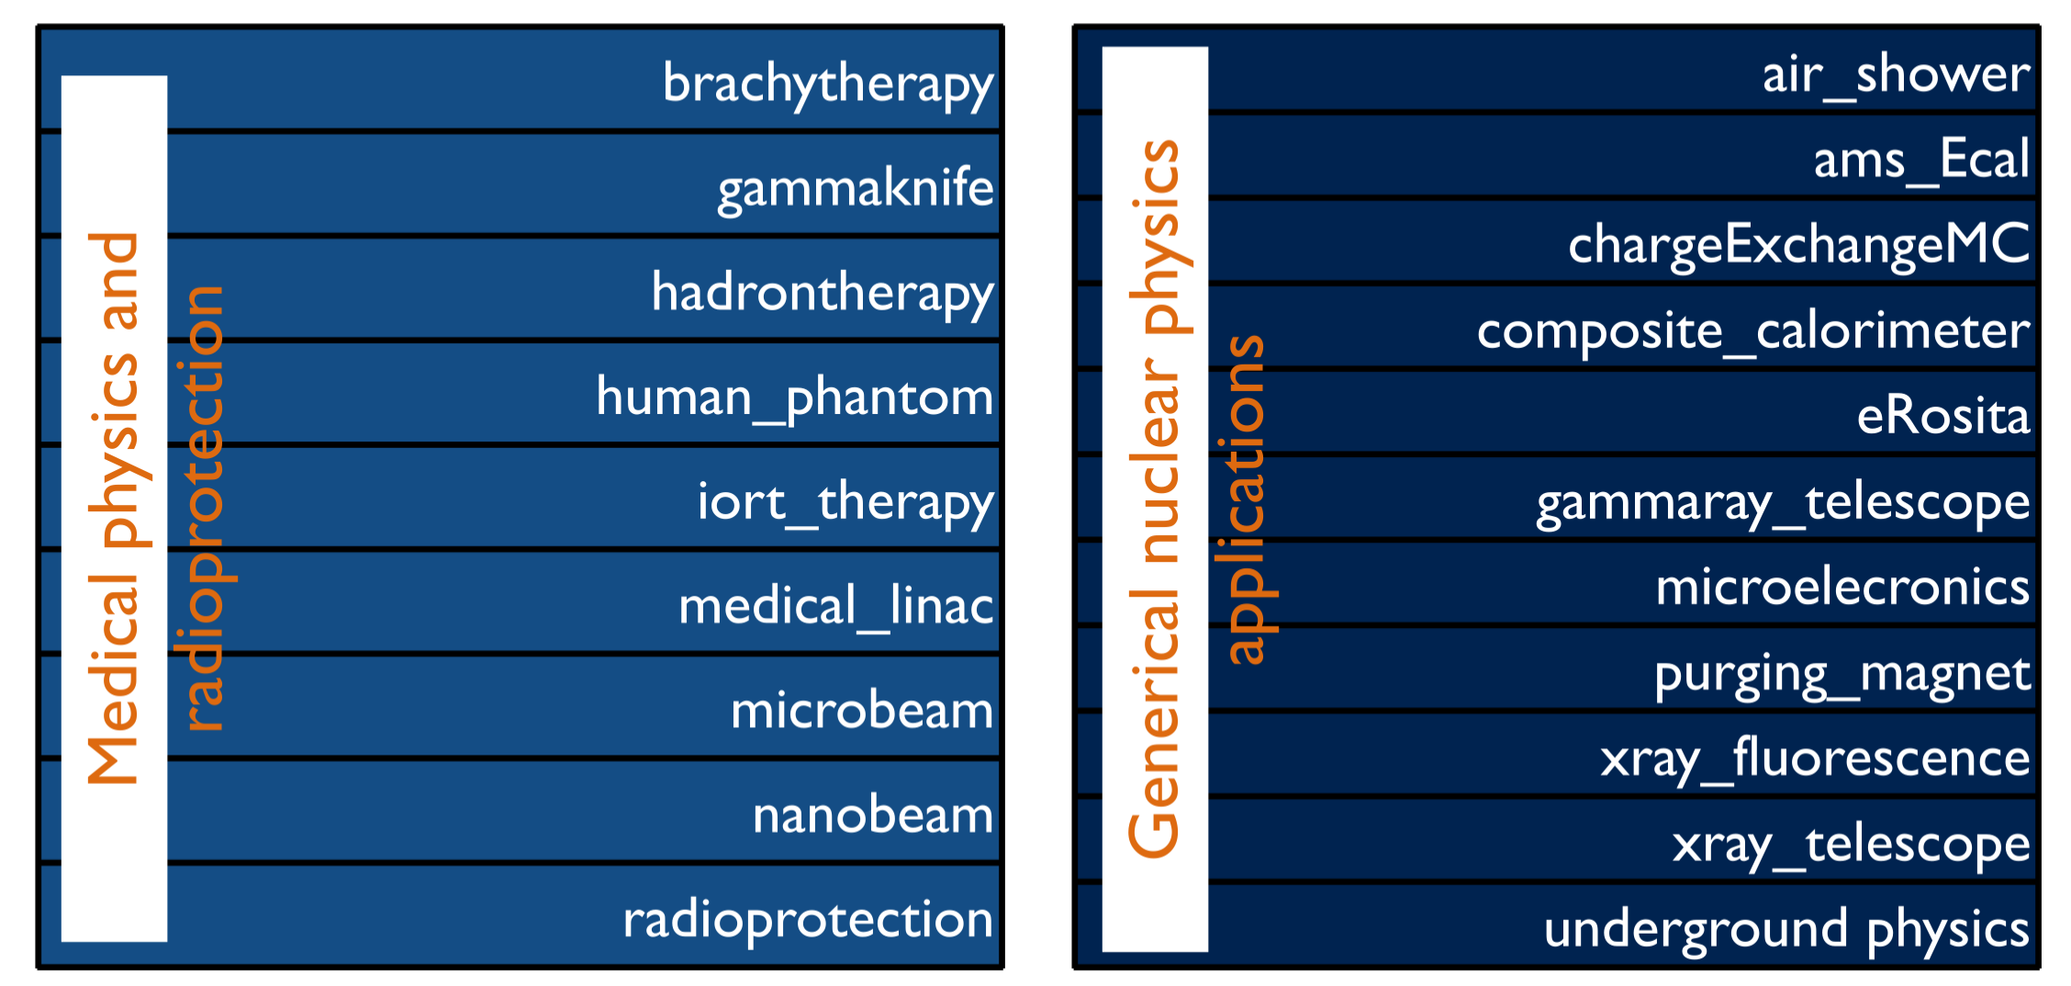
Advanced Examples
Fateme Farokhi, PhD, farokhi_f@lns.infn.it
Notes:
Approx. time: 1 min
Now we move to advanced examples. These examples are usually more complex and closer to complete applications. They may include more realistic geometries, more detailed physics configurations, analysis tools, and external dependencies. Advanced examples are very useful when we want to see how a larger Geant4 project is organized. However, for beginners, it is better to first understand the basic examples before modifying advanced ones. In the rest of the presentation, I focus on the hadrontherapy advanced example because it is very relevant for medical and accelerator applications.
<number>

Slide 19
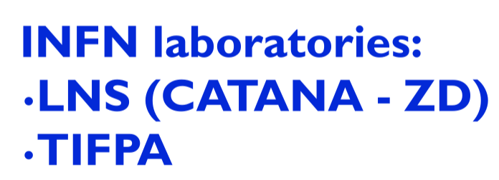
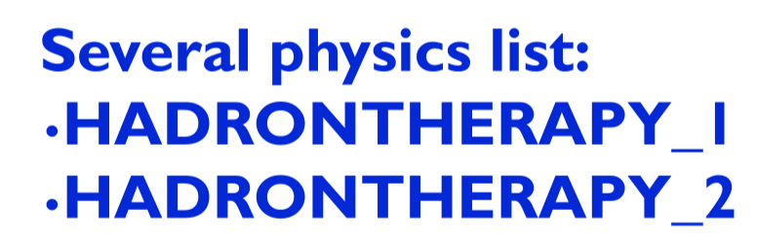
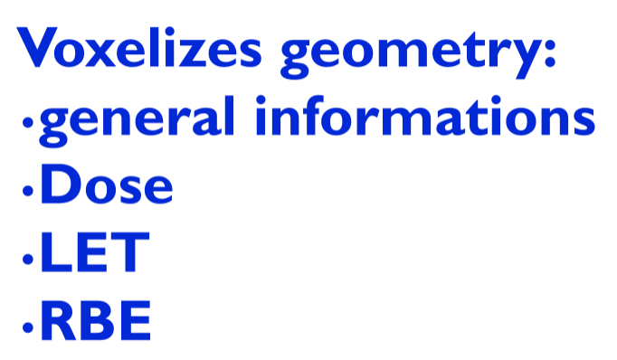
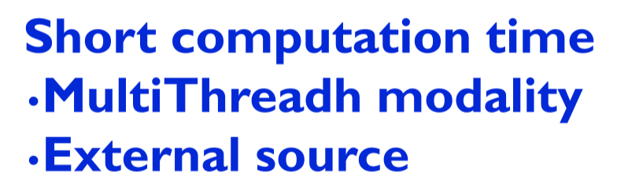
Advanced: Hadrontherapy
Hadrontherapy
Fateme Farokhi, PhD, farokhi_f@lns.infn.it
Notes:
Approx. time: 1.5 min
This slide introduces the advanced hadrontherapy example. Hadrontherapy is related to the use of charged particles, such as protons or ions, for cancer treatment. This example includes several important features: INFN laboratory beamlines, voxelized geometries, dose calculation, LET, and RBE-related quantities. It can also use different physics lists and can run with multithreading. The important point is that this example is not only a simple demonstration. It is closer to a complete application and can be used to study particle therapy beamlines and dose distributions.
<number>

Slide 20
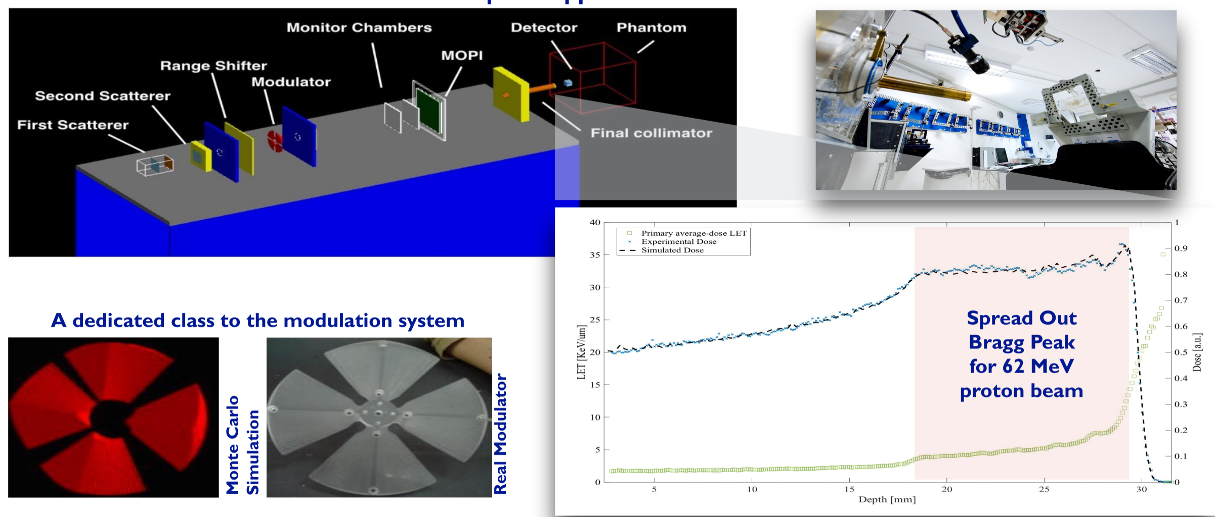
Advanced: Hadrontherapy- CATANA
Centro di AdroTerapia e Applicazioni Nucleari Avanzate
Fateme Farokhi, PhD, farokhi_f@lns.infn.it
Notes:
Approx. time: 1.5 min
Here we see the CATANA beamline, which stands for Centro di AdroTerapia e Applicazioni Nucleari Avanzate. It is connected to the INFN-LNS facility. The slide shows that the hadrontherapy example includes realistic beamline components and output plots. This kind of example is useful because it shows how a real experimental or clinical beamline can be translated into a Geant4 geometry. We can define beam modifiers, monitor chambers, collimators, and other components, then study how the beam changes along the line.
<number>

Slide 21
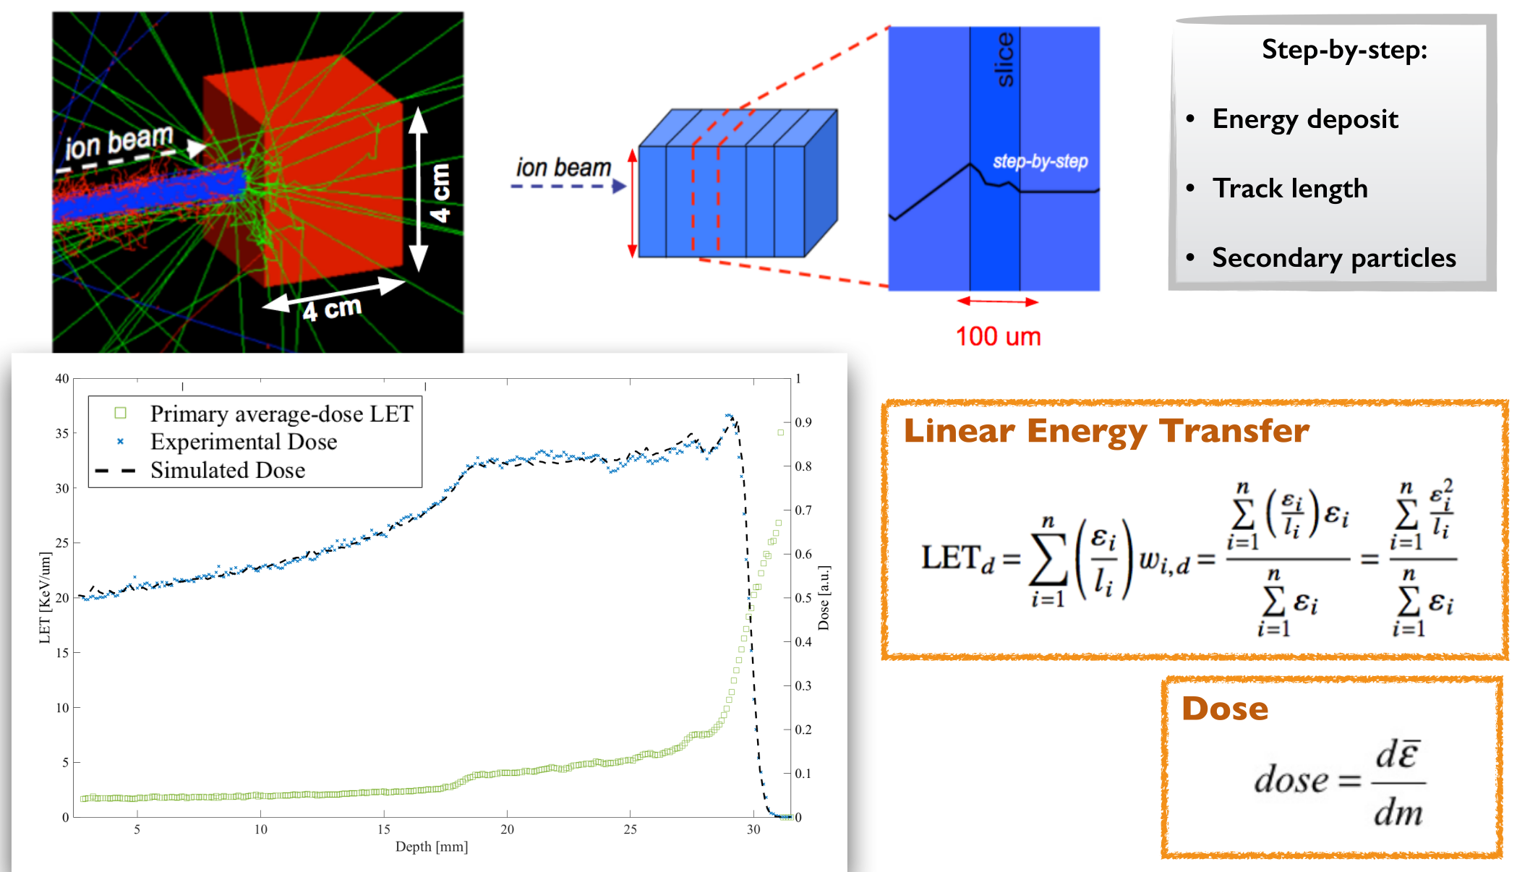
Advanced: Hadrontherapy- LET & dose calculation
Fateme Farokhi, PhD, farokhi_f@lns.infn.it
Notes:
Approx. time: 2 min
This slide focuses on LET and dose calculation in the hadrontherapy example. Dose tells us how much energy is deposited per unit mass. LET, or linear energy transfer, describes how densely energy is deposited along the particle track. LET is important in hadrontherapy because biological effectiveness depends not only on dose, but also on radiation quality. The example can calculate quantities such as energy deposit, track length, dose, and LET. These outputs help us evaluate the beam inside a phantom or patient-like geometry. This slide is a good example of how Geant4 can connect particle transport with clinically relevant quantities.
<number>

Slide 22
Thank you!
Fateme Farokhi, PhD, farokhi_f@lns.infn.it
Notes:
Approx. time: 30 s
To conclude, Geant4 examples are one of the best resources for learning and starting new simulations. Basic examples teach the structure of a Geant4 application. Extended examples show more specific physics and detector cases. Advanced examples show more complete and realistic applications. My recommendation is to always search the examples before writing new code from the beginning. Thank you for your attention. I am happy to take questions.
<number>

