Slide 1


Generating primary particles
in Geant4
Pablo Cirrone
INFN - Laboratori Nazionali del Sud
Geant4 application-developer course

Slide 2
Primary generation runs per event
INITIALISATION CLASSES
G4VUserDetectorConstruction
G4VUserPhysicsList
G4VUserActionInitialization
USER ACTIONS
Invoked at defined points in the run, event and tracking lifecycle
G4VUserPrimaryGeneratorAction
mandatory
G4UserRunAction
G4UserEventAction
G4UserTrackingAction
G4UserStackingAction
G4UserSteppingAction
Detector and physics configuration are shared; actions are registered by G4VUserActionInitialization.
Global: only one instance of them exists in memory, shared by all threads (readonly).
Managed only by the master thread.

Slide 3
The philosophy
G4Event (or history)
Is the primary unit of a run
Before the event is processed, it contains primary vertices and primary particles produced by a generator (a concrete implementation of a G4VPrimaryGenerator)
G4EventManager
The current event being simulated is managed by G4EventManager
The tracks being followed for the current event are stored in a stack managed by G4StackManager
User hooks allow for a customisation of the simulation behaviour via G4UserEventAction, G4UserStackingAction and G4VUserEventInformation.
G4VPrimaryGenerator
Event generation is performed via a concrete implementation of a G4VPrimaryGenerator class.
This is usually instantiated by the user in the user-defined concrete implementation of G4VUserPrimaryGeneratorAction
GEANT4 provides three concrete implementation of G4VPrimaryGenerator: G4ParticleGun, G4HEPEvtInterface and the G4GeneralParticleSource

Slide 4
G4VUserPrimaryGeneratorAction
It is one of the mandatory user classes and it controls the generation of primary particles
  This class does not directly generate primaries but invokes the GeneratePrimaryVertex() method of a generator to create the initial state
  It registers the primary particle(s) to the G4Event object
It has GeneratePrimaries(G4Event*) method which is purely virtual, so it must be implemented in the user class

Slide 5
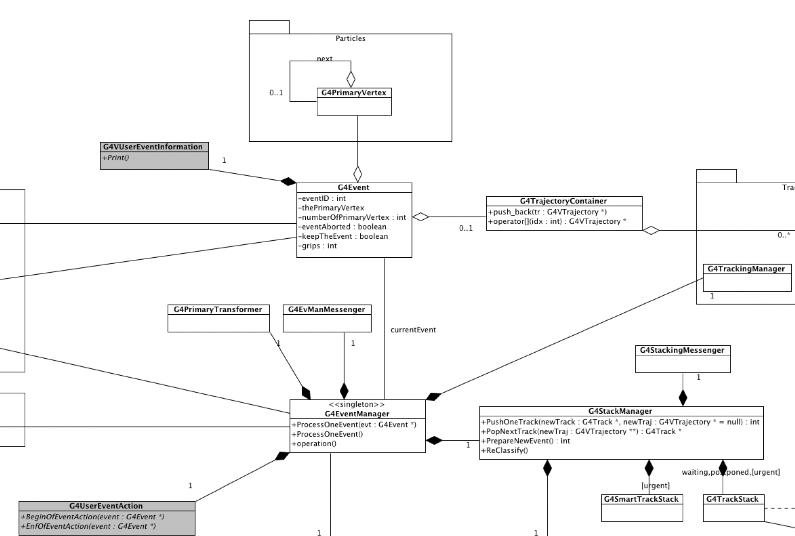
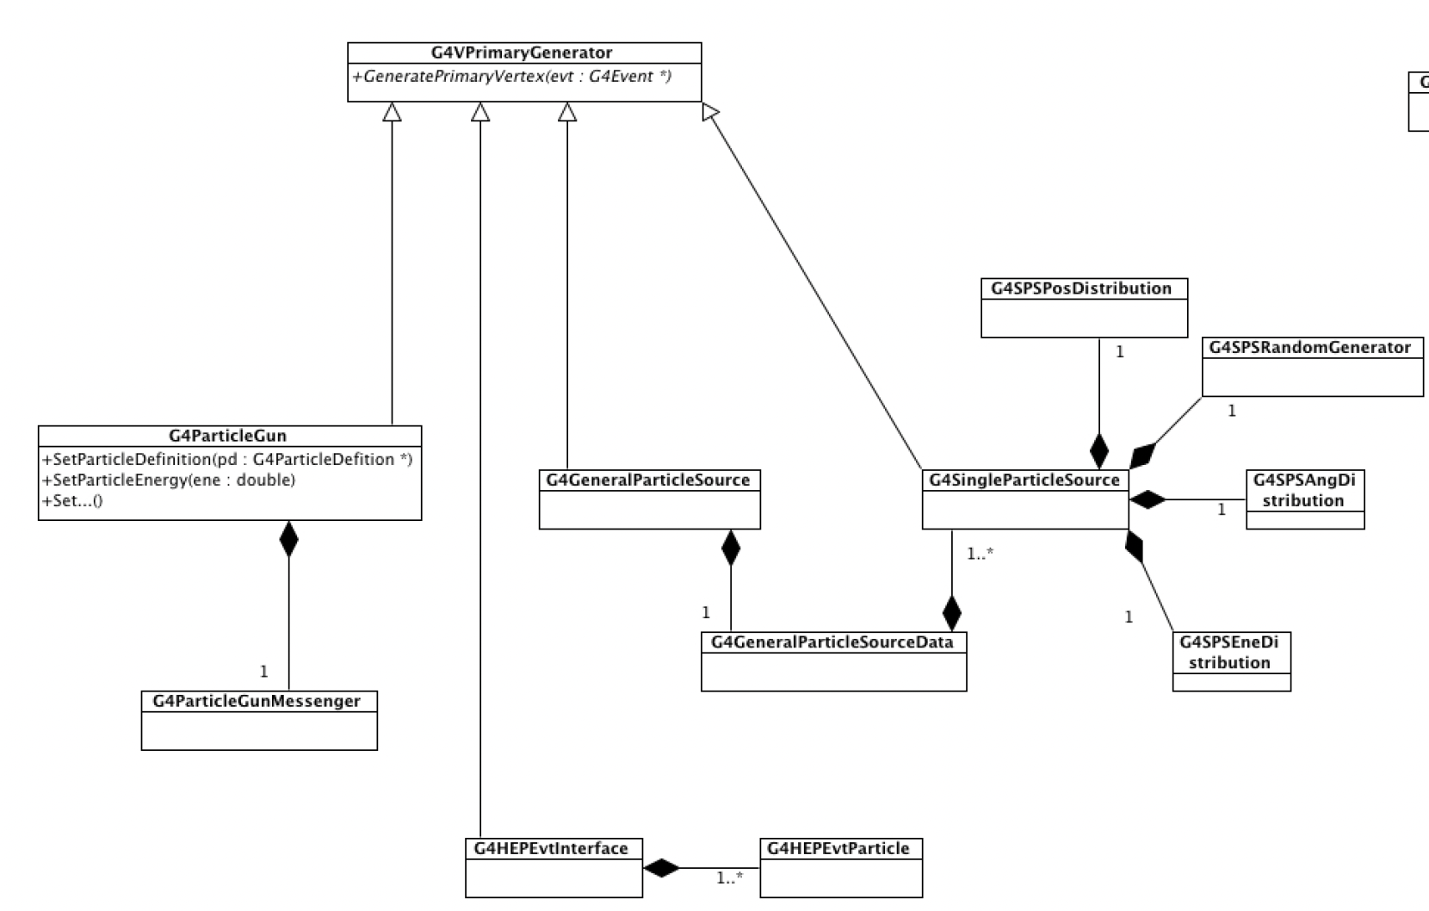

Slide 6
A primary event is a hierarchy
G4Event
contains one or more G4PrimaryVertex objects
G4PrimaryVertex
stores the common position and time
contains one or more G4PrimaryParticle objects
G4PrimaryParticle
stores particle identity, momentum and optional ancestry
Before transport, G4EventManager converts known primary particles into G4Track objects.

Slide 7
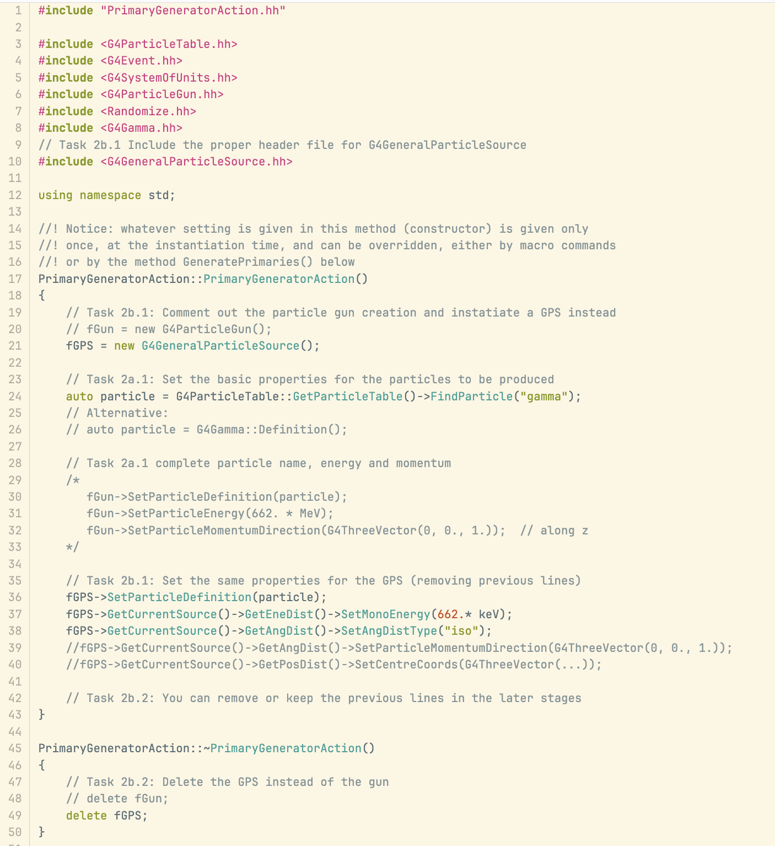
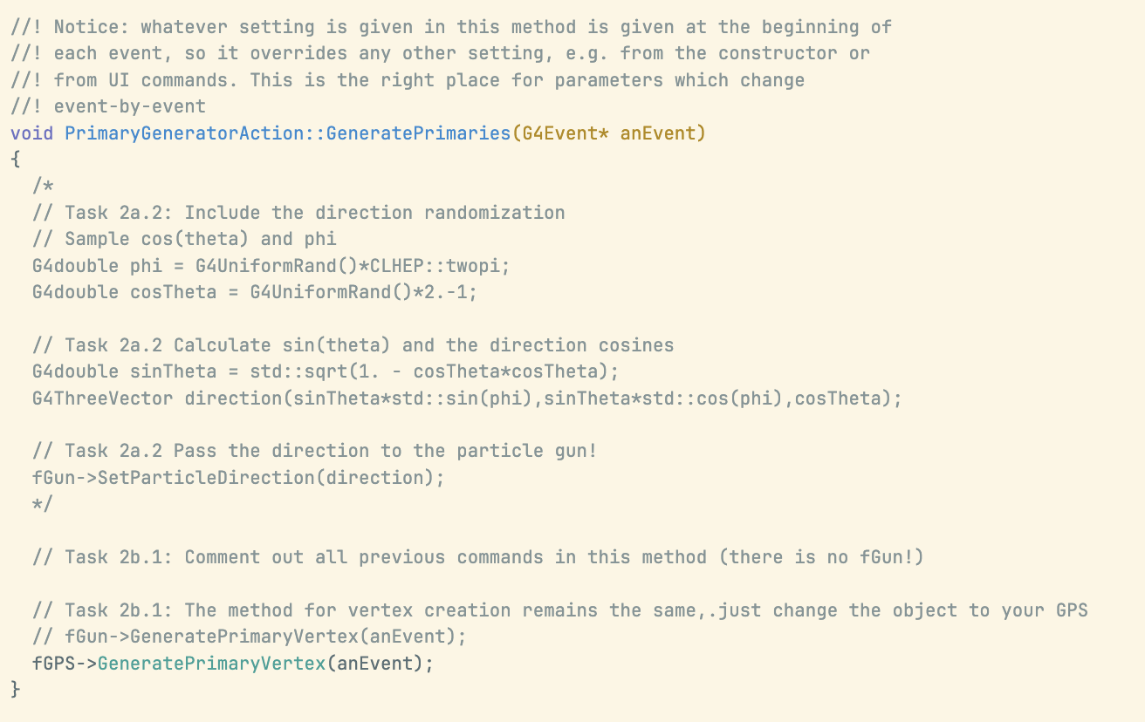

Slide 8
G4VUserPrimaryGenerator defines creation
A concrete generator implements
GeneratePrimaryVertex(G4Event*).
GeneratePrimaries()may invoke multiple G4VPrimaryGenerator objects, and each generator may be invoked more than once for the same G4Event
Geant4 provides three concrete implementations of the G4VPrimaryGenerator:
• G4ParticleGun - fixed kinematics, simple control
• G4GeneralParticleSource - configurable distributions
• G4HEPEvtInterface - ASCII event-generator interface
G4HEPEvtInterface Read ASCII distributions generated with a well defined format by external codes

Slide 9
Choose the simplest matching generator
G4ParticleGun
Known particle, position, direction and energy; randomization is simple enough to code.
G4GeneralParticleSource
Spatial, angular or spectral distributions; surfaces, volumes or multiple sources; macro control matters.
Custom G4VPrimaryGenerator
Correlated particles, several vertices, external event records or event structures that built-ins cannot express.
Notes:
[Sources]
- Geant4 Collaboration, Book For Application Developers, Release 11.4, Sections 2.6.2, 2.7, and 3.6, attached PDF.
- Cirrone - Primary particles.ppt, source slide 18, attached source deck.
[/Sources]

Slide 10
G4ParticleGun is deterministic
• Generates one or more primary particles with identical kinematics.
• Performs no randomization by itself.
• Random values must be sampled in GeneratePrimaries() before the vertex is created.
SetParticleDefinition(...)
SetParticleEnergy(...)
SetParticleMomentumDirection(...)
SetParticlePosition(...)
SetParticleTime(...)
SetParticlePolarization(...)
SetNumberOfParticles(...)

Slide 11
The recipe has two phases
Constructor() - stable configuration
• Instantiate the selected generator.
• Set defaults that do not change from event to event.
GeneratePrimary(G4Event* anEvent) - event configuration
• Sample event-dependent values.
• Update the generator state.
• Call GeneratePrimaryVertex(event).
The generator object is owned by the user action and must be released in the destructor.

Slide 12
Construct once; set stable defaults
PrimaryGeneratorAction::PrimaryGeneratorAction()
: G4VUserPrimaryGeneratorAction(),
fParticleGun(new G4ParticleGun(1))
{
fParticleGun->SetParticleDefinition(
G4Proton::ProtonDefinition());
fParticleGun->SetParticleMomentumDirection(
G4ThreeVector(0., 0., 1.));
fParticleGun->SetParticleEnergy(60.*MeV);
}
PrimaryGeneratorAction::~PrimaryGeneratorAction()
{ delete fParticleGun; }
STABLE DEFAULTS
Particle type
Direction
Nominal energy
OWNERSHIP
The user action owns the generator and releases it in the destructor.

Slide 13
Randomize, then create the vertex
void PrimaryGeneratorAction::GeneratePrimaries(G4Event* event)
{
const auto cosTheta = 2.*G4UniformRand() - 1.;
const auto phi = twopi*G4UniformRand();
const auto sinTheta =
std::sqrt(1.-cosTheta*cosTheta);
G4ThreeVector direction(
sinTheta*std::cos(phi),
sinTheta*std::sin(phi), cosTheta);
const auto energy = (5. + 5.*G4UniformRand())*MeV;
fParticleGun->SetParticleMomentumDirection(
direction);
fParticleGun->SetParticleEnergy(energy);
fParticleGun->GeneratePrimaryVertex(event);
}
1 SAMPLE
Direction and energy
2 CONFIGURE
Update gun state
3 CREATE
Append the vertex
The GeneratePrimary() is called at each event

Slide 14
Change source settings between runs
The /gun commands set deterministic values. Any value assigned later inside GeneratePrimaries() takes precedence for that event.
/gun/particle proton
/gun/energy 60 MeV
/gun/position 0 0 -10 cm
/gun/direction 0 0 1
/run/beamOn 1000
/gun/particle ion
/gun/ion 6 12
/gun/energy 120 MeV
/run/beamOn 1000
RUN 1
60 MeV protons
Change particle and energy
RUN 2
120 MeV carbon ions

Slide 15
PART II
General Particle Source (GPS)
Notes:
[Sources]
- Geant4 Collaboration, Book For Application Developers, Release 11.4, Section 2.7, attached PDF.
- Cirrone - Primary particles.ppt, source slide 13, attached source deck.
[/Sources]

Slide 16
GPS describes distributions, not just values
SPATIAL SAMPLING
Points, beams, planes, surfaces and volumes
ANGULAR DISTRIBUTIONS
Unidirectional, isotropic, cosine-law, beam or user-defined
ENERGY SPECTRA
Mono, linear, exponential, power-law, Gaussian, blackbody or tabulated
MULTIPLE SOURCES
Independent particle types and distributions in the same run

Slide 17
A GPS source can live in a macro
/gps/particle proton
/gps/pos/type Beam
/gps/pos/centre 0 0 -10 cm
/gps/pos/sigma_r 1 mm
/gps/ang/type beam2d
/gps/ang/sigma_x 0.002 rad
/gps/ang/sigma_y 0.002 rad
/gps/ene/type Gauss
/gps/ene/mono 60 MeV
/gps/ene/sigma 1 MeV
/run/beamOn 10000

Slide 18
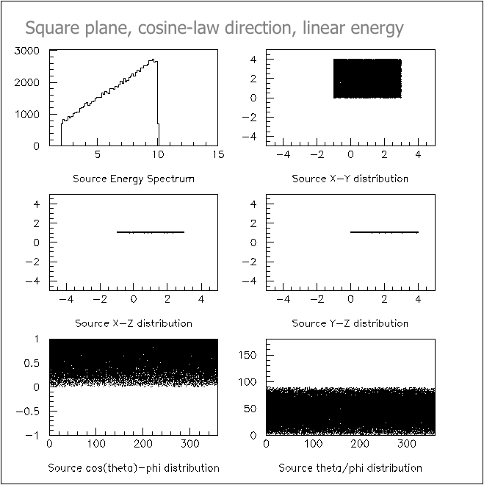
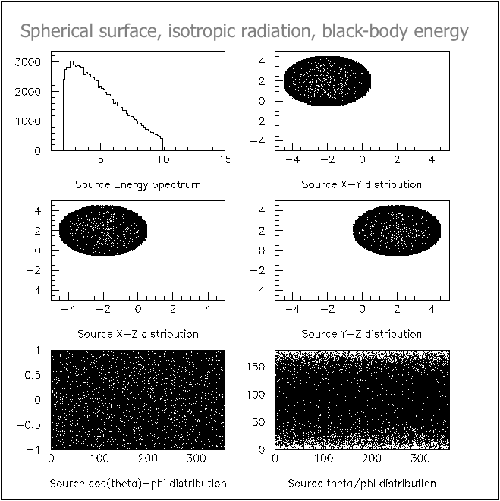
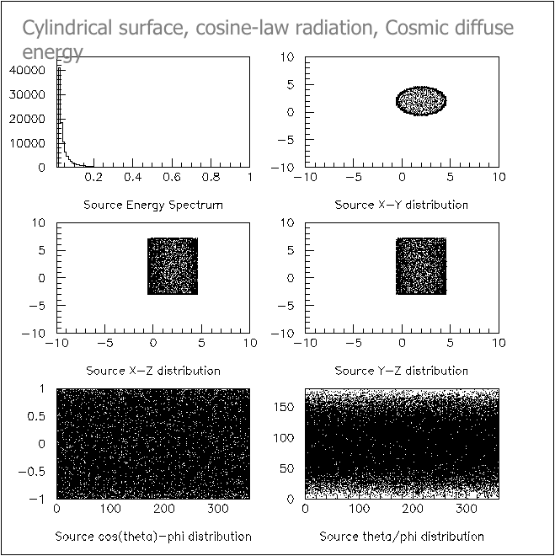
GPS samples position, direction and energy

Slide 19
Multiple GPS sources and worker threads
MULTIPLE SOURCES
/gps/source/add <intensity>
By default, one source is chosen randomly according to intensity.
/gps/source/multiplevertex true creates one vertex from each source.
MULTITHREADING
G4GeneralParticleSourceData is a thread-safe singleton containing shared source configuration.
Worker-side GPS instances sample that configuration; the split-class mechanism is transparent to the user.

Slide 20
ParticleGun or GPS?
G4ParticleGun
• One or more particles with identical kinematics
• Randomization written explicitly in C++
• Minimal state and easy debugging
G4GeneralParticleSource
• Built-in spatial, angular and energy distributions
• Surfaces, volumes, biasing and multiple sources
• Configuration through /gps commands
Rule of thumb: start with ParticleGun; move to GPS when the source model becomes a distribution.

Slide 21
G4HEPEvtInterface imports
generator kinematics
A concrete G4VPrimaryGenerator that reads an ASCII representation of the /HEPEVT/ common block.
• Reconstructs G4PrimaryParticle objects and their production chain.
• Associates the particles with a G4PrimaryVertex.
• Preserves intermediate parents for event ancestry, even when Geant4 does not transport them.
• Does not define the interaction point: set the vertex position before GeneratePrimaryVertex().
The /HEPEVT/ common block is a historical Fortran data structure used by high-energy physics event generators to share the complete description of an event.

Slide 22
Derive a custom generator only when needed
Implement G4VPrimaryGenerator::GeneratePrimaryVertex(G4Event*) when built-ins cannot express the event.
Typical reasons
• Interface to an external generator not covered by HEPEvt or HepMC.
• Several correlated particles from one vertex.
• Several vertices with correlated position or time.
• Pre-assigned decay chains or non-standard event structure.
Core objects
G4PrimaryVertex -> SetPrimary(particle)
G4Event -> AddPrimaryVertex(vertex)

Slide 23
Examples worth reading
examples/basic/B1
Minimal PrimaryGeneratorAction with G4ParticleGun
examples/extended/eventgenerator/particleGun
Three ParticleGun usage patterns
examples/extended/eventgenerator/exgps
GPS distributions and commands
examples/extended/eventgenerator/userPrimaryGenerator
Several vertices and several particles per vertex
examples/extended/eventgenerator/HepMCEx01 and HepMCEx02
HepMC-based external-generator interfaces

Slide 24
Hands-on: ParticleGun to GPS
TASK 2 Goal
Particle type to be generated: gamma
Energy distribution: monoenergetic, with a fixed energy
Angular distribution: isotropic
Spatial distribution: uniformly distributed over the surface of a sphere
Source geometry: define the centre and radius of the sphere

Slide 25
Three rules to remember
1 The user action decides how each event is configured.
2 The generator creates primary vertices and particles.
3 Start with G4ParticleGun; choose GPS for distributions; derive a custom generator for a custom event model.

