Slide 1
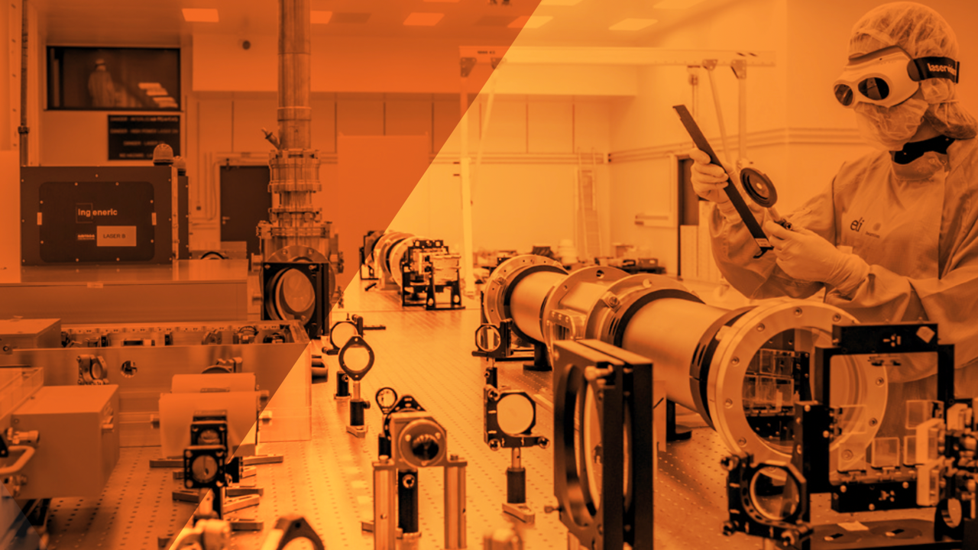


SWISSELITE Project: EMPANADE Work Package
A. Cimmino
ELI ERIC, ELI Beamlines Facility
EMPANADE Kick-off Meeting – September 3rd 2025

Slide 2
Project Management Structure
Steering Committee
CHUV
PSI
ELI
Project Administrator
Project Coordinator
R. Hvězda
WP1 -Detector Technology
WP 2 – User Access
WP3.1 - Training
WP3.2 - Innovations
WP 1.1 – TREX
WP1.2 – LUSTER
WP1.3 – EMPANADE
WP1.3 Leaders
Bailat
Hohmann
Cimmino

Slide 3
Steering Committee (SC)
Main decision-making body of the consortium
Members
  1 representative per partner (e.g., PSI, CHUV, other key RDI organizations), Project Coordinator, senior ELI ERIC leadership.
Meeting Frequency
  Quarterly (every 3 months) – ensures strategic direction, review of progress, budget allocation, and long-term planning.
Responsibilities
  Approve strategy & major decisions
  Approve work programs, reports, and budgets
  Approve engagement of partners/service providers

Slide 4
Project Management Team (PMT)
Supports daily project management
Membership
  PC, Project Administrator, Financial Officer, WP Leaders
Functions
  Project planning & support
  Organize meetings & communication
  Coordinate with HR, PR, IT, procurement
  Report to the Steering Committee
Frequency
  Monthly – focused on day-to-day management, risk monitoring, deliverables, and preparation of reports for SC.

Slide 5
Reporting
Monthly Project Team Meetings
  Short status
Project Steering Committee
  Quaterly - plan, changes
to MEYS
  Template – TBD
  Financial Reporting 30 June, 31 December
    Financial Changes before 31 October
  Annually Progress Report
    Including finacial report 31 January
  Final Report 31 March 2029
Swiss Funds Steering Committee – 2-3 times a year
  Changes above 10% of the annual budget

Slide 6
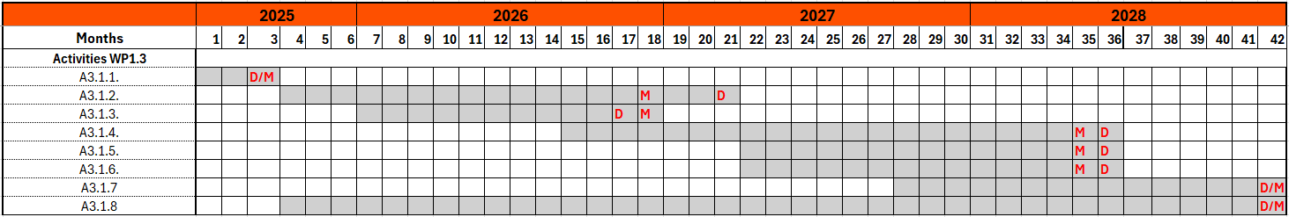
WP.1.3: EMPANADE
Activity 3.1.1 (ELI Beamlines, PSI, CHUV): Project kick-off.
Activity 3.1.2 (ELI Beamlines, PSI, CHUV): Testing of off-the-shelf active detectors.
Activity 3.1.3 (ELI Beamlines): Monte Carlo simulations for experiments in Activity 3.1.2.
Activity 3.1.4 (ELI Beamlines): Design and implementation of the measurement protocols; upgrade of the detectors.
Activity 3.1.5 (CHUV): Test of the upgraded detectors at CHUV.
Activity 3.1.6 (PSI): Test of the upgraded detectors at PSI in the SwissFEL and/or the Neutron Irradiation Facilities.
Activity 3.1.7 (ELI Beamlines): Validation of the upgraded detectors at ELI Beamlines in laser driven field.
Activity 3.1.8 (ELI Beamlines): Dissemination and exploitation (joint technical reports, conferences, papers)

Slide 7
Milestones and Deliverables
By design, each activity has 1 Milestone and 1 Deliverable
  8 deliverables : 2 papers, 5 technical notes, and at least 1 conference presentation
Acknowledgment statement not ready
  Will circulate as soon as we have it!

Slide 8
Budget
Still not sure if the budget will be annual or if it will be treated as a multi-year project
Changes to the budget (> 10%) for 2025 should be reported by the beginning of October.
  Go to budget →

Slide 9
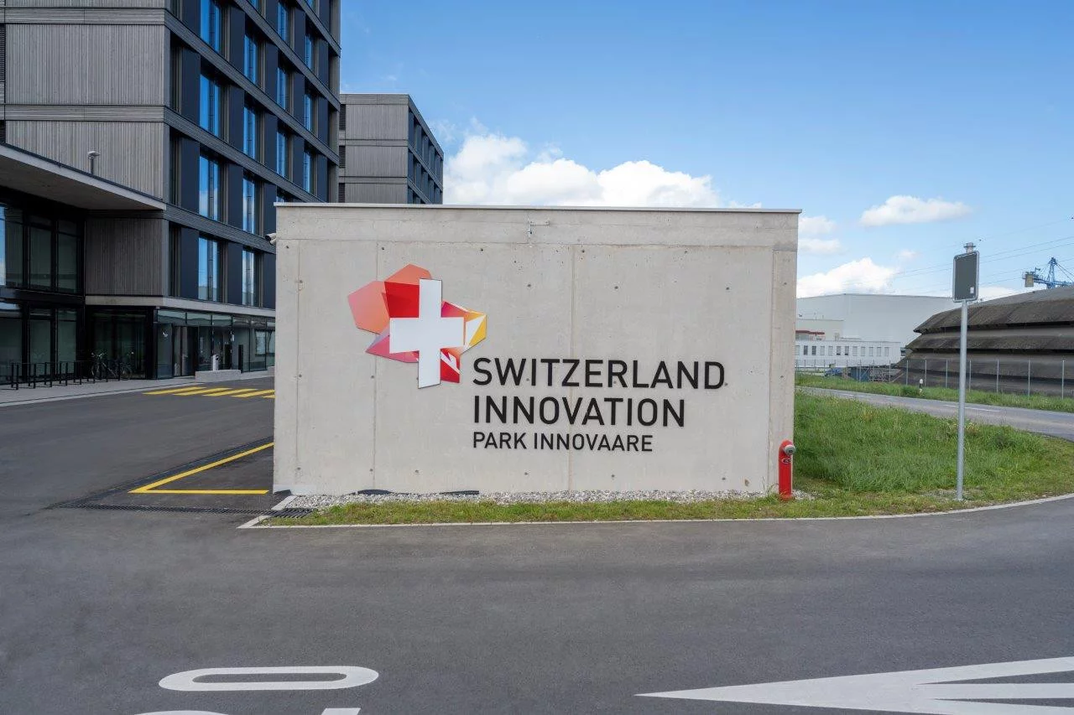
Swiss Partner Day
When: Tuesday, 16 October 2025 from 10:00-17:00
Where: Park Innovaare, innovAARE AG Parkstrasse 1,
5234 Villigen Switzerland
Afternoon session (15:00-17:00):
  Dedicated to SWISSELITE project technical meetings
  Will be at PSI
  Should include ELI Beamlines, PSI and CHUV partners

