Slide 1
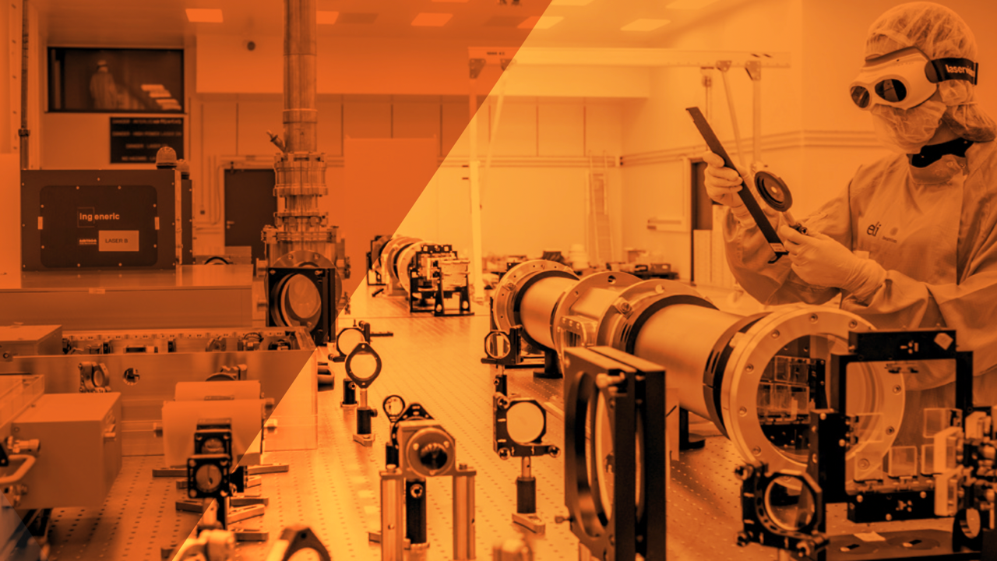
Introduction
Gabriele Maria Grittani
Leader of the electron acceleration group
LAMU Workshop, Zoom, 19th March 2025
A European Research Infrastructure Consortium

Slide 2
Introduction to LAMU Workshop
ELI Beamlines has been part of a major project to build a >20 GeV laser electron accelerator powered by its unique L4-Aton 10 PW laser (1.5 kJ, 150 fs, 0.01 Hz).
As a result of this project we have a design for this new beamline for users. Before moving forward with the implementation of the beamline, we organized this “Laser-Driven GeV Muon Sources at ELI” (LAMU) Workshop, to gather the feedback from the perspective user community.
We identified two sub-groups of users:
We did our best to attract the world leading teams in both fields!
We plan to publish in peer-reviewed journal workshop summary, so please attend the round table.
Laser Muon Source Development (Day 1)
kJ laser wakefield acceleration
Muon beam transport
Muon detection in laser-plasma environment
Muon Source Users (Day 2)
Nuclear Safety
Geology
High Energy Physics

Slide 3
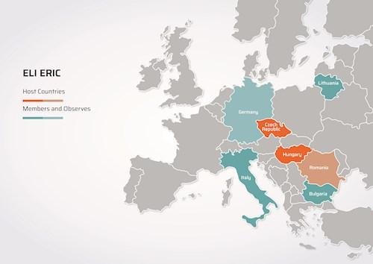
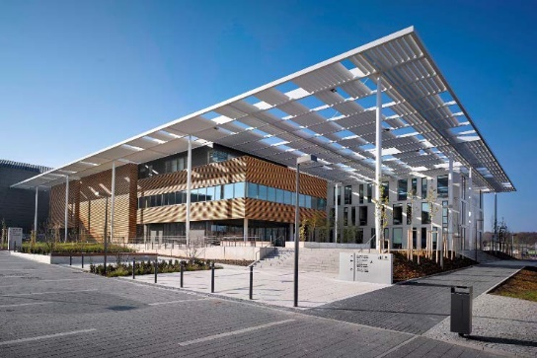
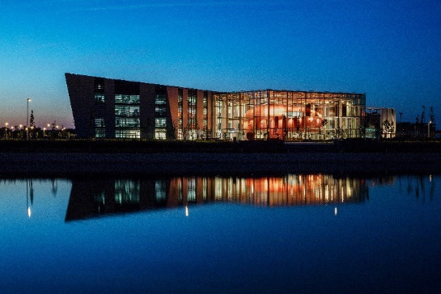
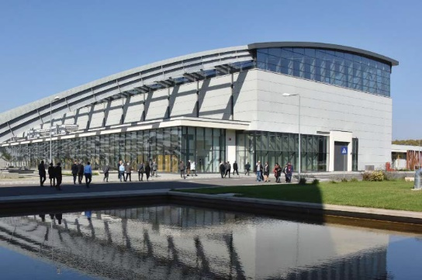
The Extreme Light Infrastructure (ELI)
ELI Beamlines
(Dolni Brezany, Czech Republic)
ELI ALPS
(Szeged, Hungary)
ELI NP
(Magurele, Romania)

Slide 4
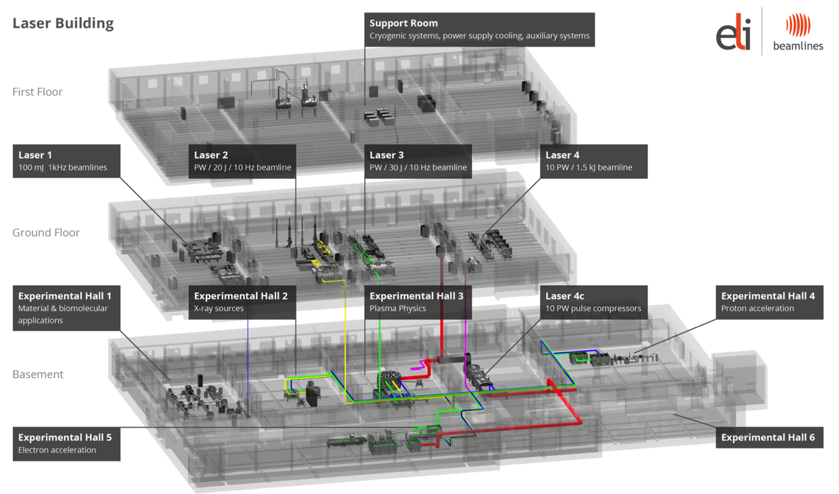
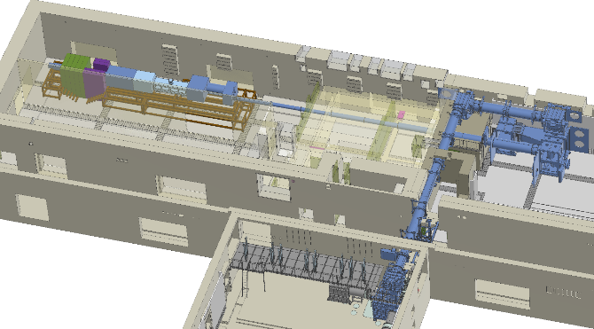
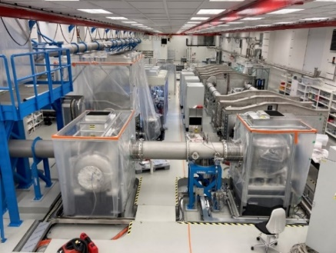
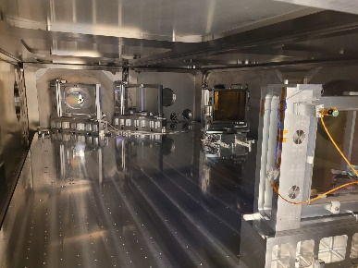
ELI Beamlines for muons
L1-Allegra | L2-Duha | L3-HAPLS | L4-Aton
OPCPA | OPCPA | Ti:Sa | Nd:Glass
100 mJ | 2 J | 30 J | 1.5 kJ
15 fs | 25 fs | 30 fs | 150 fs
1 kHz | 20 Hz | 10 Hz | 0.01 Hz
Future Beamline (L4-Aton)
ELBA Beamline (L3-HAPLS)

Slide 5
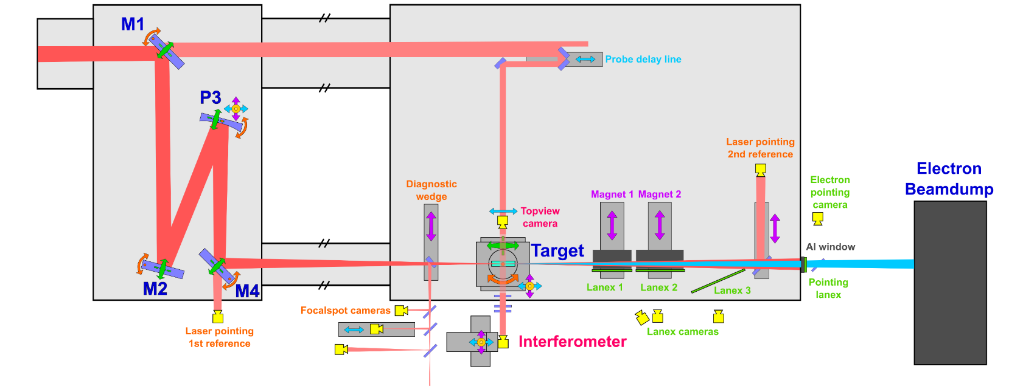
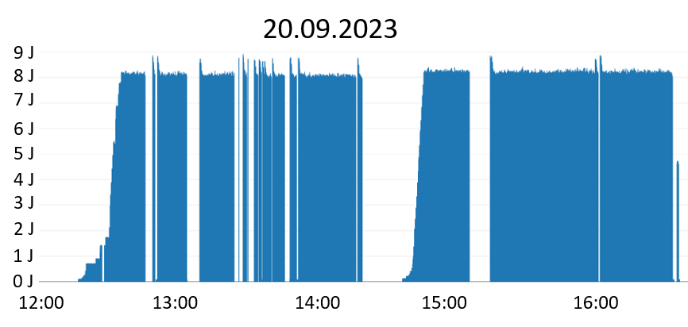
ELBA Beamline
First muon source users in May 2025!
Area for Parasitic muon beam users

Slide 6
Future 10 PW beamline for 10s GeV electrons and muons
L4 compressor
(not shown in picture, but in same room)
Optics installation (Nov. 24)
Laser beam transport in L4c
Procurement (ordered, delivery scheduled on Dec. 24)
Installation (Q2/25, depending on L4 beamtime)
Laser beam transport L4c to E5
Design (Sept. 24)
First Light (Dec. 24)
100s J demonstration (Feb. 25)
Procurement (Dec. 24)
Installation (Q1/25)
L4c

Slide 7
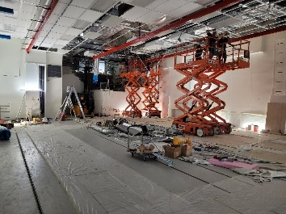
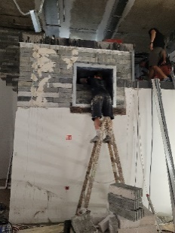
Future 10 PW beamline for 10s GeV electrons and muons
E5 works to “free up” space for L4c and E6 pipes
Completed in August 24
Vacuum chambers 7 and 8
Design (Oct. 24)
Installation (Q4/25)
Vacuum chamber 9
Design (Dec. 24)
Procurement (Q3/25)
OAP vacuum chamber
Design (Dec. 24)
Optics
OAP (delivery exp. Q2/26)
Mirrors (delivery exp. Q4/25)
Procurement (Q4/25)
Installation (Q1/26)
Procurement (Q4/25)
Installation (Q1/26)
E5

Slide 8
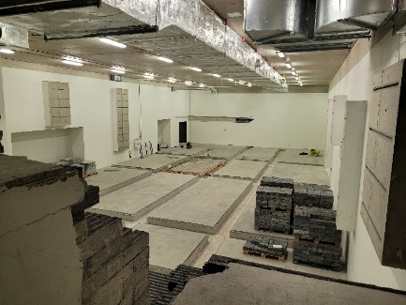
Future 10 PW beamline for 10s GeV electrons and muons
Bring E6 to clean experimental room
E6 pre-cleaned (Aug. 24)
Experimental chamber and related equipment
Design (Q2/25)
Installation (Q3/26)
Experiment
Commissioning (Q1/27)
Project (Dec. 24)
Works (Q1-Q3/25)
First run (Q2/27)
Second run (Q3/27)
E6

Slide 9
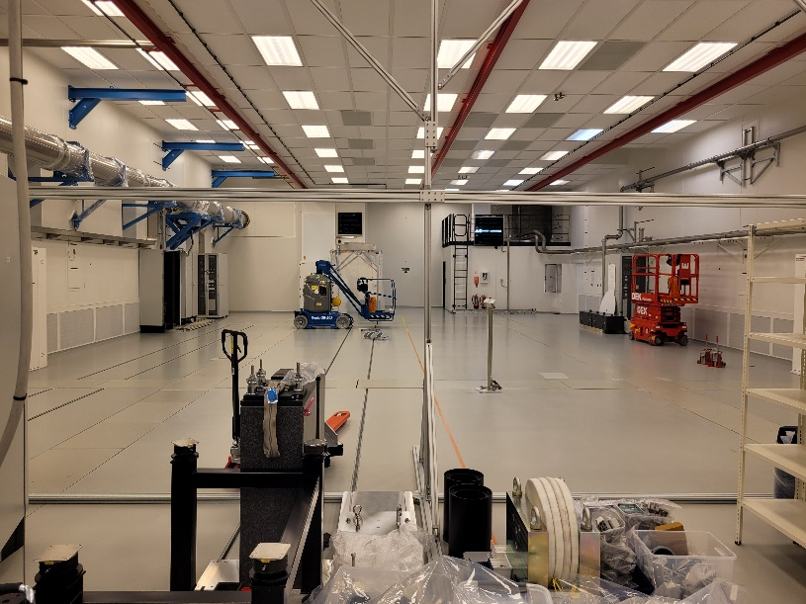
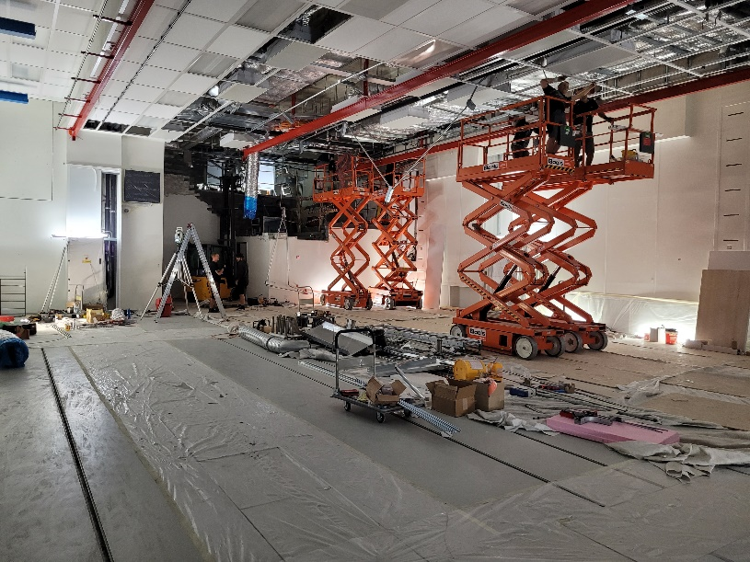
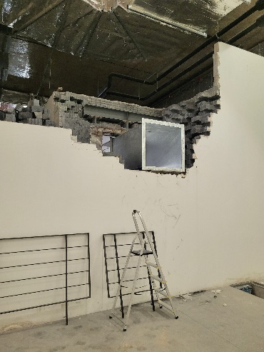
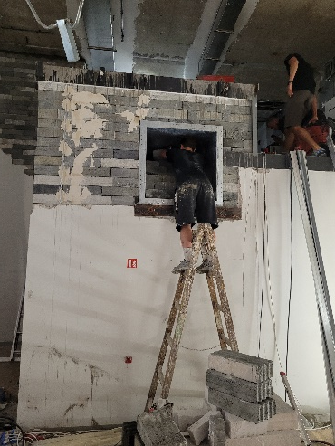
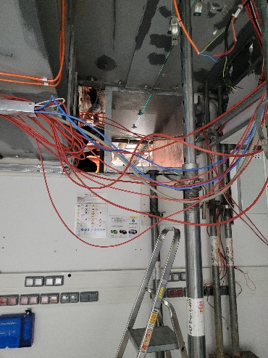
Future 10 PW beamline for 10s GeV electrons and muons
E5 works done in July-August 2024 between two user campaigns
28th June 24 – QUB User Campaign
July-August 24 Construction works
E6 Experimental Hall cleaned up
Openings created connecting E5 and E6 for future. Lot of work required to re-route the cablings on the way
E6 is not user for user activity, therefore the works can be scheduled independently

Slide 10
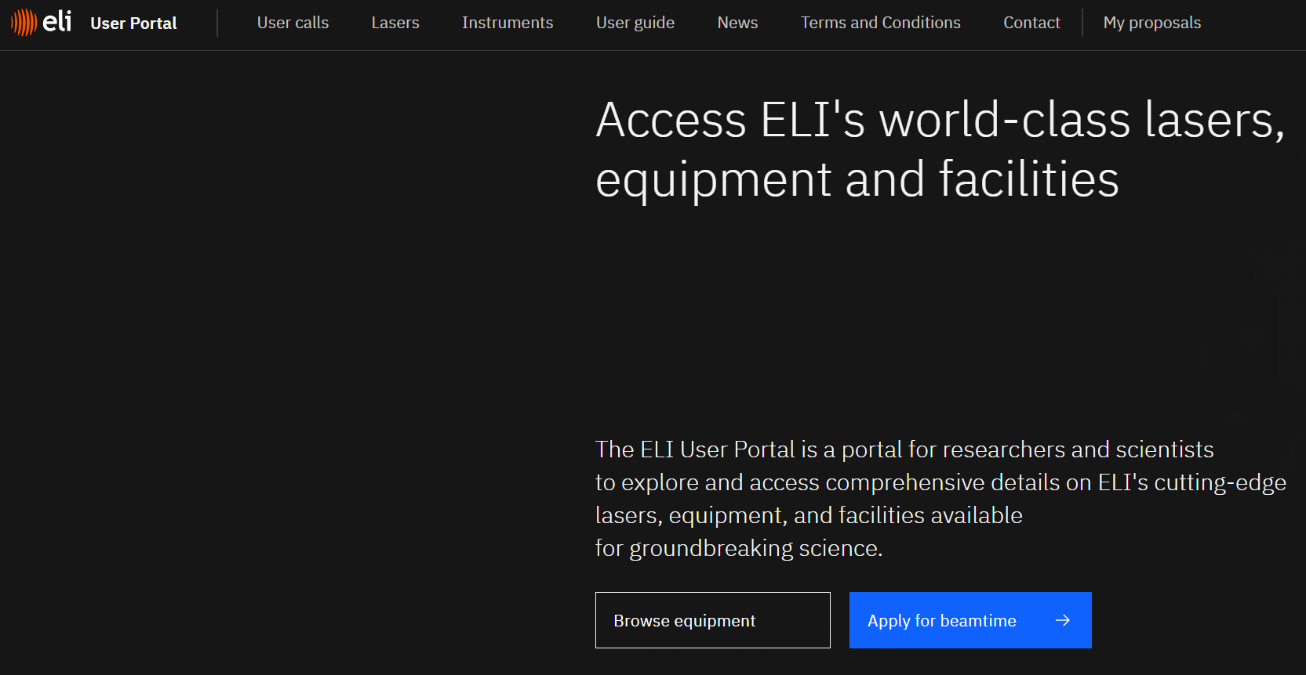
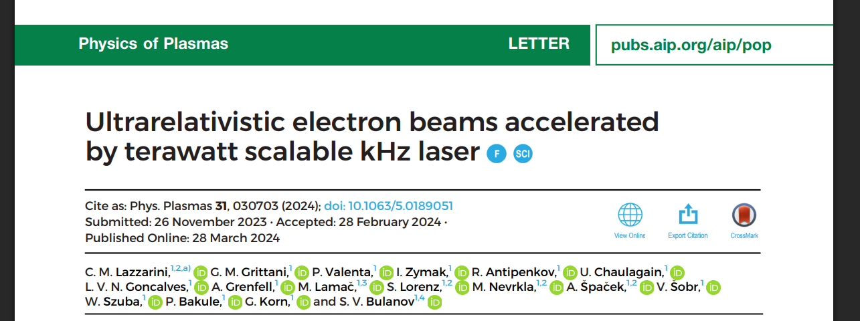
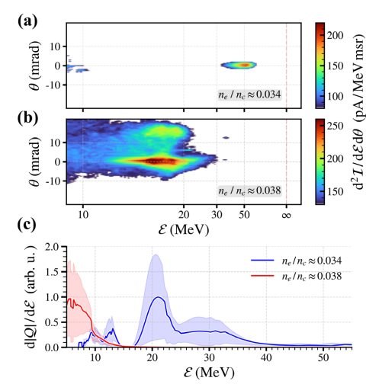
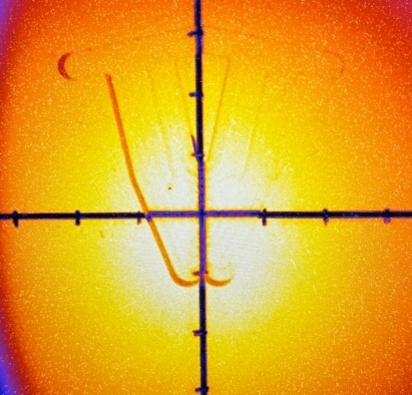
Example: history of ALFA beamline development
2018:
LEAK Workshop to understand the interest from perspective user community on kHz LWFA
2021:
Installation
2023:
ALFA part of ELI User Call
2020:
Technical Design of ALFA completed
2022: Commissioning
2025:
8 user experiments completed, half on source development, half of users of the electron beam

Slide 11
THANK YOU FOR YOUR ATTENTION!

