Slide 1
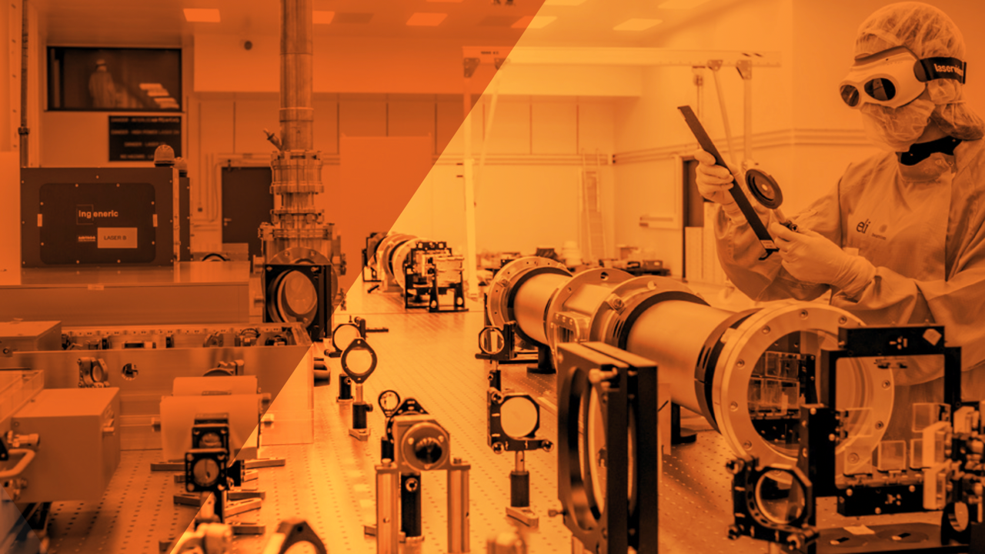


Muons at ELI Beamlines
Gabriele Maria Grittani
Leader of the electron acceleration group
LAMU Workshop, Zoom, 20th March 2025
A European Research Infrastructure Consortium

Slide 2
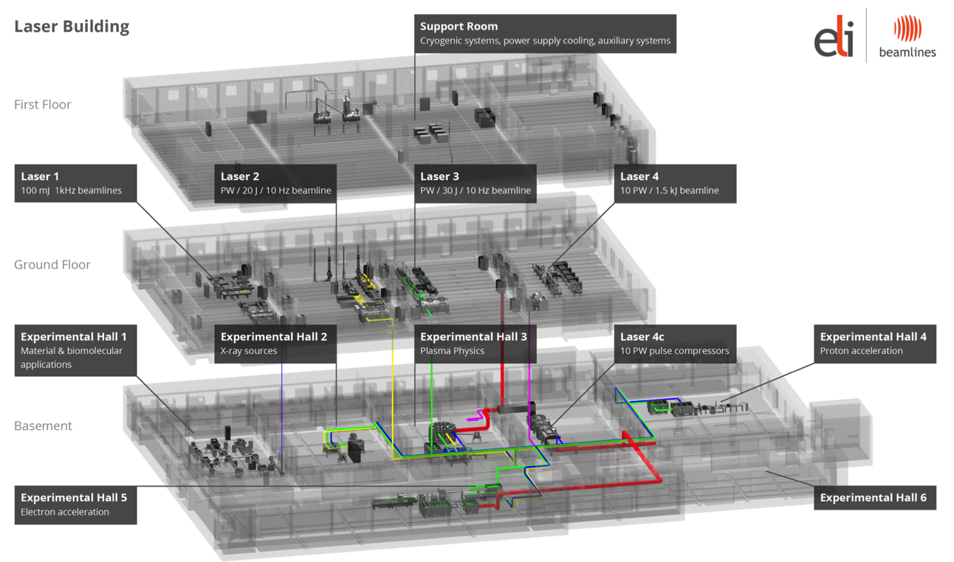
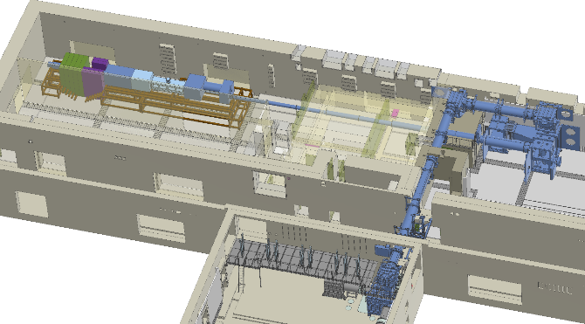
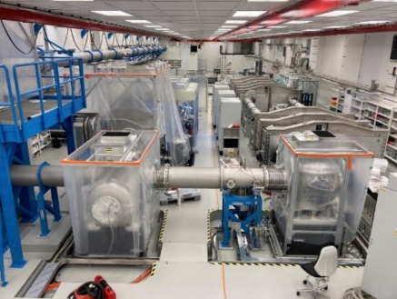
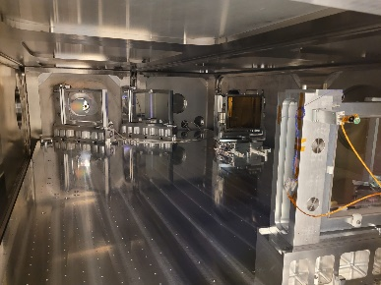
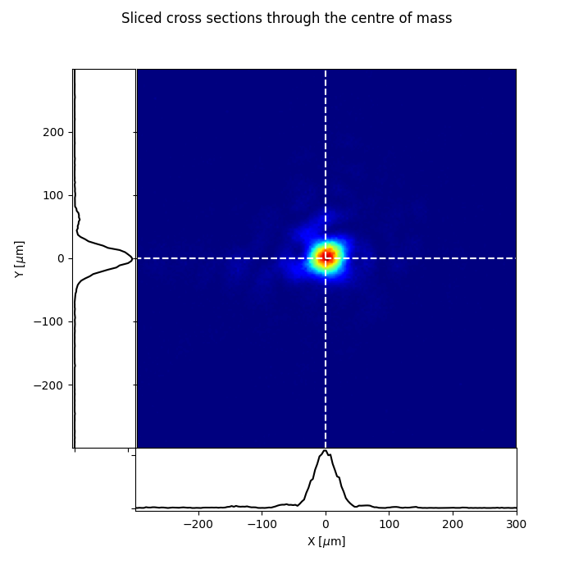
ELI Beamlines for muons
L1-Allegra | L2-Duha | L3-HAPLS | L4-Aton
OPCPA | OPCPA | Ti:Sa | Nd:Glass
100 mJ | 2 J | 30 J | 1.5 kJ
15 fs | 25 fs | 30 fs | 150 fs
1 kHz | 20 Hz | 10 Hz | 0.01 Hz
Future Beamline (L4-Aton)
ELBA Beamline (L3-HAPLS)

Slide 3
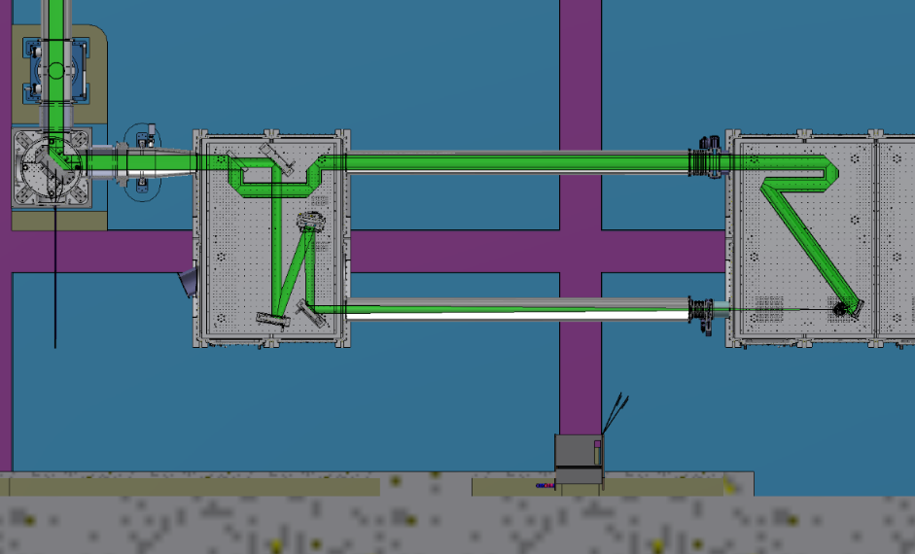
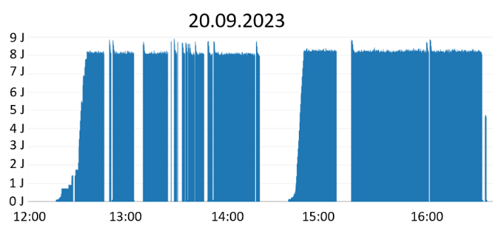
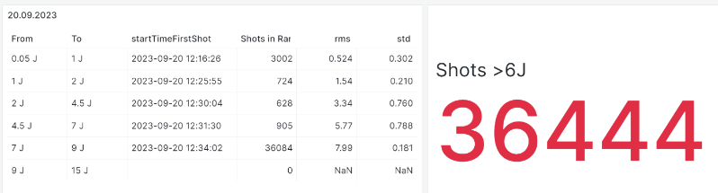
ELBA Laser Electron Collider
Parameter | Current L3 Performance | Nominal L3 performance
Laser energy before WS splitting | 13 J | 30 J
Laser time duration | 27 fs | 30 fs
Repetition Rate | 3.3 Hz | 10 Hz
Laser Wavelength | 800 nm | 800 nm
Laser Energy for LWFA | > 5 J | > 10 J
Electron beam energy (mean of QME peak) | > 1 GeV | > 2 GeV
Energy spread (FWHM) | < 20% | < 20%
Electron beam charge in QME peak | > 25 pC | > 40 pC
Electron beam divergence | < 2 mrad | < 2 mrad
Electron beam pointing stability | < 2 mrad | < 2 mrad
Laser Energy for Collider Laser | > 5 J | > 10 J
Focal number | 1.5 | 1.5
Focal length | 375 mm | 375 mm
Focal spot FWHM | < 2 μm | < 2 μm
Peak intensity | > 1.5 x 10²¹ W/cm² | >3 x 10²¹ W/cm²
Collision angle | 0° and 40° | 0° and 40°
LASER
ELECTRON
CP LASER

Slide 4
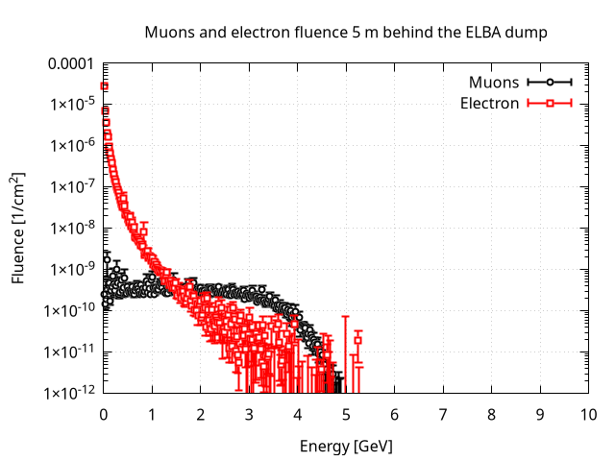
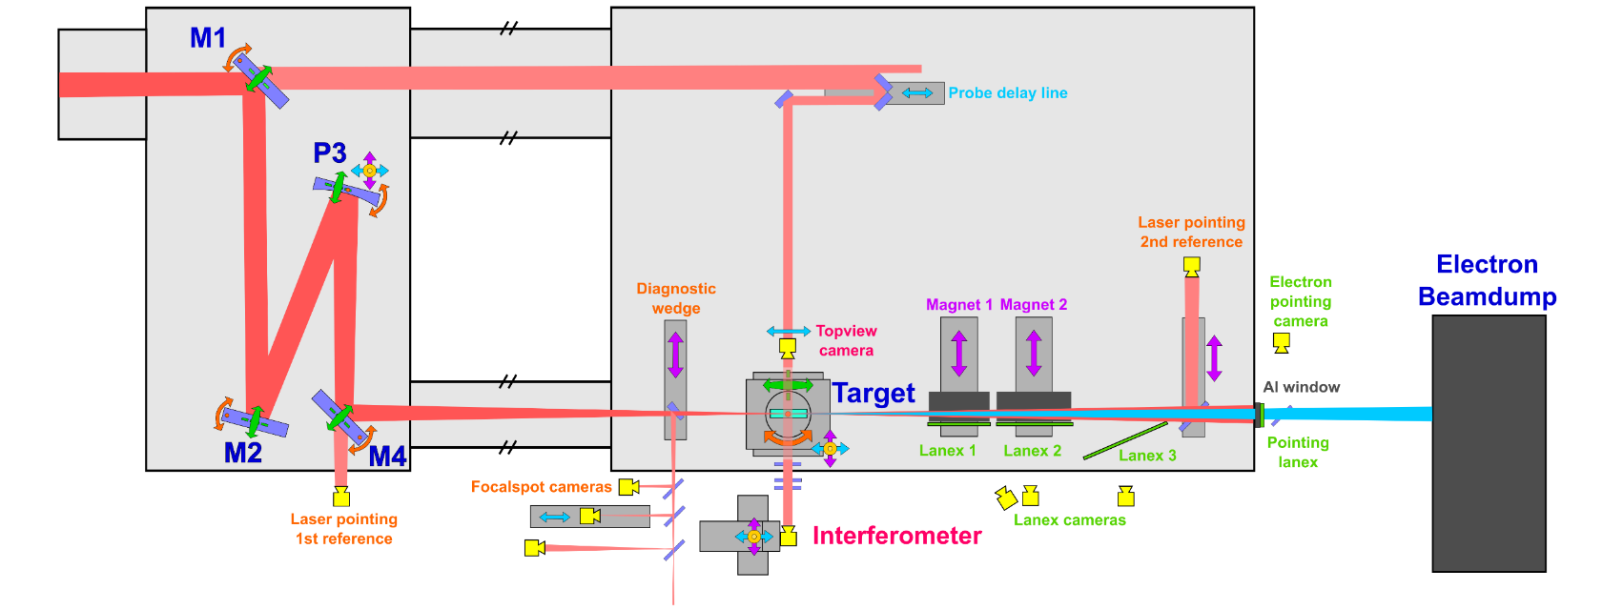
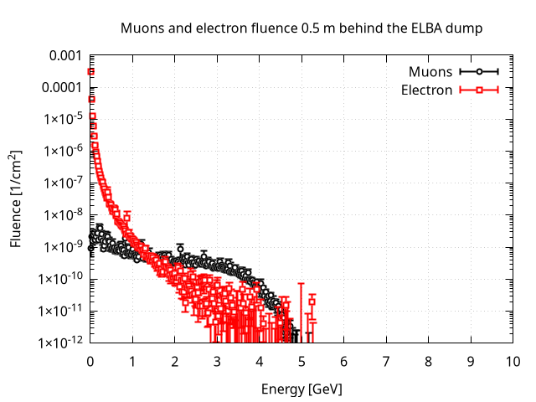
ELBA For Muons Beamline
ELBA is operated in single shot or 3.3 Hz
10⁸ µ/cm² per shot
Area for Parasitic muon beam users
Howard Milchberg’s team coming next week as ELBA users!
Experiment: UMDLWFA
Principal Investigator: Jaron Shrock (UMD)
10⁸ µ/cm² per shot
First muon source users in May 2025!
Experiment: ELBA _MuLASER
Principal Investigator: Salvatore Buontempo (CERN/INFN)

Slide 5
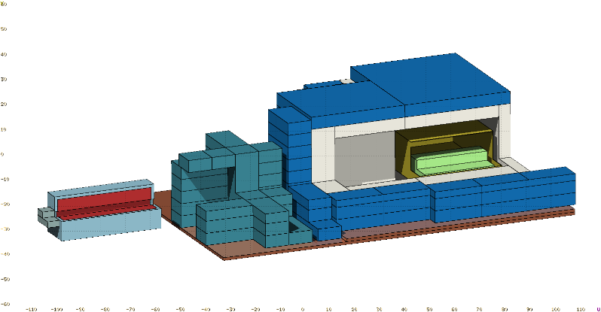
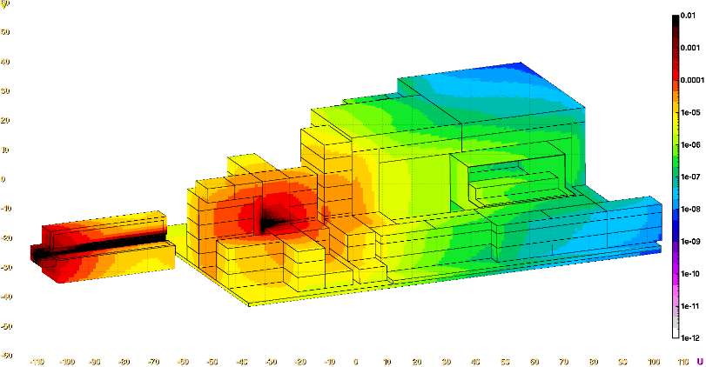
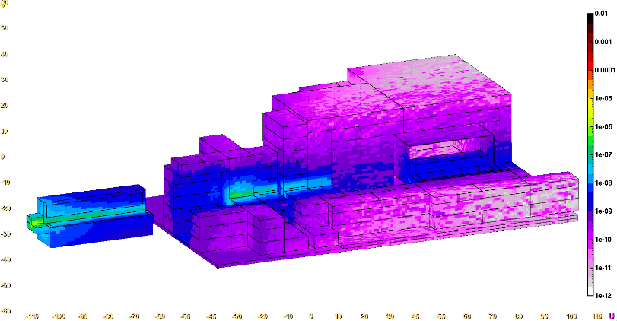
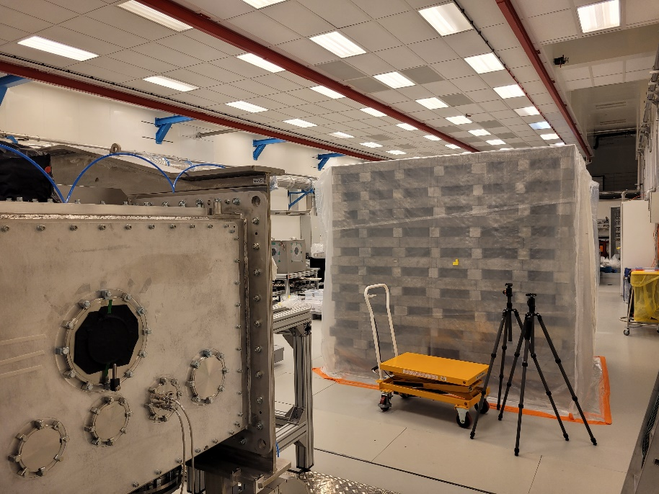
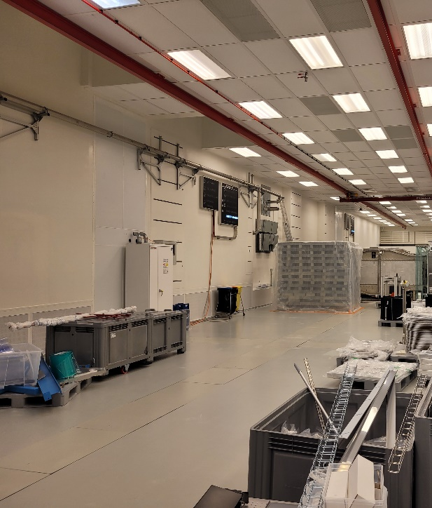
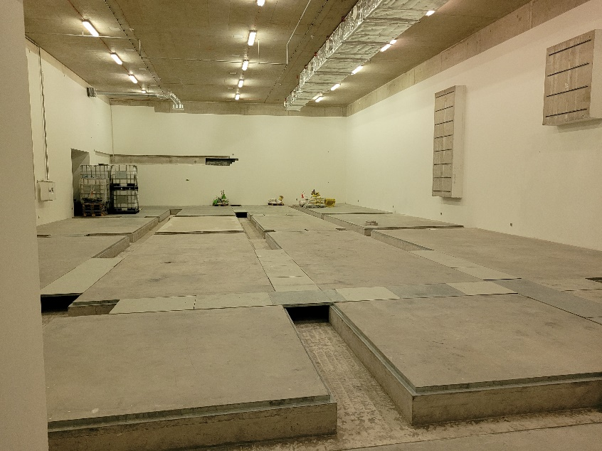
Muon detection potential in ELBA
Geometry
All-particles fluence
Muon+ fluence
magnet
shielding
Muon detector
ELBA beamline and its dump
Parasitic muon detection area
Next room E6, 30 meters after dump

Slide 6

Future 10 PW beamline for 10s GeV electrons and muons
L4 compressor
(not shown in picture, but in same room)
Optics installation (Nov. 24)
Laser beam transport in L4c
Procurement (ordered, delivery scheduled on Dec. 24)
Installation (Q2/25, depending on L4 beamtime)
Laser beam transport L4c to E5
Design (Sept. 24)
First Light (Dec. 24)
100s J demonstration (Feb. 25)
Procurement (Dec. 24)
Installation (Q1/25)
L4c

Slide 7
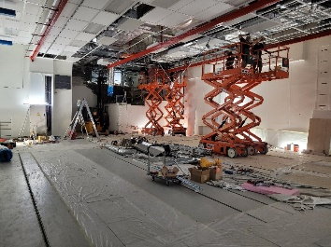
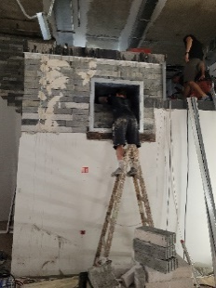
Future 10 PW beamline for 10s GeV electrons and muons
E5 works to “free up” space for L4c and E6 pipes
Completed in August 24
Vacuum chambers 7 and 8
Design (Oct. 24)
Installation (Q4/25)
Vacuum chamber 9
Design (Dec. 24)
Procurement (Q3/25)
OAP vacuum chamber
Design (Dec. 24)
Optics
OAP (delivery exp. Q2/26)
Mirrors (delivery exp. Q4/25)
Procurement (Q4/25)
Installation (Q1/26)
Procurement (Q4/25)
Installation (Q1/26)
E5

Slide 8
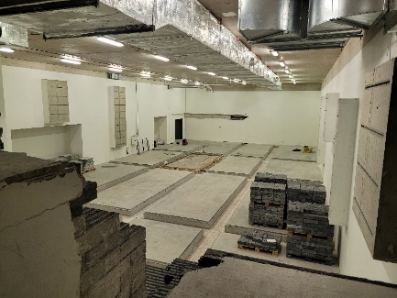
Future 10 PW beamline for 10s GeV electrons and muons
Bring E6 to clean experimental room
E6 pre-cleaned (Aug. 24)
Experimental chamber and related equipment
Design (Q2/25)
Installation (Q3/26)
Experiment
Commissioning (Q1/27)
Project (Dec. 24)
Works (Q1-Q3/25)
First run (Q2/27)
Second run (Q3/27)
E6

Slide 9
10 PW Future Beamline Parameters
Electron Beam Parameters
Estimated 10⁴-10⁶ muons with energy >1 GeV per shot

Slide 10
THANK YOU FOR YOUR ATTENTION!

