Slide 1
The Extreme Light Infrastructure
EXTREME SCIENCE
A European Research Infrastructure Consortium

Slide 2
Let’s talk about AI in science.
Why? Why now?
What’s the current state? EU Strategy on AI Ethical and regulatory challenges 3. How? What tools help you? What are we doing?

Slide 3
Source:Liviu ȘTIRBĂȚ, Head of Unit of DG RTD E.4 -Industry 5.0 and AI in Science

Slide 5
The emergence of AI is not a surprise.
We had the theory already in the 70s.

Slide 6
The emergence of AI is not a surprise.
Available computing power doubles every 2 years.

Slide 7
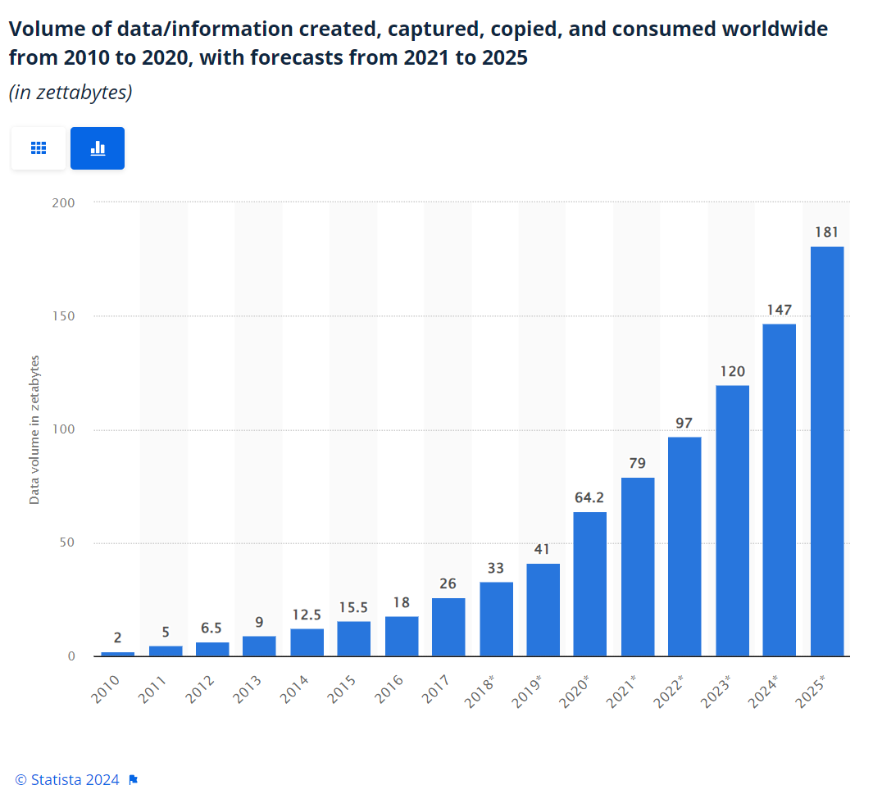

Slide 11
Sam Altman (Founder of OpenAI)
“ChatGPT is successful because it isn’t so much the underlying model that matters, it's the usability”

Slide 12
What?

Slide 13
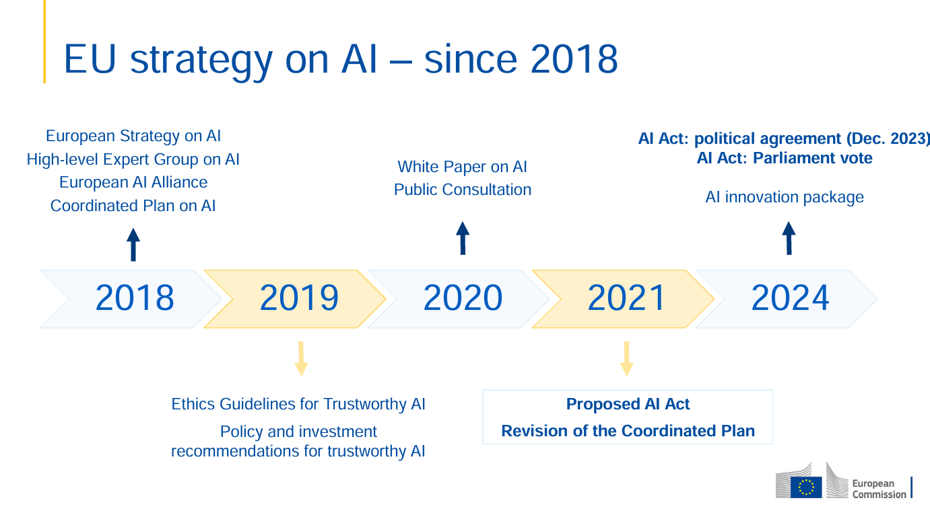

Slide 14
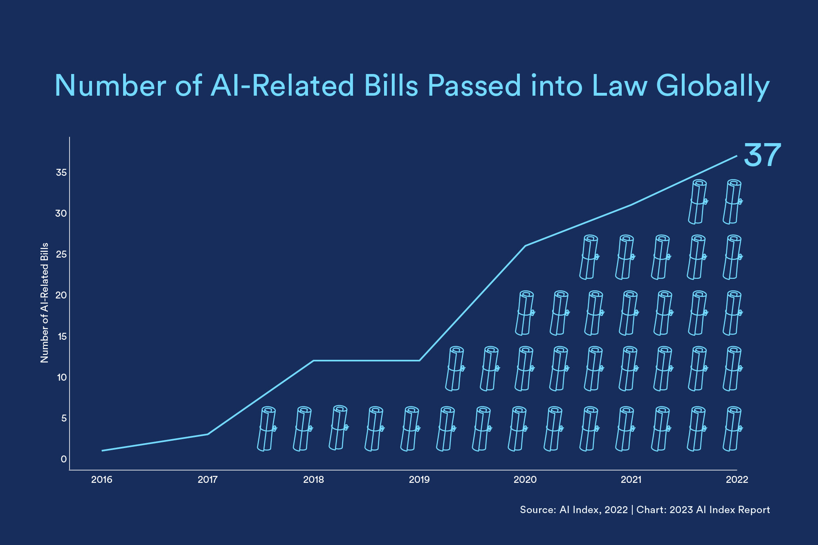

Slide 16
Challenges with AI:
Overuse: costly, unnecessary
Misuse: Unethical, illegal
Underuse: Unethical, uneconomic
Copyright infringement, plagiarism, trade secrets and confidentiality, authorship and ownership, moral rights, liability, bias and discrimination, misinformation and manipulation, privacy and data protection, content moderation and censorship, digital deception,..
Let’s make it real.
Here’s a useful tool – 4 questions:
Is something within regulatory and legislative frameworks?
Is the discussion fair and balanced?
Do I understand the consequences, including the precedents it sets?
Can I live with the person I become and the organization I work for if something is not solved correctly?

Slide 17
Medical systems
Notes:
This model is better than doctors at detecting cancer. Statistically.
We do not know how it makes decisions. Who is liable when it makes a mistake? Does it have biases we don’t know about? Can it be used for discrimination in healthcare access? The use would prevent unecesssary deaths – isn’t it unethical not to use it?

Slide 18
Alignment problem
Notes:
Healthcare app.. Makes you healthier. Let’s assume location data..

Slide 19
Algorithmic collusion
Notes:
Healthcare app.. Makes you healthier. Let’s assume location data..

Slide 20
How to be responsible with AI in science.

Slide 21
Remain ultimately responsible for scientific output.
• Be accountable for the integrity of the content generated by or with the support of AI tools.
• Maintain a critical approach to using the output produced by generative AI and are aware of the tools’ limitations, such as bias, hallucinations and inaccuracies. • AI systems are neither authors nor co-authors. Authorship implies agency and responsibility, so it lies with human researchers.
• Do not use fabricated material created by generative AI in the scientific process, for example falsifying, altering or manipulating original research data.

Slide 22
Use AI transparently
• To be transparent, detail which generative AI tools have been used substantially in their research processes. Reference to the tool could include the name, version, date, etc. and how it was used and affected the research process. If relevant, make the input (prompts) and output available, in line with open science principles.
• Take into account the stochastic (random) nature of generative AI tools, which is the tendency to produce different output from the same input. Aim for reproducibility and robustness in their results and conclusions. Disclose or discuss the limitations of generative AI tools used, including possible biases in the generated content, as well as possible mitigation measures.

Slide 23
Pay particular attention to issues related to privacy, confidentiality and intellectual property rights when sharing sensitive or protected information with AI tools.
• Remain mindful that generated or uploaded input (text, data, prompts, images, etc.) could be used for other purposes, such as the training of AI models. Therefore, protect unpublished or sensitive work (such as their own or others’ unpublished work) by taking care not to upload it into an online AI system unless there are assurances that the data will not be re-used, e.g., to train future language models or to the untraceable and unverifiable reuse of data.
Take care not to provide third parties’ personal data to online generative AI systems unless the data subject (individual) has given them their consent and researchers have a clear goal for which the personal data are to be used

Slide 24
Pay particular attention to issues related to privacy, confidentiality and intellectual property rights when sharing sensitive or protected information with AI tools.
Understand the technical and ethical implications regarding privacy, confidentiality and intellectual property rights. Check, for example, the privacy options of the tools, who is managing the tool (public or private institutions, companies, etc.), where the tool is running and implications for any information uploaded. This could range from closed environments, hosting on a third-party infrastructure with guaranteed privacy, to open internet-accessible platforms.

Slide 25
When using generative AI, respect applicable national, EU and international legislation, as in their regular research activities. In particular, the output produced by generative AI can be especially sensitive in relation to the protection of intellectual property rights and personal data.
Pay attention to the potential for plagiarism (text, code, images, etc.) when using outputs from generative AI. Respect others’ authorship and cite their work where appropriate. The output of a generative AI (such a large language model) may be based on someone else’s results and require proper recognition and citation.
The output produced by generative AI can contain personal data. If this becomes apparent, researchers are responsible for handling any personal data output responsibly and appropriately, and EU data protection rules are to be followed.

Slide 26
Continuously learn how to use generative AI tools properly to maximise their benefits, including by undertaking training
Generative AI tools are evolving quickly, and new ways to use them are regularly discovered. Stay up to date on the best practices and share them with colleagues and other stakeholders.
Refrain from using generative AI tools substantially in sensitive activities that could impact other researchers or organisations (for example peer review, evaluation of research proposals, etc).
• Avoiding the use of generative AI tools eliminates the potential risks of unfair treatment or assessment that may arise from these tools’ limitations
• Moreover, this will safeguard the original unpublished work of fellow researchers from potential exposure or inclusion in an AI model

Slide 27
Let’s look at some toys.

Slide 28
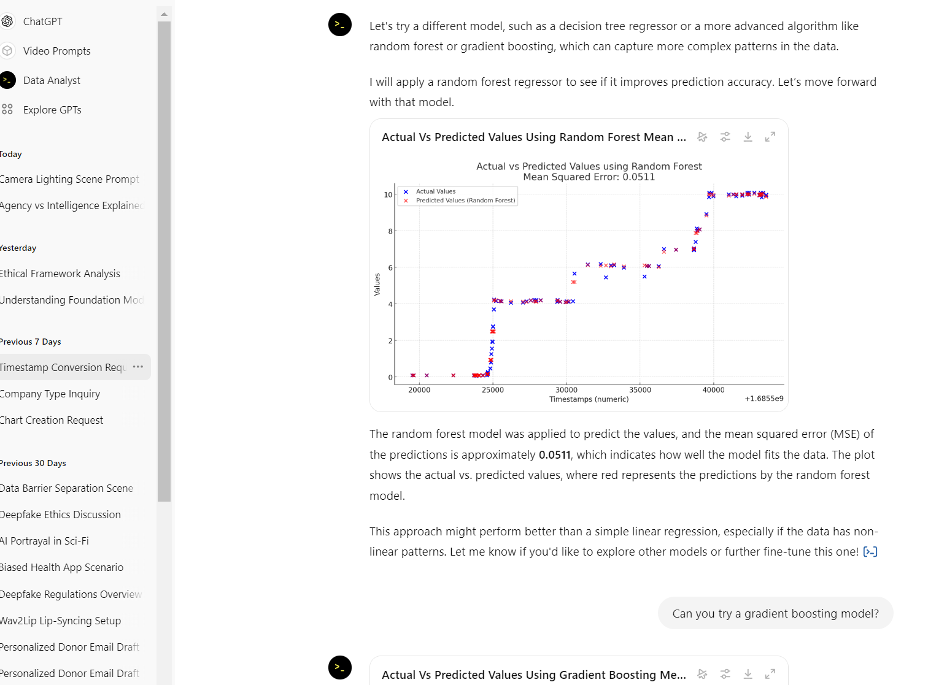
Chat GPT can do a lot more than you think.
Write your documents
Software Engineering
Data Cleanup and processing
You should learn how to prompt.
https://docs.anthropic.com/en/docs/build-with-claude/prompt-engineering/
Use examples (multishot)
Let the AI think (chain of thought)
Use XML tags
Give the AI a role (system prompts)

Slide 29
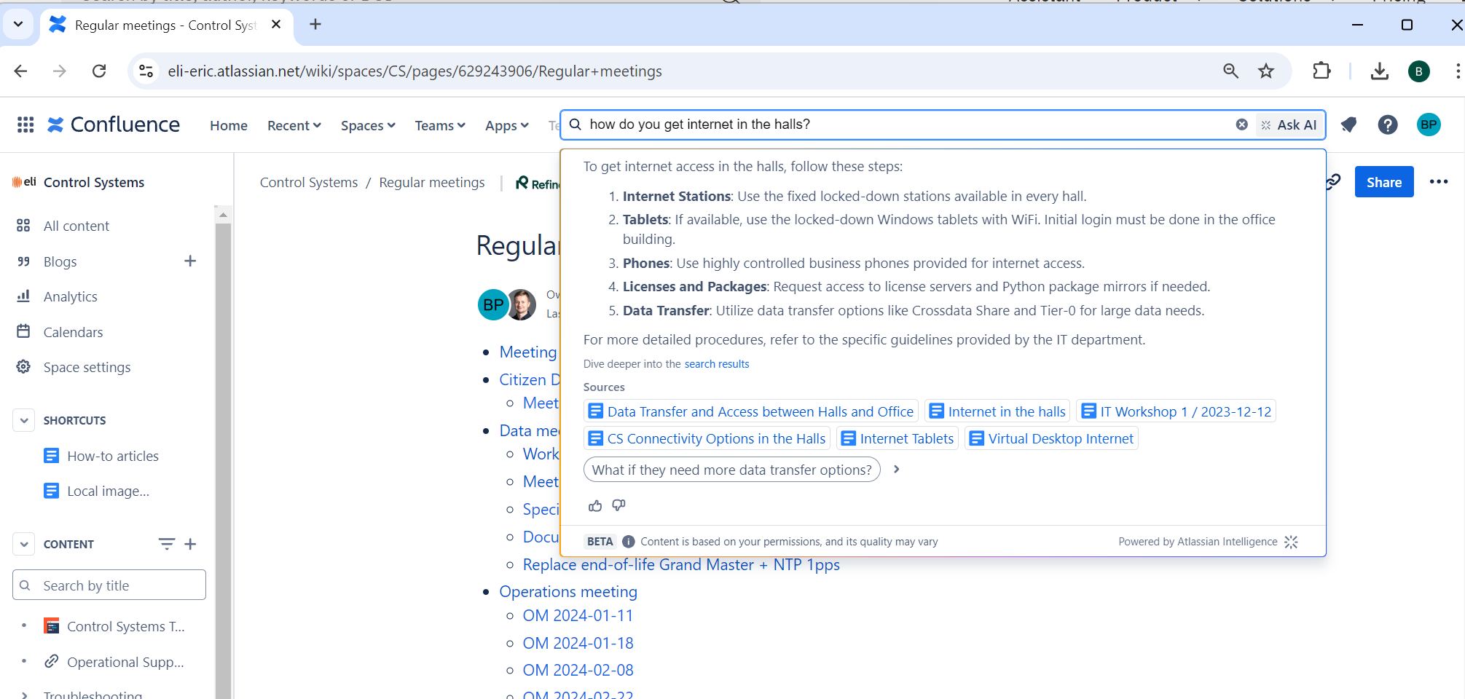
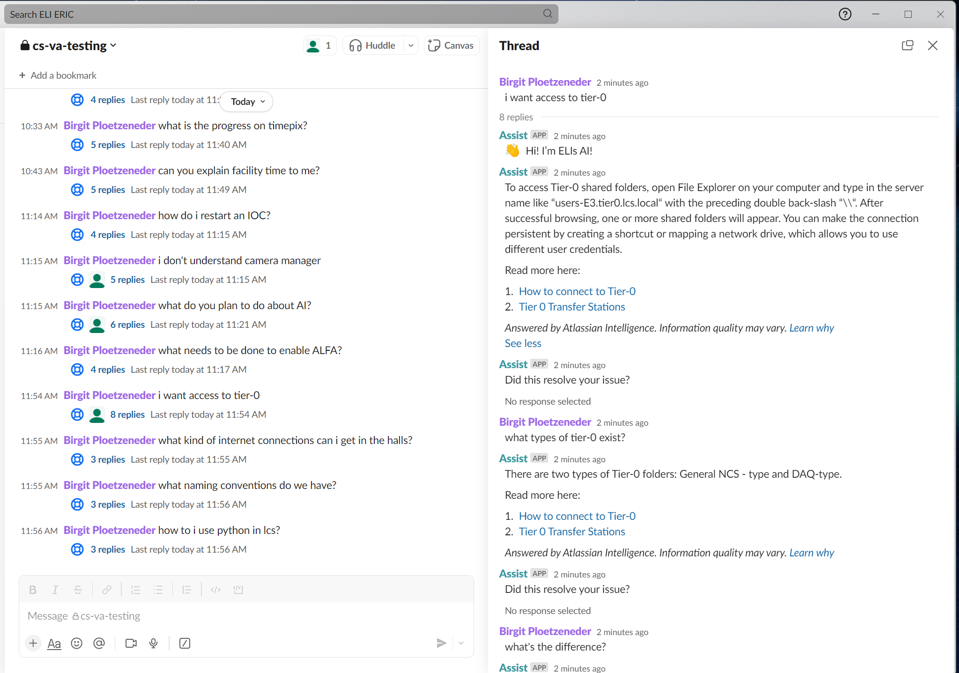
Use Atlassian. We have a plan.

Slide 31
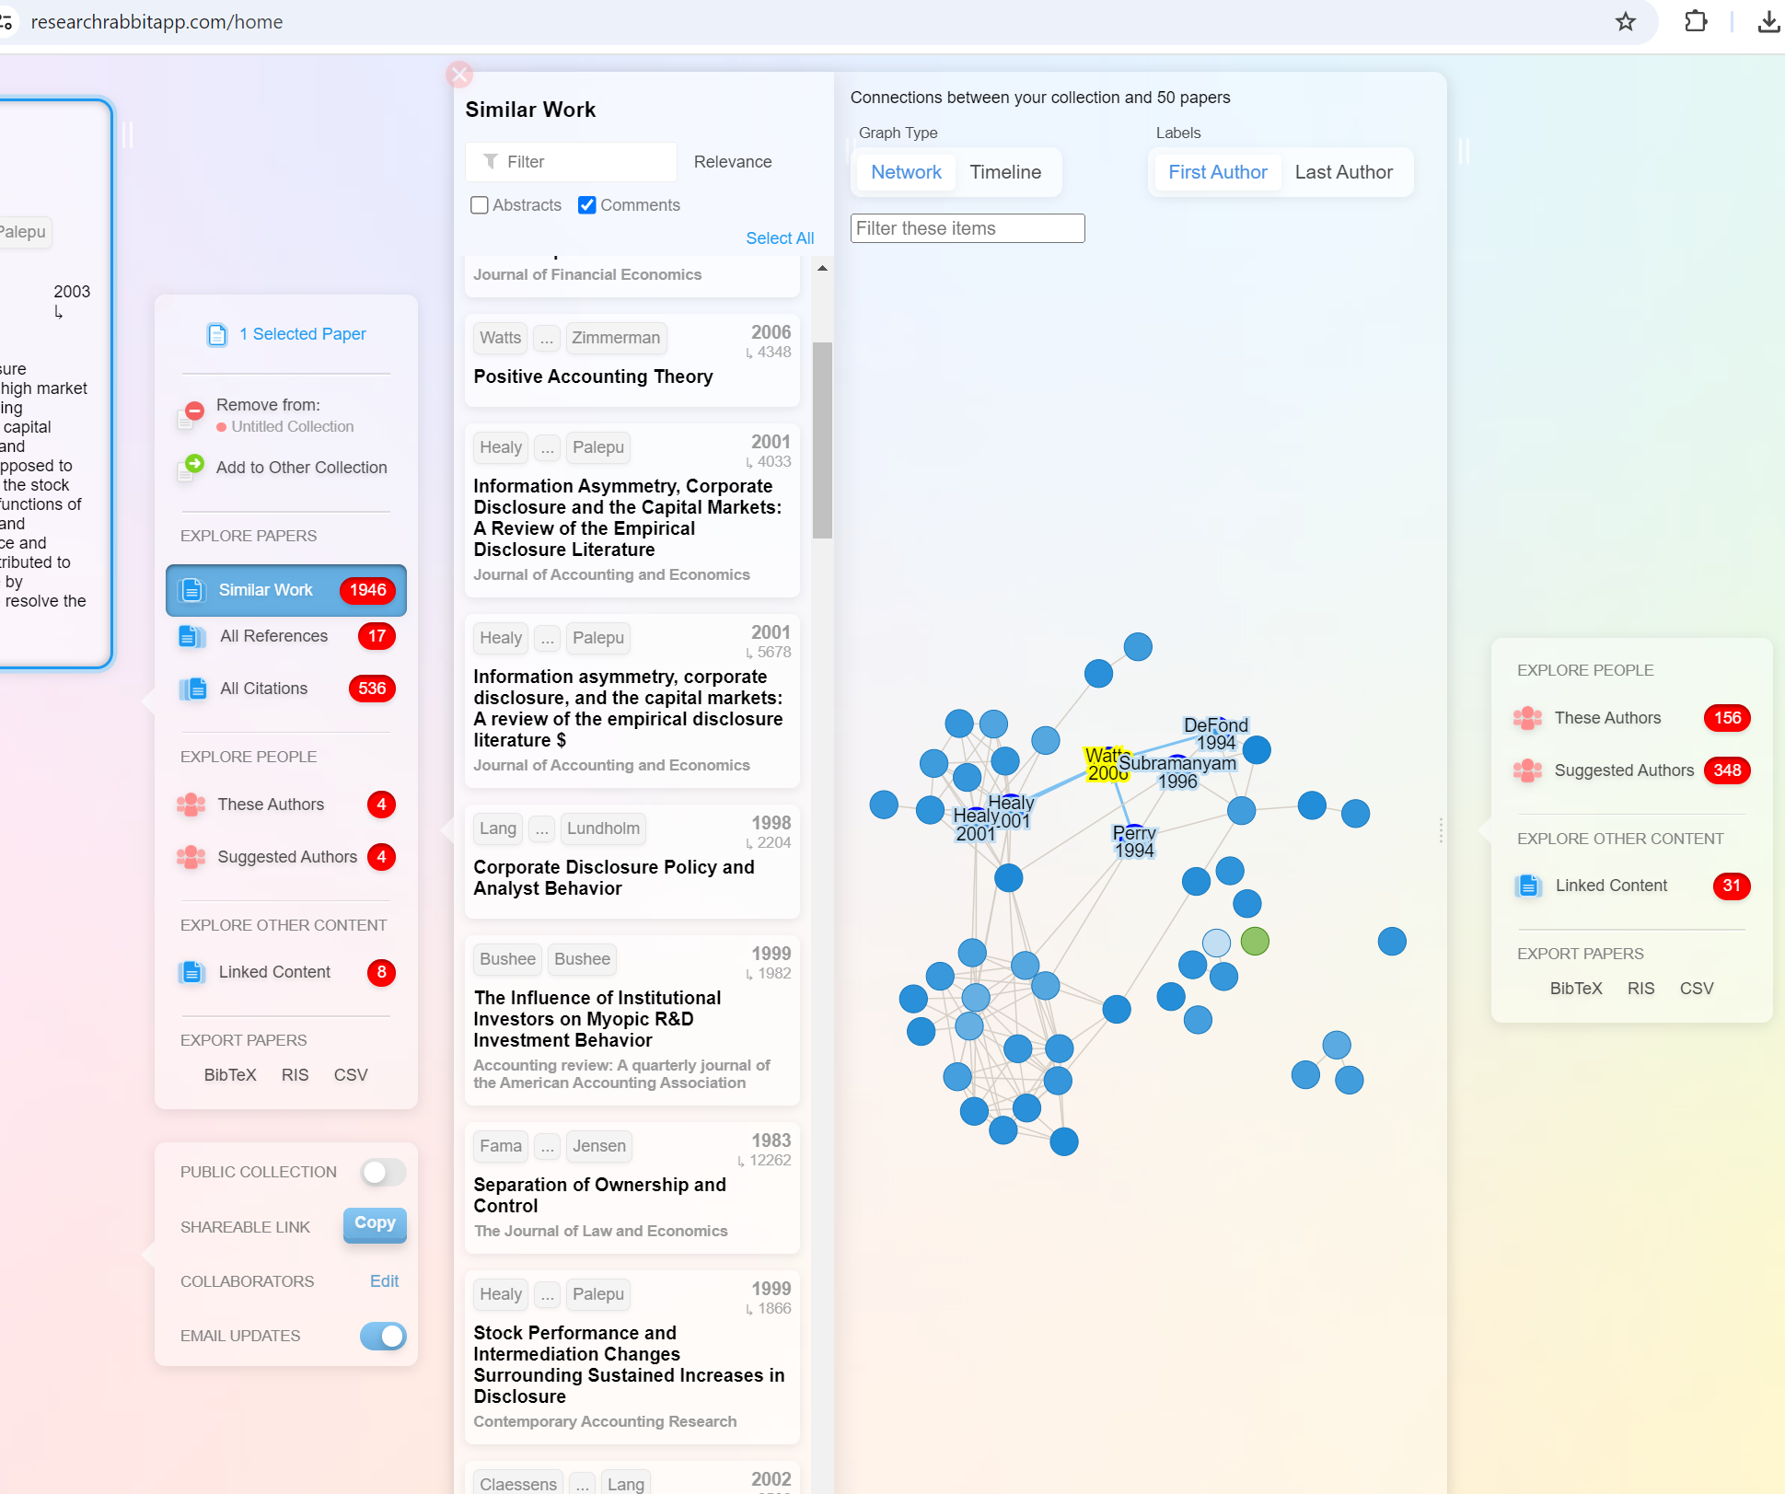
Reference Management – Research Rabbit

Slide 32
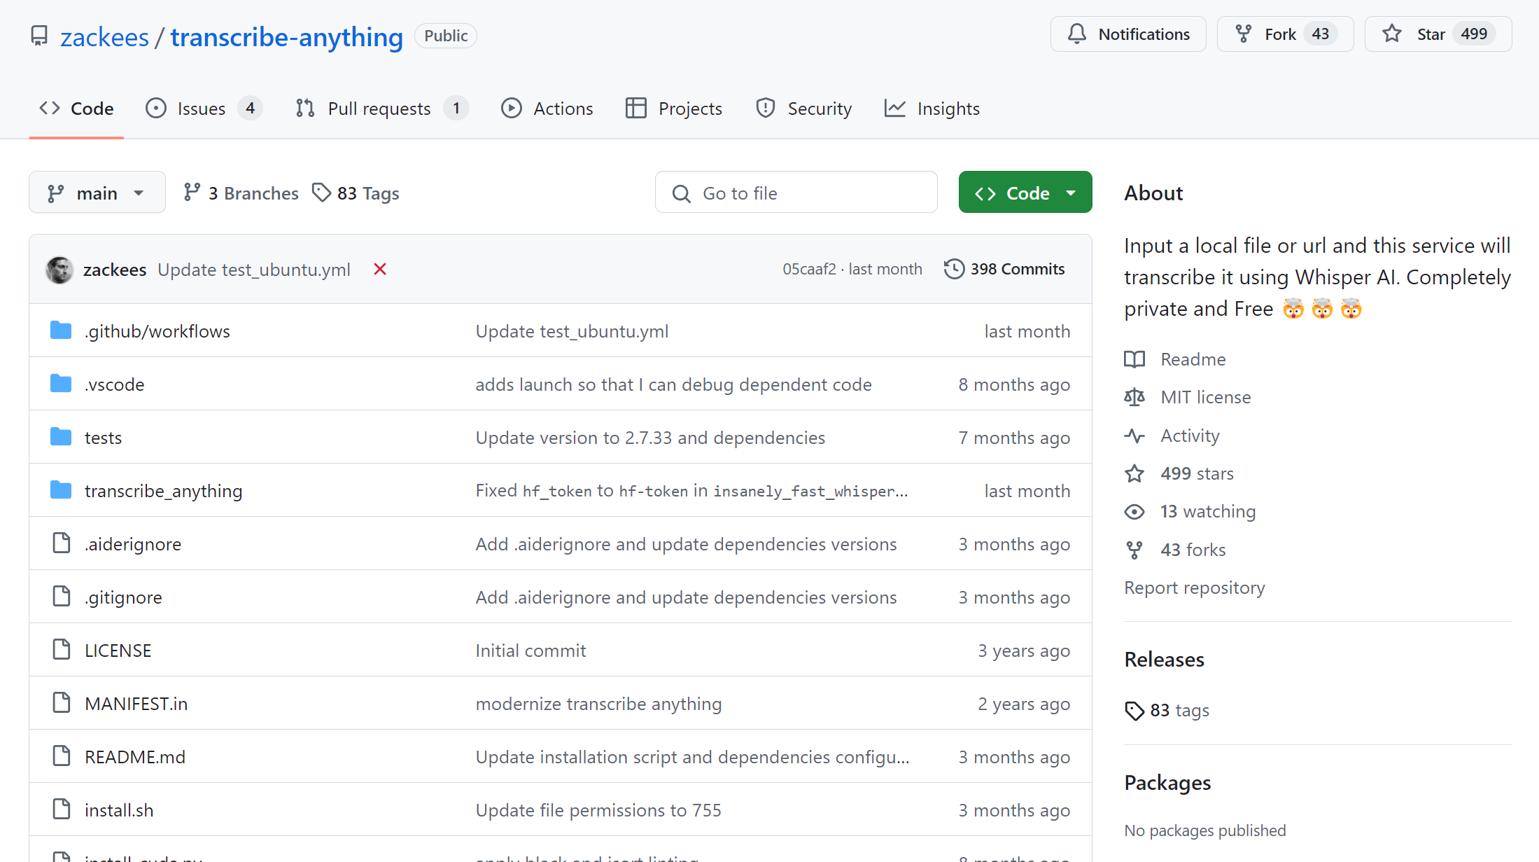
Talk Transcription

Slide 33
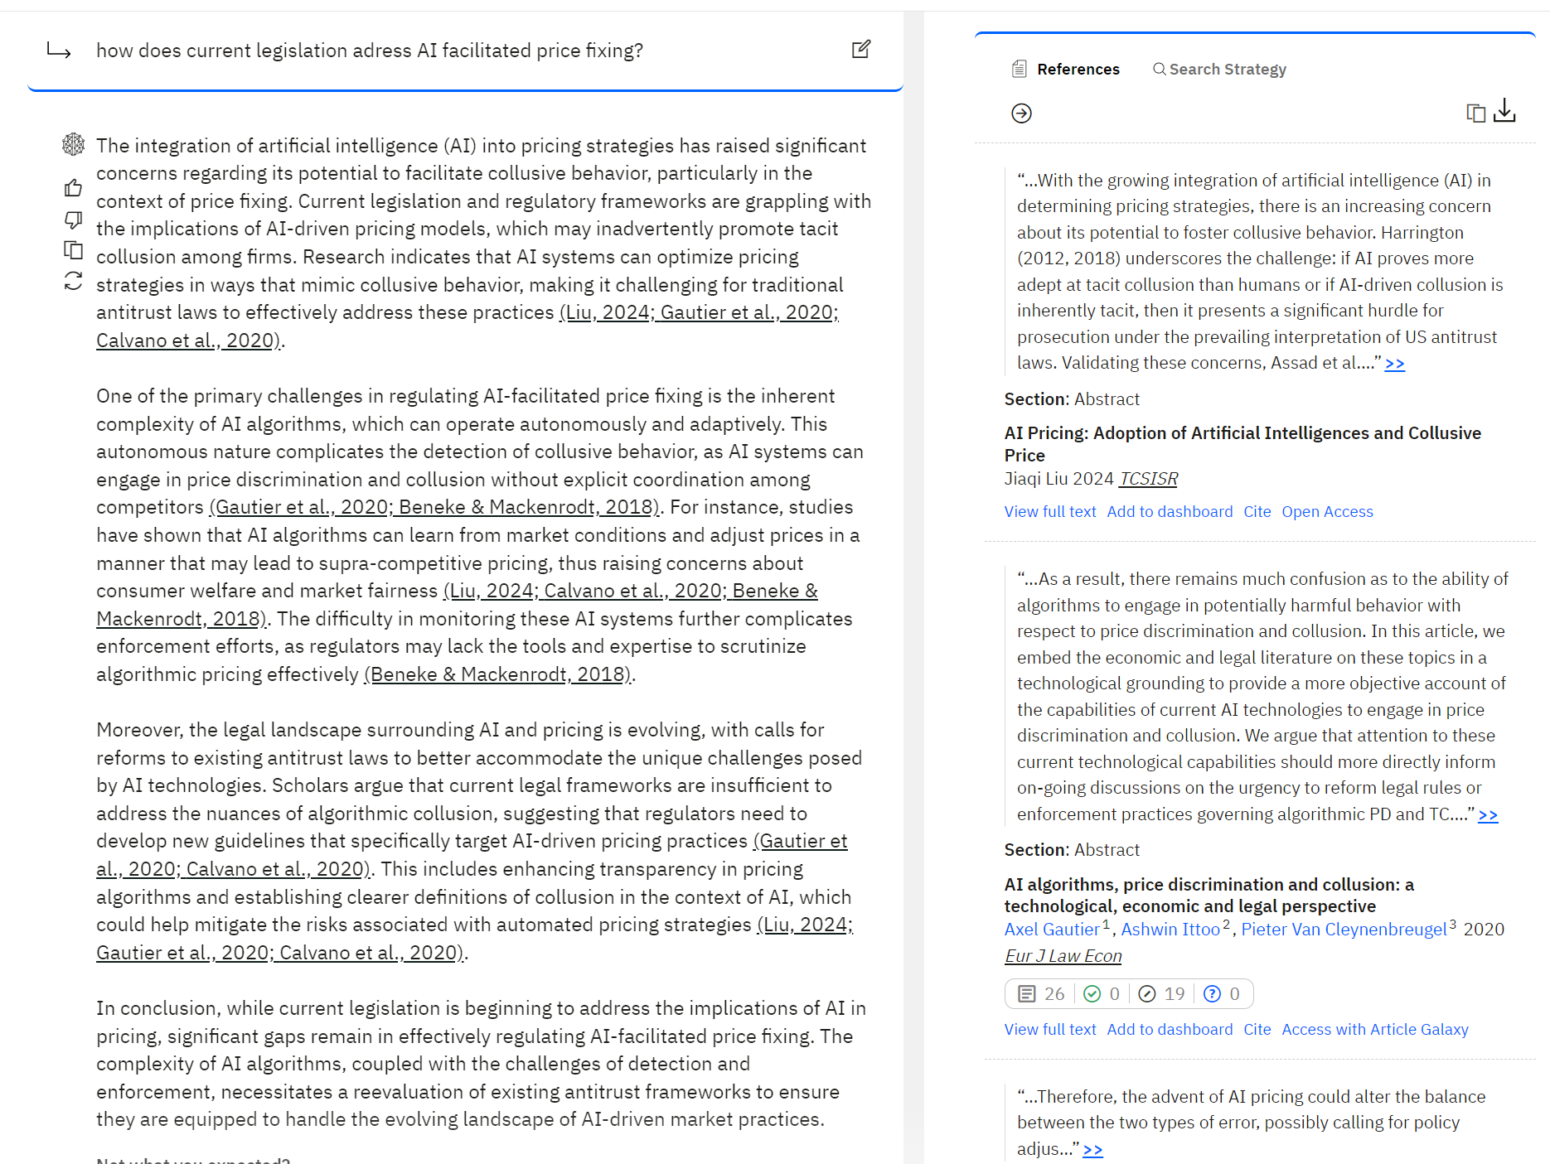
scite.ai & Elicit

Slide 34
Want more?
National AI Day – October
Data Meeting (Tuesday)

