Slide 1
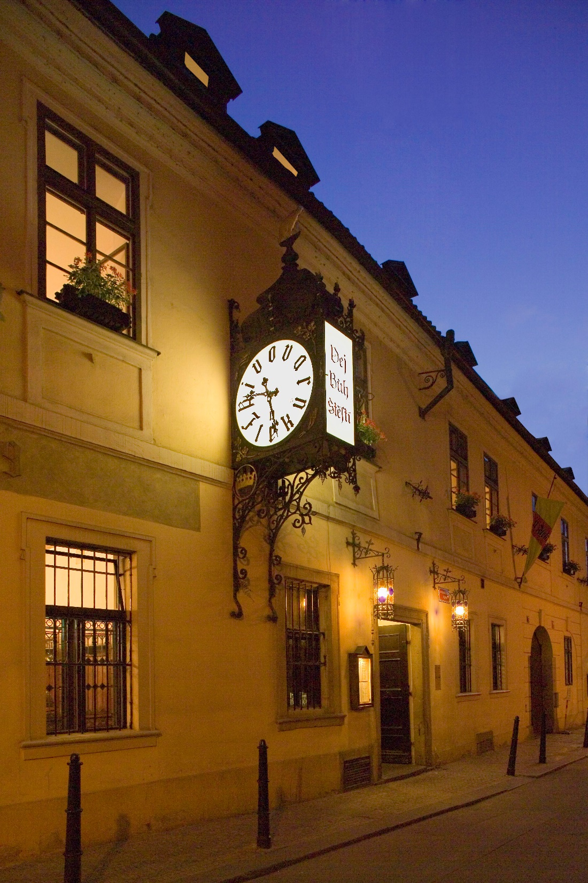
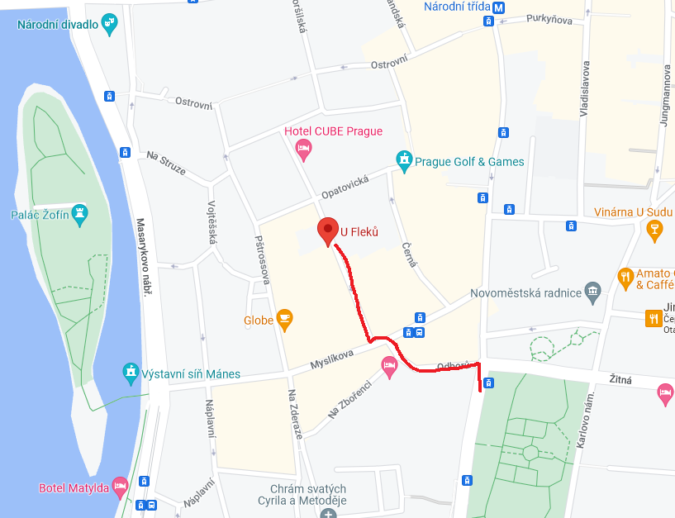
Brewery and restaurant U Fleků
Social Dinner Information
Address: Křemencova 11 110 00 Praha 1
Date and time: 26/01 at 19:00
How to reach it: (THIS IS ONLY ONE OPTIONN
Use the metro C (also know as red line). Go in the direction “Háje”, to the station “I.P. Pavlova”. Leave the metro and continue by tram No.6 or 22 or 23 to the stop "Novoměstská radnice". By walk about 3min (300m) to the restaurant.
Or download public transportation app

