Slide 1
“UHDpulse final paper”
in FRPT special issue in “Radiotherapy & Oncology”
Corresponding Author: Anna Subiel
Type: review paper summarizing the published/submitted work
Method: Overleave, everybody works on only one section like for UHDpulse announcement paper
deadline for title and preliminary list of authors: next week
deadline for submission: March/April

Slide 2
all Deliverables (other than the final two which are part of reporting) are due by 28 February 2023
the following reports are due on 29 April 2023. ->
deadline to send it to the coordinator: 31 March
Publishable Summary
Progress Report
Impact Report
Questionnaire
Final Publishable Report
DMP
Finance

Slide 3
Deliverables
hard deadline:
28.2.23
deadline to put it on SharePoint:
13.2.23
1 (A1.1.6) | D1 | Report describing the new reference fields for dosimetry in electron beams with ultra-high pulse dose rates | Report | PTB, METAS, GUM | Feb 2021 (M18)
1 (A1.2.9) | D2 | Report describing the traceability to a primary standard that will be provided for FLASH proton beams at the Proton Therapy Centre of Curie | Report | NPL, Curie | Apr 2021 (M20)
1 (A1.2.5) | D3 | Report on the comparison of the primary standards of PTB and METAS for absorbed dose to water in ultra-high dose per pulse electron beams | Comparison report | METAS, PTB | Dec 2021 (M28)
1, 2, 3 (A2.1.8) | D4 | Recommendation report about the suitability of investigated detector systems as secondary standards and for relative dosimetry in ultrahigh pulse dose per pulse electron beams including dose rate correction factors | Recommendation report | CHUV, Curie, METAS, PTB, USC, HZDR, PTW | Apr 2022 (M32)
2 (A3.2.7) | D5 | Report about the capabilities of commercially available and novel detector systems tested in clinical FLASH electron and proton beams and possible future developments and optimisations | Report | CSIC, USC, ADVACAM, FZU, UJF CAS, CMI, CHUV, Curie, PTB, PTW | Nov 2021 (M27)
3 (A2.4.5) | D6 | Recommendation report describing validated methods of relative dosimetry in emerging pre-clinical beams and including recommendations on the most optimal setup | Recommendation Report | NPL, QUB, FZU, PTB | Jun 2022 (M34)
3 (A4.4.6) | D7 | Best Practice Guide for the characterisation of stray radiation outside the pulsed ultra-high dose rate particle beams | Best Practice Guide | ADVACAM, CMI, NPL, PTB, POLiMi, UJF CAS, FZU | Aug 2022 (M36)
4 (A2.3.6) | D8 | Validated dosimetry protocol (Code of Practice) for traceable absorbed dose measurement in ultra-high pulse dose rate electron beams under reference conditions | Validated Code of Practice document | PTB, METAS, CHUV, Curie | Aug 2022 (M36)

Slide 4
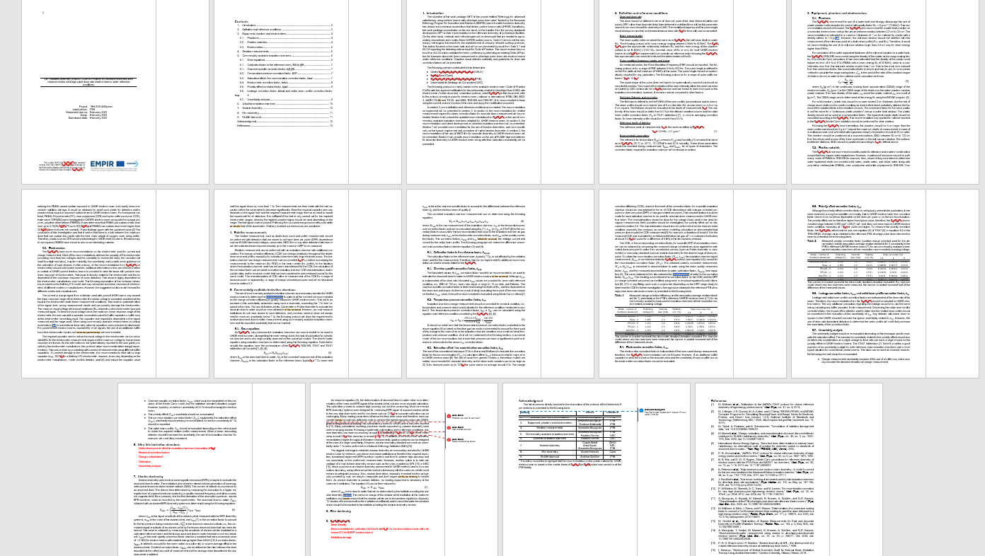
D8

Slide 5
D8

Slide 6
D4
Recommendation report about the suitability of investigated detector systems as secondary standards and for relative dosimetry in ultra high pulse dose per pulse electron beams including dose rate correction factors

Slide 7
all Deliverables (other than the final two which are part of reporting) are due by 28 February 2023
the following reports are due on 29 April 2023. ->
deadline to send it to the coordinator: 31 March
Publishable Summary
Progress Report
Impact Report
Questionnaire
Final Publishable Report
DMP
Finance

Slide 8
Activity Status Reports
deadline:
28.2.23
WP1:
A1.1.1 | Curie, Review of beam parameters in FLASH radiotherapy
A1.1.2 | PTB, Optimization of existing reference fields
A1.1.3 | PTB, Absolute charge measurements
A1.1.4 | PTB, Monte Carlo simulations of the beam and validation
A1.1.5 | PTB, Draft of a report on reference fields
A1.1.6 | PTB, Deliverable 1
A1.2.1 | METAS, Parametrization of radiation chemical yield
A1.2.2 | METAS, Establishment of primary standard Fricke dosimetry
A1.2.3 | PTB, Correction factor calculations for PTB’s water calorimeter
A1.2.4 | PTB, PTB’s water calorimeter as primary standard
A1.2.5 | METAS, Deliverable 3
A1.2.6 | GUM, Validation of a portable Graphite calorimeter
A1.2.7 | GUM, Graphite calorimetry in FLASH electron beams
A1.2.8 | NPL, Traceable graphite calorimetry of FLASH proton beams
A1.2.9 | NPL, Deliverable 2
A1.2.10 | NPL, Setup for short pulsed VHEE beams
A1.2.11 | NPL, Graphite calorimetry of VHEE beams
A.1.2.12 | NPL, Monte Carlo calculations supporting graphite calorimetry
A1.2.13 | NPL, Development of manuscript on VHEE calorimetry
A1.3.1 | NPL, Small graphite calorimeter at FLASH proton beams
A1.3.2 | NPL, Monte Carlo calculations supporting graphite calorimetry
A1.3.3 | NPL, Report on graphite calorimetry with FLASH proton beams
A1.3.4 | QUB, Characterization of laser-driven beam parameters
A1.3.5 | NPL, Small graphite calorimeter at laser-driven proton beams
A1.3.6 | QUB, Characterization of laser-driven proton beams
A1.3.7 | NPL, Graphite calorimetry at laser-driven proton beams
A1.3.8 | NPL, Manuscript on calorimetry of laser-driven proton beams
A1.3.9 | NPL, Graphite calorimetry in laser-driven electron beams

Slide 9
Activity Status Reports
deadline:
28.2.23
WP2:
A2.1.1 | PTB, Characterization of FLASH beams
A2.1.2 | METAS, Calibration of chemical dosimeters
A2.1.3 | Curie, Calibration of radiochromic dosimetry films
A2.1.4 | PTB, Characterization of Alanine/ESR secondary standard
A2.1.5 | PTB, Ionization chambers as secondary standards
A2.1.6 | PTB, Test of solid-state detectors as secondary standard
A2.1.7 | CHUV, Draft of a Recommendation Report
A2.1.8 | CHUV, Deliverable 4
A2.2.1 | NPL, Preparation of experimental setup
A2.2.2 | NPL, Ionization chambers in laser-driven proton beams
A2.2.3 | NPL, Characterization of ionization chambers in VHEE beams
A2.2.4 | NPL, Development of empirical models for ion-recombination
A2.2.5 | NPL, Development of report on ion correction effects
A2.3.1 | PTB, Reference conditions for FLASH electron beams
A2.3.2 | Curie, Beam quality specifier for reference dosimetry
A2.3.3 | PTB, Establish a formalism for reference dosimetry in FLASH-RT
A2.3.4 | Curie, Validation of formalism for reference dosimetry in FLASH
A2.3.5 | PTB, Draft of a protocol
A2.3.6 | PTB, Deliverable 8
A2.4.1 | NPL, Development of irradiation phantoms
A2.4.2 | NPL, Beam profile measurements
A2.4.3 | NPL, Beam modelling by means of Monte Carlo simulations
A2.4.4 | NPL, Draft of a Recommendation Report about relative dosimetry:
A2.4.5 | NPL, Deliverable 6

Slide 10
Activity Status Reports
deadline:
28.2.23
WP3:
A3.1.1 | CHUV, Improving the monitoring of FLASH beam facility
A3.1.2 | Curie, Exploring the relevant beam metrics of FLASH beams
A3.2.1 | CHUV, Survey of the high-dose rate pulsed beams characteristics
A3.2.2 | CHUV, Evaluating commercially available and novel detectors
A3.2.3 | USC, Designing custom-built detectors for FLASH proton beams
A3.2.4 | CSIC, Improving custom-built detectors
A3.2.5 | CHUV, Comparison of detectors for Flash beams
A3.2.6 | CSIC, Documenting the tests
A3.2.7 | CSIC, Deliverable 5
A3.2.8 | CHUV, Towards a code of practice guide
A3.3.1 | FZU, Survey of the laser-driven pulsed beams characteristics
A3.3.2 | CSIC, Testing detectors in laser-driven pulsed proton beams
A3.3.3 | CSIC, Documenting the tests
A3.3.4 | FZU, Comparison of detectors for laser-driven pulsed beams
A3.3.5 | FZU, Reporting of results

Slide 11
Activity Status Reports
deadline:
28.2.23
WP4:
A4.1.1 | ADVACAM, Testing of TPX3 sensors for stray radiation
A4.1.2 | ADVACAM, Optimization of the detector for stray radiation
A4.1.3 | CMI, Monte Carlo modelling
A4.1.4 | ADVACAM, Method for particle quantification
A4.1.5 | CMI, Method for absorbed dose to water quantification
A4.1.6 | ADVACAM, Software development
A4.1.7 | ADVACAM, Detailed tests
A4.1.8 | ADVACAM, Documentation and manual
A4.1.9 | ADVACAM, Submission of a peer-reviewed article
A4.2.1 | FZU, Testing of luminescence dosimeters in stray radiation
A4.2.2 | CMI, Monte Carlo simulations
A4.2.3 | FZU, Documentation and manual
A4.2.4 | FZU, Submission of a peer-reviewed article
A4.3.1 | PoliMi, Development of a Bonner Sphere Spectrometer read out
A4.3.2 | NPL, Response function calculations
A4.3.3 | NPL, Bonner Sphere with monoenergetic neutrons
A4.3.4 | PTB, Development of a Bonner sphere spectrometer
A4.3.5 | NPL, Detailed tests, documentation and manual
A4.4.1 | CMI, TPX3 measurements in reference, non-pulsed beams
A4.4.2 | CMI, Traceability for methods for stray radiation
A4.4.3 | CMI, Validation of methods for stray radiation
A4.4.4 | CMI, Validation report
A4.4.5 | ADVACAM, Best Practice Guide
A4.4.6 | ADVACAM, Deliverable 7

Slide 12
all Deliverables (other than the final two which are part of reporting) are due by 28 February 2023
the following reports are due on 29 April 2023. ->
deadline to send it to the coordinator: 31 March
Publishable Summary
Progress Report
Impact Report
Questionnaire
Final Publishable Report
DMP
Finance

