Slide 1
WP5: Creating Impact - review Jaroslav Šolc
EMPIR 18HLT04 UHDpulse
Metrology for advanced radiotherapy using particle beams with ultra-high pulse dose rates
27 January 2023

Slide 2
Papers and conferences
33 papers published, submitted or drafted
100 conference presentations

Slide 3
Papers and conferences
be submitted to peer-reviewed journals (but do not need to have impact factor);
have persistent identifiers (e.g. DOI, arXiv identifier, etc.);
be open access no later than 6 months from publication;
„non-open access papers ... cannot be accepted in project reports or as project outputs“;
acknowledge the funding:
This project 18HLT04 UHDpulse has received funding from the EMPIR programme co-financed by the Participating States and from the European Union’s Horizon 2020 research and innovation programme.
Display the EMPIR logo with the EU emblem;

Slide 4
Papers and conferences
Open access and fees - official MSU statement:
"EURAMET do require you to publish the paper open access even if it cannot be made open access during the project lifetime and as such the timing of the publishing is often such that the open access fees are not eligible for reporting. However the open access is still a contractual requirement.
If the fee is paid during the project lifetime it is an eligible cost and if paid later it is not an eligible costs - but it must still be paid.
It is not unusual that you will not get the final version open accessed until after project has ended. MSU had seen that the scientific community go for some other ways to publish Open access when the project had finished, for example, department budget or European Commission journal portal free for past and present funded project “Open Research Europe”.„
Open Research Europe
Fast publication and free open peer review for research stemming from Horizon 2020, Horizon Europe and Euratom funding across all subject areas.
ORE does not and will not ask to have an Impact Factor. The EC is part of an increasing number of funding agencies, institutions and organizations who are keen to support a broader view of a researcher’s output – and that it is the intrinsic value of what is published, shared and re-used, that is important as opposed to the venue, journal or platform where an article is published.

Slide 5
Datasets (open access data)
Background:
Project funded by European money (European taxpayers) and so European Commision requires that any European citizen is able to find the data of the funded research and „to make it possible for third parties to access, mine, exploit, reproduce, disseminate, use, re-evaluate — free of charge for any user — the data to validate the results;
EURAMET wants to show the EC that the projects have Impact in order to be able to ask for new funding when the current Programme ends.
Official MSU statement:
„The consortium agreed to deposit its open access data sets in suitable repositories. The requirements for “open data” are additional to the requirements for “open access publications”. Unless there are good reasons for not making the data underpinning a publication open access, we would expect such datasets to be submitted to an “open access data repository” such as Zenodo in addition to the paper being open access. Such datasets need to be listed in 3 places: 1. In your Data Management Plan, 2. In your output and impact report, and 3. Submitted to the EURAMET Repository Link."

Slide 6
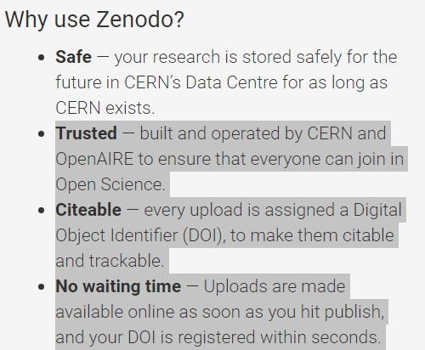
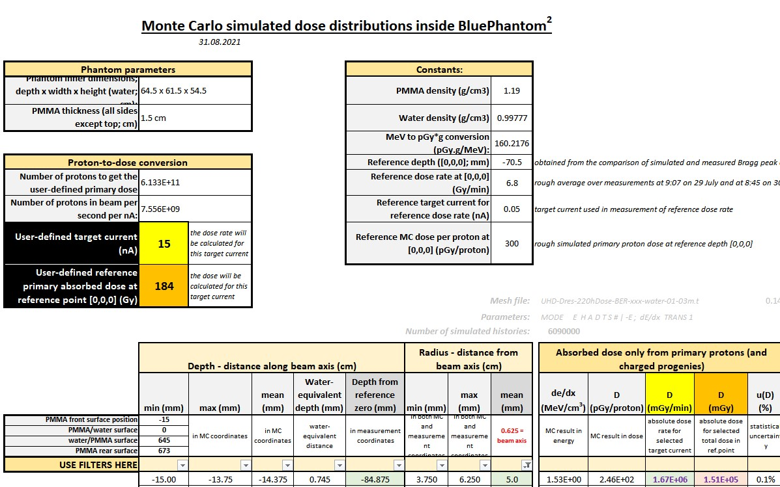
Datasets
EURAMET suggests Zenodo.org;
Example:
Processed MC simulations of dose distribution in water phantom
Not raw data
Excel sheet for data presented in a paper as a figure only.

Slide 7
Follow-on collaborations, patents
„Follow-on research collaborations and staff exchanges at the European or International level that have resulted from the project. This includes any collaborations that involve at least two of the project participants (you may also include new partners in addition to the project participants).

Slide 8
Uptake and Exploitation
Spread of project results among interested groups.
Examples:
Companies (or other organisations) implementing new devices, software, procedures, methods, protocols developed by the project to support the development or implementation of new and / or improved products, processes or services;
Companies (or other organisations) using the new measurement capabilities at NMIs / DIs to test / validate instruments, processes, methods, etc.
These might be accessed via consultancy or calibration work based on the new measurement capabilities available at NMIs / DIs as a result of the project
Invitations to present the findings of the project (privately) to companies (or other potential user organisations)
New calibration / test services available (or soon to be available) at NMIs / DIs or other organisations based on the new measurement capabilities resulting from the project.

Slide 9
Impact
=> Not asking for additional work, but asking to check what you have already achieved, maybe it can be included in the project impact.

Slide 10
Deliverables
MSU official statement:
Deliverables: "The document should contain enough information to assess successful completion of the Deliverable/Objective. This means that a deliverable will be accepted when title presented in the project protocol and the content of the document agree. MSU will review the document and they expect to see some explanation of the key words used in the Deliverable title along the document.“
Example:
D7: Best Practice Guide for the characterisation of stray radiation outside the pulsed ultra-high dose rate particle beams.
Correct wording will decrease the number of comments from EURAMET.
„The document can be as detailed as you wish but it should include the “key results/methodologies/devices” as suggested in the title. Many coordinators prepare reports with analysis, results and discussion while some others prepare some working graphs/tables to support the successful completion of the deliverable/objective. EURAMET does not publish deliverables but encourage you to make them public when possible."
Include EURAMET logo

Slide 11
Deliverable D9
Evidence of contributions to or influence on new or improved international guides, recommendations and standards with a specific focus on the following guides and committees: IAEA, EURAMET TC-IR, CCRI(I), EURADOS, IPEM and DIN. Examples of early uptake of project outputs by end-users.
List in the Impact report but no description – 1 paragraph should be enough, hard evidence (presentation, meeting agenda/report mentioning the project) is welcomed.
Evidence examples:
Project partners, who are members of the IEC committees, presented the consortium activities and research results to the IEC/TC45/SC45B.
The result of the activity AAA was provided to XXX who used it for the newly developed standard ...

Slide 12
Deliverable D9
Early uptake examples:
Swiss company SwissDrones Operating AG developing and producing UAVs adopted method for monitoring after nuclear accident using HPGe detector and joint tests were performed in Switzerland with real radioactive sources. (WP1)
Environment Radiation Monitoring Laboratory of NPP Dukovany (CZ) will use the data and experience from long-term monitoring by transportable air-sampling system developed in WP2.

Slide 13
Project website
http://uhdpulse-empir.eu/
It will be maintained by CMI for at least 3 years after the end of the project.

Slide 14
Thank you for your attention!
Contact:
Jaroslav Šolc
jsolc@cmi.cz
Czech Metrology Institute

