Slide 1
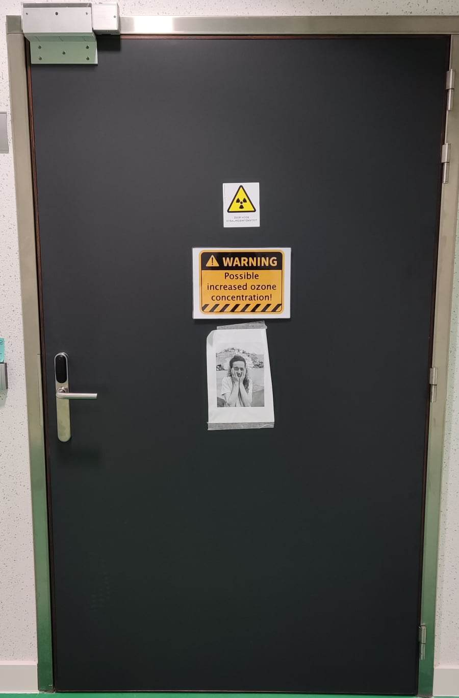


UHDR dosimetry in Antwerp
Verdi Vanreusel^{1,2,3}, A. Gasparini^{1,2}, L. De Freitas Nascimento³, D. Verellen^{1,2}
¹ University of Antwerp, Antwerp, Belgium; ² Iridium Netwerk, Wilrijk, Belgium; ³ SCK CEN, Mol, Belgium;
UHDPulse 2nd
stakeholders meeting
-- 28/01/2023

Slide 2
Introduction: Antwerp UHDR research
AReRO
Medical Physics
Detector production + implementation
Dosimetric Framework
In vitro/vivo infrastructures
(Multimodality and image guidance)
Radiobiology
ElectronFlash (ELF)
In vitro/vivo models
  Breast cancer
  Skin cancer
3D cultures + organoids
Radiation oncology
Clinical translation of FLASH-RT (IOeRT)
Slide adapted from A. Gasparini

Slide 3
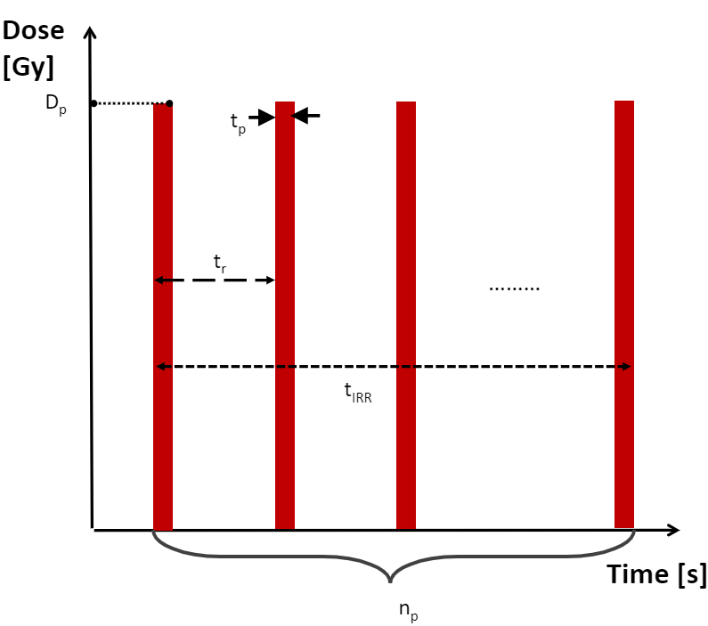

Introduction: Antwerp accelerator
Slide adapted from A. Gasparini

Slide 4

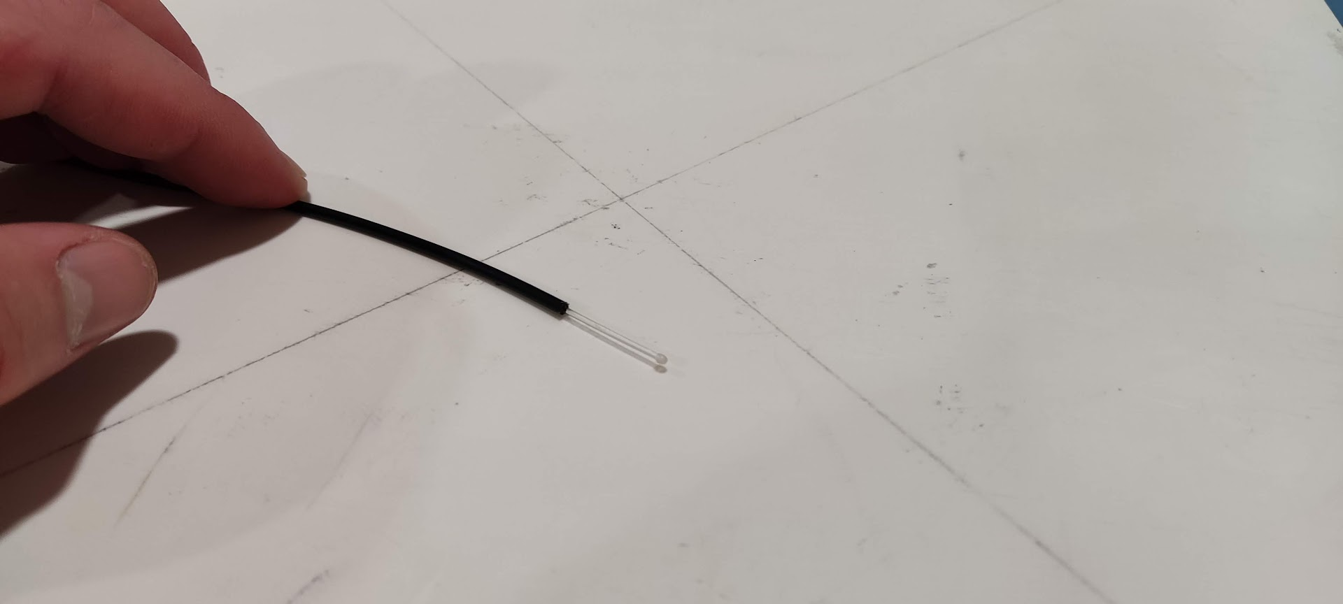
Introduction: Antwerp dosimetry
FLASHDiamond
Ionization chambers
Alanine EPR
Optically stimulated
luminescence
Point scintillators
2D scintillating system

Slide 5
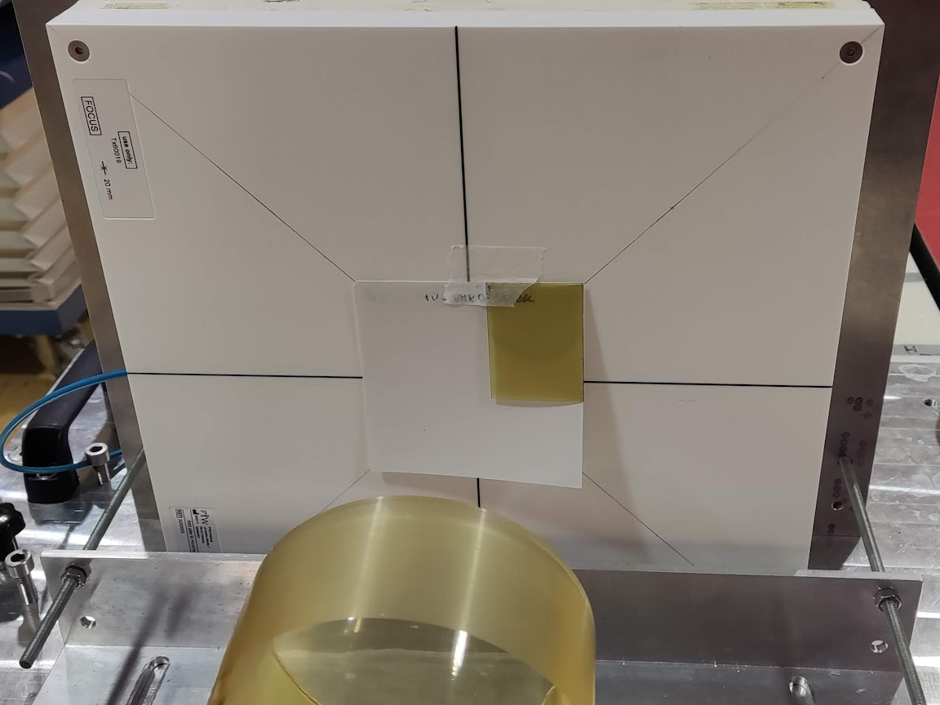
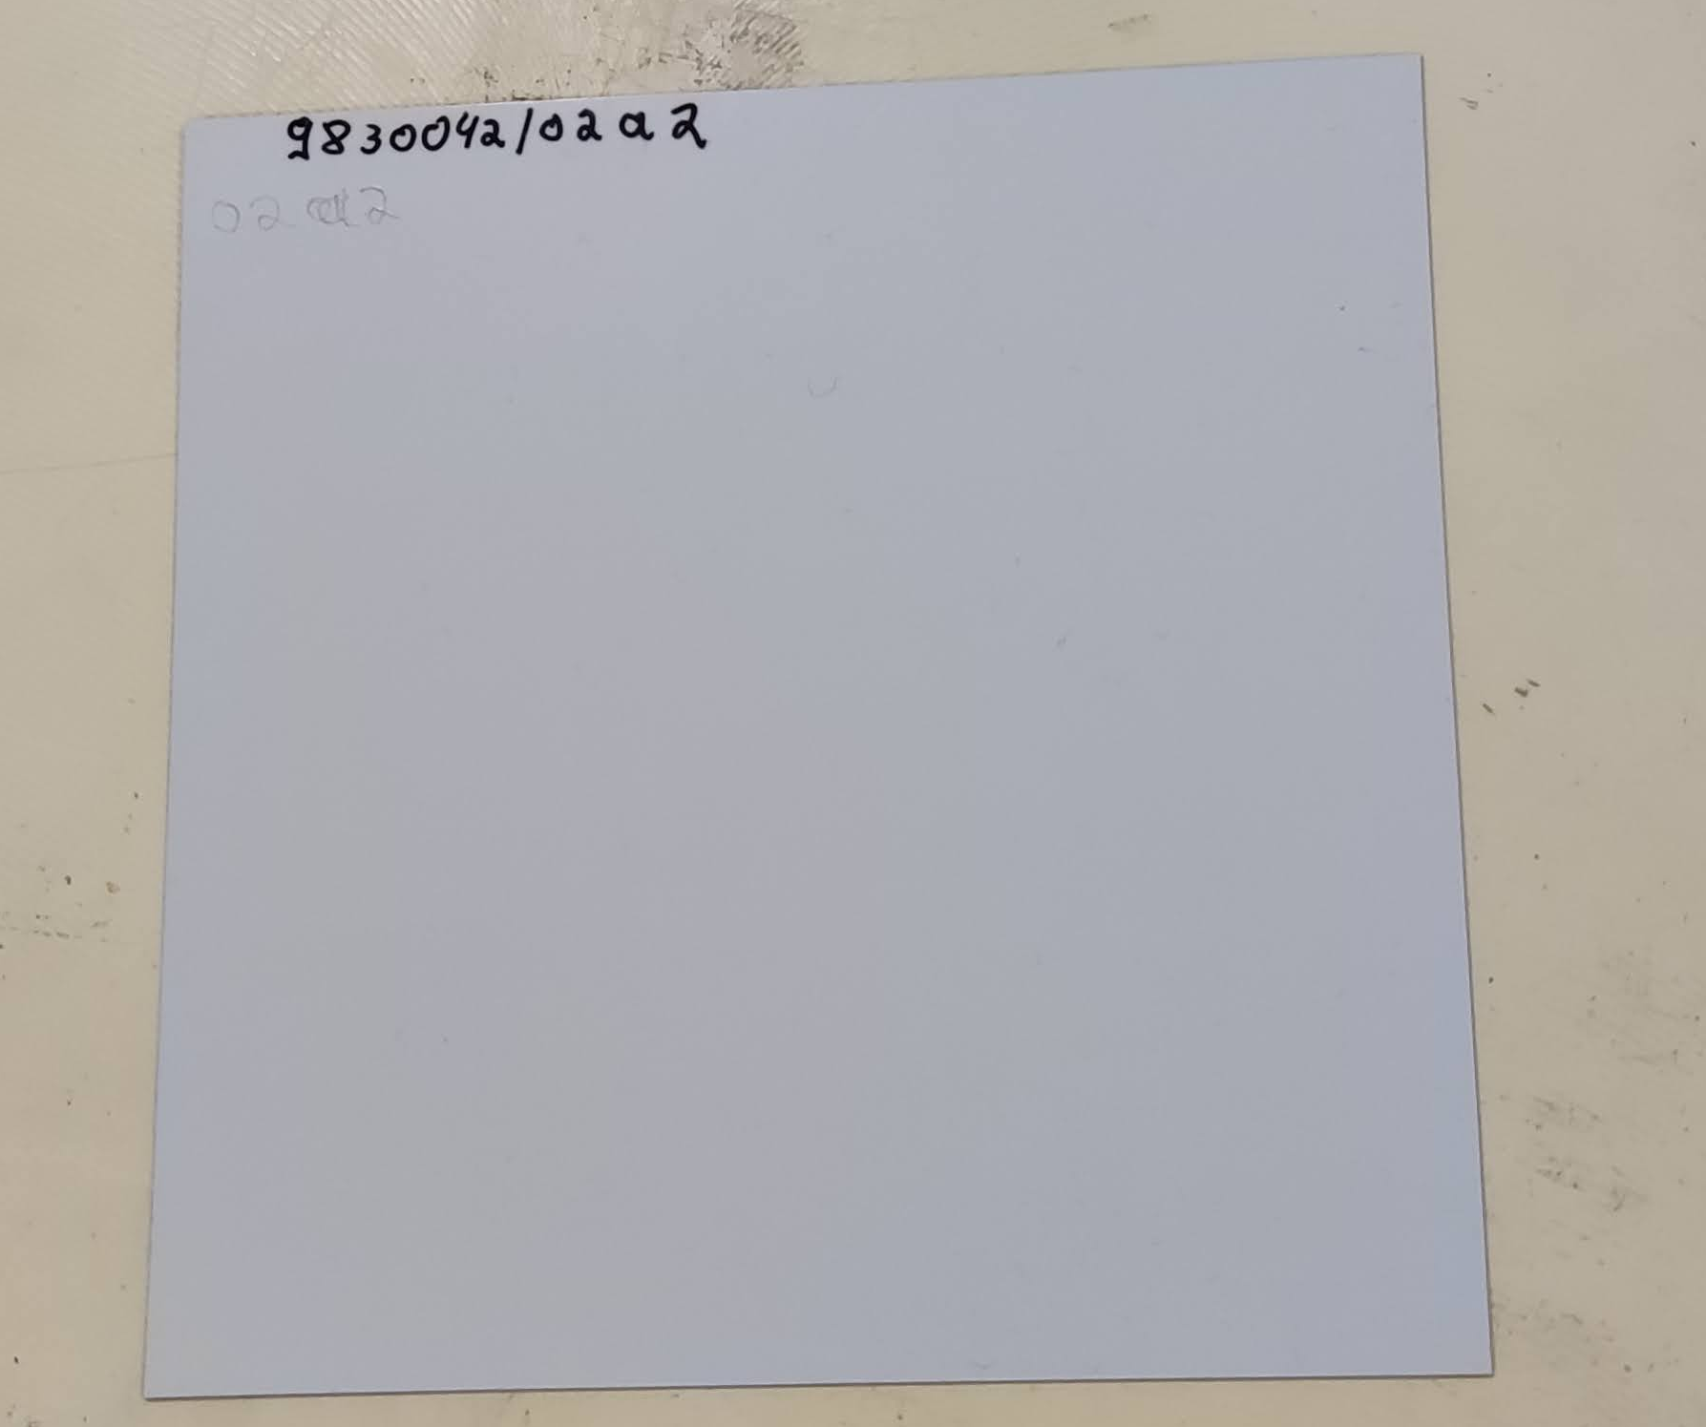
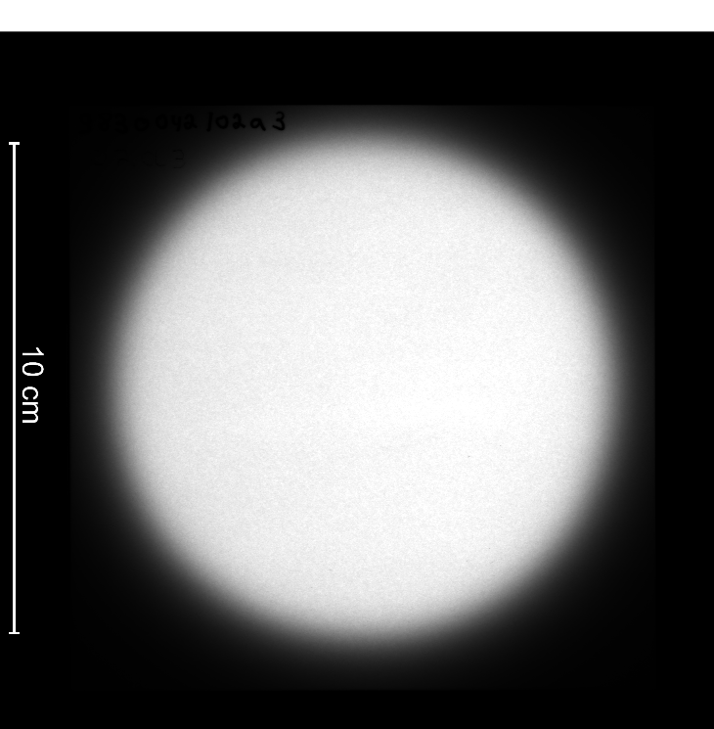
Optically stimulated luminescence dosimetry
Semi-flexible sheet
Irradiation in dark
Read-out: CR-reader
Grey Value → Dose
Dark decay → Timing!

Slide 6
Optically stimulated luminescence dosimetry
 | OSL_{high} | OSL_{medium} | OSL_{low}
Particle size (µm) | 3.2 | 1.5 | ±0.2
Phosphor/binder | 12/98 | 5.3/94.7 | 11/99
Thickness (µm) | 33 | 8 | 23
Phosphor coating weight (g/m²) | 4.4 | 0.5 | 3.3
Sensitivity at 60 kVp | 1900 | 180 | 30

Slide 7
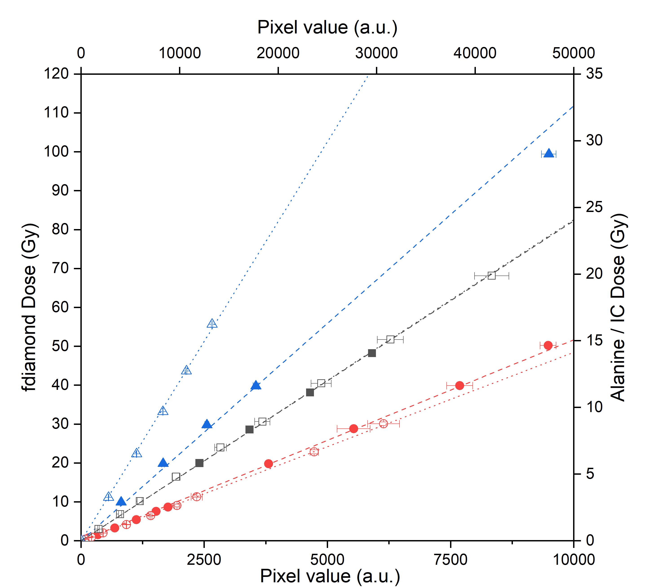
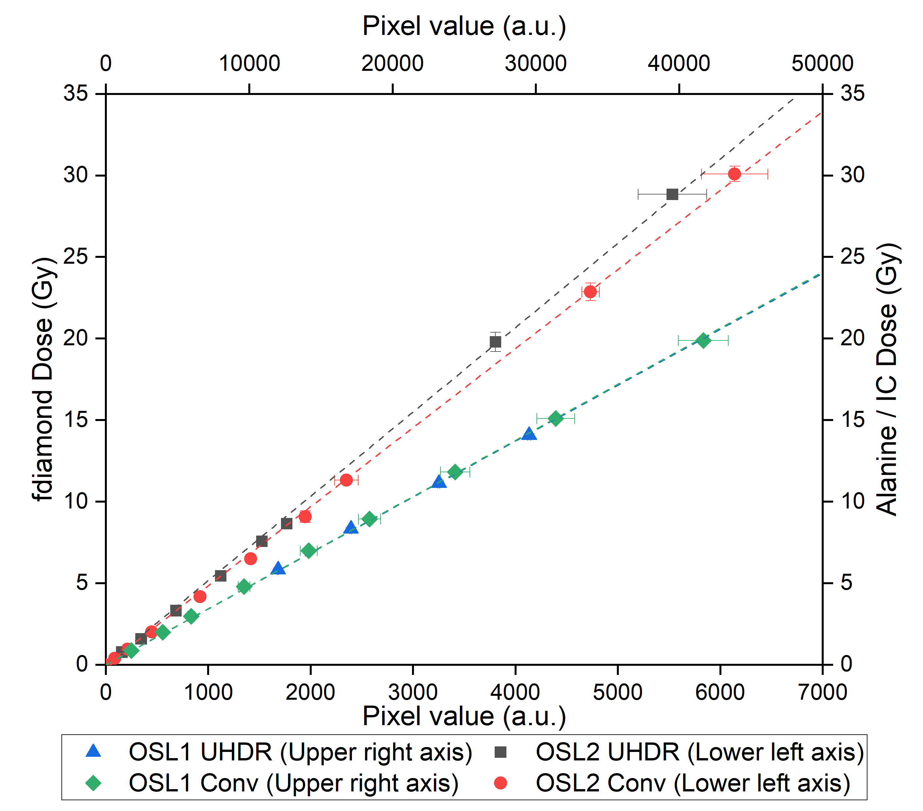
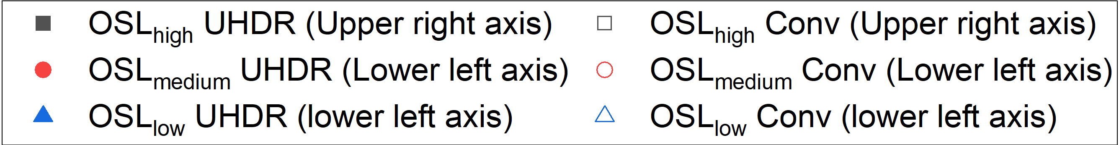
OSL dosimetry: Calibration
 | Slope (Conventional) | Slope (UHDR)
OSL_{high} | 0.48 ◦ 10⁻³ | 0.48 ◦ 10⁻³
OSL_{medium} | 4.85 ◦ 10⁻³ | 5.17 ◦ 10⁻³
OSL_{low} | 20.53 ◦ 10⁻³ | 11.18 ◦ 10⁻³

Slide 8
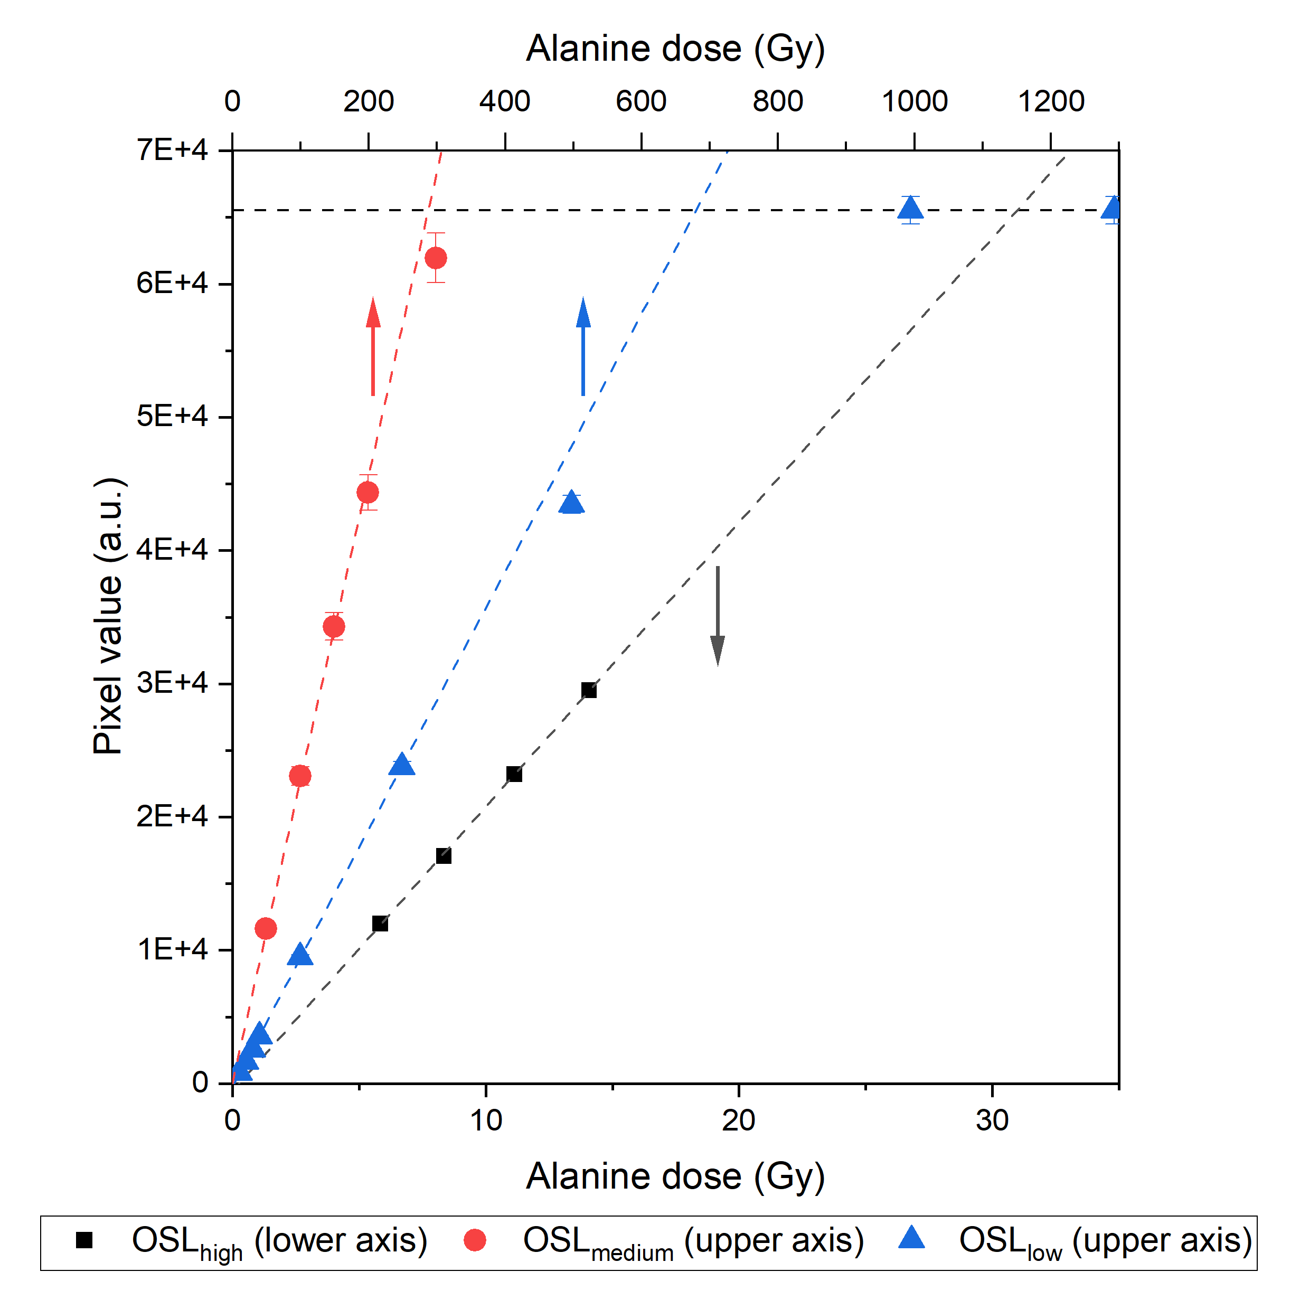
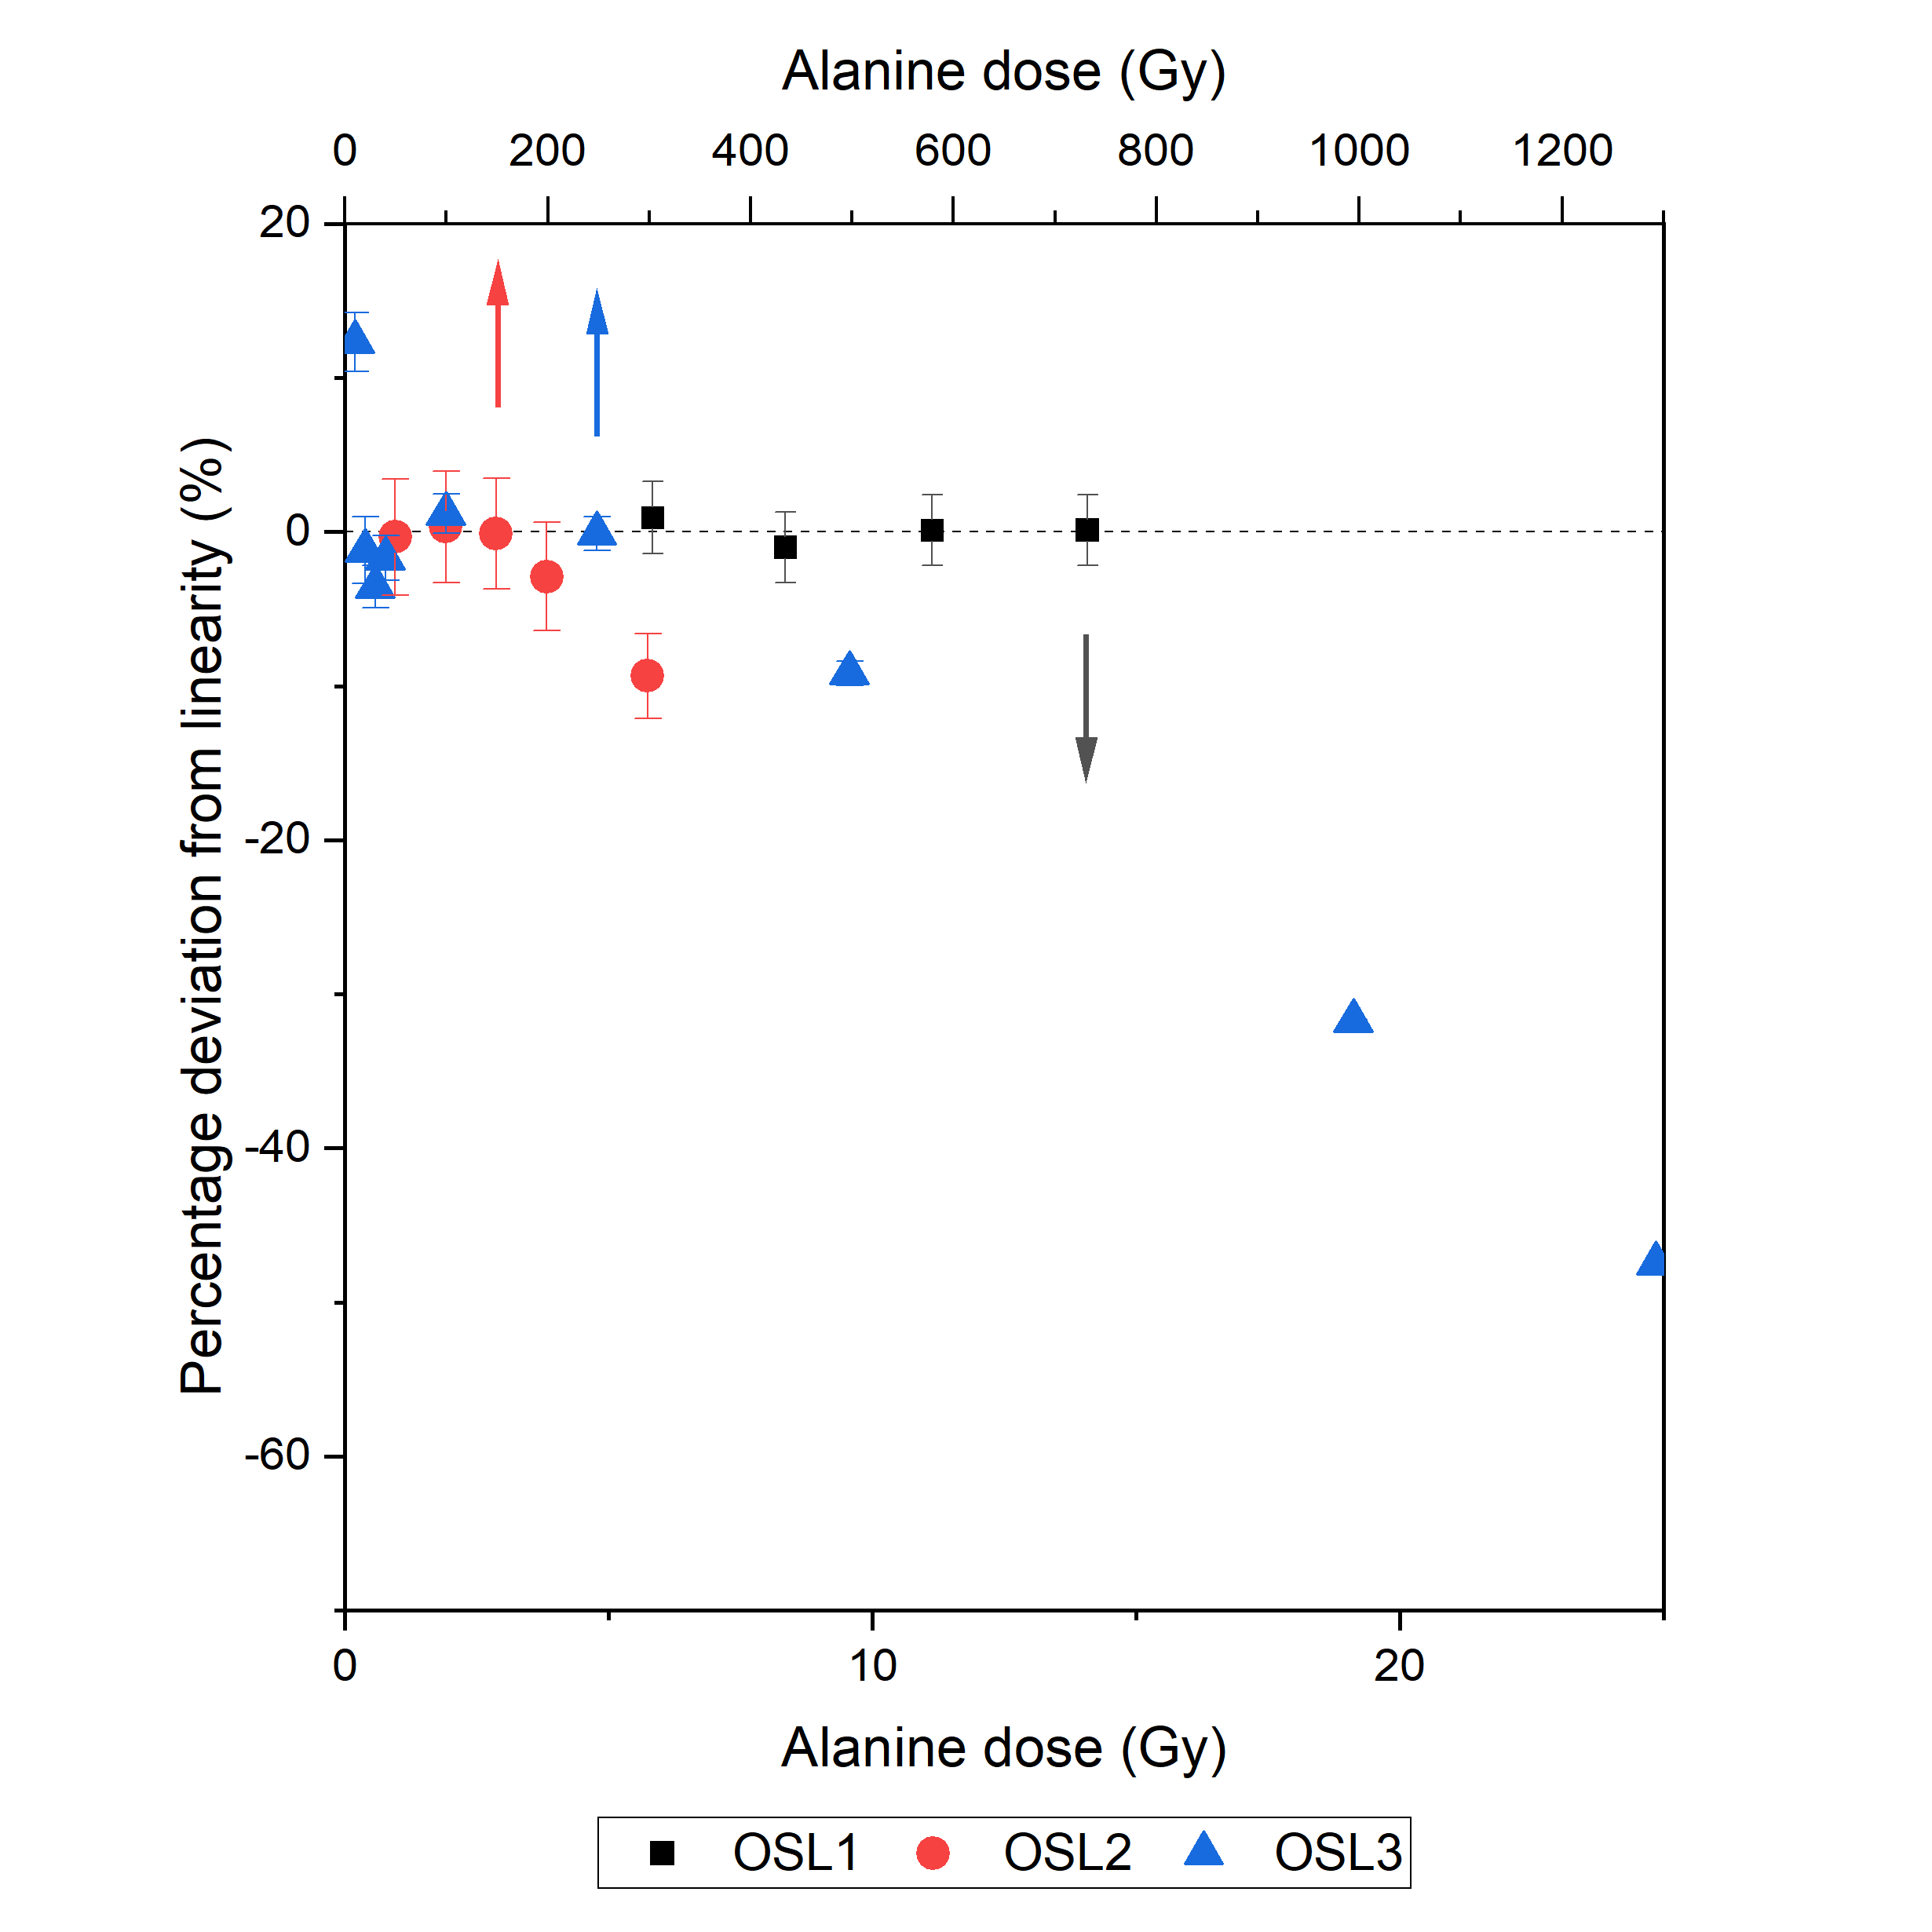
OSL dosimetry: Dose limit
OSL_{medium} and OSL_{low} ➔ Saturation

Slide 9
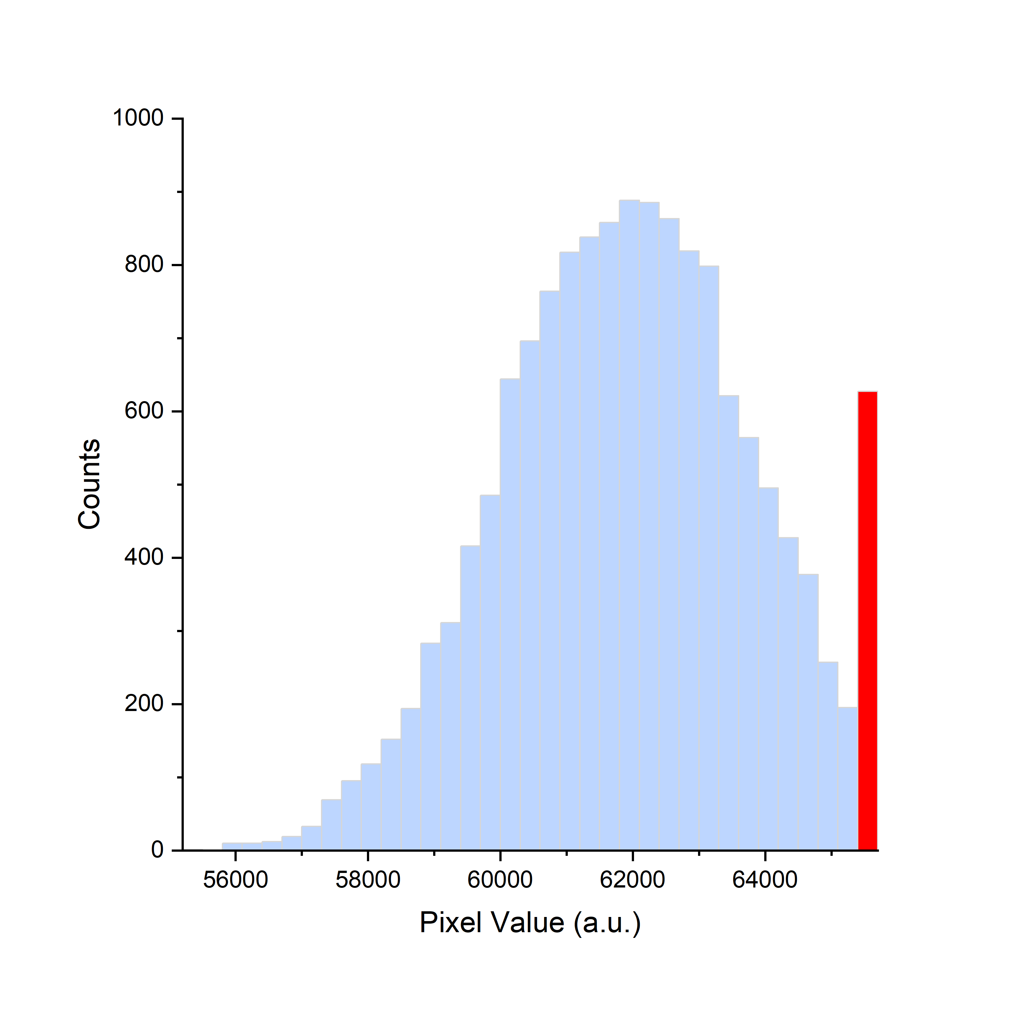
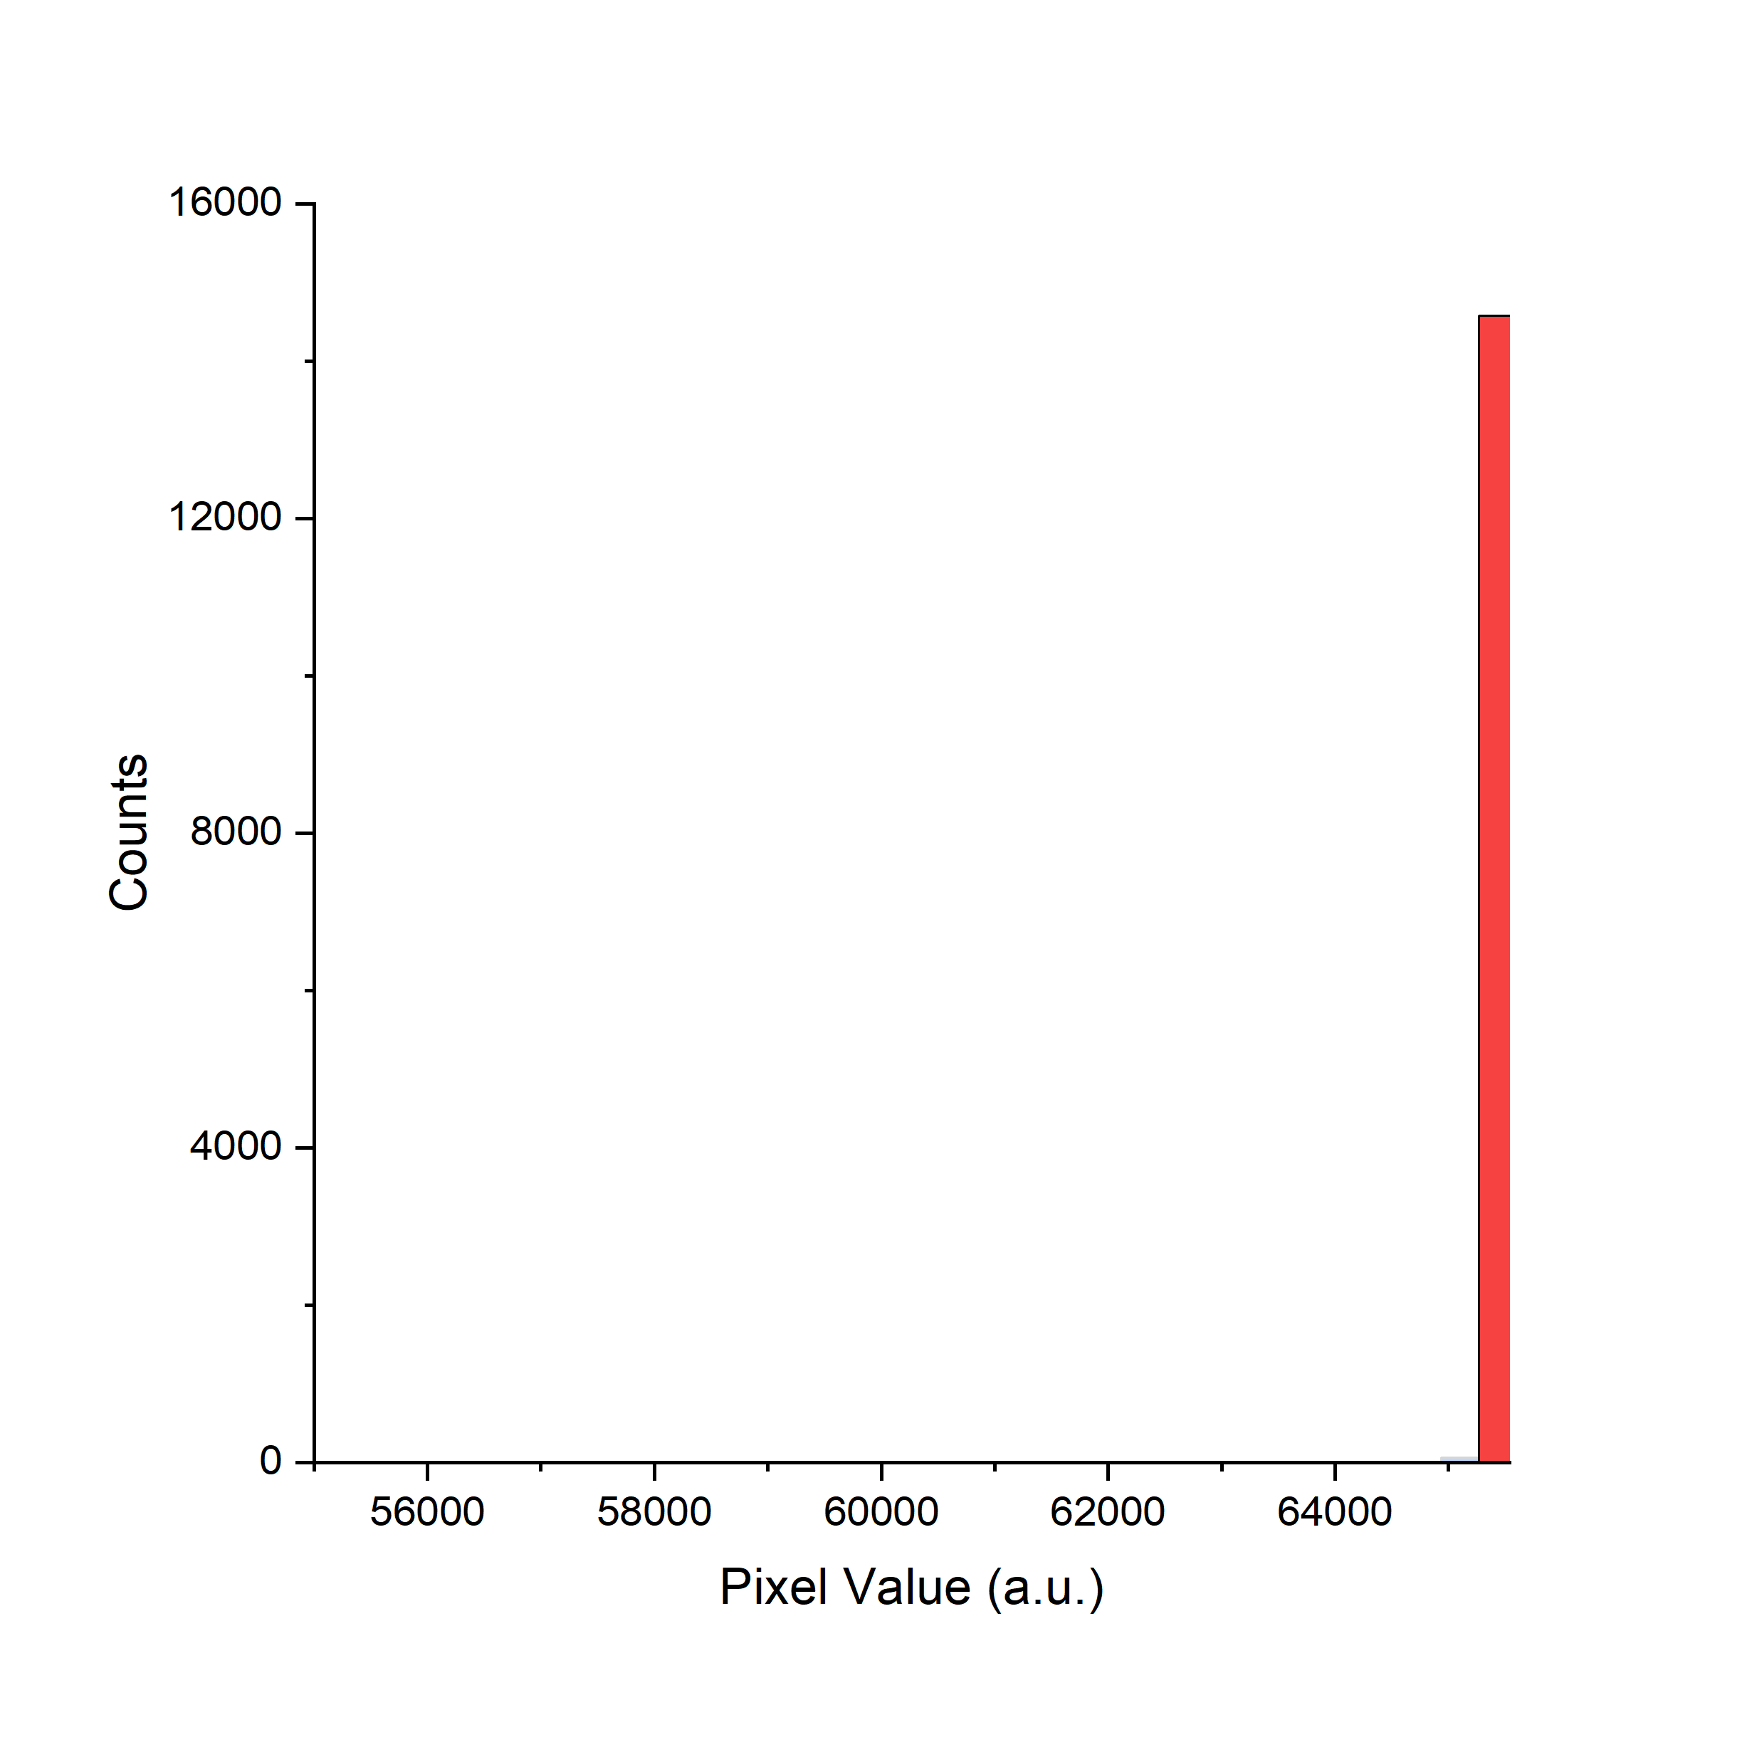
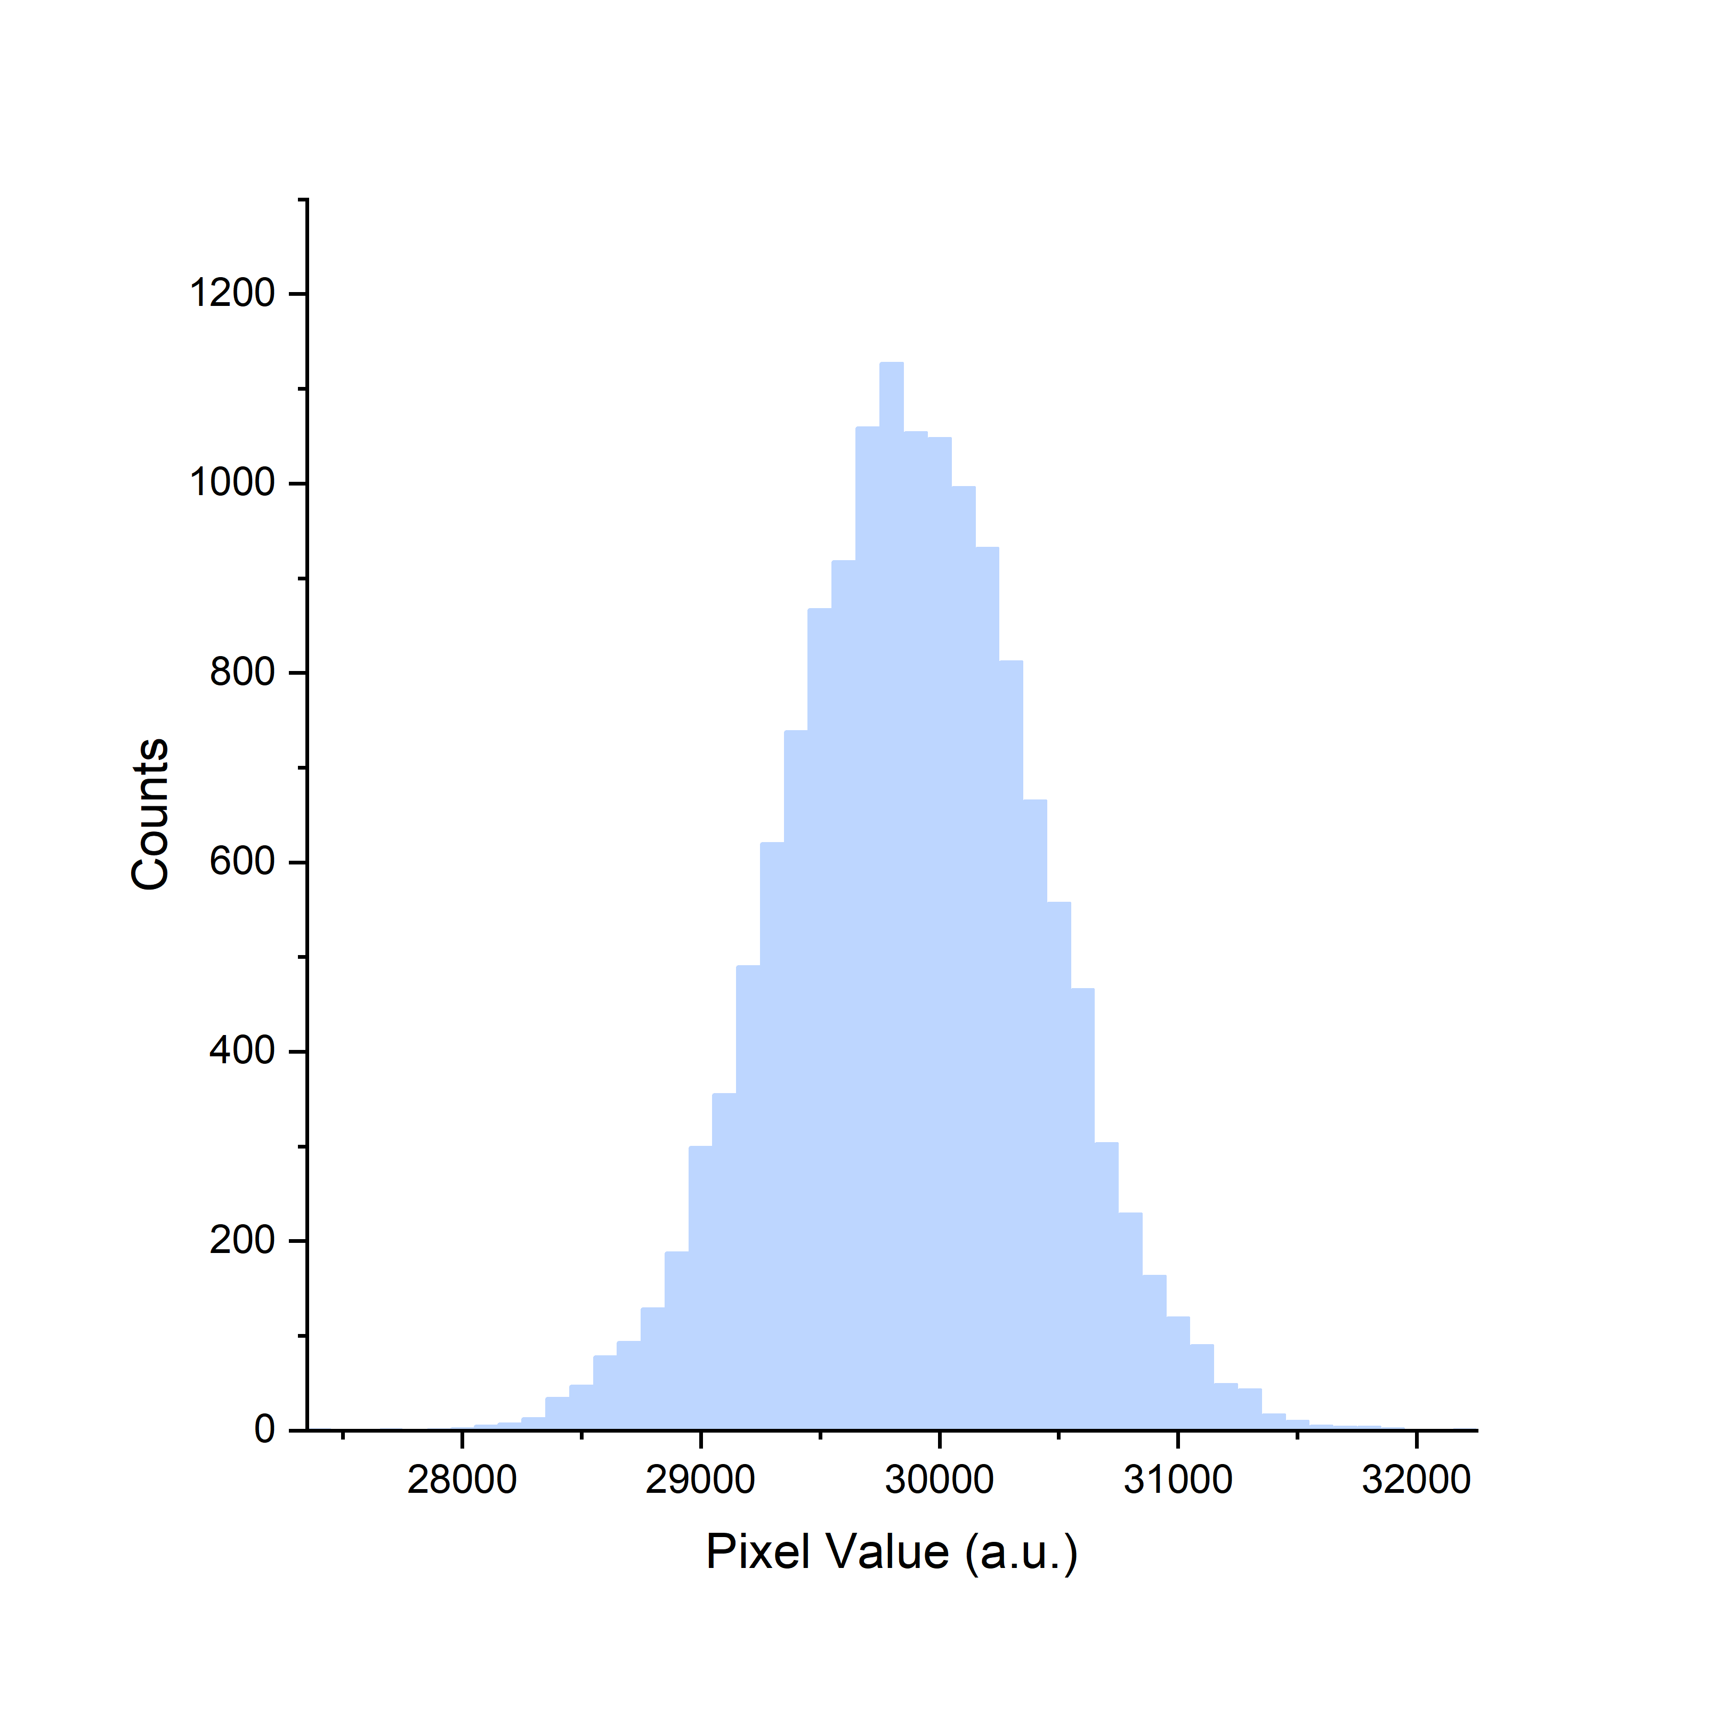
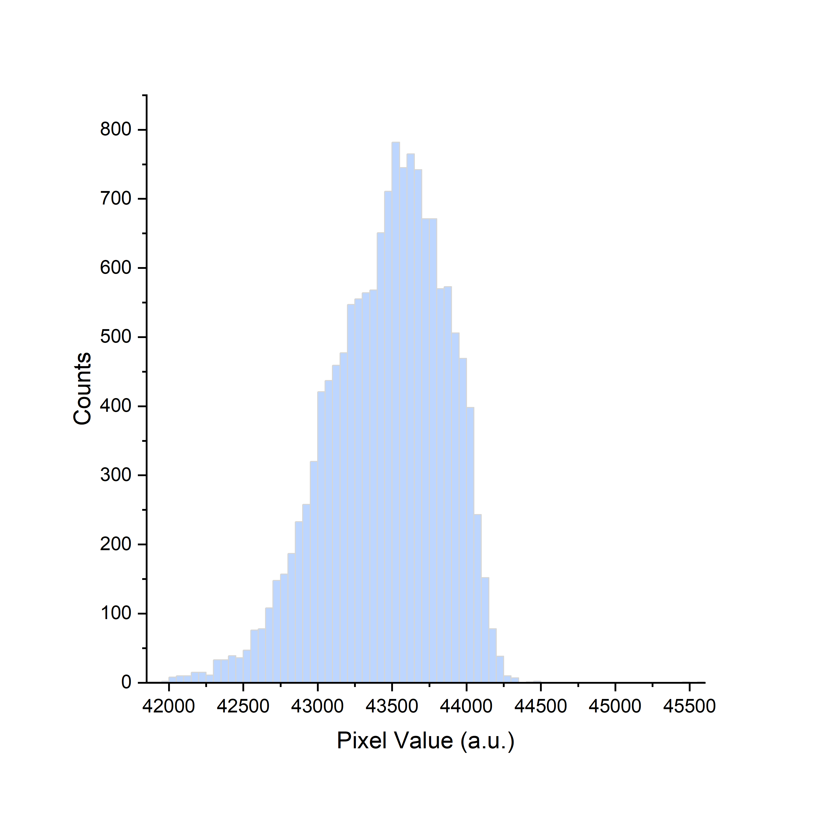
OSL dosimetry: Dose limit

Slide 10
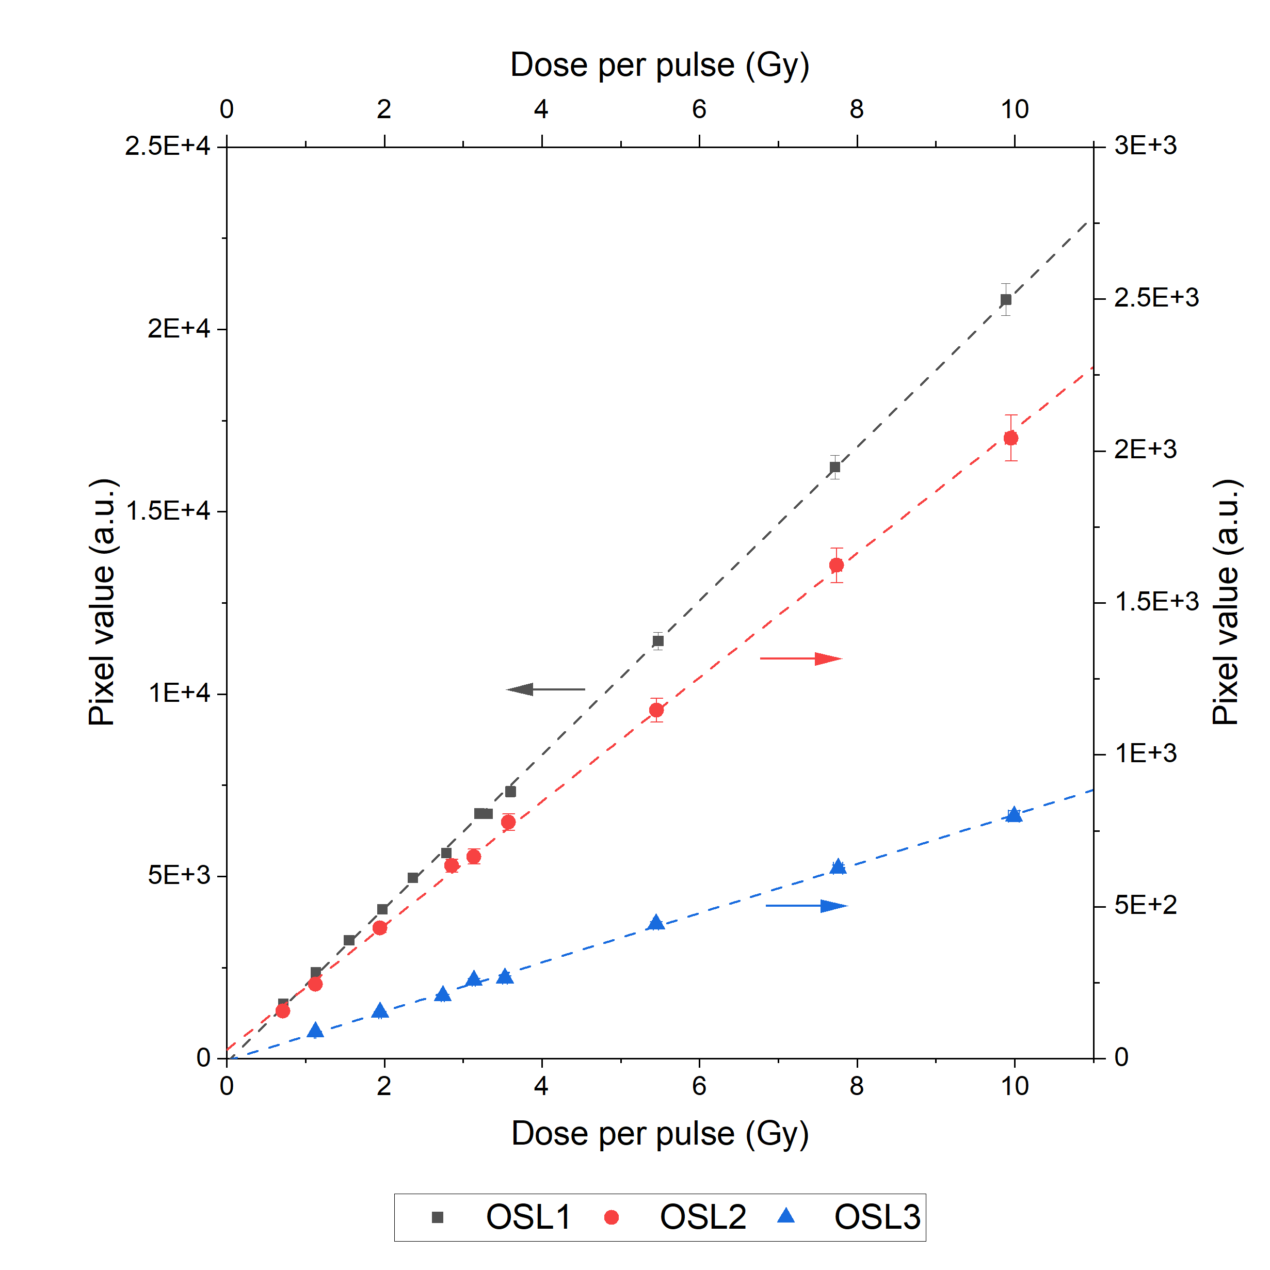
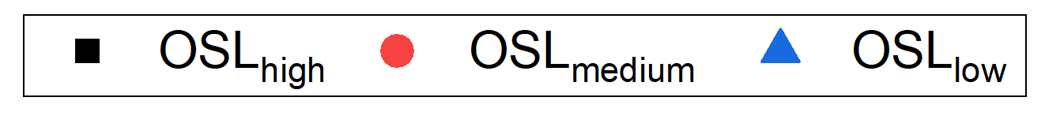
OSL dosimetry: Linearity with DPP
Linear with dose per pulse up to 10 Gy
 | R²
OSL_{high} | 0.9997
OSL_{medium} | 0.9994
OSL_{low} | 0.9988

Slide 11
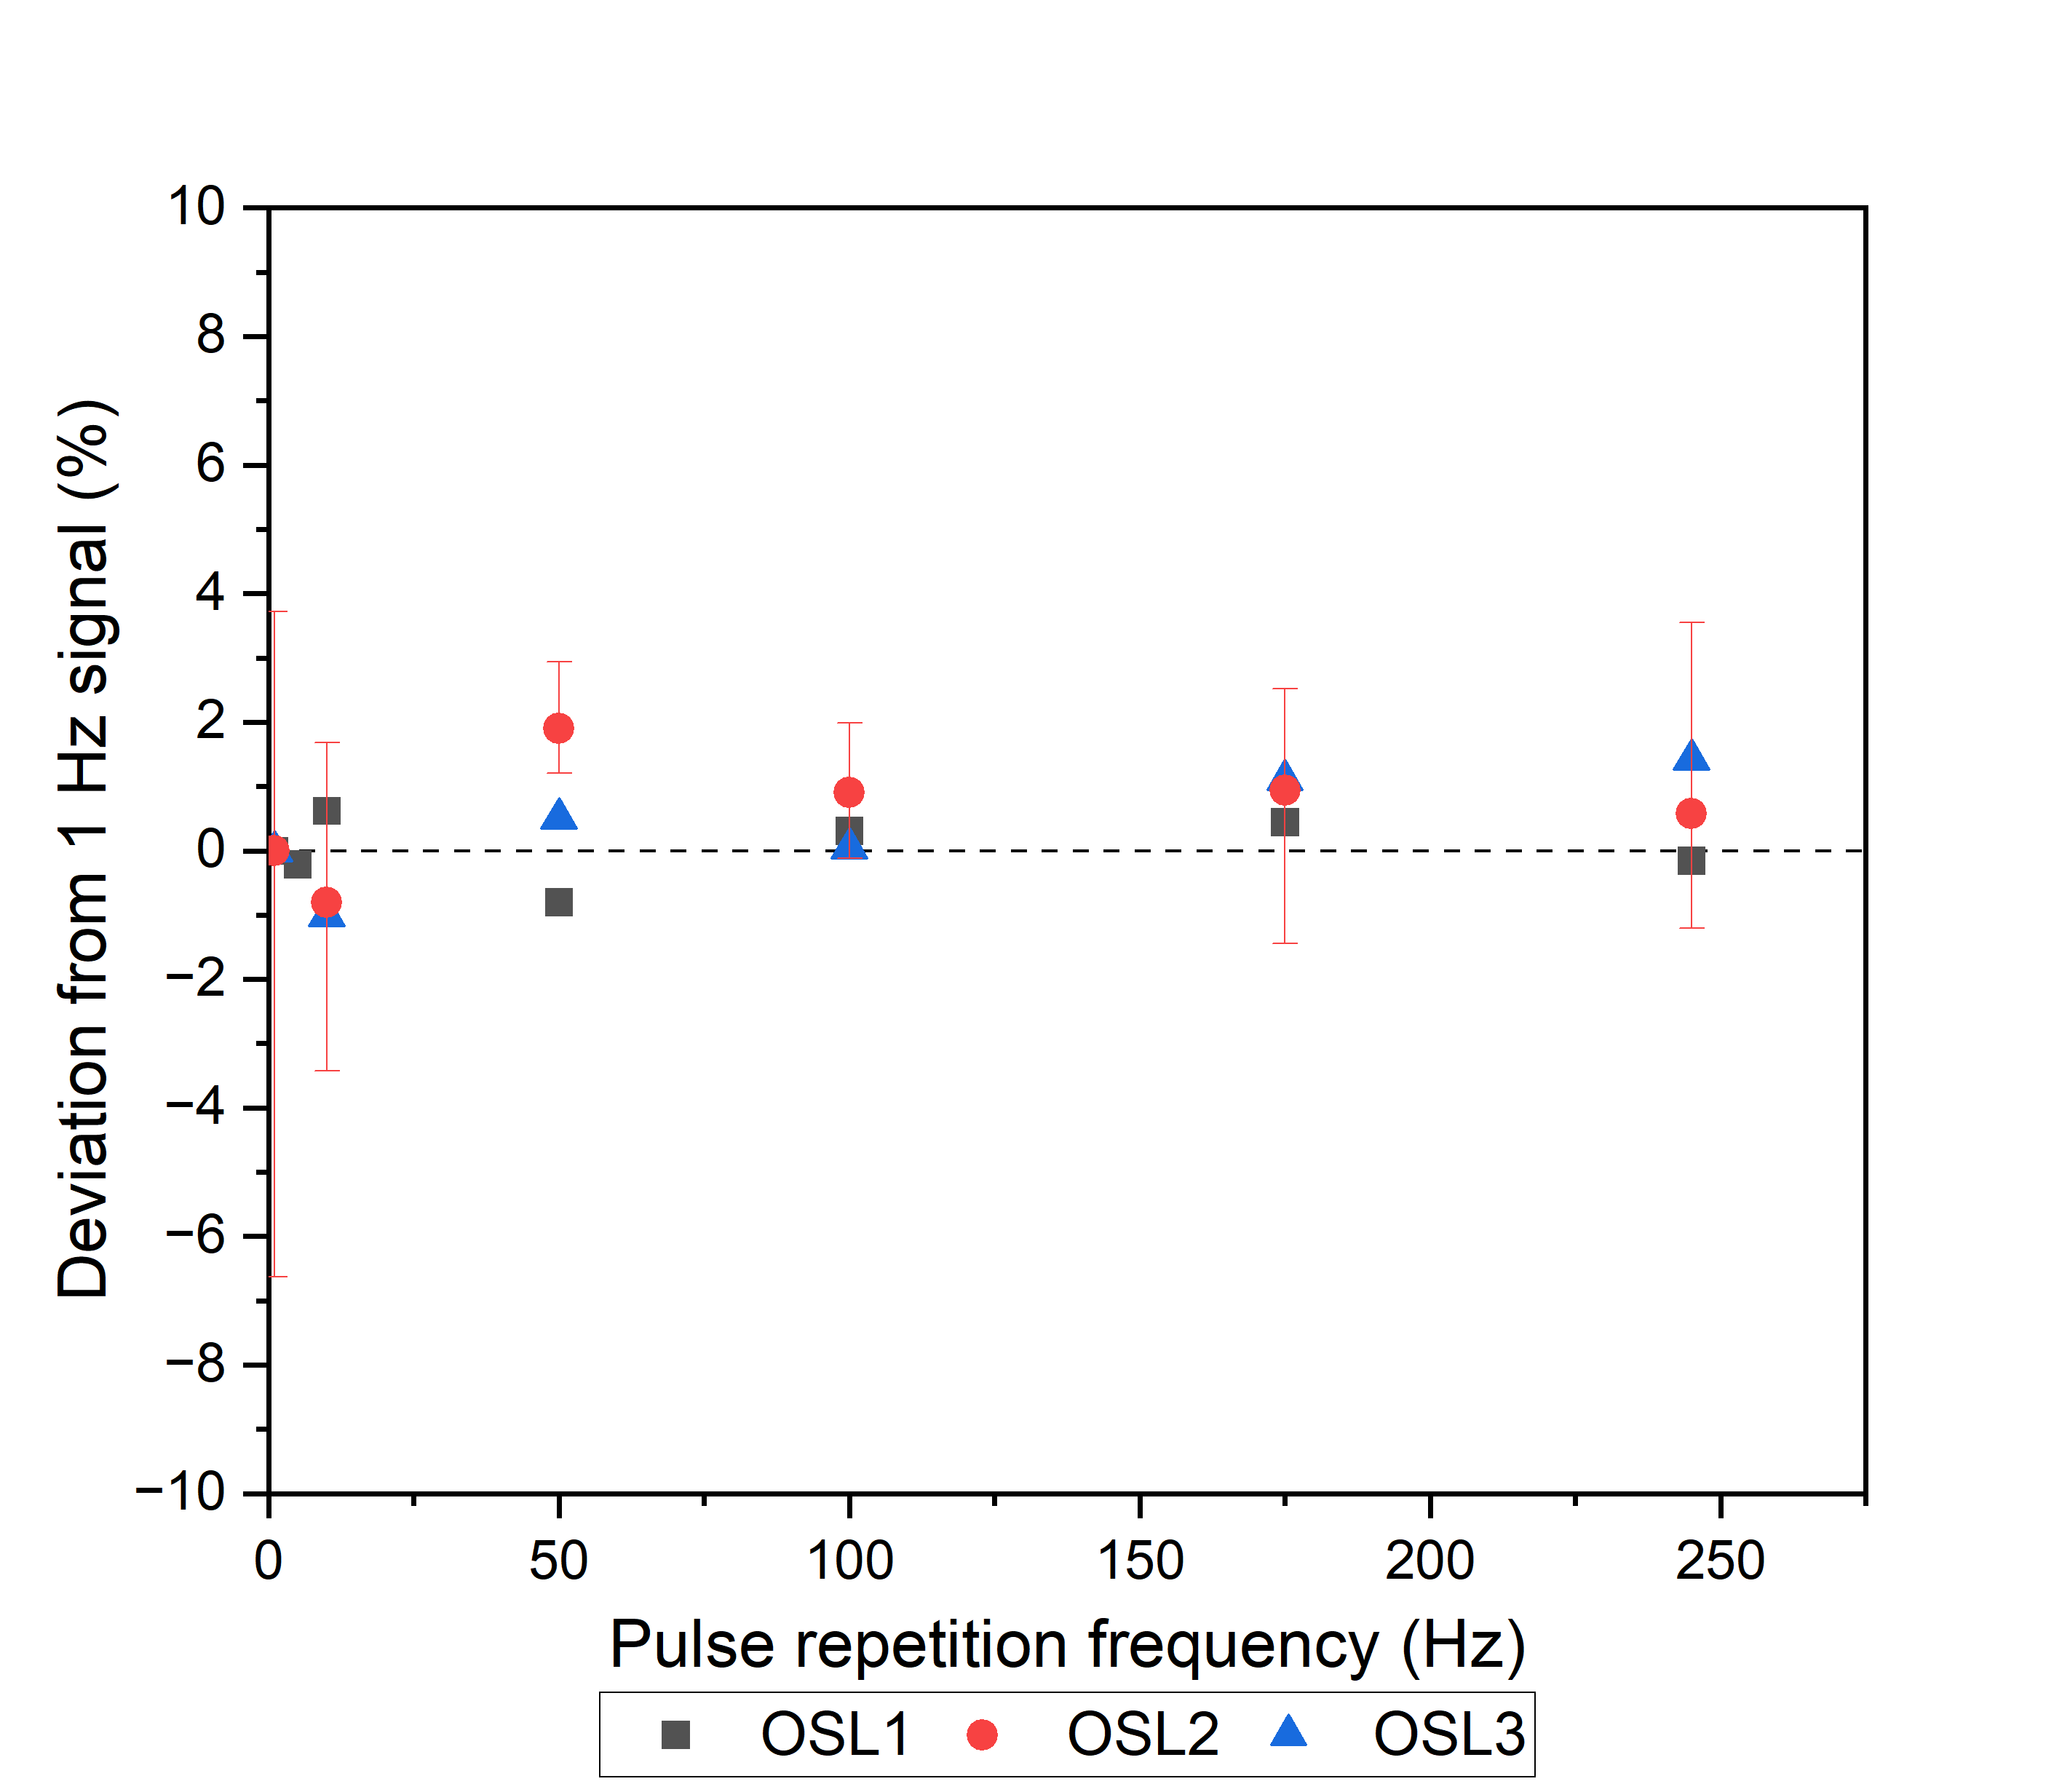
OSL dosimetry: Stability with PRF
Stability with PRF
 | Maximal deviation (%)
OSL_{high} | -0.80
OSL_{medium} | [-6.63, 3.72]
OSL_{low} | 1.42

Slide 12
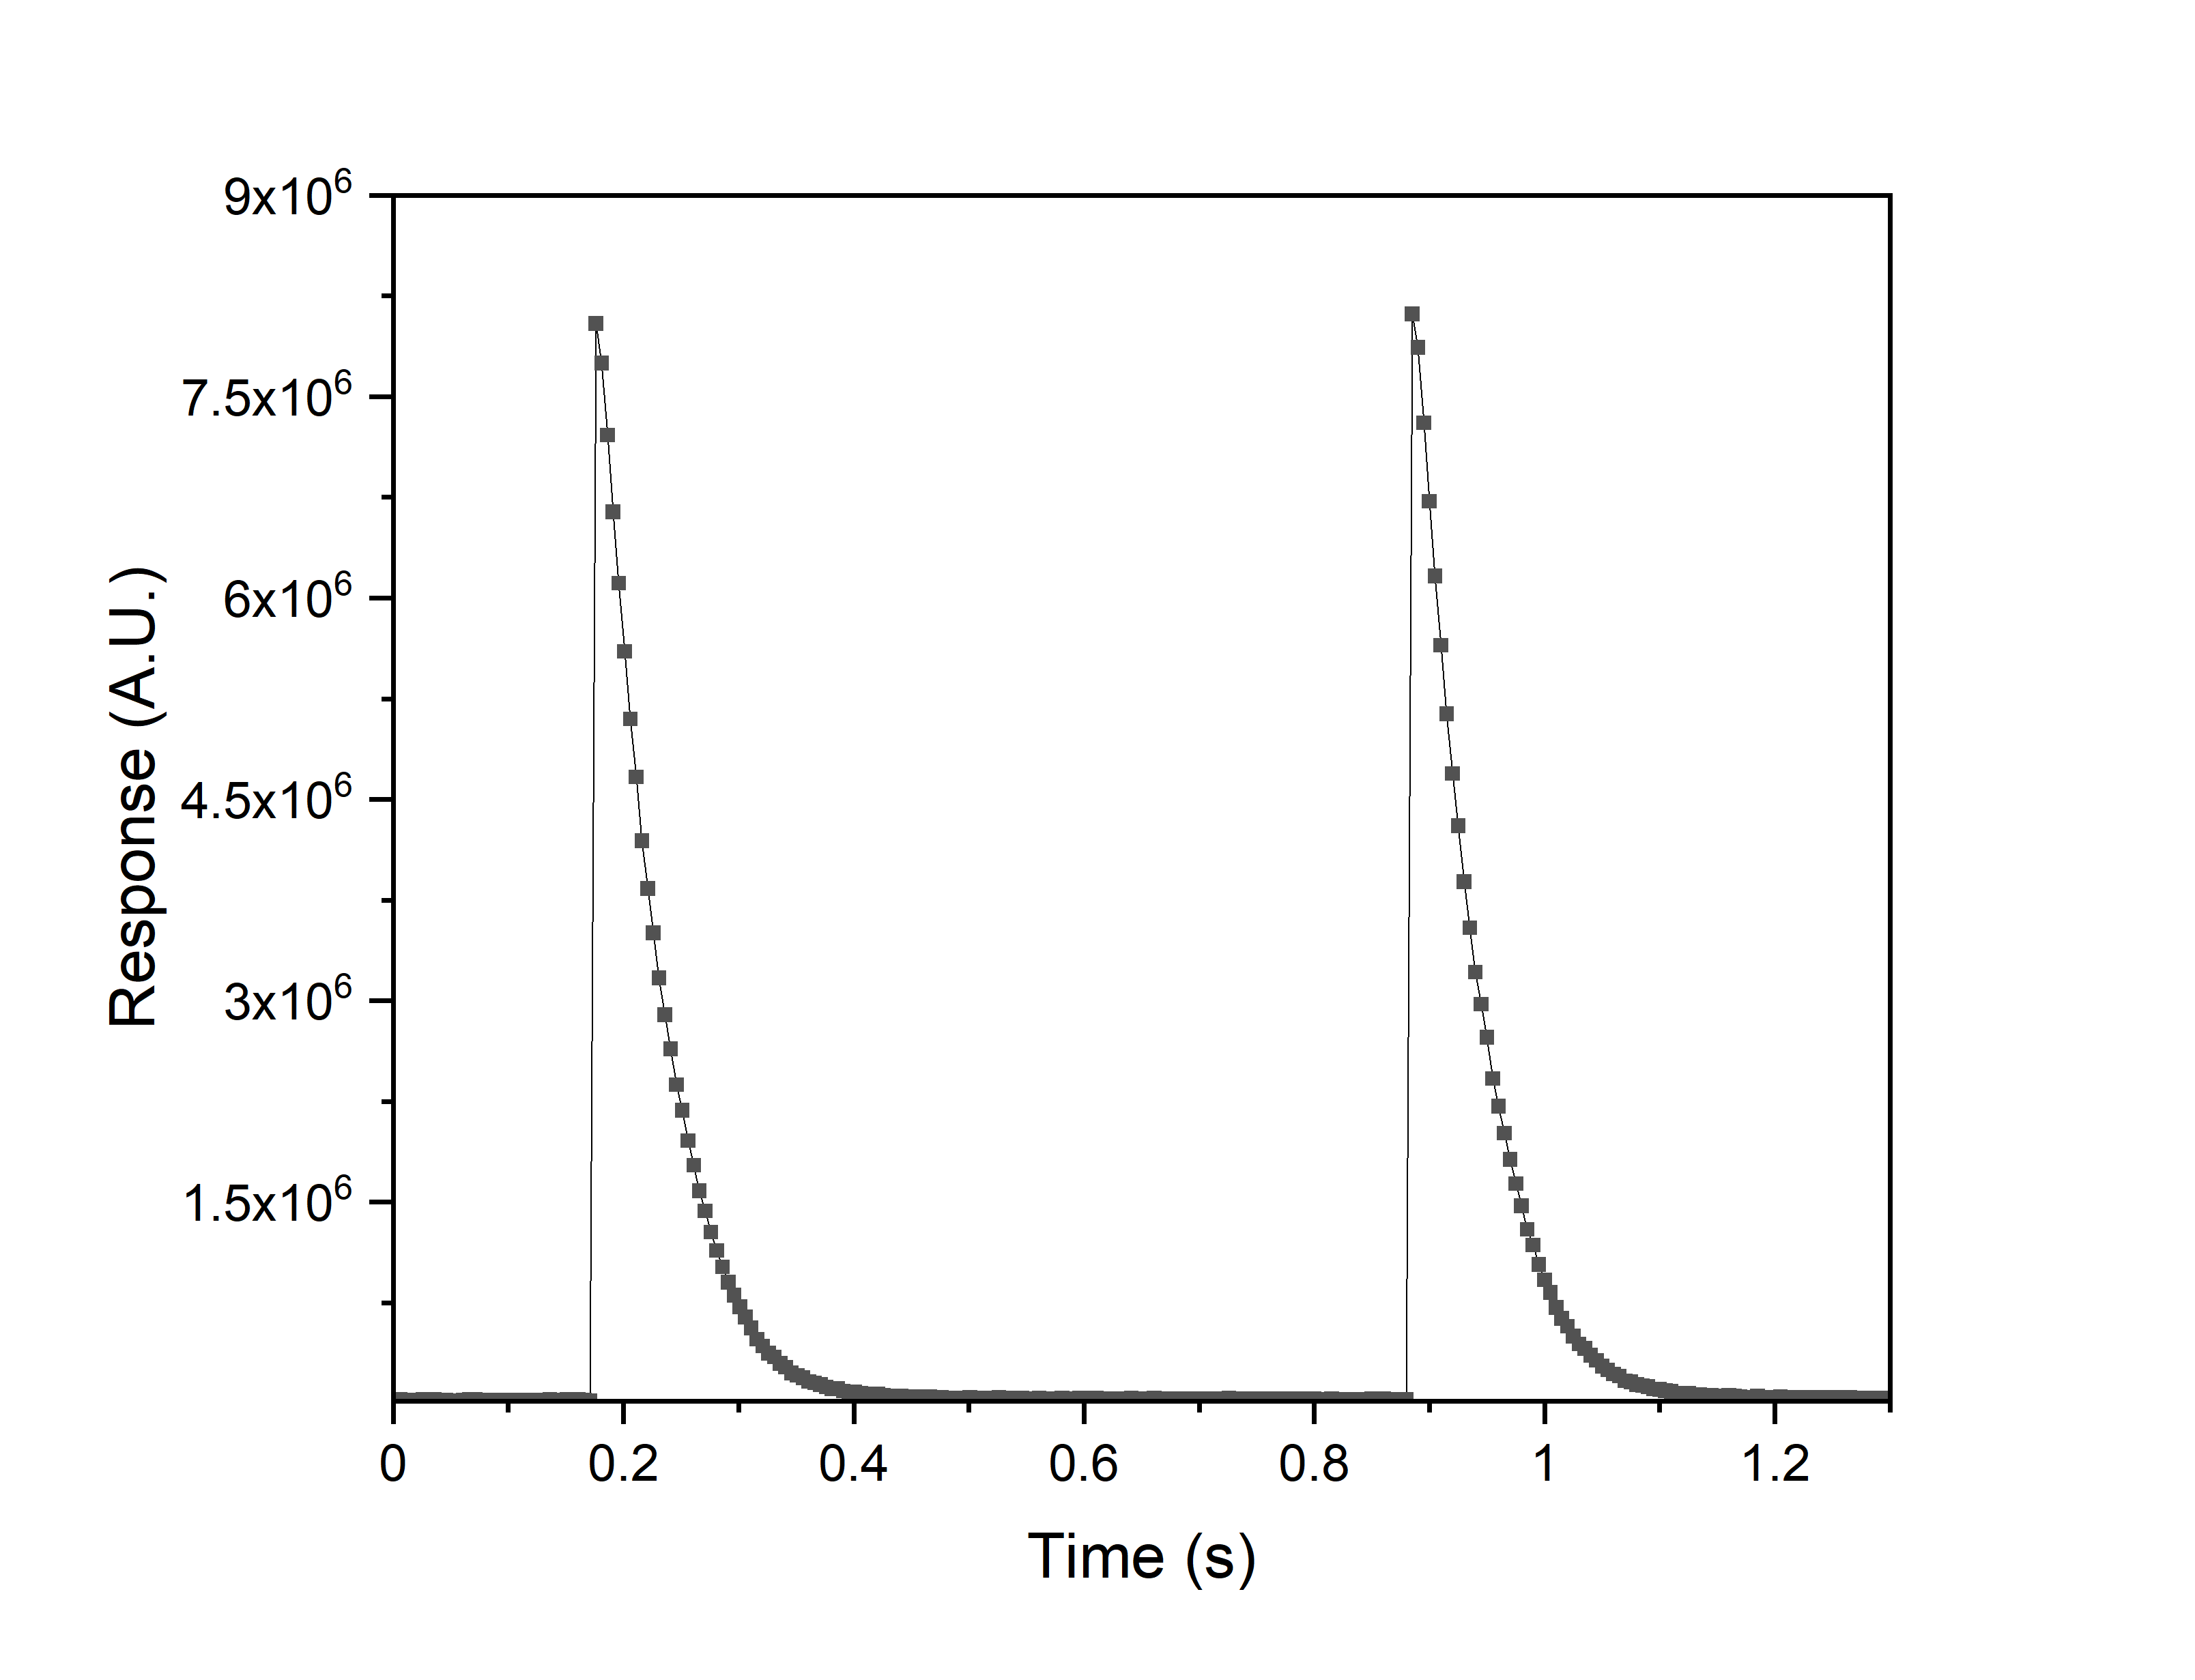
Point scintillator dosimetry
Scintillating head + lightguide
Read-out: PMT
Intensity → Dose rate
Decay time!

Slide 13
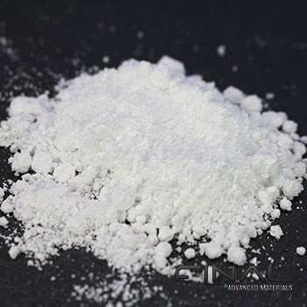
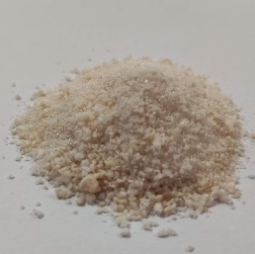
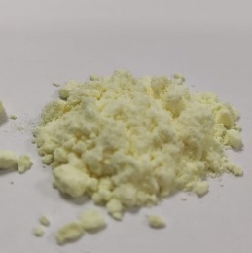
Point scintillator dosimetry
 | AlO | OrgCl | OrgBr
Material | Al₂O₃:C,Mg | (C₃₈H₃₄P₂)MnCl₄ | (C₃₈H₃₄P₂)MnBr₄
Emission wavelength [nm] | 420 | 525 | 525
Decay time [ms] | 35 | 5 | 0.4
Picture

Slide 14
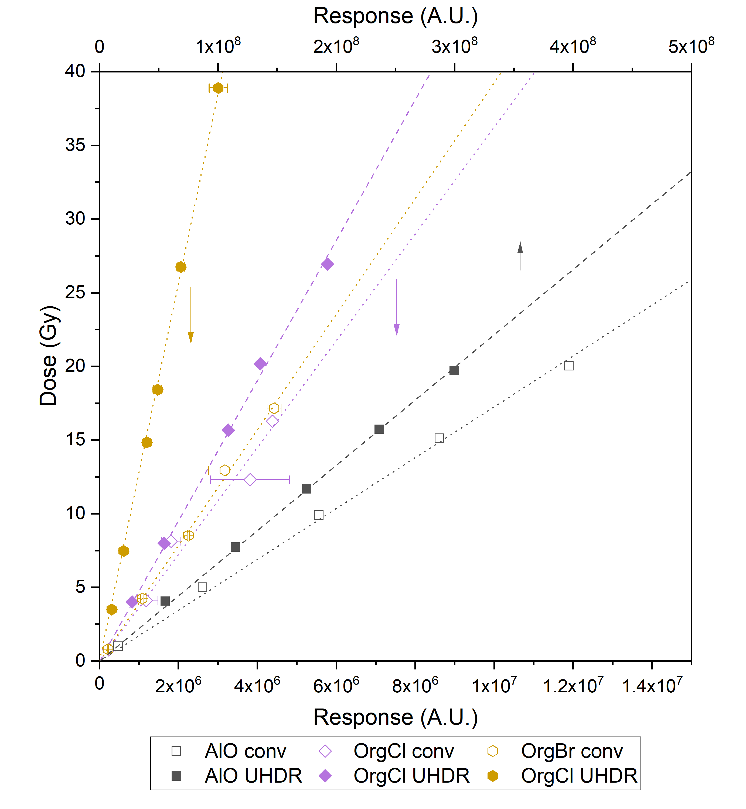
Point scintillators: Calibration
 | Slope (Conventional) | Slope (UHDR)
AlO | 51.80 ◦ 10⁻⁹ | 66.49 ◦ 10⁻⁹
OrgCl | 3.63 ◦ 10⁻⁶ | 4.76 ◦ 10⁻⁶
OrgBr | 3.93 ◦ 10⁻⁶ | 12.84 ◦ 10⁻⁶
Vanreusel et al. Physica Medica; 2022

Slide 15
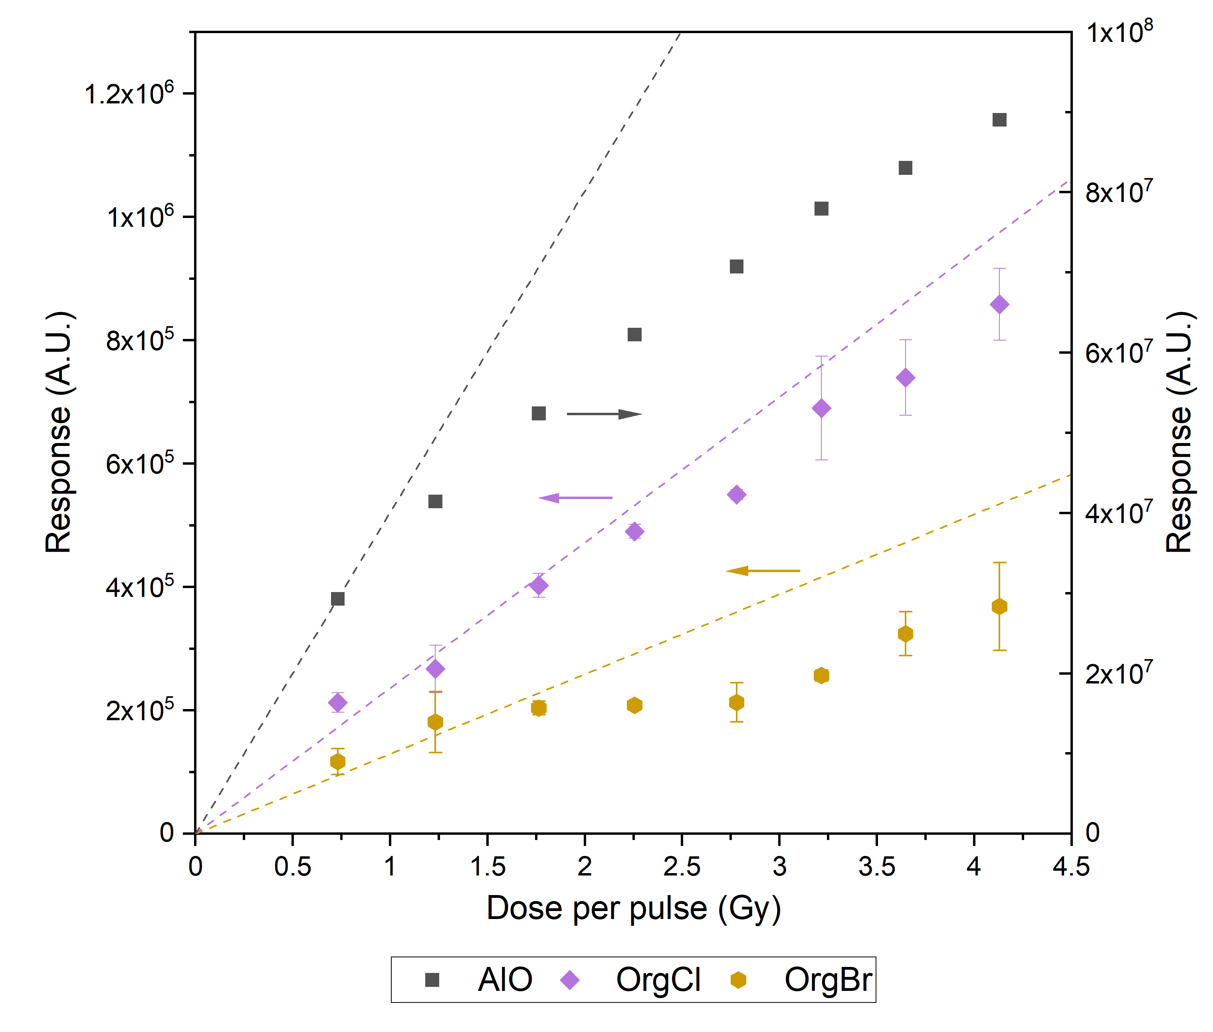
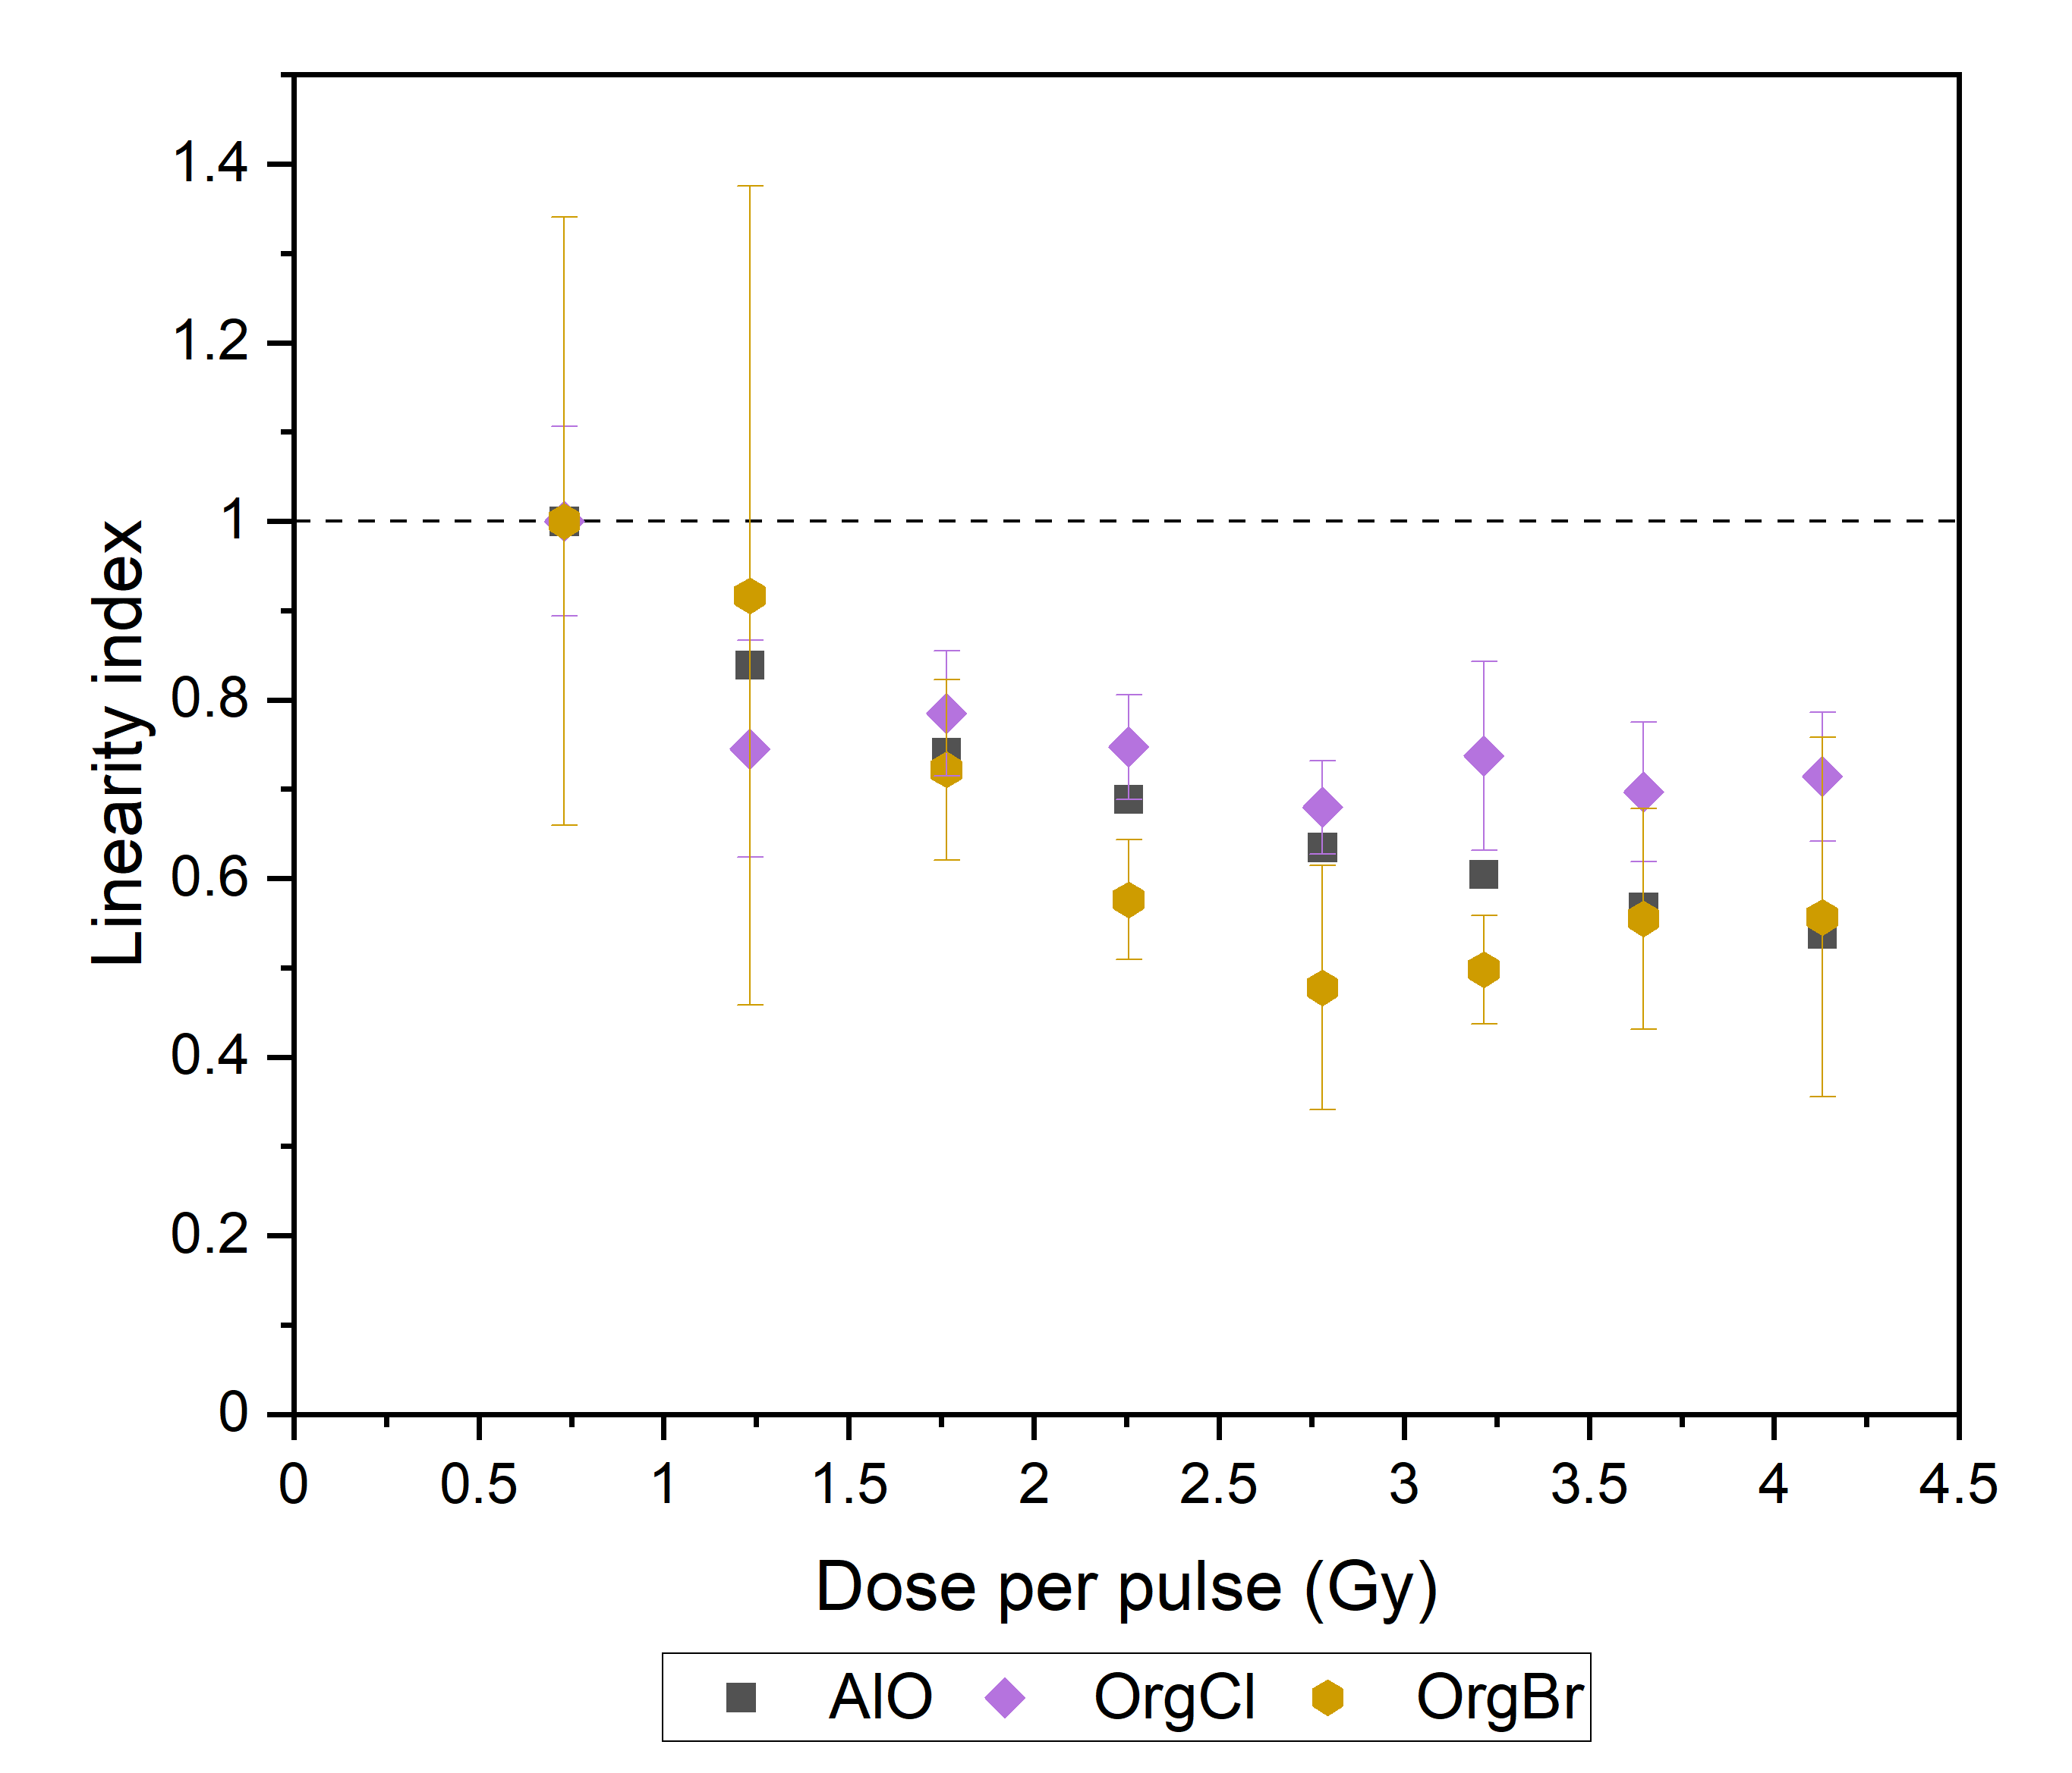
Point scintillators: Linearity with DPP
Vanreusel et al. Physica Medica; 2022

Slide 16
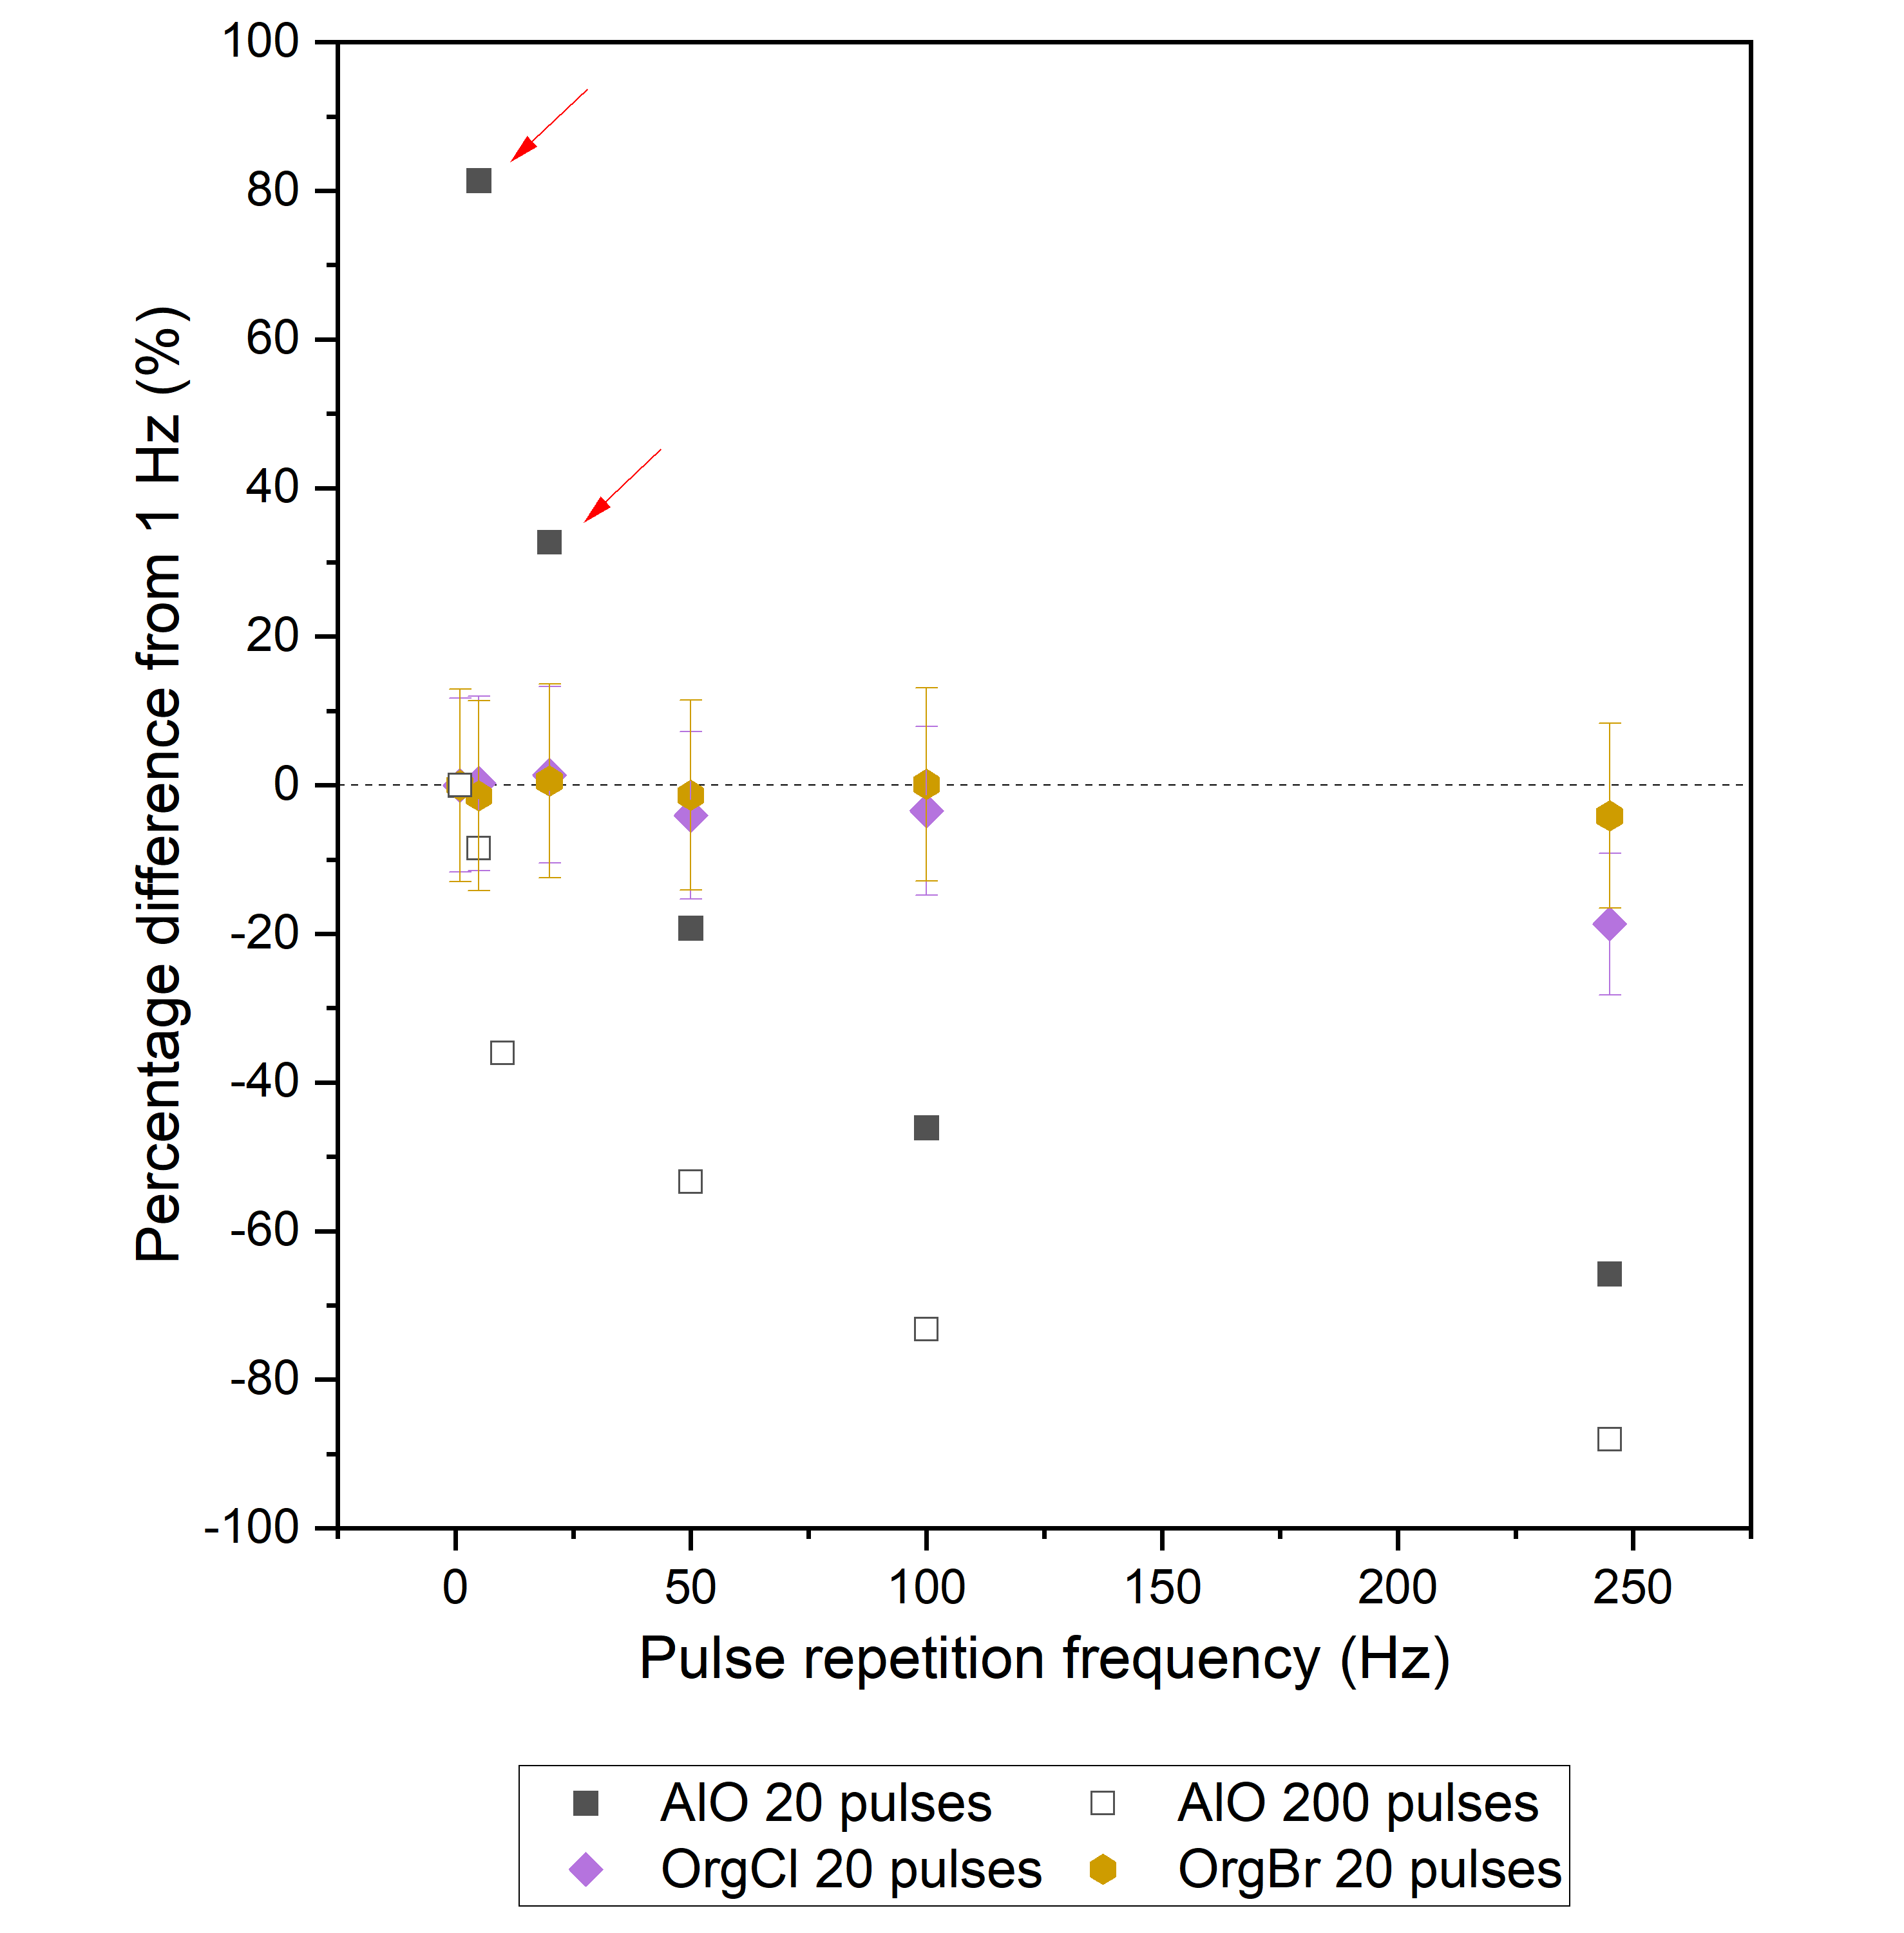
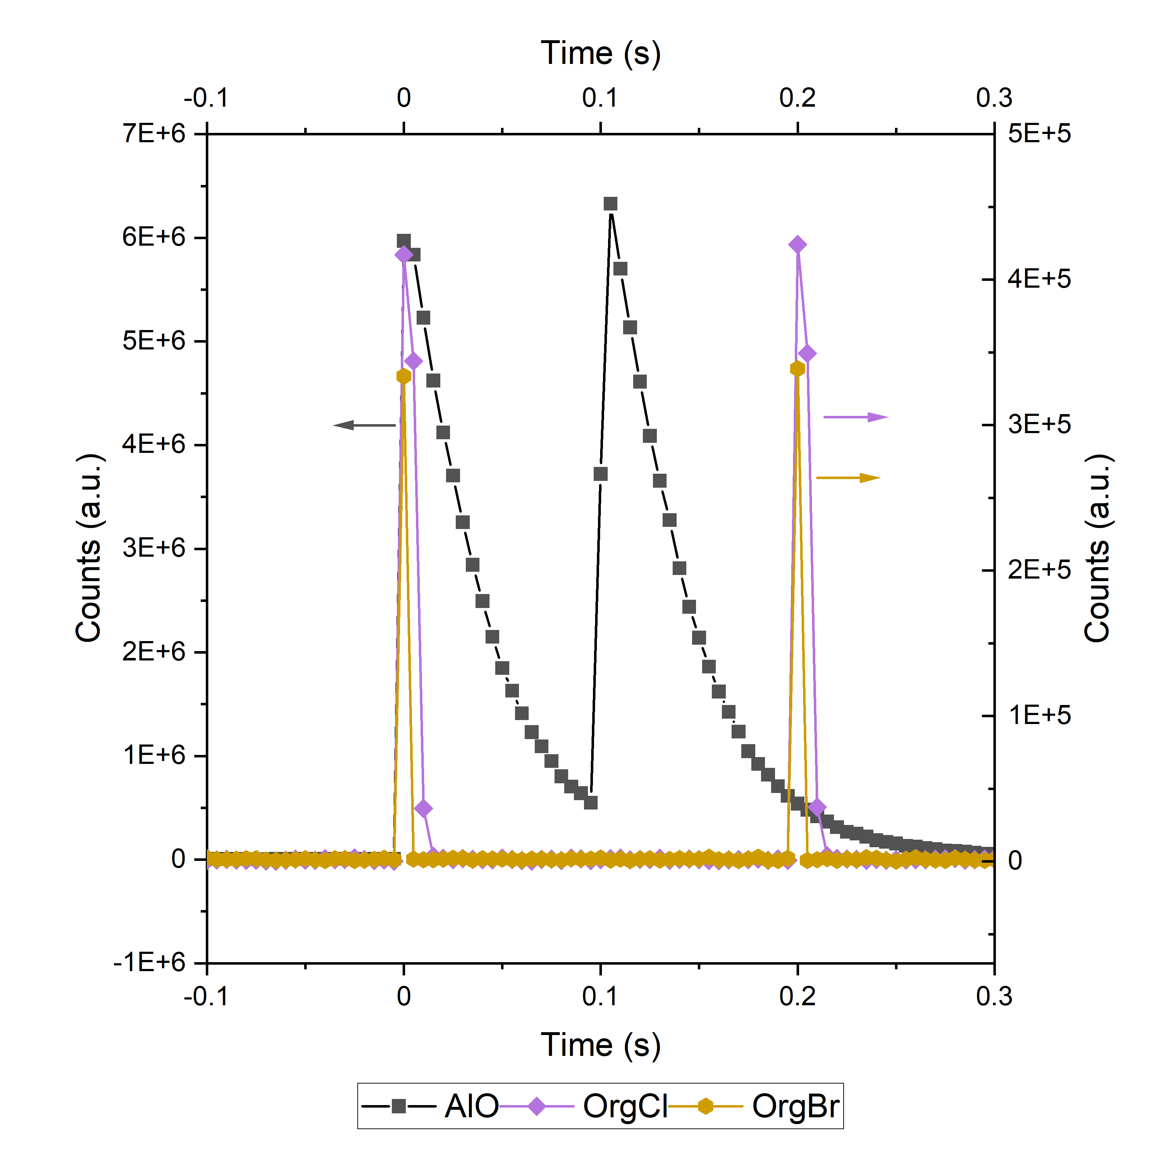
Point scintillators: Stability with PRF
Vanreusel et al. Physica Medica; 2022

Slide 17

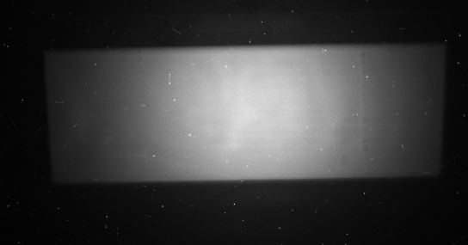
2D scintillator dosimetry
Scintillating sheets
Read-out: camera
Intensity → Dose rate
Decay time!

Slide 18
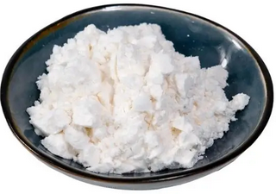
2D scintillator dosimetry
 | AlO | OrgBr | Triazine
Material | Al₂O₃:C,Mg | (C₃₈H₃₄P₂)MnBr₄ | C₃H₃N₃
Emission wavelength [nm] | 420 | 525 | ?
Decay time [ms] | 35 | 0.4 | ?
Picture

Slide 19
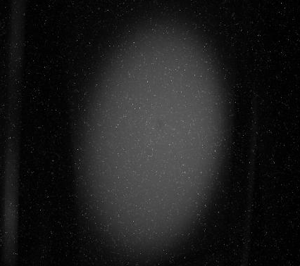
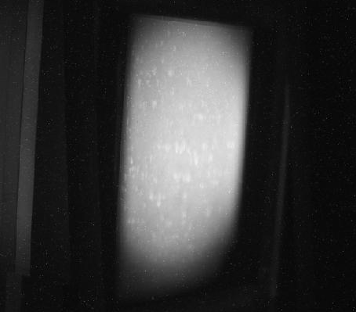
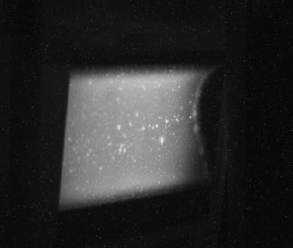
2D scintillator dosimetry
 | AlO | OrgBr | Triazine
Sensitivity (visual)
Gain | 2800 | 100 | 1000
Mean grey value | 6700 | 25000 | 18000
Relative yield | 1 | 104.5 | 7.5
Homogeneity | 6.5% | 5.4% | 5.9%

Slide 20
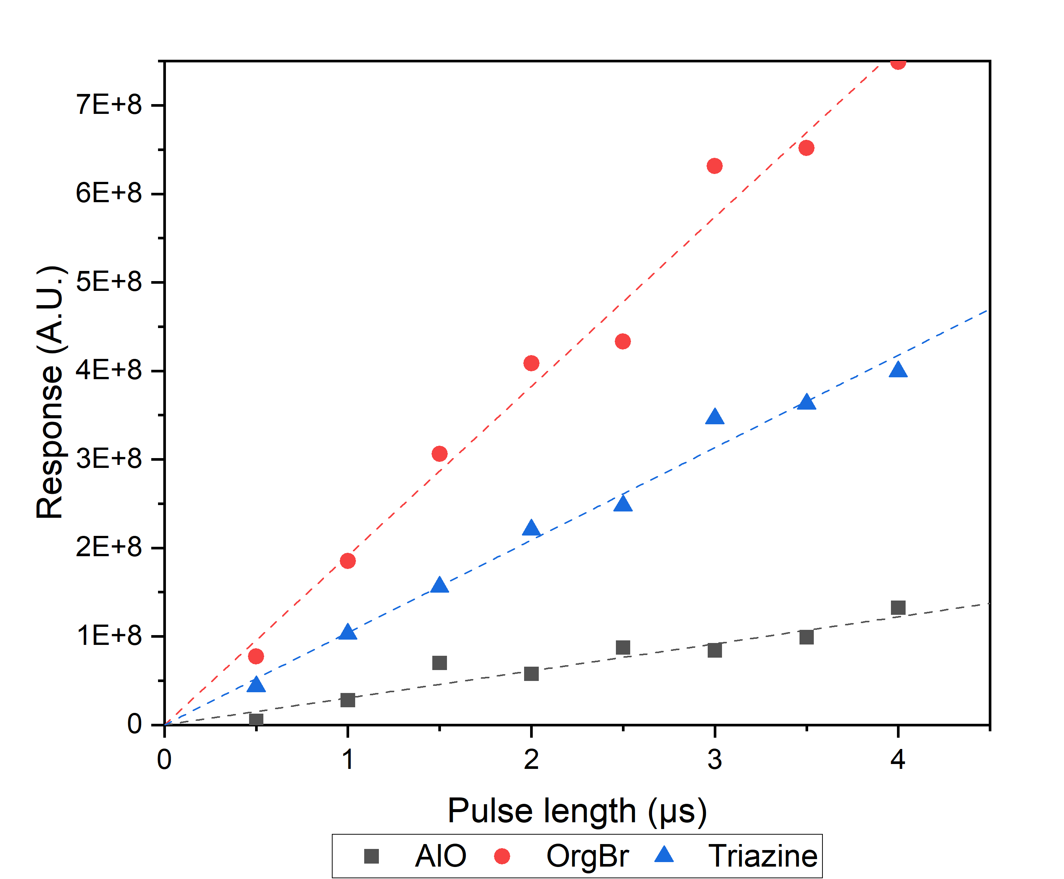
2D scintillators: Linearity with DPP
 | R²
AlO | 0.89
OrgBr | 0.98
Triazine | 0.98

Slide 21
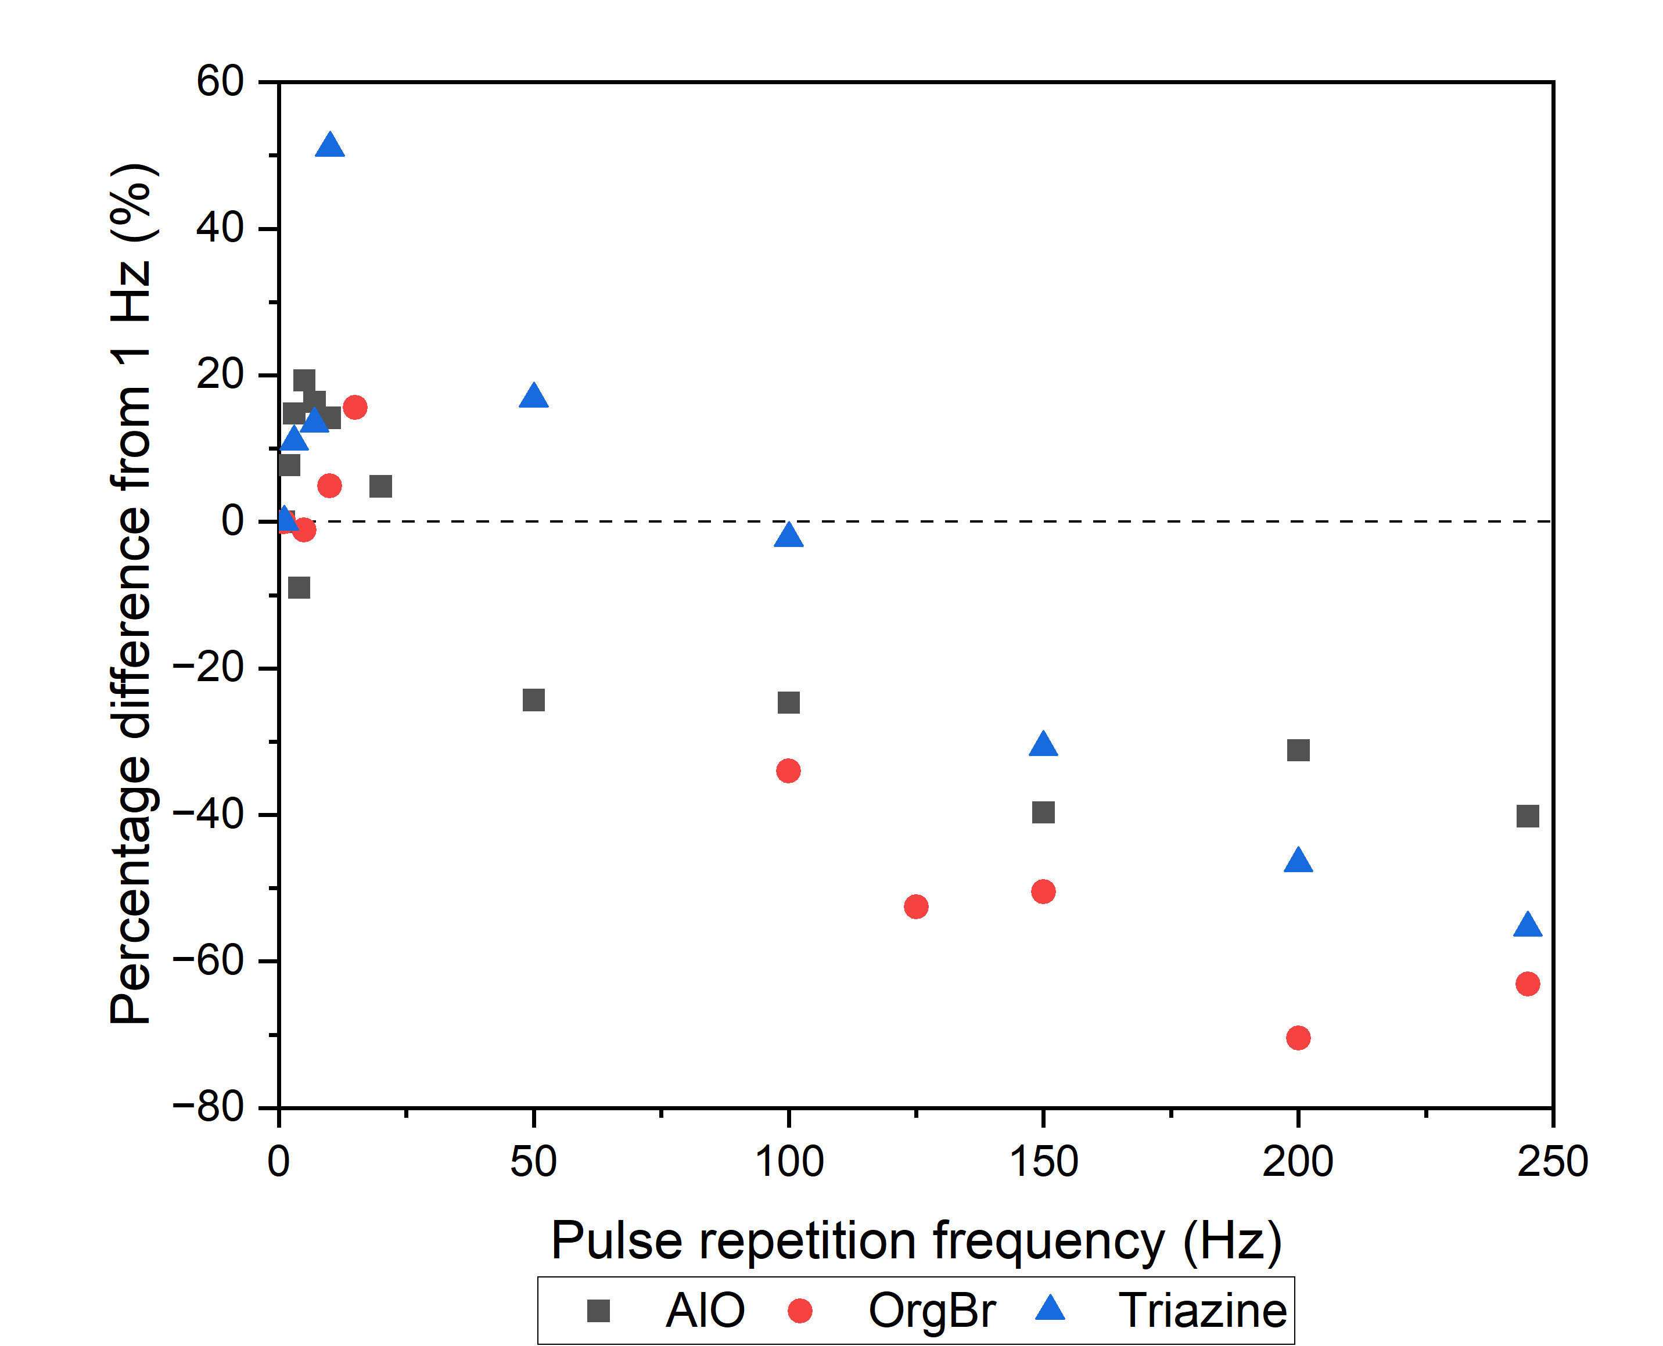
2D scintillators: Stability with PRF
Initial increase
Thereafter strong decrease
Not expected to be due to decay time
Further investigation needed!

Slide 22
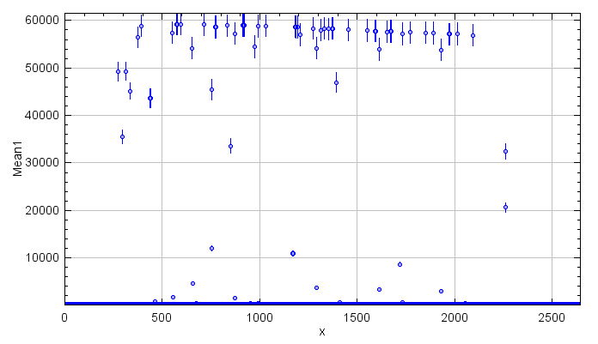
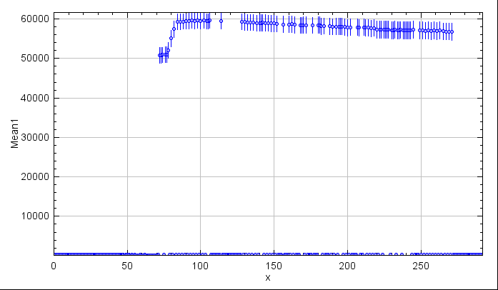
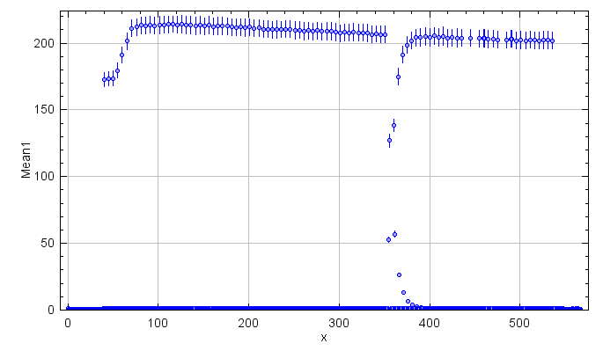
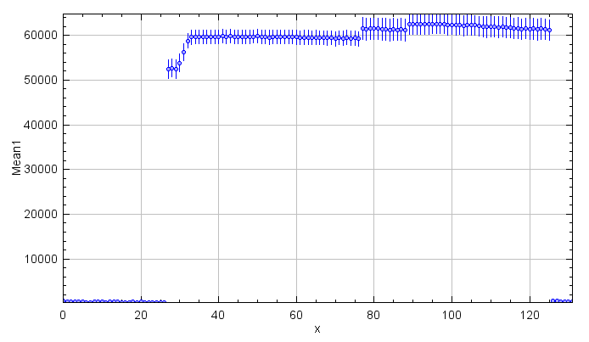
2D scintillators: Dead time camera
# pulses: 100
PRF: 10 Hz
PL: 4 µs
50 ms
5 ms
20 ms
100 ms

Slide 23
Conclusion
Parameters | OSL | Point scintillators | 2D scintillators
Calibration | OSL_{high}: conv = UHDR | UHDR > Conv = saturation! | Dead time camera More investigation needed
Linearity with dose | Good Limited by digitization process | Good No upper limit detected | More investigation needed
Linearity with dose per pulse | Good up to 10 Gy/pulse | Further investigation needed (IT) | Good for all materials
Stability with PRF | Good stability with PRF | Good for materials with short decay time | More investigation needed

Slide 24
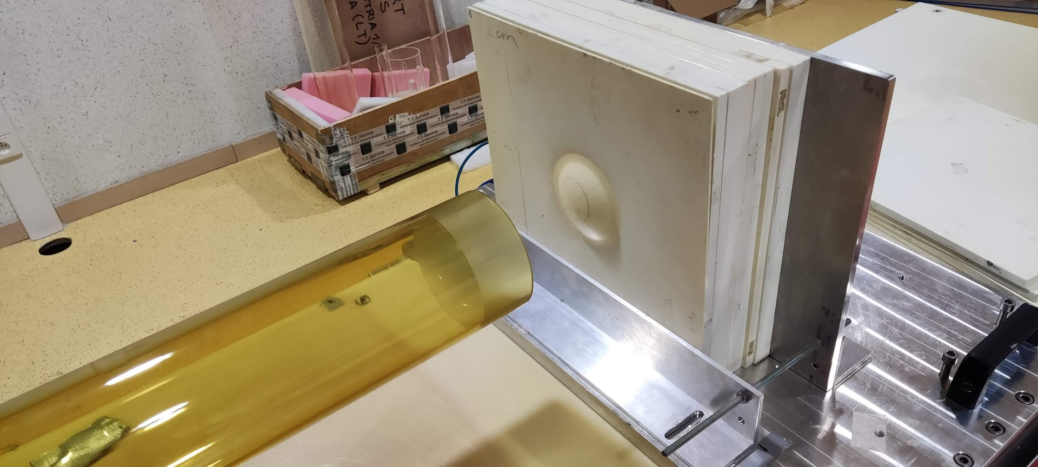
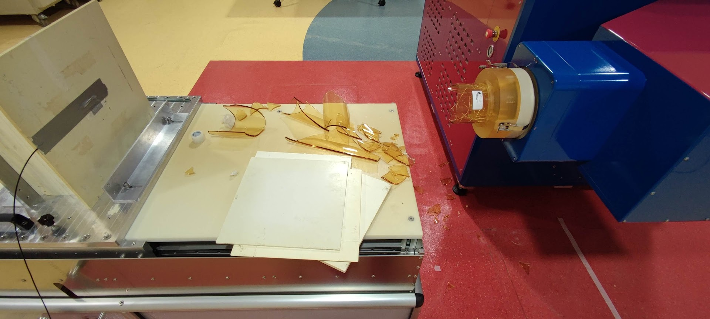
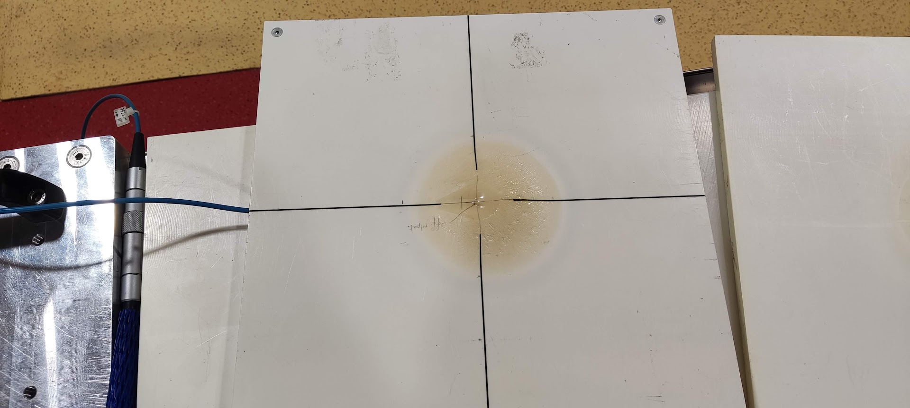
Dangers of UHDR dosimetry

Slide 25
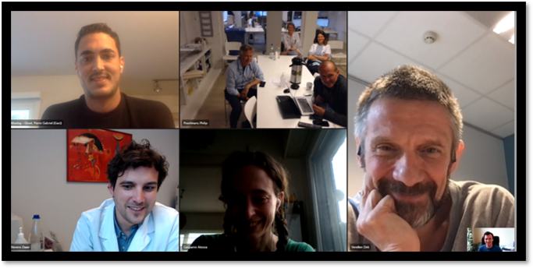
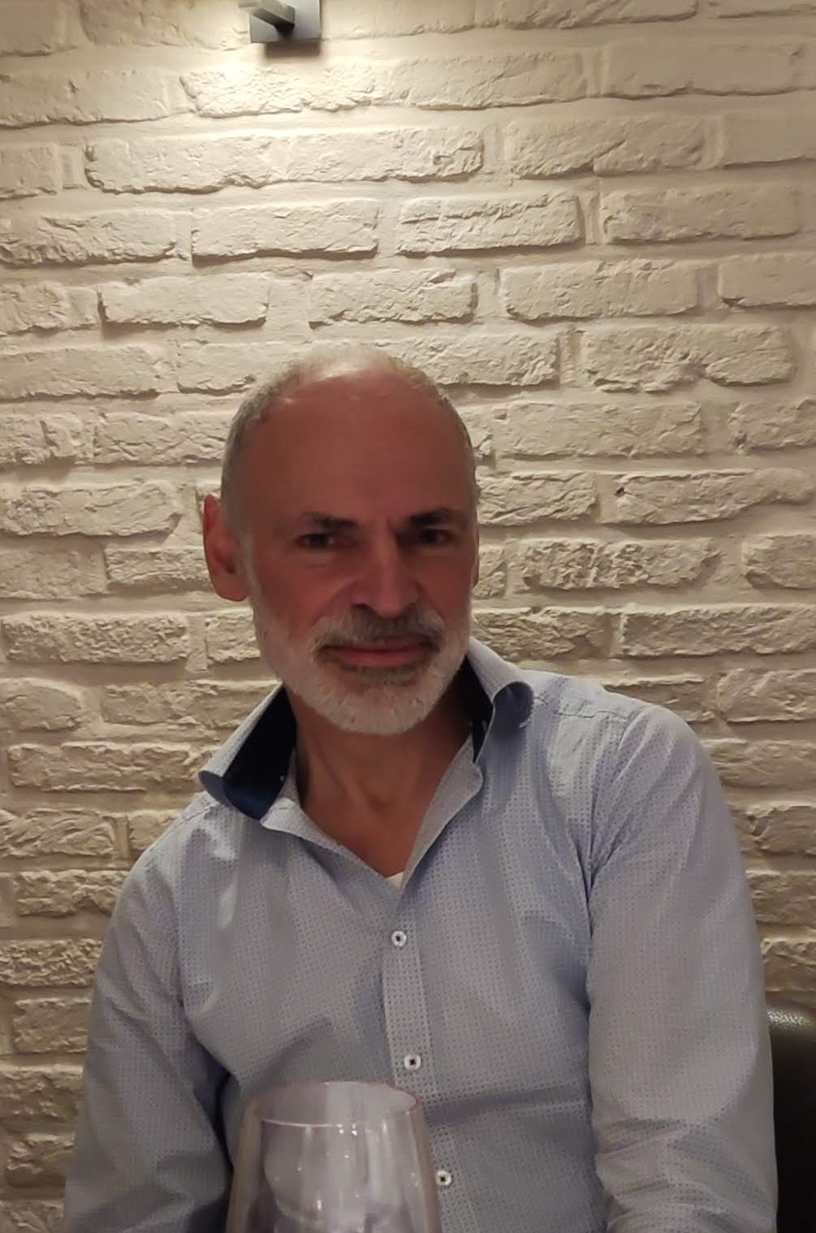
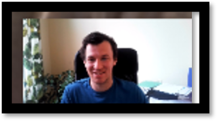
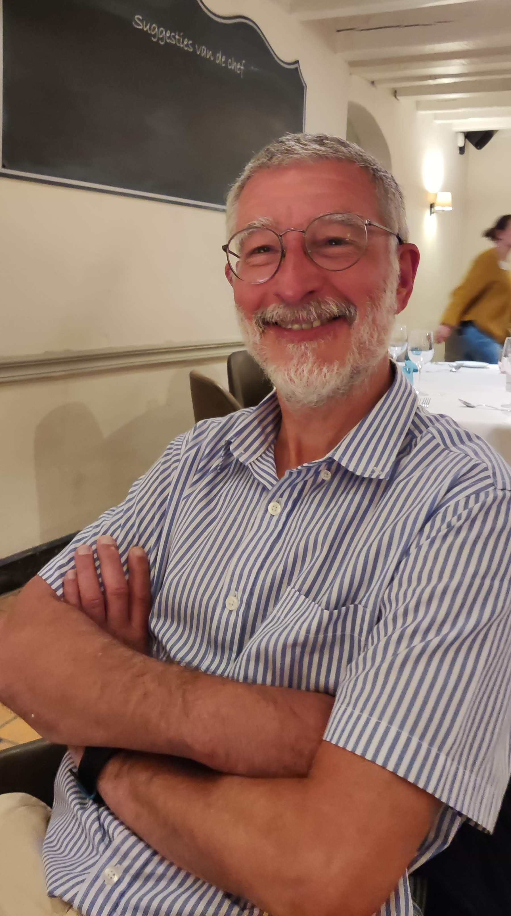
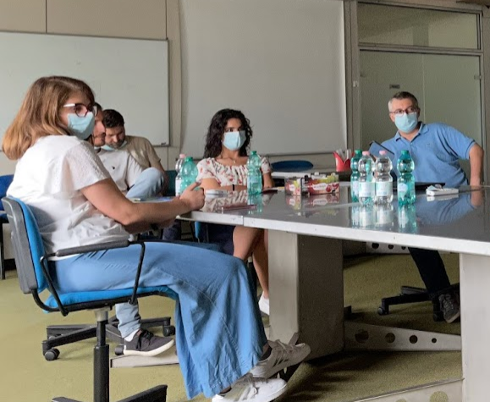



Made possible by the FLASH team:
The EL(F)ves (University of Antwerp)
Corporate Innovation Office (AGFA)
The (baby)SITters (S.I.T.)
The RDA-team (SCK CEN)

