Slide 1

Ionisation Chamber Dosimetry in Ultra-Short Pulsed High Dose-Rate Very High Energy Electron (VHEE) Beams
Anna Subiel, PhD
Medical Radiation Science, National Physical Laboratory, Hampton Road, Teddington, Middlesex, TW11 0LW, UK
UHDpulse 2nd Stakeholder Meeting, 26-27 January 2023

Slide 2
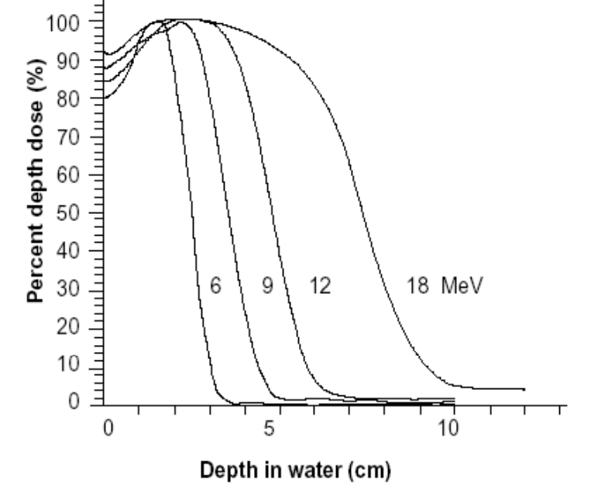
FLASH RT
Most of the studies performed using electron beams accelerated by modified clinical LINAC or dedicated electron accelerators (E < 20 MeV)
DRAWBACKS
Limitations of clinical electrons
High relative surface dose
Shallow penetration/short range
Range straggling (no Bragg peak)
High penumbra
Bulging effect
Spread of beam in air (why we have cones)
BEAM ENERGY
Radiation Oncology Physics, IAEA 2005
Limitations of electron beams due to energy – what happens if the electron energy is increased??

Slide 3
What happens if the electron energy is increased (100+ MeV)?
Increases depth of penetration
No range straggling if beam penetrates through patient
Ability to control position electromagnetically
  Scanning beams more easily done than heavy particles
  Speed of electromagnetic scanning allows for ~ 100X more beams delivered in the same time as photons
Lower beam spread and reduced bulging effect
While maintaining some low energy characteristics
Can produce pencil beams
Less costly than heavy particles
High surface dose

Slide 4
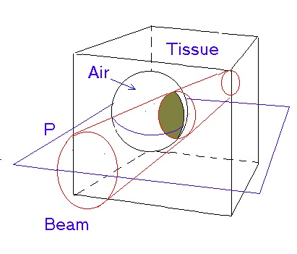
Advantages of VHEE RT
VHEE unlike X-ray photons maintain electronic equilibrium in tissues with varying densities
VHEE
conventional
RT photons
Perturbation of dose, - consequence - under or over dosage of tissue
Credit: C. DesRosiers
DesRosiers et al., Proceedings of the SPIE, Vol. 6881, (2008)

Slide 5
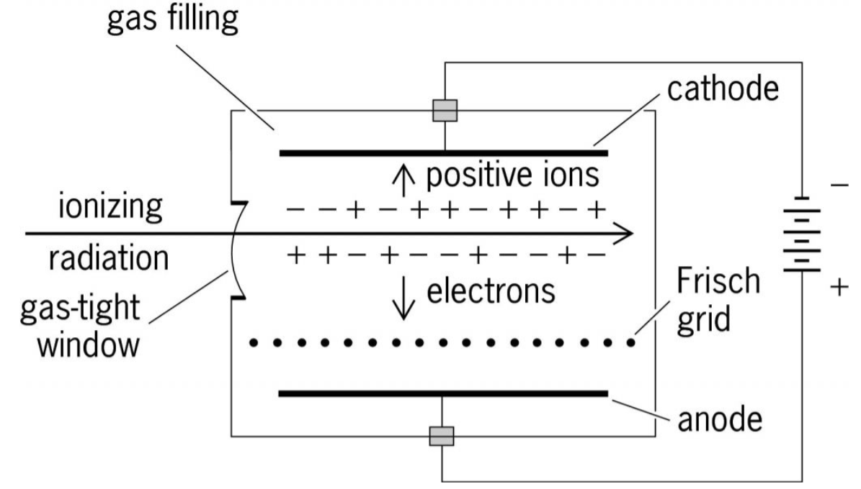
Ionization chamber
general recomb.
+
-
+
+
-
+
-
+
-
+
-
+
-
+
-
+
-
+
-
+
-
+
-
+
-
+
-
+
-
+
-
+
-
+
-
+
-
-
+
-
initial recomb.
Initial Recombination
Recombination along a single charged particle track.
Independent of dose and dose-rate.
More pronounced in highly ionising particles such as alpha-particles.
General Recombination
Recombination between separate charged particle tracks.
Directly dependent on charge density i.e the number of ions produced per unit volume.
Dose-rate dependent.
General recombination is likely to play a much larger role in recombination effect in UHDR pulsed beams

Slide 6
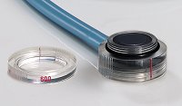
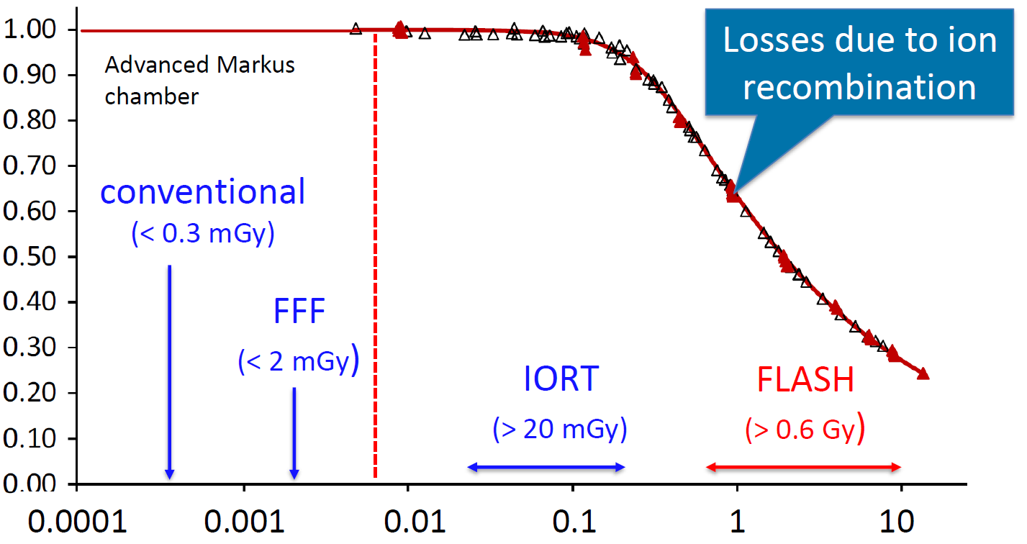
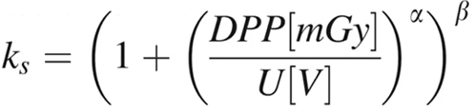
IC: Metrological challenges of dosimetry at UHDR
Typical behaviour of an IC at UHDR dose rates for pulsed electron beams
6 MeV e-beam
ion recombination effect
PTW Advanced Markus
(1 mm electrode separation)
Ion collection efficiency
ion collection time: 22 us
no physical meaning
Dose-per-pulse [Gy]
Petersson et al., Med Phys 44 (2017) 1157

Slide 7

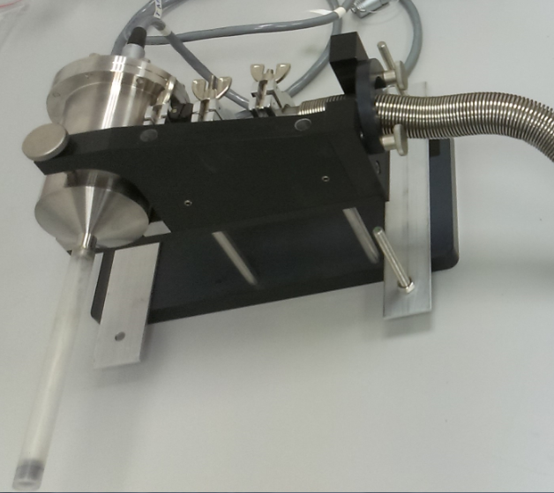
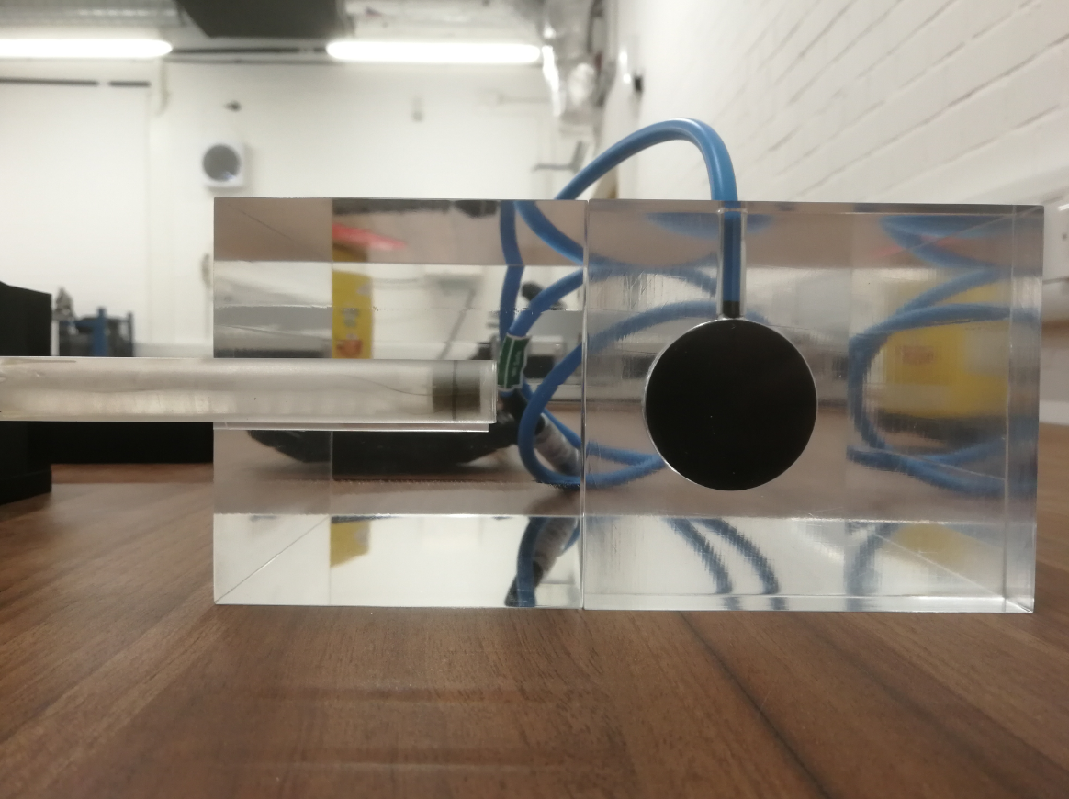
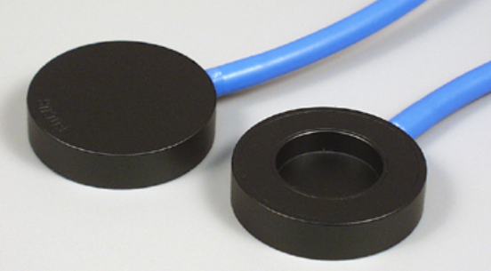
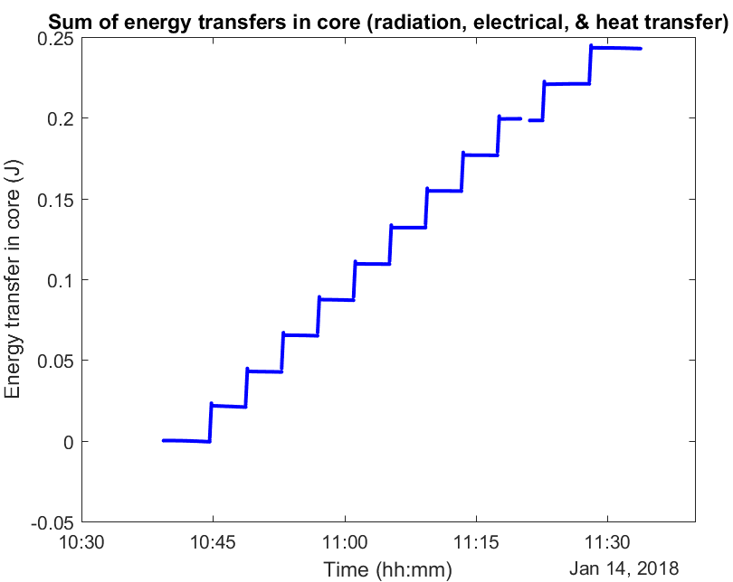
First experimental results: UHPDR VHEEs
PTW Roos chamber
(2 mm electrode separation)
ion collection time: 125 us

Slide 8
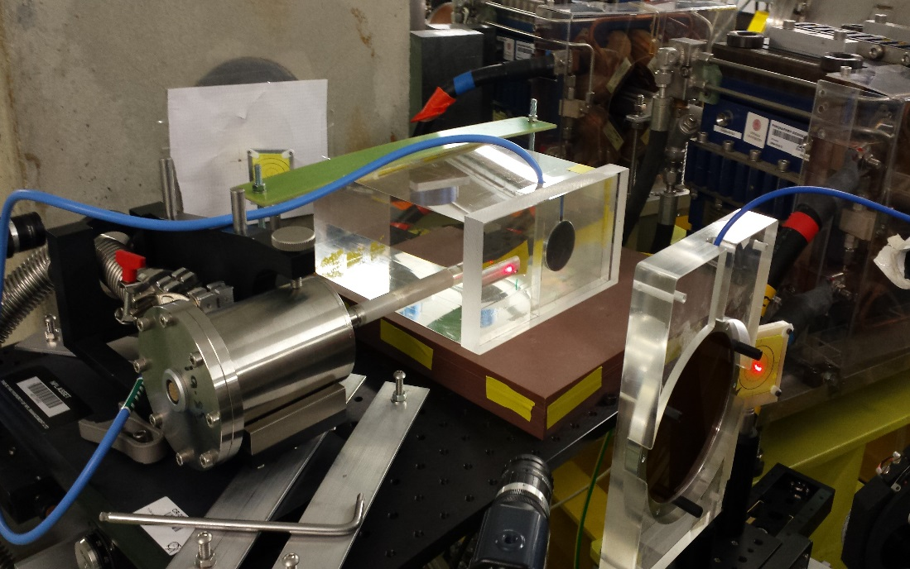

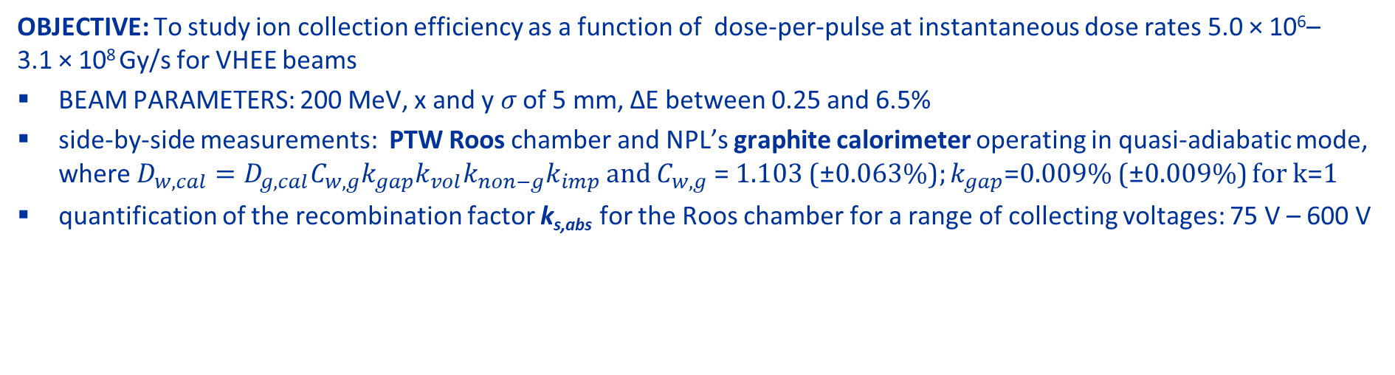
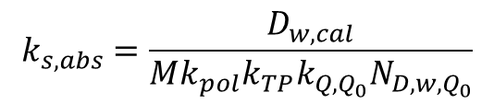
Experimental results: UHPDR VHEEs
OBJECTIVE: To study ion collection efficiency as a function of dose-per-pulse at instantaneous dose rates 5.0 × 10⁶–3.1 × 10⁸ Gy/s for VHEE beams
BEAM PARAMETERS: 200 MeV, x and y 𝜎 of 5 mm, ΔE between 0.25 and 6.5%
side-by-side measurements: PTW Roos chamber and NPL’s graphite calorimeter operating in quasi-adiabatic mode, where $D_{w,cal}=D_{g,cal}C_{w,g}k_{gap}k_{vol}k_{non−g}k_{imp}$ and $C_{w,g}$ = 1.103 (±0.063%); $k_{gap}$=0.009% (±0.009%) for k=1
quantification of the recombination factor k_{s,abs} for the Roos chamber for a range of collecting voltages: 75 V – 600 V
Nominal Beam Charge (nC/pulse) | Dw,cal (Gy/pulse) | ks,abs
 |  | 75 V | 200 V | 350 V | 600 V
0.05 | 0.03 | 1.3 | 0.98 | 0.89 | 0.78
0.2 | 0.20 | 3.41 | 1.87 | 1.56 | 1.14
0.25 | 0.14 | 2.46 | 1.33 | 2.05 | -
1 | 0.67 | 6.00 | 3.07 | 2.12 | 1.58
2.2 | 1.25 | 8.80 | 4.12 | 2.80 | 1.94
3 | 1.95 | 11.96 | 5.67 | - | 2.58
4.5 | 2.63 | 14.99 | 6.87 | 4.59 | 3.07
6 | 3.66 | 18.94 | 8.54 | 5.63 | 3.81
7.5 | 4.12 | 19.54 | 8.77 | 5.69 | 3.74
9 | 4.56 | 21.38 | 9.30 | 5.99 | 4.23
10.5 | 5.26 | 22.99 | 9.95 | 6.50 | 4.24
IC
BEAM DIRECTION
CALORIMETER
MONITOR CHAMBER
The test-stand at the CLEAR facility, with the calorimeter, ion chamber and monitor chamber placed along the beam line with the beam travelling from right to left.
$$k_{s,abs}=\frac{D_{w,cal}}{Mk_{pol}k_{TP}{k_{Q,Q_{0}}N}_{D,w,Q_{0}}}$$

Slide 9
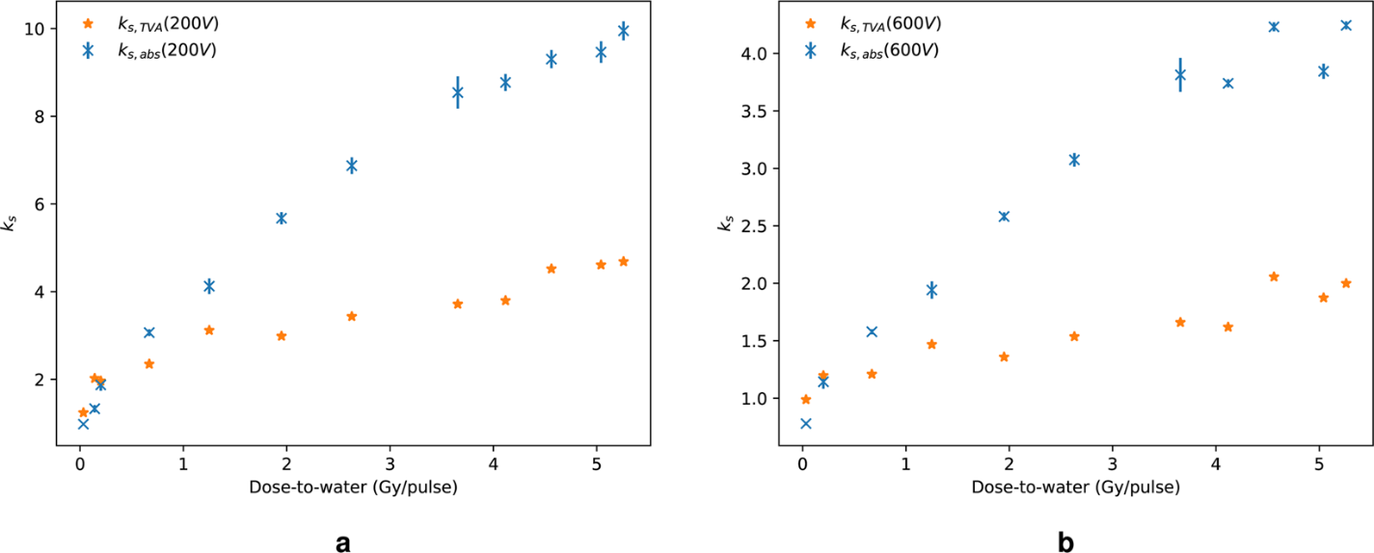
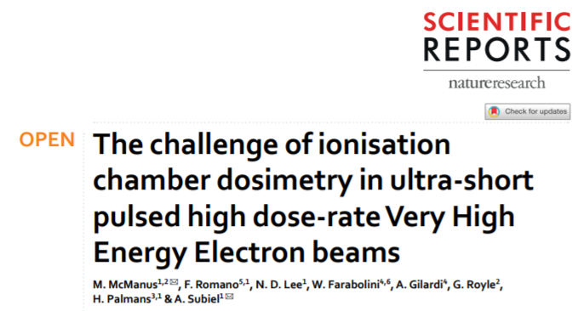
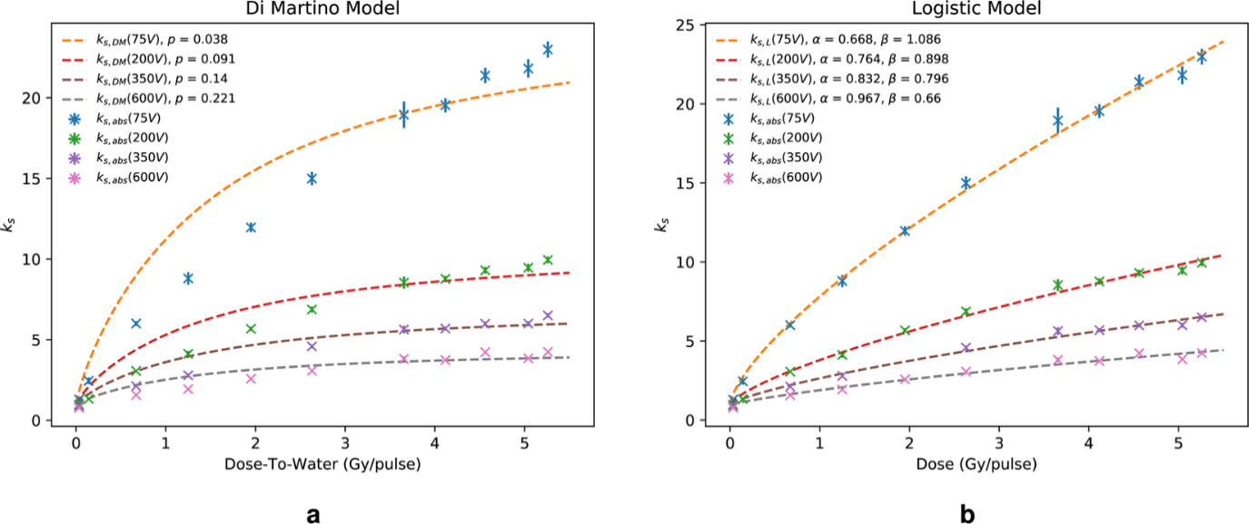
Results
k_{s} up to 10 (V = 200V) → collection eff. 10%
k_{s} up to 4 (V = 600V) → collection eff. 25%
k_{s,abs} compared with k_{s,TVA} (two-voltage method)
Available recombination models include Boag’s free-electron fraction models (Boag 1996)
By optimising the free-electron fraction parameter in these equations, we were able to determine a best fit of our data.
All analytical models of Boag and Di Martino show similar predictions of the recombination factor and estimations of the free-electron fraction
Analytical (Boag 1996, Di Martino 2005) and logistic (Petterson 2017) models tested
The logistic model from Petersson shows the best fit to data over the whole dose-per-pulse range, however this model has no physical meaning and simply relies on two fitting constants α and β
Credit: M. McManus

Slide 10
Conclusions
We carried out ion recombination study for PTW Roos chamber in 200 MeV e-beam
Transfer standard graphite calorimeter has been used as a reference instrument
The Roos chamber exposed to UHDR VHEE suffers from significant collection loses which cannot be described with currently available analytical ion recombination models
Using higher collecting voltage is not solving the problem, but application of ultra-thin gap IC could alleviate the challenge of ion recombination in UHDR VHEEs

Slide 11

Thank you
Acknowledgements
Michael McManus
Francesco Romano
Nigel Lee
Hugo Palmans
Wilfrid Farabolini
Antonio Gilardi
This project (18HLT04) has received funding from the EMPIR programme co-financed by the Participating States and from the European Union’s Horizon 2020 research and innovation programme.
anna.subiel@npl.co.uk
http://uhdpulse-empir.eu/

