Slide 1
VOLUME RECOMBINATION IN PARALLEL-PLATE IONIZATION CHAMBERS F. Gómez^{1,2}, A. Schüller³, J. Paz-Martín¹, A. Bourgouin³, R. Kranzer^{4,5}, J. Pardo-Montero⁶, D. Gonzalez-Castaño², N. Gómez-Fernández², G. Felici⁷, D. Velleren^{8,9}, A. Gasparini^{8,9,10}, V. Vanreusel^{8,9,10}
1 Universidad de Santiago, Santiago 15782, Spain;
2 Laboratorio de Radiofísica, Universidad de Santiago, Santiago 15782, Spain;
3 Physikalisch-Technische Bundesanstalt, Braunschweig 38116, Germany;
4 PTW-Freiburg (R&D), Freiburg 79115, Germany;
5 University Clinic for Medical Radiation Physics, Medical Campus Pius Hospital, Carl von Ossietzky University Oldenburg, 26121, Germany;
6 Group of Medical Physics and Biomathematics, Instituto de Investigación Sanitaria de Santiago (IDIS), Travesía da Choupana, Santiago de Compostela, A Coruña, 15706, Spain;
7 SIT, Aprilia, Italy;
8 Department of Radiotherapy, Iridium Network, Belgium;
9 Faculty of Medicine and Health Sciences, University of Antwerp, Belgium;
10 SCK CEN, Research in Dosimetric Applications, Mol, Belgium;
This work has received funding from the EMPIR programme project 18HLT04 UHDpulse co-financed by the Participating States and from the European Union’s Horizon 2020 research and innovation programme .

Slide 2
The problem of recombination
UHDR and the recombination problem in PPIC
Equations of charge carrier transport and numerical solutions
Electron mobility and electron attachment
Free electron fraction
Contribution of electric field perturbation and electron-ion recombination
Magnitudes of influence
Pulse structure
Instantaneous electrical current data
The importance of the electrode distance: Ultra Thin IC
Saturation effect
Charge multiplication
Dose rate dependence
Some invariants from experimental data

Slide 3
The problem of recombination
x
Parallel plate ionization chamber in the transversal coordinate
E
E
CCE
E
n+
n-
n+
n-
n+
n-
0
d
x
0
d
x
0
d
x
Dose per pulse (Gy)
Very Low DPP
Linear behaviour of carrier densities
Almost constant electric field
Negligible recombination
Low & Moderate DPP
Small non linear behaviour of carrier densities
Small screening of electric field
Aproximate analytical solutions for recombination
High & Ultra High DPP
Dominant non linear behaviour of carrier densities
Very large screening of electric field
No analytical solutions for recombination
Electron beam at MELAF (PTB)
Chamber PPC40
Pulse duration 2.5 µs
Frequency 5 Hz

Slide 4
The problem of recombination
Radiation model
Electron atachment τ_{e}(E)
Recombination and attachment
Ionization
Ion recombination rate α
Charge Carrier densities
Electric field
Charge transport
Electron mobility v_{e}(E)
Ion mobility μ₊(E) μ₋(E)
Deattachment/e-ion recombination / mobility /diffusion
Electrical current

Slide 5
Equations of charge carrier transport
In the ultra-high dose per pulse limit the air ionization chambers are subject to large recombination losses and substantial k_{sat} correction factor values. Most approaches until now consider the one-dimensional equivalent problem:
$$\frac{∂}{∂t}n_{+}\left(x,t\right)=N\left(x,t\right)−α n_{+}\left(x,t\right){ n}_{−}\left(x,t\right)−θ{ n}_{+}\left(x,t\right){ n}_{e}\left(x,t\right)−\frac{∂}{∂x}\left\{E\left(x,t\right){ μ}_{+}n_{+}\left(x,t\right)\right\}$$
$$\frac{∂}{∂t}n_{−}\left(x,t\right)=γ n_{e}\left(x,t\right)−α n_{+}\left(x,t\right){ n}_{−}\left(x,t\right)+\frac{∂}{∂x}\left\{E\left(x,t\right){ μ}_{−}n_{−}\left(x,t\right)\right\}$$
$$\frac{∂}{∂t}n_{e}\left(x,t\right)=N\left(x,t\right)−γ n_{e}\left(x,t\right)−θ{ n}_{+}\left(x,t\right){ n}_{e}\left(x,t\right)+\frac{∂}{∂x}\left\{E\left(x,t\right){ μ}_{e}{ n}_{e}\left(x,t\right)\right\}$$
$n_{+}\left(x,t\right)$, $n_{−}\left(x,t\right), n_{e}\left(x,t\right)$ are the positive, negative ion and electron densities
$N\left(x,t\right)$number of electron-ion pairs roduced by radiation escaping initial recombination per unit time and unit volume
$α$ is the recombination coefficient for ionic species, $θ$ is the electron-ion recombination coefficient
${ μ}_{+}$, ${ μ}_{−}$, ${ μ}_{e}$ are the charge carrier mobilities
$γ$ is the electron attachment constant
Paz-Martin J. et al. Physica Medica 103, pp. 147-156 (2022)

Slide 6
Equations of charge carrier transport
Numerical solutions are built through a discretization of time and coordinate between electrodes:
$$∆t< \frac{x_{step}}{v_{max}}$$
typically
$∆t<{10}^{−11}$ s
$$∆x<1 µm$$
N $≥3000$
First versión of PPIC simulator released in April 2021
Example of the accuracy of the simulation of a 2 mm chamber.
Paz-Martin J. et al. Physica Medica 103, pp. 147-156 (2022)

Slide 7
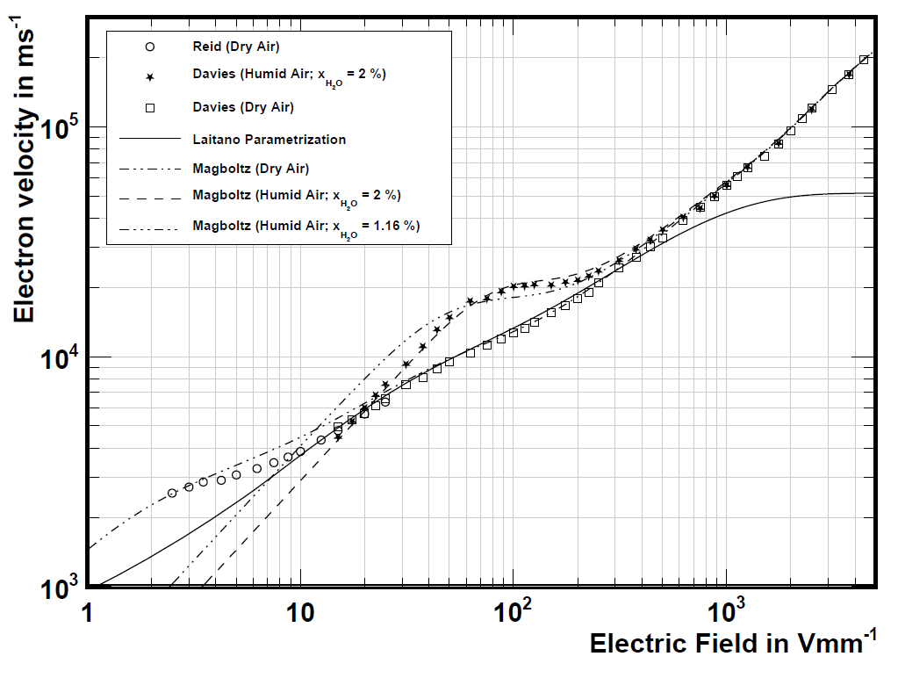
Electron mobility
Electron drift velocity as a function of electric field is substantially different in humid air respect to dry air for moderate electric field ( ~100 V/mm)
Paz-Martin J. et al. Physica Medica 103, pp. 147-156 (2022)

Slide 8
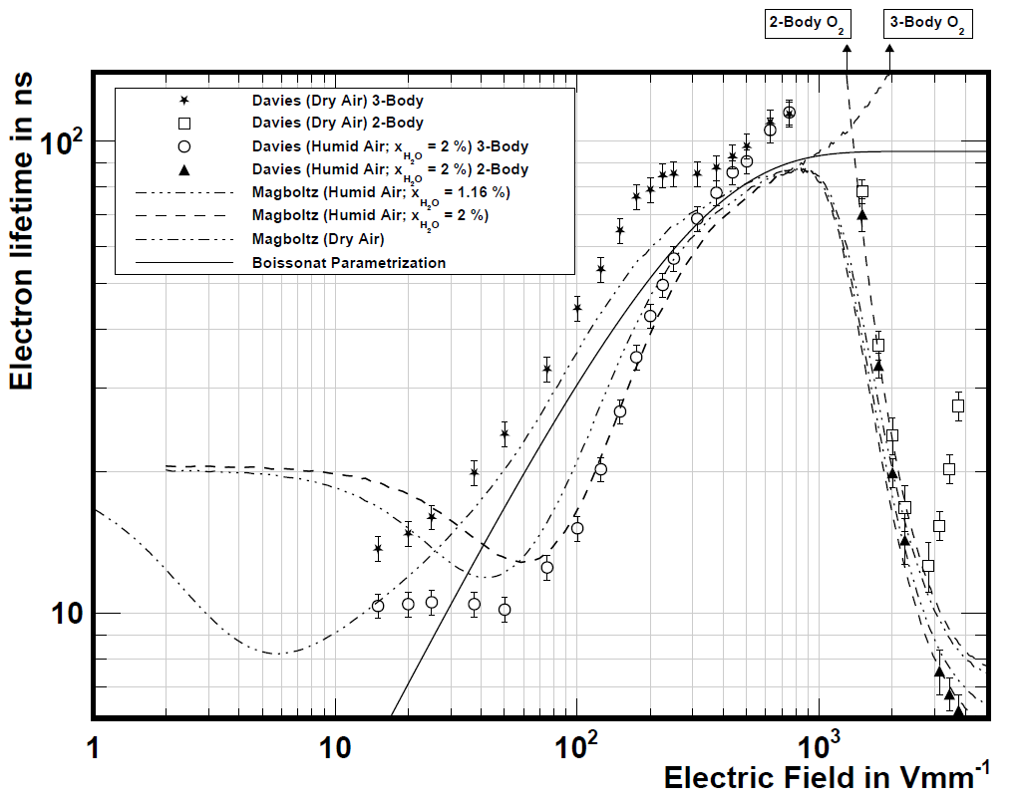
Electron attachment
Three-body attachment
$$e+O_{2}+O_{2}→O_{2}^{−}+O_{2}$$
…
Two-body attachment
$$e+H_{2}O→O_{}^{−}+H_{2}$$
…
Advanced
Markus
@ 300 V
UTIC
0.25 mm
@ 300 V
The use of very high electric can enhance the two-body attachment processes and yield an effective reduction of electron lifetime.
Paz-Martin J. et al. Physica Medica 103, pp. 147-156 (2022)

Slide 9
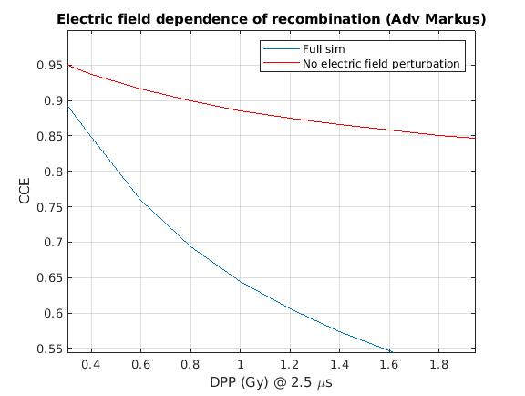
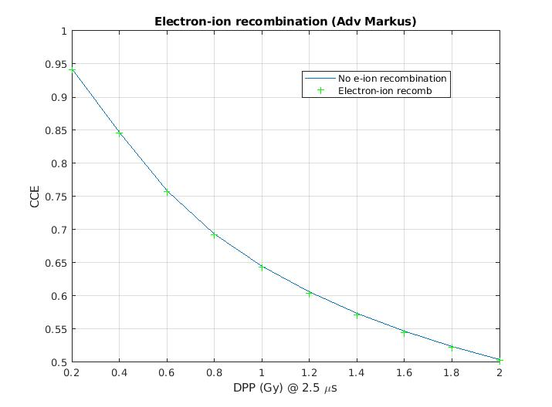
The problem of recombination
Models without electric field perturbation can not reproduce the problem in an accurate way.
Electron-ion recombination typical contribution to CCE is bellow 1%
($θ=4.45×{10}^{−12}$m³ s⁻¹)

Slide 10
Free electron fraction
1) FEF Boag definition:
Fraction of electrons liberated in the chamber that reach the positive electrode.
$${FEF}_{Boag}=\frac{v_{e} τ}{d}\left[1−\exp\left(−\frac{d}{v_{e} τ}\right)\right]=p=\frac{Q_{e}}{Q_{sat}}$$
$$\lim_{τ→∞}{{FEF}_{Boag}}=1$$
2) FEF signal:
Fraction of the total charge readout of the chamber due to free electrons respect to saturation charge (neglecting volume recombination).
$${FEF}_{Ind}=\frac{v_{e} τ}{d}\left[1−{FEF}_{Boag}\right]=\frac{Q_{e}^{ind}}{Q_{sat}}$$
$$\lim_{τ→∞}{{FEF}_{Ind}}=0.5$$
3) Effective FEF signal:
Fraction of the total charge readout of the chamber respect to the total collected charge.
$${FEF′}_{Ind}=\frac{Q_{e}^{ind}}{Q_{coll}}=\frac{Q_{sat}}{Q_{coll}}\frac{Q_{e}^{ind}}{Q_{sat}}=\frac{{FEF}_{Ind}}{CCE}$$
This last quantity is the only one directly measurable!

Slide 11
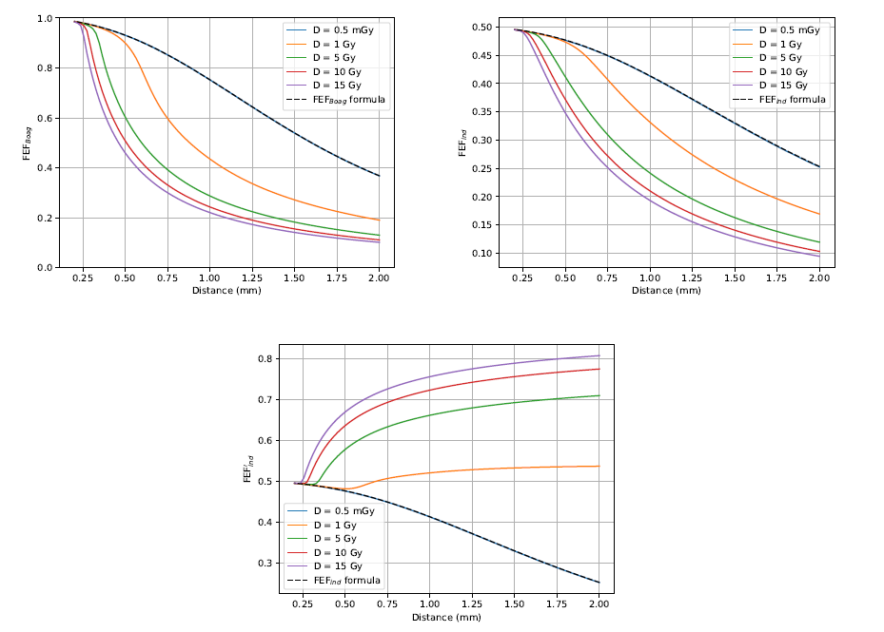
Free electron fraction (Roos chamber)
FEF Boag
FEF ind
Values obtained from numerical simulation.
Voltage polarization 300 V and pulse duration 4.5 µs.
FEF’ ind

Slide 12
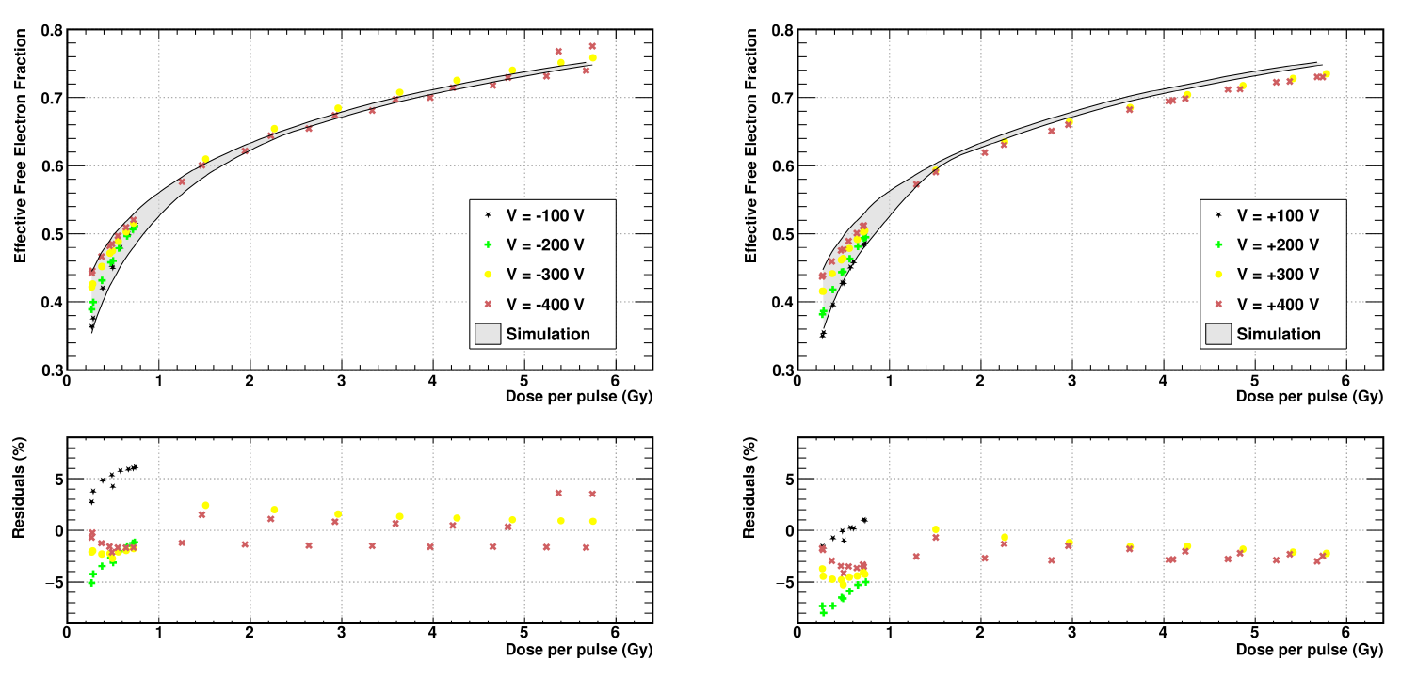
Free electron fraction (Roos chamber)
Effective free electron fraction for a 2.5 µs pulse in MELAF (PTB).
Experimental and simulated effective FEF’ind obtained from integrating the electrical current during the pulse.
“Numerical modeling of air-vented parallel plate ionization chambers for ultra-high dose rate applications” Phys Med. 2022 Oct 28;103:147-156. doi: 10.1016/j.ejmp.2022.10.006.

Slide 13
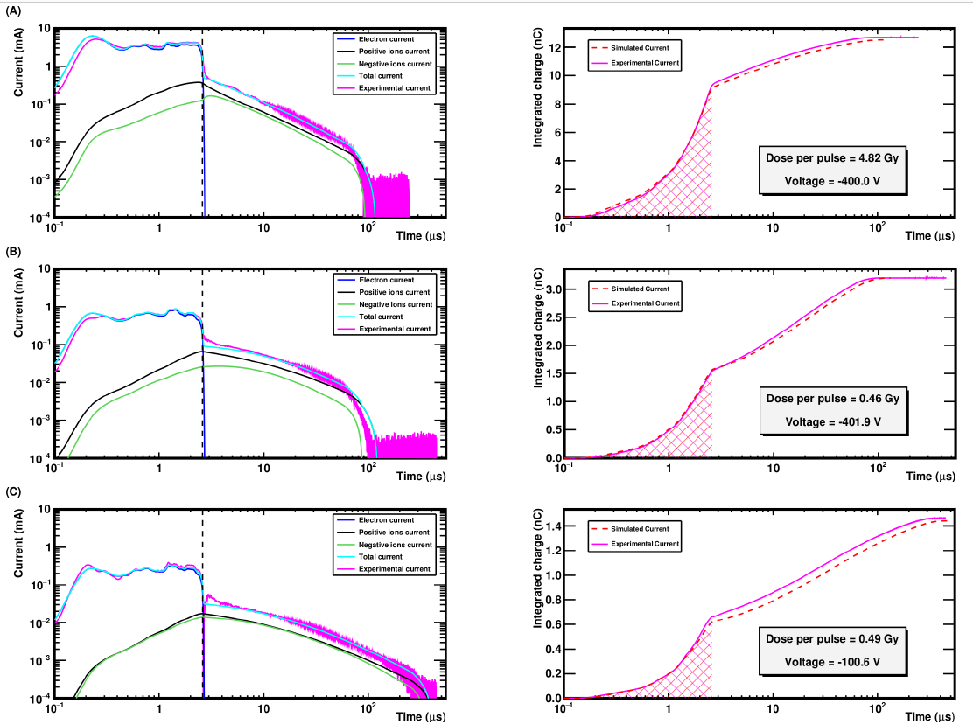
Instantaneous current (Roos chamber)
Instantaneous current for a 2.5 µs pulse in MELAF (PTB)
“Numerical modeling of air-vented parallel plate ionization chambers for ultra-high dose rate applications” Phys Med. 2022 Oct 28;103:147-156. doi: 10.1016/j.ejmp.2022.10.006.

Slide 14
Charge collection efficiency (Roos chamber)
Chambers operated at 300 V for a pulse duration of 2.5 µs
“Numerical modeling of air-vented parallel plate ionization chambers for ultra-high dose rate applications” Phys Med. 2022 Oct 28;103:147-156. doi: 10.1016/j.ejmp.2022.10.006.

Slide 15
Charge collection efficiency (Adv Markus)
Agreement is not so perfect in general once volume recombination coefficient is fixed and treat the whole set of data equally.
Data from MELAF PTB for
2.5 $μ$s pulse duration and
$α=1.1 ×{10}^{−12}$m³ s⁻¹
N.B.: Unpublished data.

Slide 16
Pulse time structure (Roos chamber)
CCE dependence on pulse duration for a 2 mm PPIC operated at 300 V bias voltage for a dose per pulse $D_{0}$ of 0.5 Gy.
“Numerical modeling of air-vented parallel plate ionization chambers for ultra-high dose rate applications” Phys Med. 2022 Oct 28;103:147-156. doi: 10.1016/j.ejmp.2022.10.006.
$${∆t}_{1}=δ ∆t$$
$${\dot{D}}_{1}=\frac{1−δ}{δ}\frac{D_{0}}{∆t}$$
$${\dot{D}}_{2}=\frac{δ}{1−δ}\frac{D_{0}}{∆t}$$
$${∆t}_{2}=(1−δ) ∆t$$

Slide 17
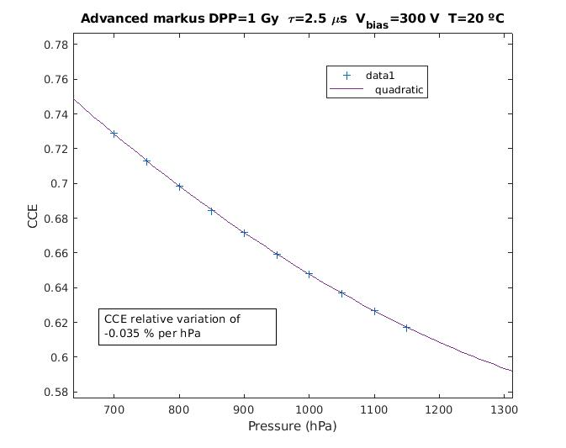
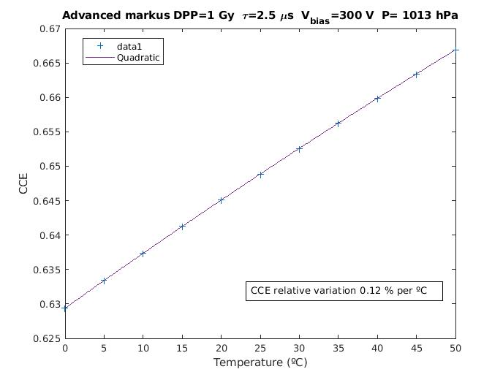
Charge collection efficiency and influence magnitudes
Typical sensitivity factors for CCE Advanced Markus (@ 1 Gy DPP and 1 μs)
Magnitude | Sensitivity
Temperature | 0.12 % K⁻¹
Pressure | 0.03 % hPa⁻¹
Voltage | 0.08 % V⁻¹
Chamber gap | 0.06 % μm⁻¹

Slide 18
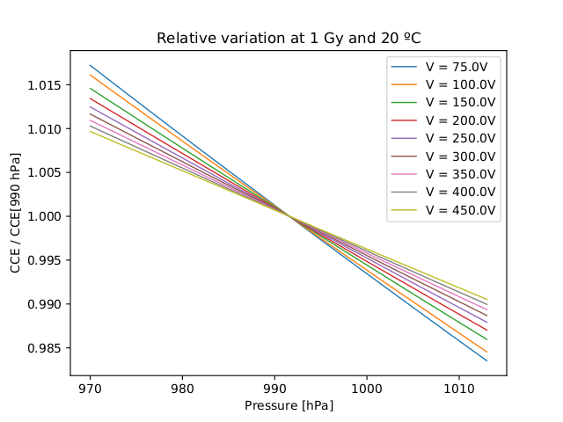
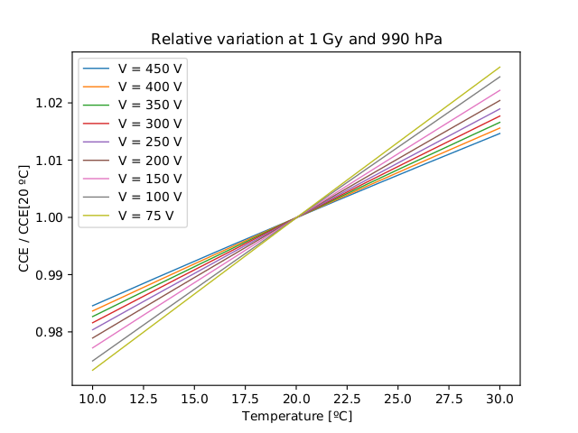
Charge collection efficiency and influence magnitudes
CCE Advanced Markus (pulse duration 2.5 μs)

Slide 19
The importance of electrode distance
Gómez, F, Gonzalez-Castaño, DM, Fernández, NG, Pardo-Montero, J, Schüller, A, Gasparini, A, Vanreusel, V, Verellen, D, Felici, G, Kranzer, R, Paz-Martín, J. Development of an ultra-thin parallel plate ionization chamber for dosimetry in FLASH radiotherapy. Med Phys. 2022; 49: 4705– 4714.
https://doi.org/10.1002/mp.15668
Charge collection efficiency 99% @ 300 V

Slide 20
The importance of electrode distance: Ultra Thin IC
“Charge collection efficiency, underlying recombination mechanisms, and the role of electrode distance of vented ionization chambers under ultra-high dose-per-pulse conditions”
Phys Med. 2022 Nov 7;104:10-17.
doi: 10.1016/j.ejmp.2022.10.021.
Charge collection efficiency of the PPICs with different electrode distances and three different chamber voltages. From left to right d = 1 mm, 0.5 mm, 0.25 mm. Experimental and simulated data as well as comparative data from the literature are presented

Slide 21
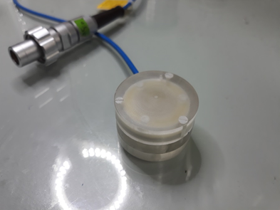
The importance of electrode distance: UTIC
250 V
Gómez, F, Gonzalez-Castaño, DM, Fernández, NG, Pardo-Montero, J, Schüller, A, Gasparini, A, Vanreusel, V, Verellen, D, Felici, G, Kranzer, R, Paz-Martín, J. Development of an ultra-thin parallel plate ionization chamber for dosimetry in FLASH radiotherapy. Med Phys. 2022; 49: 4705– 4714.
https://doi.org/10.1002/mp.15668
Measurement of UTIC charge vs. dose per pulse at water phantom PTB, pulse duration 2.5 µs.

Slide 22
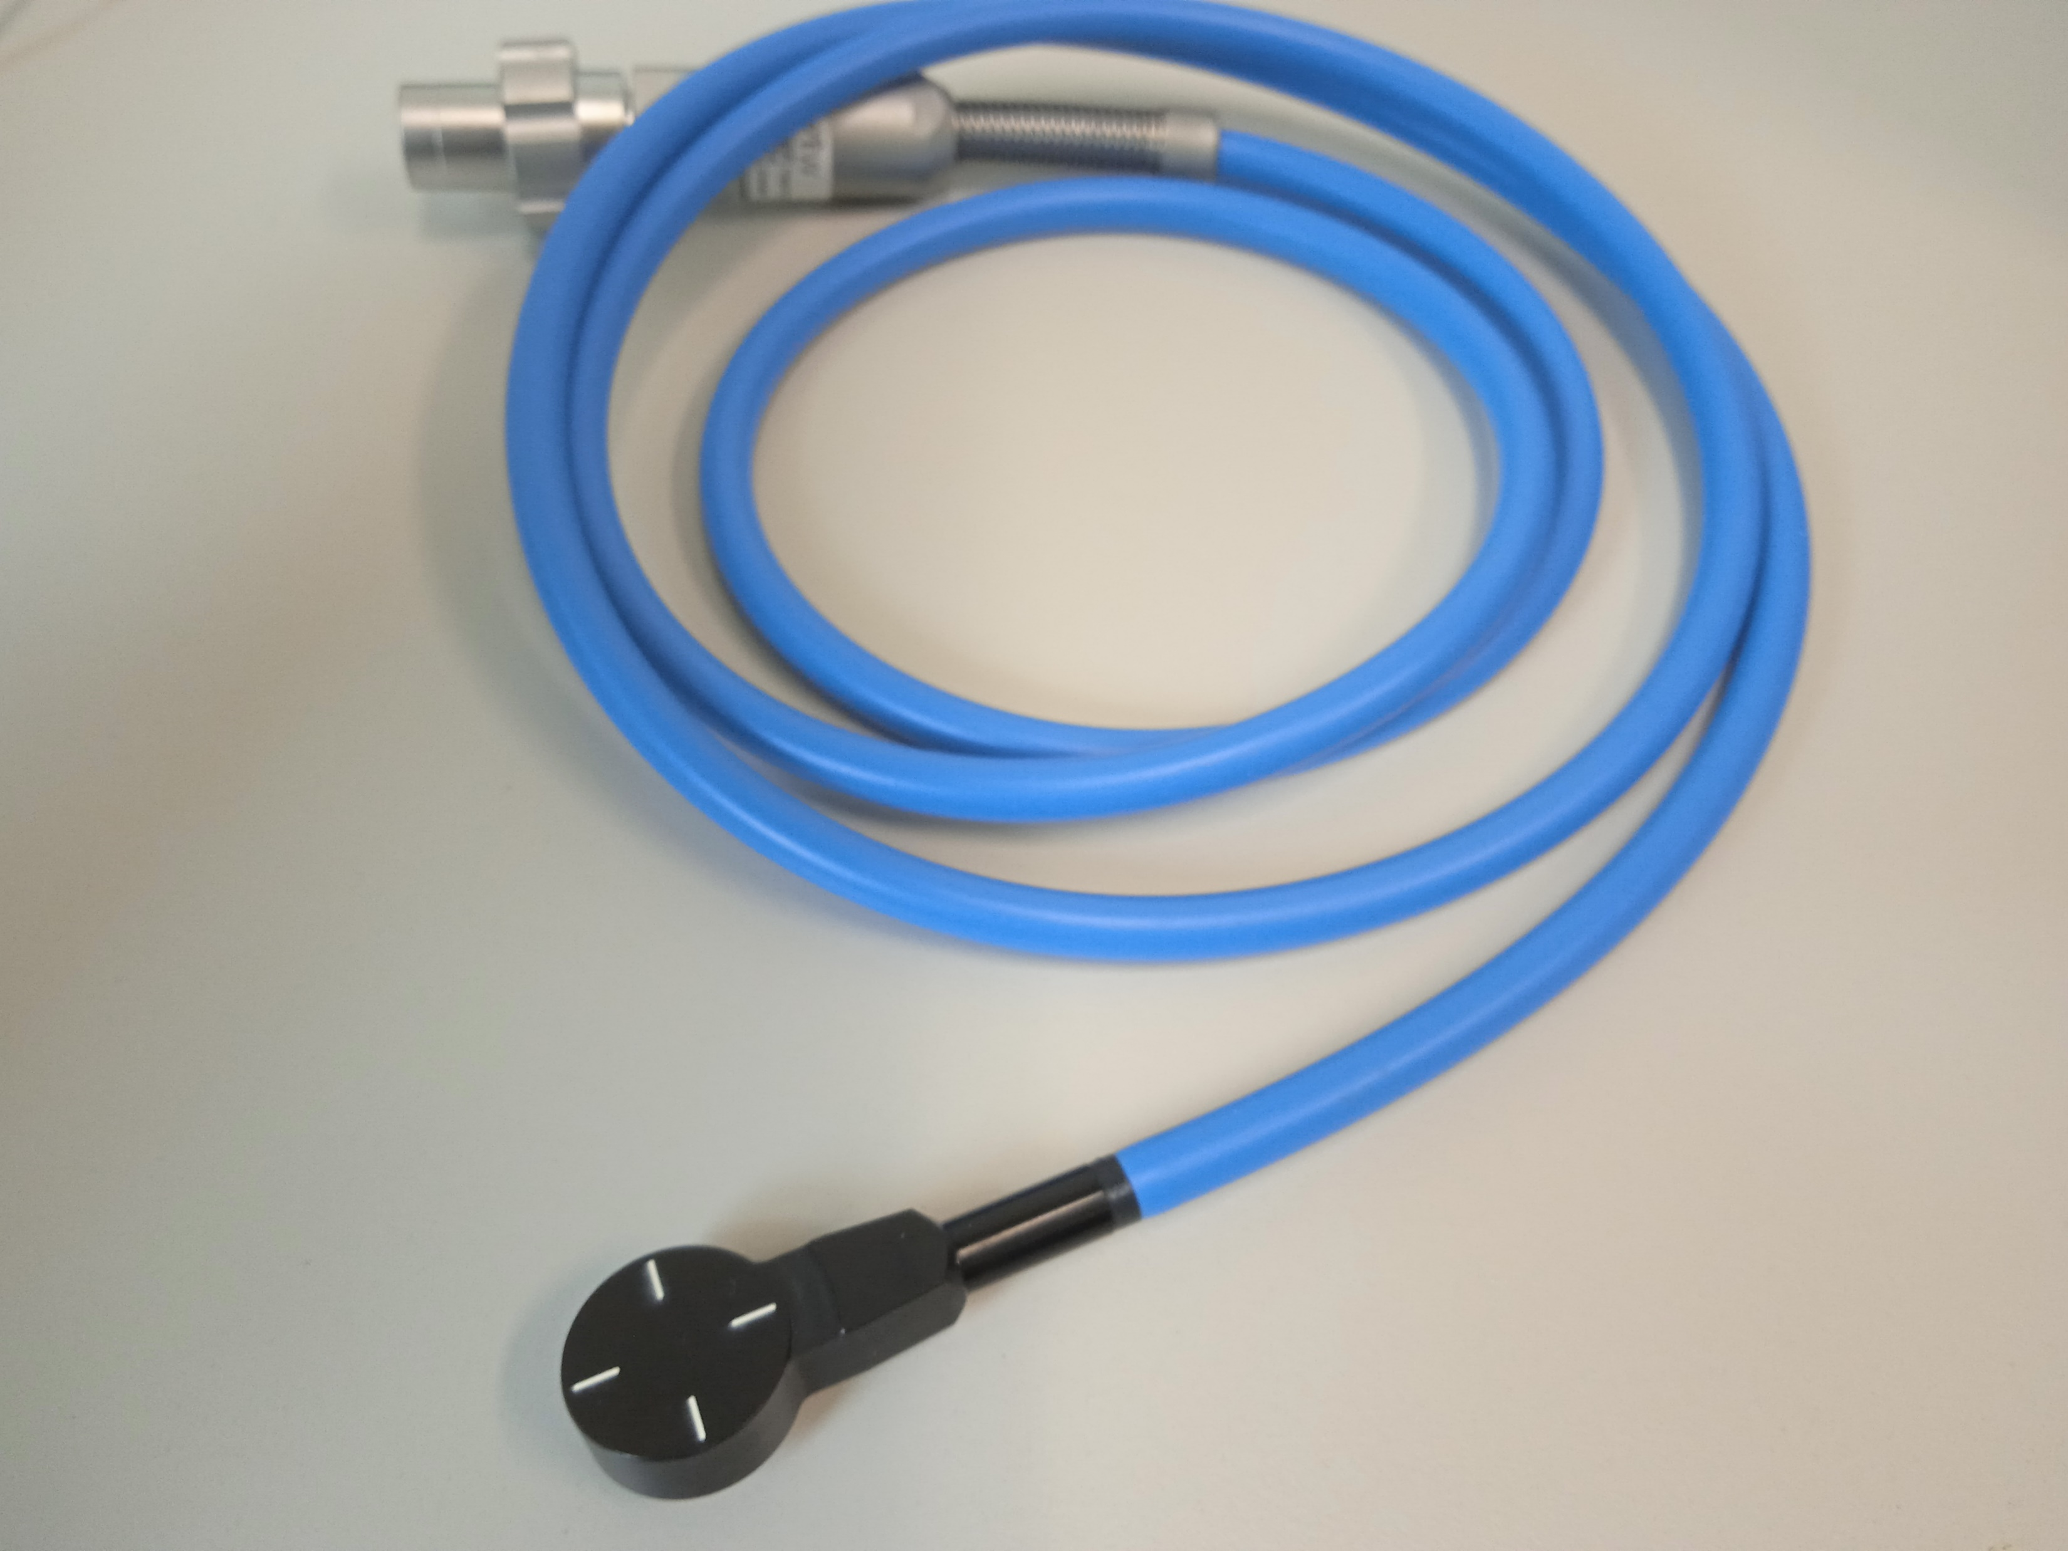
The importance of electrode distance: UTIC
Measured dose per pulse vs reference dose for an UTIC operated at 250 V in MELAF 20 MeV electron beam
pulse duration 2.5 µs.
“Charge collection efficiency, underlying recombination mechanisms, and the role of electrode distance of vented ionization chambers under ultra-high dose-per-pulse conditions”
Phys Med. 2022 Nov 7;104:10-17.
doi: 10.1016/j.ejmp.2022.10.021.

Slide 23
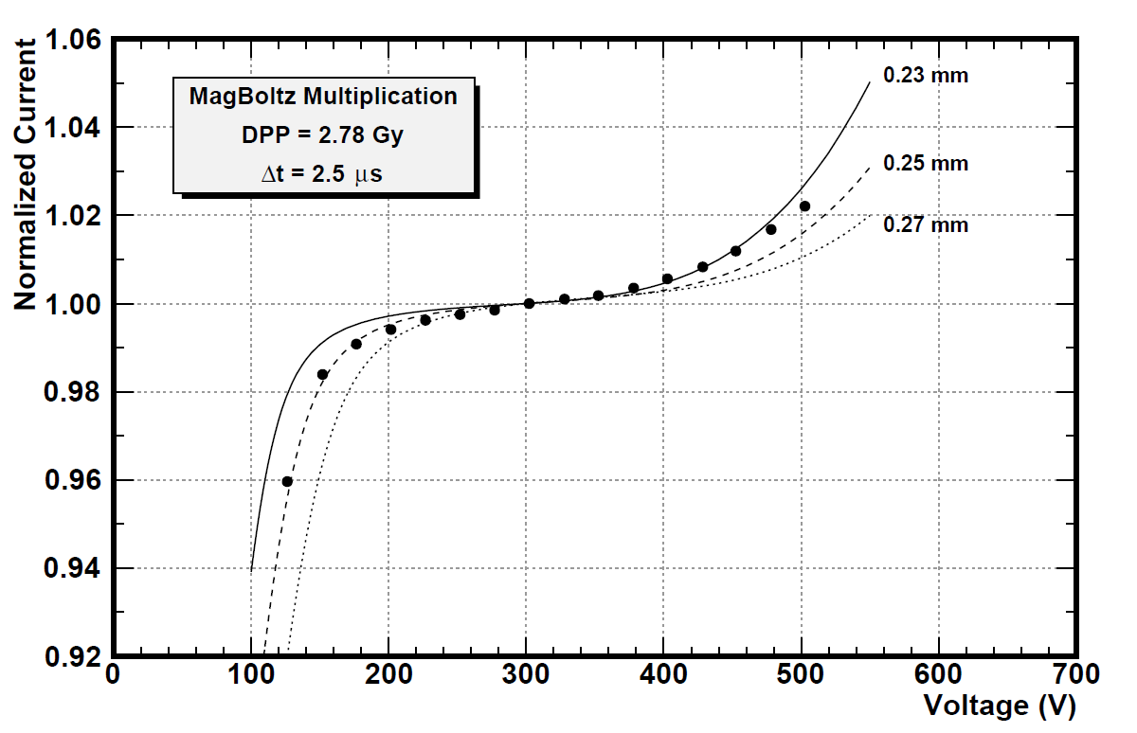
Charge multiplication
First Townsend coefficient in air
“Charge collection efficiency, underlying recombination mechanisms, and the role of electrode distance of vented ionization chambers under ultra-high dose-per-pulse conditions”
Phys Med. 2022 Nov 7;104:10-17.
doi: 10.1016/j.ejmp.2022.10.021.
Relative signal excess for UTIC at 500 V around 2 %.

Slide 24
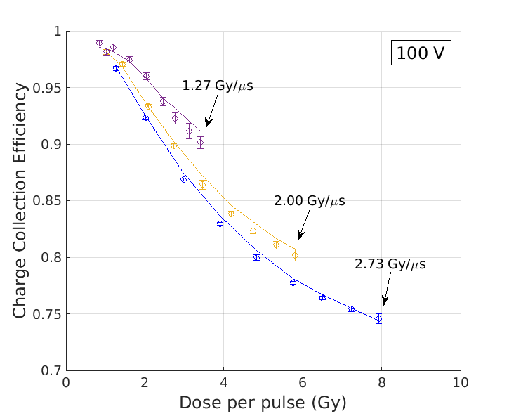
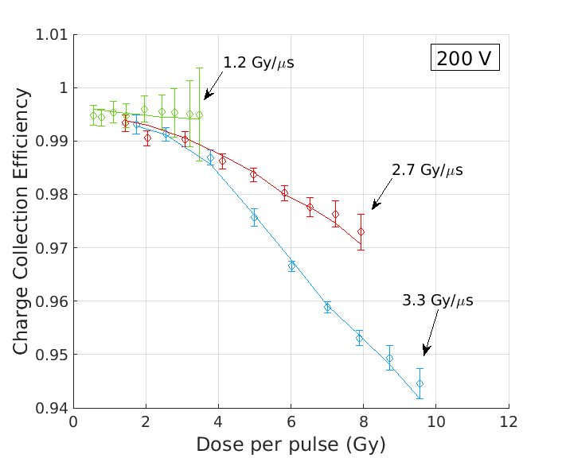
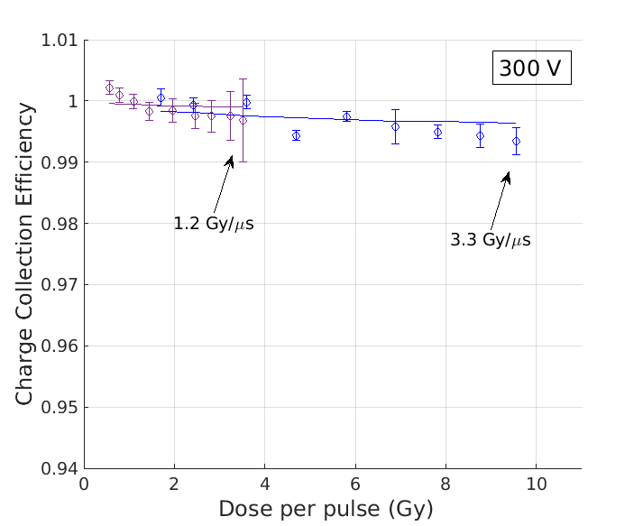
UTIC dose rate dependence
CCE dependence on instantaneous dose rate is more evident for chambers with ion collection time similar to pulse duration.
CCE as a function of dose per pulse for different instantaneous dose rates for the Ultra-Thin Ionization Chamber (0.25 mm) operated at different polarization voltages: A) 100 V, B) 200 V and C) 300 V. Experimental data from MELAF (PTB) is shown with circles with uncertainty bars while numerical simulation predictions are indicated with solid lines.
E-poster “ION RECOMBINATION DOSE RATE DEPENDENCE OF ULTRA THIN AIR IONIZATION CHAMBER” FRPT2022

Slide 25
Some invariants from experimental data
Ion collection time defined at 99.95% of total collected charge for a Roos chamber show a linear relationship with inverse of the operating chamber voltage independently of the DPP (0.2 Gy to 5.8 Gy).

Slide 26
Some invariants from experimental data
Under equal irradiation conditions CCE between two PPIC chambers is invariant if
$$\frac{{d_{1}}^{2}}{U_{1}}=\frac{{d_{2}}^{2}}{U_{2}}$$
“Charge collection efficiency, underlying recombination mechanisms, and the role of electrode distance of vented ionization chambers under ultra-high dose-per-pulse conditions”
Phys Med. 2022 Nov 7;104:10-17.
doi: 10.1016/j.ejmp.2022.10.021.

Slide 27
Conclusions
Ultra Thin Air Ionization Chambers are able to work at DPP of 5.5 Gy with CCE > 99 % for 2.5 µs pulse duration and V_{bias} 250 V.
Pulse duration has some effect in chamber readout (ion collection time/delivery time). For UTIC it has very limited effect at nominal voltage.
Invariance of some quantities found in simulation and in data have to be properly explained from Physics.
Universal correction of large saturation effect is difficult due to the unit to unit variation, dependence on pulse duration (time structure) and effect of magnitudes of influence.

Slide 28
Complexity vs model
“Non-equilibrium Air Plasmas at atmospheric Pressure” 2005 Institute of Physics, Ed. K H Becker, U. Kogelschatz, K H Schoenbach, R J Barker

