Slide 1


Primary standard calorimetry for UHDR proton beams
Anna Subiel, PhD, CPhys
Medical Radiation Science, National Physical Laboratory, Hampton Road, Teddington, Middlesex, TW11 0LW, UK
UHDpulse 2nd Stakeholder Meeting, 26-27 January 2023

Slide 2
Calorimeters used as prim. standards in high energy beams
R₂
R_{th+wire}
R₃
V_{out}
D=c·ΔT
R₄
thermistor
bridge circuit
3.0E-06
bridge output signal
V_{m}
2.5E-06
2.0E-06
(V)
out
1.5E-06
ΔT
V
calorimeter phantom
1.0E-06
5.0E-07
isolation
0.0E-07
-200
-100
0
100
200
Time (s)

Slide 3
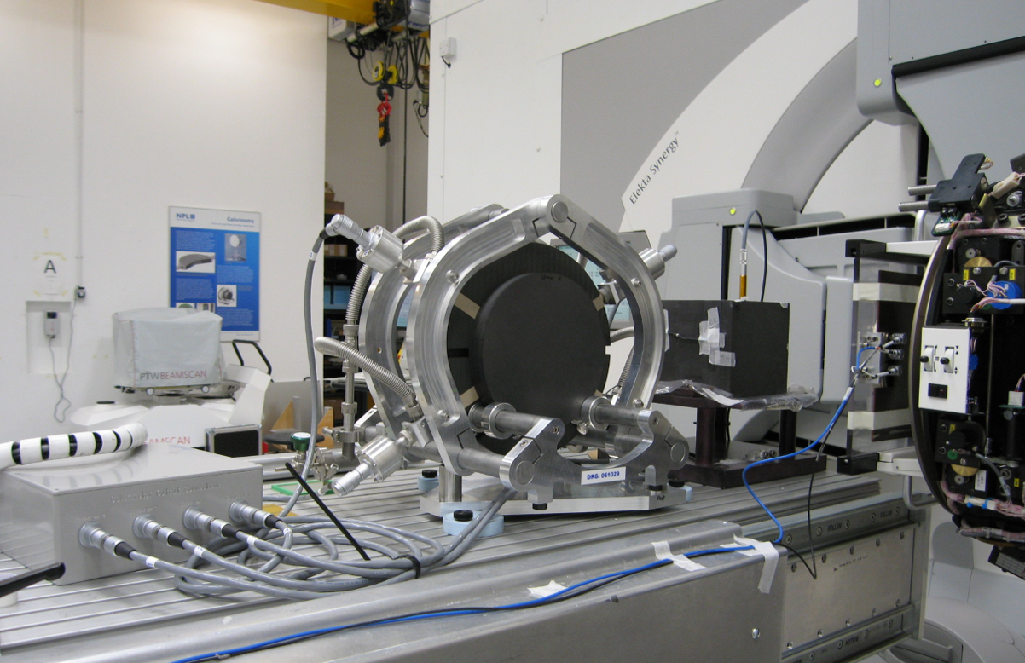
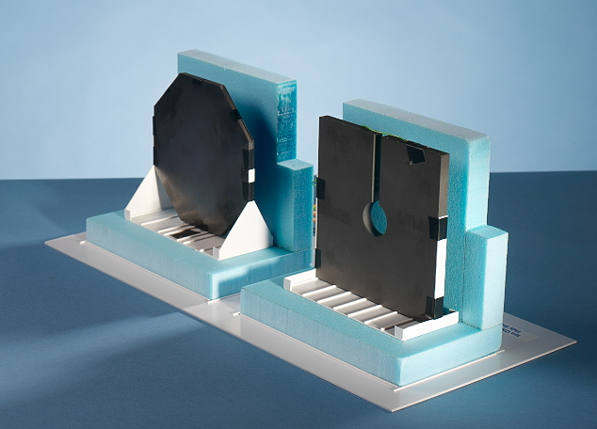
Calibration in high energy beams
For high-energy photon & electron beams:
calibrations based on a primary standard calorimeters for the direct determination of absorbed dose to water with uncertainties on reference dosimetry of:
0.65% (k=1) for photons
0.75% (k=1) for electrons
NPL photon calorimeter
NPL electron calorimeter
X-rays

Slide 4
Calibration in proton beams

Slide 5
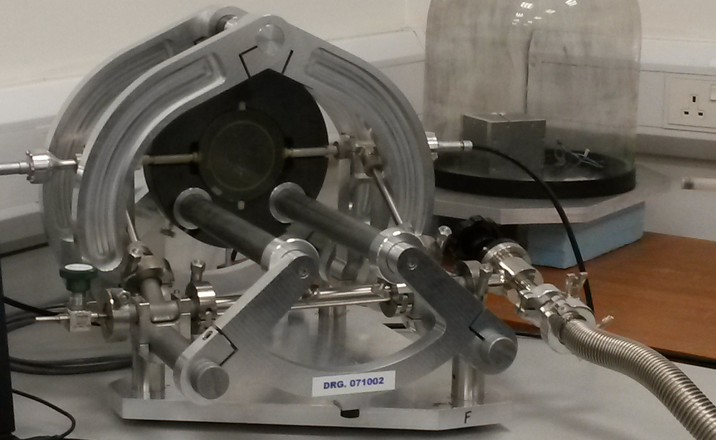
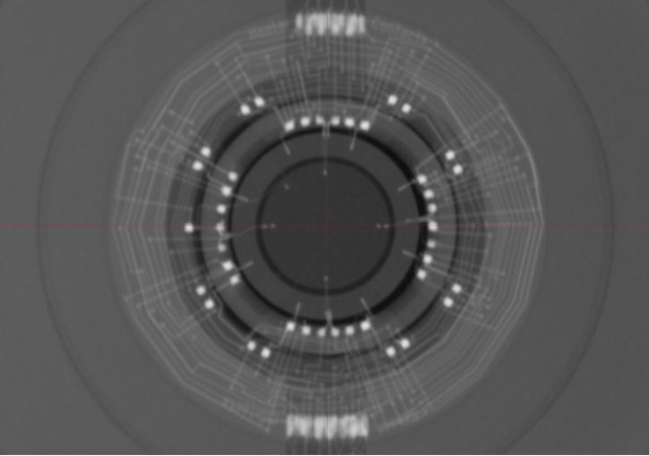
World’s 1st Primary-Standard Calorimeter for Protons
Graphite calorimeter
Originally developed for use with conventional proton beams,
Consists of graphite discs arranged in a nested construction, maintained under vacuum

Slide 6

World’s 1st Primary-Standard Calorimeter for Protons
$$\text{D}\text{=}\text{c}\text{·}\text{Δ}\text{T}$$
Graphite calorimeter
Originally developed for use with conventional proton beams,
Consists of graphite discs arranged in a nested construction, maintained under vacuum

Slide 7
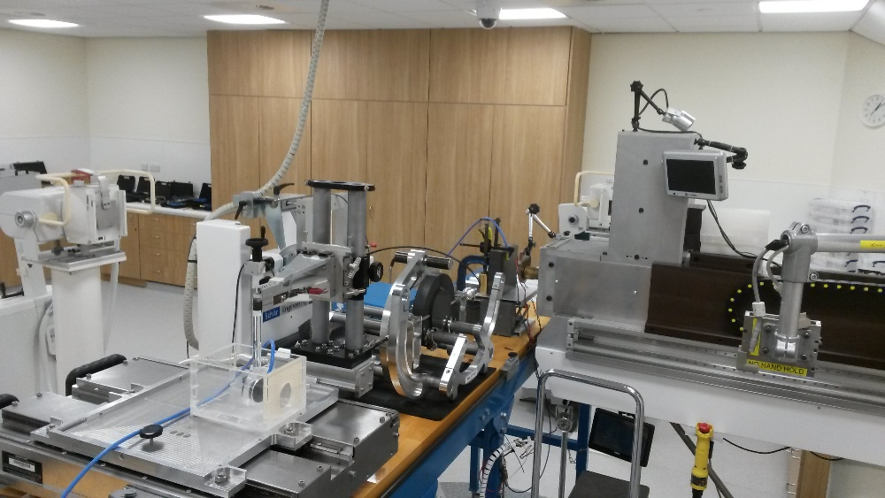
World’s 1st Primary-Standard Calorimeter for Protons
$$\text{D}\text{=}\text{c}\text{·}\text{Δ}\text{T}$$
Graphite calorimeter
4 thermistors – 0.4 mm diameter typical fraction of treatment - 2 Gy, 0.002 degrees
Delivers an uncertainty on reference dosimetry for protons <1% (k=1)
White tiny spot - thermistor
16 mm
$$D_{\text{w}}=\left[{\left(m_{core,eff}c_{g}k_{c}∆T_{core}−\int{{∆P}_{core}dt}−\sum_{i}{\int{h_{core,i}\left(T_{i}−T_{core}\right)−a_{j}P_{j}dt}}\right)}/{m_{\text{core}\text{, }\text{eff}}}\right].k_{imp}k_{gap}k_{z,cal}k_{d,cal}k_{an,cal}s_{w,g}k_{fl}$$

Slide 8
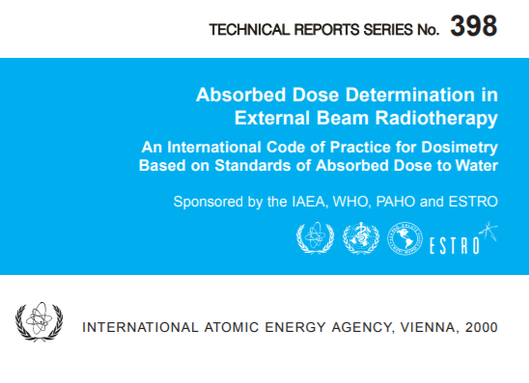
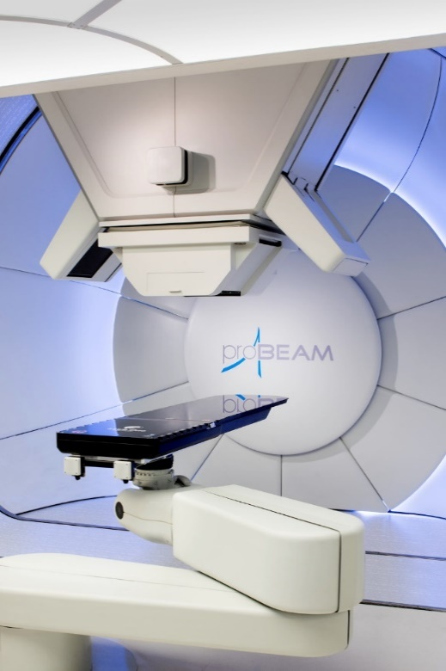
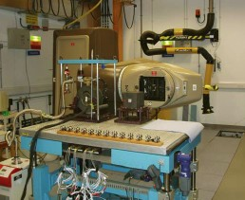
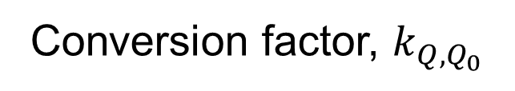
Proton reference dosimetry
2000 – IAEA TRS 398
  Ionisation chambers
Uncertainty on $D_{w,Q}$ for protons: 2.3% (k=1)
Uncertainty in dose at least 2 times larger than the recommended uncertainty
Detectors currently used in the proton clinics are calibrated in a Cobalt-60 beam
Dose in a proton beam
Conversion factor, $k_{Q,Q_{0}}$
Analytical
Courtesy of A. Lourenço

Slide 9
Proton reference dosimetry
Calibrate the detectors directly in the same or similar beam used clinically
Detectors currently used in the proton clinics are calibrated in a Cobalt-60 beam
Dose in a proton beam
Conversion factor, $k_{Q,Q_{0}}$
Analytical
Courtesy of A. Lourenço

Slide 10
Analogy between FLASH RT and proton RT

Slide 11


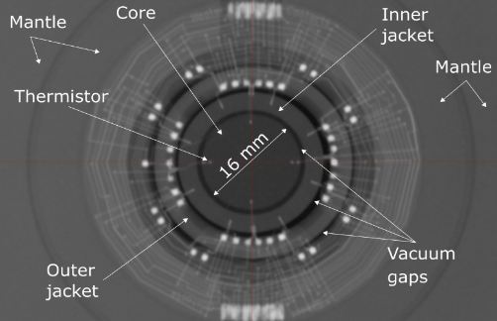
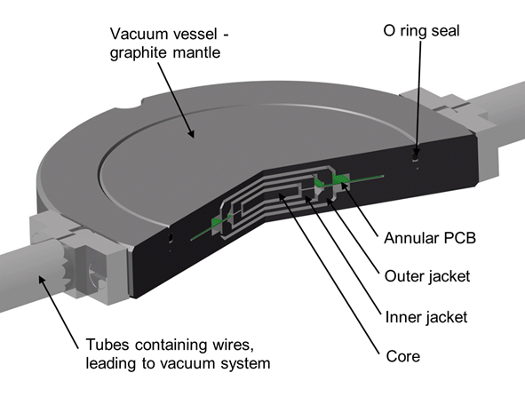
Calorimetry in UHDR beams
NPL primary standard graphite calorimeter
the control and analysis software was reconfigured to enable it to be used with UHDR particle beams
Operated in quasi-adiabatic mode, thermistors detect changes in temperature of the graphite created by energy absorbed from the radiation beam allowing derivation of absorbed dose
Fig. NPL’s primary standard graphite calorimeter.

Slide 12
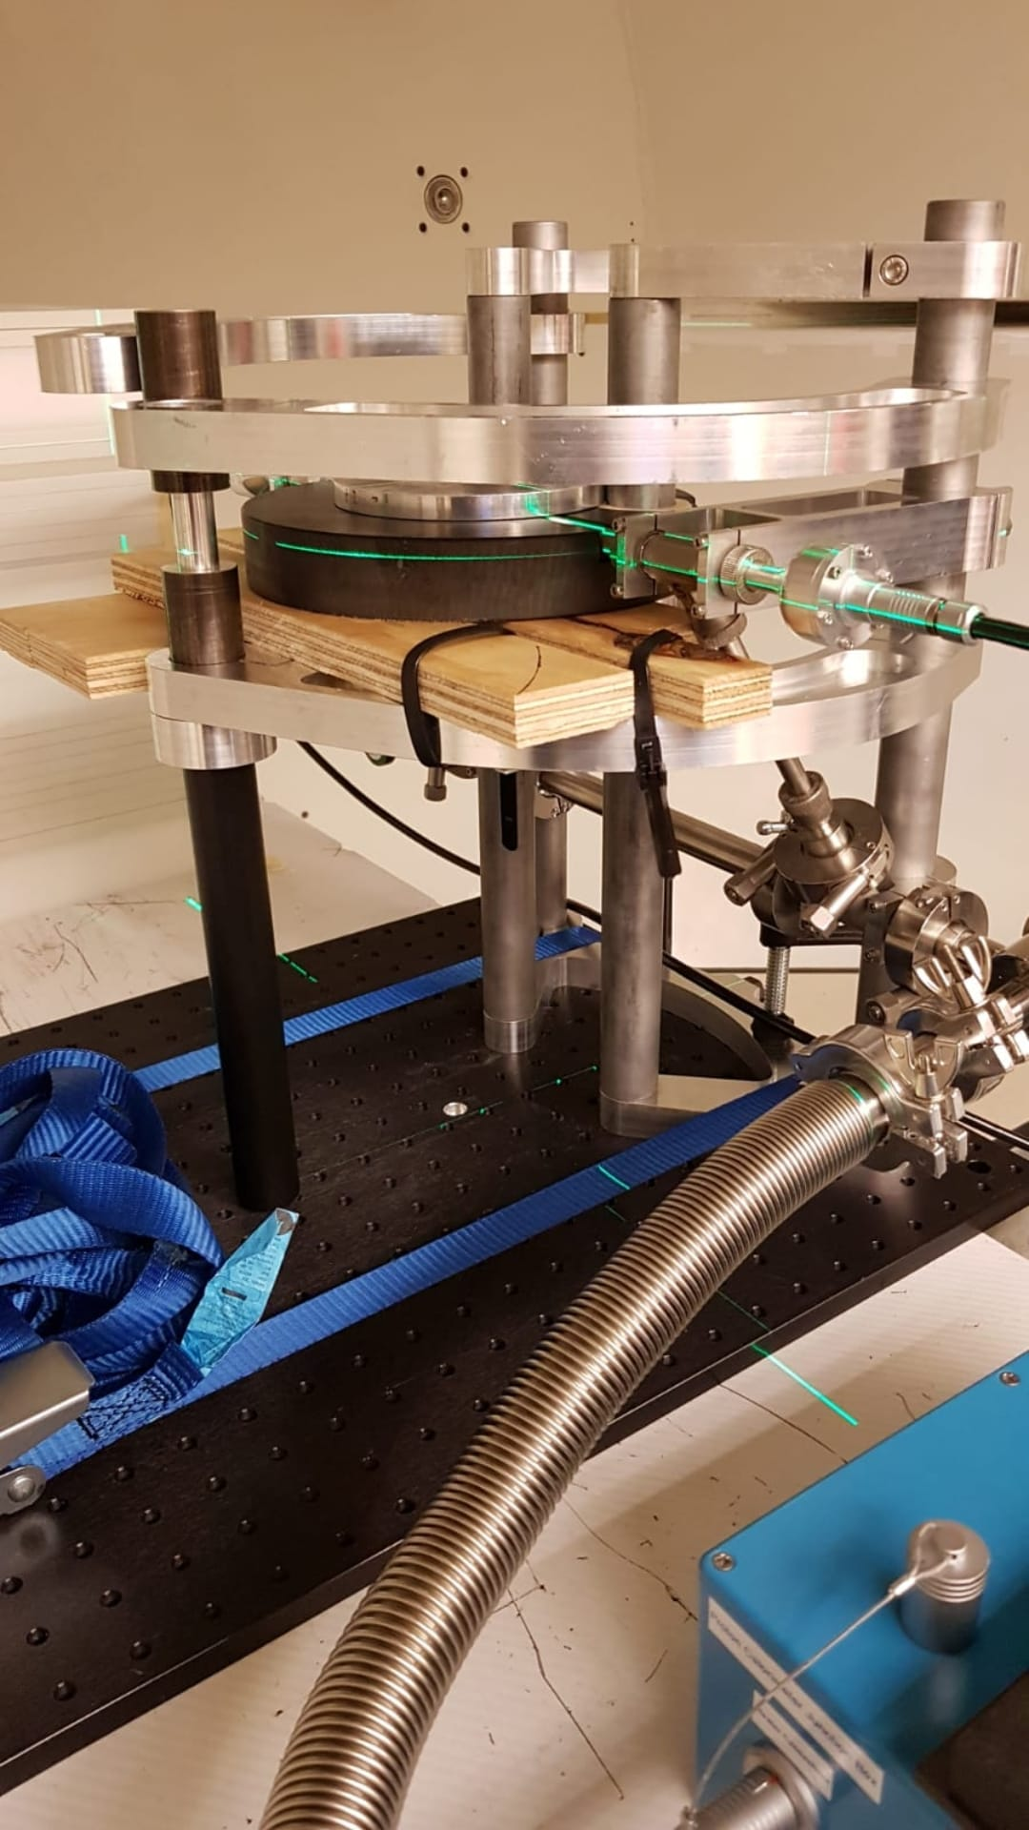
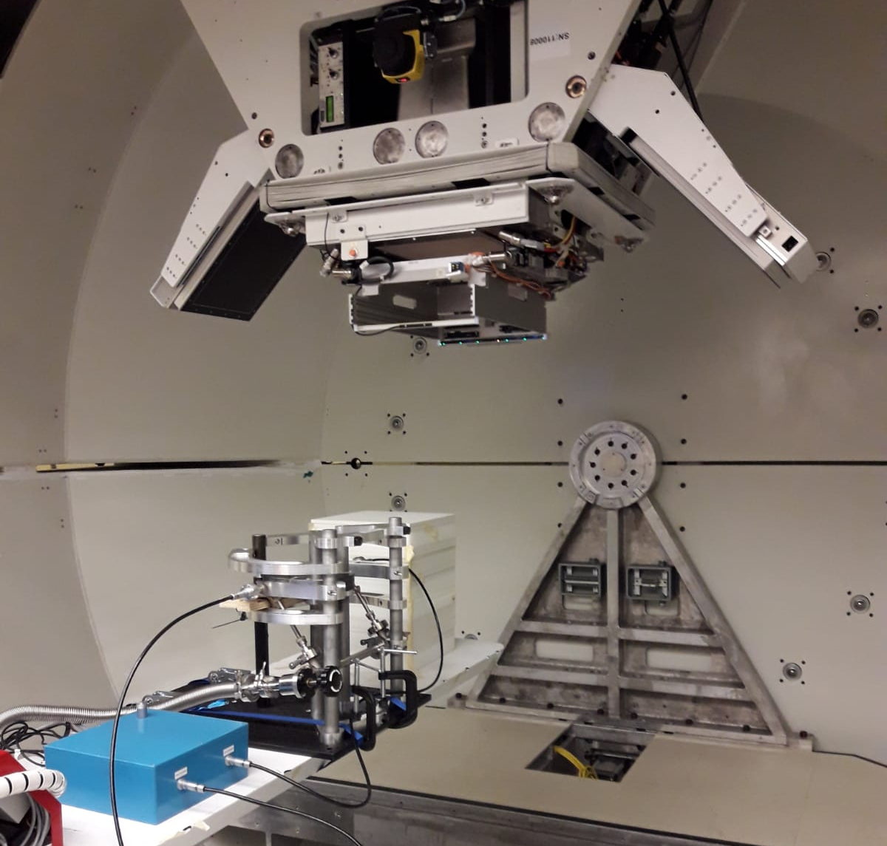
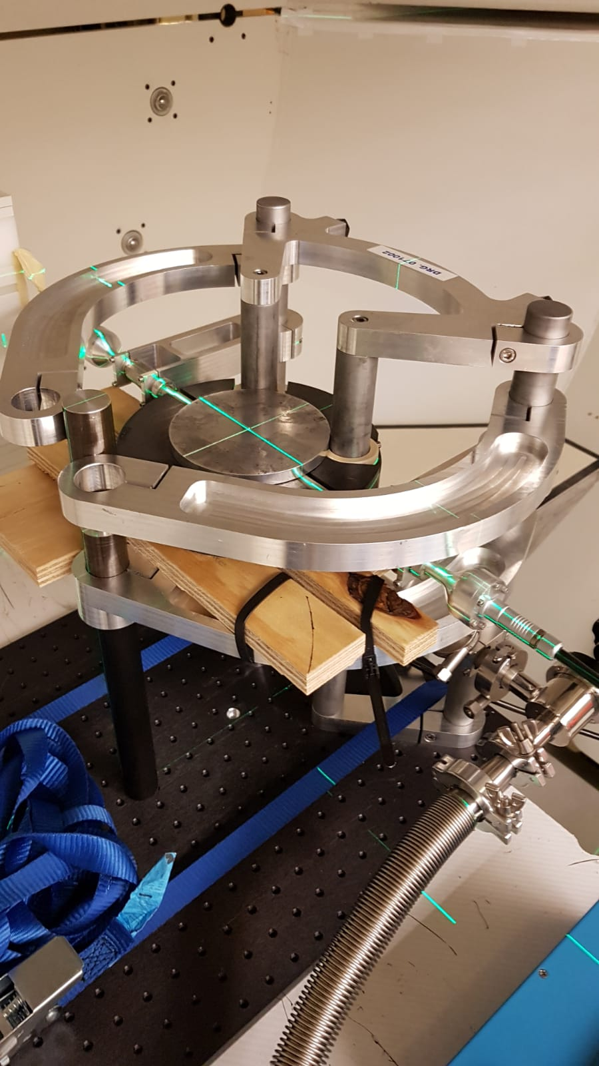

Slide 13


Slide 14
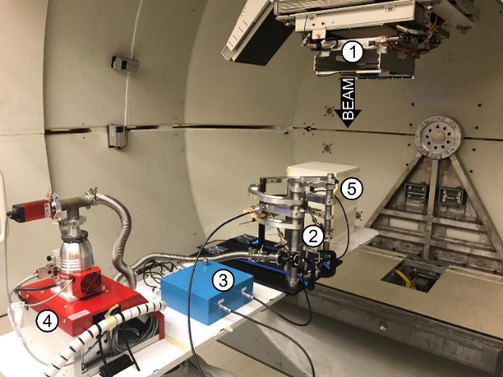
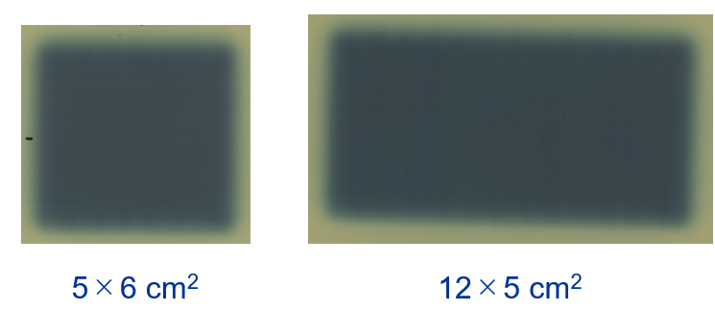
Calorimetry in UHDR beams
NPL primary standard graphite calorimeter
250 MeV (Varian ProBeam® operating in research mode) at ~63 Gy/s, proton bunches with 0.2-ns pulse duration at 72.8-MHz RF repetition rate corresponding to 0.2-ns micro-pulses separated by 13.7-ns intervals
The core of the calorimeter was positioned at the isocentre with graphite plates placed in front to position the core at a WET of 5.2 gcm⁻²
    5×6 cm²
    5×8 cm²
    5×10 cm²
    5×12 cm²
    6×5 cm²
    12×5 cm²
Experimental setup mounted on the patient couch and radiograph of the NPL PSPC. (a) (1) Gantry, (2) NPL PSPC, (3) measurement instrumentation for the NPL PSPC, (4) vacuum pump, (5) ionisation chamber setup.

Slide 15
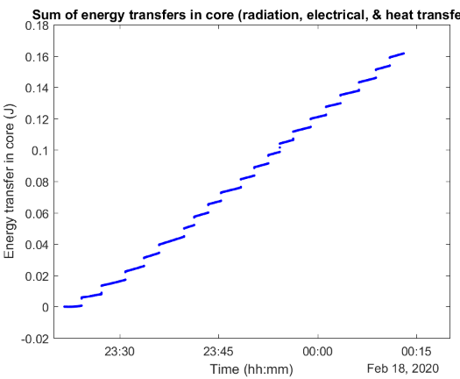

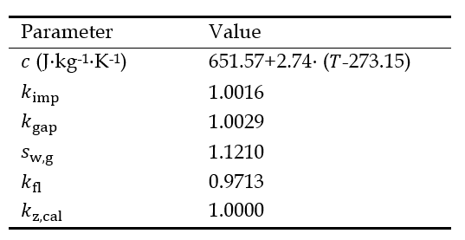
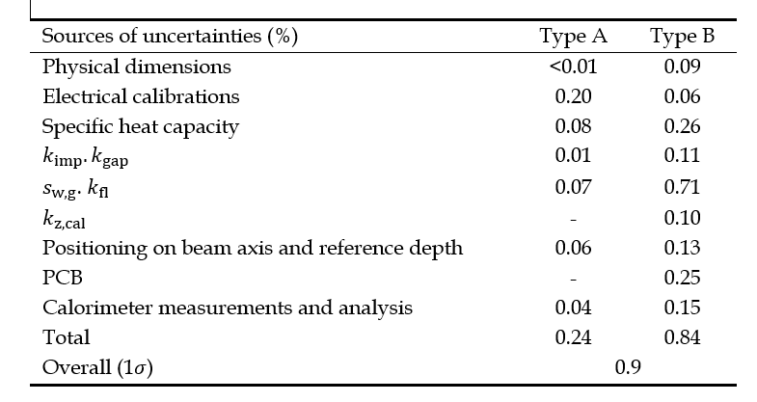


Calorimetry in UHDR beams
Data were collected at 5 Hz and irradiations were repeated at least 20 times for each field tested to achieve a relative standard uncertainty of 0.04% (Type A)
The average measured absorbed dose for the six fields by the NPL PSPC was 7.8 Gy with a standard deviation of 0.5%.
$$D_{\text{core}}=∆T_{core}{.c}_{g}$$
$$D_{\text{w}}=D_{\text{core}}.k_{imp}k_{gap}k_{z,cal}s_{w,g}k_{fl}$$
Beam
direction
Calorimetry run in 250 MeV FLASH proton beam for 5x6 cm2
Lourenço et al. Sci.Rep. accepted

Slide 16


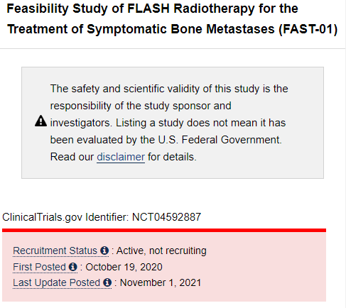
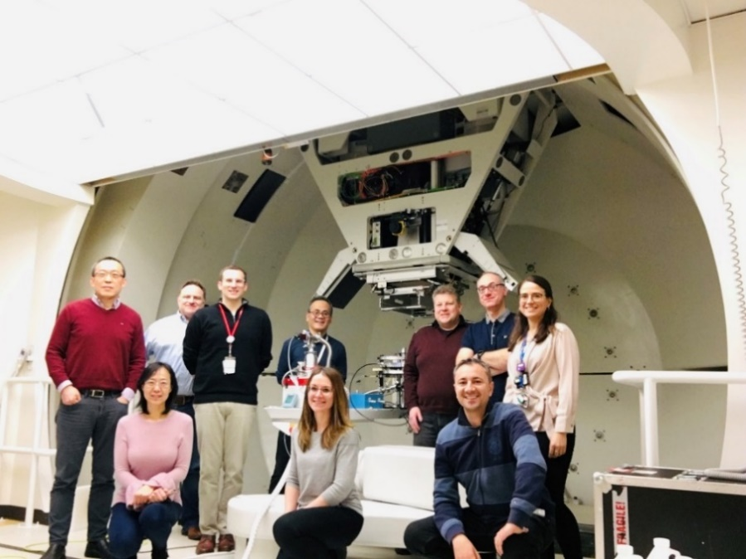
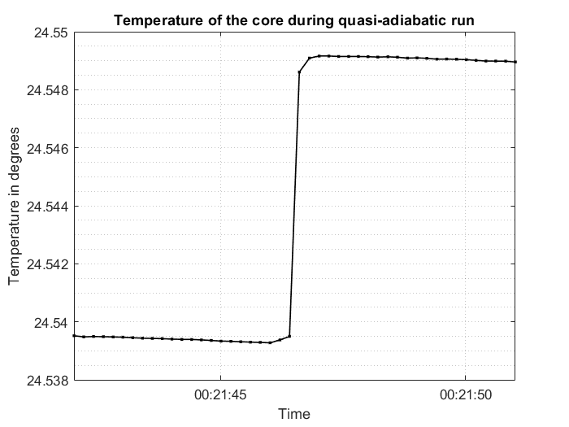
Calorimetry in UHDR proton beams
→ First ever calorimetry measurements in UHDR proton beam
Established the correction factors required for absolute dosimetry of FLASH proton beam radiotherapy (Lourenço et al., 2023 Nature, Scientific Reports, accepted) → see also Deliverable 2 of the UHDpulse project
Measurement uncertainty of 0.9% (k=1) – in line with clinical requirement
Underpinned the FDA approval and provided the hospital with confidence to commence clinical implementation of this novel technology
NPL and Cincinnati Teams

Slide 17
Thank you
Acknowledgements
Ana Lourenco
Nigel Lee
Hugo Palmans
Russell Thomas
This project (18HLT04) has received funding from the EMPIR programme co-financed by the Participating States and from the European Union’s Horizon 2020 research and innovation programme.
anna.subiel@npl.co.uk
http://uhdpulse-empir.eu/

