Slide 1
Absolute Charge Measurement in UHDpulse electron beams
F. Frei, A. Schüller, C.Bailat, P. Peier

Slide 2
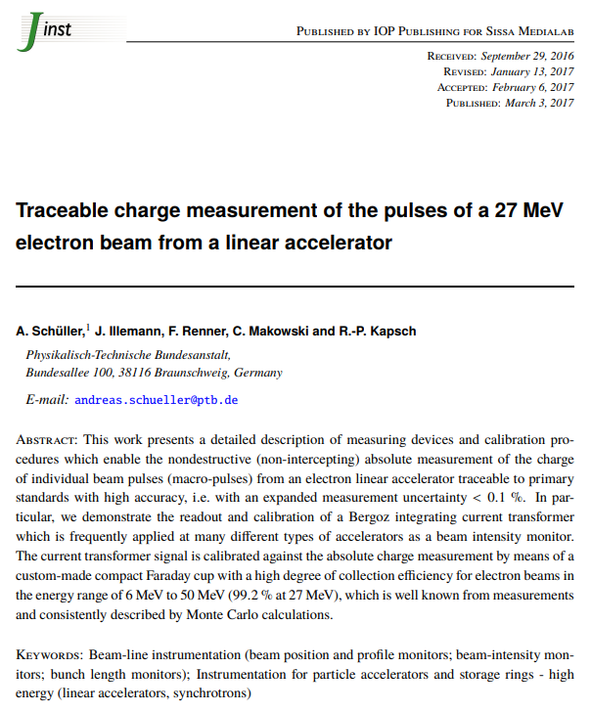
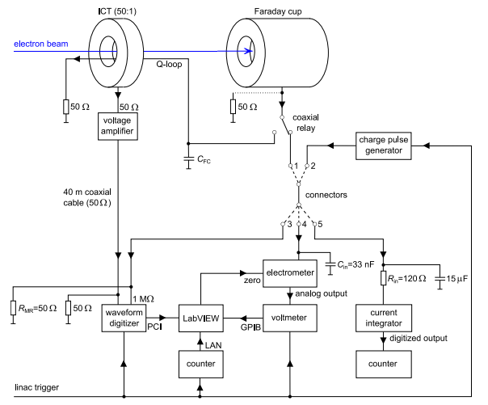
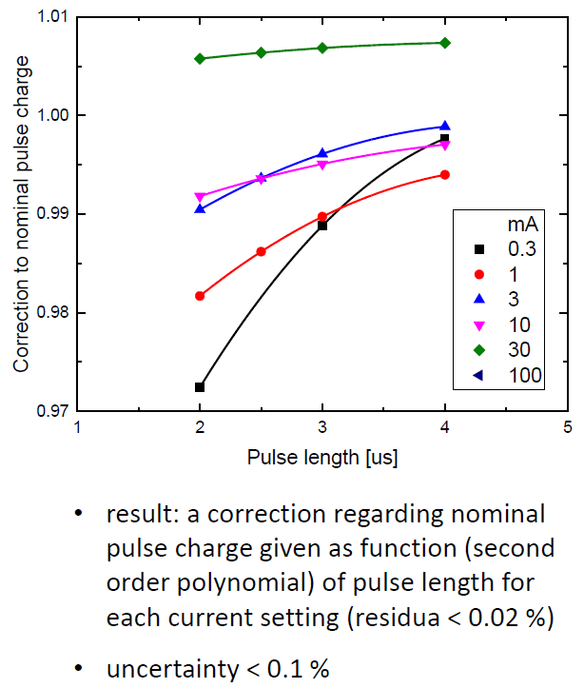
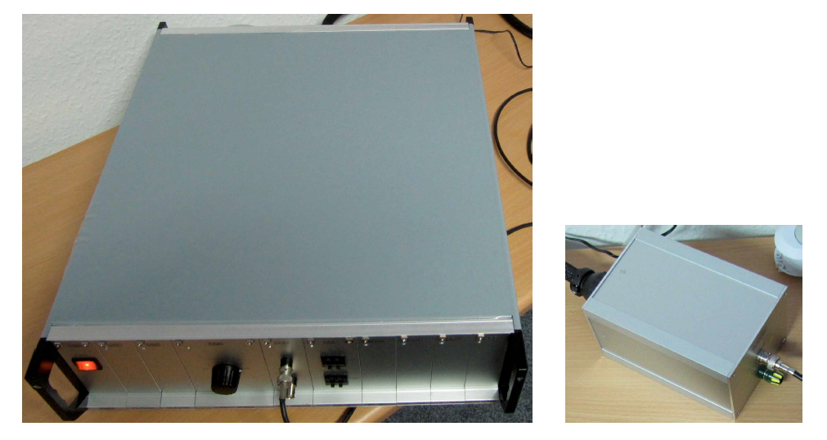
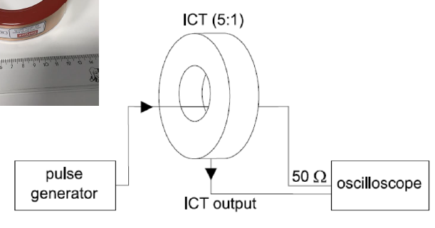
Calibration of absolute charge measurement
Reference charge pulse generator (PTB)
A1.1.3

Slide 3
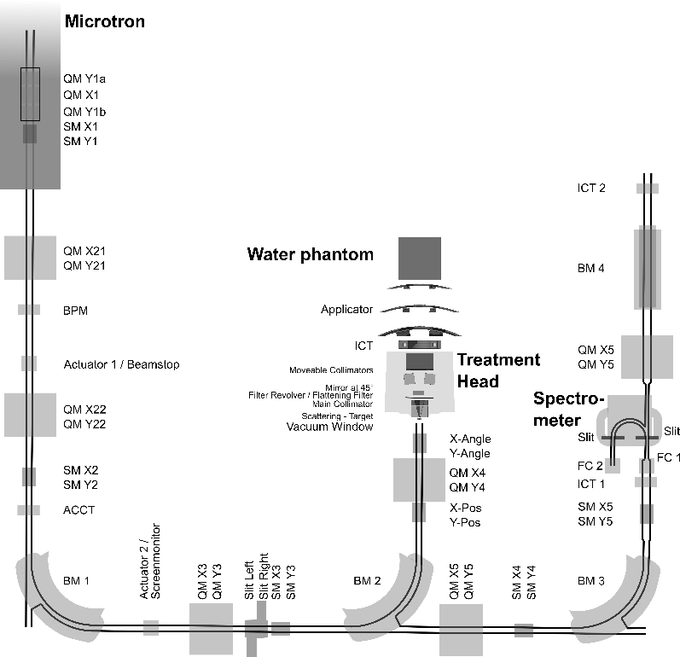
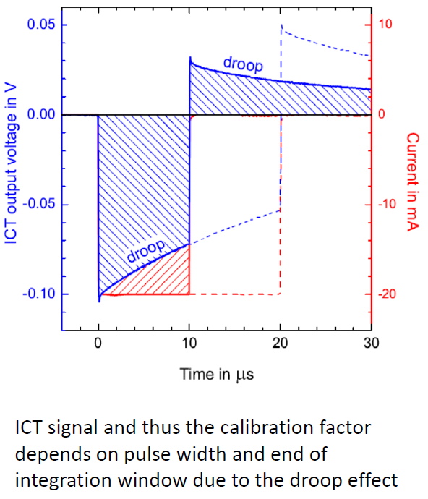
Calibration of absolute charge measurement
Reference charge pulse generator (PTB)
ICTs and ACCT@METAS

Slide 4
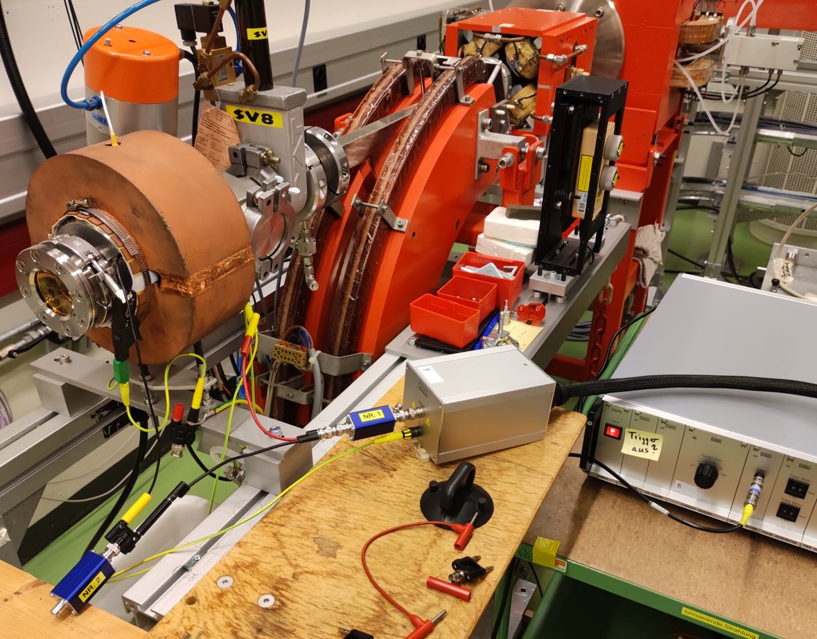
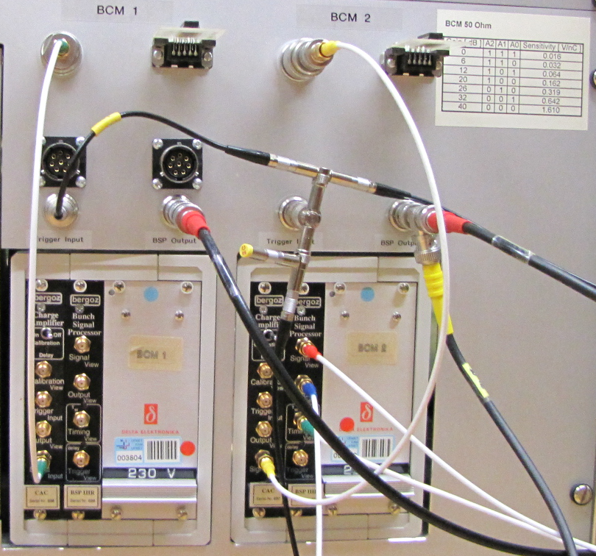
Calibration of absolute charge measurement
raw signal from accelerator
Verifications
Using accelerator:
Connecting full measurement chain including proper readout electronics
Record traces with respect to timing windows
Check center of mass
Check relative signal contributions in timing windows
Connecting calibrated reference charge pulse generator:
Set proper pulse length (3us)
Adjust delay to match situation with accelerator (center of mass with respect to timing windows)
Verify relative signal contributions in timing windows
filtering
26dB gain
Baseline
+
-
ICT signal

Slide 5
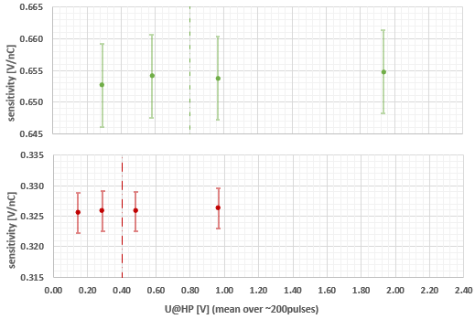
Calibration of absolute charge measurement
With calibrated reference charge pulse generator:
32dB gain
26dB gain
Expanded uncertainty of deduced sensitivity: 1% (k=2) Dominant contribution from: correction factor of nominal pulse charge given as a function of pulse length for each current setting.

Slide 6
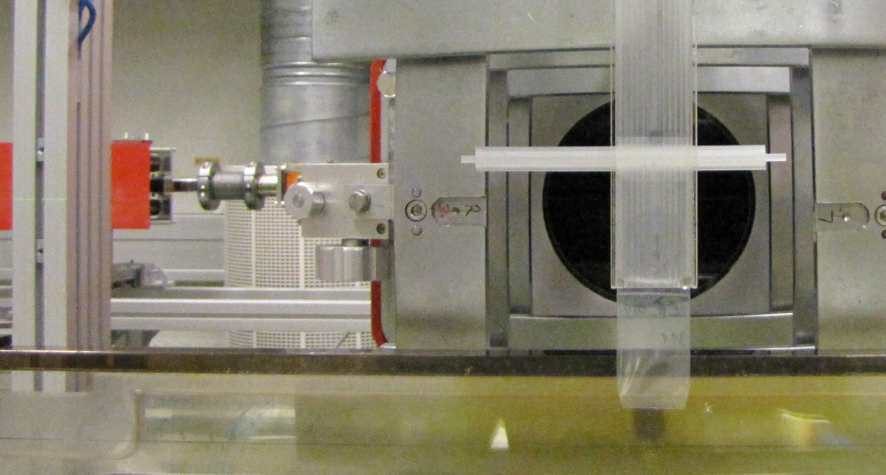
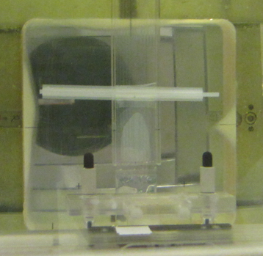
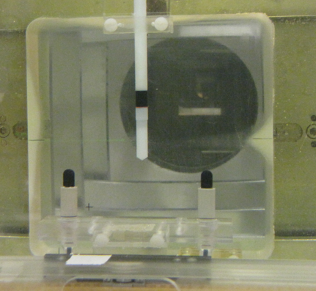
Absolute charge measurement used for Fricke dosimetry
Fricke total absorption:
$$ε∙G=\frac{ΔA}{ρ∙l∙D_{F}}=\frac{ΔA}{ρ∙l}∙\frac{m}{E_{el}∙N∙f_{p}}$$
number of electrons
Fricke dosimeter in bags:
$$D_{W}=D_{F}∙f_{F/W}=\frac{Δc∙f_{F/W}}{ρ∙G}= \frac{ΔA∙f_{F/W}}{ρ∙l∙ε∙G}$$
Comparison of the primary standards of PTB and METAS for absorbed dose to water in ultra-high dose per pulse electron beams via alanine dosimeters provided by the National Research Council of Canada (NRC).
The summary of this analysis is that the standards of the METAS and PTB for UHDR electron beams agree within the combined standard uncertainty of the comparison measurement, R_{METAS/PTB} = 1.002 ± 0.012 (k=1). -> Deliverable 3 (See talk 24. of Alexandra Bourgoin, PTB).

Slide 7
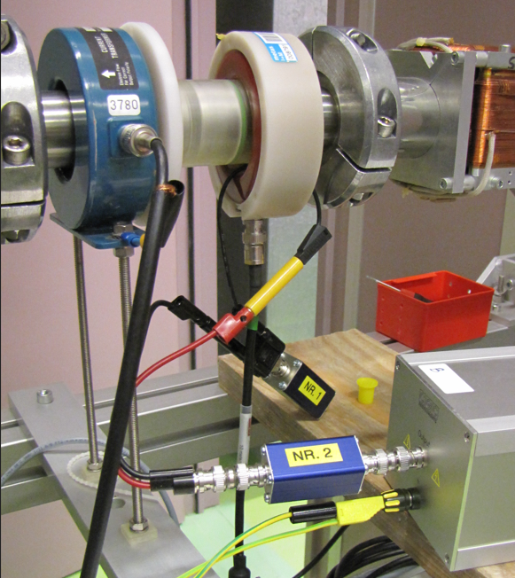
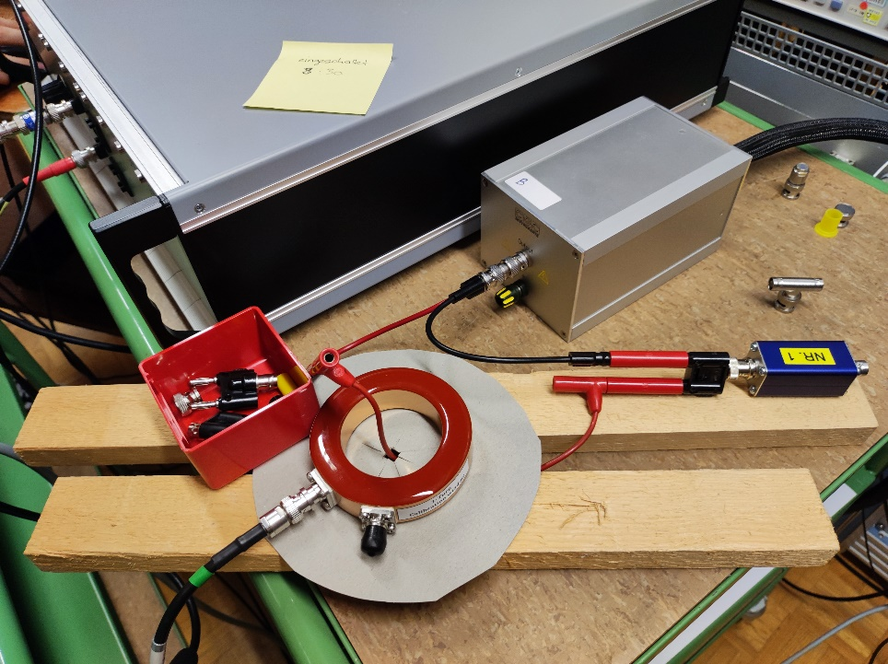
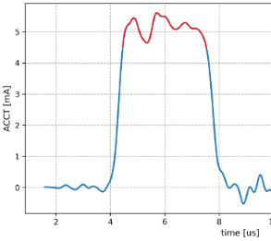
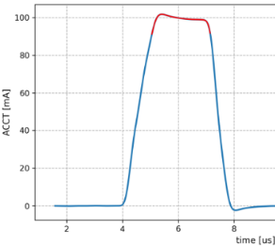
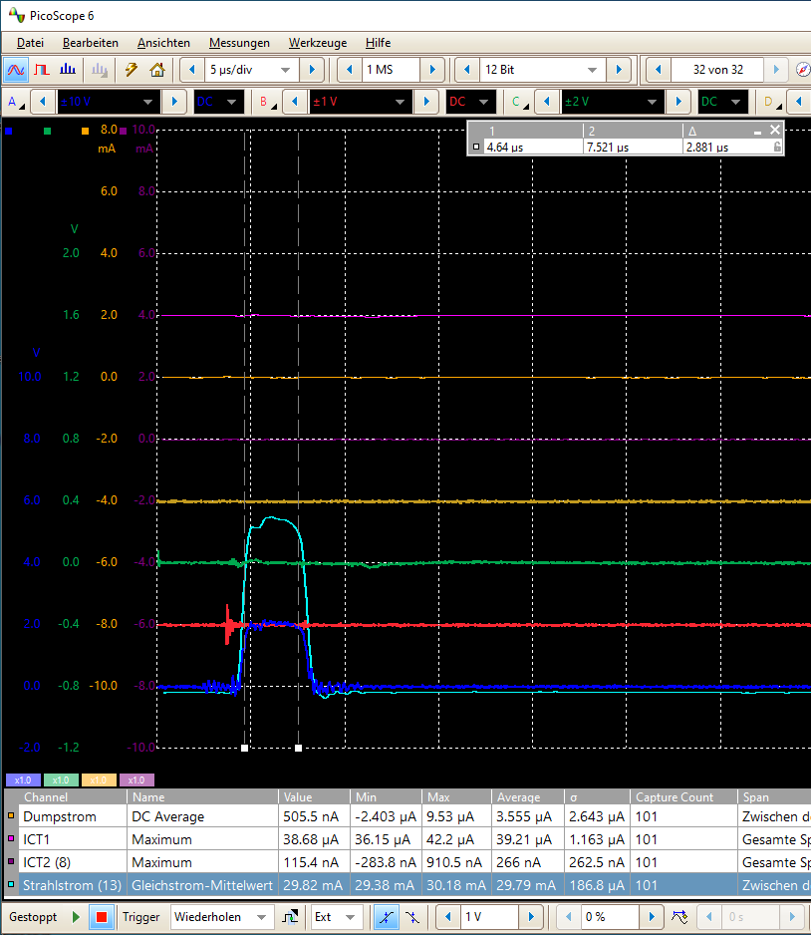
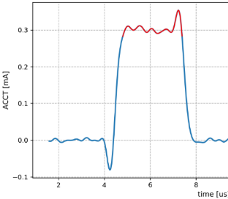
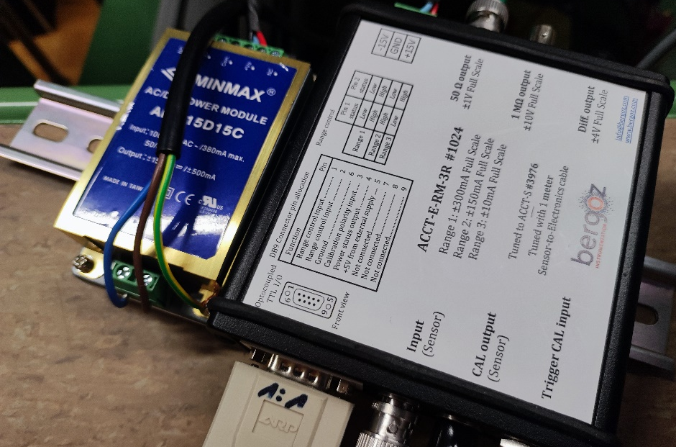
Calibration of ACCT
METS ACCT
accelerator
CHUV ACCT
@METAS:
Existing calibration in good agreement with the calibrated reference charge pulse generator.
Since the ACCT signal is only used for rough beam setup, the calibration coefficient were not updated.

Slide 9
Thank you very much for your attention

