Slide 1



Absolute dosimetry measurements with laser-driven ion beams using a portable calorimeter
Sean McCallum
Proof-of-principle measurements: UHDPulse 2nd Stakeholders meeting
January 2023, Prague, CZ

Slide 2
What happens if I am sick during my pregnancy?
If you are absent from work due to pregnancy related reasons you need to follow the normal process for advising your manager and providing Fit Notes if applicable. If you are absent for pregnancy related reasons within four weeks of your expected week of childbirth, your maternity leave will automatically commence.
What is the current rate of Statutory Maternity Pay?
The government sets this annually. You can find out on www.gov.uk
I am on a fixed term contract. How does that affect my entitlements?
You will have the same entitlements to pay and leave providing you meet the qualifying criteria. If your fixed term contract ends during your maternity leave and is not renewed, the entitlement to the enhanced University maternity pay will cease but SMP will continue to be paid.
How does the University maternity entitlement differ from the statutory one?
The University offers enhanced maternity pay to eligible employees, based on length of service. The current entitlements are set out in the Maternity Policy and in this guidance.
What happens if I choose not to return to work after my maternity leave?
If you decide not to return to work, you will need to provide written notice in accordance with your contract of employment. If you have received enhanced University maternity pay but do not return to work for at least three months, you will be required to repay the difference between the enhanced payments and SMP.
Do I still accrue holiday while I am on maternity leave?
Yes. Your holiday will still accrue as normal.
When can I start my maternity leave?
You can begin your maternity leave on any date after the 11th week before your expected week of childbirth. Your midwife will confirm your expected week of childbirth on the MATB1 form around your 20th week of pregnancy.
What happens to my job while I am on leave?
Managers have various options. They may choose to bring in temporary cover or seek to manage the duties via secondments or redistribution of work with other team members. Your manager will discuss this with you. However your job is covered in your absence, you have the right to return to it, or a similar role with comparable terms and conditions.
What if I want to change my return date once my leave commences?
We will write to you to confirm the latest date you are expected to return to work after your maternity leave. This will be at the end of the 52nd week. If you want to return sooner than this date then please confirm this in writing, at least 28 days before the date you intend to return to work. If you would like to return later, for example by taking parental additional leave, please notify your manager in writing of your request.
I gave a date that I would like to start my maternity leave, but now I want to change it. Can I do that?
Yes. You are required to tell us in writing at least 28 days prior to the new date.
Can I return to work on a phased basis?
This may be possible depending on operational requirements. Please discuss this with your manager.
What happens to my maternity leave if my baby is born early?
Maternity leave is triggered by childbirth. If your baby is born early your maternity leave will therefore start immediately.
When I return to work, I want to change my hours of work. What do I need to do?
You can make a flexible working request prior to your return to work under our Flexible Working Policy. You can discuss your plans with your manager at any time. See http://documents.manchester.ac.uk/DocuInfo.aspx?DocID=9
Can I take holiday during my maternity leave?
All holiday must be taken outside of the maternity leave period. It is not possible to be on maternity leave and holiday at the same time. Holiday can be taken immediately before or after maternity leave.
Can I carry holiday forward into next year?
In most cases there should be sufficient time leading up to the leave period to effectively plan the use of holiday in advance of the maternity leave period. The University allows up to one week’s holiday to be carried over into the next holiday year.
What happens to my pension contributions when I am on maternity leave?
There are different rules for different pension schemes. For more information please contact your scheme provider or a member of the pensions team who will be able to provide more information
Can my manager ask me to come into work during my maternity leave? If so, do I have to agree?
The University, as an employer, is allowed to make reasonable contact with employees whilst they are on maternity leave. You are not obliged to do any work or attend any work related events during maternity leave, however if you and your manager both agree, then you can work up to a total of 10 days during your leave. These are called ‘Keeping in Touch’ days.
Do I have to agree in advance if I want to come to work for a Keeping in Touch Day?
Yes, you and your manager should agree in advance when you are going to attend work for one of your Keeping in Touch Days to allow both parties to make any necessary arrangements.
If I attend work for half a day or less, is this classed as one of my Keeping in Touch Days?
Yes, as soon as you start work, even if it is for only a few hours, this is counted as one of your 10 KIT days. The number of hours that you attend work can be up to the maximum of the full time equivalent.
Will I be placed at a disadvantage on my return if I don’t come into work prior to the end of my maternity leave?
Employees are encouraged to make use of KIT days as a positive way to keep in contact with developments in their workplace. As work during maternity leave may only take place with the agreement of both parties, you will not be at any disadvantage regarding the options you choose about KIT days.
I have been asked to be an external examiner for another University; can I use a Keeping in Touch Day to undertake this work?
No, because this is paid work for another employer and will therefore impact upon your maternity arrangements.
What type of work will I be expected to undertake whilst in work on a Keeping in Touch Day?
The purpose of these days is to allow you to be kept informed and up to date on developments within your own workplace or within the University. This may include attending a conference, undertaking training or a team event.
How else can I keep in touch during my maternity leave?
The University encourages managers and employees to discuss this prior to the start of maternity leave. Ultimately, it is up to you how you want to be updated about work matters. Some employees want a regular update, others would prefer no contact at all.
Outline of the work
Laser-driven particle acceleration
Dosimetry challenges of UHDR beams
Calorimetry techniques – development & refurbishing the NPL SPGC
Proof-of-principle calorimetry measurements at RAL, UK
Outlook, acknowledgements, references

Slide 3
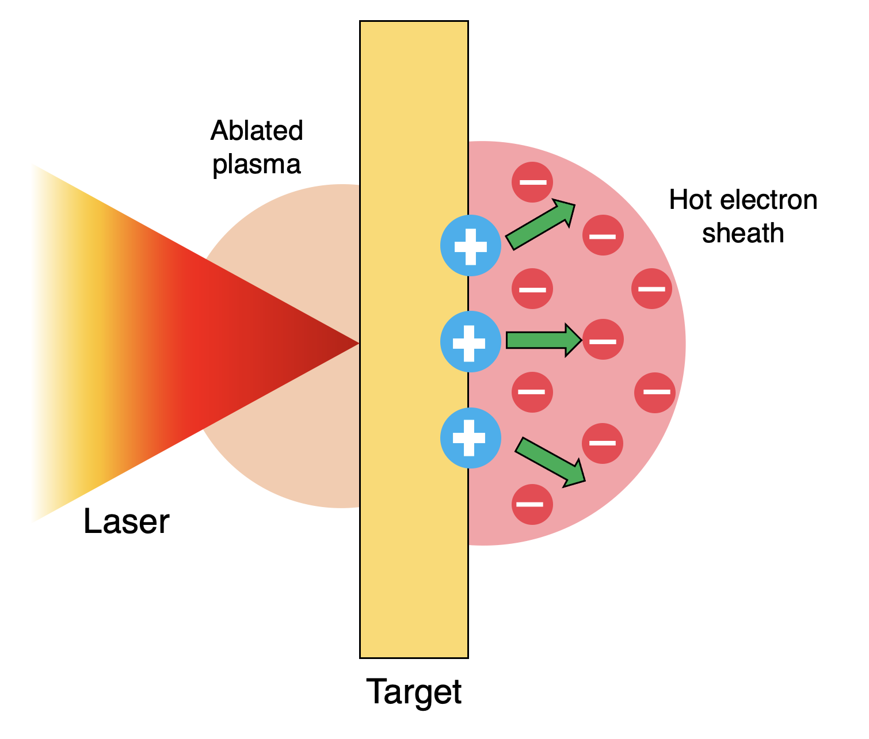
What happens if I am sick during my pregnancy?
If you are absent from work due to pregnancy related reasons you need to follow the normal process for advising your manager and providing Fit Notes if applicable. If you are absent for pregnancy related reasons within four weeks of your expected week of childbirth, your maternity leave will automatically commence.
What is the current rate of Statutory Maternity Pay?
The government sets this annually. You can find out on www.gov.uk
I am on a fixed term contract. How does that affect my entitlements?
You will have the same entitlements to pay and leave providing you meet the qualifying criteria. If your fixed term contract ends during your maternity leave and is not renewed, the entitlement to the enhanced University maternity pay will cease but SMP will continue to be paid.
How does the University maternity entitlement differ from the statutory one?
The University offers enhanced maternity pay to eligible employees, based on length of service. The current entitlements are set out in the Maternity Policy and in this guidance.
What happens if I choose not to return to work after my maternity leave?
If you decide not to return to work, you will need to provide written notice in accordance with your contract of employment. If you have received enhanced University maternity pay but do not return to work for at least three months, you will be required to repay the difference between the enhanced payments and SMP.
Do I still accrue holiday while I am on maternity leave?
Yes. Your holiday will still accrue as normal.
When can I start my maternity leave?
You can begin your maternity leave on any date after the 11th week before your expected week of childbirth. Your midwife will confirm your expected week of childbirth on the MATB1 form around your 20th week of pregnancy.
What happens to my job while I am on leave?
Managers have various options. They may choose to bring in temporary cover or seek to manage the duties via secondments or redistribution of work with other team members. Your manager will discuss this with you. However your job is covered in your absence, you have the right to return to it, or a similar role with comparable terms and conditions.
What if I want to change my return date once my leave commences?
We will write to you to confirm the latest date you are expected to return to work after your maternity leave. This will be at the end of the 52nd week. If you want to return sooner than this date then please confirm this in writing, at least 28 days before the date you intend to return to work. If you would like to return later, for example by taking parental additional leave, please notify your manager in writing of your request.
I gave a date that I would like to start my maternity leave, but now I want to change it. Can I do that?
Yes. You are required to tell us in writing at least 28 days prior to the new date.
Can I return to work on a phased basis?
This may be possible depending on operational requirements. Please discuss this with your manager.
What happens to my maternity leave if my baby is born early?
Maternity leave is triggered by childbirth. If your baby is born early your maternity leave will therefore start immediately.
When I return to work, I want to change my hours of work. What do I need to do?
You can make a flexible working request prior to your return to work under our Flexible Working Policy. You can discuss your plans with your manager at any time. See http://documents.manchester.ac.uk/DocuInfo.aspx?DocID=9
Can I take holiday during my maternity leave?
All holiday must be taken outside of the maternity leave period. It is not possible to be on maternity leave and holiday at the same time. Holiday can be taken immediately before or after maternity leave.
Can I carry holiday forward into next year?
In most cases there should be sufficient time leading up to the leave period to effectively plan the use of holiday in advance of the maternity leave period. The University allows up to one week’s holiday to be carried over into the next holiday year.
What happens to my pension contributions when I am on maternity leave?
There are different rules for different pension schemes. For more information please contact your scheme provider or a member of the pensions team who will be able to provide more information
Can my manager ask me to come into work during my maternity leave? If so, do I have to agree?
The University, as an employer, is allowed to make reasonable contact with employees whilst they are on maternity leave. You are not obliged to do any work or attend any work related events during maternity leave, however if you and your manager both agree, then you can work up to a total of 10 days during your leave. These are called ‘Keeping in Touch’ days.
Do I have to agree in advance if I want to come to work for a Keeping in Touch Day?
Yes, you and your manager should agree in advance when you are going to attend work for one of your Keeping in Touch Days to allow both parties to make any necessary arrangements.
If I attend work for half a day or less, is this classed as one of my Keeping in Touch Days?
Yes, as soon as you start work, even if it is for only a few hours, this is counted as one of your 10 KIT days. The number of hours that you attend work can be up to the maximum of the full time equivalent.
Will I be placed at a disadvantage on my return if I don’t come into work prior to the end of my maternity leave?
Employees are encouraged to make use of KIT days as a positive way to keep in contact with developments in their workplace. As work during maternity leave may only take place with the agreement of both parties, you will not be at any disadvantage regarding the options you choose about KIT days.
I have been asked to be an external examiner for another University; can I use a Keeping in Touch Day to undertake this work?
No, because this is paid work for another employer and will therefore impact upon your maternity arrangements.
What type of work will I be expected to undertake whilst in work on a Keeping in Touch Day?
The purpose of these days is to allow you to be kept informed and up to date on developments within your own workplace or within the University. This may include attending a conference, undertaking training or a team event.
How else can I keep in touch during my maternity leave?
The University encourages managers and employees to discuss this prior to the start of maternity leave. Ultimately, it is up to you how you want to be updated about work matters. Some employees want a regular update, others would prefer no contact at all.
Laser-driven charged particle beams
Laser-target interaction can generate energetic proton bunches
  Near-instantaneous dose deliveries
Possibility to operate at extremely high dose rates per pulse
Several 10’s of MeV in energy
Ultrashort pulse durations
- ps at source, ns at delivery site
Ultra high dose rates per pulse
- 10⁹ – 10¹⁰ Gy/s
Wide energy distributions
- up to 100% spread
Characterization of energy spectra possible through RCF spectroscopy (see poster)
Notes:
.

Slide 4



What happens if I am sick during my pregnancy?
If you are absent from work due to pregnancy related reasons you need to follow the normal process for advising your manager and providing Fit Notes if applicable. If you are absent for pregnancy related reasons within four weeks of your expected week of childbirth, your maternity leave will automatically commence.
What is the current rate of Statutory Maternity Pay?
The government sets this annually. You can find out on www.gov.uk
I am on a fixed term contract. How does that affect my entitlements?
You will have the same entitlements to pay and leave providing you meet the qualifying criteria. If your fixed term contract ends during your maternity leave and is not renewed, the entitlement to the enhanced University maternity pay will cease but SMP will continue to be paid.
How does the University maternity entitlement differ from the statutory one?
The University offers enhanced maternity pay to eligible employees, based on length of service. The current entitlements are set out in the Maternity Policy and in this guidance.
What happens if I choose not to return to work after my maternity leave?
If you decide not to return to work, you will need to provide written notice in accordance with your contract of employment. If you have received enhanced University maternity pay but do not return to work for at least three months, you will be required to repay the difference between the enhanced payments and SMP.
Do I still accrue holiday while I am on maternity leave?
Yes. Your holiday will still accrue as normal.
When can I start my maternity leave?
You can begin your maternity leave on any date after the 11th week before your expected week of childbirth. Your midwife will confirm your expected week of childbirth on the MATB1 form around your 20th week of pregnancy.
What happens to my job while I am on leave?
Managers have various options. They may choose to bring in temporary cover or seek to manage the duties via secondments or redistribution of work with other team members. Your manager will discuss this with you. However your job is covered in your absence, you have the right to return to it, or a similar role with comparable terms and conditions.
What if I want to change my return date once my leave commences?
We will write to you to confirm the latest date you are expected to return to work after your maternity leave. This will be at the end of the 52nd week. If you want to return sooner than this date then please confirm this in writing, at least 28 days before the date you intend to return to work. If you would like to return later, for example by taking parental additional leave, please notify your manager in writing of your request.
I gave a date that I would like to start my maternity leave, but now I want to change it. Can I do that?
Yes. You are required to tell us in writing at least 28 days prior to the new date.
Can I return to work on a phased basis?
This may be possible depending on operational requirements. Please discuss this with your manager.
What happens to my maternity leave if my baby is born early?
Maternity leave is triggered by childbirth. If your baby is born early your maternity leave will therefore start immediately.
When I return to work, I want to change my hours of work. What do I need to do?
You can make a flexible working request prior to your return to work under our Flexible Working Policy. You can discuss your plans with your manager at any time. See http://documents.manchester.ac.uk/DocuInfo.aspx?DocID=9
Can I take holiday during my maternity leave?
All holiday must be taken outside of the maternity leave period. It is not possible to be on maternity leave and holiday at the same time. Holiday can be taken immediately before or after maternity leave.
Can I carry holiday forward into next year?
In most cases there should be sufficient time leading up to the leave period to effectively plan the use of holiday in advance of the maternity leave period. The University allows up to one week’s holiday to be carried over into the next holiday year.
What happens to my pension contributions when I am on maternity leave?
There are different rules for different pension schemes. For more information please contact your scheme provider or a member of the pensions team who will be able to provide more information
Can my manager ask me to come into work during my maternity leave? If so, do I have to agree?
The University, as an employer, is allowed to make reasonable contact with employees whilst they are on maternity leave. You are not obliged to do any work or attend any work related events during maternity leave, however if you and your manager both agree, then you can work up to a total of 10 days during your leave. These are called ‘Keeping in Touch’ days.
Do I have to agree in advance if I want to come to work for a Keeping in Touch Day?
Yes, you and your manager should agree in advance when you are going to attend work for one of your Keeping in Touch Days to allow both parties to make any necessary arrangements.
If I attend work for half a day or less, is this classed as one of my Keeping in Touch Days?
Yes, as soon as you start work, even if it is for only a few hours, this is counted as one of your 10 KIT days. The number of hours that you attend work can be up to the maximum of the full time equivalent.
Will I be placed at a disadvantage on my return if I don’t come into work prior to the end of my maternity leave?
Employees are encouraged to make use of KIT days as a positive way to keep in contact with developments in their workplace. As work during maternity leave may only take place with the agreement of both parties, you will not be at any disadvantage regarding the options you choose about KIT days.
I have been asked to be an external examiner for another University; can I use a Keeping in Touch Day to undertake this work?
No, because this is paid work for another employer and will therefore impact upon your maternity arrangements.
What type of work will I be expected to undertake whilst in work on a Keeping in Touch Day?
The purpose of these days is to allow you to be kept informed and up to date on developments within your own workplace or within the University. This may include attending a conference, undertaking training or a team event.
How else can I keep in touch during my maternity leave?
The University encourages managers and employees to discuss this prior to the start of maternity leave. Ultimately, it is up to you how you want to be updated about work matters. Some employees want a regular update, others would prefer no contact at all.
Challenges of dosimetry measurements at UHDR
Response of established active detectors influenced by high dose rates (saturation)
  - Consequence of the ultra-short pulse durations
Harsh experimental environment created during laser-target interaction
  - Generation of a large electromagnetic pulse (EMP)
Conventional source
Controlled delivery
Laser-driven approach
Particle burst
Revision of current dosimetry protocols and framework for dose measurements
Notes:
.

Slide 5
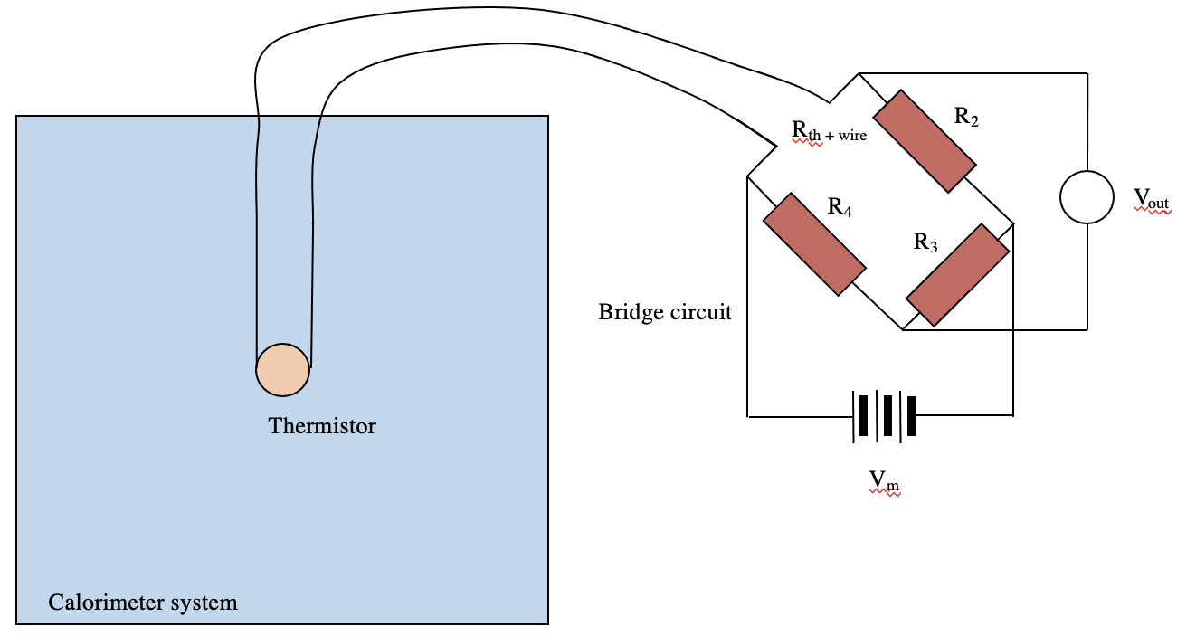
What happens if I am sick during my pregnancy?
If you are absent from work due to pregnancy related reasons you need to follow the normal process for advising your manager and providing Fit Notes if applicable. If you are absent for pregnancy related reasons within four weeks of your expected week of childbirth, your maternity leave will automatically commence.
What is the current rate of Statutory Maternity Pay?
The government sets this annually. You can find out on www.gov.uk
I am on a fixed term contract. How does that affect my entitlements?
You will have the same entitlements to pay and leave providing you meet the qualifying criteria. If your fixed term contract ends during your maternity leave and is not renewed, the entitlement to the enhanced University maternity pay will cease but SMP will continue to be paid.
How does the University maternity entitlement differ from the statutory one?
The University offers enhanced maternity pay to eligible employees, based on length of service. The current entitlements are set out in the Maternity Policy and in this guidance.
What happens if I choose not to return to work after my maternity leave?
If you decide not to return to work, you will need to provide written notice in accordance with your contract of employment. If you have received enhanced University maternity pay but do not return to work for at least three months, you will be required to repay the difference between the enhanced payments and SMP.
Do I still accrue holiday while I am on maternity leave?
Yes. Your holiday will still accrue as normal.
When can I start my maternity leave?
You can begin your maternity leave on any date after the 11th week before your expected week of childbirth. Your midwife will confirm your expected week of childbirth on the MATB1 form around your 20th week of pregnancy.
What happens to my job while I am on leave?
Managers have various options. They may choose to bring in temporary cover or seek to manage the duties via secondments or redistribution of work with other team members. Your manager will discuss this with you. However your job is covered in your absence, you have the right to return to it, or a similar role with comparable terms and conditions.
What if I want to change my return date once my leave commences?
We will write to you to confirm the latest date you are expected to return to work after your maternity leave. This will be at the end of the 52nd week. If you want to return sooner than this date then please confirm this in writing, at least 28 days before the date you intend to return to work. If you would like to return later, for example by taking parental additional leave, please notify your manager in writing of your request.
I gave a date that I would like to start my maternity leave, but now I want to change it. Can I do that?
Yes. You are required to tell us in writing at least 28 days prior to the new date.
Can I return to work on a phased basis?
This may be possible depending on operational requirements. Please discuss this with your manager.
What happens to my maternity leave if my baby is born early?
Maternity leave is triggered by childbirth. If your baby is born early your maternity leave will therefore start immediately.
When I return to work, I want to change my hours of work. What do I need to do?
You can make a flexible working request prior to your return to work under our Flexible Working Policy. You can discuss your plans with your manager at any time. See http://documents.manchester.ac.uk/DocuInfo.aspx?DocID=9
Can I take holiday during my maternity leave?
All holiday must be taken outside of the maternity leave period. It is not possible to be on maternity leave and holiday at the same time. Holiday can be taken immediately before or after maternity leave.
Can I carry holiday forward into next year?
In most cases there should be sufficient time leading up to the leave period to effectively plan the use of holiday in advance of the maternity leave period. The University allows up to one week’s holiday to be carried over into the next holiday year.
What happens to my pension contributions when I am on maternity leave?
There are different rules for different pension schemes. For more information please contact your scheme provider or a member of the pensions team who will be able to provide more information
Can my manager ask me to come into work during my maternity leave? If so, do I have to agree?
The University, as an employer, is allowed to make reasonable contact with employees whilst they are on maternity leave. You are not obliged to do any work or attend any work related events during maternity leave, however if you and your manager both agree, then you can work up to a total of 10 days during your leave. These are called ‘Keeping in Touch’ days.
Do I have to agree in advance if I want to come to work for a Keeping in Touch Day?
Yes, you and your manager should agree in advance when you are going to attend work for one of your Keeping in Touch Days to allow both parties to make any necessary arrangements.
If I attend work for half a day or less, is this classed as one of my Keeping in Touch Days?
Yes, as soon as you start work, even if it is for only a few hours, this is counted as one of your 10 KIT days. The number of hours that you attend work can be up to the maximum of the full time equivalent.
Will I be placed at a disadvantage on my return if I don’t come into work prior to the end of my maternity leave?
Employees are encouraged to make use of KIT days as a positive way to keep in contact with developments in their workplace. As work during maternity leave may only take place with the agreement of both parties, you will not be at any disadvantage regarding the options you choose about KIT days.
I have been asked to be an external examiner for another University; can I use a Keeping in Touch Day to undertake this work?
No, because this is paid work for another employer and will therefore impact upon your maternity arrangements.
What type of work will I be expected to undertake whilst in work on a Keeping in Touch Day?
The purpose of these days is to allow you to be kept informed and up to date on developments within your own workplace or within the University. This may include attending a conference, undertaking training or a team event.
How else can I keep in touch during my maternity leave?
The University encourages managers and employees to discuss this prior to the start of maternity leave. Ultimately, it is up to you how you want to be updated about work matters. Some employees want a regular update, others would prefer no contact at all.
Calorimetry techniques for absolute dosimetry
Calorimeters measure radiation induced temperature rise in an absorber material
Temperature changes involved are extremely low, 1 Gy ~ 1.4 mK
  - Sensitive measurement equipment required
  - Isolation of the sensitive region from thermal effects in environment
D_{w} = c_{x} . ∆T . f_{w, x}
Analogous structure consisting of graphite components enclosing one another
Notes:
.

Slide 6
What happens if I am sick during my pregnancy?
If you are absent from work due to pregnancy related reasons you need to follow the normal process for advising your manager and providing Fit Notes if applicable. If you are absent for pregnancy related reasons within four weeks of your expected week of childbirth, your maternity leave will automatically commence.
What is the current rate of Statutory Maternity Pay?
The government sets this annually. You can find out on www.gov.uk
I am on a fixed term contract. How does that affect my entitlements?
You will have the same entitlements to pay and leave providing you meet the qualifying criteria. If your fixed term contract ends during your maternity leave and is not renewed, the entitlement to the enhanced University maternity pay will cease but SMP will continue to be paid.
How does the University maternity entitlement differ from the statutory one?
The University offers enhanced maternity pay to eligible employees, based on length of service. The current entitlements are set out in the Maternity Policy and in this guidance.
What happens if I choose not to return to work after my maternity leave?
If you decide not to return to work, you will need to provide written notice in accordance with your contract of employment. If you have received enhanced University maternity pay but do not return to work for at least three months, you will be required to repay the difference between the enhanced payments and SMP.
Do I still accrue holiday while I am on maternity leave?
Yes. Your holiday will still accrue as normal.
When can I start my maternity leave?
You can begin your maternity leave on any date after the 11th week before your expected week of childbirth. Your midwife will confirm your expected week of childbirth on the MATB1 form around your 20th week of pregnancy.
What happens to my job while I am on leave?
Managers have various options. They may choose to bring in temporary cover or seek to manage the duties via secondments or redistribution of work with other team members. Your manager will discuss this with you. However your job is covered in your absence, you have the right to return to it, or a similar role with comparable terms and conditions.
What if I want to change my return date once my leave commences?
We will write to you to confirm the latest date you are expected to return to work after your maternity leave. This will be at the end of the 52nd week. If you want to return sooner than this date then please confirm this in writing, at least 28 days before the date you intend to return to work. If you would like to return later, for example by taking parental additional leave, please notify your manager in writing of your request.
I gave a date that I would like to start my maternity leave, but now I want to change it. Can I do that?
Yes. You are required to tell us in writing at least 28 days prior to the new date.
Can I return to work on a phased basis?
This may be possible depending on operational requirements. Please discuss this with your manager.
What happens to my maternity leave if my baby is born early?
Maternity leave is triggered by childbirth. If your baby is born early your maternity leave will therefore start immediately.
When I return to work, I want to change my hours of work. What do I need to do?
You can make a flexible working request prior to your return to work under our Flexible Working Policy. You can discuss your plans with your manager at any time. See http://documents.manchester.ac.uk/DocuInfo.aspx?DocID=9
Can I take holiday during my maternity leave?
All holiday must be taken outside of the maternity leave period. It is not possible to be on maternity leave and holiday at the same time. Holiday can be taken immediately before or after maternity leave.
Can I carry holiday forward into next year?
In most cases there should be sufficient time leading up to the leave period to effectively plan the use of holiday in advance of the maternity leave period. The University allows up to one week’s holiday to be carried over into the next holiday year.
What happens to my pension contributions when I am on maternity leave?
There are different rules for different pension schemes. For more information please contact your scheme provider or a member of the pensions team who will be able to provide more information
Can my manager ask me to come into work during my maternity leave? If so, do I have to agree?
The University, as an employer, is allowed to make reasonable contact with employees whilst they are on maternity leave. You are not obliged to do any work or attend any work related events during maternity leave, however if you and your manager both agree, then you can work up to a total of 10 days during your leave. These are called ‘Keeping in Touch’ days.
Do I have to agree in advance if I want to come to work for a Keeping in Touch Day?
Yes, you and your manager should agree in advance when you are going to attend work for one of your Keeping in Touch Days to allow both parties to make any necessary arrangements.
If I attend work for half a day or less, is this classed as one of my Keeping in Touch Days?
Yes, as soon as you start work, even if it is for only a few hours, this is counted as one of your 10 KIT days. The number of hours that you attend work can be up to the maximum of the full time equivalent.
Will I be placed at a disadvantage on my return if I don’t come into work prior to the end of my maternity leave?
Employees are encouraged to make use of KIT days as a positive way to keep in contact with developments in their workplace. As work during maternity leave may only take place with the agreement of both parties, you will not be at any disadvantage regarding the options you choose about KIT days.
I have been asked to be an external examiner for another University; can I use a Keeping in Touch Day to undertake this work?
No, because this is paid work for another employer and will therefore impact upon your maternity arrangements.
What type of work will I be expected to undertake whilst in work on a Keeping in Touch Day?
The purpose of these days is to allow you to be kept informed and up to date on developments within your own workplace or within the University. This may include attending a conference, undertaking training or a team event.
How else can I keep in touch during my maternity leave?
The University encourages managers and employees to discuss this prior to the start of maternity leave. Ultimately, it is up to you how you want to be updated about work matters. Some employees want a regular update, others would prefer no contact at all.
Potentiality of calorimeters for use with laser-driven beams
Provide instant readout
Dose-rate independent
Measure the absorbed dose from first principles
Have already been applied for use with UHDR electron beams
Well established use with conventional RF beams (NPL pioneer in this area)
However, application to laser-driven beams not trivial …
  Near instantaneous deliveries, harsh experimental environment, inhomogeneous dose depositions
Notes:
.

Slide 7
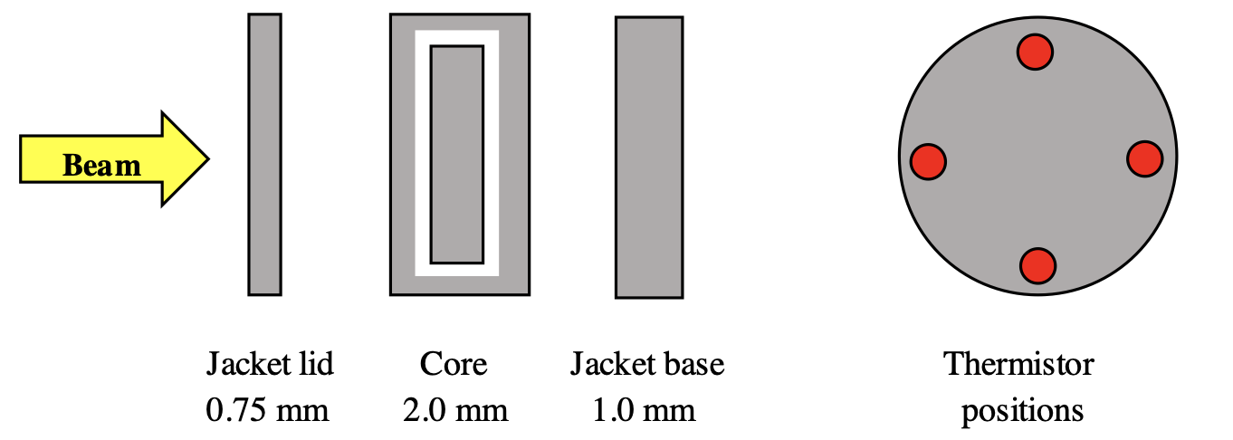
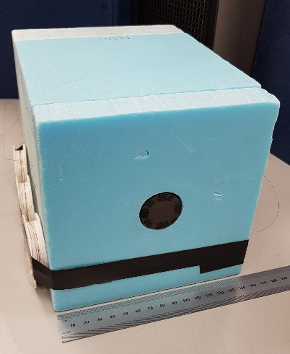
What happens if I am sick during my pregnancy?
If you are absent from work due to pregnancy related reasons you need to follow the normal process for advising your manager and providing Fit Notes if applicable. If you are absent for pregnancy related reasons within four weeks of your expected week of childbirth, your maternity leave will automatically commence.
What is the current rate of Statutory Maternity Pay?
The government sets this annually. You can find out on www.gov.uk
I am on a fixed term contract. How does that affect my entitlements?
You will have the same entitlements to pay and leave providing you meet the qualifying criteria. If your fixed term contract ends during your maternity leave and is not renewed, the entitlement to the enhanced University maternity pay will cease but SMP will continue to be paid.
How does the University maternity entitlement differ from the statutory one?
The University offers enhanced maternity pay to eligible employees, based on length of service. The current entitlements are set out in the Maternity Policy and in this guidance.
What happens if I choose not to return to work after my maternity leave?
If you decide not to return to work, you will need to provide written notice in accordance with your contract of employment. If you have received enhanced University maternity pay but do not return to work for at least three months, you will be required to repay the difference between the enhanced payments and SMP.
Do I still accrue holiday while I am on maternity leave?
Yes. Your holiday will still accrue as normal.
When can I start my maternity leave?
You can begin your maternity leave on any date after the 11th week before your expected week of childbirth. Your midwife will confirm your expected week of childbirth on the MATB1 form around your 20th week of pregnancy.
What happens to my job while I am on leave?
Managers have various options. They may choose to bring in temporary cover or seek to manage the duties via secondments or redistribution of work with other team members. Your manager will discuss this with you. However your job is covered in your absence, you have the right to return to it, or a similar role with comparable terms and conditions.
What if I want to change my return date once my leave commences?
We will write to you to confirm the latest date you are expected to return to work after your maternity leave. This will be at the end of the 52nd week. If you want to return sooner than this date then please confirm this in writing, at least 28 days before the date you intend to return to work. If you would like to return later, for example by taking parental additional leave, please notify your manager in writing of your request.
I gave a date that I would like to start my maternity leave, but now I want to change it. Can I do that?
Yes. You are required to tell us in writing at least 28 days prior to the new date.
Can I return to work on a phased basis?
This may be possible depending on operational requirements. Please discuss this with your manager.
What happens to my maternity leave if my baby is born early?
Maternity leave is triggered by childbirth. If your baby is born early your maternity leave will therefore start immediately.
When I return to work, I want to change my hours of work. What do I need to do?
You can make a flexible working request prior to your return to work under our Flexible Working Policy. You can discuss your plans with your manager at any time. See http://documents.manchester.ac.uk/DocuInfo.aspx?DocID=9
Can I take holiday during my maternity leave?
All holiday must be taken outside of the maternity leave period. It is not possible to be on maternity leave and holiday at the same time. Holiday can be taken immediately before or after maternity leave.
Can I carry holiday forward into next year?
In most cases there should be sufficient time leading up to the leave period to effectively plan the use of holiday in advance of the maternity leave period. The University allows up to one week’s holiday to be carried over into the next holiday year.
What happens to my pension contributions when I am on maternity leave?
There are different rules for different pension schemes. For more information please contact your scheme provider or a member of the pensions team who will be able to provide more information
Can my manager ask me to come into work during my maternity leave? If so, do I have to agree?
The University, as an employer, is allowed to make reasonable contact with employees whilst they are on maternity leave. You are not obliged to do any work or attend any work related events during maternity leave, however if you and your manager both agree, then you can work up to a total of 10 days during your leave. These are called ‘Keeping in Touch’ days.
Do I have to agree in advance if I want to come to work for a Keeping in Touch Day?
Yes, you and your manager should agree in advance when you are going to attend work for one of your Keeping in Touch Days to allow both parties to make any necessary arrangements.
If I attend work for half a day or less, is this classed as one of my Keeping in Touch Days?
Yes, as soon as you start work, even if it is for only a few hours, this is counted as one of your 10 KIT days. The number of hours that you attend work can be up to the maximum of the full time equivalent.
Will I be placed at a disadvantage on my return if I don’t come into work prior to the end of my maternity leave?
Employees are encouraged to make use of KIT days as a positive way to keep in contact with developments in their workplace. As work during maternity leave may only take place with the agreement of both parties, you will not be at any disadvantage regarding the options you choose about KIT days.
I have been asked to be an external examiner for another University; can I use a Keeping in Touch Day to undertake this work?
No, because this is paid work for another employer and will therefore impact upon your maternity arrangements.
What type of work will I be expected to undertake whilst in work on a Keeping in Touch Day?
The purpose of these days is to allow you to be kept informed and up to date on developments within your own workplace or within the University. This may include attending a conference, undertaking training or a team event.
How else can I keep in touch during my maternity leave?
The University encourages managers and employees to discuss this prior to the start of maternity leave. Ultimately, it is up to you how you want to be updated about work matters. Some employees want a regular update, others would prefer no contact at all.
Refurbishment of the NPL small portable graphite calorimeter
Small portable graphite calorimeter (SPGC) developed at NPL
  Initially for use in measurement of low energy clinical proton beams
Innermost cylindrical core (20 mm diameter, 2 mm thickness) containing 4 thermistors
  Sidewall embedded, coupled in 4 DC Wheatstone bridge arrangements
Core enclosed within graphite jacket (30 mm diameter) – fits in 2 pieces (0.75 mm lid, 1.0 mm lid)
Graphite components held within Styrofoam enclosure (160 (w) × 160 (h) × 200 mm (d))
Notes:
.

Slide 8
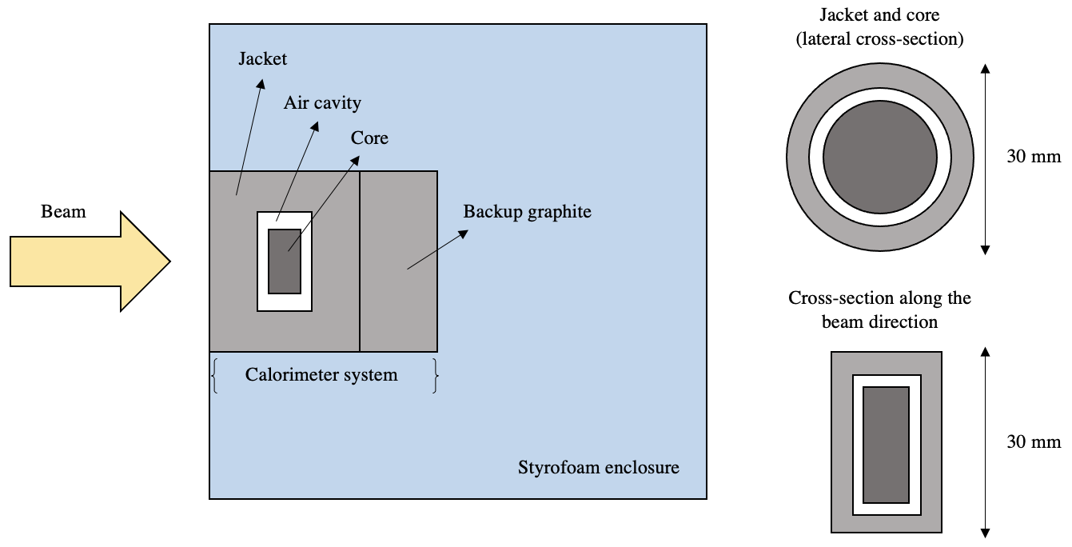
What happens if I am sick during my pregnancy?
If you are absent from work due to pregnancy related reasons you need to follow the normal process for advising your manager and providing Fit Notes if applicable. If you are absent for pregnancy related reasons within four weeks of your expected week of childbirth, your maternity leave will automatically commence.
What is the current rate of Statutory Maternity Pay?
The government sets this annually. You can find out on www.gov.uk
I am on a fixed term contract. How does that affect my entitlements?
You will have the same entitlements to pay and leave providing you meet the qualifying criteria. If your fixed term contract ends during your maternity leave and is not renewed, the entitlement to the enhanced University maternity pay will cease but SMP will continue to be paid.
How does the University maternity entitlement differ from the statutory one?
The University offers enhanced maternity pay to eligible employees, based on length of service. The current entitlements are set out in the Maternity Policy and in this guidance.
What happens if I choose not to return to work after my maternity leave?
If you decide not to return to work, you will need to provide written notice in accordance with your contract of employment. If you have received enhanced University maternity pay but do not return to work for at least three months, you will be required to repay the difference between the enhanced payments and SMP.
Do I still accrue holiday while I am on maternity leave?
Yes. Your holiday will still accrue as normal.
When can I start my maternity leave?
You can begin your maternity leave on any date after the 11th week before your expected week of childbirth. Your midwife will confirm your expected week of childbirth on the MATB1 form around your 20th week of pregnancy.
What happens to my job while I am on leave?
Managers have various options. They may choose to bring in temporary cover or seek to manage the duties via secondments or redistribution of work with other team members. Your manager will discuss this with you. However your job is covered in your absence, you have the right to return to it, or a similar role with comparable terms and conditions.
What if I want to change my return date once my leave commences?
We will write to you to confirm the latest date you are expected to return to work after your maternity leave. This will be at the end of the 52nd week. If you want to return sooner than this date then please confirm this in writing, at least 28 days before the date you intend to return to work. If you would like to return later, for example by taking parental additional leave, please notify your manager in writing of your request.
I gave a date that I would like to start my maternity leave, but now I want to change it. Can I do that?
Yes. You are required to tell us in writing at least 28 days prior to the new date.
Can I return to work on a phased basis?
This may be possible depending on operational requirements. Please discuss this with your manager.
What happens to my maternity leave if my baby is born early?
Maternity leave is triggered by childbirth. If your baby is born early your maternity leave will therefore start immediately.
When I return to work, I want to change my hours of work. What do I need to do?
You can make a flexible working request prior to your return to work under our Flexible Working Policy. You can discuss your plans with your manager at any time. See http://documents.manchester.ac.uk/DocuInfo.aspx?DocID=9
Can I take holiday during my maternity leave?
All holiday must be taken outside of the maternity leave period. It is not possible to be on maternity leave and holiday at the same time. Holiday can be taken immediately before or after maternity leave.
Can I carry holiday forward into next year?
In most cases there should be sufficient time leading up to the leave period to effectively plan the use of holiday in advance of the maternity leave period. The University allows up to one week’s holiday to be carried over into the next holiday year.
What happens to my pension contributions when I am on maternity leave?
There are different rules for different pension schemes. For more information please contact your scheme provider or a member of the pensions team who will be able to provide more information
Can my manager ask me to come into work during my maternity leave? If so, do I have to agree?
The University, as an employer, is allowed to make reasonable contact with employees whilst they are on maternity leave. You are not obliged to do any work or attend any work related events during maternity leave, however if you and your manager both agree, then you can work up to a total of 10 days during your leave. These are called ‘Keeping in Touch’ days.
Do I have to agree in advance if I want to come to work for a Keeping in Touch Day?
Yes, you and your manager should agree in advance when you are going to attend work for one of your Keeping in Touch Days to allow both parties to make any necessary arrangements.
If I attend work for half a day or less, is this classed as one of my Keeping in Touch Days?
Yes, as soon as you start work, even if it is for only a few hours, this is counted as one of your 10 KIT days. The number of hours that you attend work can be up to the maximum of the full time equivalent.
Will I be placed at a disadvantage on my return if I don’t come into work prior to the end of my maternity leave?
Employees are encouraged to make use of KIT days as a positive way to keep in contact with developments in their workplace. As work during maternity leave may only take place with the agreement of both parties, you will not be at any disadvantage regarding the options you choose about KIT days.
I have been asked to be an external examiner for another University; can I use a Keeping in Touch Day to undertake this work?
No, because this is paid work for another employer and will therefore impact upon your maternity arrangements.
What type of work will I be expected to undertake whilst in work on a Keeping in Touch Day?
The purpose of these days is to allow you to be kept informed and up to date on developments within your own workplace or within the University. This may include attending a conference, undertaking training or a team event.
How else can I keep in touch during my maternity leave?
The University encourages managers and employees to discuss this prior to the start of maternity leave. Ultimately, it is up to you how you want to be updated about work matters. Some employees want a regular update, others would prefer no contact at all.
Notes:
.

Slide 9
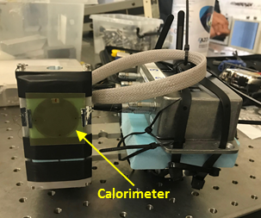
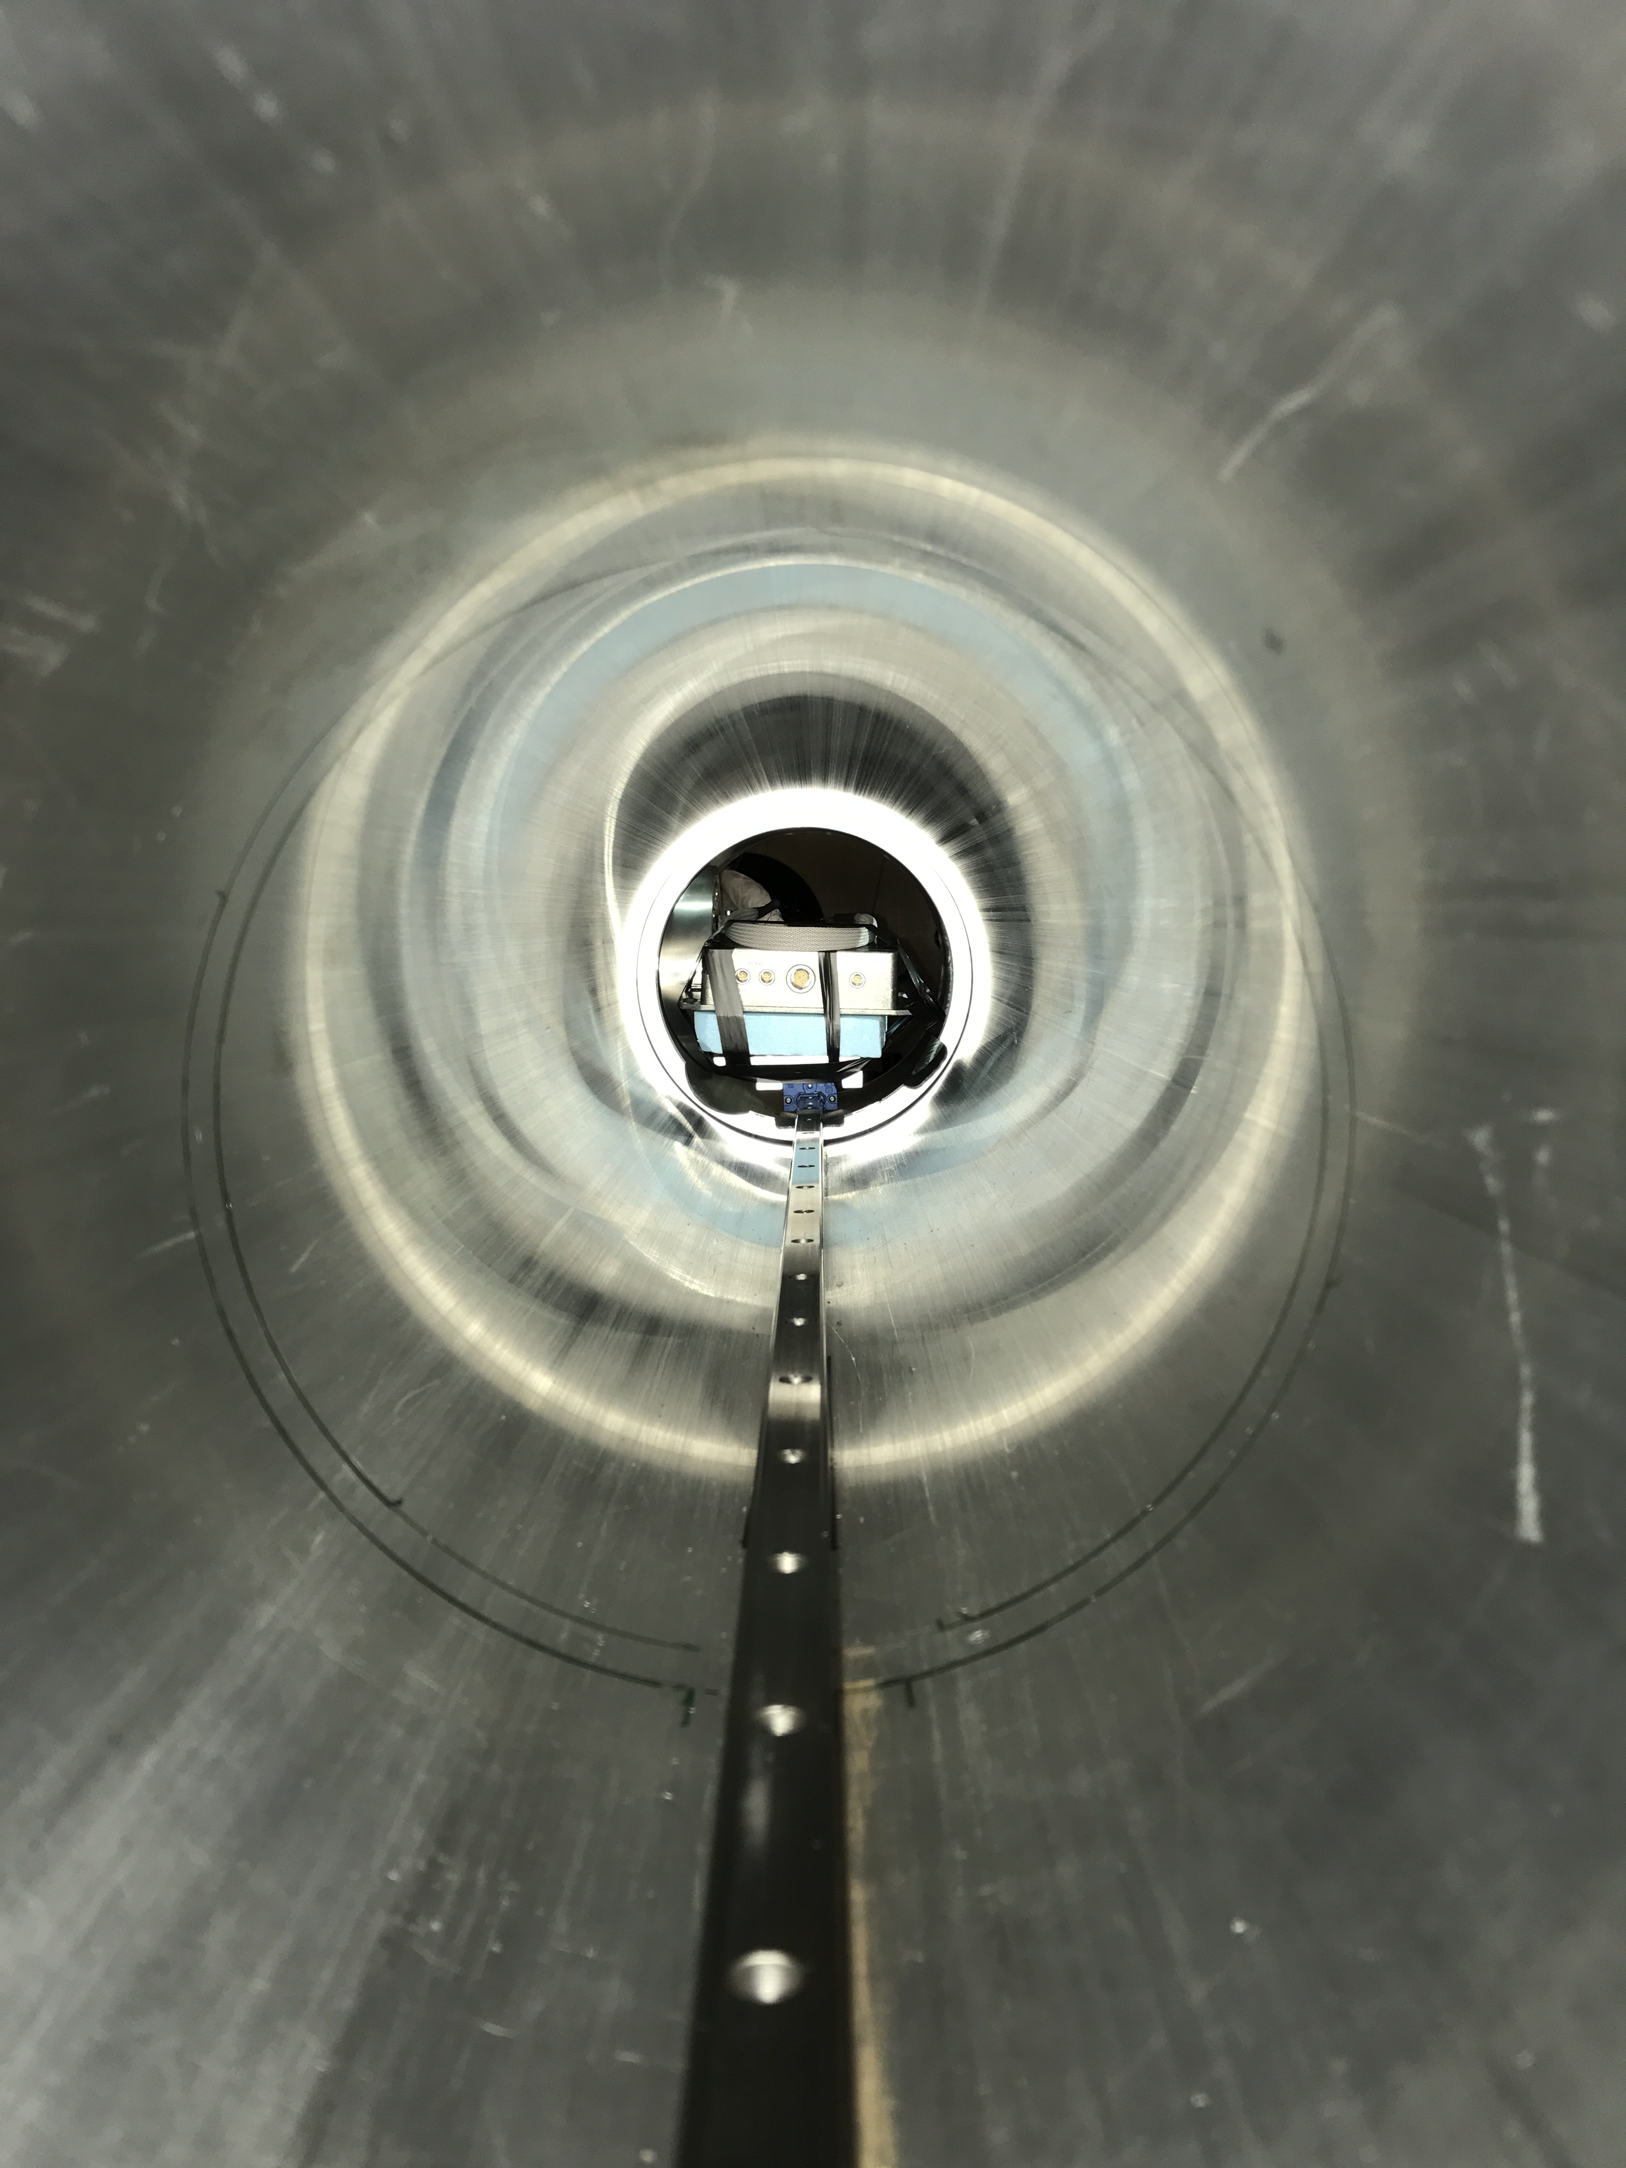
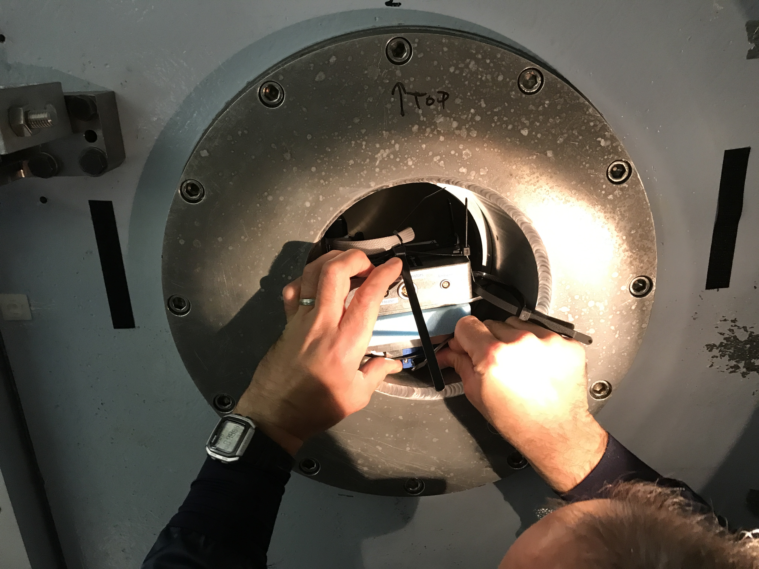
What happens if I am sick during my pregnancy?
If you are absent from work due to pregnancy related reasons you need to follow the normal process for advising your manager and providing Fit Notes if applicable. If you are absent for pregnancy related reasons within four weeks of your expected week of childbirth, your maternity leave will automatically commence.
What is the current rate of Statutory Maternity Pay?
The government sets this annually. You can find out on www.gov.uk
I am on a fixed term contract. How does that affect my entitlements?
You will have the same entitlements to pay and leave providing you meet the qualifying criteria. If your fixed term contract ends during your maternity leave and is not renewed, the entitlement to the enhanced University maternity pay will cease but SMP will continue to be paid.
How does the University maternity entitlement differ from the statutory one?
The University offers enhanced maternity pay to eligible employees, based on length of service. The current entitlements are set out in the Maternity Policy and in this guidance.
What happens if I choose not to return to work after my maternity leave?
If you decide not to return to work, you will need to provide written notice in accordance with your contract of employment. If you have received enhanced University maternity pay but do not return to work for at least three months, you will be required to repay the difference between the enhanced payments and SMP.
Do I still accrue holiday while I am on maternity leave?
Yes. Your holiday will still accrue as normal.
When can I start my maternity leave?
You can begin your maternity leave on any date after the 11th week before your expected week of childbirth. Your midwife will confirm your expected week of childbirth on the MATB1 form around your 20th week of pregnancy.
What happens to my job while I am on leave?
Managers have various options. They may choose to bring in temporary cover or seek to manage the duties via secondments or redistribution of work with other team members. Your manager will discuss this with you. However your job is covered in your absence, you have the right to return to it, or a similar role with comparable terms and conditions.
What if I want to change my return date once my leave commences?
We will write to you to confirm the latest date you are expected to return to work after your maternity leave. This will be at the end of the 52nd week. If you want to return sooner than this date then please confirm this in writing, at least 28 days before the date you intend to return to work. If you would like to return later, for example by taking parental additional leave, please notify your manager in writing of your request.
I gave a date that I would like to start my maternity leave, but now I want to change it. Can I do that?
Yes. You are required to tell us in writing at least 28 days prior to the new date.
Can I return to work on a phased basis?
This may be possible depending on operational requirements. Please discuss this with your manager.
What happens to my maternity leave if my baby is born early?
Maternity leave is triggered by childbirth. If your baby is born early your maternity leave will therefore start immediately.
When I return to work, I want to change my hours of work. What do I need to do?
You can make a flexible working request prior to your return to work under our Flexible Working Policy. You can discuss your plans with your manager at any time. See http://documents.manchester.ac.uk/DocuInfo.aspx?DocID=9
Can I take holiday during my maternity leave?
All holiday must be taken outside of the maternity leave period. It is not possible to be on maternity leave and holiday at the same time. Holiday can be taken immediately before or after maternity leave.
Can I carry holiday forward into next year?
In most cases there should be sufficient time leading up to the leave period to effectively plan the use of holiday in advance of the maternity leave period. The University allows up to one week’s holiday to be carried over into the next holiday year.
What happens to my pension contributions when I am on maternity leave?
There are different rules for different pension schemes. For more information please contact your scheme provider or a member of the pensions team who will be able to provide more information
Can my manager ask me to come into work during my maternity leave? If so, do I have to agree?
The University, as an employer, is allowed to make reasonable contact with employees whilst they are on maternity leave. You are not obliged to do any work or attend any work related events during maternity leave, however if you and your manager both agree, then you can work up to a total of 10 days during your leave. These are called ‘Keeping in Touch’ days.
Do I have to agree in advance if I want to come to work for a Keeping in Touch Day?
Yes, you and your manager should agree in advance when you are going to attend work for one of your Keeping in Touch Days to allow both parties to make any necessary arrangements.
If I attend work for half a day or less, is this classed as one of my Keeping in Touch Days?
Yes, as soon as you start work, even if it is for only a few hours, this is counted as one of your 10 KIT days. The number of hours that you attend work can be up to the maximum of the full time equivalent.
Will I be placed at a disadvantage on my return if I don’t come into work prior to the end of my maternity leave?
Employees are encouraged to make use of KIT days as a positive way to keep in contact with developments in their workplace. As work during maternity leave may only take place with the agreement of both parties, you will not be at any disadvantage regarding the options you choose about KIT days.
I have been asked to be an external examiner for another University; can I use a Keeping in Touch Day to undertake this work?
No, because this is paid work for another employer and will therefore impact upon your maternity arrangements.
What type of work will I be expected to undertake whilst in work on a Keeping in Touch Day?
The purpose of these days is to allow you to be kept informed and up to date on developments within your own workplace or within the University. This may include attending a conference, undertaking training or a team event.
How else can I keep in touch during my maternity leave?
The University encourages managers and employees to discuss this prior to the start of maternity leave. Ultimately, it is up to you how you want to be updated about work matters. Some employees want a regular update, others would prefer no contact at all.
Proof-of-principle measurement – CLF, RAL
First recorded measurement of calorimeter system with laser-driven proton beams
High-power VULCAN-PW laser system of CLF, Rutherford Appleton Laboratory used
Ultrashort pulse durations possible
- approx. 500 – 700 fs durations
High on target laser energies
- 600 J per pulse
Energetic proton bunches accelerated
- up to 45 MeV, Gy level doses
Notes:
.

Slide 10
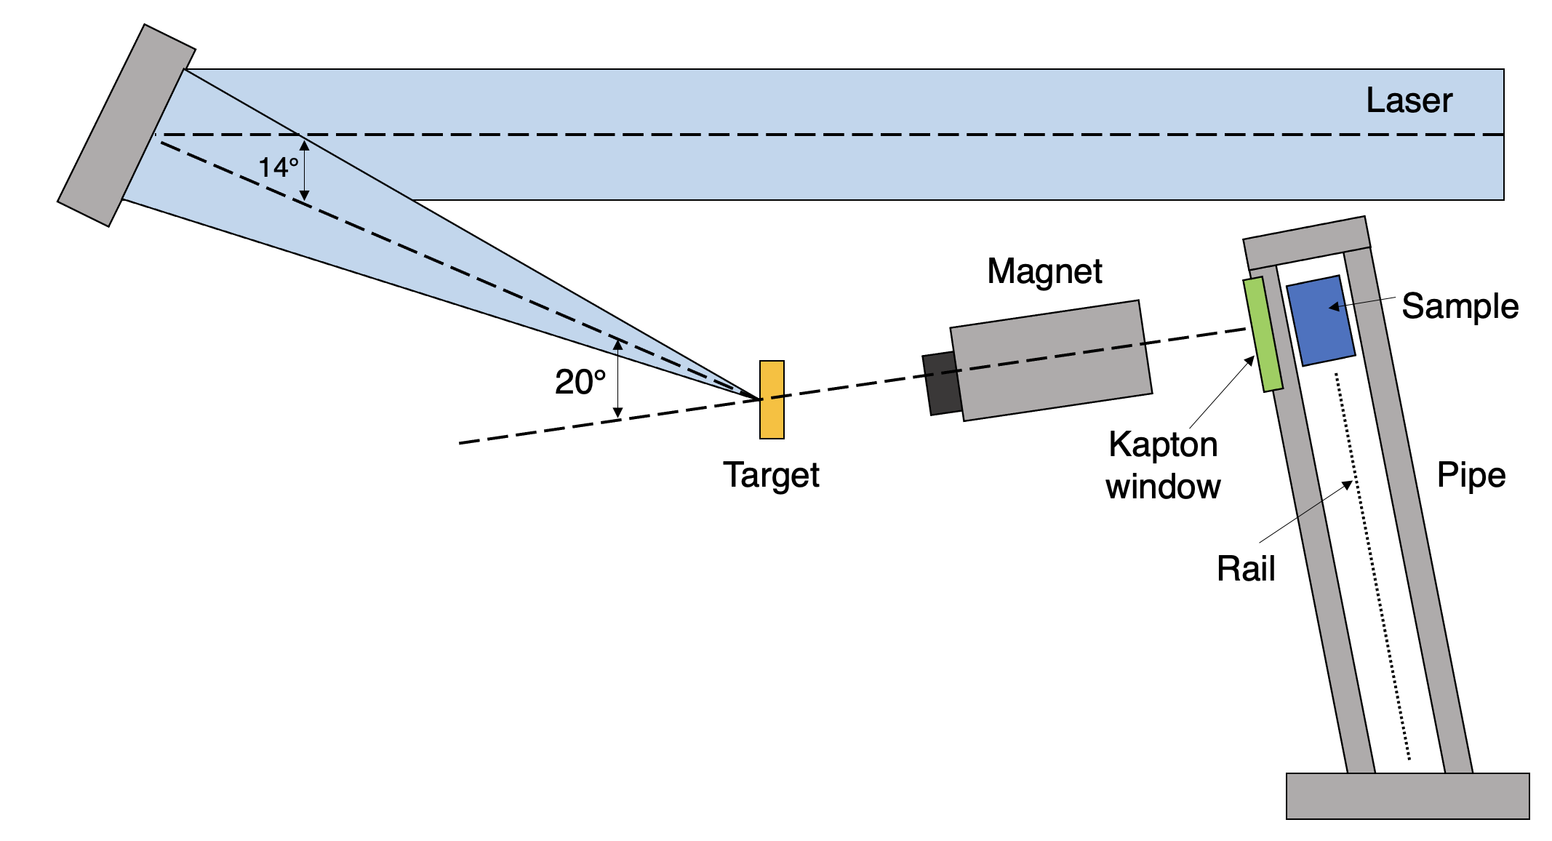
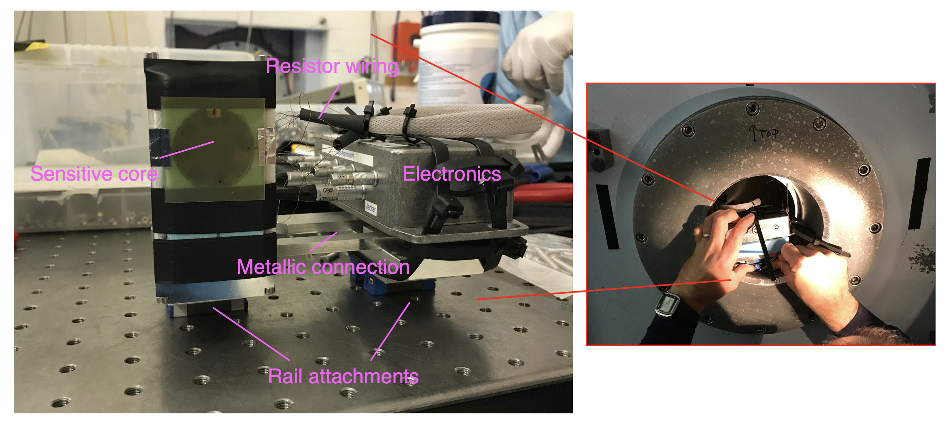
What happens if I am sick during my pregnancy?
If you are absent from work due to pregnancy related reasons you need to follow the normal process for advising your manager and providing Fit Notes if applicable. If you are absent for pregnancy related reasons within four weeks of your expected week of childbirth, your maternity leave will automatically commence.
What is the current rate of Statutory Maternity Pay?
The government sets this annually. You can find out on www.gov.uk
I am on a fixed term contract. How does that affect my entitlements?
You will have the same entitlements to pay and leave providing you meet the qualifying criteria. If your fixed term contract ends during your maternity leave and is not renewed, the entitlement to the enhanced University maternity pay will cease but SMP will continue to be paid.
How does the University maternity entitlement differ from the statutory one?
The University offers enhanced maternity pay to eligible employees, based on length of service. The current entitlements are set out in the Maternity Policy and in this guidance.
What happens if I choose not to return to work after my maternity leave?
If you decide not to return to work, you will need to provide written notice in accordance with your contract of employment. If you have received enhanced University maternity pay but do not return to work for at least three months, you will be required to repay the difference between the enhanced payments and SMP.
Do I still accrue holiday while I am on maternity leave?
Yes. Your holiday will still accrue as normal.
When can I start my maternity leave?
You can begin your maternity leave on any date after the 11th week before your expected week of childbirth. Your midwife will confirm your expected week of childbirth on the MATB1 form around your 20th week of pregnancy.
What happens to my job while I am on leave?
Managers have various options. They may choose to bring in temporary cover or seek to manage the duties via secondments or redistribution of work with other team members. Your manager will discuss this with you. However your job is covered in your absence, you have the right to return to it, or a similar role with comparable terms and conditions.
What if I want to change my return date once my leave commences?
We will write to you to confirm the latest date you are expected to return to work after your maternity leave. This will be at the end of the 52nd week. If you want to return sooner than this date then please confirm this in writing, at least 28 days before the date you intend to return to work. If you would like to return later, for example by taking parental additional leave, please notify your manager in writing of your request.
I gave a date that I would like to start my maternity leave, but now I want to change it. Can I do that?
Yes. You are required to tell us in writing at least 28 days prior to the new date.
Can I return to work on a phased basis?
This may be possible depending on operational requirements. Please discuss this with your manager.
What happens to my maternity leave if my baby is born early?
Maternity leave is triggered by childbirth. If your baby is born early your maternity leave will therefore start immediately.
When I return to work, I want to change my hours of work. What do I need to do?
You can make a flexible working request prior to your return to work under our Flexible Working Policy. You can discuss your plans with your manager at any time. See http://documents.manchester.ac.uk/DocuInfo.aspx?DocID=9
Can I take holiday during my maternity leave?
All holiday must be taken outside of the maternity leave period. It is not possible to be on maternity leave and holiday at the same time. Holiday can be taken immediately before or after maternity leave.
Can I carry holiday forward into next year?
In most cases there should be sufficient time leading up to the leave period to effectively plan the use of holiday in advance of the maternity leave period. The University allows up to one week’s holiday to be carried over into the next holiday year.
What happens to my pension contributions when I am on maternity leave?
There are different rules for different pension schemes. For more information please contact your scheme provider or a member of the pensions team who will be able to provide more information
Can my manager ask me to come into work during my maternity leave? If so, do I have to agree?
The University, as an employer, is allowed to make reasonable contact with employees whilst they are on maternity leave. You are not obliged to do any work or attend any work related events during maternity leave, however if you and your manager both agree, then you can work up to a total of 10 days during your leave. These are called ‘Keeping in Touch’ days.
Do I have to agree in advance if I want to come to work for a Keeping in Touch Day?
Yes, you and your manager should agree in advance when you are going to attend work for one of your Keeping in Touch Days to allow both parties to make any necessary arrangements.
If I attend work for half a day or less, is this classed as one of my Keeping in Touch Days?
Yes, as soon as you start work, even if it is for only a few hours, this is counted as one of your 10 KIT days. The number of hours that you attend work can be up to the maximum of the full time equivalent.
Will I be placed at a disadvantage on my return if I don’t come into work prior to the end of my maternity leave?
Employees are encouraged to make use of KIT days as a positive way to keep in contact with developments in their workplace. As work during maternity leave may only take place with the agreement of both parties, you will not be at any disadvantage regarding the options you choose about KIT days.
I have been asked to be an external examiner for another University; can I use a Keeping in Touch Day to undertake this work?
No, because this is paid work for another employer and will therefore impact upon your maternity arrangements.
What type of work will I be expected to undertake whilst in work on a Keeping in Touch Day?
The purpose of these days is to allow you to be kept informed and up to date on developments within your own workplace or within the University. This may include attending a conference, undertaking training or a team event.
How else can I keep in touch during my maternity leave?
The University encourages managers and employees to discuss this prior to the start of maternity leave. Ultimately, it is up to you how you want to be updated about work matters. Some employees want a regular update, others would prefer no contact at all.
Notes:
.

Slide 11
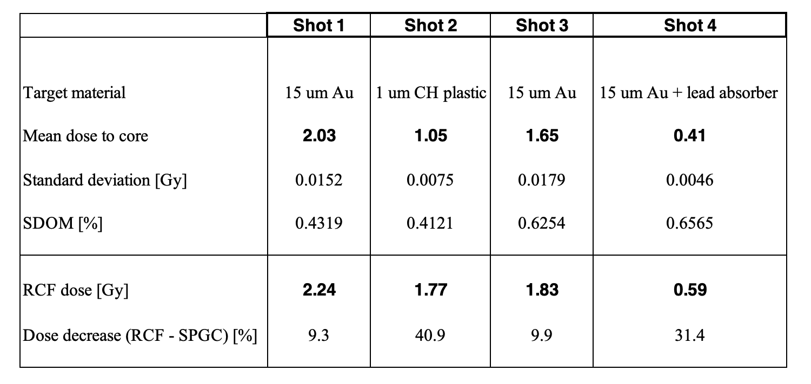
What happens if I am sick during my pregnancy?
If you are absent from work due to pregnancy related reasons you need to follow the normal process for advising your manager and providing Fit Notes if applicable. If you are absent for pregnancy related reasons within four weeks of your expected week of childbirth, your maternity leave will automatically commence.
What is the current rate of Statutory Maternity Pay?
The government sets this annually. You can find out on www.gov.uk
I am on a fixed term contract. How does that affect my entitlements?
You will have the same entitlements to pay and leave providing you meet the qualifying criteria. If your fixed term contract ends during your maternity leave and is not renewed, the entitlement to the enhanced University maternity pay will cease but SMP will continue to be paid.
How does the University maternity entitlement differ from the statutory one?
The University offers enhanced maternity pay to eligible employees, based on length of service. The current entitlements are set out in the Maternity Policy and in this guidance.
What happens if I choose not to return to work after my maternity leave?
If you decide not to return to work, you will need to provide written notice in accordance with your contract of employment. If you have received enhanced University maternity pay but do not return to work for at least three months, you will be required to repay the difference between the enhanced payments and SMP.
Do I still accrue holiday while I am on maternity leave?
Yes. Your holiday will still accrue as normal.
When can I start my maternity leave?
You can begin your maternity leave on any date after the 11th week before your expected week of childbirth. Your midwife will confirm your expected week of childbirth on the MATB1 form around your 20th week of pregnancy.
What happens to my job while I am on leave?
Managers have various options. They may choose to bring in temporary cover or seek to manage the duties via secondments or redistribution of work with other team members. Your manager will discuss this with you. However your job is covered in your absence, you have the right to return to it, or a similar role with comparable terms and conditions.
What if I want to change my return date once my leave commences?
We will write to you to confirm the latest date you are expected to return to work after your maternity leave. This will be at the end of the 52nd week. If you want to return sooner than this date then please confirm this in writing, at least 28 days before the date you intend to return to work. If you would like to return later, for example by taking parental additional leave, please notify your manager in writing of your request.
I gave a date that I would like to start my maternity leave, but now I want to change it. Can I do that?
Yes. You are required to tell us in writing at least 28 days prior to the new date.
Can I return to work on a phased basis?
This may be possible depending on operational requirements. Please discuss this with your manager.
What happens to my maternity leave if my baby is born early?
Maternity leave is triggered by childbirth. If your baby is born early your maternity leave will therefore start immediately.
When I return to work, I want to change my hours of work. What do I need to do?
You can make a flexible working request prior to your return to work under our Flexible Working Policy. You can discuss your plans with your manager at any time. See http://documents.manchester.ac.uk/DocuInfo.aspx?DocID=9
Can I take holiday during my maternity leave?
All holiday must be taken outside of the maternity leave period. It is not possible to be on maternity leave and holiday at the same time. Holiday can be taken immediately before or after maternity leave.
Can I carry holiday forward into next year?
In most cases there should be sufficient time leading up to the leave period to effectively plan the use of holiday in advance of the maternity leave period. The University allows up to one week’s holiday to be carried over into the next holiday year.
What happens to my pension contributions when I am on maternity leave?
There are different rules for different pension schemes. For more information please contact your scheme provider or a member of the pensions team who will be able to provide more information
Can my manager ask me to come into work during my maternity leave? If so, do I have to agree?
The University, as an employer, is allowed to make reasonable contact with employees whilst they are on maternity leave. You are not obliged to do any work or attend any work related events during maternity leave, however if you and your manager both agree, then you can work up to a total of 10 days during your leave. These are called ‘Keeping in Touch’ days.
Do I have to agree in advance if I want to come to work for a Keeping in Touch Day?
Yes, you and your manager should agree in advance when you are going to attend work for one of your Keeping in Touch Days to allow both parties to make any necessary arrangements.
If I attend work for half a day or less, is this classed as one of my Keeping in Touch Days?
Yes, as soon as you start work, even if it is for only a few hours, this is counted as one of your 10 KIT days. The number of hours that you attend work can be up to the maximum of the full time equivalent.
Will I be placed at a disadvantage on my return if I don’t come into work prior to the end of my maternity leave?
Employees are encouraged to make use of KIT days as a positive way to keep in contact with developments in their workplace. As work during maternity leave may only take place with the agreement of both parties, you will not be at any disadvantage regarding the options you choose about KIT days.
I have been asked to be an external examiner for another University; can I use a Keeping in Touch Day to undertake this work?
No, because this is paid work for another employer and will therefore impact upon your maternity arrangements.
What type of work will I be expected to undertake whilst in work on a Keeping in Touch Day?
The purpose of these days is to allow you to be kept informed and up to date on developments within your own workplace or within the University. This may include attending a conference, undertaking training or a team event.
How else can I keep in touch during my maternity leave?
The University encourages managers and employees to discuss this prior to the start of maternity leave. Ultimately, it is up to you how you want to be updated about work matters. Some employees want a regular update, others would prefer no contact at all.
Results of measurements at CLF, RAL
Five irradiations performed with this setup and beam parameters
  ~ 600 J energies, three 15 $μm$ Au & one 1 $μm$ CH target, full adiabatic mode of operation
Remarkably good consistency between thermistor temperatures (except T4)
  Systematic uncertainty conservatively estimated at ~13%
Notes:
.

Slide 12
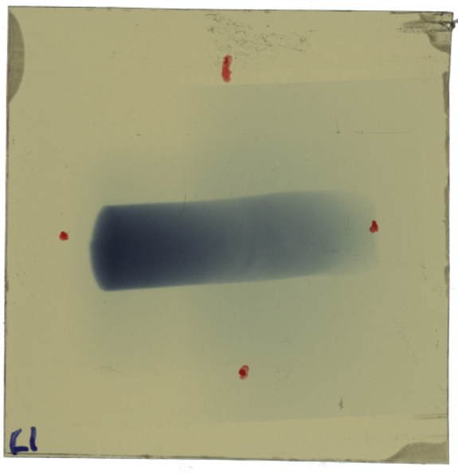
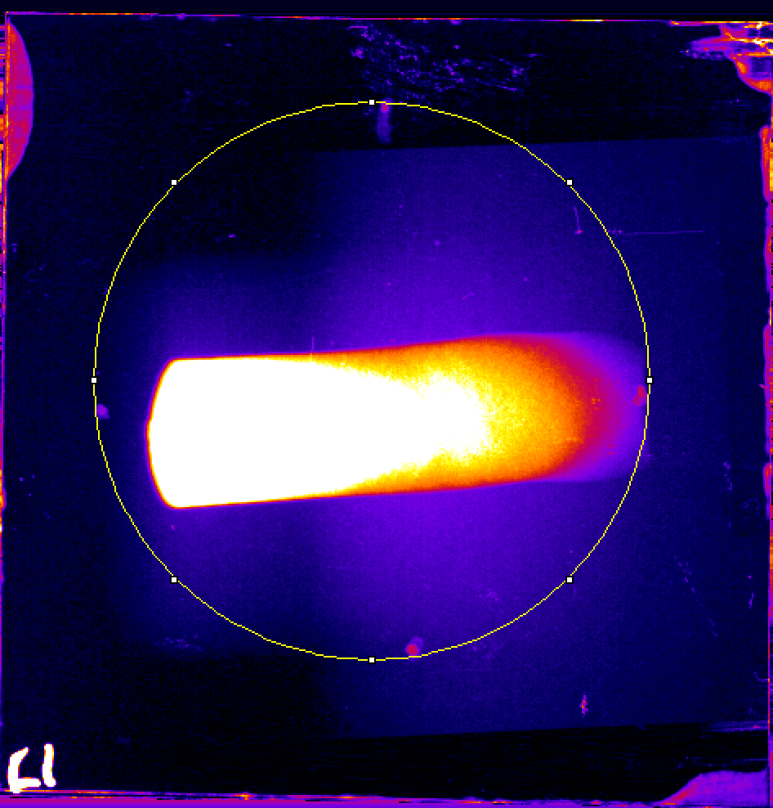
What happens if I am sick during my pregnancy?
If you are absent from work due to pregnancy related reasons you need to follow the normal process for advising your manager and providing Fit Notes if applicable. If you are absent for pregnancy related reasons within four weeks of your expected week of childbirth, your maternity leave will automatically commence.
What is the current rate of Statutory Maternity Pay?
The government sets this annually. You can find out on www.gov.uk
I am on a fixed term contract. How does that affect my entitlements?
You will have the same entitlements to pay and leave providing you meet the qualifying criteria. If your fixed term contract ends during your maternity leave and is not renewed, the entitlement to the enhanced University maternity pay will cease but SMP will continue to be paid.
How does the University maternity entitlement differ from the statutory one?
The University offers enhanced maternity pay to eligible employees, based on length of service. The current entitlements are set out in the Maternity Policy and in this guidance.
What happens if I choose not to return to work after my maternity leave?
If you decide not to return to work, you will need to provide written notice in accordance with your contract of employment. If you have received enhanced University maternity pay but do not return to work for at least three months, you will be required to repay the difference between the enhanced payments and SMP.
Do I still accrue holiday while I am on maternity leave?
Yes. Your holiday will still accrue as normal.
When can I start my maternity leave?
You can begin your maternity leave on any date after the 11th week before your expected week of childbirth. Your midwife will confirm your expected week of childbirth on the MATB1 form around your 20th week of pregnancy.
What happens to my job while I am on leave?
Managers have various options. They may choose to bring in temporary cover or seek to manage the duties via secondments or redistribution of work with other team members. Your manager will discuss this with you. However your job is covered in your absence, you have the right to return to it, or a similar role with comparable terms and conditions.
What if I want to change my return date once my leave commences?
We will write to you to confirm the latest date you are expected to return to work after your maternity leave. This will be at the end of the 52nd week. If you want to return sooner than this date then please confirm this in writing, at least 28 days before the date you intend to return to work. If you would like to return later, for example by taking parental additional leave, please notify your manager in writing of your request.
I gave a date that I would like to start my maternity leave, but now I want to change it. Can I do that?
Yes. You are required to tell us in writing at least 28 days prior to the new date.
Can I return to work on a phased basis?
This may be possible depending on operational requirements. Please discuss this with your manager.
What happens to my maternity leave if my baby is born early?
Maternity leave is triggered by childbirth. If your baby is born early your maternity leave will therefore start immediately.
When I return to work, I want to change my hours of work. What do I need to do?
You can make a flexible working request prior to your return to work under our Flexible Working Policy. You can discuss your plans with your manager at any time. See http://documents.manchester.ac.uk/DocuInfo.aspx?DocID=9
Can I take holiday during my maternity leave?
All holiday must be taken outside of the maternity leave period. It is not possible to be on maternity leave and holiday at the same time. Holiday can be taken immediately before or after maternity leave.
Can I carry holiday forward into next year?
In most cases there should be sufficient time leading up to the leave period to effectively plan the use of holiday in advance of the maternity leave period. The University allows up to one week’s holiday to be carried over into the next holiday year.
What happens to my pension contributions when I am on maternity leave?
There are different rules for different pension schemes. For more information please contact your scheme provider or a member of the pensions team who will be able to provide more information
Can my manager ask me to come into work during my maternity leave? If so, do I have to agree?
The University, as an employer, is allowed to make reasonable contact with employees whilst they are on maternity leave. You are not obliged to do any work or attend any work related events during maternity leave, however if you and your manager both agree, then you can work up to a total of 10 days during your leave. These are called ‘Keeping in Touch’ days.
Do I have to agree in advance if I want to come to work for a Keeping in Touch Day?
Yes, you and your manager should agree in advance when you are going to attend work for one of your Keeping in Touch Days to allow both parties to make any necessary arrangements.
If I attend work for half a day or less, is this classed as one of my Keeping in Touch Days?
Yes, as soon as you start work, even if it is for only a few hours, this is counted as one of your 10 KIT days. The number of hours that you attend work can be up to the maximum of the full time equivalent.
Will I be placed at a disadvantage on my return if I don’t come into work prior to the end of my maternity leave?
Employees are encouraged to make use of KIT days as a positive way to keep in contact with developments in their workplace. As work during maternity leave may only take place with the agreement of both parties, you will not be at any disadvantage regarding the options you choose about KIT days.
I have been asked to be an external examiner for another University; can I use a Keeping in Touch Day to undertake this work?
No, because this is paid work for another employer and will therefore impact upon your maternity arrangements.
What type of work will I be expected to undertake whilst in work on a Keeping in Touch Day?
The purpose of these days is to allow you to be kept informed and up to date on developments within your own workplace or within the University. This may include attending a conference, undertaking training or a team event.
How else can I keep in touch during my maternity leave?
The University encourages managers and employees to discuss this prior to the start of maternity leave. Ultimately, it is up to you how you want to be updated about work matters. Some employees want a regular update, others would prefer no contact at all.
Radiochromic film measurements – simultaneous
Gafchromic EBT3 film (3 cm by 3 cm) attached to SPGC front surface
  Positions of the core thermistors roughly marked
Films digitised and then analysed to measure the absorbed dose within a suitable ROI
  Differences in the dose determined
Notes:
.

Slide 13
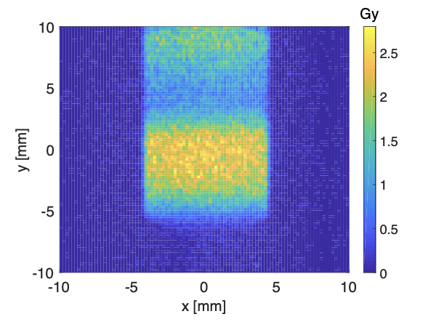
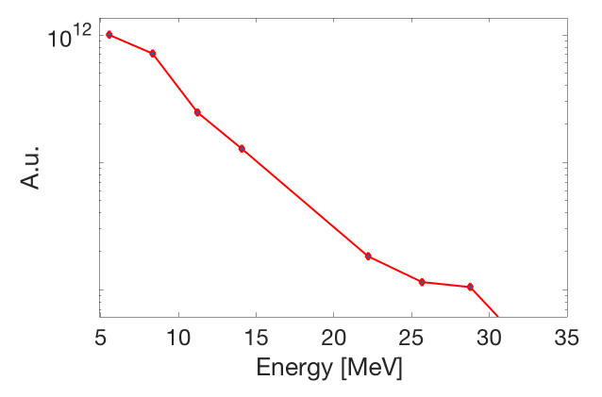
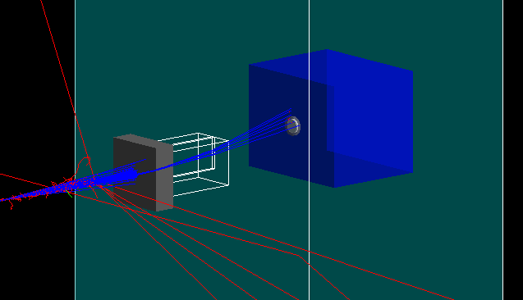
What happens if I am sick during my pregnancy?
If you are absent from work due to pregnancy related reasons you need to follow the normal process for advising your manager and providing Fit Notes if applicable. If you are absent for pregnancy related reasons within four weeks of your expected week of childbirth, your maternity leave will automatically commence.
What is the current rate of Statutory Maternity Pay?
The government sets this annually. You can find out on www.gov.uk
I am on a fixed term contract. How does that affect my entitlements?
You will have the same entitlements to pay and leave providing you meet the qualifying criteria. If your fixed term contract ends during your maternity leave and is not renewed, the entitlement to the enhanced University maternity pay will cease but SMP will continue to be paid.
How does the University maternity entitlement differ from the statutory one?
The University offers enhanced maternity pay to eligible employees, based on length of service. The current entitlements are set out in the Maternity Policy and in this guidance.
What happens if I choose not to return to work after my maternity leave?
If you decide not to return to work, you will need to provide written notice in accordance with your contract of employment. If you have received enhanced University maternity pay but do not return to work for at least three months, you will be required to repay the difference between the enhanced payments and SMP.
Do I still accrue holiday while I am on maternity leave?
Yes. Your holiday will still accrue as normal.
When can I start my maternity leave?
You can begin your maternity leave on any date after the 11th week before your expected week of childbirth. Your midwife will confirm your expected week of childbirth on the MATB1 form around your 20th week of pregnancy.
What happens to my job while I am on leave?
Managers have various options. They may choose to bring in temporary cover or seek to manage the duties via secondments or redistribution of work with other team members. Your manager will discuss this with you. However your job is covered in your absence, you have the right to return to it, or a similar role with comparable terms and conditions.
What if I want to change my return date once my leave commences?
We will write to you to confirm the latest date you are expected to return to work after your maternity leave. This will be at the end of the 52nd week. If you want to return sooner than this date then please confirm this in writing, at least 28 days before the date you intend to return to work. If you would like to return later, for example by taking parental additional leave, please notify your manager in writing of your request.
I gave a date that I would like to start my maternity leave, but now I want to change it. Can I do that?
Yes. You are required to tell us in writing at least 28 days prior to the new date.
Can I return to work on a phased basis?
This may be possible depending on operational requirements. Please discuss this with your manager.
What happens to my maternity leave if my baby is born early?
Maternity leave is triggered by childbirth. If your baby is born early your maternity leave will therefore start immediately.
When I return to work, I want to change my hours of work. What do I need to do?
You can make a flexible working request prior to your return to work under our Flexible Working Policy. You can discuss your plans with your manager at any time. See http://documents.manchester.ac.uk/DocuInfo.aspx?DocID=9
Can I take holiday during my maternity leave?
All holiday must be taken outside of the maternity leave period. It is not possible to be on maternity leave and holiday at the same time. Holiday can be taken immediately before or after maternity leave.
Can I carry holiday forward into next year?
In most cases there should be sufficient time leading up to the leave period to effectively plan the use of holiday in advance of the maternity leave period. The University allows up to one week’s holiday to be carried over into the next holiday year.
What happens to my pension contributions when I am on maternity leave?
There are different rules for different pension schemes. For more information please contact your scheme provider or a member of the pensions team who will be able to provide more information
Can my manager ask me to come into work during my maternity leave? If so, do I have to agree?
The University, as an employer, is allowed to make reasonable contact with employees whilst they are on maternity leave. You are not obliged to do any work or attend any work related events during maternity leave, however if you and your manager both agree, then you can work up to a total of 10 days during your leave. These are called ‘Keeping in Touch’ days.
Do I have to agree in advance if I want to come to work for a Keeping in Touch Day?
Yes, you and your manager should agree in advance when you are going to attend work for one of your Keeping in Touch Days to allow both parties to make any necessary arrangements.
If I attend work for half a day or less, is this classed as one of my Keeping in Touch Days?
Yes, as soon as you start work, even if it is for only a few hours, this is counted as one of your 10 KIT days. The number of hours that you attend work can be up to the maximum of the full time equivalent.
Will I be placed at a disadvantage on my return if I don’t come into work prior to the end of my maternity leave?
Employees are encouraged to make use of KIT days as a positive way to keep in contact with developments in their workplace. As work during maternity leave may only take place with the agreement of both parties, you will not be at any disadvantage regarding the options you choose about KIT days.
I have been asked to be an external examiner for another University; can I use a Keeping in Touch Day to undertake this work?
No, because this is paid work for another employer and will therefore impact upon your maternity arrangements.
What type of work will I be expected to undertake whilst in work on a Keeping in Touch Day?
The purpose of these days is to allow you to be kept informed and up to date on developments within your own workplace or within the University. This may include attending a conference, undertaking training or a team event.
How else can I keep in touch during my maternity leave?
The University encourages managers and employees to discuss this prior to the start of maternity leave. Ultimately, it is up to you how you want to be updated about work matters. Some employees want a regular update, others would prefer no contact at all.
Monte Carlo model of the experimental setup
Interaction chamber and SPGC simulated in MC toolkit, Geant4
  Supplementary work also conducted with TOPAS
Dose retrieved in both jacket front piece and core using whole volume scoring
  ~ 6 % reduction in the jacket and core dose values
Simulated energy spectrum
Simulated setup up at RAL (Geant4)
Expected dose map obtained from Monte Carlo simulations
Notes:
.

Slide 14
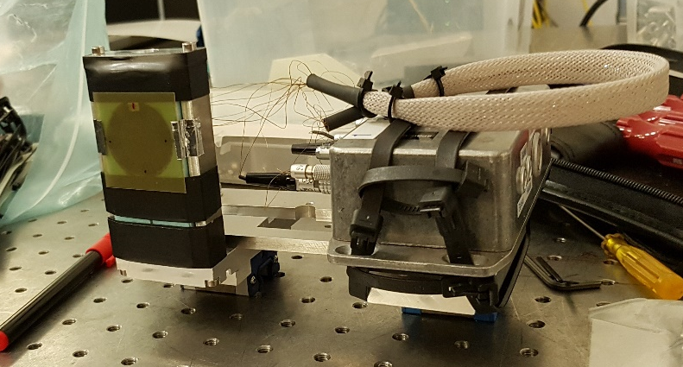
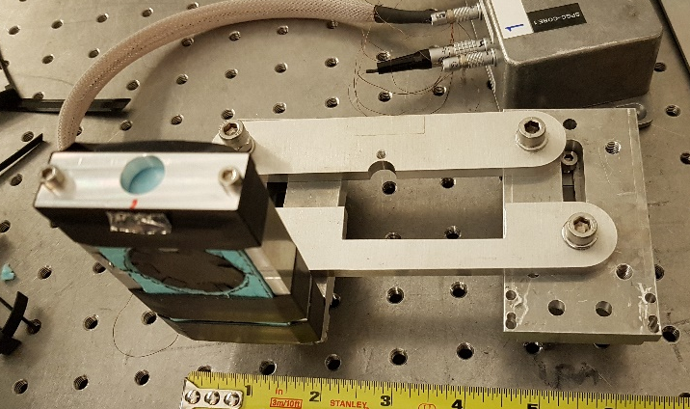
What happens if I am sick during my pregnancy?
If you are absent from work due to pregnancy related reasons you need to follow the normal process for advising your manager and providing Fit Notes if applicable. If you are absent for pregnancy related reasons within four weeks of your expected week of childbirth, your maternity leave will automatically commence.
What is the current rate of Statutory Maternity Pay?
The government sets this annually. You can find out on www.gov.uk
I am on a fixed term contract. How does that affect my entitlements?
You will have the same entitlements to pay and leave providing you meet the qualifying criteria. If your fixed term contract ends during your maternity leave and is not renewed, the entitlement to the enhanced University maternity pay will cease but SMP will continue to be paid.
How does the University maternity entitlement differ from the statutory one?
The University offers enhanced maternity pay to eligible employees, based on length of service. The current entitlements are set out in the Maternity Policy and in this guidance.
What happens if I choose not to return to work after my maternity leave?
If you decide not to return to work, you will need to provide written notice in accordance with your contract of employment. If you have received enhanced University maternity pay but do not return to work for at least three months, you will be required to repay the difference between the enhanced payments and SMP.
Do I still accrue holiday while I am on maternity leave?
Yes. Your holiday will still accrue as normal.
When can I start my maternity leave?
You can begin your maternity leave on any date after the 11th week before your expected week of childbirth. Your midwife will confirm your expected week of childbirth on the MATB1 form around your 20th week of pregnancy.
What happens to my job while I am on leave?
Managers have various options. They may choose to bring in temporary cover or seek to manage the duties via secondments or redistribution of work with other team members. Your manager will discuss this with you. However your job is covered in your absence, you have the right to return to it, or a similar role with comparable terms and conditions.
What if I want to change my return date once my leave commences?
We will write to you to confirm the latest date you are expected to return to work after your maternity leave. This will be at the end of the 52nd week. If you want to return sooner than this date then please confirm this in writing, at least 28 days before the date you intend to return to work. If you would like to return later, for example by taking parental additional leave, please notify your manager in writing of your request.
I gave a date that I would like to start my maternity leave, but now I want to change it. Can I do that?
Yes. You are required to tell us in writing at least 28 days prior to the new date.
Can I return to work on a phased basis?
This may be possible depending on operational requirements. Please discuss this with your manager.
What happens to my maternity leave if my baby is born early?
Maternity leave is triggered by childbirth. If your baby is born early your maternity leave will therefore start immediately.
When I return to work, I want to change my hours of work. What do I need to do?
You can make a flexible working request prior to your return to work under our Flexible Working Policy. You can discuss your plans with your manager at any time. See http://documents.manchester.ac.uk/DocuInfo.aspx?DocID=9
Can I take holiday during my maternity leave?
All holiday must be taken outside of the maternity leave period. It is not possible to be on maternity leave and holiday at the same time. Holiday can be taken immediately before or after maternity leave.
Can I carry holiday forward into next year?
In most cases there should be sufficient time leading up to the leave period to effectively plan the use of holiday in advance of the maternity leave period. The University allows up to one week’s holiday to be carried over into the next holiday year.
What happens to my pension contributions when I am on maternity leave?
There are different rules for different pension schemes. For more information please contact your scheme provider or a member of the pensions team who will be able to provide more information
Can my manager ask me to come into work during my maternity leave? If so, do I have to agree?
The University, as an employer, is allowed to make reasonable contact with employees whilst they are on maternity leave. You are not obliged to do any work or attend any work related events during maternity leave, however if you and your manager both agree, then you can work up to a total of 10 days during your leave. These are called ‘Keeping in Touch’ days.
Do I have to agree in advance if I want to come to work for a Keeping in Touch Day?
Yes, you and your manager should agree in advance when you are going to attend work for one of your Keeping in Touch Days to allow both parties to make any necessary arrangements.
If I attend work for half a day or less, is this classed as one of my Keeping in Touch Days?
Yes, as soon as you start work, even if it is for only a few hours, this is counted as one of your 10 KIT days. The number of hours that you attend work can be up to the maximum of the full time equivalent.
Will I be placed at a disadvantage on my return if I don’t come into work prior to the end of my maternity leave?
Employees are encouraged to make use of KIT days as a positive way to keep in contact with developments in their workplace. As work during maternity leave may only take place with the agreement of both parties, you will not be at any disadvantage regarding the options you choose about KIT days.
I have been asked to be an external examiner for another University; can I use a Keeping in Touch Day to undertake this work?
No, because this is paid work for another employer and will therefore impact upon your maternity arrangements.
What type of work will I be expected to undertake whilst in work on a Keeping in Touch Day?
The purpose of these days is to allow you to be kept informed and up to date on developments within your own workplace or within the University. This may include attending a conference, undertaking training or a team event.
How else can I keep in touch during my maternity leave?
The University encourages managers and employees to discuss this prior to the start of maternity leave. Ultimately, it is up to you how you want to be updated about work matters. Some employees want a regular update, others would prefer no contact at all.
Electromagnetic pulse protection
Large electromagnetic pulse (EMP) produced during laser-target interaction
  Potentially damaging effects on the electronics/signal distortion
One laser shot conducted with SPGC withdrawn from the irradiation point
  External, discrete protection electronics added to SPGC
Absence of EMP effects evident from the excellent signal-to-noise ratio observed
Notes:
.

Slide 15
What happens if I am sick during my pregnancy?
If you are absent from work due to pregnancy related reasons you need to follow the normal process for advising your manager and providing Fit Notes if applicable. If you are absent for pregnancy related reasons within four weeks of your expected week of childbirth, your maternity leave will automatically commence.
What is the current rate of Statutory Maternity Pay?
The government sets this annually. You can find out on www.gov.uk
I am on a fixed term contract. How does that affect my entitlements?
You will have the same entitlements to pay and leave providing you meet the qualifying criteria. If your fixed term contract ends during your maternity leave and is not renewed, the entitlement to the enhanced University maternity pay will cease but SMP will continue to be paid.
How does the University maternity entitlement differ from the statutory one?
The University offers enhanced maternity pay to eligible employees, based on length of service. The current entitlements are set out in the Maternity Policy and in this guidance.
What happens if I choose not to return to work after my maternity leave?
If you decide not to return to work, you will need to provide written notice in accordance with your contract of employment. If you have received enhanced University maternity pay but do not return to work for at least three months, you will be required to repay the difference between the enhanced payments and SMP.
Do I still accrue holiday while I am on maternity leave?
Yes. Your holiday will still accrue as normal.
When can I start my maternity leave?
You can begin your maternity leave on any date after the 11th week before your expected week of childbirth. Your midwife will confirm your expected week of childbirth on the MATB1 form around your 20th week of pregnancy.
What happens to my job while I am on leave?
Managers have various options. They may choose to bring in temporary cover or seek to manage the duties via secondments or redistribution of work with other team members. Your manager will discuss this with you. However your job is covered in your absence, you have the right to return to it, or a similar role with comparable terms and conditions.
What if I want to change my return date once my leave commences?
We will write to you to confirm the latest date you are expected to return to work after your maternity leave. This will be at the end of the 52nd week. If you want to return sooner than this date then please confirm this in writing, at least 28 days before the date you intend to return to work. If you would like to return later, for example by taking parental additional leave, please notify your manager in writing of your request.
I gave a date that I would like to start my maternity leave, but now I want to change it. Can I do that?
Yes. You are required to tell us in writing at least 28 days prior to the new date.
Can I return to work on a phased basis?
This may be possible depending on operational requirements. Please discuss this with your manager.
What happens to my maternity leave if my baby is born early?
Maternity leave is triggered by childbirth. If your baby is born early your maternity leave will therefore start immediately.
When I return to work, I want to change my hours of work. What do I need to do?
You can make a flexible working request prior to your return to work under our Flexible Working Policy. You can discuss your plans with your manager at any time. See http://documents.manchester.ac.uk/DocuInfo.aspx?DocID=9
Can I take holiday during my maternity leave?
All holiday must be taken outside of the maternity leave period. It is not possible to be on maternity leave and holiday at the same time. Holiday can be taken immediately before or after maternity leave.
Can I carry holiday forward into next year?
In most cases there should be sufficient time leading up to the leave period to effectively plan the use of holiday in advance of the maternity leave period. The University allows up to one week’s holiday to be carried over into the next holiday year.
What happens to my pension contributions when I am on maternity leave?
There are different rules for different pension schemes. For more information please contact your scheme provider or a member of the pensions team who will be able to provide more information
Can my manager ask me to come into work during my maternity leave? If so, do I have to agree?
The University, as an employer, is allowed to make reasonable contact with employees whilst they are on maternity leave. You are not obliged to do any work or attend any work related events during maternity leave, however if you and your manager both agree, then you can work up to a total of 10 days during your leave. These are called ‘Keeping in Touch’ days.
Do I have to agree in advance if I want to come to work for a Keeping in Touch Day?
Yes, you and your manager should agree in advance when you are going to attend work for one of your Keeping in Touch Days to allow both parties to make any necessary arrangements.
If I attend work for half a day or less, is this classed as one of my Keeping in Touch Days?
Yes, as soon as you start work, even if it is for only a few hours, this is counted as one of your 10 KIT days. The number of hours that you attend work can be up to the maximum of the full time equivalent.
Will I be placed at a disadvantage on my return if I don’t come into work prior to the end of my maternity leave?
Employees are encouraged to make use of KIT days as a positive way to keep in contact with developments in their workplace. As work during maternity leave may only take place with the agreement of both parties, you will not be at any disadvantage regarding the options you choose about KIT days.
I have been asked to be an external examiner for another University; can I use a Keeping in Touch Day to undertake this work?
No, because this is paid work for another employer and will therefore impact upon your maternity arrangements.
What type of work will I be expected to undertake whilst in work on a Keeping in Touch Day?
The purpose of these days is to allow you to be kept informed and up to date on developments within your own workplace or within the University. This may include attending a conference, undertaking training or a team event.
How else can I keep in touch during my maternity leave?
The University encourages managers and employees to discuss this prior to the start of maternity leave. Ultimately, it is up to you how you want to be updated about work matters. Some employees want a regular update, others would prefer no contact at all.
Summary and Outlook
UHPDR/laser-driven beams offer potential benefits for applications
Challenges associated with dosimetry at these high dose rates
Alternative approach through calorimetry of laser-driven beams demonstrated
Dedicated campaign for calorimetry measurements of laser-driven protons proposed
Results will serve as a tool to aid potential clinical applications of these beams

Slide 16
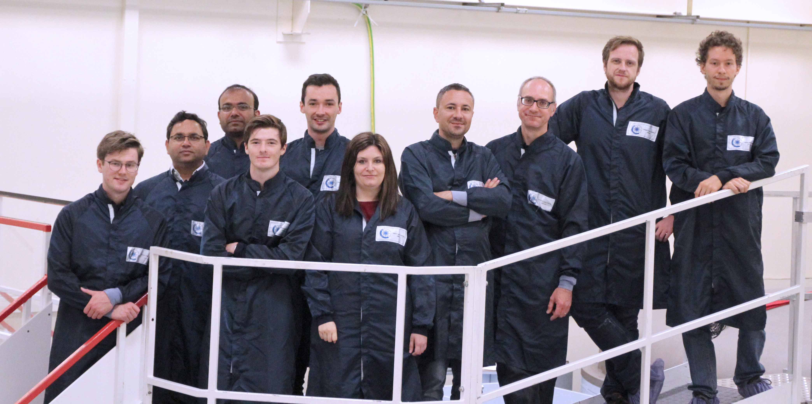
What happens if I am sick during my pregnancy?
If you are absent from work due to pregnancy related reasons you need to follow the normal process for advising your manager and providing Fit Notes if applicable. If you are absent for pregnancy related reasons within four weeks of your expected week of childbirth, your maternity leave will automatically commence.
What is the current rate of Statutory Maternity Pay?
The government sets this annually. You can find out on www.gov.uk
I am on a fixed term contract. How does that affect my entitlements?
You will have the same entitlements to pay and leave providing you meet the qualifying criteria. If your fixed term contract ends during your maternity leave and is not renewed, the entitlement to the enhanced University maternity pay will cease but SMP will continue to be paid.
How does the University maternity entitlement differ from the statutory one?
The University offers enhanced maternity pay to eligible employees, based on length of service. The current entitlements are set out in the Maternity Policy and in this guidance.
What happens if I choose not to return to work after my maternity leave?
If you decide not to return to work, you will need to provide written notice in accordance with your contract of employment. If you have received enhanced University maternity pay but do not return to work for at least three months, you will be required to repay the difference between the enhanced payments and SMP.
Do I still accrue holiday while I am on maternity leave?
Yes. Your holiday will still accrue as normal.
When can I start my maternity leave?
You can begin your maternity leave on any date after the 11th week before your expected week of childbirth. Your midwife will confirm your expected week of childbirth on the MATB1 form around your 20th week of pregnancy.
What happens to my job while I am on leave?
Managers have various options. They may choose to bring in temporary cover or seek to manage the duties via secondments or redistribution of work with other team members. Your manager will discuss this with you. However your job is covered in your absence, you have the right to return to it, or a similar role with comparable terms and conditions.
What if I want to change my return date once my leave commences?
We will write to you to confirm the latest date you are expected to return to work after your maternity leave. This will be at the end of the 52nd week. If you want to return sooner than this date then please confirm this in writing, at least 28 days before the date you intend to return to work. If you would like to return later, for example by taking parental additional leave, please notify your manager in writing of your request.
I gave a date that I would like to start my maternity leave, but now I want to change it. Can I do that?
Yes. You are required to tell us in writing at least 28 days prior to the new date.
Can I return to work on a phased basis?
This may be possible depending on operational requirements. Please discuss this with your manager.
What happens to my maternity leave if my baby is born early?
Maternity leave is triggered by childbirth. If your baby is born early your maternity leave will therefore start immediately.
When I return to work, I want to change my hours of work. What do I need to do?
You can make a flexible working request prior to your return to work under our Flexible Working Policy. You can discuss your plans with your manager at any time. See http://documents.manchester.ac.uk/DocuInfo.aspx?DocID=9
Can I take holiday during my maternity leave?
All holiday must be taken outside of the maternity leave period. It is not possible to be on maternity leave and holiday at the same time. Holiday can be taken immediately before or after maternity leave.
Can I carry holiday forward into next year?
In most cases there should be sufficient time leading up to the leave period to effectively plan the use of holiday in advance of the maternity leave period. The University allows up to one week’s holiday to be carried over into the next holiday year.
What happens to my pension contributions when I am on maternity leave?
There are different rules for different pension schemes. For more information please contact your scheme provider or a member of the pensions team who will be able to provide more information
Can my manager ask me to come into work during my maternity leave? If so, do I have to agree?
The University, as an employer, is allowed to make reasonable contact with employees whilst they are on maternity leave. You are not obliged to do any work or attend any work related events during maternity leave, however if you and your manager both agree, then you can work up to a total of 10 days during your leave. These are called ‘Keeping in Touch’ days.
Do I have to agree in advance if I want to come to work for a Keeping in Touch Day?
Yes, you and your manager should agree in advance when you are going to attend work for one of your Keeping in Touch Days to allow both parties to make any necessary arrangements.
If I attend work for half a day or less, is this classed as one of my Keeping in Touch Days?
Yes, as soon as you start work, even if it is for only a few hours, this is counted as one of your 10 KIT days. The number of hours that you attend work can be up to the maximum of the full time equivalent.
Will I be placed at a disadvantage on my return if I don’t come into work prior to the end of my maternity leave?
Employees are encouraged to make use of KIT days as a positive way to keep in contact with developments in their workplace. As work during maternity leave may only take place with the agreement of both parties, you will not be at any disadvantage regarding the options you choose about KIT days.
I have been asked to be an external examiner for another University; can I use a Keeping in Touch Day to undertake this work?
No, because this is paid work for another employer and will therefore impact upon your maternity arrangements.
What type of work will I be expected to undertake whilst in work on a Keeping in Touch Day?
The purpose of these days is to allow you to be kept informed and up to date on developments within your own workplace or within the University. This may include attending a conference, undertaking training or a team event.
How else can I keep in touch during my maternity leave?
The University encourages managers and employees to discuss this prior to the start of maternity leave. Ultimately, it is up to you how you want to be updated about work matters. Some employees want a regular update, others would prefer no contact at all.
Thank you for your attention!
smccallum05@qub.ac.uk

Slide 17

What happens if I am sick during my pregnancy?
If you are absent from work due to pregnancy related reasons you need to follow the normal process for advising your manager and providing Fit Notes if applicable. If you are absent for pregnancy related reasons within four weeks of your expected week of childbirth, your maternity leave will automatically commence.
What is the current rate of Statutory Maternity Pay?
The government sets this annually. You can find out on www.gov.uk
I am on a fixed term contract. How does that affect my entitlements?
You will have the same entitlements to pay and leave providing you meet the qualifying criteria. If your fixed term contract ends during your maternity leave and is not renewed, the entitlement to the enhanced University maternity pay will cease but SMP will continue to be paid.
How does the University maternity entitlement differ from the statutory one?
The University offers enhanced maternity pay to eligible employees, based on length of service. The current entitlements are set out in the Maternity Policy and in this guidance.
What happens if I choose not to return to work after my maternity leave?
If you decide not to return to work, you will need to provide written notice in accordance with your contract of employment. If you have received enhanced University maternity pay but do not return to work for at least three months, you will be required to repay the difference between the enhanced payments and SMP.
Do I still accrue holiday while I am on maternity leave?
Yes. Your holiday will still accrue as normal.
When can I start my maternity leave?
You can begin your maternity leave on any date after the 11th week before your expected week of childbirth. Your midwife will confirm your expected week of childbirth on the MATB1 form around your 20th week of pregnancy.
What happens to my job while I am on leave?
Managers have various options. They may choose to bring in temporary cover or seek to manage the duties via secondments or redistribution of work with other team members. Your manager will discuss this with you. However your job is covered in your absence, you have the right to return to it, or a similar role with comparable terms and conditions.
What if I want to change my return date once my leave commences?
We will write to you to confirm the latest date you are expected to return to work after your maternity leave. This will be at the end of the 52nd week. If you want to return sooner than this date then please confirm this in writing, at least 28 days before the date you intend to return to work. If you would like to return later, for example by taking parental additional leave, please notify your manager in writing of your request.
I gave a date that I would like to start my maternity leave, but now I want to change it. Can I do that?
Yes. You are required to tell us in writing at least 28 days prior to the new date.
Can I return to work on a phased basis?
This may be possible depending on operational requirements. Please discuss this with your manager.
What happens to my maternity leave if my baby is born early?
Maternity leave is triggered by childbirth. If your baby is born early your maternity leave will therefore start immediately.
When I return to work, I want to change my hours of work. What do I need to do?
You can make a flexible working request prior to your return to work under our Flexible Working Policy. You can discuss your plans with your manager at any time. See http://documents.manchester.ac.uk/DocuInfo.aspx?DocID=9
Can I take holiday during my maternity leave?
All holiday must be taken outside of the maternity leave period. It is not possible to be on maternity leave and holiday at the same time. Holiday can be taken immediately before or after maternity leave.
Can I carry holiday forward into next year?
In most cases there should be sufficient time leading up to the leave period to effectively plan the use of holiday in advance of the maternity leave period. The University allows up to one week’s holiday to be carried over into the next holiday year.
What happens to my pension contributions when I am on maternity leave?
There are different rules for different pension schemes. For more information please contact your scheme provider or a member of the pensions team who will be able to provide more information
Can my manager ask me to come into work during my maternity leave? If so, do I have to agree?
The University, as an employer, is allowed to make reasonable contact with employees whilst they are on maternity leave. You are not obliged to do any work or attend any work related events during maternity leave, however if you and your manager both agree, then you can work up to a total of 10 days during your leave. These are called ‘Keeping in Touch’ days.
Do I have to agree in advance if I want to come to work for a Keeping in Touch Day?
Yes, you and your manager should agree in advance when you are going to attend work for one of your Keeping in Touch Days to allow both parties to make any necessary arrangements.
If I attend work for half a day or less, is this classed as one of my Keeping in Touch Days?
Yes, as soon as you start work, even if it is for only a few hours, this is counted as one of your 10 KIT days. The number of hours that you attend work can be up to the maximum of the full time equivalent.
Will I be placed at a disadvantage on my return if I don’t come into work prior to the end of my maternity leave?
Employees are encouraged to make use of KIT days as a positive way to keep in contact with developments in their workplace. As work during maternity leave may only take place with the agreement of both parties, you will not be at any disadvantage regarding the options you choose about KIT days.
I have been asked to be an external examiner for another University; can I use a Keeping in Touch Day to undertake this work?
No, because this is paid work for another employer and will therefore impact upon your maternity arrangements.
What type of work will I be expected to undertake whilst in work on a Keeping in Touch Day?
The purpose of these days is to allow you to be kept informed and up to date on developments within your own workplace or within the University. This may include attending a conference, undertaking training or a team event.
How else can I keep in touch during my maternity leave?
The University encourages managers and employees to discuss this prior to the start of maternity leave. Ultimately, it is up to you how you want to be updated about work matters. Some employees want a regular update, others would prefer no contact at all.
Acknowledgements
Dr. F, Romano; Istituto Nazionale di Fisica Nucleare, Sezione di Catania, Via S Sofia 64, 95123 Catania, Italy; National Physical Laboratory; CMES - Medical Radiation Science, Teddington TW11 0LW, Middlesex, UK;
Dr. A, Subiel; National Physical Laboratory; CMES - Medical Radiation Science, Teddington TW11 0LW, Middlesex, UK;
Dr. G, Milluzzo, Prof. M, Borghesi, Mr. A, McIlvenny; Centre for Plasma Physics, Queen’s University Belfast, BT7 1NN;
Dr. H, Palmans, National Physical Laboratory, CMES - Medical Radiation Science, Teddington TW11 0LW, Middlesex, UK; Medical Physics Group, EBG MedAustron GmbH, A-2700 Wiener Neustadt, Austria;
Dr. A, Schueller, Physikalisch-Technische Bundesanstalt, Braunschweig and Berlin, Bundesallee 100, 38116 Braunschweig;

Slide 18
What happens if I am sick during my pregnancy?
If you are absent from work due to pregnancy related reasons you need to follow the normal process for advising your manager and providing Fit Notes if applicable. If you are absent for pregnancy related reasons within four weeks of your expected week of childbirth, your maternity leave will automatically commence.
What is the current rate of Statutory Maternity Pay?
The government sets this annually. You can find out on www.gov.uk
I am on a fixed term contract. How does that affect my entitlements?
You will have the same entitlements to pay and leave providing you meet the qualifying criteria. If your fixed term contract ends during your maternity leave and is not renewed, the entitlement to the enhanced University maternity pay will cease but SMP will continue to be paid.
How does the University maternity entitlement differ from the statutory one?
The University offers enhanced maternity pay to eligible employees, based on length of service. The current entitlements are set out in the Maternity Policy and in this guidance.
What happens if I choose not to return to work after my maternity leave?
If you decide not to return to work, you will need to provide written notice in accordance with your contract of employment. If you have received enhanced University maternity pay but do not return to work for at least three months, you will be required to repay the difference between the enhanced payments and SMP.
Do I still accrue holiday while I am on maternity leave?
Yes. Your holiday will still accrue as normal.
When can I start my maternity leave?
You can begin your maternity leave on any date after the 11th week before your expected week of childbirth. Your midwife will confirm your expected week of childbirth on the MATB1 form around your 20th week of pregnancy.
What happens to my job while I am on leave?
Managers have various options. They may choose to bring in temporary cover or seek to manage the duties via secondments or redistribution of work with other team members. Your manager will discuss this with you. However your job is covered in your absence, you have the right to return to it, or a similar role with comparable terms and conditions.
What if I want to change my return date once my leave commences?
We will write to you to confirm the latest date you are expected to return to work after your maternity leave. This will be at the end of the 52nd week. If you want to return sooner than this date then please confirm this in writing, at least 28 days before the date you intend to return to work. If you would like to return later, for example by taking parental additional leave, please notify your manager in writing of your request.
I gave a date that I would like to start my maternity leave, but now I want to change it. Can I do that?
Yes. You are required to tell us in writing at least 28 days prior to the new date.
Can I return to work on a phased basis?
This may be possible depending on operational requirements. Please discuss this with your manager.
What happens to my maternity leave if my baby is born early?
Maternity leave is triggered by childbirth. If your baby is born early your maternity leave will therefore start immediately.
When I return to work, I want to change my hours of work. What do I need to do?
You can make a flexible working request prior to your return to work under our Flexible Working Policy. You can discuss your plans with your manager at any time. See http://documents.manchester.ac.uk/DocuInfo.aspx?DocID=9
Can I take holiday during my maternity leave?
All holiday must be taken outside of the maternity leave period. It is not possible to be on maternity leave and holiday at the same time. Holiday can be taken immediately before or after maternity leave.
Can I carry holiday forward into next year?
In most cases there should be sufficient time leading up to the leave period to effectively plan the use of holiday in advance of the maternity leave period. The University allows up to one week’s holiday to be carried over into the next holiday year.
What happens to my pension contributions when I am on maternity leave?
There are different rules for different pension schemes. For more information please contact your scheme provider or a member of the pensions team who will be able to provide more information
Can my manager ask me to come into work during my maternity leave? If so, do I have to agree?
The University, as an employer, is allowed to make reasonable contact with employees whilst they are on maternity leave. You are not obliged to do any work or attend any work related events during maternity leave, however if you and your manager both agree, then you can work up to a total of 10 days during your leave. These are called ‘Keeping in Touch’ days.
Do I have to agree in advance if I want to come to work for a Keeping in Touch Day?
Yes, you and your manager should agree in advance when you are going to attend work for one of your Keeping in Touch Days to allow both parties to make any necessary arrangements.
If I attend work for half a day or less, is this classed as one of my Keeping in Touch Days?
Yes, as soon as you start work, even if it is for only a few hours, this is counted as one of your 10 KIT days. The number of hours that you attend work can be up to the maximum of the full time equivalent.
Will I be placed at a disadvantage on my return if I don’t come into work prior to the end of my maternity leave?
Employees are encouraged to make use of KIT days as a positive way to keep in contact with developments in their workplace. As work during maternity leave may only take place with the agreement of both parties, you will not be at any disadvantage regarding the options you choose about KIT days.
I have been asked to be an external examiner for another University; can I use a Keeping in Touch Day to undertake this work?
No, because this is paid work for another employer and will therefore impact upon your maternity arrangements.
What type of work will I be expected to undertake whilst in work on a Keeping in Touch Day?
The purpose of these days is to allow you to be kept informed and up to date on developments within your own workplace or within the University. This may include attending a conference, undertaking training or a team event.
How else can I keep in touch during my maternity leave?
The University encourages managers and employees to discuss this prior to the start of maternity leave. Ultimately, it is up to you how you want to be updated about work matters. Some employees want a regular update, others would prefer no contact at all.
References
1. E. Schüler, et al., Int J Radiat Oncol Biol Phys, (2017)
2. http://uhdpulse-empir.eu
3. S. Duane et al., Metrologia, 49, S168, (2012)
4. H, Palmans , et al., Physics in Medicine and Biology, (2004)
5. McManus, M., et al (2020)
6. Bourgouin, A., et al (2019)
7. Renaud, J., et al (2013), (2017) & (2018)
8. Bourgouin, A., et al (2020) & (2022)
9. GafChromic, Ashland Advanced Materials
10. J Perl, et al., Med Phys. 2012 Nov; 39(11):6818-37
11. B Faddegon, et al., Phys Med. 2020 Apr 02; 72:114-121

