Slide 1











Overview of WP4:
Detector systems and methods for dosimetry outside primary beam – stray radiation
2nd Stakeholder Meeting, Prague 26-27th January 2022
Jiri Pivec

Slide 2
Overview of WP4
Detector systems and methods for dosimetry outside primary beam
electrons and protons
Task 4.1
Develop a Timepix3 based radiation monitor and spectrometer for pulsed mixed radiation fields
(ADV, CMI, FZU-ELI, NPI)
Task 4.2
Characterization of the response of passive detector system (OSL, TLD) in pulsed mixed radiation fields
(FZU-ELI, CMI, NPI)
Task 4.4
Traceability and validation of methods for characterization of stray radiation
(CMI, ADV, FZU-ELI, NPI, POLIMI, NPL, PTB)
neutrons
Task 4.3
Development, characterization and comparison of
Bonner Sphere Spectrometers (Read out in current mode, Fission chamber) based on active detectors
(NPL, POLiMi, PTB)
Notes:
The first task is dedicated to the development of active detection techniques based on state-of-the-art pixel
detector. The second task aims to test and characterise the response of passive detection systems. The third
task is focused on active detection systems and methods for characterisation of neutron spectra over a wide
energy range. All these techniques will be investigated in parallel, tested, experimentally verified, and
compared with Monte Carlo simulations. In Task 4.4, the methods for characterisation of stray radiation
developed and tested in previous tasks will be validated by comparison to each other. Also, traceability to a
standard of absorbed dose to water developed in WP1 will be assured in this task. For neutrons, the traceability
to primary standards will be provided by NPL and PTB. Finally, the results of the WP4 will lead to the
compilation of a Best Practice Guide for the characterisation of stray radiation outside the UHPDR particle
beams.

Slide 3
Status of Task 4.1: Develop a Timepix3 based radiation monitor and spectrometer for pulsed mixed radiation fields (electron and protons)
Activity Milestone | Activity description | Status | Partners
A4.1.1 M06 | Testing of potentially suitable TPX3 sensors for stray radiation measurement | Completed 07/2021 | ADV, CMI
A4.1.2 M15 | Optimization of the detector for stray radiation measurement in water-phantom | Completed 06/2020 | ADV
A4.1.3 M18 | Monte Carlo modelling of optimized TPX3 detector | Completed 10/2021 | CMI, ADV, NPI, FZU
A4.1.4 M21 | Method for particle quantification for different particle track types, measured by opt. TPX3 det | Completed 02/2022 | ADV CMI
A4.1.5 M24 | Method for absorbed dose to water quantification | Delayed to 01/2023 Finalizing the method, verification measurement at PTB early Jan 23 | CMI ADV
A4.1.6 M24 | Software development | Completed 05/2022 | ADV
A4.1.7 M27 | Detailed tests of TPX3 detector | Completed 10/2022 | ADV CMI, PTB
A4.1.8 M30 | Documentation and manual | Completed 10/2022 | ADV CMI
A4.1.9 M36 | Submission of a peer-reviewed article | On schedule 3 articles published, 4th in final stage | ADV CMI

Slide 4
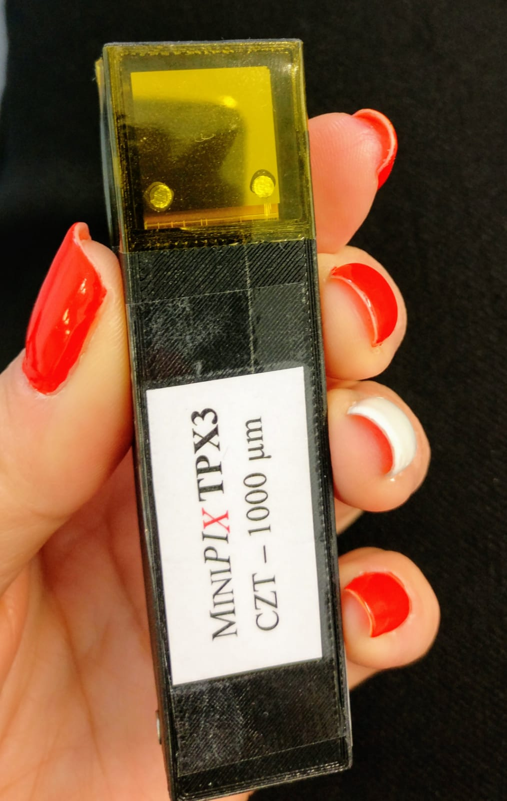
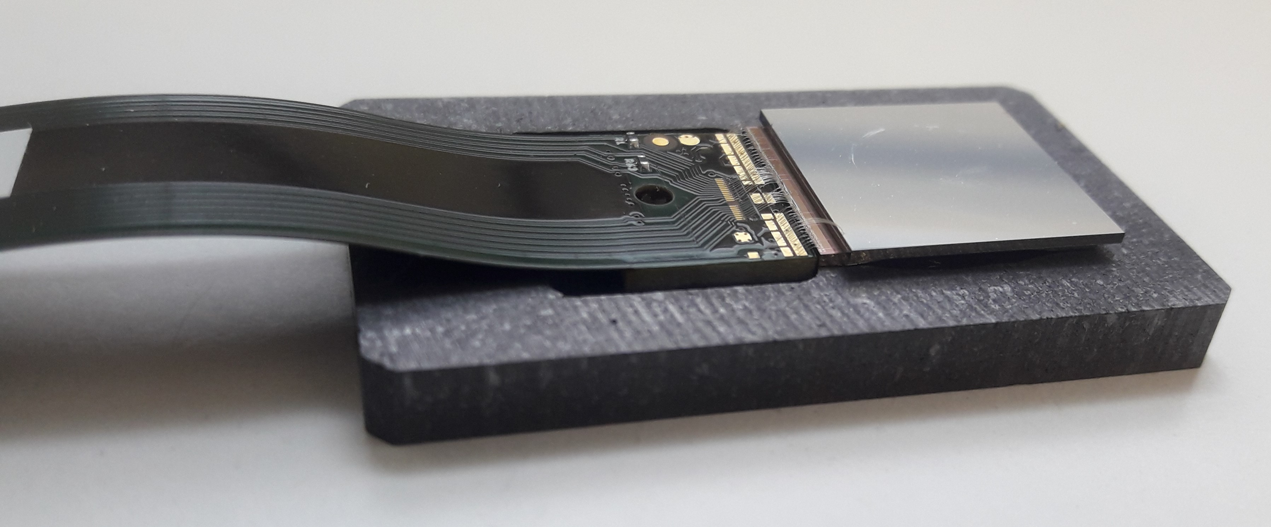
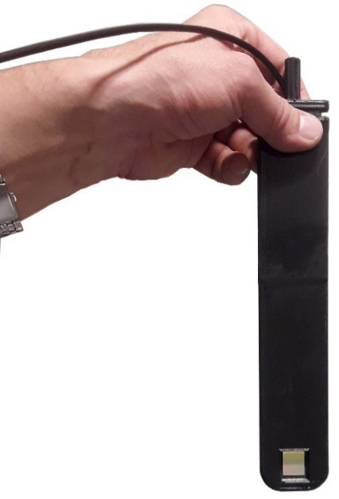
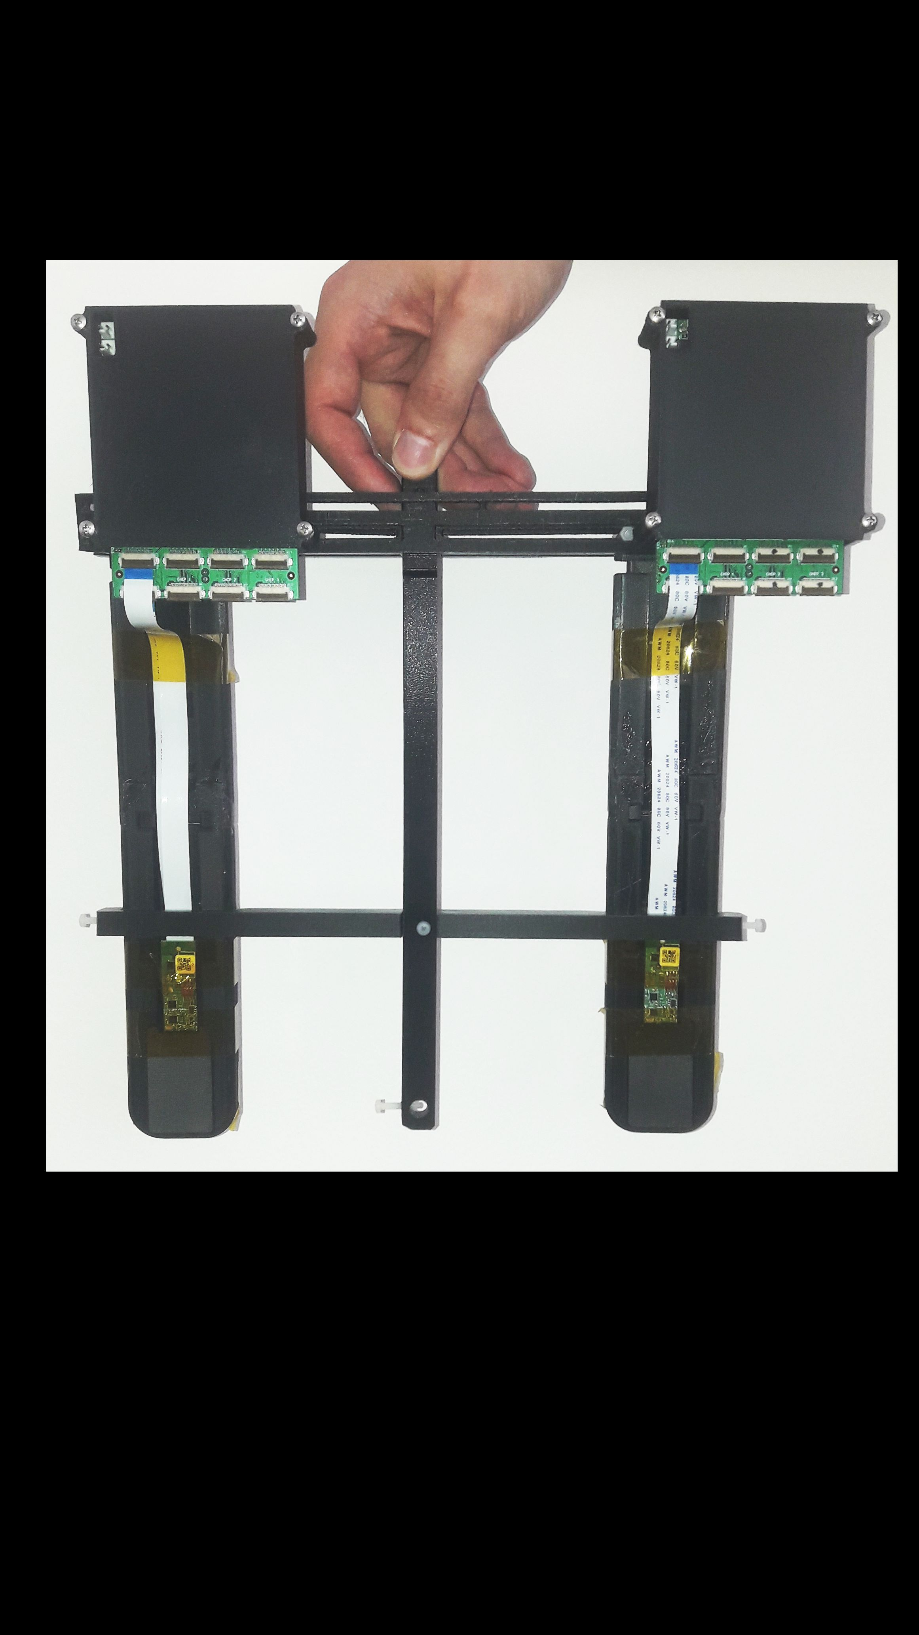
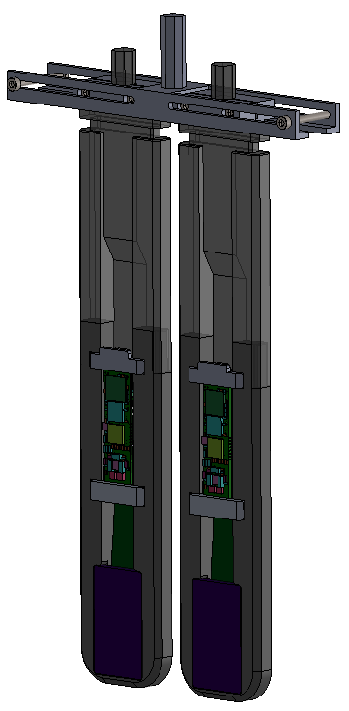
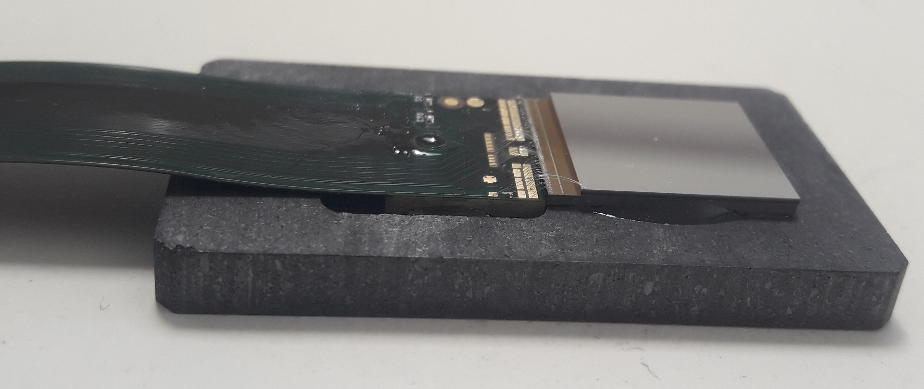
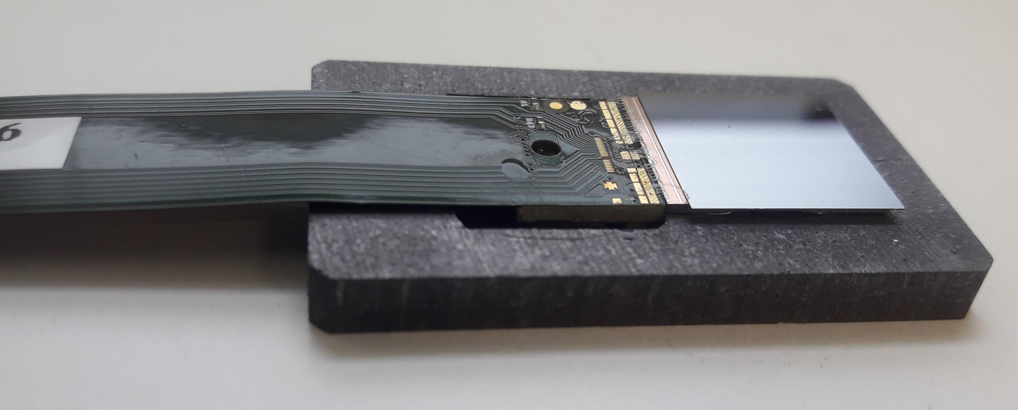
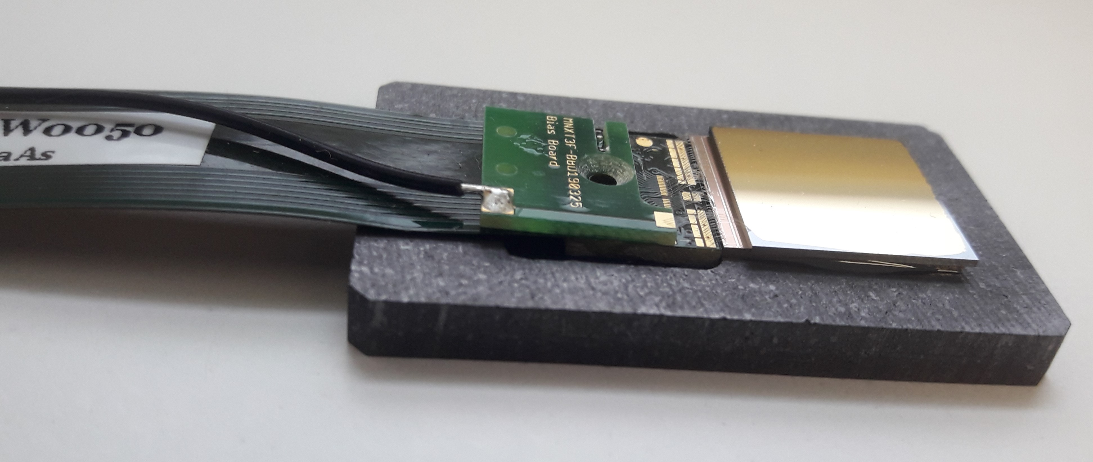
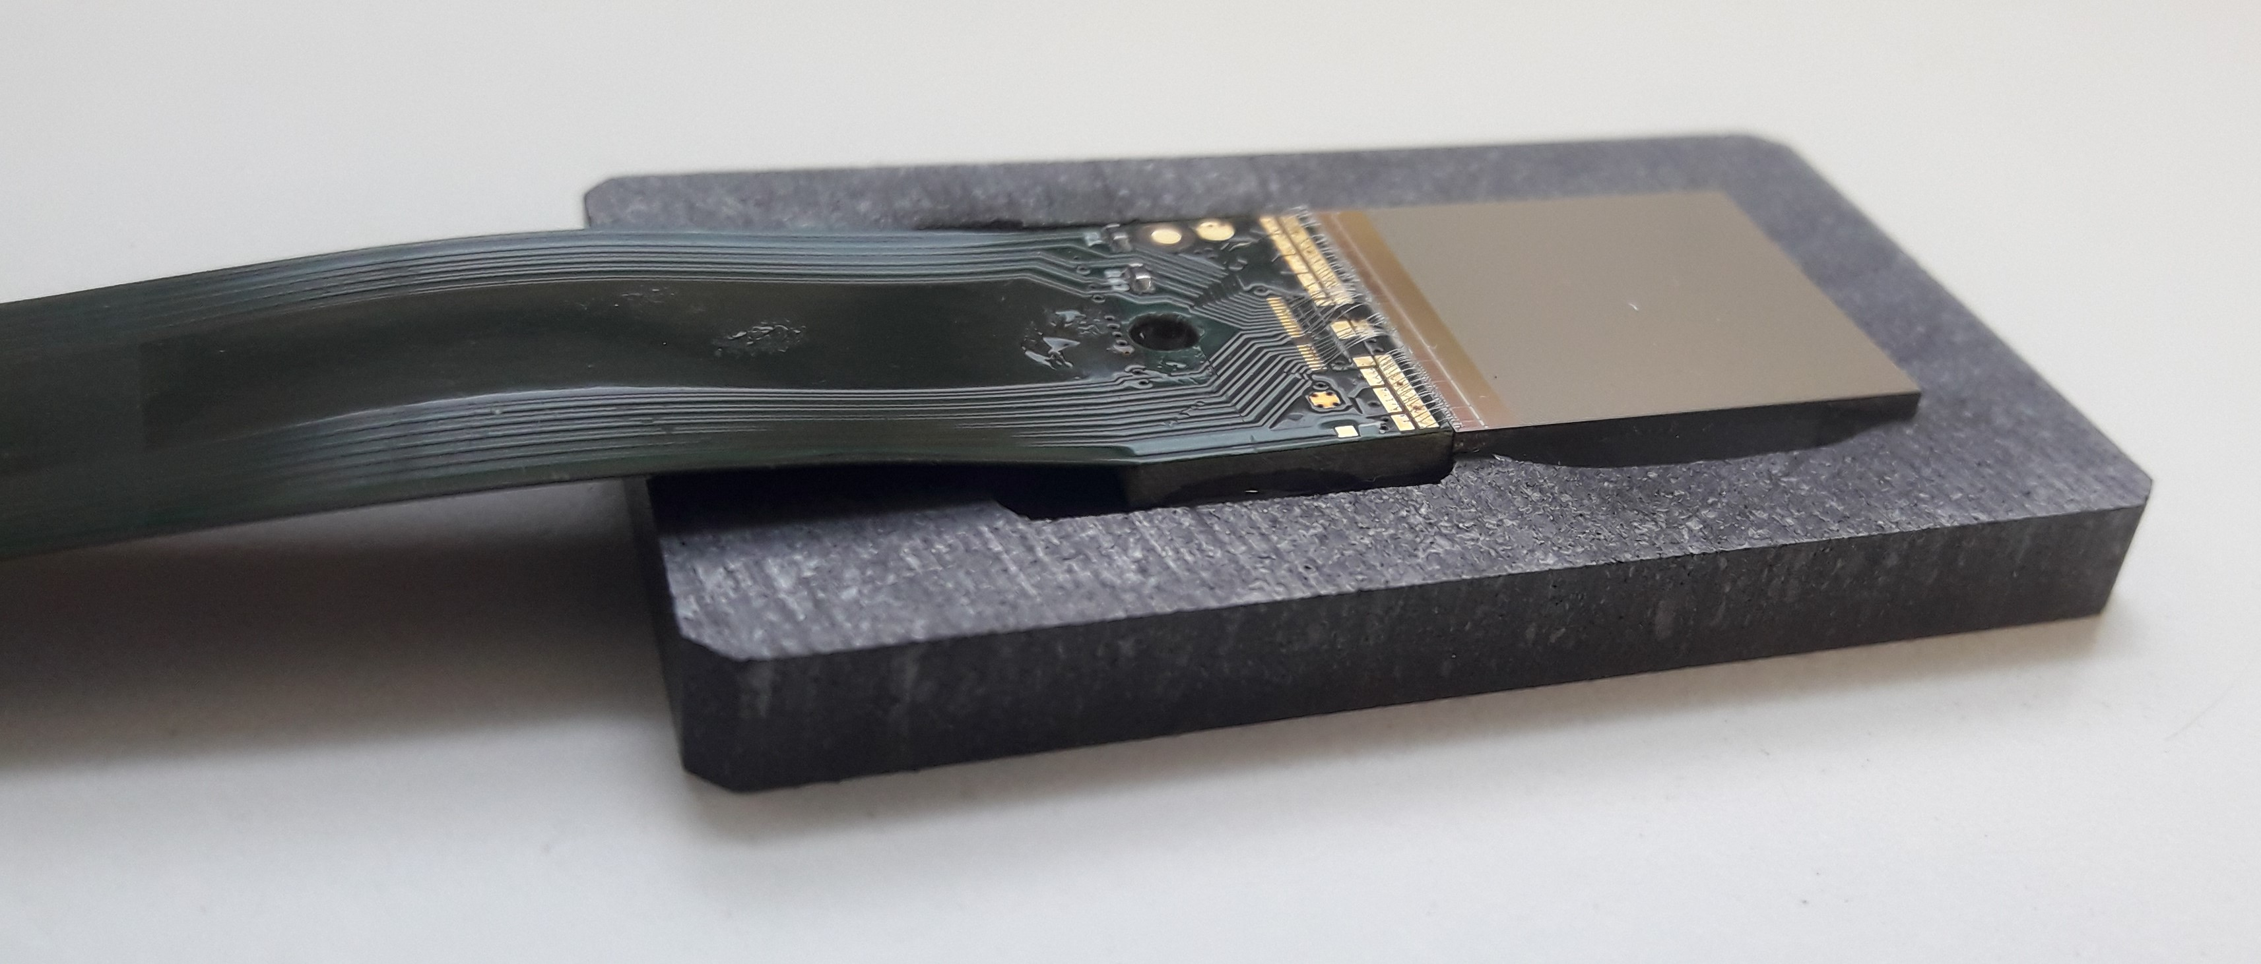
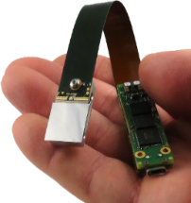
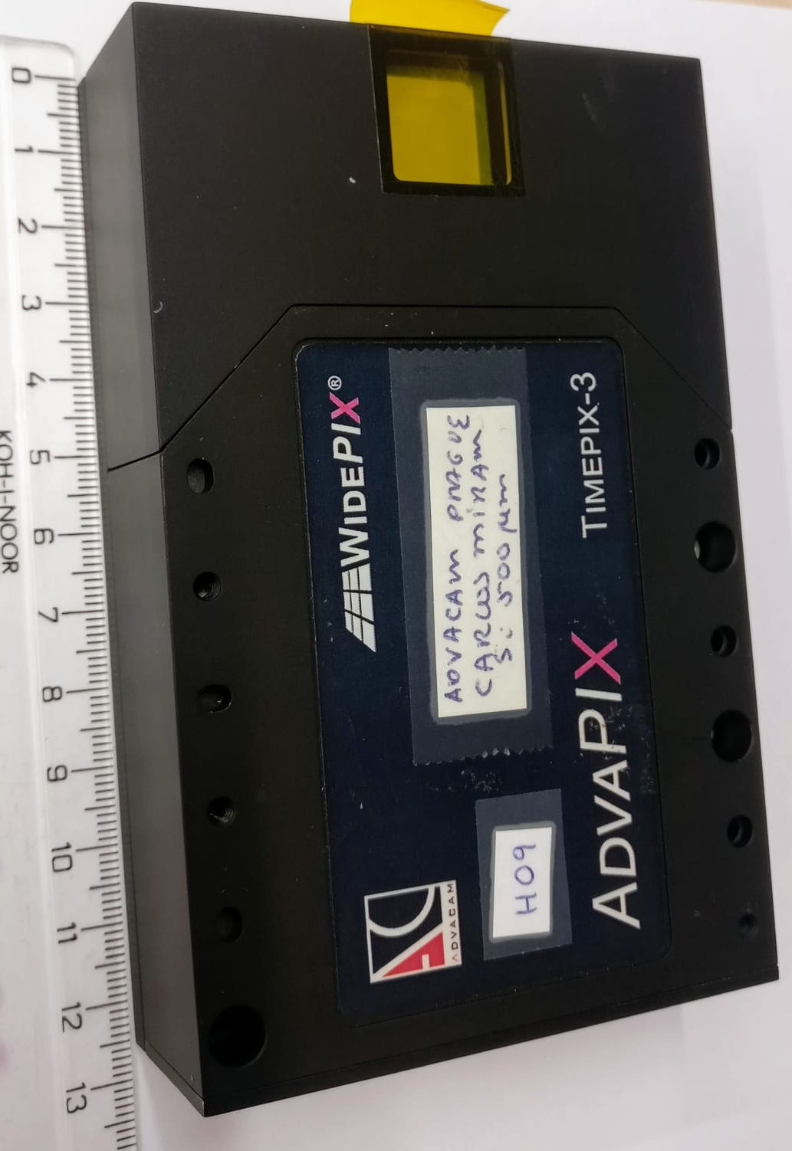
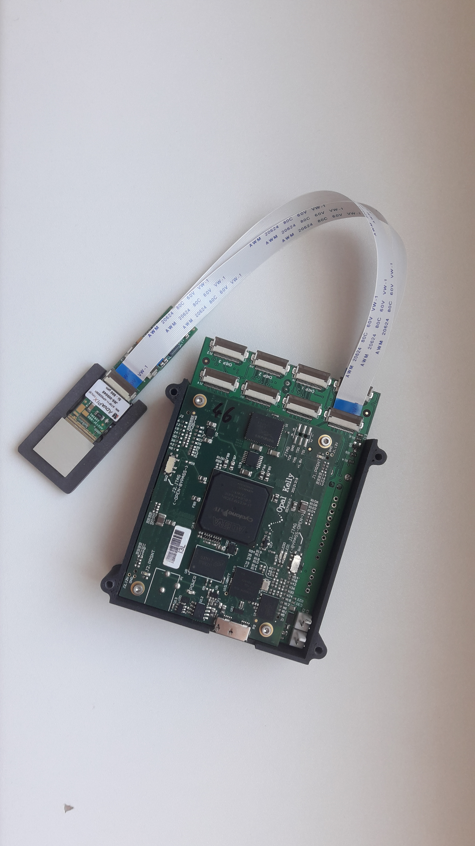
Development chain of Timepix3 detectors for UHD Pulse
Initial test with commercial detectors
Various sensor types and thickness tested with TimePIX3 chip by MiniPIX flex electronic
Build into single detector holder, free of metals
Double detector holder to speed up experimnets
Final AdvaPIX flex version (10x faster) to cope better with High DR
Si 650 µm
5x Si 500 µm
4x Si 100 µm
2x GaAs 500 µm
3xNaked TimePIX3 ASIC

Slide 5
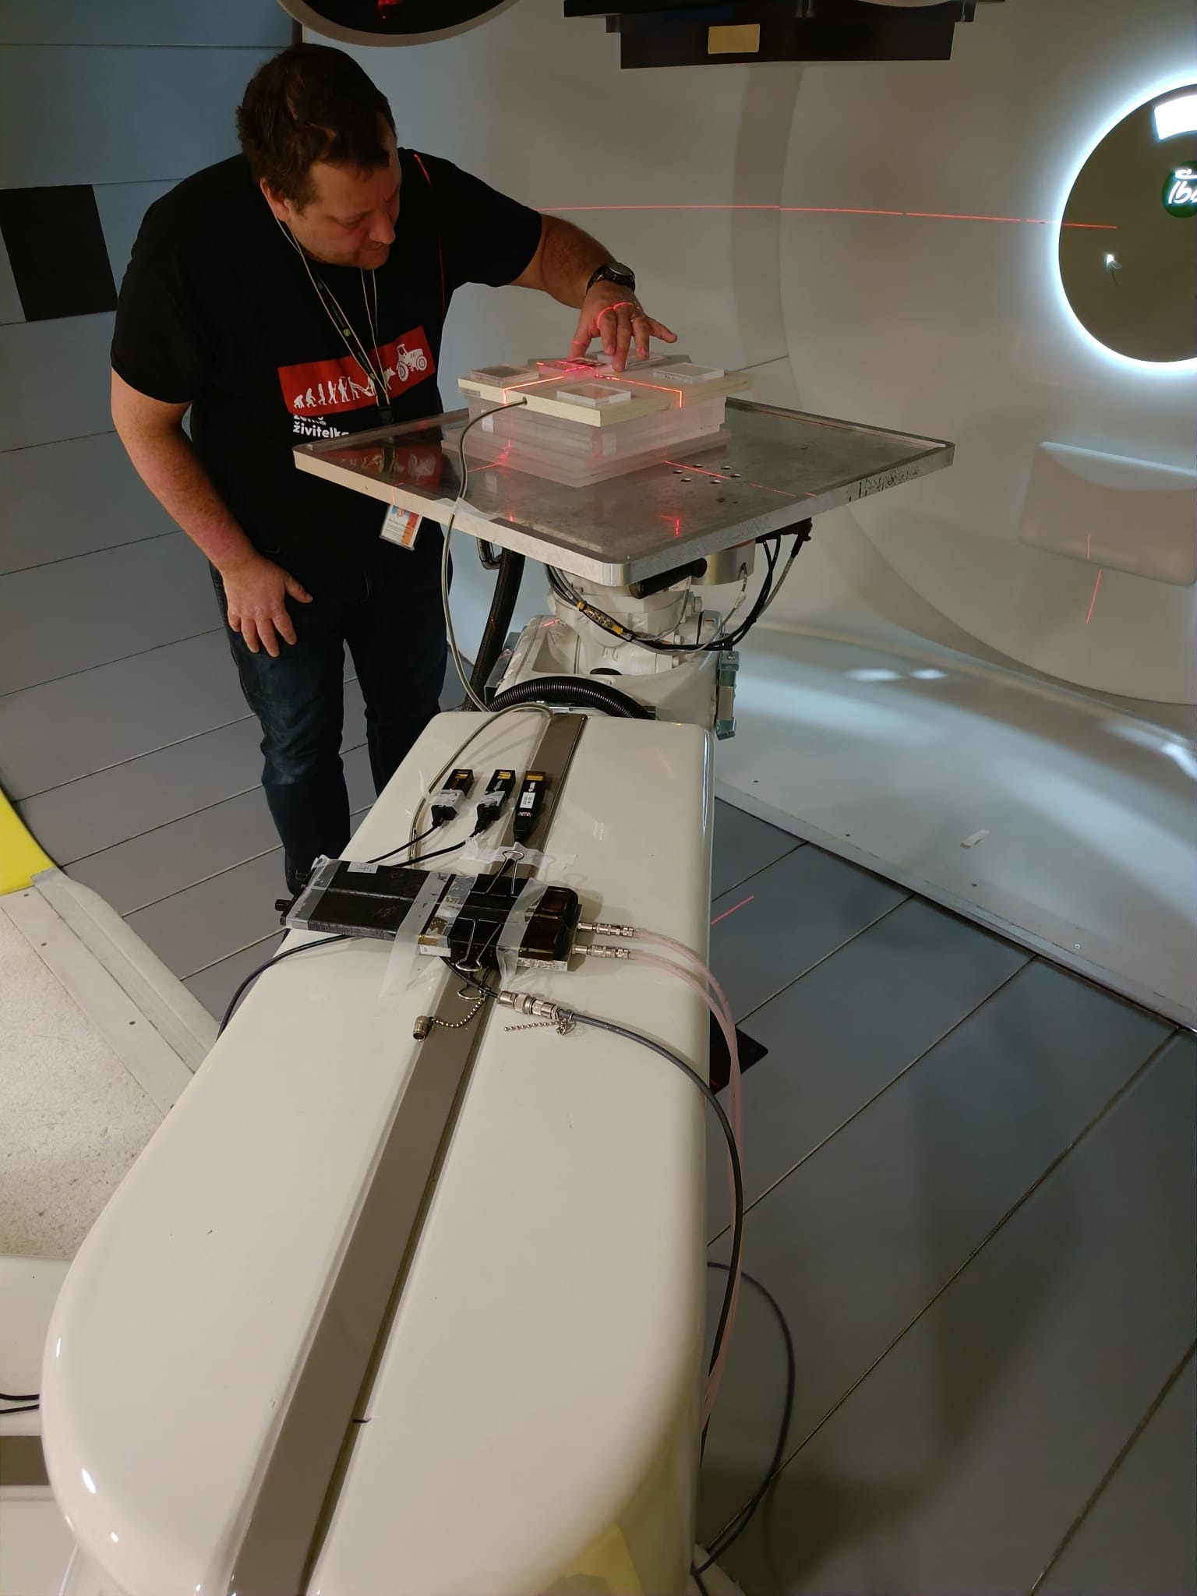
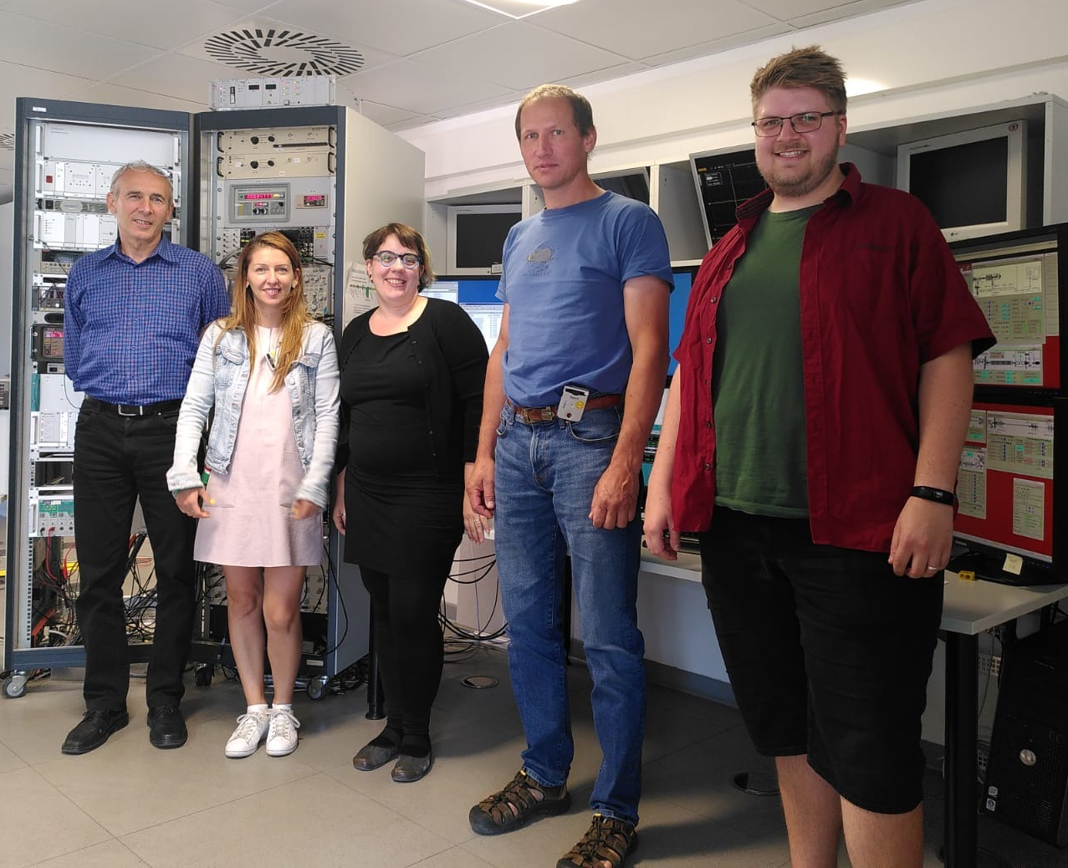
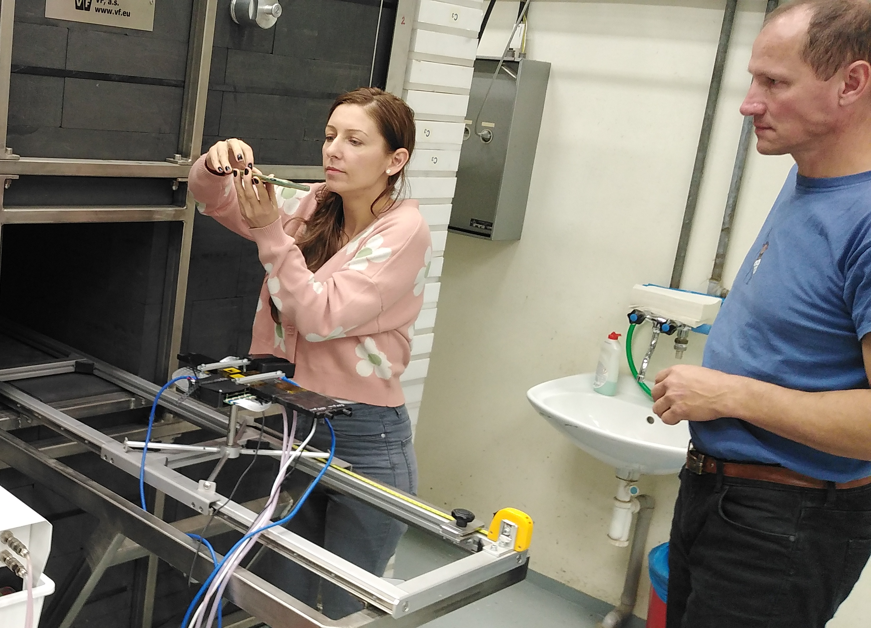
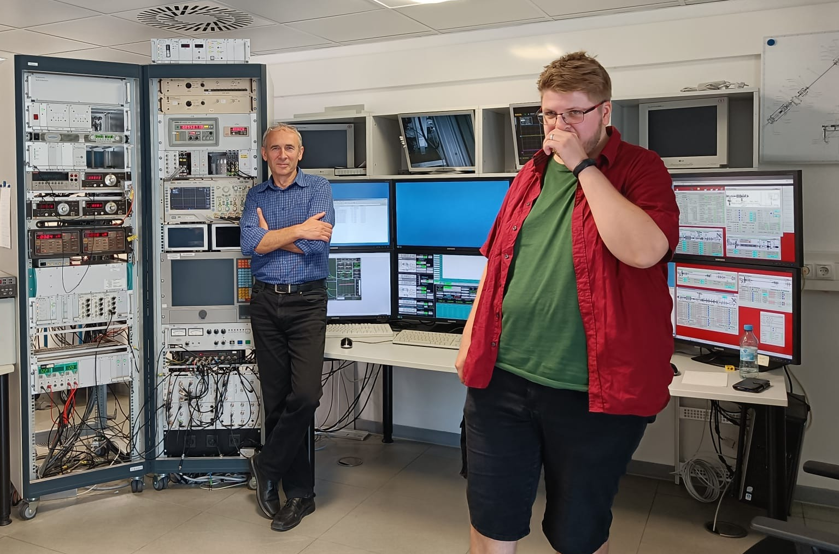
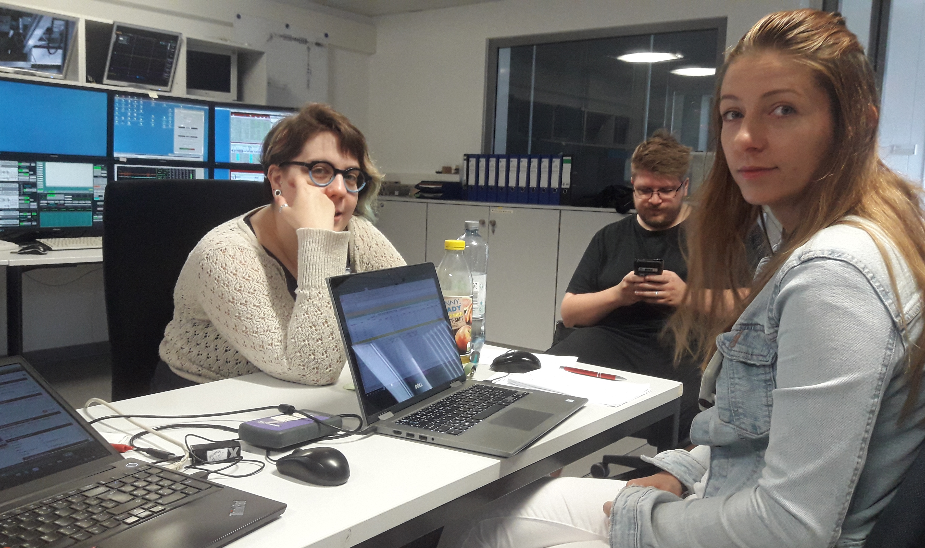
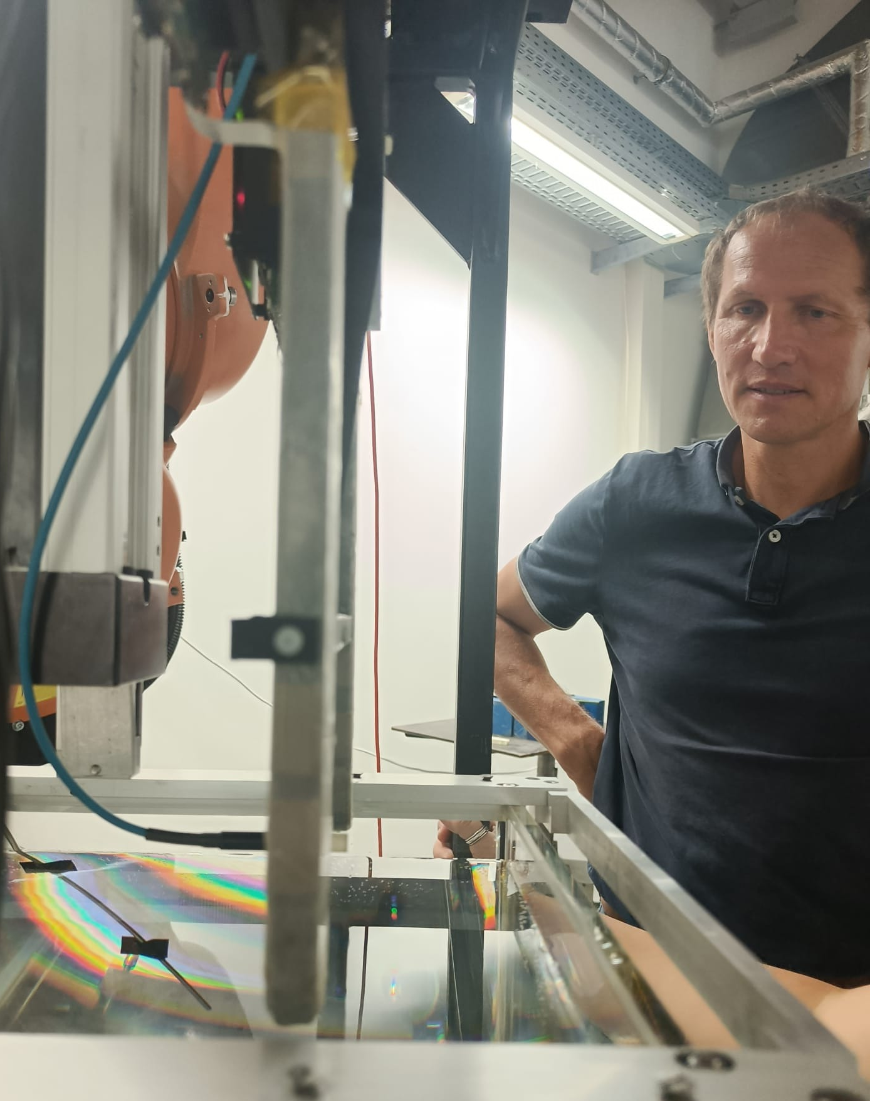
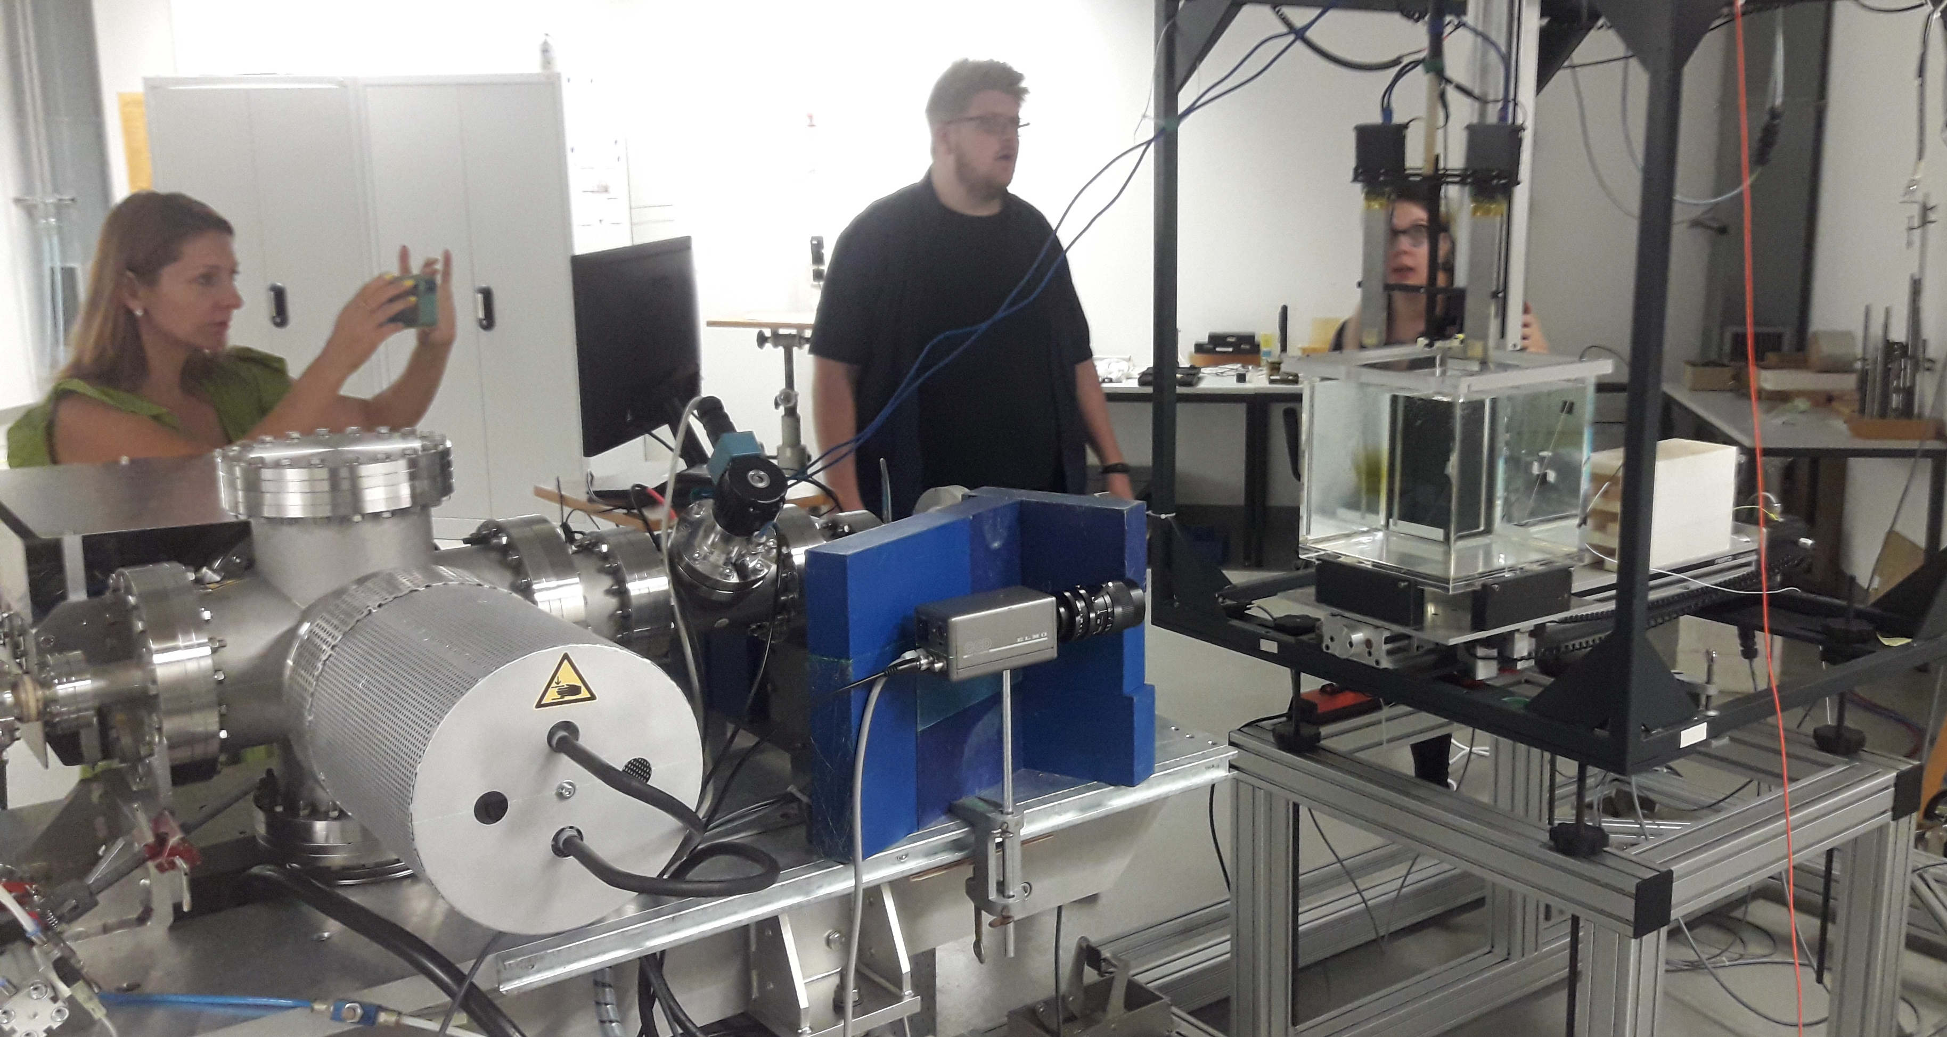
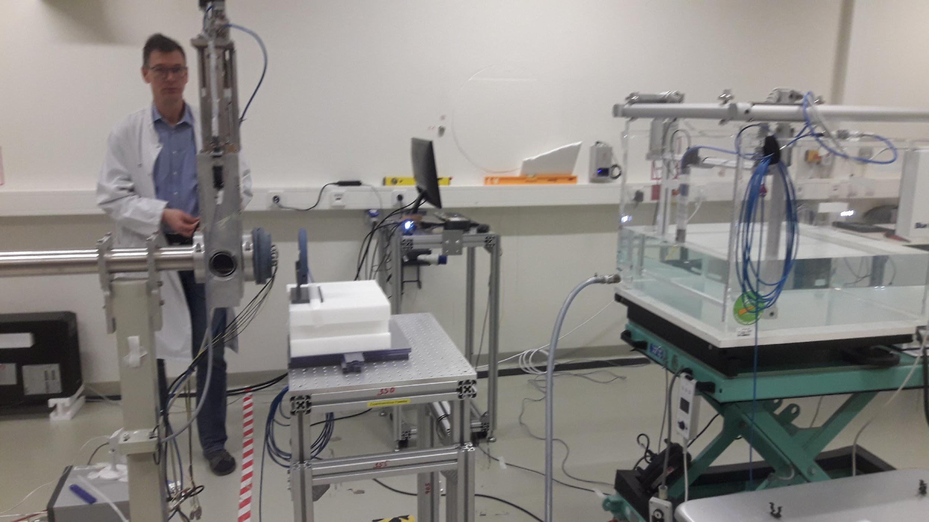
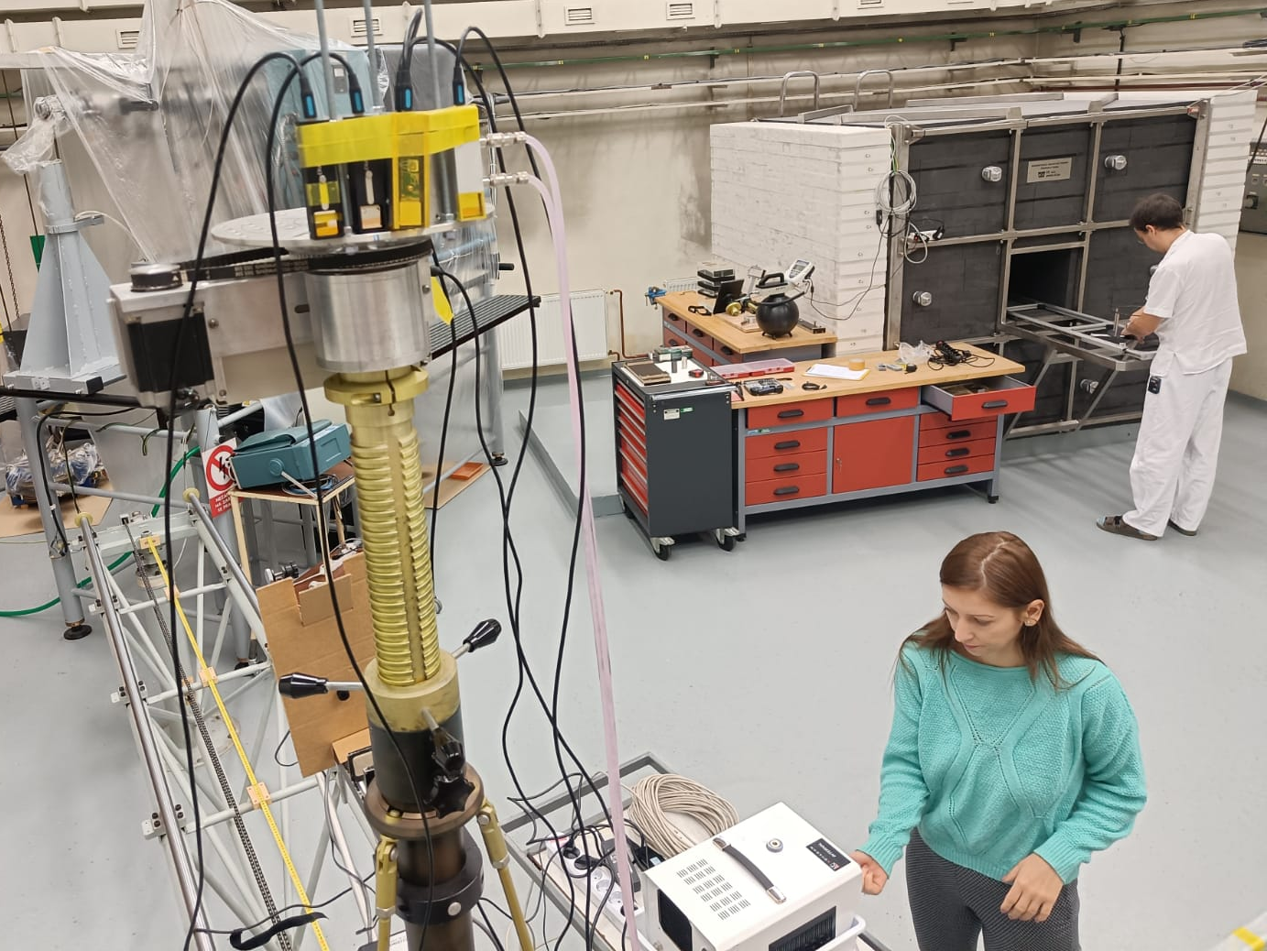
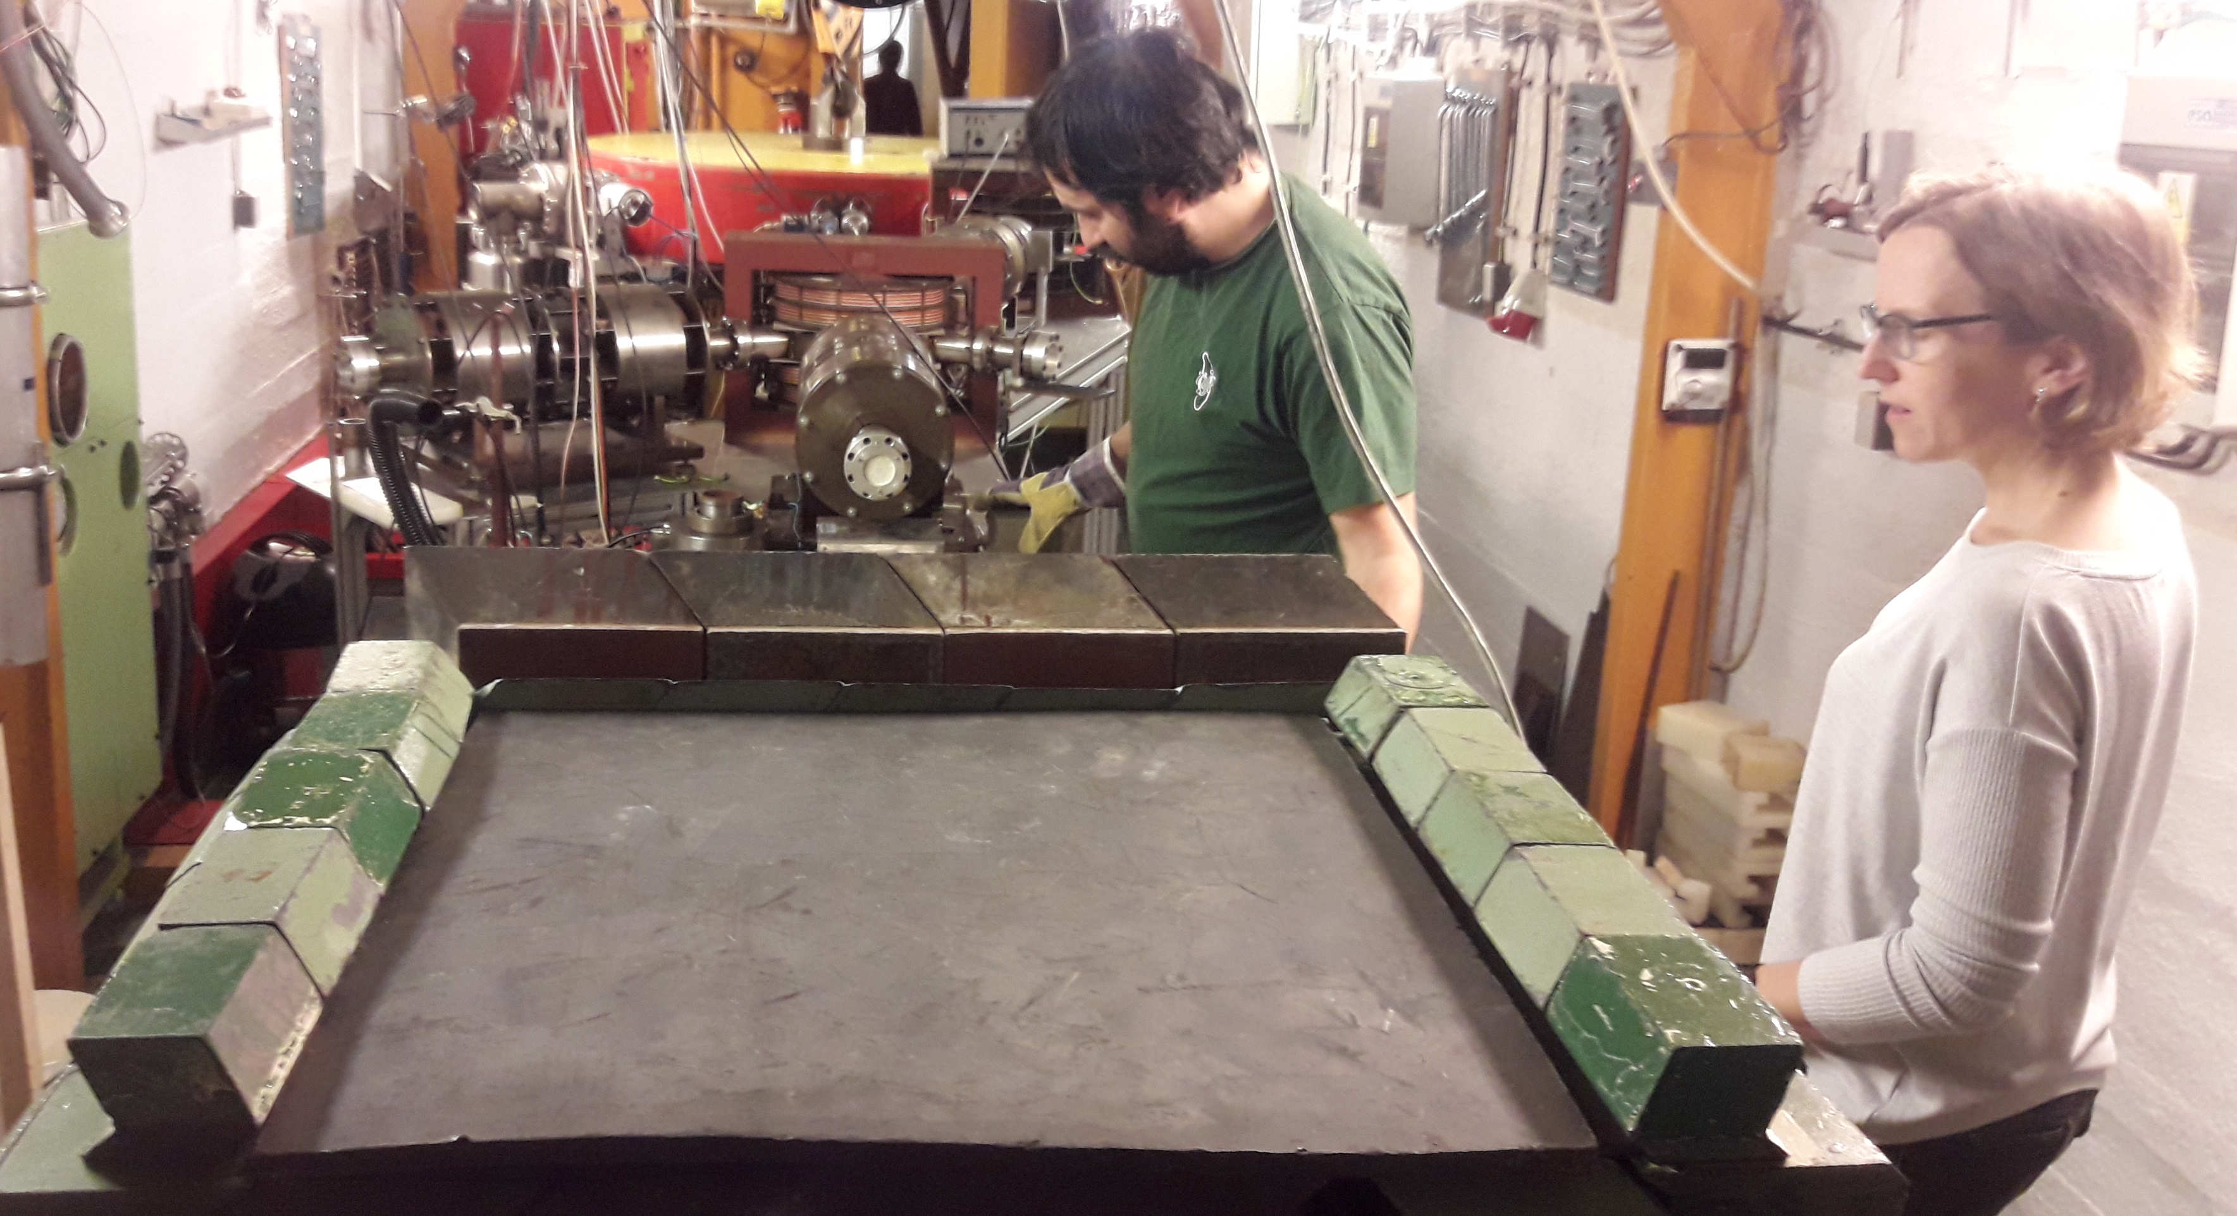
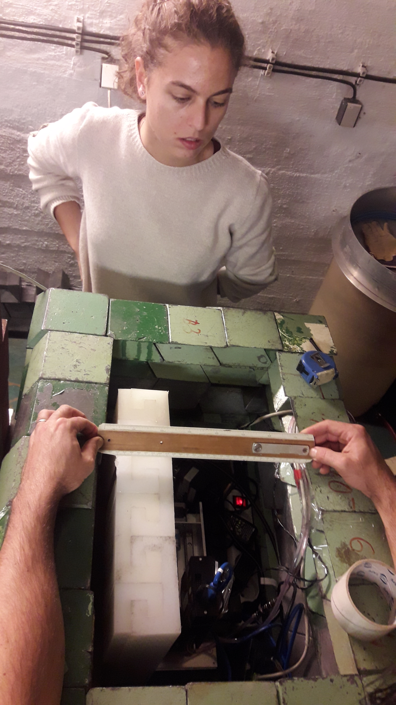
Experiments in pulsed mixed radiation fields with TimePIX3
7x Microtron Prague – cyclic electron akcelerator (NPI)
3 x OncoRay Clinique in Dresden – Proton flash beam
2x Proton Therapy Center in Prague
2x PTB – Calibrated electron beam
2x Emory University, Atlanta, USA flash proton
3x Czech Metrology Institute in Prague - Calibration measurement for thermal and fast neutrons and X-Rays
36 days of measurement in total

Slide 6
Status of Task 4.2: Characterization of the response of passive detector system in pulsed mixed radiation fields (electrons and protons)
Activity Milestone | Activity description | Status | Partners
A4.2.1 M19 | Testing of luminescence dosimeters in stray radiation field - TLD and OSL passive dosimeters tested inside and outside of water or water-equivalent phantom | Completed 11/2022 Laser-driven el beam at ALFA station Eli Electrom beam at PTB Proton Flash proton beam at OncoRay | FZU-ELI NPI
A4.2.2 M20 | Monte Carlo modelling of the irradiation set-ups with water or water-equivalent phantoms | Completed 10/2021 Continues support | CMI FZU-ELI, NPI
A4.2.3 M30 | Documentation and manual | Completed 11/2022 https://arxiv.org/abs/2211.15418 | FZU-ELI NPI
A4.2.4 M35 | Submission of a peer-reviewed article | Delayed to 02/2023 In a good progress | FZU-ELI ADVACAM, CMI, UJF CAS

Slide 7
Status of Task 4.3: Development, characterization and comparison of Bonner Sphere Spectrometers based on active detectors - pulsed neutron fields
Activity Milestone | Activity description | Status | Partners
A4.3.1 M12 | Development of a Bonner Sphere Spectrometer read out in current mode | Completed 04/2021 | POLiMi NPL
A4.3.2 M18 | Response function calculations of the different Bonner Spheres with detailed Monte Carlo simulations. | Completed 01/2023 After adjustments a satisfactory agreement with measurements obtain once the discriminator threshold of the electronics is taken into account. Necessary to assess the change in response each time the threshold is changed | NPL POLiMi
A4.3.3 M23 | Bonner Sphere characterization with monoenergetic neutron beams | Completed 04/2022 Measurements made at NPL in March, analysis completed in April | NPL POLiMi
A4.3.4 M12 | Development of a Bonner sphere spectrometer NEMUS based on U-235 fission chamber | Completed 04/2022 developed and tested in different neutron reference fields of PTB. Response functions of the setup were calculated, validated and transformed into a standardized response matrix file. Results were compared against the other Bonner sphere spectrometers | PTB
A4.3.5 M32 | Detail tests, documentation and manual | Delayed to 02/2023 Results are still being discussed Document will be drawn together from existing reports with additional material as required over the coming weeks. | NPL POLiMi, PTB

Slide 8
Status of Task 4.4: Traceability and validation of methods for characterization of stray radiation
Activity Milestone | Activity description | Status | Partners
A4.4.1 M18 | Optimized TPX3 detector measurements in reference, non-pulsed fields (X-ray, gamma-ray, and neutron fields available at CMI), inside and outside of a suitable water or water-equivalent phantom | Completed 10/2021 Measurement done with neutron (thermal + fast), Cs-137 X-ray, and Co-60 | CMI
A4.4.2 M33 | Traceability for methods for characterization of stray radiation | Delayed to 01/2023 Traceability obtained from 20 MeV calib. El. Beam and from various PTB neutron reference fields | CMI ADV, FZU, NPI, POLiMi, NPL, PTB
A4.4.3 M33 | Validation of methods for stray radiation | Delayed to 02/2023 validation of every system is being coordinated by CMI | CMI ADV, FZU, NPI, POLiMi, NPL, PTB, CHUV
A4.4.4 M35 | Validation report | Delayed to 02/2023 To be finished by end of Feb 23 | CMI ADV, FZU, NPI, POLiMi, NPL, PTB, CHUV
A4.4.5 M36 | Best Practice Guide | On schedule Draft for completion to all partners to be finished by mid of Feb 23 | ADV CMI, FZU, NPI, POLiMi, NPL, PTB, CHUV
A4.4.6 | Deliverable 7 | On schedule Revision within consortium and submission by end of Feb 23 | ADV CMI, FZU, NPI, POLiMi, NPL, PTB, CHUV

Slide 9
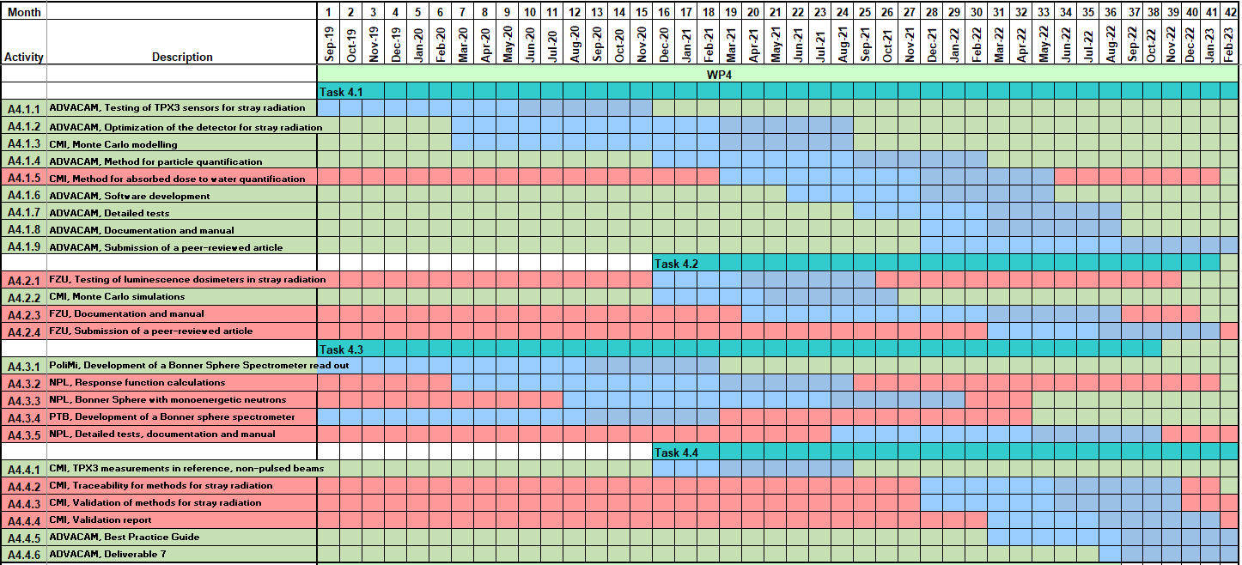
Actual Gantt chart of WP4
All Activity Status Reports are updated on SharePoint within WP4 – Thanks!
Jan 27th 2023

Slide 10
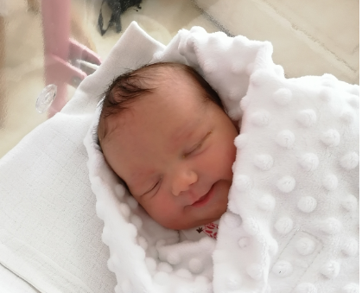
Conclusion of WP4 overview
Majority of activities defined within WP4 are accomplished
9 activities remaining in progress to be accomplished in time, thanks to natural Student distribution effort, including Deliverable 7, where all outcomes are integrated
Thank to all involved for the great work!
…and don‘t forget, there was even baby borne and raised within the project
Alicia *29thApril 2020

