Slide 1

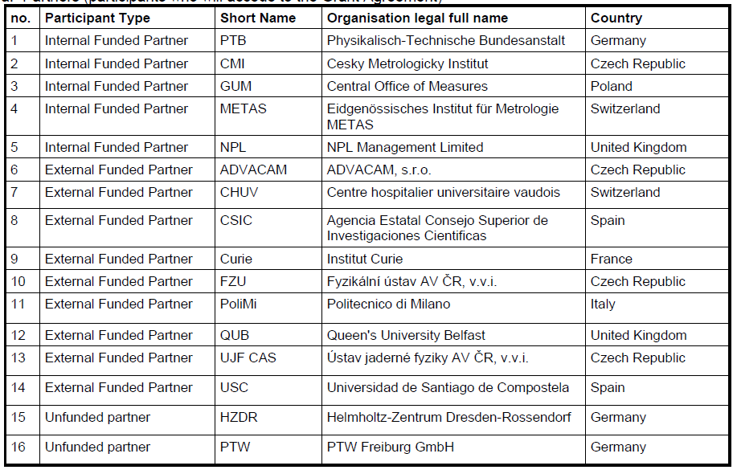











Metrology for advanced radiotherapy using particle beams with ultra-high pulse dose rates
WP3 overview

Slide 2
WP3: Introduction
Goal: evaluate novel absolute and relative dosimetric systems.
Exploration of detectors:
  not necessarily primary measurement detectors
  tailored to pre-clinical and clinical accelerators
  secondary and working standards.
Three tasks
  3.1: Monitor systems for clinical FLASH facilities
  3.2: Detectors for absorbed dose to water measurement in clinical beams (FLASH electron and proton beams)
  3.3: Test of detectors for dose measurement in pre-clinical emerging beams (laser-driven proton beams)

Slide 3

WP3 planning
WP3 suffered from the COVID restriction due to many activities connected to comparison scheme or tests at remote facilities which were closed.
  Remediation: more bilateral comparison and no broad interlaboratory comparison

Slide 4
WP3
  3.1: Monitor systems for clinical FLASH facilities
  3.2: Detectors for absorbed dose to water measurement in clinical beams (FLASH electron and proton beams)
  3.3: Test of detectors for dose measurement in pre-clinical emerging beams (laser-driven proton beams)

Slide 5
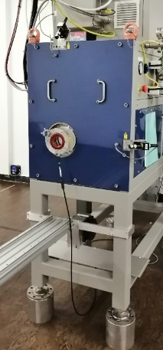
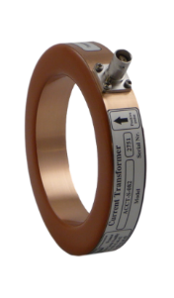
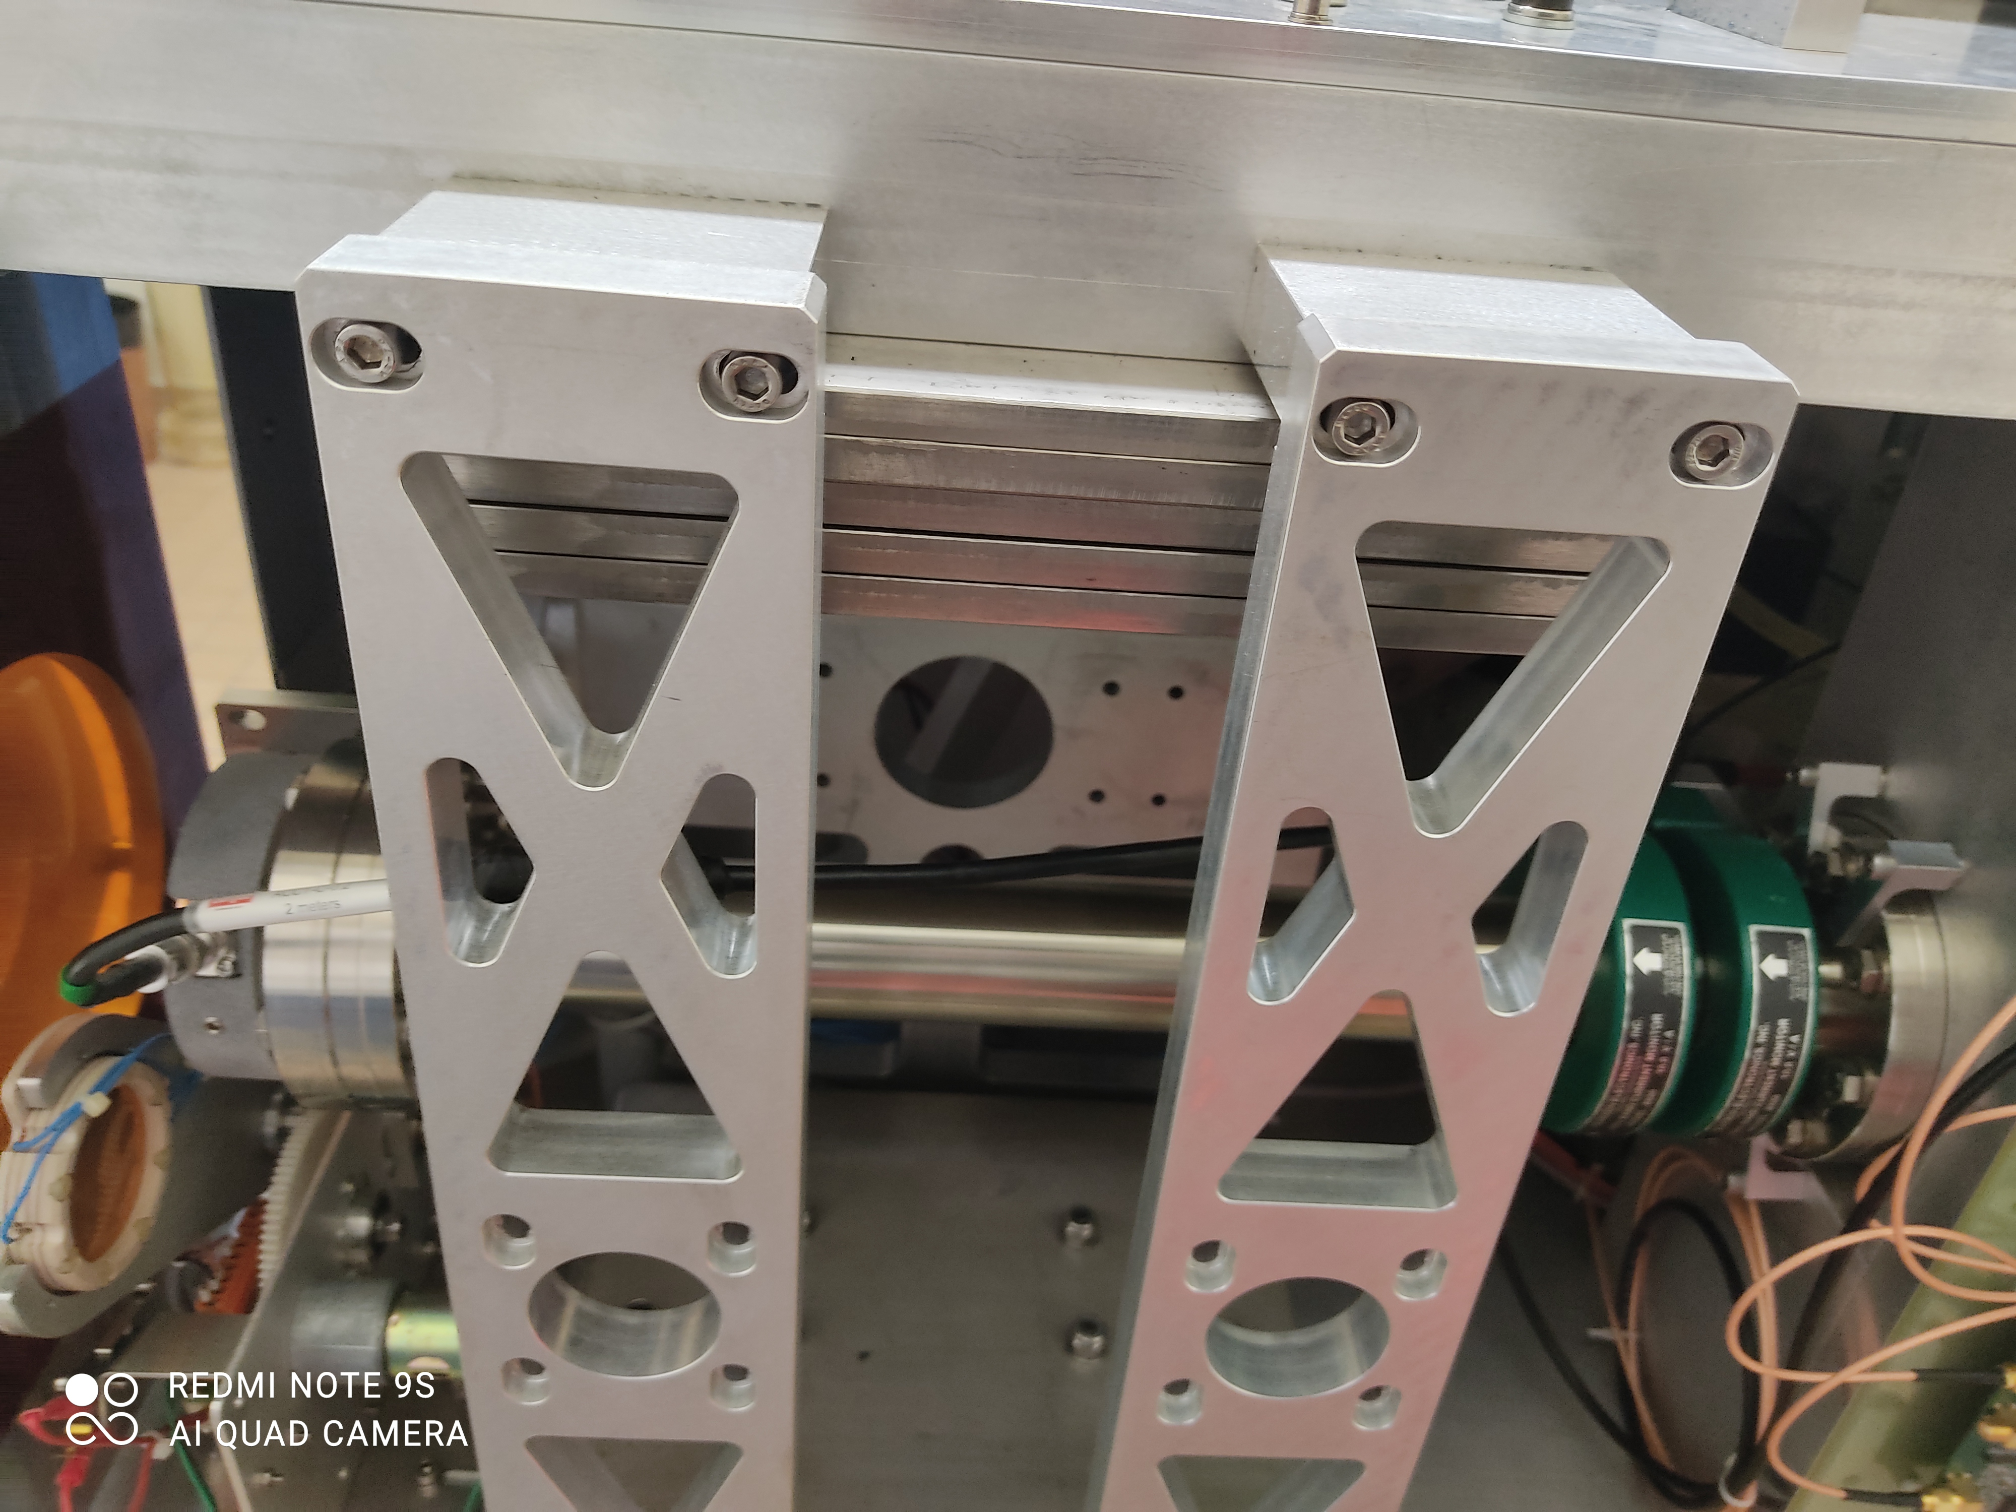
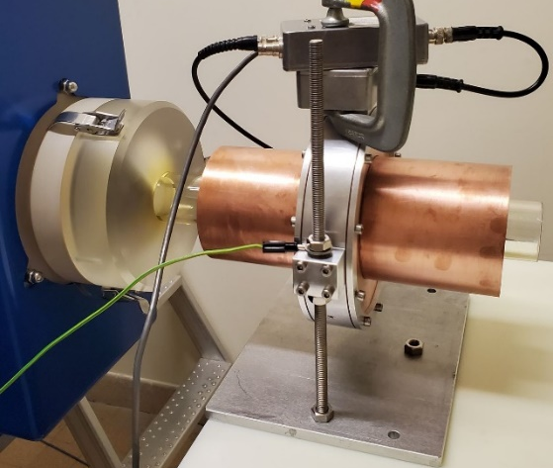


WP3 – A3.1.1
Improving the monitoring of FLASH beam facility
Monitoring using ICT
Toroïds
Inside the linac gantry, just before the exit windows
DosiFLASH

Slide 6
A3.1.1 Improving the monitoring of FLASH beam facility
Monitoring using ICT
Implementation of a monitoring system based on ACCT on the eRT6, the Mobetron, a commercial LINAC, and SIT systems
Conclusions:
  Reliable for monitoring
  Reliable for diagnostic and optimization of accelerators
  Limited use for absolute dosimetry
  Large dynamic range

Slide 7
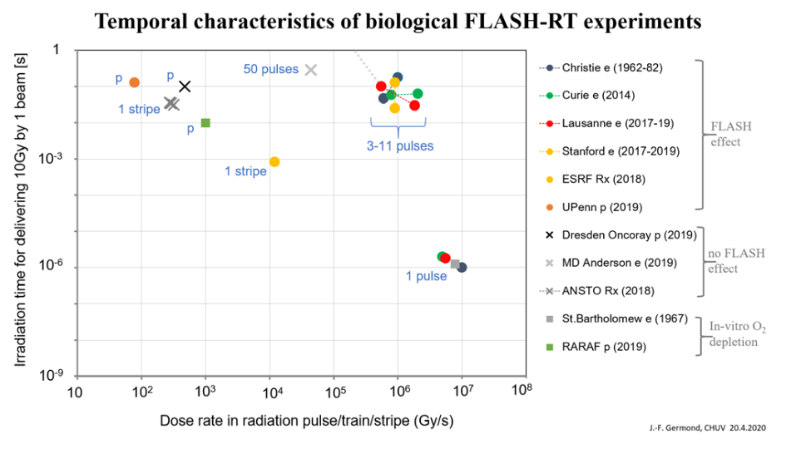
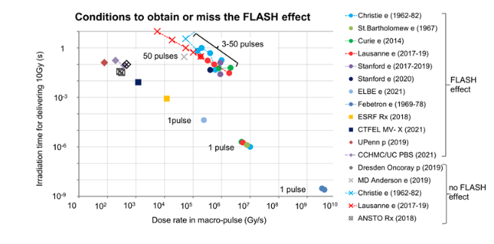
A3.1.2 Exploring the relevant beam metrics of FLASH beams
A3.2.1 Survey of the high-dose rate pulsed beams characteristics for radiobiology experiment
Survey of radiobiology results
  No beam parameters evidence.
  No new metric could be isolated.
  Some parameters seem to be more important.
  Many review papers to investigate.

Slide 8
WP3
  3.1: Monitor systems for clinical FLASH facilities
  3.2: Detectors for absorbed dose to water measurement in clinical beams (FLASH electron and proton beams)
  3.3: Test of detectors for dose measurement in pre-clinical emerging beams (laser-driven proton beams)

Slide 9
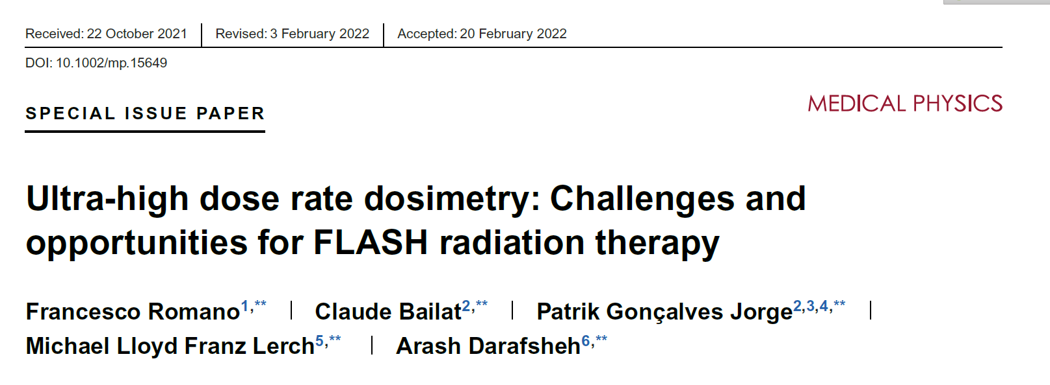
A3.2.2 Evaluating commercially available and novel detectors in clinical FLASH electron beams
Many active and passive dosimeters were tested. Most of them commercial or soon-to-be
Good review paper, see table 2

Slide 10


A3.2.3 + 3.2.4 Designing and improving custom-built detectors for FLASH proton beams
PTW+Vergata University: microdiamond
USC+PTW: ultrathin IC
Curie: has developed a proton very high dose rate (VHDR) experimental setup and started to evaluate conventional and custom-built detectors.
CSIC: Silicon carbide diode dosimeters

Slide 11
A3.2.5 Comparison of detectors for FLASH beams
Only bilateral comparison reported in other activities and D4.
Reported in D5 (A3.2.7)
A3.2.6 Documenting the tests
A3.2.8 Towards a code of practice guide for traceable measurement in FLASH beams → A2.3.5

Slide 12
WP3
  3.1: Monitor systems for clinical FLASH facilities
  3.2: Detectors for absorbed dose to water measurement in clinical beams (FLASH electron and proton beams)
  3.3: Test of detectors for dose measurement in pre-clinical emerging beams (laser-driven proton beams)

Slide 13
A3.3.1 Survey of the laser-driven pulsed beams characteristics
Comprehensive list of available ultra-high intensity laser-driven pulsed beam facilities including:
  names of the facilities, lasers systems, and the most relevant physical beam parameters.

Slide 14
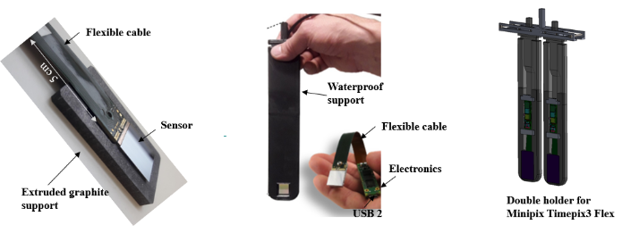
A3.3.2/3 Testing detectors in laser-driven pulsed proton beams and documenting
ELI beam not possible
  Tests performed at OncoRay by FZU and ADVACAM using 220 MeV proton beams.
Conclusion: unlikely that current detectors will work for laser-driven protons.

Slide 15
A3.3.2/3 Testing detectors in laser-driven pulsed proton beams and documenting
A3.3.4/5 Comparison of detectors for laser-driven pulsed beams and documenting
ELI and ILIL beam not possible

Slide 16

WP3: Overviewing conclusions
Three tasks
  3.1: Monitor systems for clinical FLASH facilities
  3.2: Detectors for absorbed dose to water measurement in clinical beams (FLASH electron and proton beams)
  3.3: Test of detectors for dose measurement in pre-clinical emerging beams (laser-driven proton beams)
Goal to evaluate novel absolute and relative dosimetric systems was achieved within pandemic constrains.
Goal to test in laser driven proton beam was achieved using surrogates.
Thank all the collaborators for the hard work done in difficult times.
To be continued…

