Slide 1
EMPIR Project 18HLT04 UHDpulse Final Meeting – Overview WP2
Peter Peier

Slide 2
Introduction WP2
Secondary standards and reference methods for reference and relative dosimetry Aim: Transfer traceable dosimetry into clinical and preclinical accelerators with Ultra High Pulse Dose Rate.
Transfer from primary standards developed in WP1 to implementation in the reference dosimetry at (pre)clinical facilities
Develop methods and methodologies to appropriately characterize and monitor UHPDR particle beams
WP divided in four tasks and 24 activities.
Involved Partners:
PTB, NPL, METAS, CHUV, Curie, HZDR, PTW, USC, CSIC, QUB, FZU, new Partners…

Slide 3
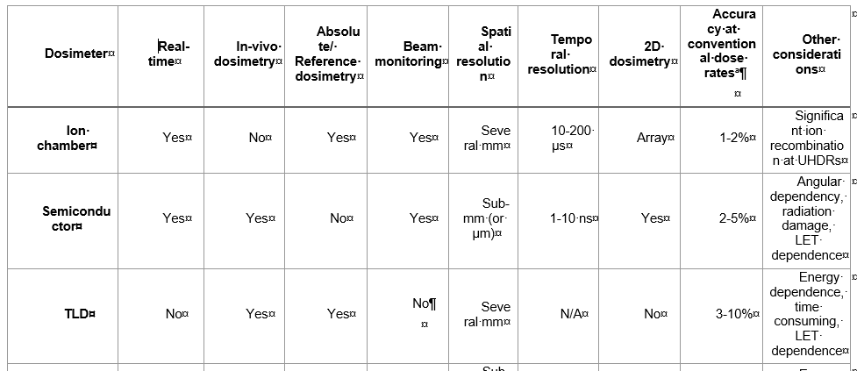
Secondary standards for clinical beams (FLASH)
Aim of task 2.1: Investigate several detector types with regard to their suitability for reference dosimetry → absolute (chambers, chemical and alanine) and relative dosimetry (film, solid state) were investigated specifically for the dependence of the response on the dose rate.
Deliverable 4: Recommendation Report about the suitability of different detectors as secondary standard and for relative dosimetry in ultra-high pulse dose rate electron beams

Slide 4
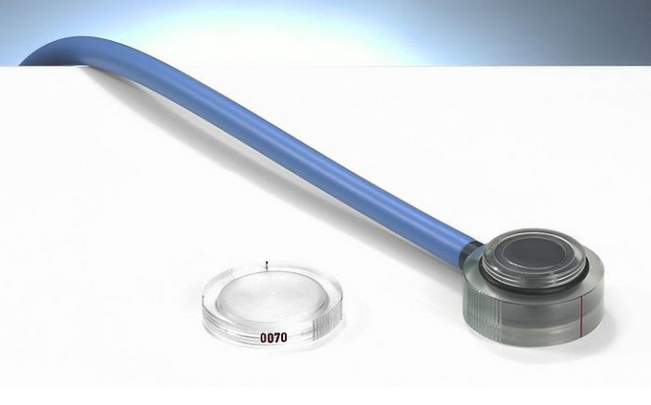
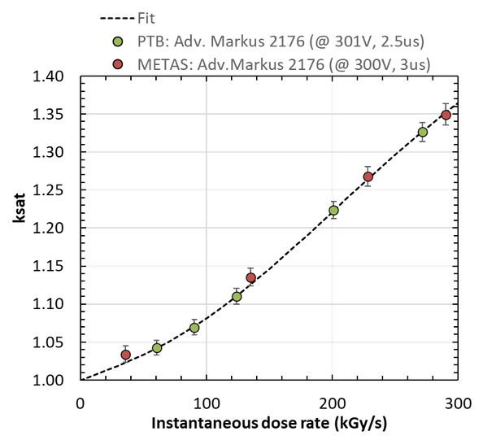
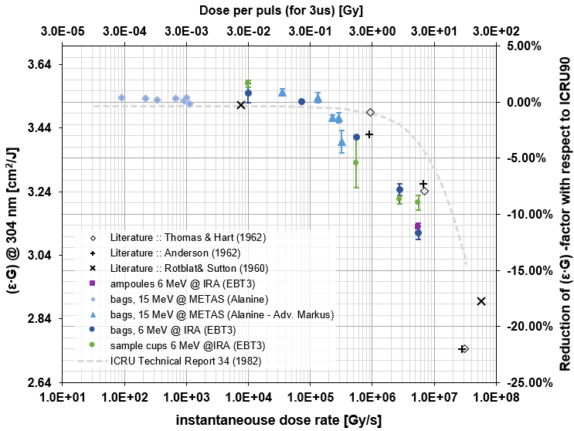
Highlights Task 2.1
Overview of the clinical FLASH accelerators
Intensive study of Adv. Markus and Fricke dosimetry
 | Kinetron (CGRMeV/PMB-Alcen) | Oriatron eRT6 (PMB Alcen) | Oxford linac | Modified Varian (Stanford) | Modified Elekta | Mobetron (IntraOp) | FLASH-knife (PMB- Alcen) | SIT (Sordina) | FLEX (Radia- Beam)
Available beam energy [MeV] | 4.5 | 6 | 6 | 17 | 10 | 6 and 9 | 6 and 9 | 7 | 9
Maximum dose per pulse [Gy] | 6.3 | 12 | 5 | 2 | 1.9 | > 8 | > 8 | 18.2 | >25

Slide 5
Highlights Task 2.1
Further dosimetry systems were investigated for their suitability as reference measurement systems in FLASH electron beams.
Film dosimetry
Alanine
Solid-state detectors → microDiamond and FLASHDiamond

Slide 6
Secondary standards for emerging pre-clinical beams (laser-driven accelerators, VHEE beams)
Aim of task 2.2: Investigate several detector types with regard to their suitability for reference dosimetry in laser-driven proton and VHEE beams. Also alanine dosimetry will be evaluated with regard to its suitability as an absolute dosimetry detector.

Slide 7
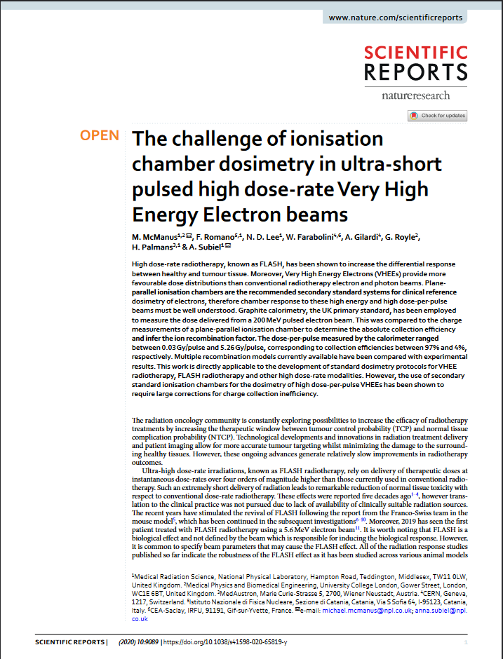
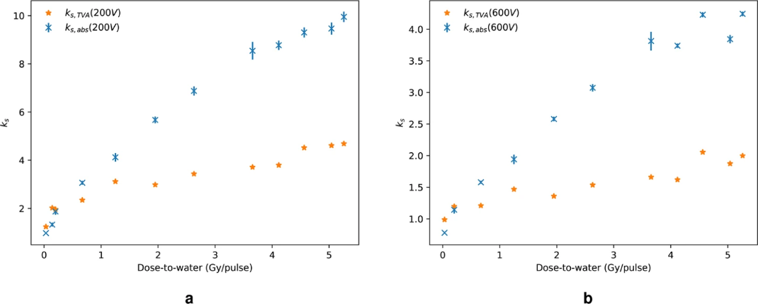
Highlights Task 2.2
Phantom with Roos chamber and graphite calorimeter for VHEE
Characterisation of Roos chamber and development of empirical models
Publications of results in scientific reports and PMB

Slide 8
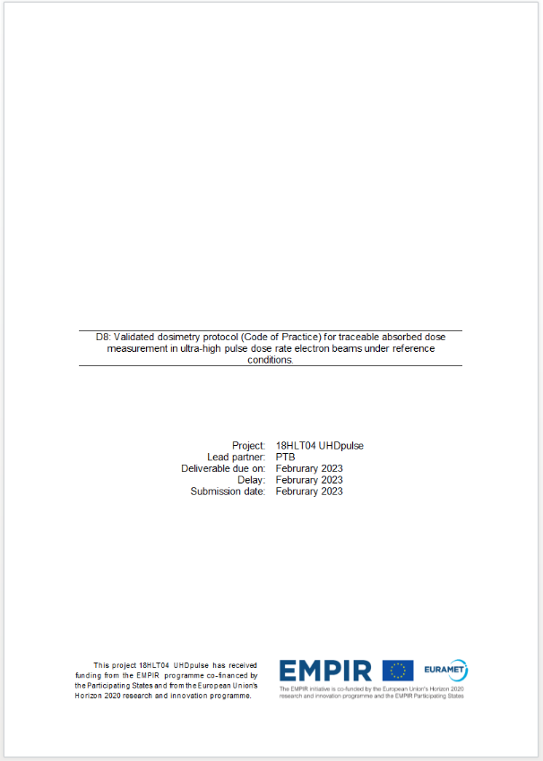
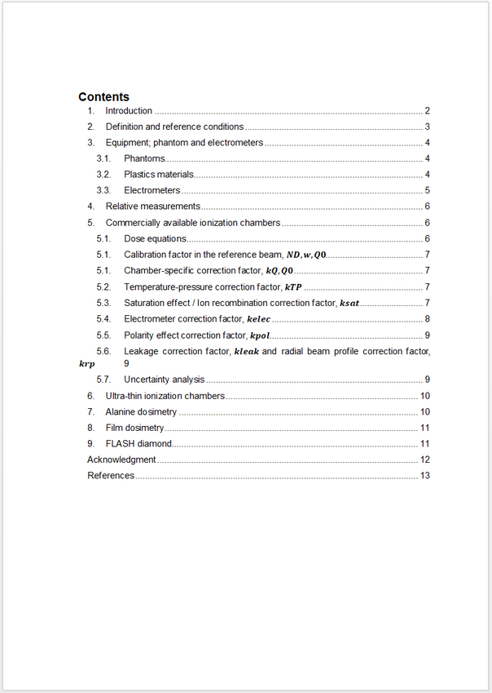
Towards a Code of Practice for clinical beams (FLASH)
Aim of task 2.3: Derive a formalism for reference dosimetry as basis for a Code of Practice, for which the reference conditions as well as a beam quality index will have to be established
Deliverable 8: Protocol for traceable absorbed dose measurement in ultra-high pulse dose rate electron beams

Slide 9
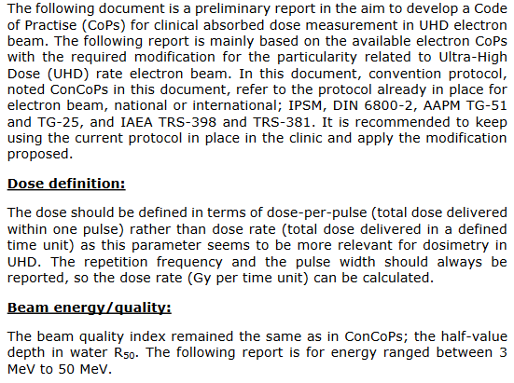
Highlights Task 2.3
Reference conditions for absorbed dose measurements were compiled in a document
Definition of beam specifiers, i.e. parameters accessible by measurements and representative for the properties of FLASH beams → the combination of the 3 independent values Dose-per-pulse (DPP), Pulse duration/length (PL) and Pulse Repetition Frequency (PRF)

Slide 10
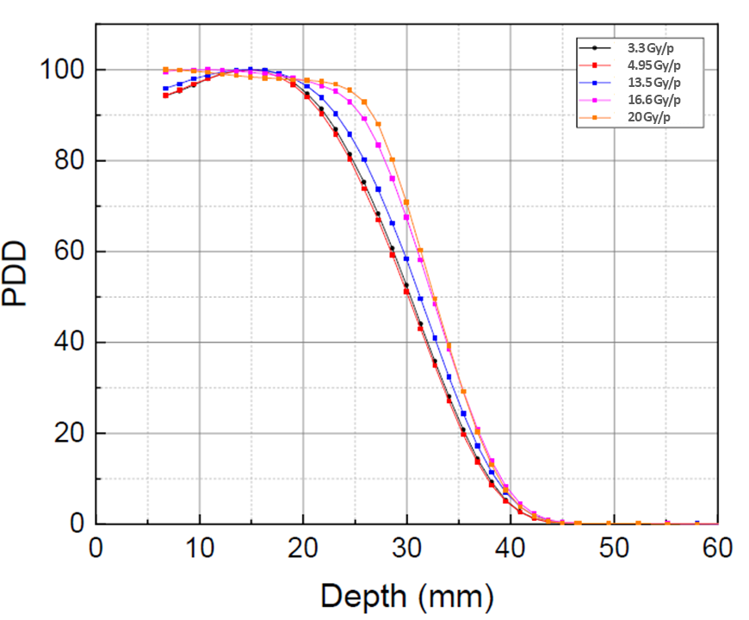
Highlights Task 2.3
The shape of the PDD directly measured with the intended detector may serve as an empirical quantity.
A draft for a new protocol for traceable absorbed dose measurement in ultra-high pulse dose rate electron beams under reference conditions is currently being prepared.

Slide 11
Methods for relative dosimetry in emerging pre-clinical beams (laser-driven accel., VHEE beams)
Aim of task 2.4: Film and alanine dosimetry and ionization chambers will be characterized for respective use in relative dosimetry in laser-driven proton and VHEE beams. The findings will be supported by means of Monte-Carlo simulations.
Deliverable 6: Recommendation Report about validated methods of relative dosimetry in emerging pre-clinical beams

Slide 12
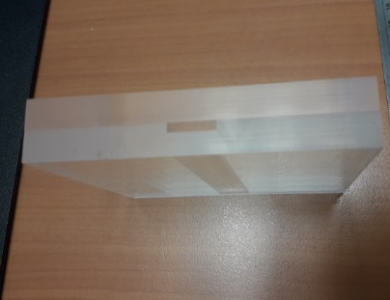
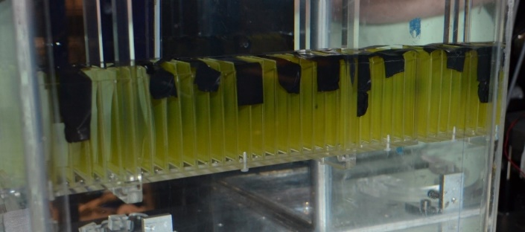
Highlights Task 2.4
Irradiation phantoms for use in VHEE beams
Several measurements at facilities with VHEE and laser-driven beams were considerably delayed due to Covid-19.

Slide 13
Summary of Achievements of WP2
FLASH electron beams of available accelerators were characterized
reference conditions for FLASH electron beams were defined
a beam quality specifier was determined
several detectors were investigated for their suitability for absolute or relative measurements: ionisation chambers, Alanine, film, Fricke
setups for testing secondary standards in VHEE and laser-driven beams were developed
relative dosimetry in pre-clinical beams was established
Recommendation reports and a measurement protocol were drafted → 3 Deliverables
>5 papers were published

Slide 14
Agenda Session WP2

Slide 15
Thank you very much for your attention

