Slide 1
EMPIR project UHDpulse WP1 overview: SI-traceable primary standards for absorbed dose measurements
Anna Subiel
UHDpulse 2nd Stakeholder Meeting, 26-27 January 2023

Slide 2
Requirement for accuracy in dosimetry
The ICRU Rep.24 (1976) states:
An uncertainty of 5% (k=1) is tolerable in the delivery
of absorbed dose to the target volume
This is an OVERALL UNCERTAINTY
(incl. dose delivery, dose calculations, patient positioning etc.)
Dose measurement at the reference conditions
should to be less than 1% (k=1)!

Slide 3
Description of WP1
Aim of WP1:
To establish a primary standard for the absorbed dose measurements due to UHPDR electron and proton beams and commence developments of graphite calorimeters for absolute dosimetry for ultra-short, UHPR charged particle beams generated with a laser-driven accelerators
UHDR electron beams
UHDR proton beams
Very high energy electron (VHEE) beams with UHDR
Laser-driven charged particles
Alexandra Bourgouin
Anna Subiel
Sean McCallum

Slide 4
Description of WP1
TASKS
Task 1.1:Development, optimisation and commissioning of reference radiation fields for electron beams with ultra-high dose per pulse
Task 1.2: Develop and test primary standards for absorbed dose in electron and proton beams with ultra-high dose per pulse or ultra-short pulse duration
Task 1.3: Development and optimisation of prototype calorimeters for absorbed dose measurement of ultra-short pulses of laser-driven proton and electron beams

Slide 5
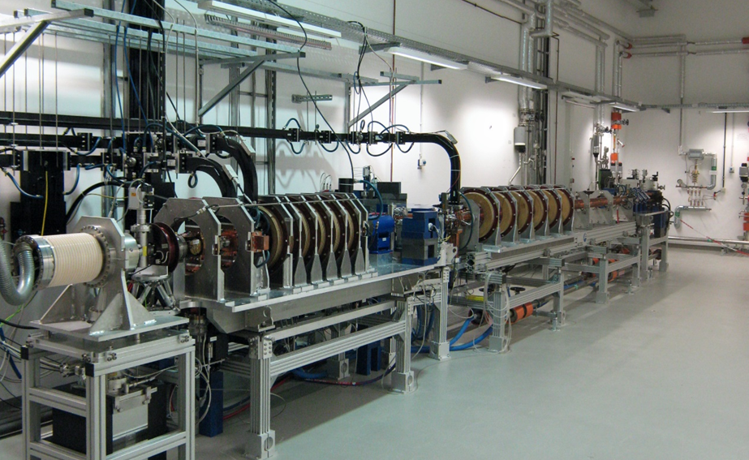
WP1 – task 1.1
Development, optimisation and commissioning of reference radiation fields for electron beams with ultra-high dose per pulse
AIM
to provide well characterised reference radiation fields for testing and traceable calibrations of dosimeters used for FLASH radiotherapy
modification and optimisation of accelerators available at PSDLs to achieve reference electron beams with UHDPP
commissioning of reference beams with UHPDR
Partners:
Fig. 1: PTB’s research accelerator

Slide 6
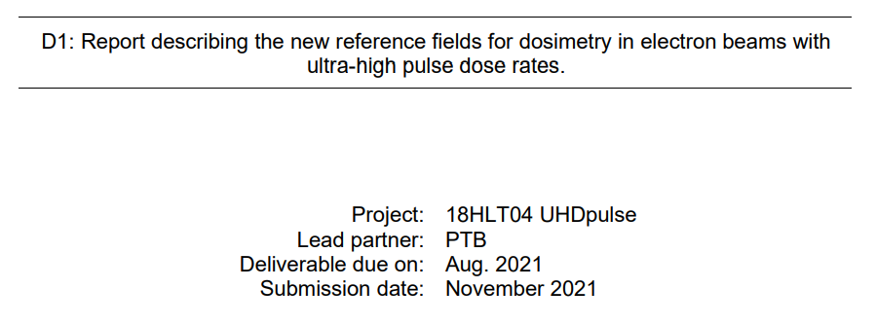
WP1 – task 1.1
Development, optimisation and commissioning of reference radiation fields for electron beams with ultra-high dose per pulse
Highlights:
Review of beam parameters in FLASH RT → Sophie Heinrich (s/s on the SharePoint)
PTB and METAS optizmized electron accelerators to establish the reference fields for e-FLASH RT
available at http://uhdpulse-empir.eu/

Slide 7
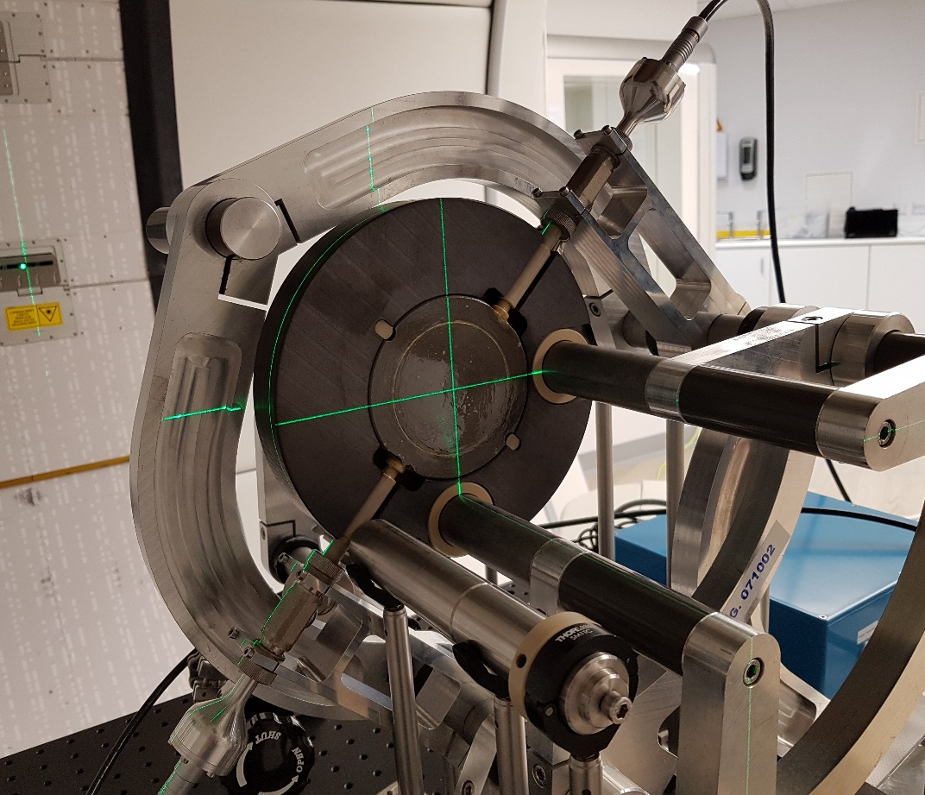
WP1 – task 1.2
Develop and test primary standards for absorbed dose in electron and proton beams with ultra-high dose per pulse or ultra-short pulse duration
AIM
to develop and test techniques as primary dosimetry standards in UHDR electron and proton beams.
Fricke dosimetry for electron beams with UHDR
Water calorimetry for electron beams with UHDR
Graphite calorimetry for electron beams with UHDR
Graphite calorimetry for UHDR protons and VHEEs
Supporting Partners:
Fig. 2: NPL’s portable graphite calorimeter

Slide 8
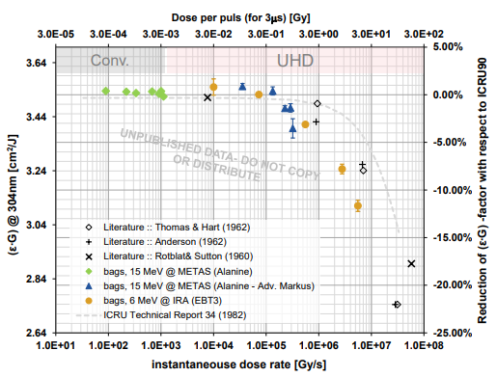
WP1 – task 1.2
Highlights
Fricke dosimetry for electron beams with UHDR
At ~> 1Gy/pulse (of 3us) radical-radical reactions start to reduce the value of radiation yield G.
NOTE: ICRU Rep.34 Fricke solution without NaCl
Courtesy of F. Frei and P. Peier
NOTE: ICRU Rep.34 Fricke solution without NaCl

Slide 9
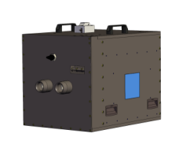
WP1 – task 1.2
Highlights
Water calorimetry for electron beams with UHDR

Slide 10
WP1 – task 1.2
Highlights
Water calorimetry for electron beams with UHDR

Slide 11
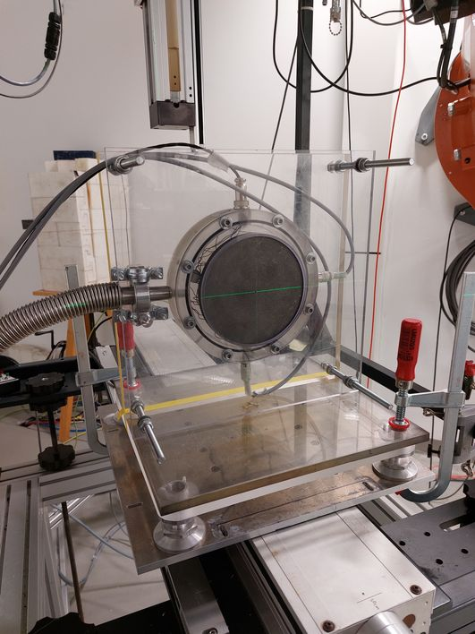
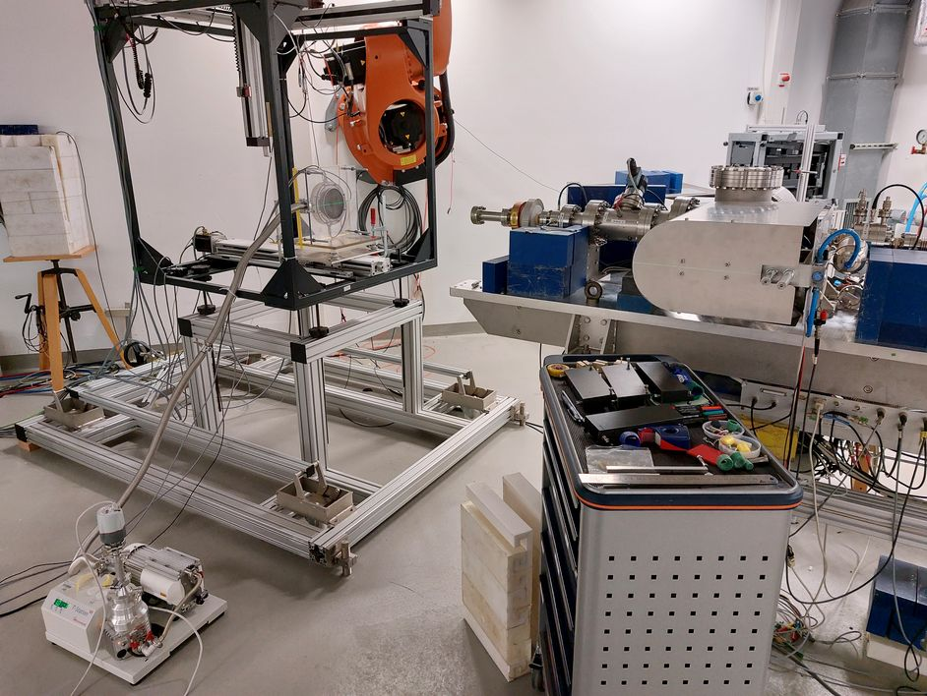
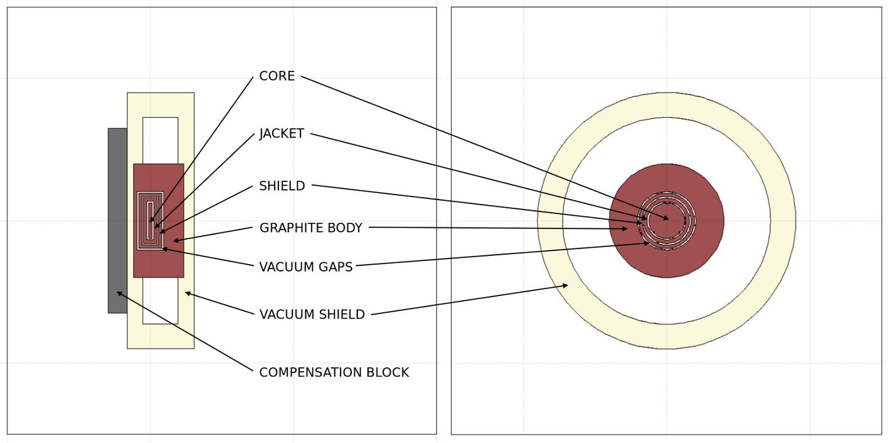
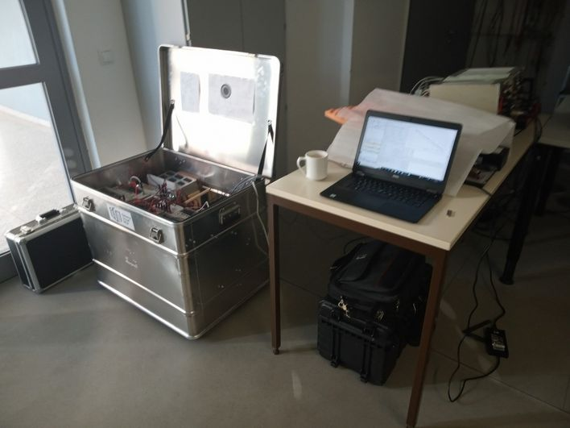
Portable graphite calorimetry in UHDR electron beams
GUM portable graphite calorimeter during measurements using a UHPDR 20 MeV electron beam provided by research linear accelerator (linac) at Metrological Electron Accelerator Facility (MELAF) in Germany National Metrology Institute, PTB Braunschweig.
graphite calorimeter
turbomolecular pump
measuring system: 3 channels
Wheatstone DC bridge,
electrical calibrator,
PC computer

Slide 12
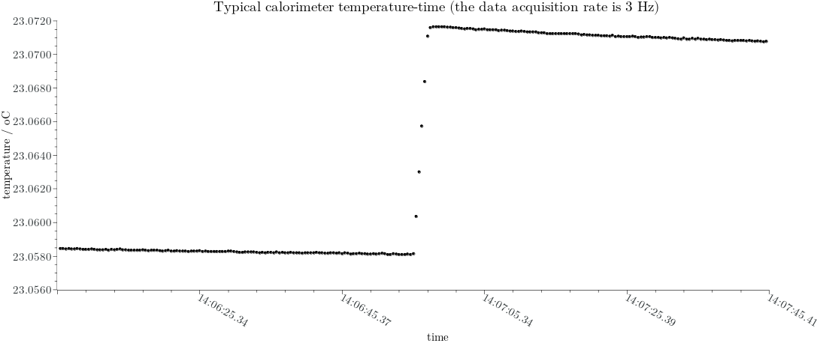
Portable graphite calorimetry in UHDR electron beams
beam OFF
ΔT
beam ON
cg – specific heat capacity of graphite,
ΔT – radiation-induced temperature rise,
(Dw/Dg)MC – calculated ratio of absorbed dose to water and to the graphite core using Monte Carlo simulation,
Πki – product of the correction factors to be applied to the standard.

Slide 13
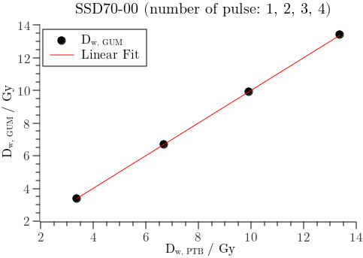
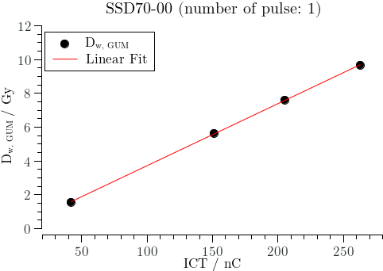
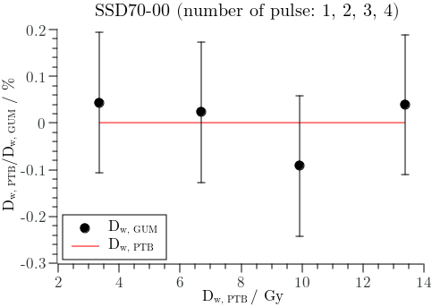
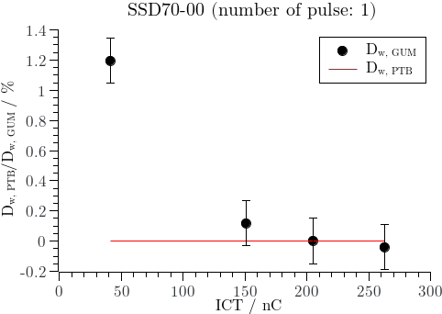
Portable graphite calorimetry in UHDR electron beams

Slide 14
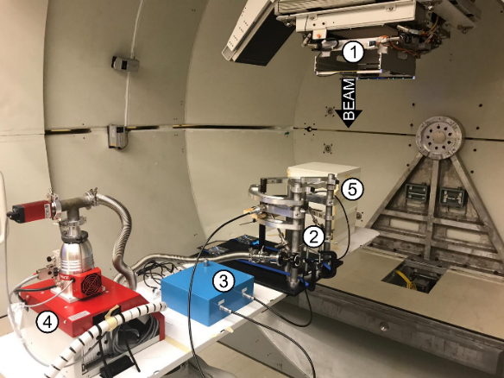
WP1 – task 1.2
Highlights
Graphite calorimetry for UHDR protons

Slide 15
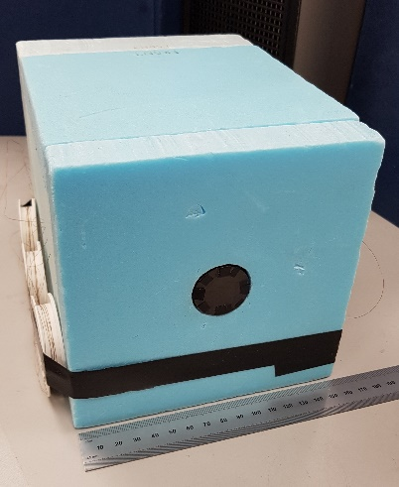
WP1 – task 1.3:
Development and optimisation of prototype calorimeters for absorbed dose measurement of ultra-short pulses of laser-driven proton and e-beams
AIM
characterisation of beams parameters of the laser driven sources used for graphite calorimetry measurements
to develop and evaluate absolute dosimetry methods via graphite calorimetry for ultra-short charged particle beams generated with laser-driven accelerators
Partners:
Fig. 3: NPL’s small portable graphite calorimeter

Slide 16
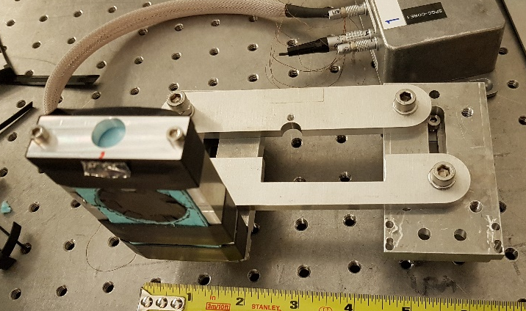
WP1 – task 1.3:
Highlight

Slide 17
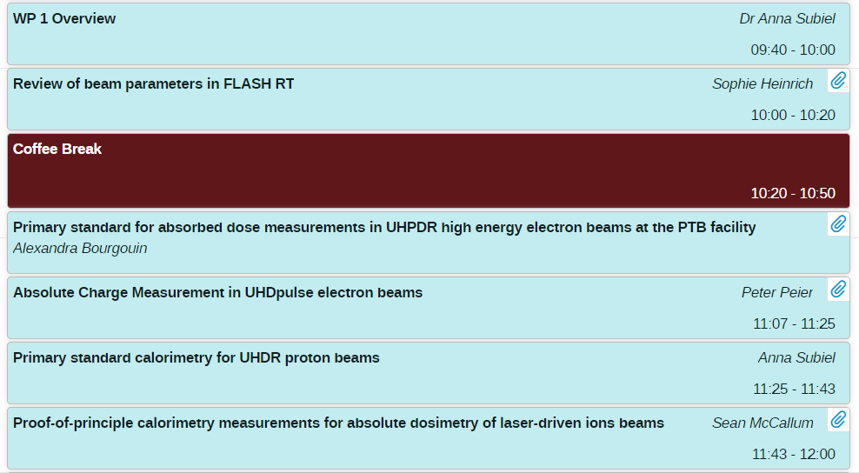
Agenda for WP1

