Slide 1
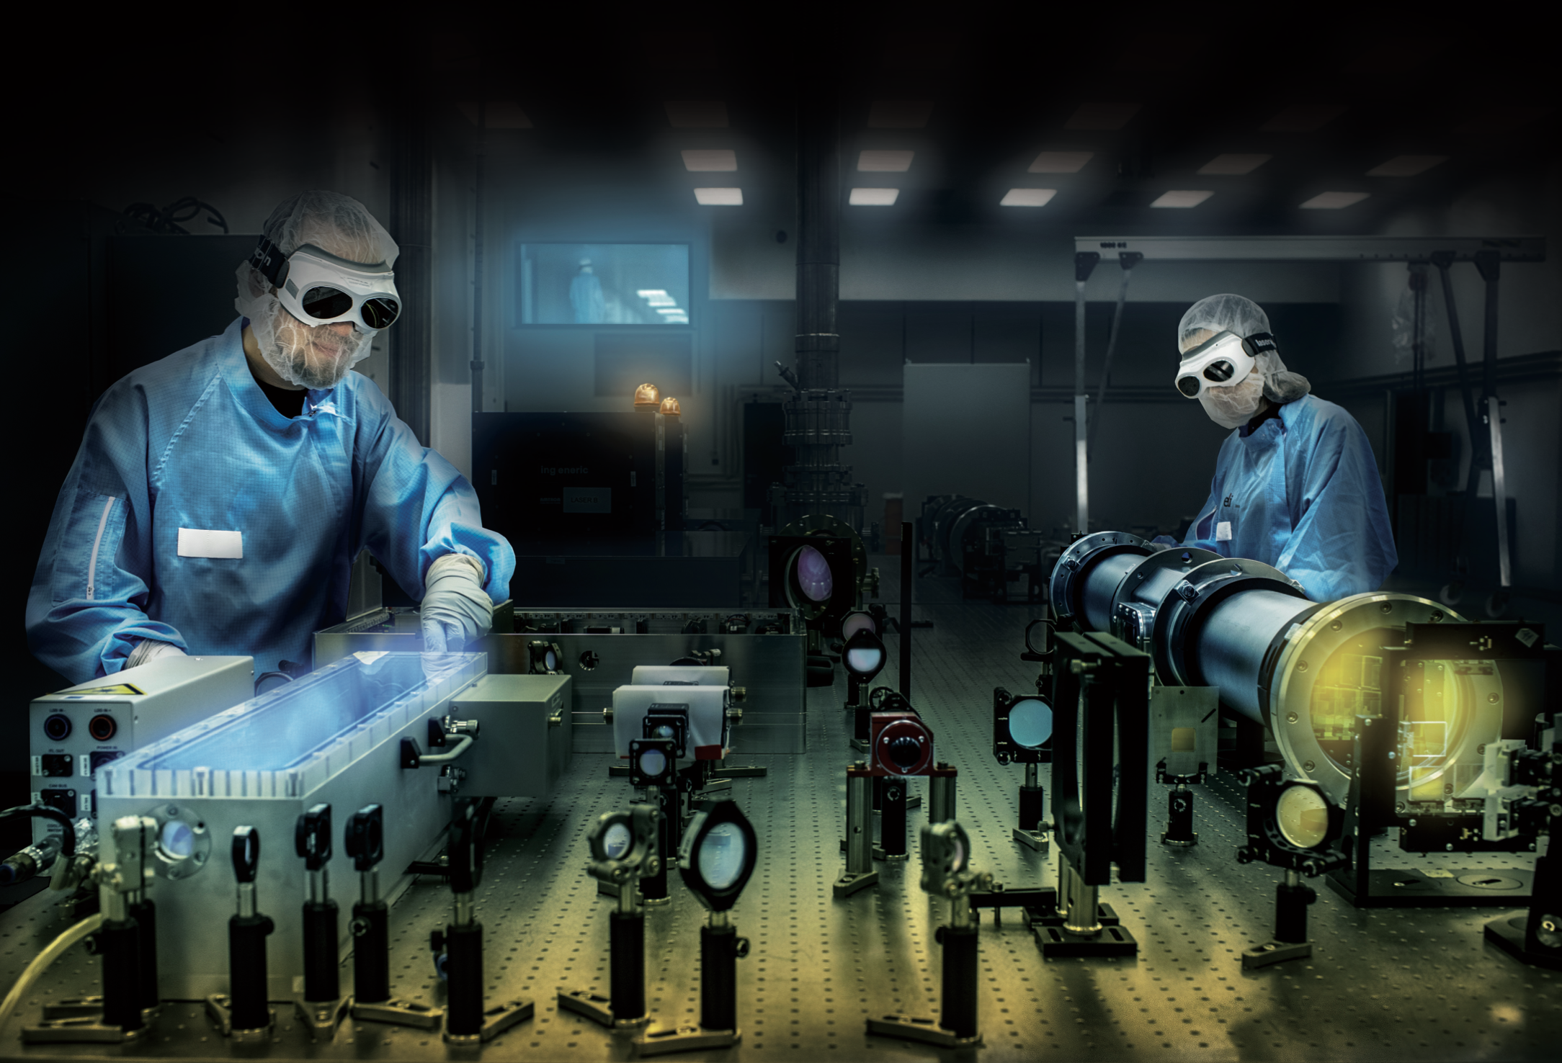

WORK PACKAGE 3
Ramping-up Towards
Excellent Steady-State Operations
IMPULSE
IMPULSE Kick-off Meeting / 16 December 2020
Federico Canova (ELI-DC). Lajos Fülöp (ELI-ALPS)

Slide 2
IMPULSE

Slide 3

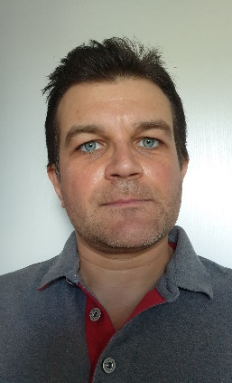
WP3 - Ramping-up Towards Excellent Steady-State Operations
IMPULSE
WP3 Leader : L. Fulop, ELI-ALPS
PMT support : F. Canova, ELI-DC
Objectives
WP3 aims at ensuring that the ELI Facilities achieve excellence in routine operations through a joint approach aiming at optimising performance, reliability and efficiency through standardisation of operational procedures and metrology and capacity building, in close interaction with users and operators of large RIs.
Task 3.1: operational modes
Task 3.2: metrology procedures
Task 3.3: spare parts
Task 3.4: training

Slide 4
WP3 –task leaders & partner contacts
IMPULSE
T3.1
T3.2
Task Leader Bálint Kiss (ELI-ALPS)
Pavel Bakule(ELI-Beamlines)
Florin Negoita (ELI-NP)
Federico Canova (ELI-DC)
Task Leader Daniel Ursescu (ELI-NP)
Eric Cormier (ELI-ALPS)
Pavel Bakule (ELI-Beamlines)
Federico Canova (ELI-DC)
Ulrich Schramm (HZDR)
Luca Volpe (CLPU)
Stefan Karsch (LMU)
T3.3
T3.4
Task Leader Pavel Bakule (ELI-Beamlines)
Lajos Schrettner (ELI-ALPS)
Florin Negoita (ELI-NP)
Federico Canova et Teodor Ivanoaica (ELI-DC)
t.b.c. (STFC)
Task Leader Zita Varadi (ELI-ALPS)
Pavel Bakule (ELI-Beamlines)
Florin Negoita (ELI-NP)
Federico Canova (ELI-DC)
t.b.c. (STFC)

Slide 5




Task 3.1: Joint definition, review and optimisation of operational modes
IMPULSE
Systematic definition & efficient implementation of operational modes & alignment procedures
Ensure routine, reliable and risk-controlled operations of the lasers and secondary sources
Consistency of the experimental conditions & the maximisation of beam availability & parameters
Establish & implement clear & detailed procedures for the operation of the various experimental systems
Represent the reference documentation for daily operations
A clear description of the various roles and functions of the staff involved
Procedures and rules for the operation of the lasers, secondary sources, end-stations and support systems
The optimised operation modes & tested alignment & operational procedure, implemented at the ELI facilities
ELI-ALPS, ELI-Beamlines, ELI-NP

Slide 6
Task 3.2: Standardization of the metrology procedures for the lasers & secondary sources
IMPULSE
Reliable solutions & accepted protocols for the metrology of high-peak power, high-repetition rate lasers & the secondary sources
Critical both for the operation of the ELI Facilities and for enabling excellent research and user access at ELI
The identification, testing and implementation of adapted metrology solutions (diagnostics and protocols) where appropriate standards do not yet exist;
The standardisation of metrology instruments and protocols, wherever possible, within ELI and, as much as possible, within the community.
Establish a sustainable network of labs able to cross-calibrate each other’s instruments
Well-defined procedures and processes guaranteeing consistency in ELI’s metrology, together
The identified standard diagnostics will be available for implementation at the ELI Facilities
Strong networking among the ELI Facilities &with the community to facilitate the dissemination & improvement
ELI-NP, ELI-ALPS, ELI-Beamlines
HZDR, LMU, CLPU

Slide 7
Task 3.3: Optimised management of spare parts to maximise cost efficiency, machine safety & reliability
IMPULSE
Minimise downtime and costs while maximising the performances offered to users
Systematic data collection on the spares and technology components
The fragmentation of the information on the specifications of the spare parts in use at the ELI Facilities
A database will be developed to consolidate spares part data (e.g., specifications, stock, price, lead time, life expectancy, criticality, suppliers, etc.) at the ELI Facilities to best inform the definition of risk-controlled operational modes, support ELI-wide standardisation and optimise procurement
Spare parts database at the ELI Facilities allowing each of them to effectively collect, manage and integrate all available information on spare parts
Extraction functionalities will allow to leverage data in particular for joint procurement planning, joint management of stock, standardisation of components
ELI-Beamlines, ELI-ALPS, ELI-NP
STFC

Slide 8
Task 3.4: Capacity building through training of operating teams
IMPULSE
The availability of competent staff trained to operate the sources of the ELI Facilities is a key condition to guarantee routine quality operations at ELI
Efficiency by providing training aiming at ensuring operators can provide best support to users;
Cost-efficient operations through the definition of a harmonised staffing model (and related competence profiles) facilitating inter-operability of staff at ELI
Reinforce capacity of ELI to operate the Facilities by having available operational teams trained to the best practices, consistently with the operational modes described in Task 3.1.
The ELI employees are highly trained with high mobility and career possibilities within all the European RIs
ELI-ALPS, ELI-Beamlines, ELI-NP
STFC

Slide 9
WP3 – high level overview
IMPULSE

Slide 10
WP3 – deliverables & milestones
IMPULSE

Slide 11
WP3 - Deliverables and Milestones follow-up
IMPULSE
Additional milestones are necessary to plan efficiently for the deliverables

Slide 12
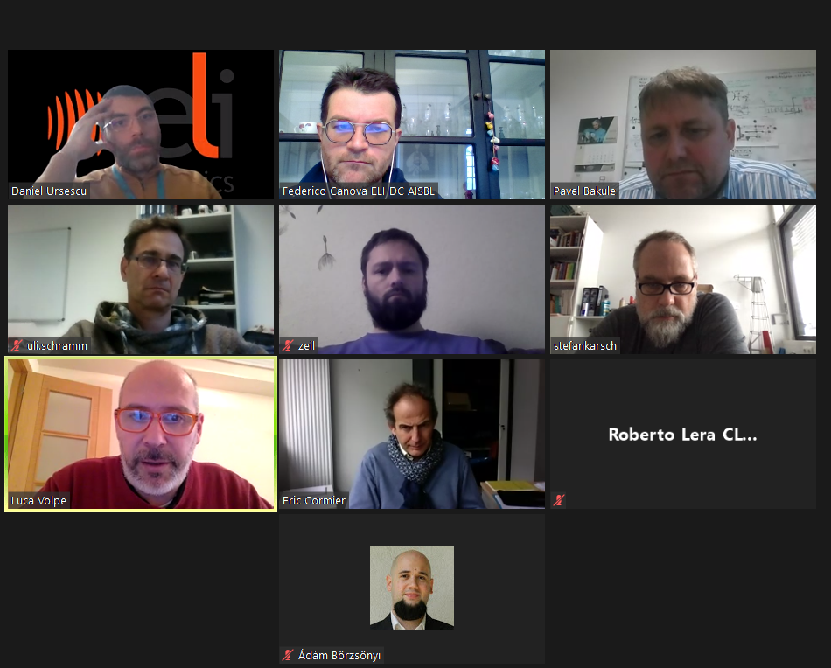
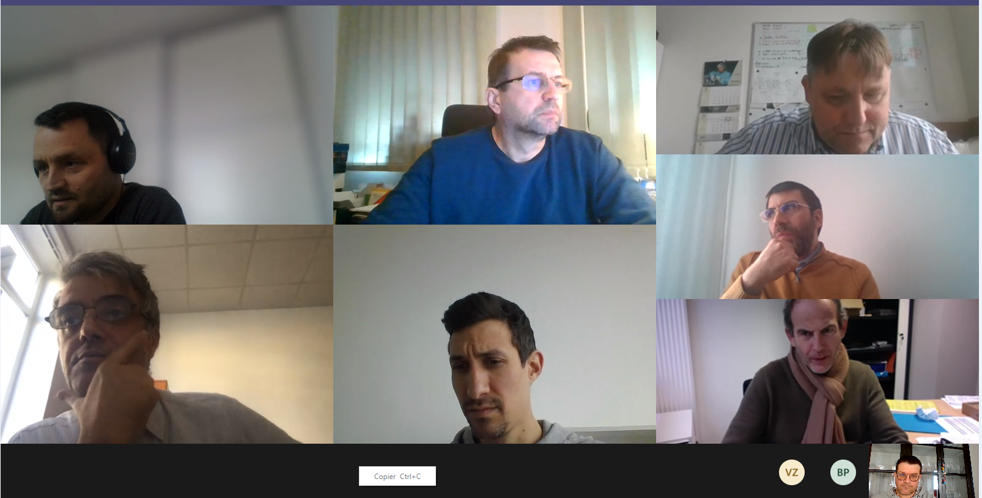
WP3 – Summary & next steps
IMPULSE
Former meetings, pre-kick offs
9th Dec - Task 3.2 of IMPULSE project - meeting with the contributors
4th Dec – WP3 preliminary kick-off
27th Nov – Task 3.2 preliminary kick-off
Build on the outcome of former projects
EUCall, IT-ELLI, ELITrans or any other
Survey & discover all relations by end of Jan 2021
Reporting period at every 6 month
Full internal plan for each task, for every 6 month period
By end of Jan 2021 [task leaders & partner contacts]
Resource management & planning
Equipment & task budget planning by end of Jan 2021

Slide 13



WP3 - Budgets
IMPULSE
Workpackage budget
Partners’ budget (€, PM)

Slide 14
Thank you !
IMPULSE
Lajos Fülöp (ELI-ALPS) Lajos.Fulop@eli-alps.hu
Federico Canova (ELI-DC) federico.canova@eli-laser.eu

