Slide 1
Helmholtz-Zentrum Dresden-Rossendorf HZDR
a member of the Helmholtz Association of German Research Centers
U. Schramm, T. Cowan, K. Zeil, J. Metzkes-Ng, A. Irman, B. Schramm, A. Weissig
Programmatic research of societal relevance
(cancer research, matter under extreme fields, advanced accelerators)
Operation of research infrastructures dedicated to user access
(radiation source ELBE, Ion Beam Center, High Magnetic Field Lab,
PW laser driven plasma accelerators ATHENA, HIBEF @ XFEL.EU)

Slide 2
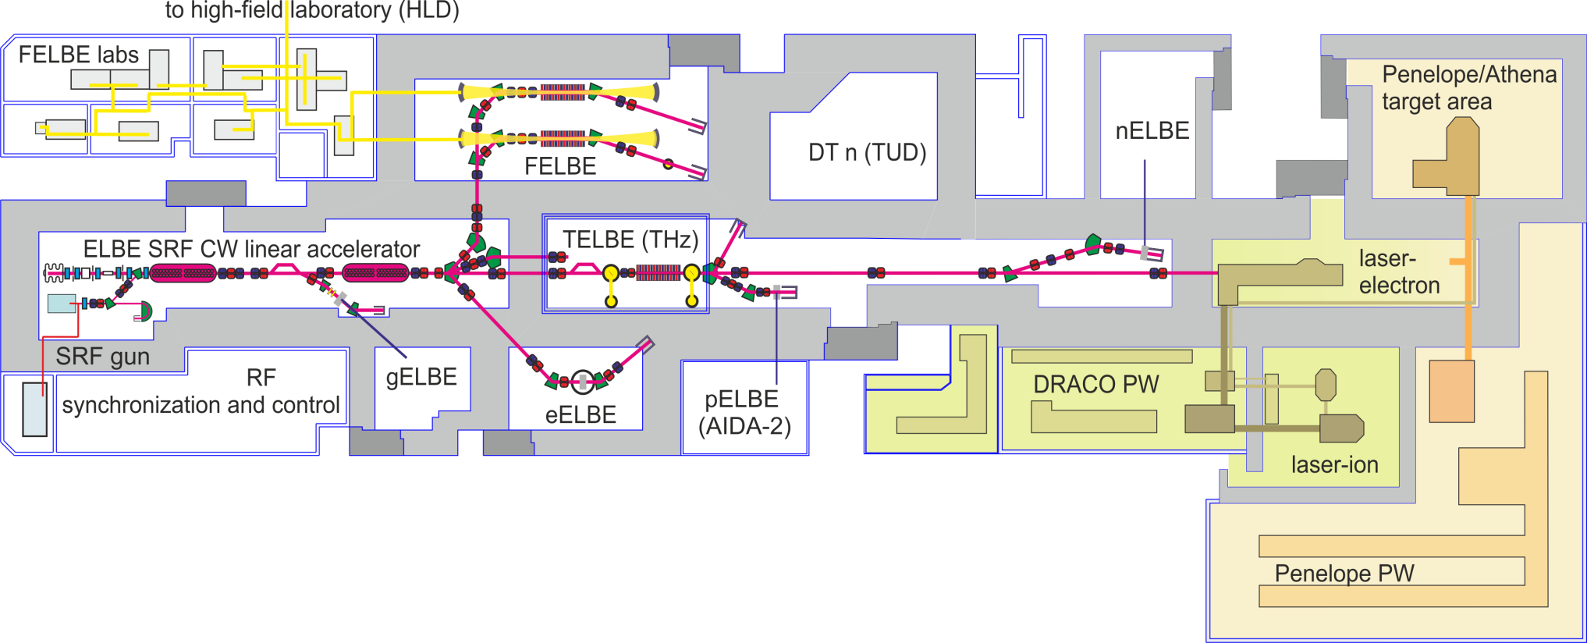
ELBE - Center for High-power Radiation Sources
10m
A linear accelerator driven user facility (24/7 operation)
and advanced accelerator R&D complex
including PW laser infrastructures (30J / 30fs 1Hz, 150J / 150fs diode pumped)

Slide 3
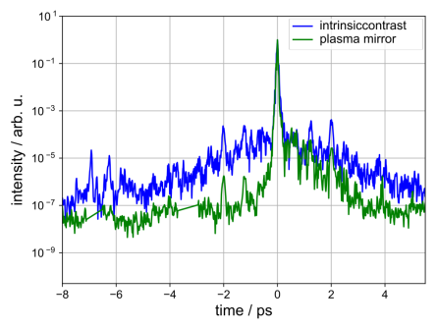
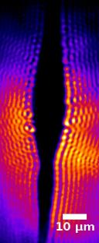
WP3 – sharing expertise in laser / on target metrology
Single shot laser diagnostics
On-shot target probing
single shot contrast SRSI
15µm
multi-color off-harmonic probing
of plasma ionization / expansion
indirect on target laser diagnostics

Slide 4
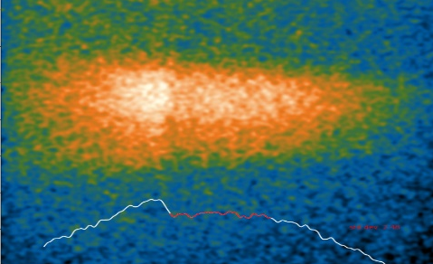
WP 4 - LWFA - primary and secondary beam generation
High peak current LWFA - hybrid LPWFA
Electron beam diagnostics / applications
Two beam pump
(betatron) probe
(cold Cu-k-edge)

Slide 5
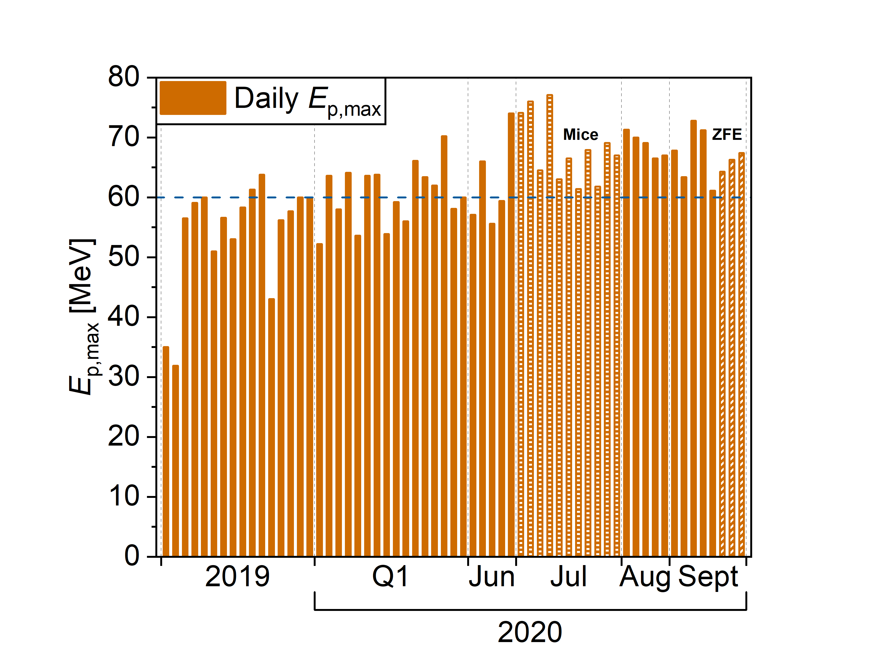
WP4 - proton acceleration and applications in radiobiology
Stable proton acceleration, targetry, on-shot monitoring
Pulsed beamline development (dose control)

Slide 6
User Access Management
Expertise:
Central HZDR user office
Entanglement of all activities related to user office, European science policy and projects, RI networks and collaborations
Coordination of the Integrating Activities CALIPSOplus and RADIATE, member of EMFL*
Task 5.1 - suggestions
Workshop on relevant topics for user offices, e.g. user expectations, intercultural competence and diversity, statistics, reporting, useful KPIs
Short trainings during "interesting" periods (user meeting, proposal evaluation)
Internships at the HZDR user office
Task 5.2 - suggestions
Extended internship at the IT department in charge of the electronic tool used for the access management (GATE)
Workshops e.g. GDPR rules
*ESFRI Landmark

