Slide 1
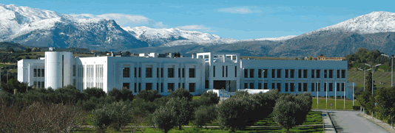
Dimitris Charalambidis
chara@iesl.forth.gr
Dimitris.Charalambidis@eli-alps.hu
FO.R.T.H.
(Foundation for Research & Technology-Hellas)
.
IMPULSE kick-off meeting
On-line 16 December 2020
FO.R.T.H. - I.E.S.L.

Slide 2
About FO.R.T.H.
The Foundation for Research and Technology - Hellas (FORTH) was founded in 1983. It is one of the largest research centers in Greece with well-organized facilities, highly qualified personnel and a reputation as a top-level research institution worldwide.
Personnel: ~1500 (including stipends)
Annual turn over: ~55MEuro
FO.R.T.H. - I.E.S.L.

Slide 3
FO.R.T.H.
The Institutes
FO.R.T.H. - I.E.S.L.

Slide 4
FO.R.T.H. – I.E.S.L.
Groups/Labs
FO.R.T.H. - I.E.S.L.

Slide 5
FO.R.T.H. – I.E.S.L.
European Facilities
FO.R.T.H. - I.E.S.L.

Slide 6
EUROPEAN LASER FACILITY in FORTH:
Access provided during1990-2019
309 projects, 518 researchers from European Research Centers, 3582 days of access
FO.R.T.H. - I.E.S.L.

Slide 7
FO.R.T.H. – I.E.S.L.
National Facilities
FO.R.T.H. - I.E.S.L.

Slide 8
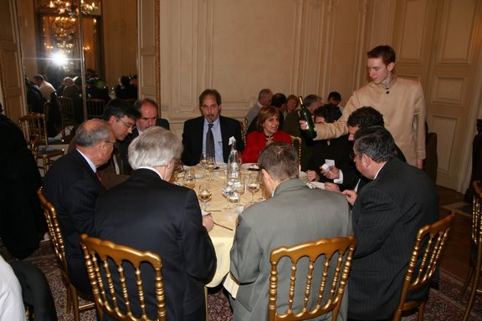
FO.R.T.H.
Involvement in ELI
FO.R.T.H. is involved in ELI since the preparation of the proposal of the ELI preparatory phase to the EU
FO.R.T.H. involvement` implementing contracts with ELI-ALPS for:
providing scientific advisory services
Designing and co-developing an energetic attosecond beamline for ELI-ALPS in the framework of an R&D contract
ELI-PP kick-off February 2008
FO.R.T.H. - I.E.S.L.

Slide 9
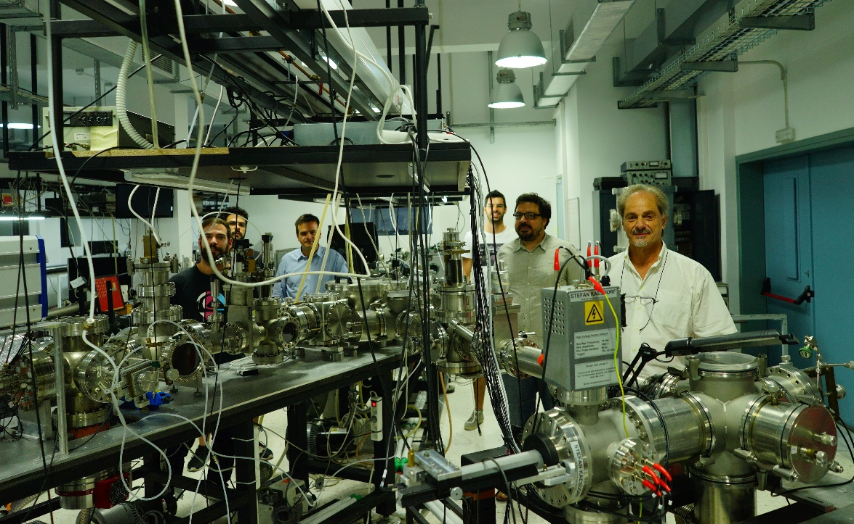
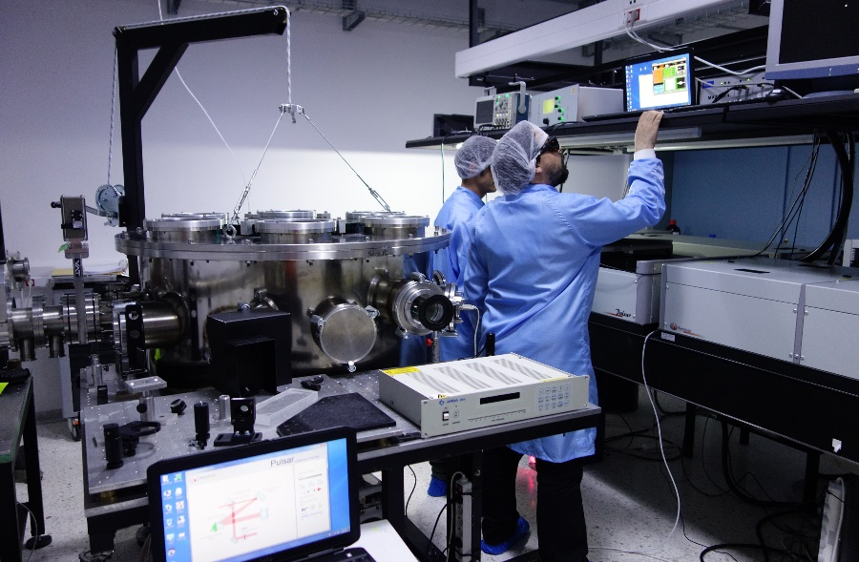
FO.R.T.H. – I.E.S.L
Attosecond Science & Technology Lab
FO.R.T.H. - I.E.S.L.

Slide 10
FO.R.T.H.
Involvement in the IMPULSE project
T4.4
FORTH will develop a magnetic-bottle electron time-of-flight (MBE-TOF) spectrometer. FORTH will design, construct, test, ship to ELI-ALPS the MBE-TOF and participate in test measurements at ELI-ALPS.
T7.4
Support the development of the user base through outreach towards established and prospective user communities (dedicated networking events and structures), communication of ELI’s scientific offer and user training measures.
FORTH will act as the ambassador of ELI in Greece (has already brought 4 commissioning user projects to ELI-ALPS).
FO.R.T.H. - I.E.S.L.

Slide 11
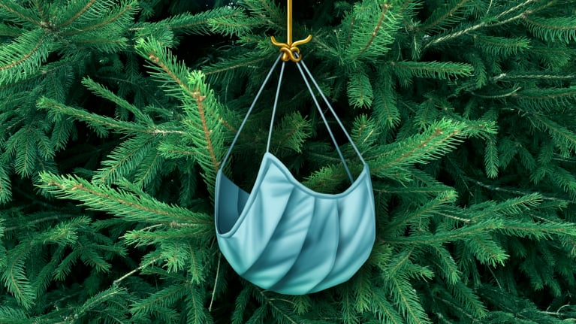
Thank you!
& seasons greetings….

